Slide 1





A New Generation of Nuclear Schiff Moment Search with ^{227,229}ThO Molecular Beam at FRIB
Xing Wu
????
Facility for Rare Isotope Beams (FRIB)
EDM limit
FRIB
FRIB
QuEST: Quantum-Enhanced teST
for fundamental symmetry
Office of Science

Slide 2
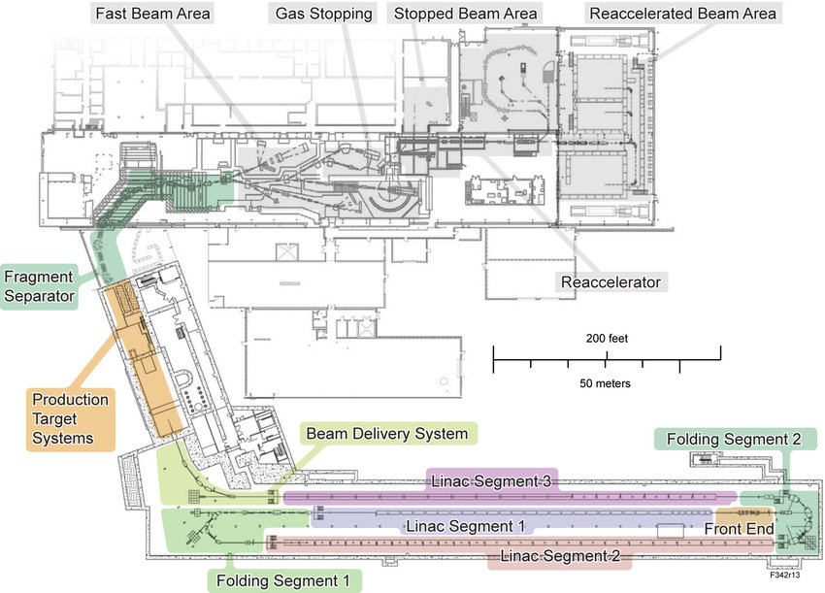

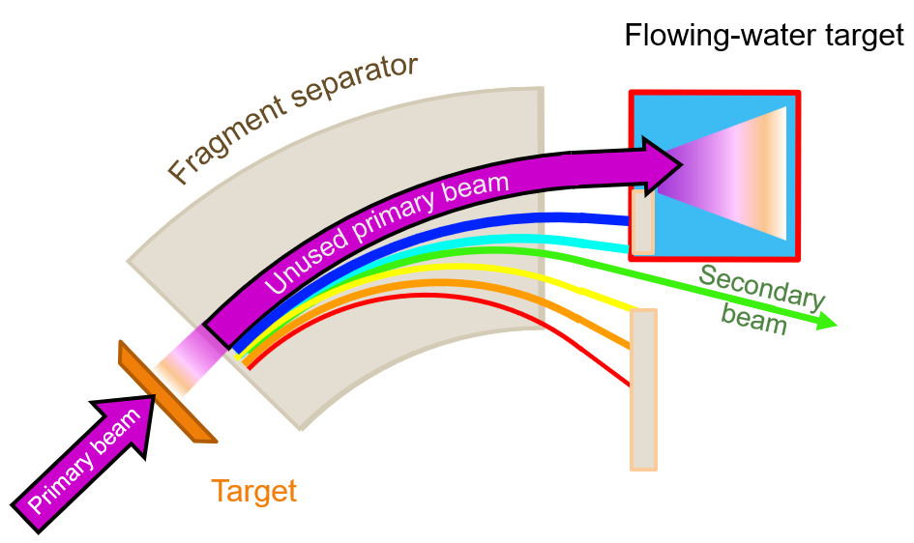
Isotope Harvesting @ FRIB:
Capable to Support Hadronic CP-Violation Test
“Projected” Yield:
²²⁵Ra:
1E7 s⁻¹ (current)
1E9 s⁻¹ (future)
²²⁷Th:
1E8 s⁻¹ (current)
1E10 s⁻¹ (future)
²²⁹Th:
5E7 s⁻¹ (current)
5E9 s⁻¹ (future)

Slide 3
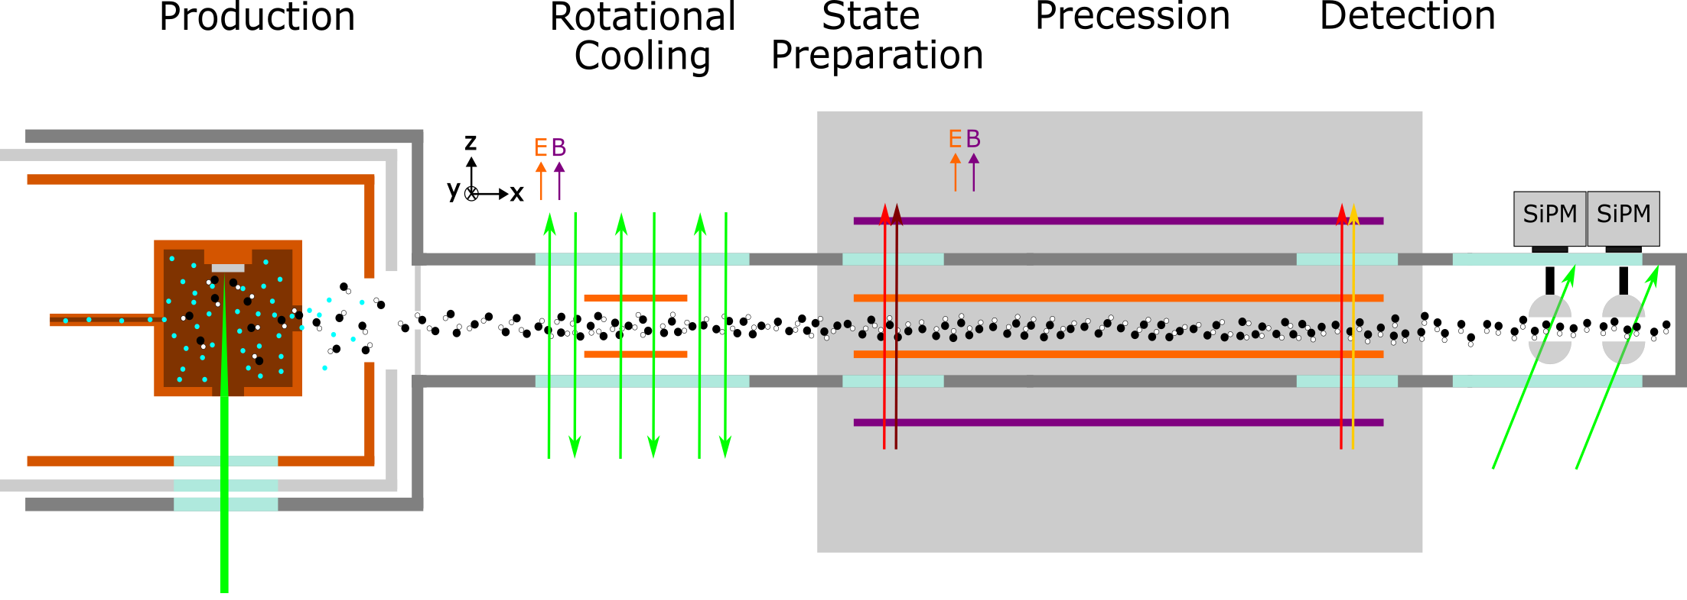
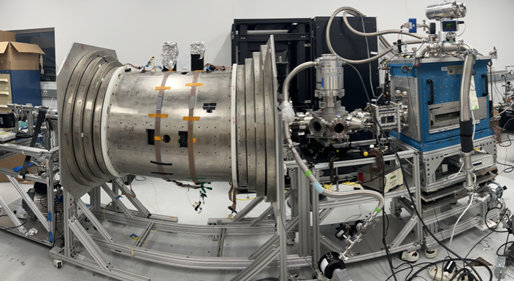
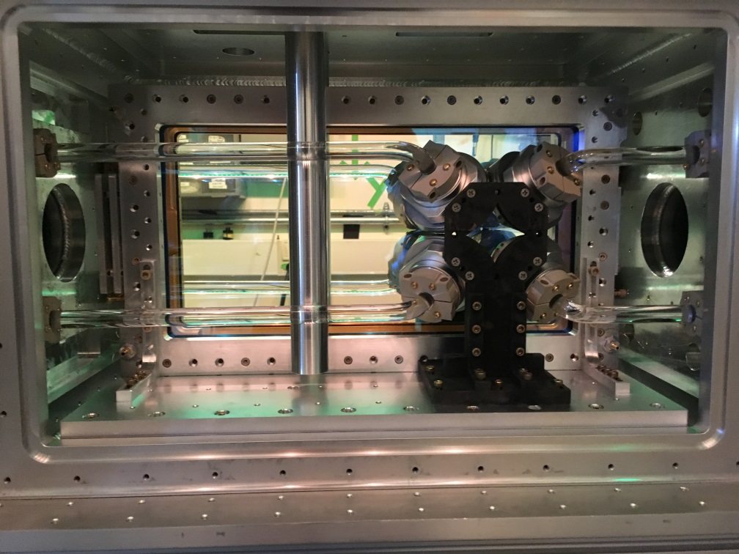






A New Generation of Nuclear Schiff Moment
(NSM) Search with ^{227,229}ThO Molecular Beam at FRIB
Phase I:
Molecular-beam style nuclear Schiff moment (NSM) search
Legacy ACME II e⁻EDM beamline:
Now be repurposed for the NSM search at FRIB
ACME Collaboration

Slide 4










Project “Dragonfly”: a Collaborative Effort at FRIB
External Helpers:
A.Borschevsky (Groningen)
L. Cheng (JHU)
C. Düllmann (Mainz)
J. Engel (UNC)
JM Yao (SYSU)
N. Hutzler (CalTech)
T. Langern (TU Vienna)
O. Grasdijk (ANL)
M. Bishof (ANL)
P. MohanMurthy (MIT)
R. Garcia-Ruiz (MIT)
E. Cornell (CU Boulder)
D. DeMille (JHU)
J. M. Doyle (Harvard)
G.Gabrielse (Northwestern)
Radiochemical synthesis
Quantum state control
E & B field control
Fluorescence Detection
Katharina
Domnanich
Alyssa Gaiser
Xing Wu
Jaideep Singh
Oscar Naviliat-Cucic
Nuclear spin and magnetic moment of ²²⁷Th via FRIB online facility
Precision spectroscopy of radioactive molecules
Nuclear structure theory
Kei Minamisono
Shane Wilkins
Witek Nazarewicz
Heiko Hergert

Slide 5
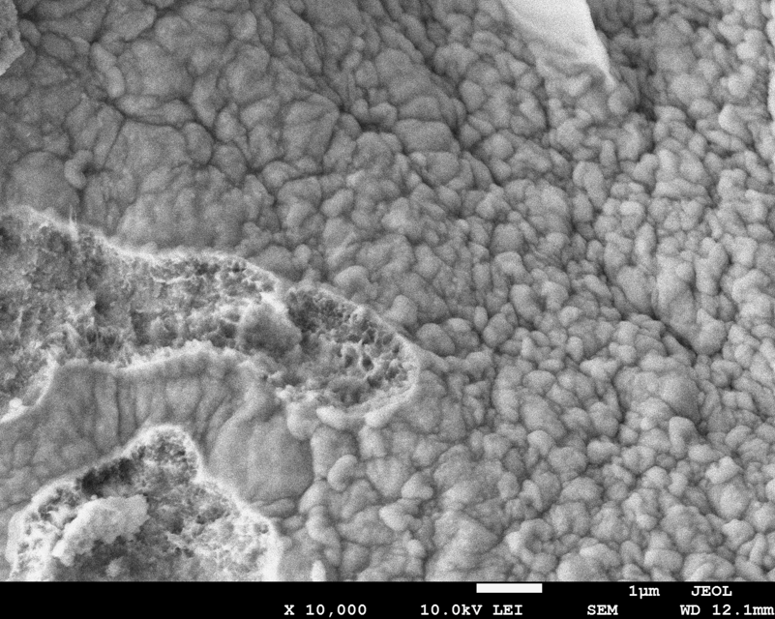
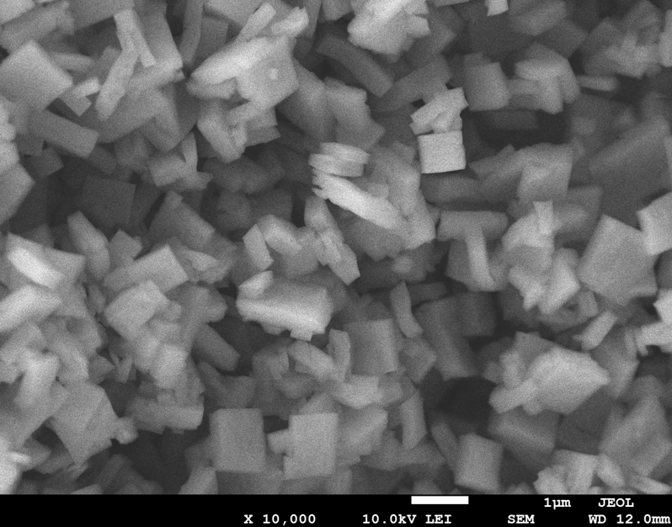
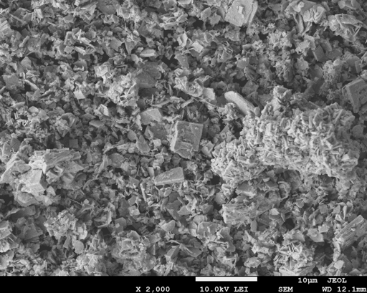

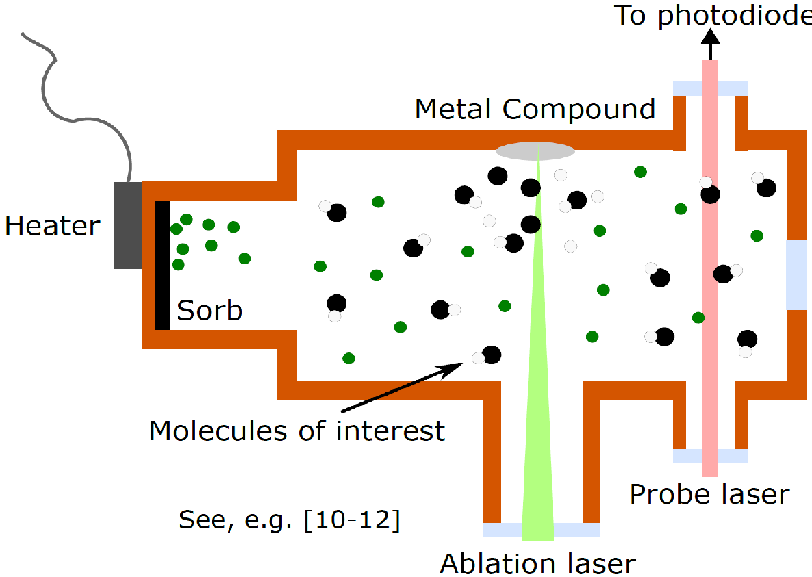
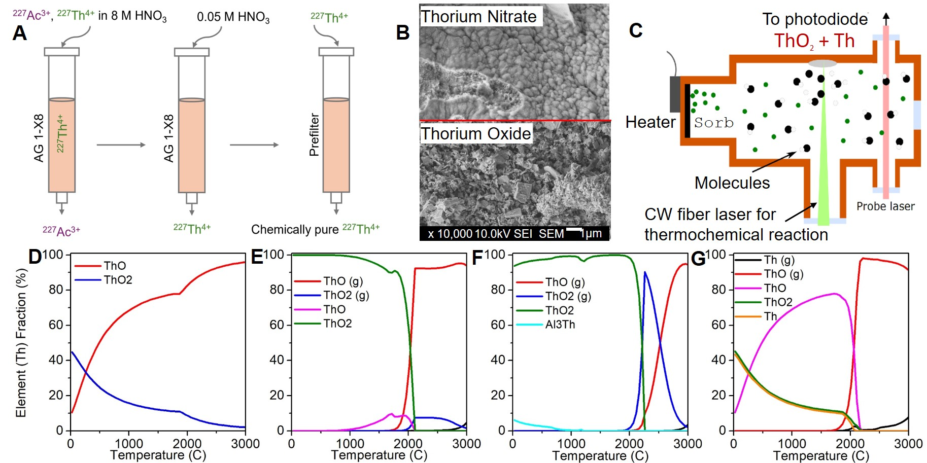
Efficient Radiochemical Process to Produce ThO2 and ThO
Thanks to DOE, We are getting 4mCi of 227Ac, and have received 100ug of 229Th
We have demonstrated 95% efficiency in each steps
Thorium Nitrate
Thorium Oxalate
Thorium Oxide
x 10,000
10.0kV SEI SEM
1μm
x 10,000
10.0kV SEI SEM
1μm
x 10,000
10.0kV SEI SEM
1μm
Monika Fouad
(FRIB Grad)
Katharina
Domnanich
Alyssa Gaiser
Based on a declassified Technical Report, ORNL(1960)
HSC Chemistry simulations
Co-supervisor
To photodiode
ThO₂ on Th
ThO₂ on Ti
ThO₂ on Al
Th(NO₃)₄ on Th
ThO₂ + Th
Heater
Sorb
Molecules
CW fiber laser for
thermochemical reaction

Slide 6
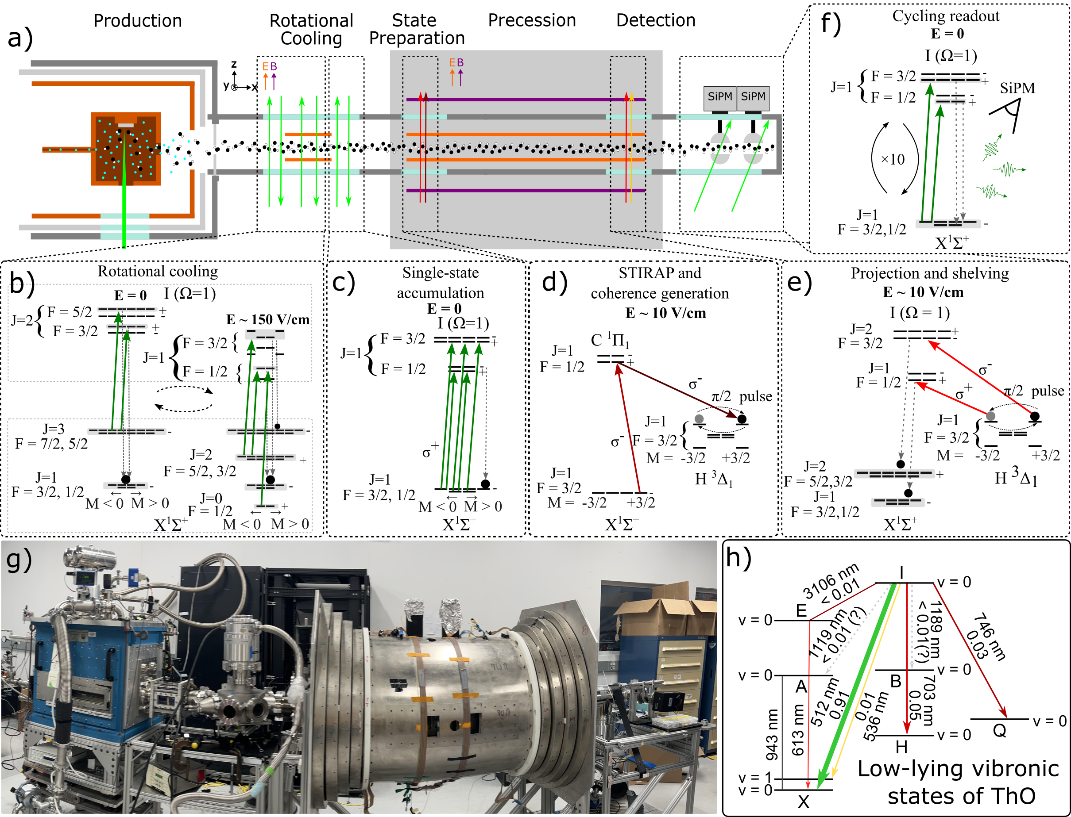
We Have Worked Out ²²⁷ThO Quantum State Control and Readout Schemes
(Manuscript in prep.)

Slide 7
We Have Worked Out ²²⁷ThO Quantum State Control and Readout Schemes
(Manuscript in prep.)

Slide 8
We Have Worked Out ²²⁷ThO Quantum State Control and Readout Schemes
(Manuscript in prep.)

Slide 9
We Have Worked Out ²²⁷ThO Quantum State Control and Readout Schemes
(Manuscript in prep.)

Slide 10
We Have Worked Out ²²⁷ThO Quantum State Control and Readout Schemes
Inspired by CeNTREX, ACME, YbF, YbOH, HfF⁺
(Manuscript in prep.)

Slide 11

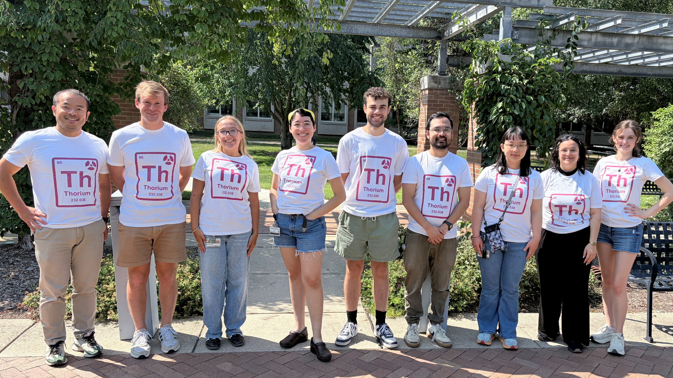
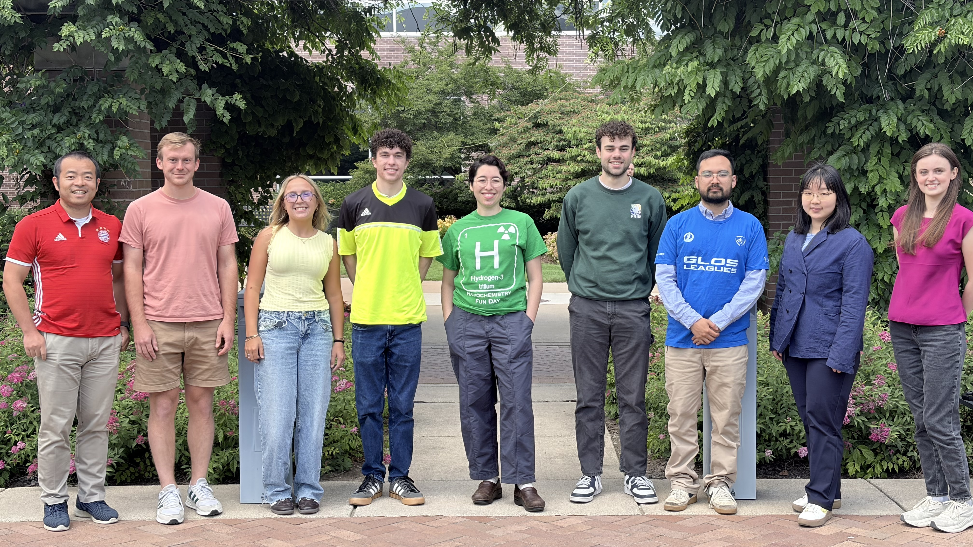


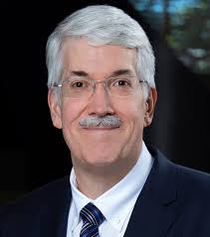





Acknowledgements
FRIB PAC4 Proposal on Solid Harvesting of ²²⁷Th
Internal and external support
Katharina
Domnanich
Alyssa Gaiser
Jaideep Singh
Kei Minamisono
Oscar Naviliat-Cucic
Shane Wilkins
Witek Nazarewicz
Heiko Hergert
Chris Düllman
(Mainz)
Nick Hutzler
(CalTech)
John Doyle, Dave DeMille, Jerry Gabrielse
ACME Experiment
Anastasia Borschevsky
(Groningen)
Ronald Gacia Ruiz (MIT)
From left to right of the Rainbow:
Xing Wu (PI), Alex Frenett (postdoc), Julia Dunn (REU Notre Dame), Arianna Rodriguez (postdoc), Nick Emtage (grad), Sebastian Miki-Silva (grad), Dorothy Gan (grad), Monika Fouad (grad), Alexandria Hunter (undergrad)
Funding

Slide 13
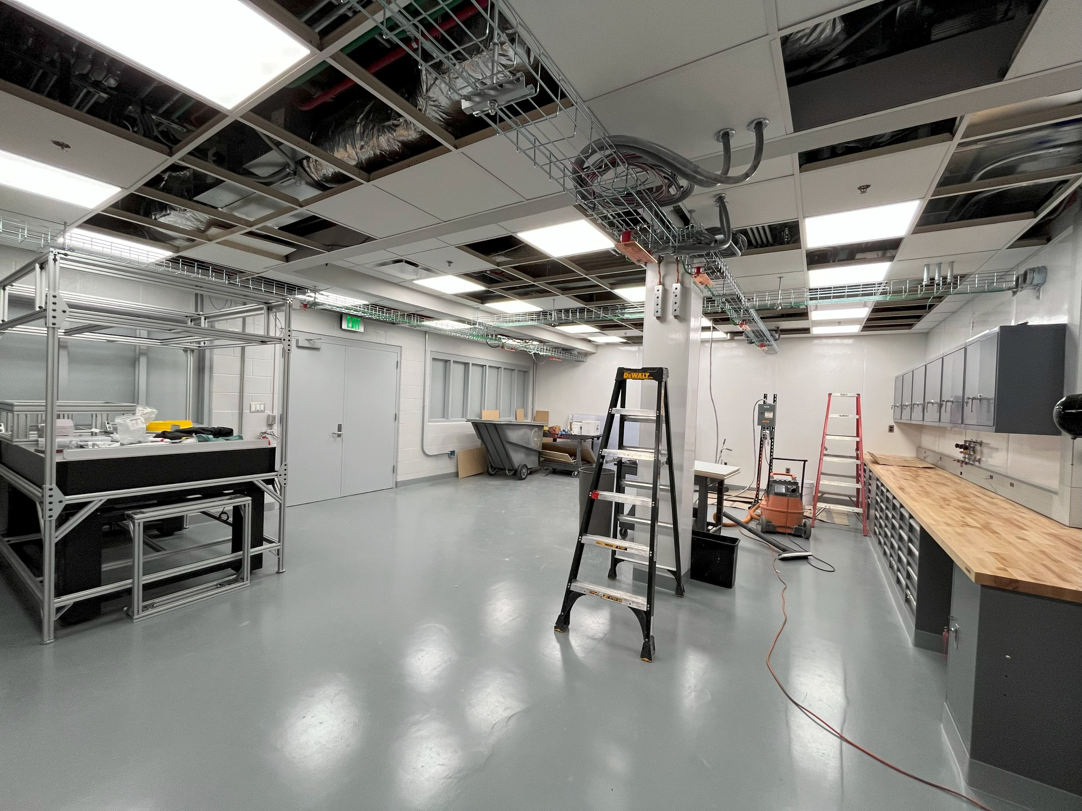
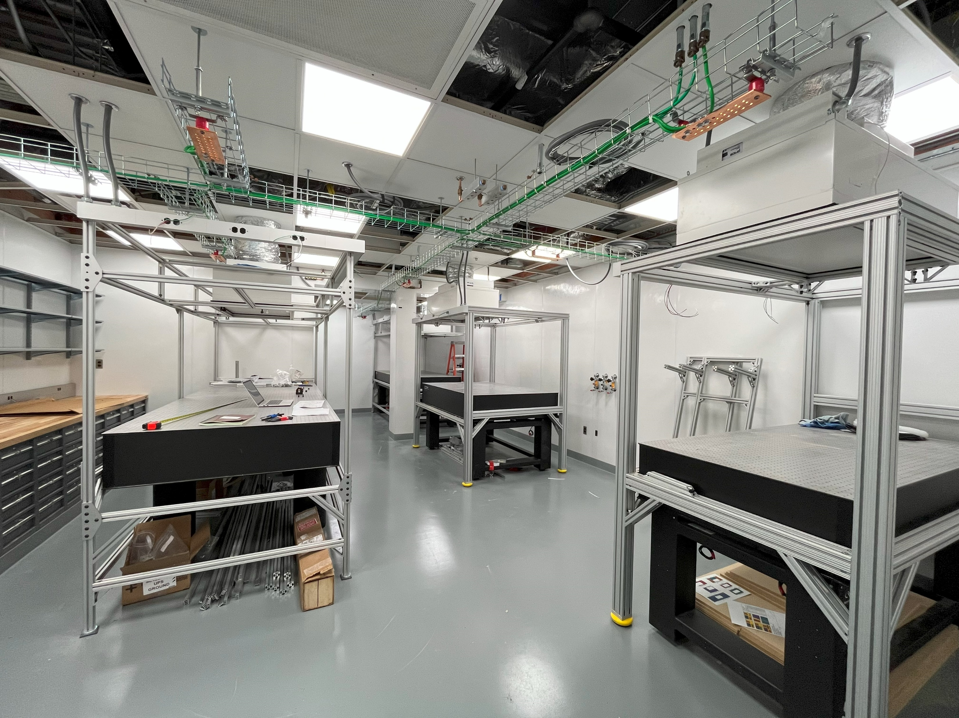
QuEST Lab @ FRIB in April 2025

Slide 14
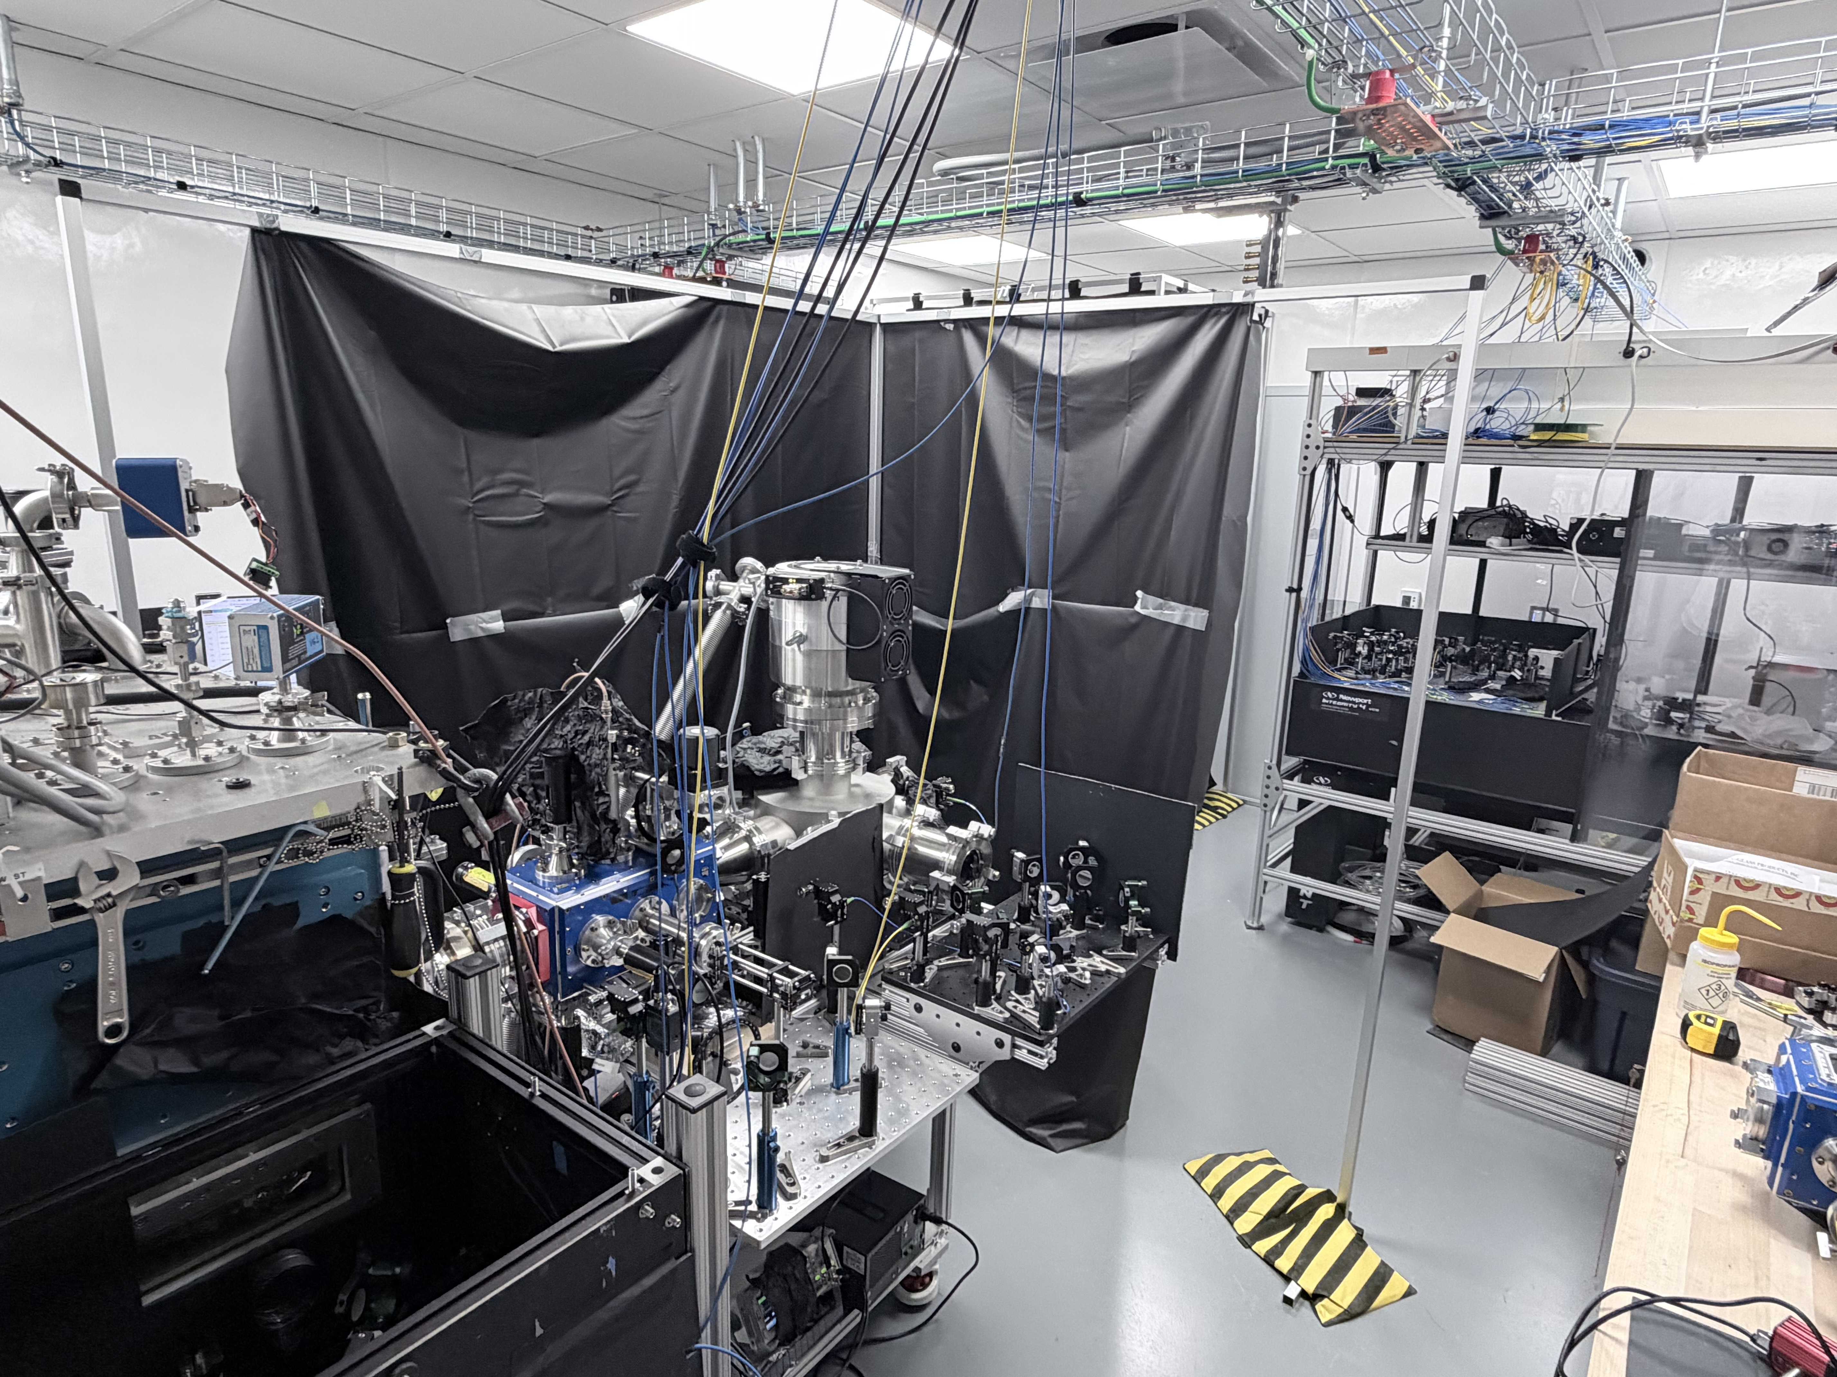
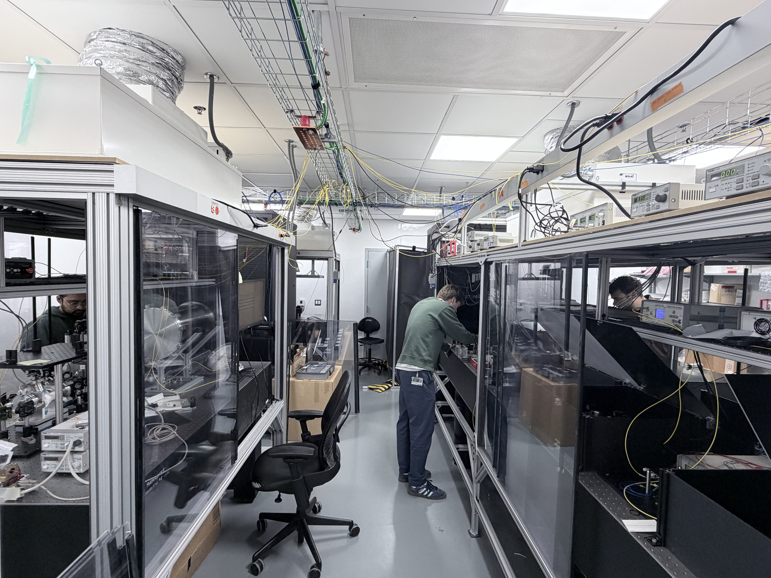
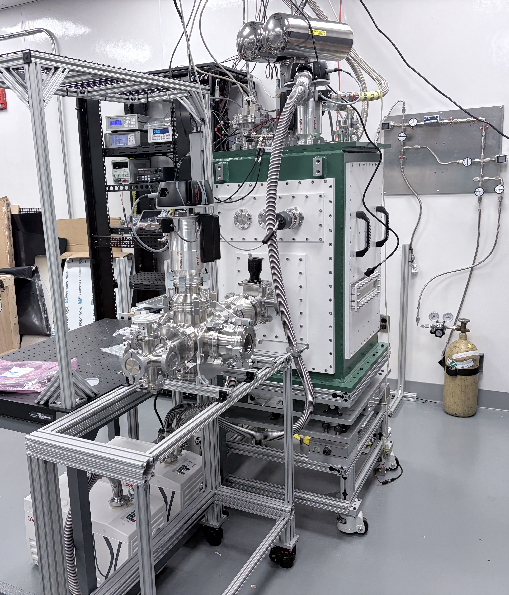
QuEST Lab @ FRIB in April 2026
Have a running ThO molecule beam now
18 running lasers + a few more under construction

Slide 15
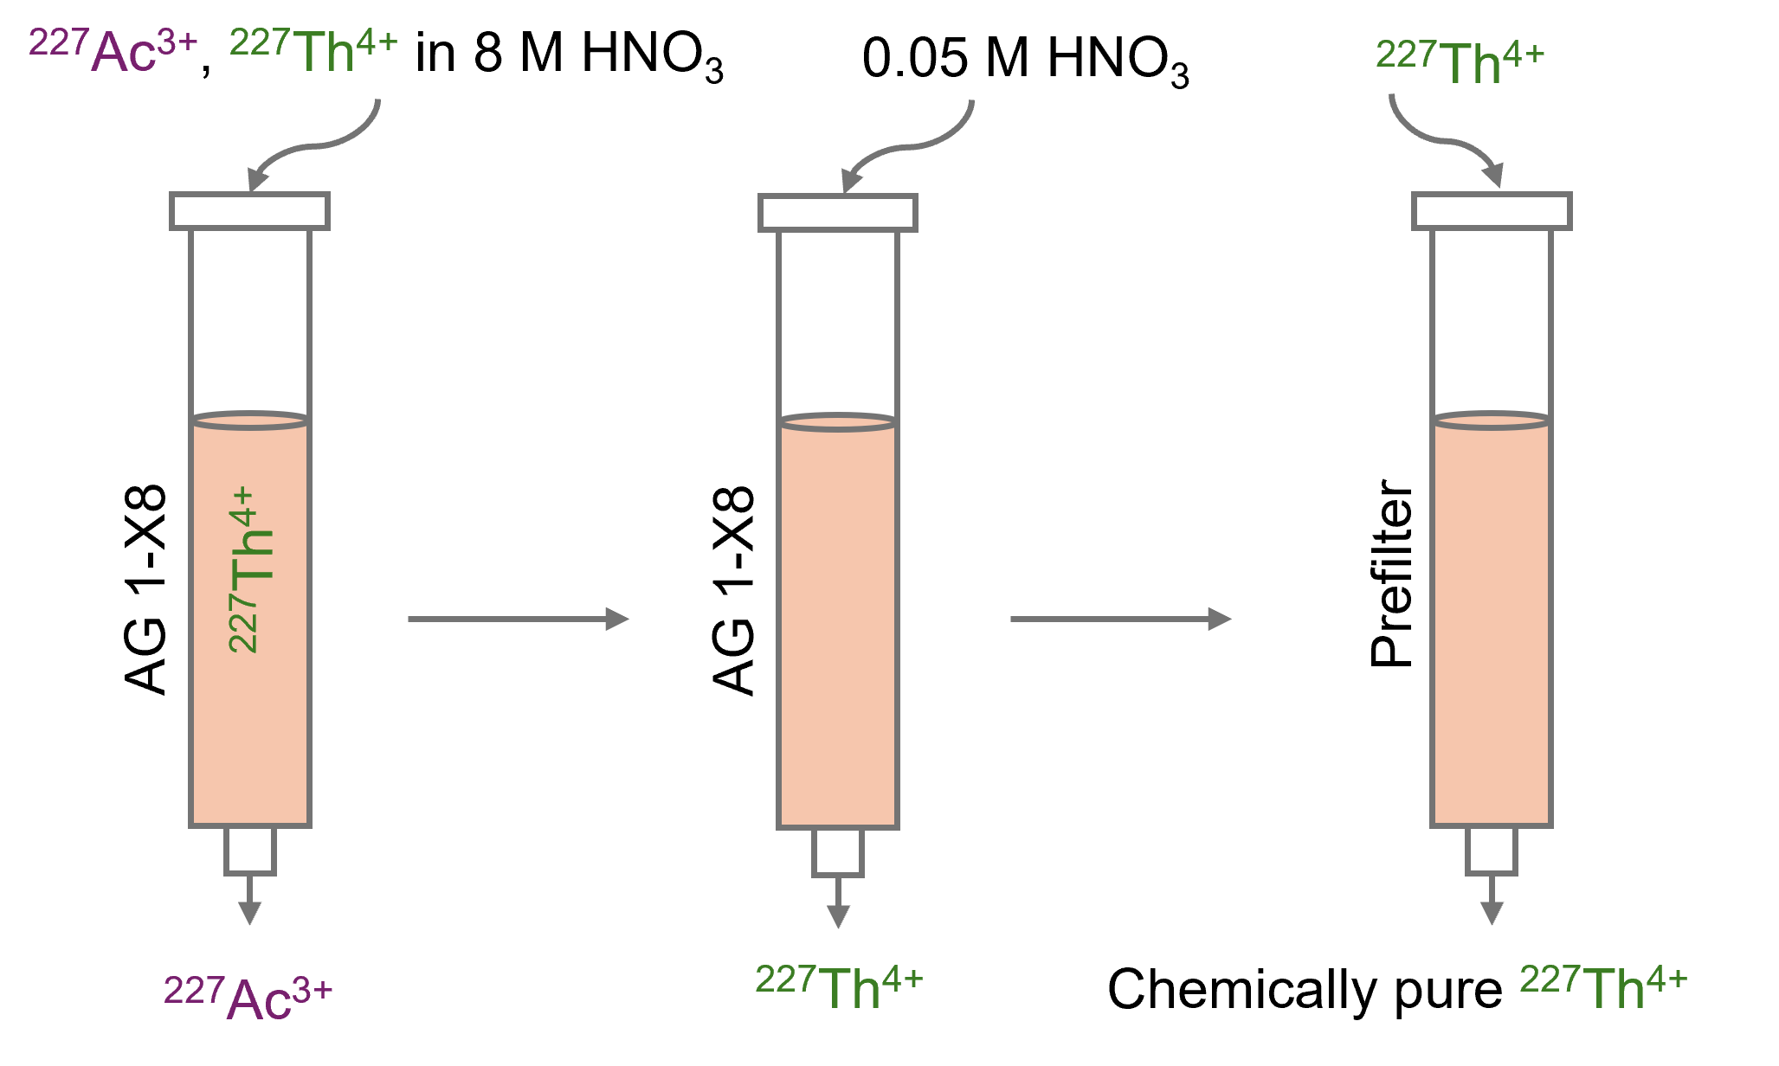
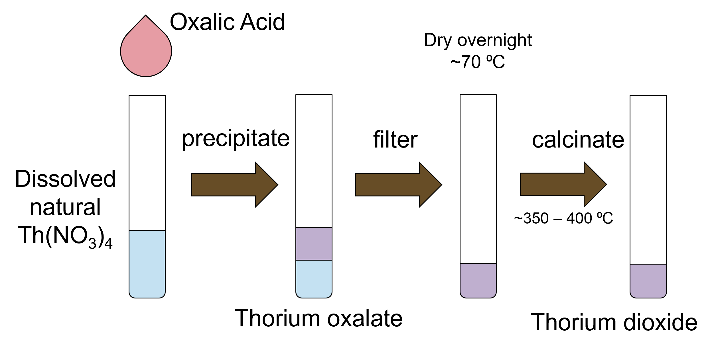
Plans of ²²⁷ThO Synthesis Have Been Established through Internal Collaboration with FRIB Radiochemists
We have secured a stockpile of ²²⁷Ac (~4mCi) from ORNL, β-decay to ²²⁷Th
Extract and purify Th-227 in Gaiser Lab
Turn Th-227 from Nitrate to Oxide in Domnanich Lab
Alyssa Gaiser
Katharina
Domnanich
Monika Fouad
Co-supervisor
Declassified Technical Report, Oak Ridge National Lab (1960)

Slide 16
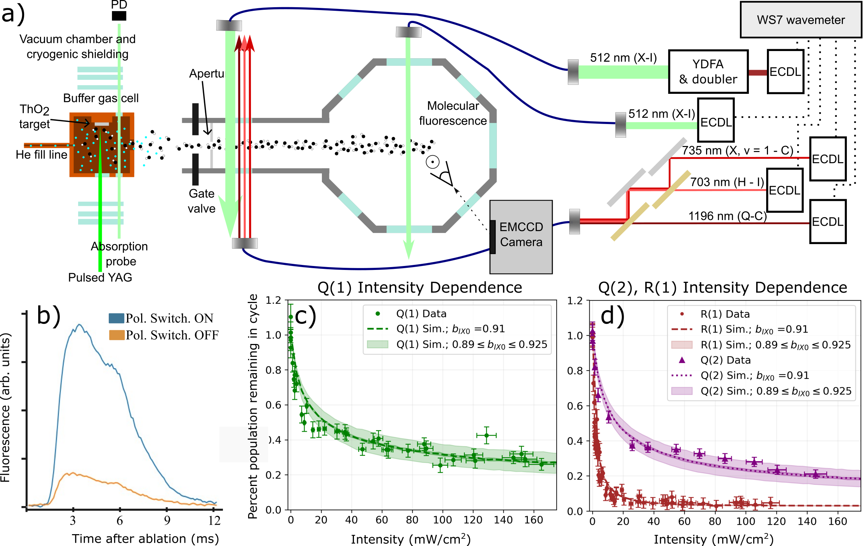
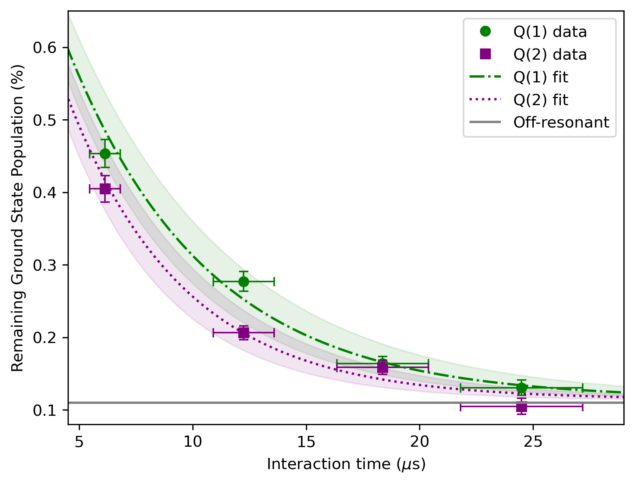
QuEST Lab Has Demonstrated Steady Progress Towards Efficient Single ThO Molecule Detection Via Photon-Cycling
More systematic verifications of branching ratio, scaterring rate, etc.

Slide 17
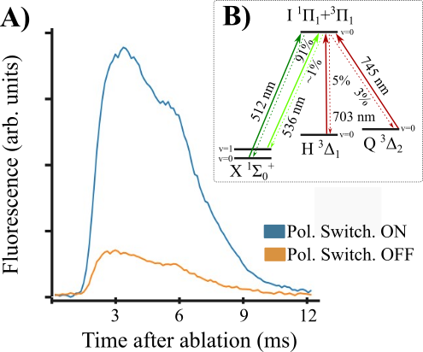
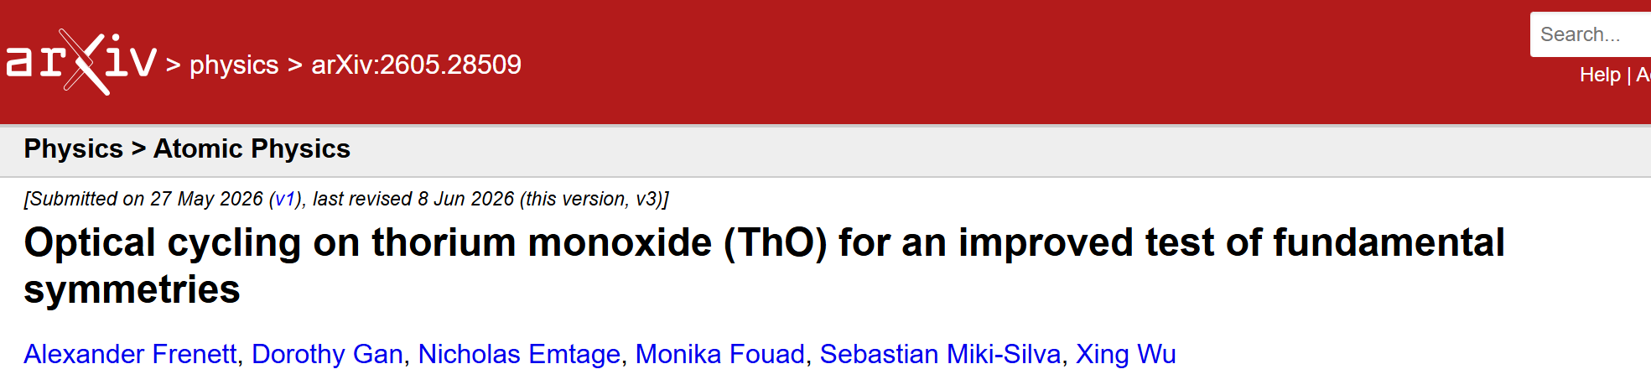
QuEST Lab Has Demonstrated Steady Progress Towards Efficient Single ThO Molecule Detection Via Photon-Cycling
Towards First Laser Cooling of Radioactive Molecules!

Slide 18
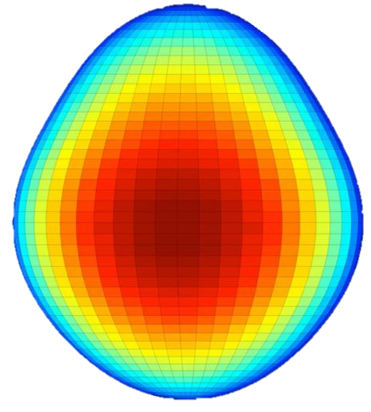

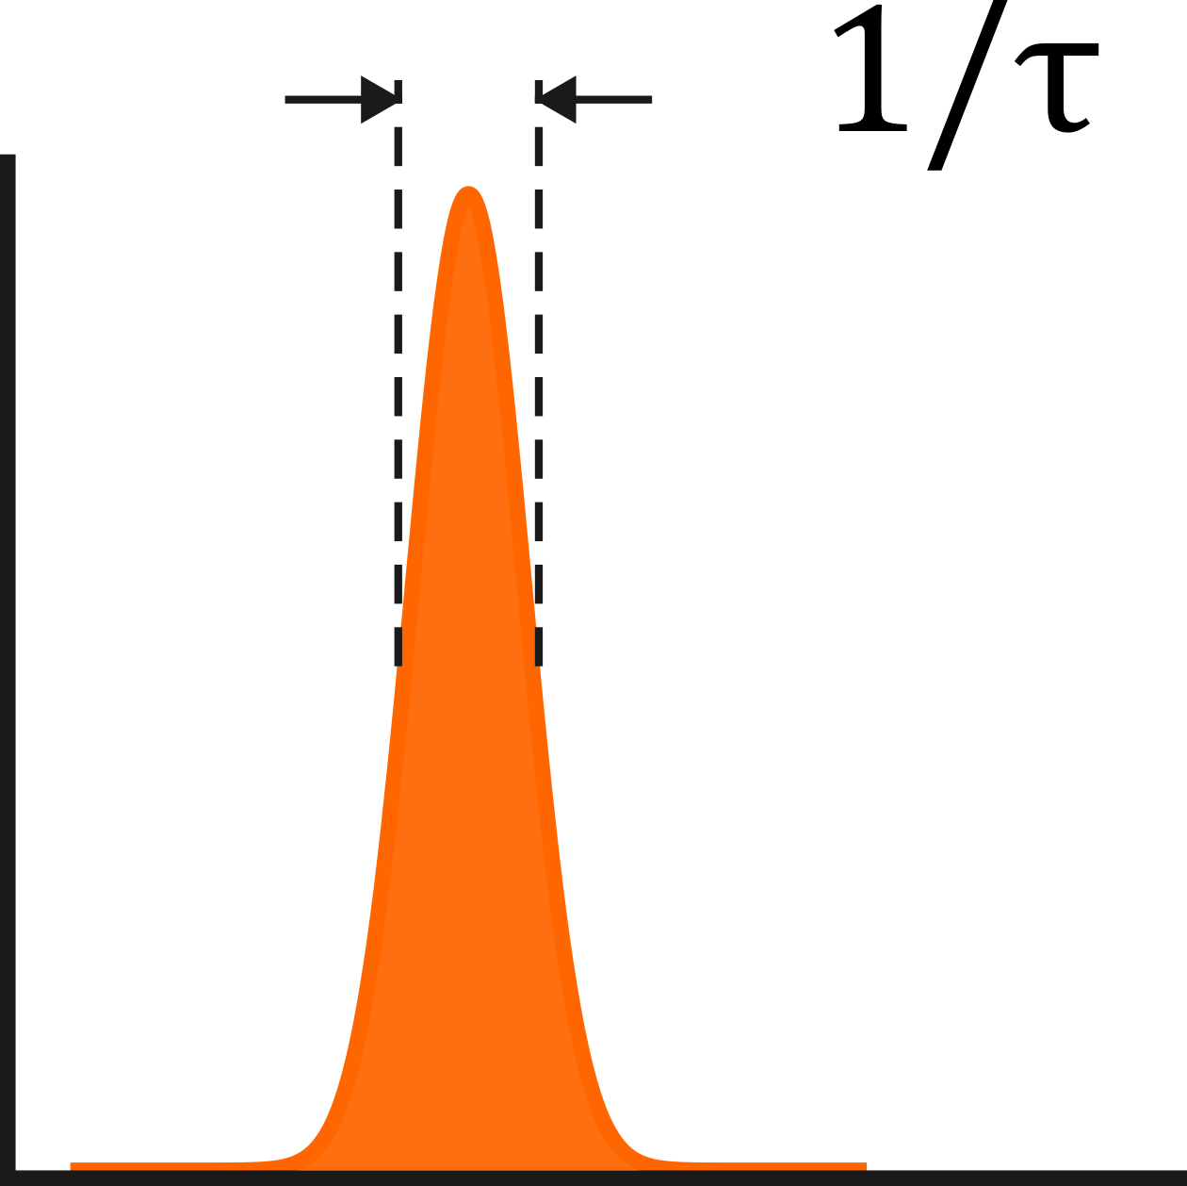
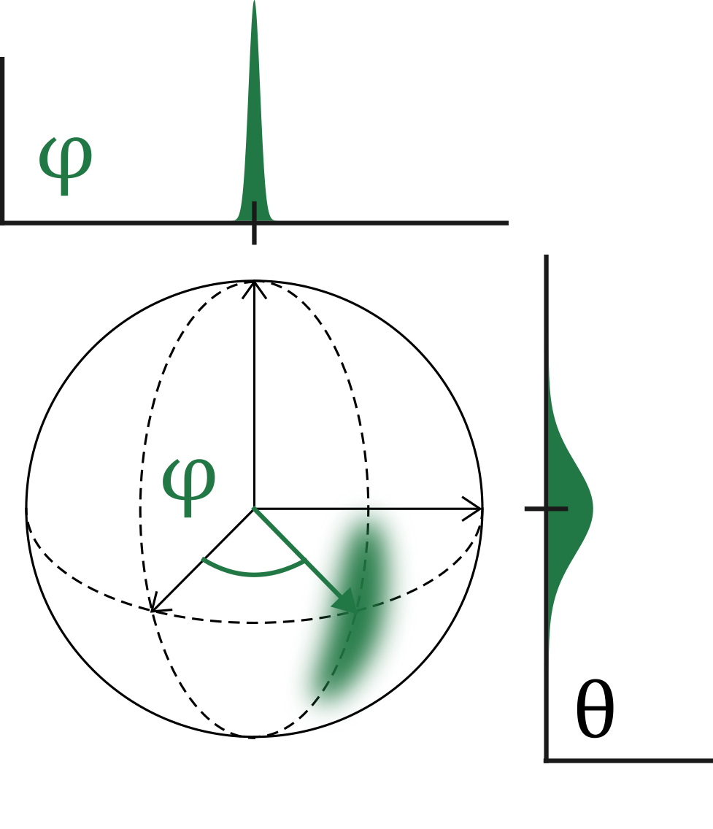








Ultracold radioactive polar molecules are a more sensitive platform to Beyond Standard Model (BSM) physics
We have already heard from some talks
Piggybacking from previous talks, molecules enhance experimental signal for Schiff moment and EDM measurements.
Further enhancements for molecules with heavy radioactive species.
²²⁵Ra, ²²⁷Th
from FRIB Isotope Harvesting Program!
Molecular E-field
Heavy atoms
Pear-shaped nuclei
$$ℰ_{ext}$$
Many orders of magnitude enhancement!
$$ℰ_{int}$$
$$\frac{β_{2}β_{3}^{2}}{ΔE_{±}}$$
$$s,p \text{orbital} \text{mixing}$$
$$Z^{3}$$
$$∆φ→\frac{1}{N}$$
Approach Heisenberg limit
$∆ω∝\frac{1}{τ}$
Adapted from (Gross, 2012)
S$lower→$ longer $τ$
Notes:
Ultracold: when only few partial waves contribute to scattering. Also can think of when DeBroglie wavelength approaches size of molecule.
Two ways we can improve the experiment is to enhance the signal of an EDM, and also to decrease our uncertainty.
Two ways to enhance an EDM signal is to use Heavy, radioactive atoms in molecules. Polar molecules have high polarizability, leading to a much larger effective field than with atoms. Additionally, heavy atoms lead to an enhancement in the magnitude of their internal electric fields proportional to Z^3. Lastly, Radioactive atoms such as Ra225 can have enhancements to the EDM signal due to nuclei shape deformations while having narrowly-spaced (10s of keV) energy levels.
Last part: Xing, 2024 FPUA

Slide 19
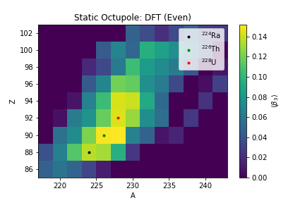
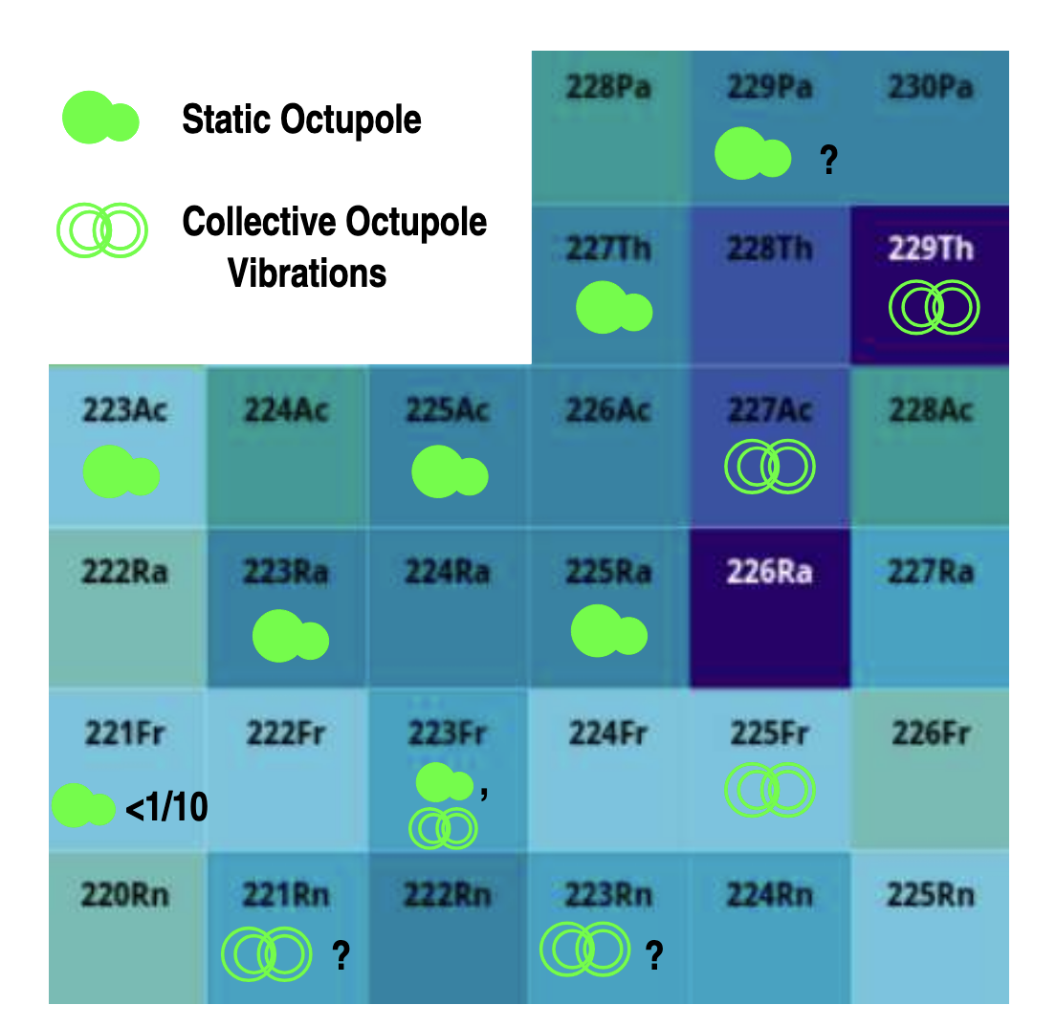
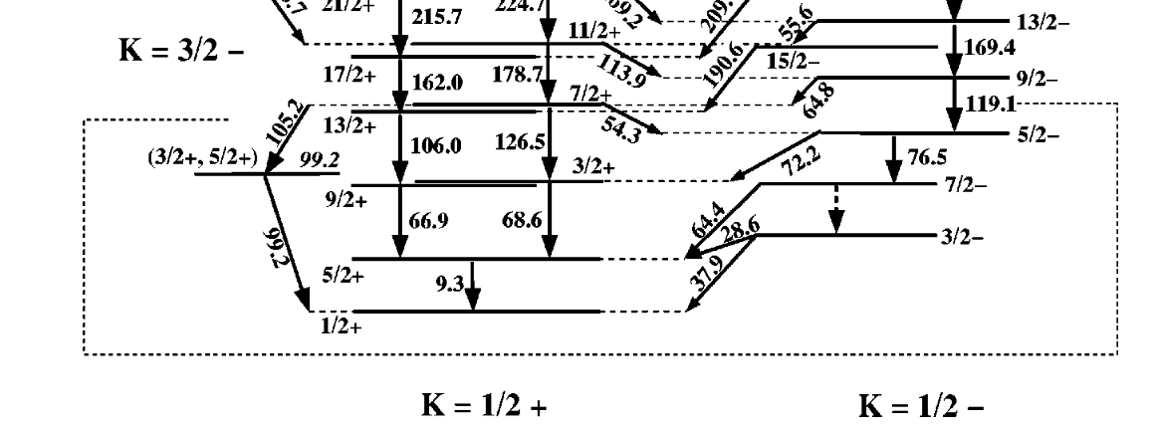
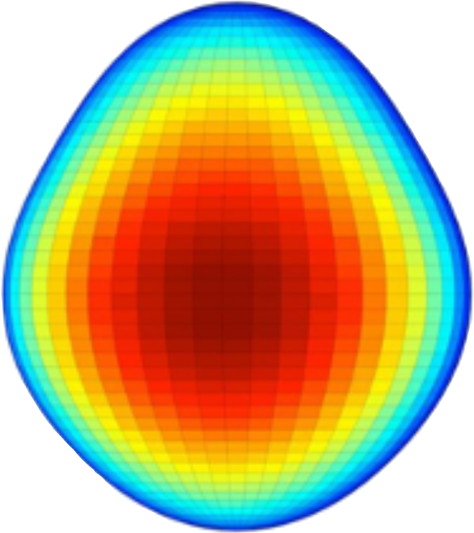





^{227,229}ThO As Quantum Sensor: Nuclear EDM Search
Witek Nazarewicz
Phys. Lett. B 224, 5 (1989)
Octupole deformed
Spin 1/2
I = 1/2
I = 3/2
I ≥ 5/2
Hammond et al., Phys. Rev. C 65 064315 (2002)
J. Singh via Yuchen Cao et al., Phys. Rev. C 102, 024311 (2020)
Better machinery for theory calculation on Octupole Enhancement in ²²⁹Th is underway, and for ²²⁷Th
^{227,229}Th are also used in ion systems
²²⁷ThF⁺
²²⁹ThF⁺
Jonathan Engel
(UNC)
Jiangming Yao
(SYSU, China)
Malbrunot-Ettenauer
Xing Fan

Slide 20
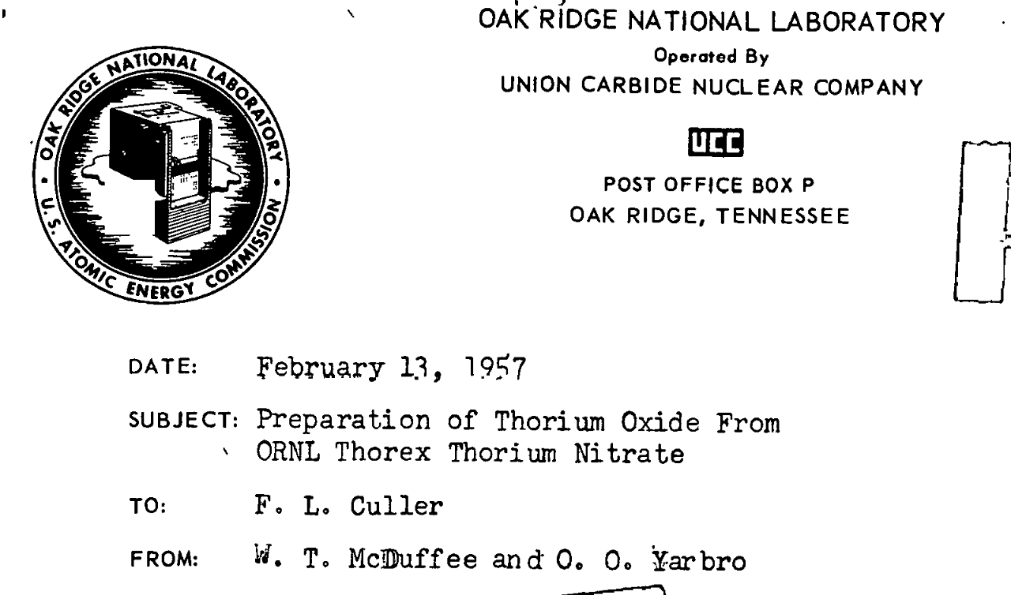
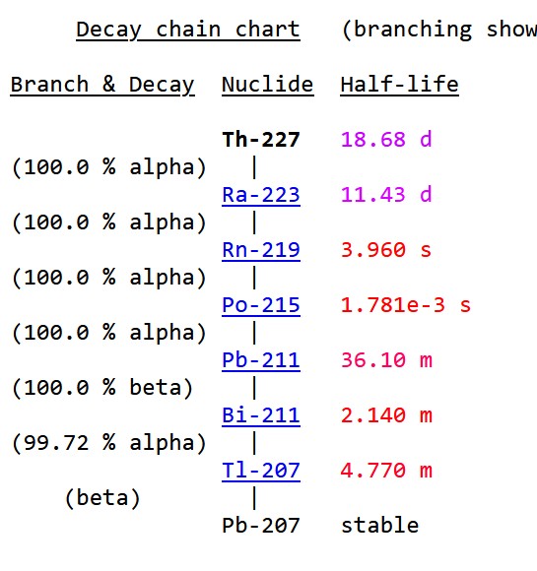
^{227,229}ThO As Quantum Sensor: Nuclear EDM Search
Witek Nazarewicz
Phys. Lett. B 224, 5 (1989)
Octupole deformed
Spin 1/2
I = 1/2
I = 3/2
I ≥ 5/2
Hammond et al., Phys. Rev. C 65 064315 (2002)
J. Singh via Yuchen Cao et al., Phys. Rev. C 102, 024311 (2020)
Chemically (better) understood
²²⁷Th is NOT horrible to work with
Barely radioactive, readily accessible, cousin ²³²Th means:
  Much more chemistry done that rarer species
  Can test everything with larger quantities
𝜏~ 19 days
Short-lived daughters
Mostly alpha decays
Declassified from 1957(!)
wise-uranium.org

Slide 21
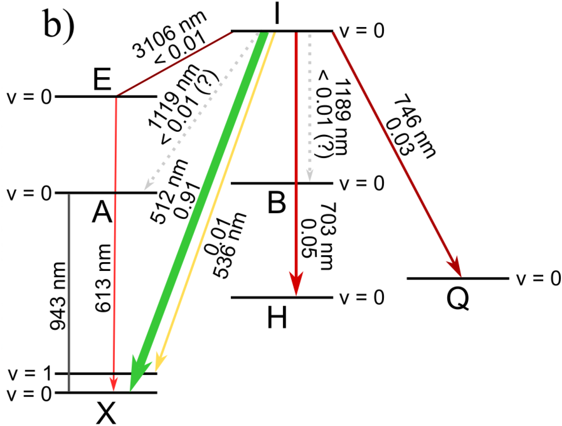
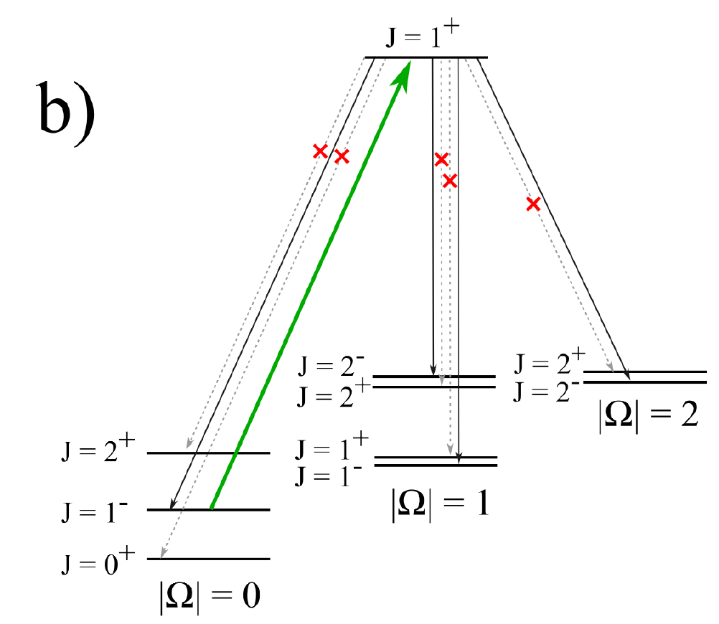
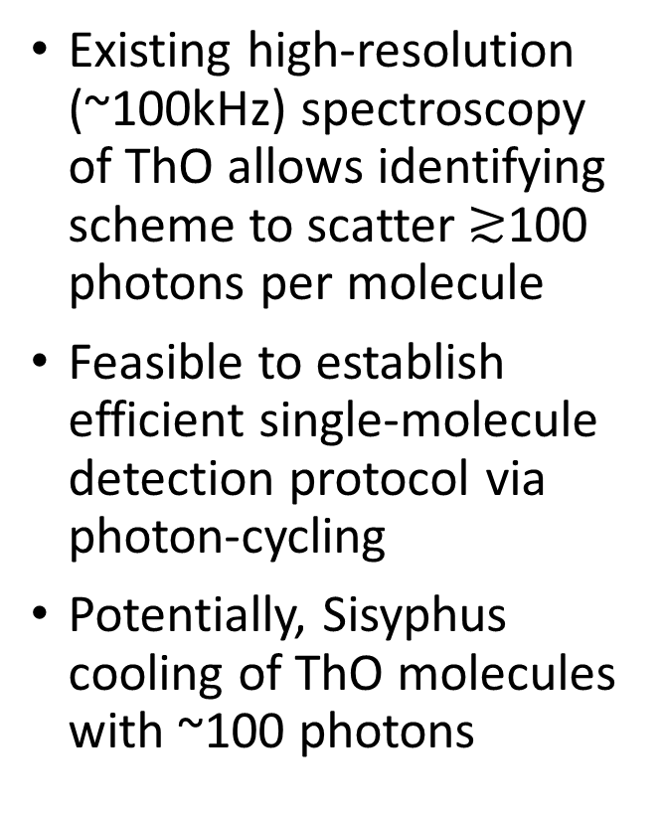
ThO Benefits from Past 15 Years Experience of Quantum Control & Readout of ²³²ThO Developed at ACME eEDM Project
Existing high-resolution (~100kHz) spectroscopy of ThO allows identifying scheme to scatter $≳$100 photons per molecule
Feasible to establish efficient single-molecule detection protocol via photon-cycling
Potentially, Sisyphus cooling of ThO molecules with ~100 photons
ACME Collaboration
Closure of Vibronic Levels
Closure of Rotat. Levels
I
Q
H
X

Slide 22
Naïve Expectations for a First-Gen measurement
Competitive with current limits with modest sample size
  Realistic optimization of a few aspects could improve e.g. θ_{QCD} limit by 10x
Citations:
[1] B. Graner et al. PRL 116, 161601 (2016)
[2] O Grasdijk et al. Quantum Sci. Technol. 6 (2021)
[3] Chen et al., J Phys Chem A 128 (2024)
[4] Flambaum and Dzuba, PRA 101 (2020)
Species | N/s | τ (s) | T (hrs) | Phase sens. | W_{s} | S/θ_{QCD} (e fm³) | θ_{QCD} sens.
¹⁹⁹Hg | 10¹⁴ in cell [1] | ~170 [1] | ~2000 [1] | 20 pHz [1] | ~2* | 0.005 [4] | 1.5 x 10⁻¹⁰ [1]
²⁰⁵TlF | 10⁸-10⁹ [2] | 0.01 [2] | 300 [2] | 50 nHz, projected in [2] | 33 000[3] | 0.027 [4] | 10⁻¹², projected in [2]
²²⁷ThO (beam) | 50 000 | 0.001 | 300 | 600 uHz | 25 000[3] | ~1 [4, est] | 10⁻¹⁰
²²⁷ThO (beam) | 200 000 | 0.005 | 300 | 60 uHz | 25 000[3] | ~1 [4, est] | 10⁻¹¹
²²⁷ThO (trap) | 10 000 | 0.5 | 900 | 2 uHz | 25 000[3] | ~1 [4, est] | 3x10⁻¹³

