Slide 1
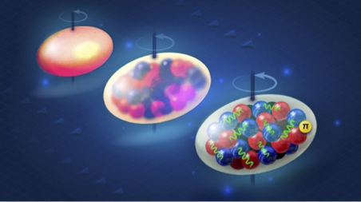


First-Principles Computations of Nuclei to Study Fundamental Physics
Thomas Papenbrock, tpapenbr@utk.edu
University of Tennessee & Oak Ridge National Laboratory
Radioactive Isotopes for Fundamental Physics Workshop (RadIs 2026)
ORNL, Aug. 26, 2026

Slide 2
Executive Summary
We perform ab initio computations of atomic nuclei and nuclear matter
  Based on Hamiltonians from effective field theories of quantum chromodynamics, using two-nucleon and three-nucleon forces
  Development of accurate Hamiltonians (i.e. adjustment of low-energy constants) and uncertainty quantification are key
  Computational approach based on the coupled-cluster method
    Employed approximations scale polynomially with mass number
    Expensive but affordable on leadership-class computing facilities
    Systematically improvable approach
  Accurate computations of nuclei to probe fundamental symmetries are possible
Nuclear theory has moved from being explanatory to being predictive

Slide 3
What we can compute really well
(and have predictive power)
Ground-state energies of nuclei with closed subshells (and their neighbors)
  Low-lying excited states of such nuclei (that are sufficiently simple in structure)
  Magnetic moments and strong beta decays in such nuclei; their charge radii

Slide 4
Predicted: ⁷⁸Ni is a neutron-rich doubly magic nucleus
Doubly magic nuclei are more strongly bound, and more difficult to excite, than their neighbors
They are the cornerstones for understanding entire regions of the nuclear chart
Our prediction from 2016
Hagen, Jansen, TP,
Phys. Rev. Lett. 117, 172501
R. Taniuchi, C. Santamaria, P. Doornenbal, A. Obertelli, K. Yoneda et al., Nature 569, 53-58 (2019); arXiv:1912.05978

Slide 5
What we can compute really well
(and have predictive power)
Ground-state energies of nuclei with closed subshells (and their neighbors)
  Low-lying excited states of such nuclei (that are sufficiently simple in structure)
  Magnetic moments and strong beta decays in such nuclei; their charge radii
Ground-state energies and ground-state rotational bands of strongly deformed nuclei (“rigid rotors”)
  Electric quadrupole transitions in such nuclei

Slide 6
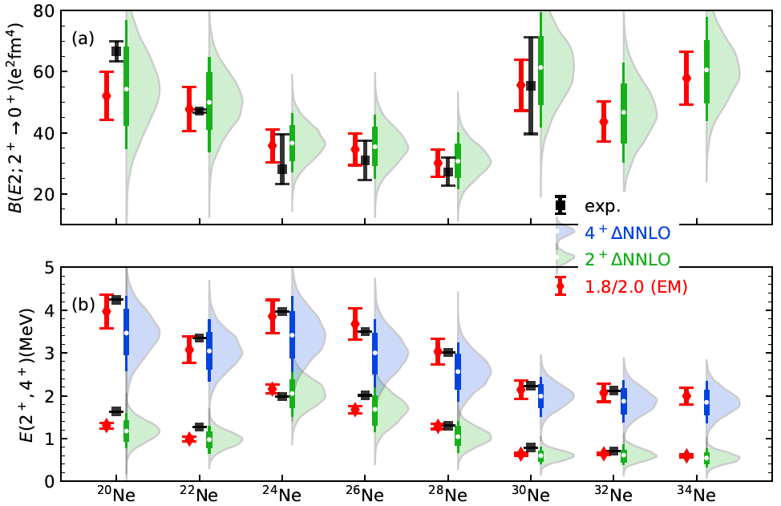
Collective properties of neon nuclei
Zhonghao Sun, A. Ekström, C. Forssén, G. Hagen, G. R. Jansen, TP, Phys. Rev. X 15, 011028 (2025)

Slide 7
What we can compute really well
(and have predictive power)
Ground-state energies of nuclei with closed subshells (and their neighbors)
  Low-lying excited states of such nuclei (that are sufficiently simple in structure)
  Magnetic moments and strong beta decays in such nuclei, their charge radii
Ground-state energies and ground-state rotational bands of strongly deformed nuclei (“rigid rotors”)
  Electric quadrupole transitions in such nuclei
Differences of strongly correlated observables
  Thickness of the neutron skin in doubly-magi nuclei

Slide 8
What we can compute
(but not as precisely as we wished)
Charge radii along a chain of isotopes

Slide 9
Challenges: Charge radii challenge nuclear theory
W.G. Jiang et al, arXiv:2006.16774
Sharp increase beyond N=28 not reproduced by EFT Hamiltonians
A. Koszorus, X. F. Yang et al, Nature Physics 17, 439 (2021); arXiv:2012.01864

Slide 10
What we are working on
(hard problems requiring precision and UQ)
Nuclear matrix elements relevant for tests of fundamental symmetries
  Neutrinoless double beta decay
  Schiff moments
  Coulomb corrections in superallowed beta decays

Slide 11
Challenges: Nuclear matrix element for neutrinoless 𝛽𝛽 decay
Challenges:
Higher precision
⁷⁶Ge, mass 130 nuclei are used in detectors (and not ⁴⁸Ca)
Contact of unknown strength also enters (to keep RG invariance), [Cirigliano, Dekens, de Vries, Graesser, Mereghetti, Pastore, van Kolck, Phys. Rev. Lett. 120, 202001 (2018); arXiv:1802.10097]
⁴⁸Ca
EFT Hamiltonians
J. M. Yao et al., Phys. Rev. Lett. 124, 232501 (2020); arXiv:1908.05424.
S. J. Novario et al., Phys. Rev. Lett. 126, 182502 (2021); arXiv:2008.09696

Slide 12
What we are working on
(hard problems requiring precision and UQ)
Nuclear matrix elements relevant for tests of fundamental symmetries
  Neutrinoless double beta decay
  Schiff moments

Slide 13
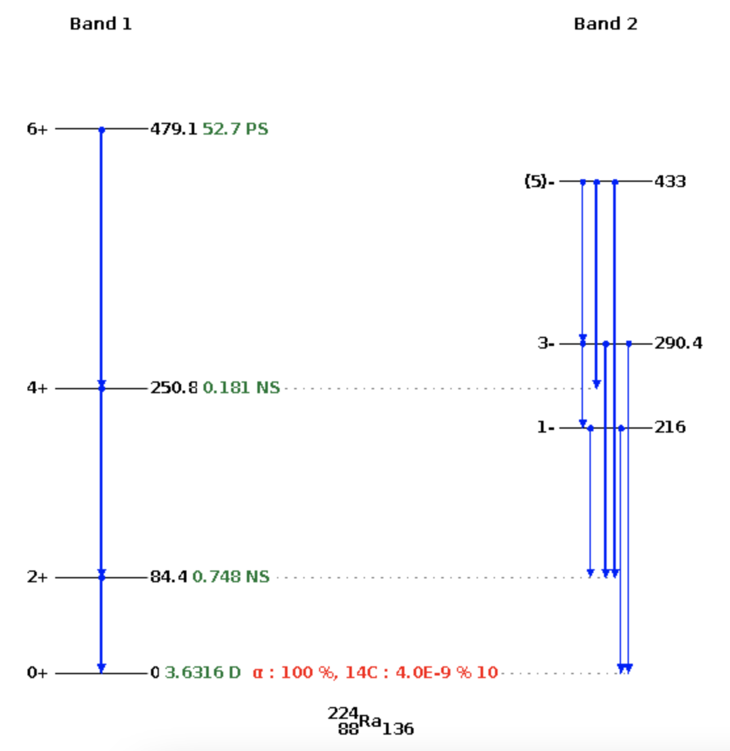
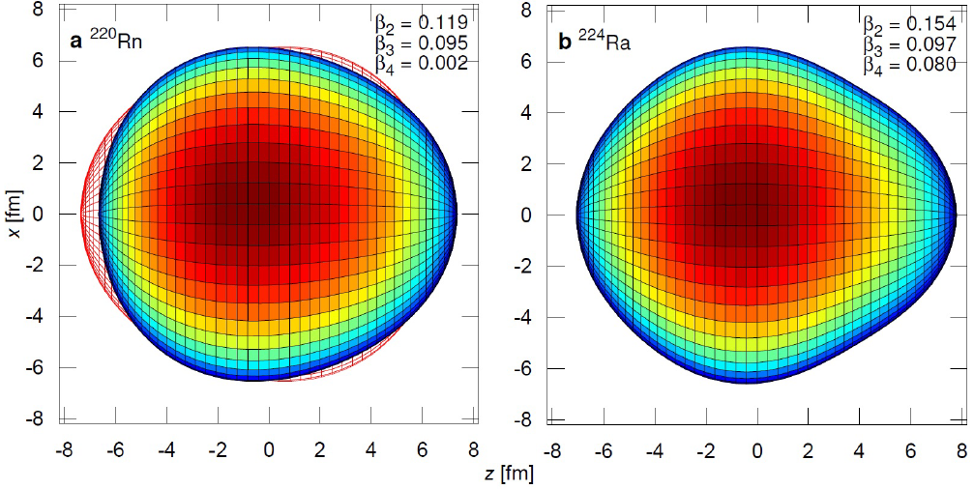
Symmetry breaking: octupole deformation
Gaffney et al. Nature 497, 199 (2013)
Credit: NNDC, https://www.nndc.bnl.gov/nudat3/

Slide 14
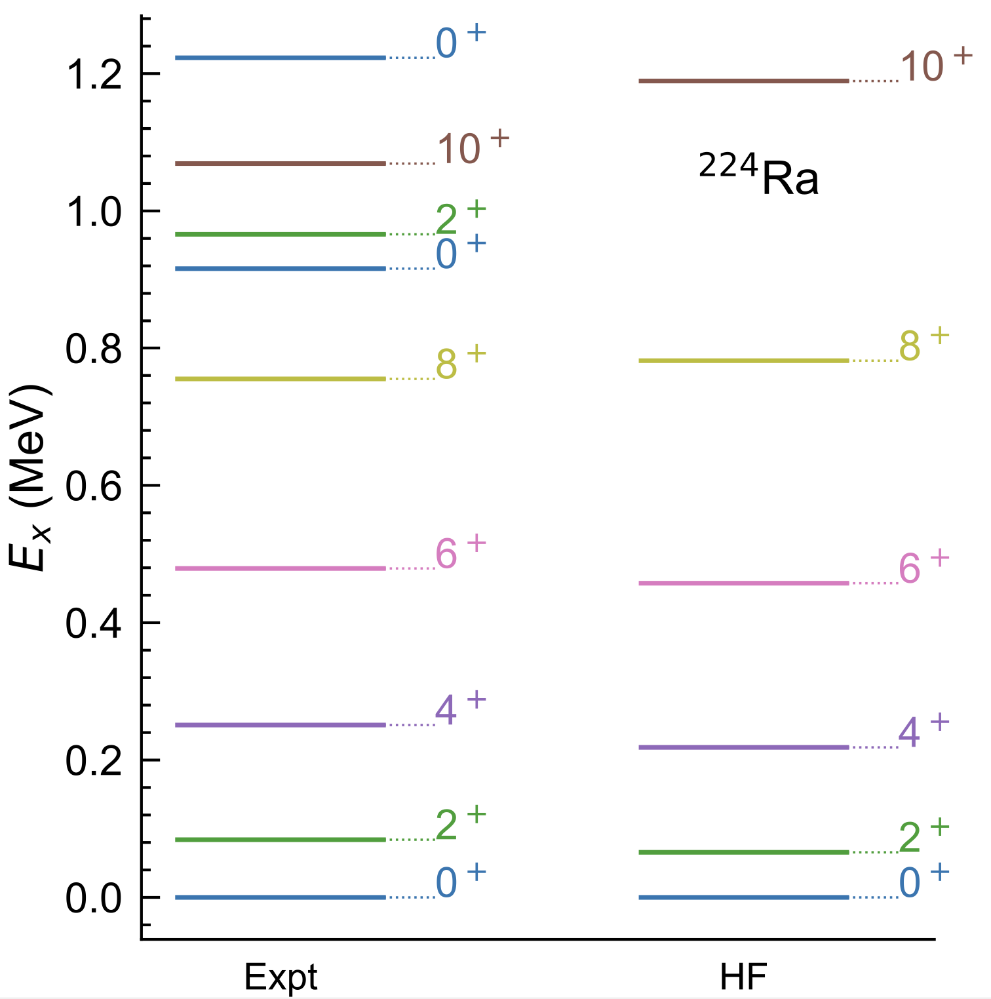
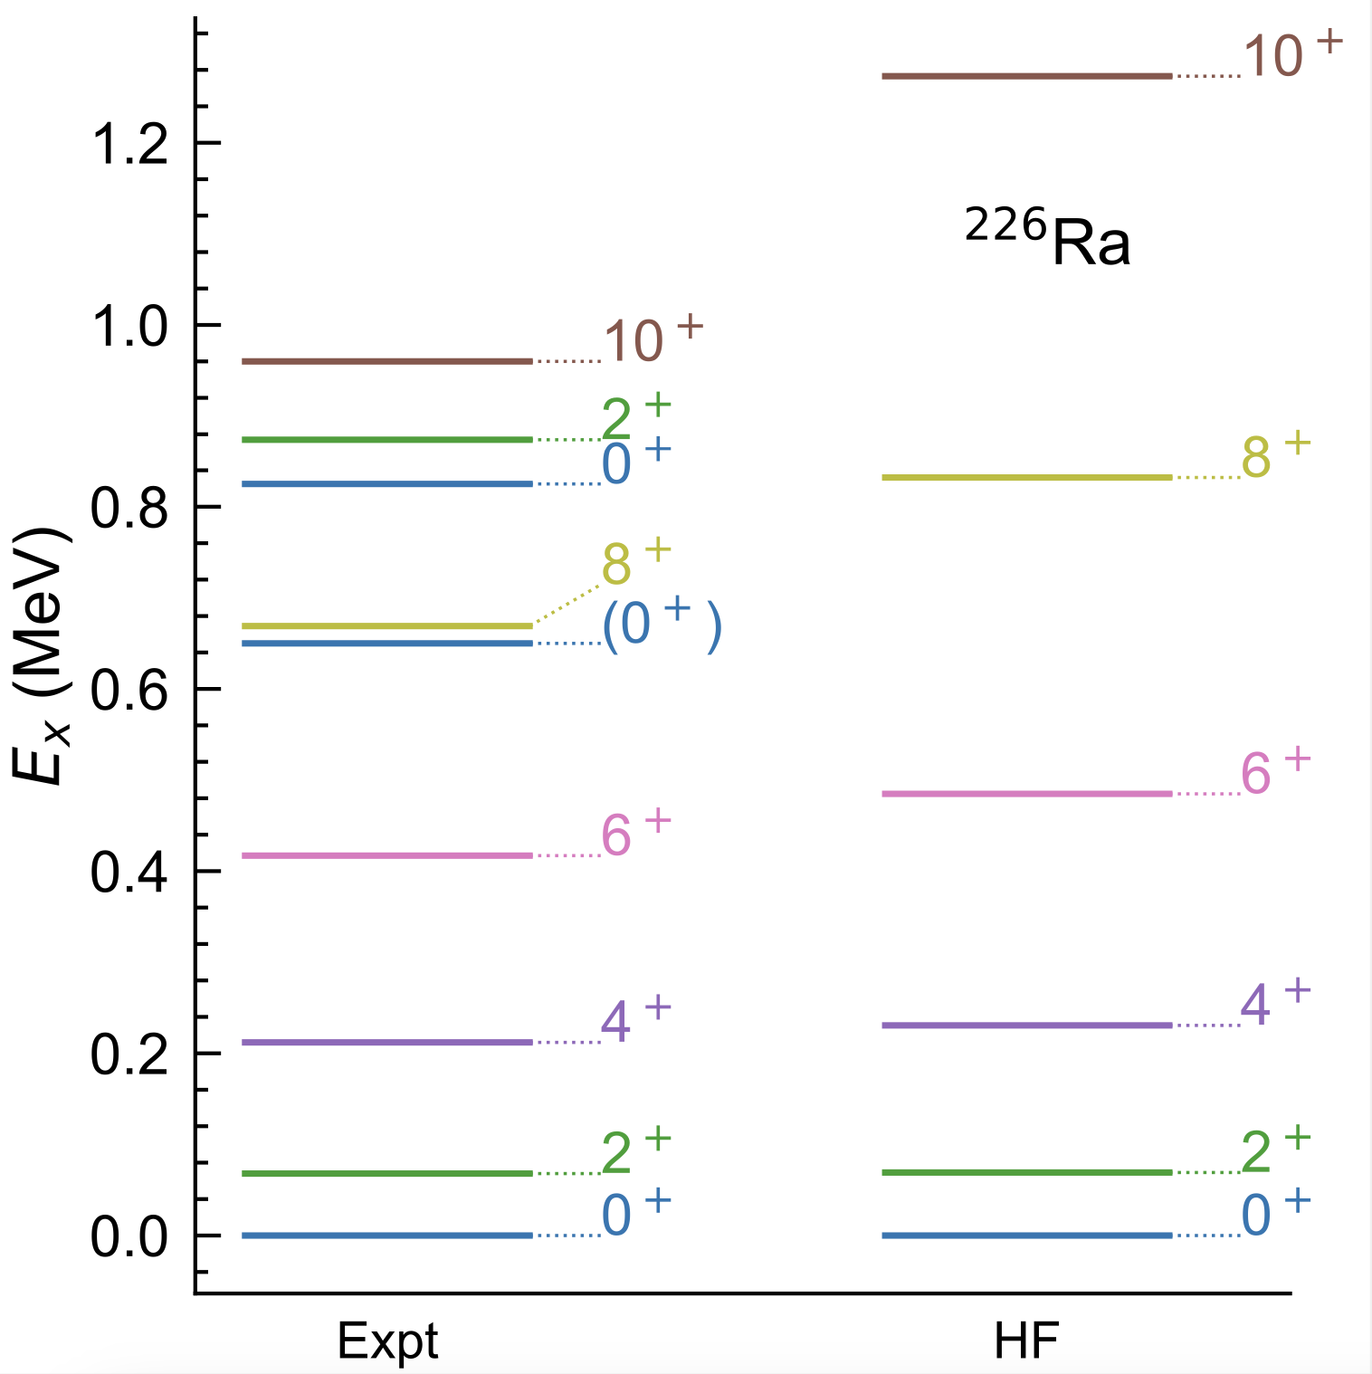
Towards coupled cluster computations of Schiff moments in radium nuclei
preliminary
Baishan Hu, Zhonghao Sun, G. Hagen, TP, … work in progress
Notes:
The scientific works were collaborations between theorists and hardware specialists (owners/operators of quantum chips).

Slide 15
What we are working on
(hard problems requiring precision and UQ)
Nuclear matrix elements relevant for tests of fundamental symmetries
  Neutrinoless double beta decay
  Schiff moments
  Coulomb corrections in superallowed beta decays

