Slide 1
²²⁶Ra for the production of ²²⁷Ac, ²²⁸Th and useful decay daughters
Workshop on
Radioactive Isotopes for Fundamental Physics
August 25 – 27, 2026
Dan Stracener
Oak Ridge National Laboratory
This work is supported by the Office of Isotope R&D and Production in the U.S. Department of Energy.

Slide 2
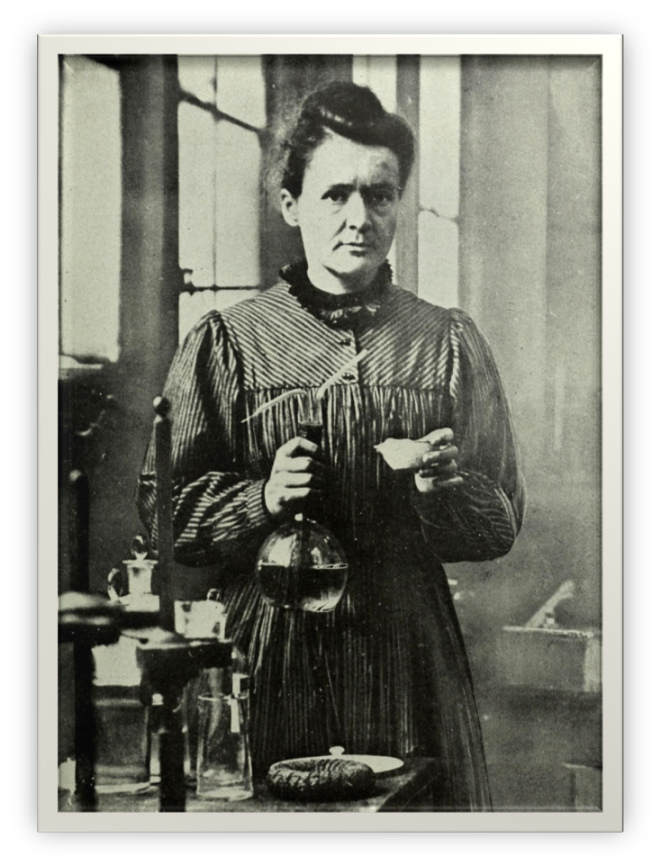
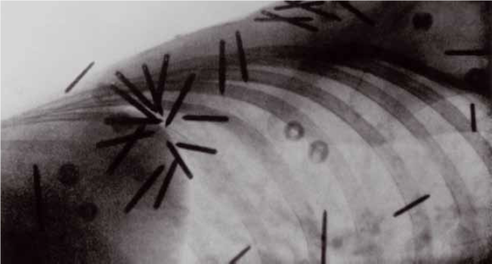
Radium – the original radioisotope for medical use
Radium was discovered by Marie and Pierre Curie in 1898 (a few months after they discovered polonium) and in 1907 determined the mass to be 226.45 amu
Marie Curie won the Nobel Prize in Chemistry 1911 for these discoveries
By 1901, ²²⁶Ra was being used to treat skin lesions
The Curie as a unit of radioactivity was defined in 1910 as the activity emanating from 1 gram of ²²⁶Ra and was named in honor of Pierre Curie
  Marie Curie accepted this definition after she insisted that 1 Curie should correspond to 1 gram of ²²⁶Ra rather than 10 ng as was originally proposed
Brachytherapy is a type of radiation therapy where a sealed radioactive source is placed into or near a tumor.
²²⁶Ra devices were used to treat various cancers from the 1920 to 1960s.
²²⁶Ra use was discontinued by the late 1960s.

Slide 3
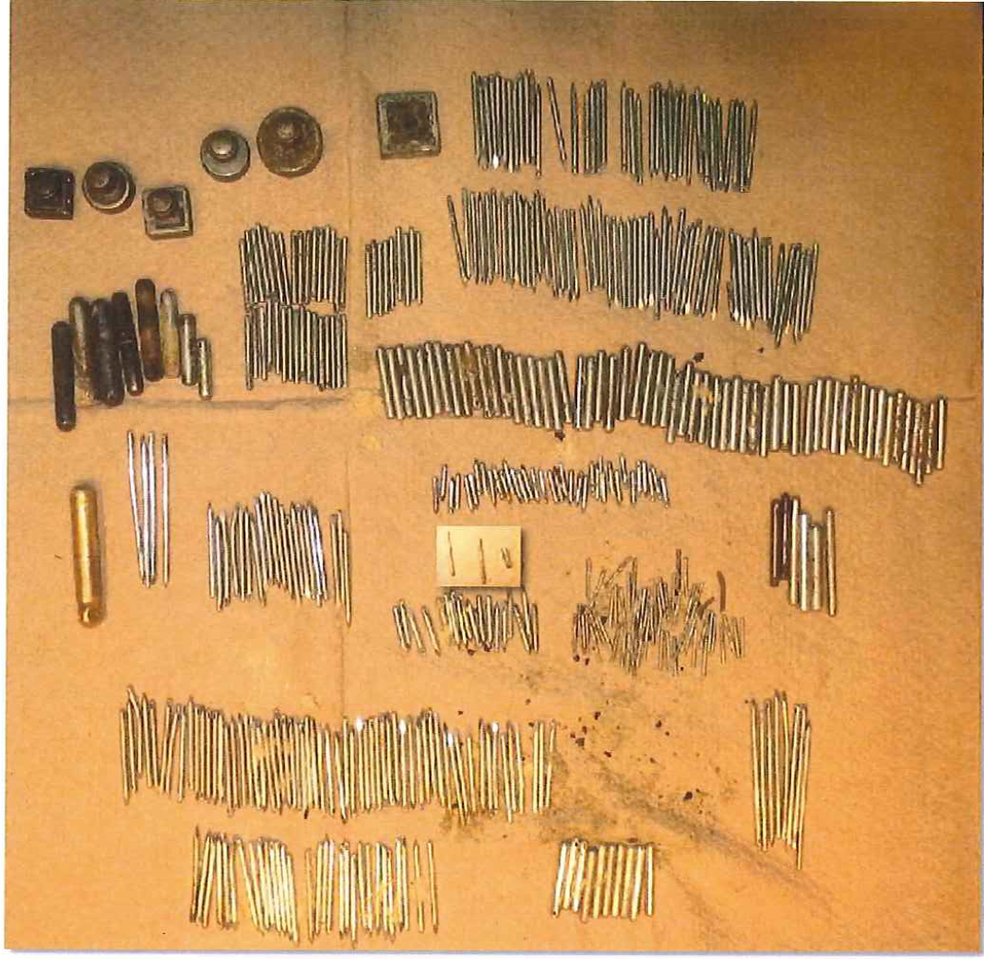
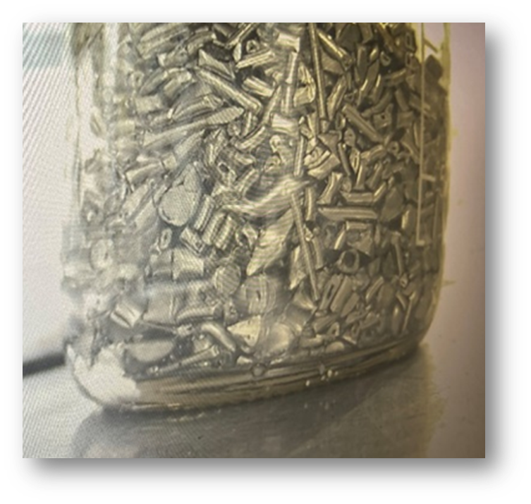
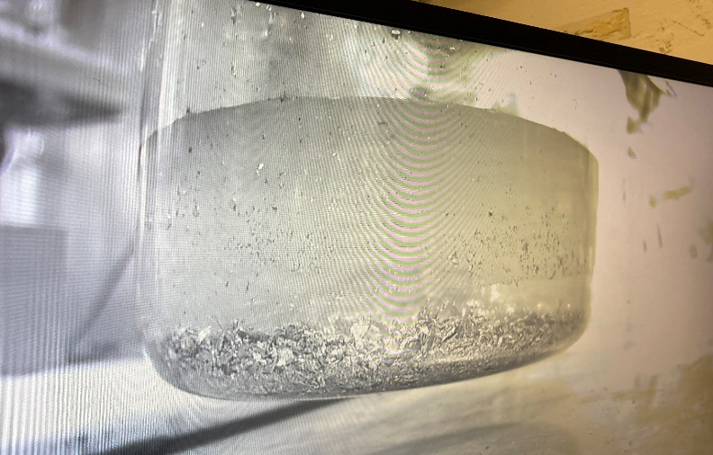
Recovery from Legacy Radium Medical Devices
Devices are mechanically disassembled, and radium is chemically dissolved from the fragments
Plaques
Tubes
Needles
Individual sources contain various amounts of ²²⁶Ra
Notes:
Sources-Plaques not viable, solids filler material makes difficult
Smaller needles and tubes are preferable-easier to mechanically open

Slide 4
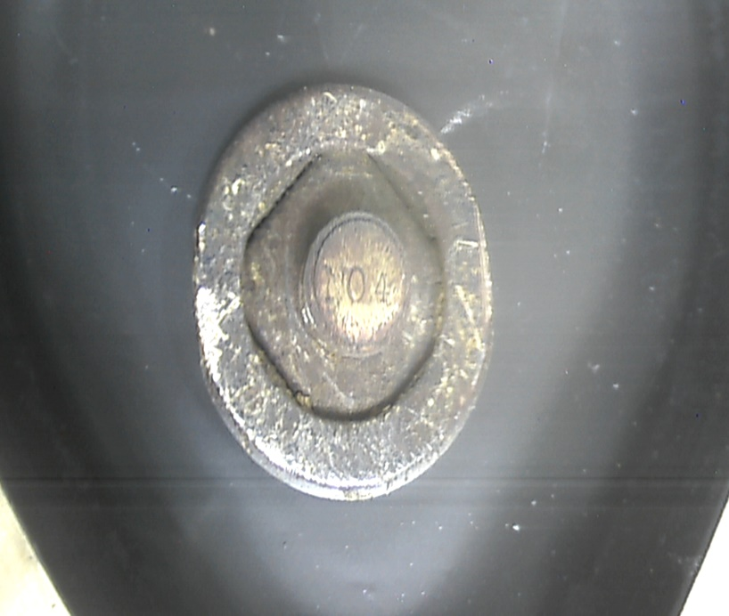
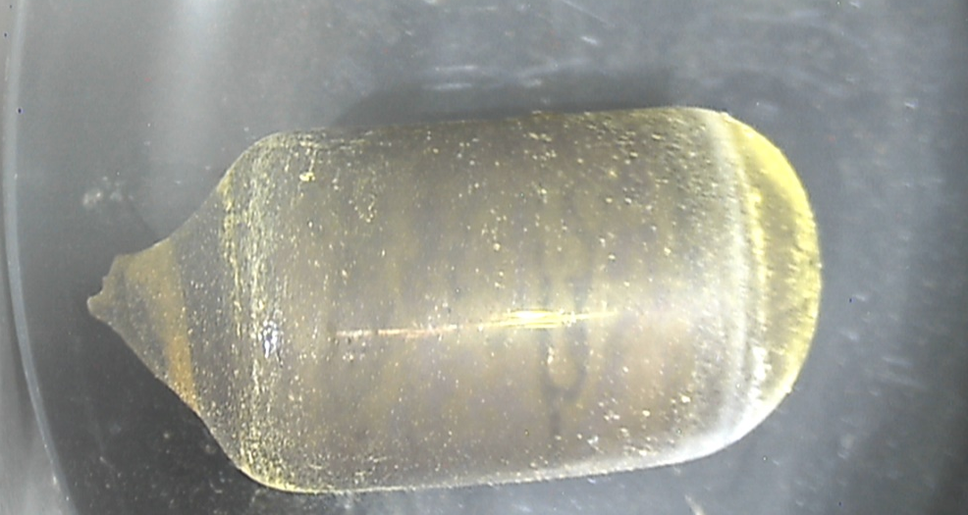
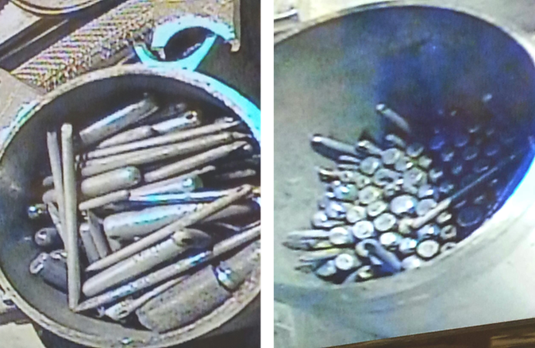
Examples of legacy medical devices containing ²²⁶Ra
Legacy ²²⁶Ra devices received at ORNL from repositories around the world
These legacy medical devices come in a large variety of shapes and sizes
Plaque
Glass ampoule
Variety of needles, tubes and cylinders in the SFC

Slide 5
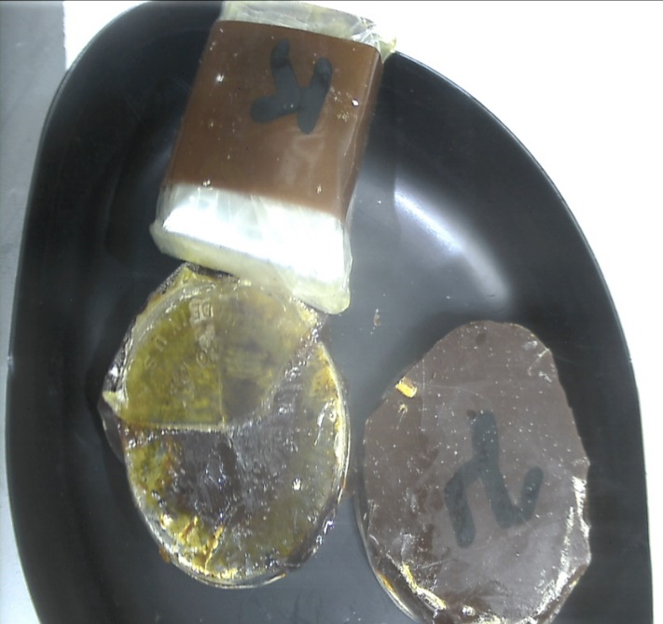
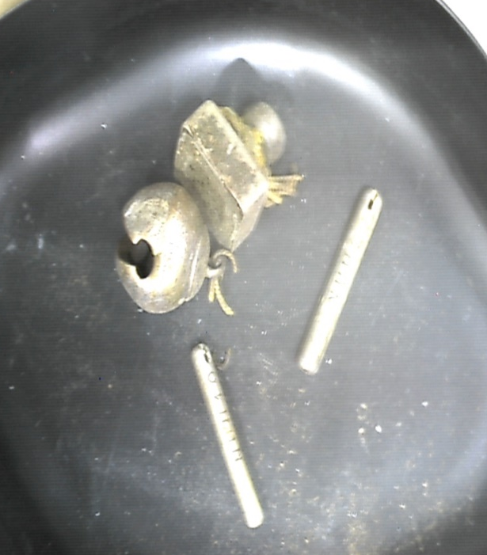
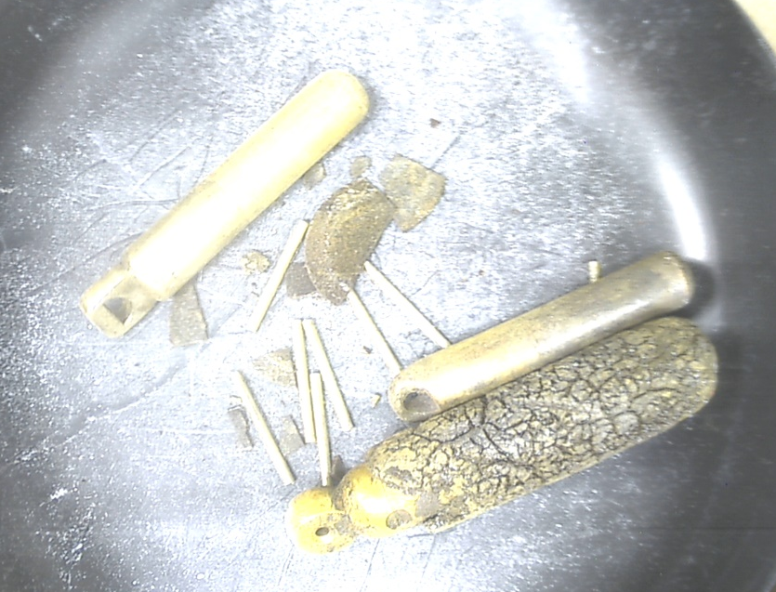
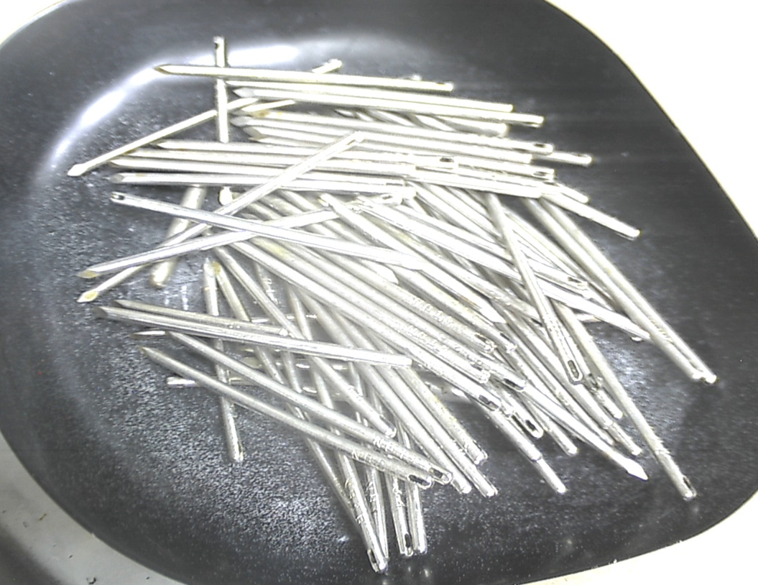
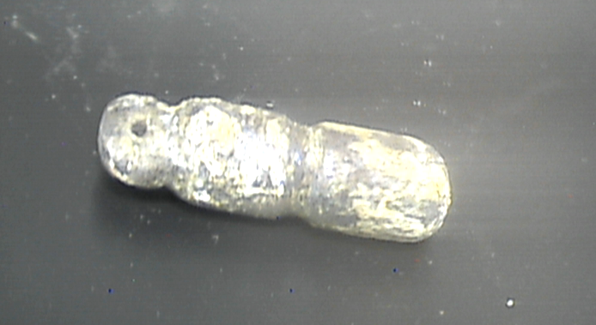
More examples of legacy medical devices containing ²²⁶Ra

Slide 6
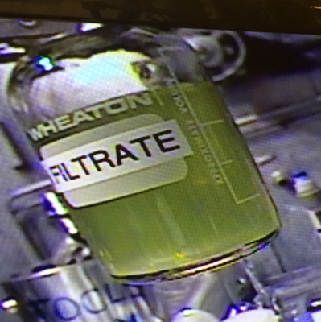
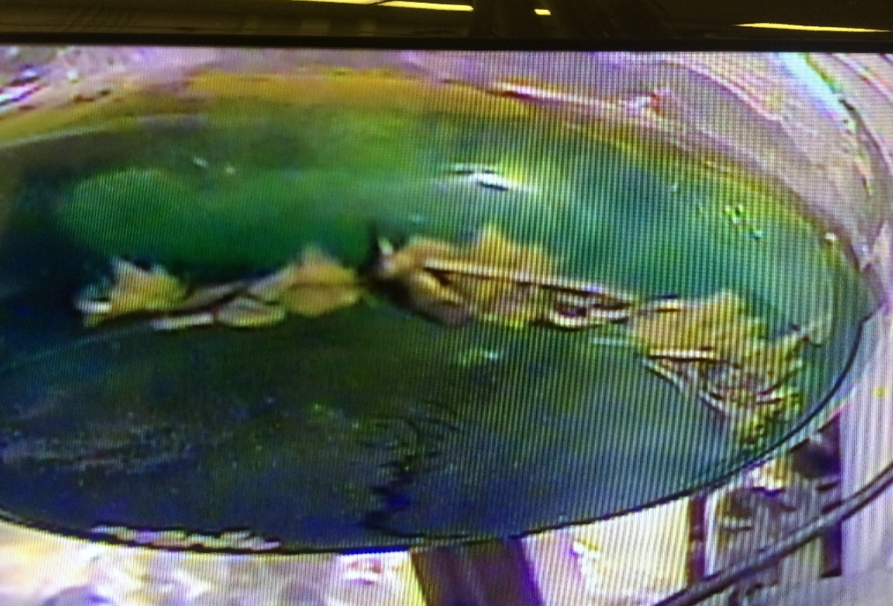
Dissolving and purifying ²²⁶Ra
The chemistry to purify the ²²⁶Ra material is not trivial
The ‘filler’ material is quite varied, including
  Group 2 elements (Ca, Ba, …)
  Transition metals (Cu, Ni, Ag, …)
  Pb and Bi
  Pt and Ir from the devices
The process must be versatile and optimized to reduce the volume of waste generated

Slide 7
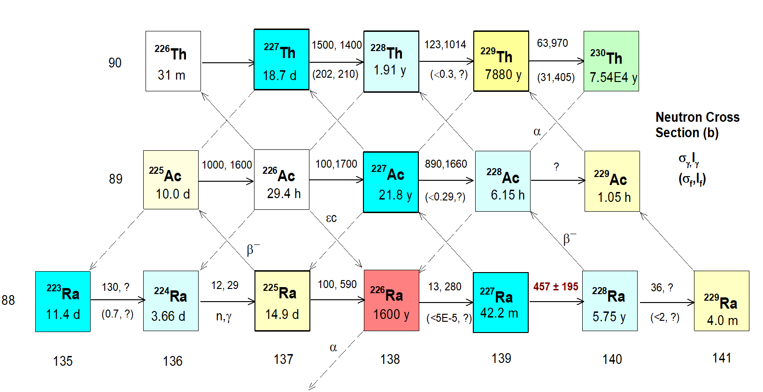
²²⁶Ra is important for the DOE Isotope Program
A valuable feedstock for production of alpha-emitting radioisotopes at HFIR
ORNL is uniquely qualified for large scale processing and irradiation of ²²⁶Ra targets
  HFIR, infrastructure (hot cells, gloveboxes, transportation), safety systems, radiochemistry experience
S. Hogle et al., Reactor Production of Thorium-229, Appl. Radiat. Isot. 114, 19 (2016)

Slide 8
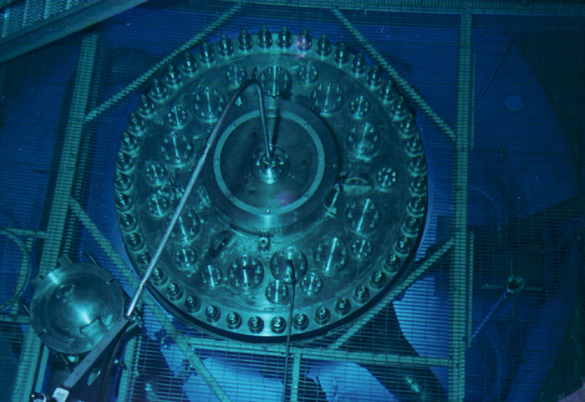
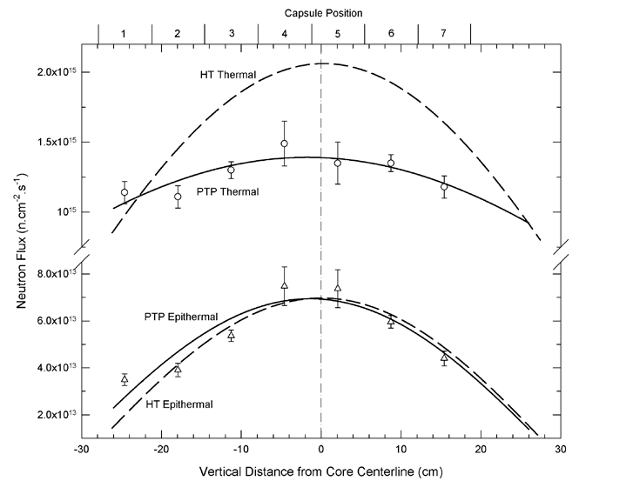
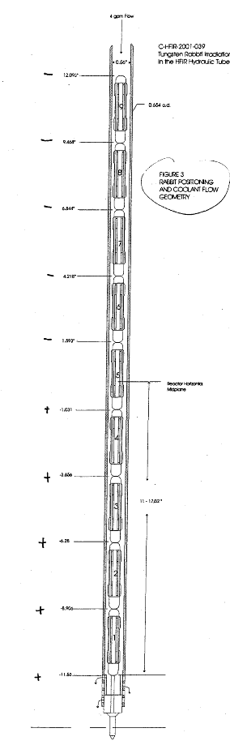
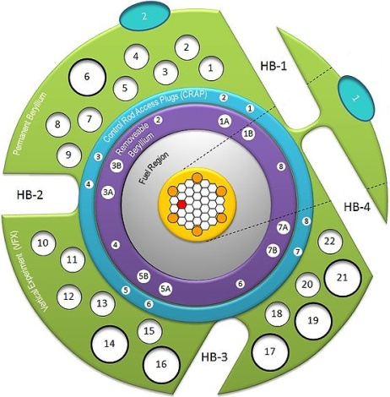
Hydraulic Tube at the 85 MW High Flux Isotope Reactor
The HFIR hydraulic tube facility allows for targets to be inserted/removed during operation of the reactor
This makes it possible to optimize production of isotopes, such as ²²⁷Ac and ²²⁸Th (while minimizing unwanted radioisotopes that contribute to radioactive waste)

Slide 9
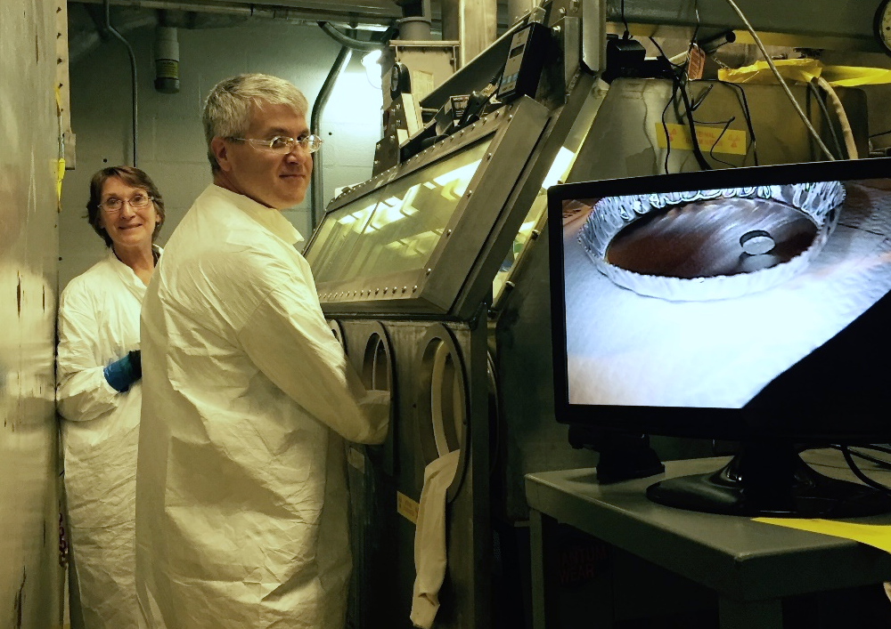
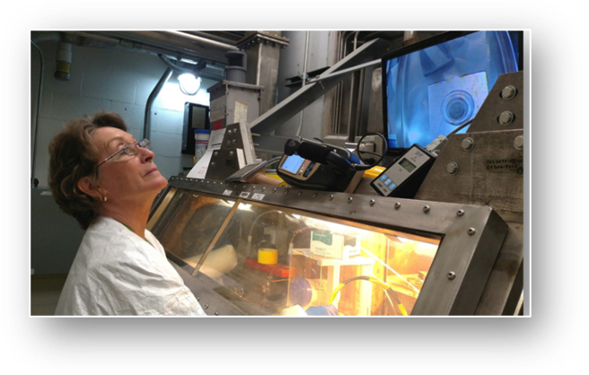
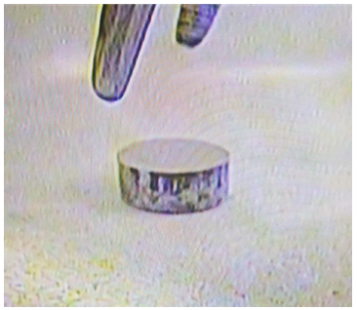
Fabricating ²²⁶Ra targets for HFIR irradiation
Purified ²²⁶Ra is pressed into solid pellets for irradiation at HFIR
  Mixture of RaCO₃ and aluminum powder (for thermal conductivity)
Heat is generated in the target during irradiation, and it must be removed efficiently to prevent melting
  Heat capacity, thermal conductivity, and thermal expansion are all considered in the heat calculations that are required to determine target temperature during irradiation at HFIR
Preparation of ²²⁶Ra targets in a glovebox

Slide 10
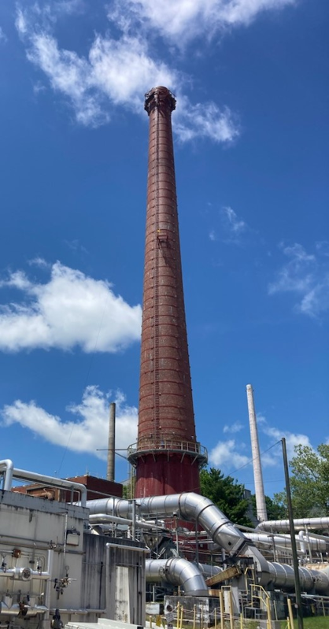
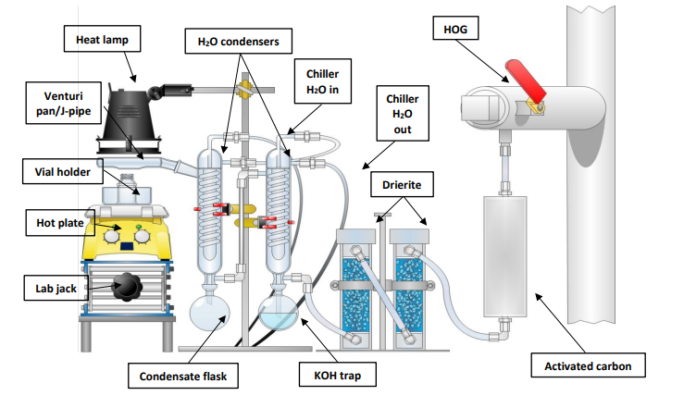
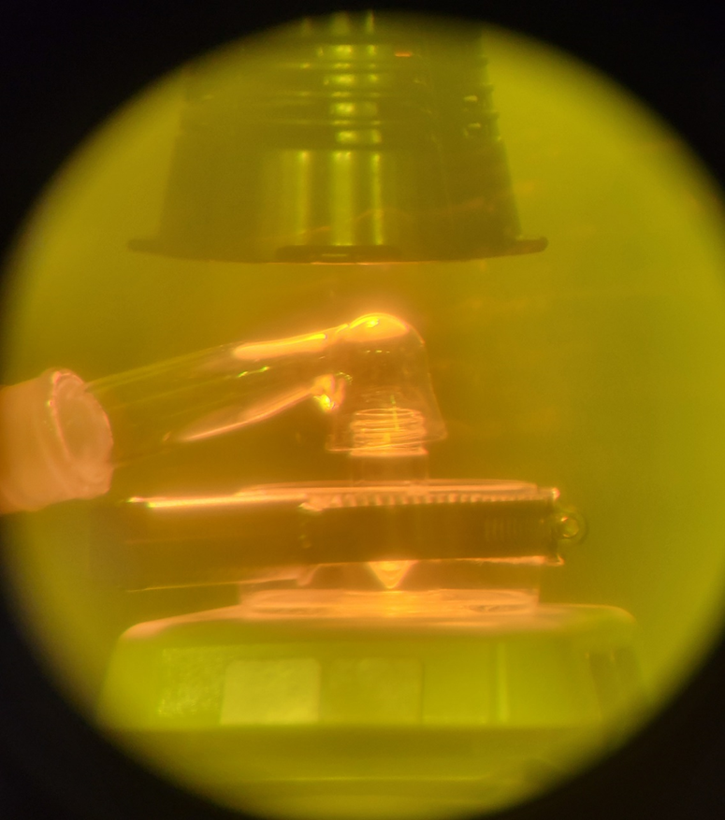
Reducing environmental emissions with in-cell controls
Schematic of in-cell gas trapping apparatus
Evaporation set-up in the hot cell with heat lamp and venturi collector that is connected to the HOG system

Slide 11
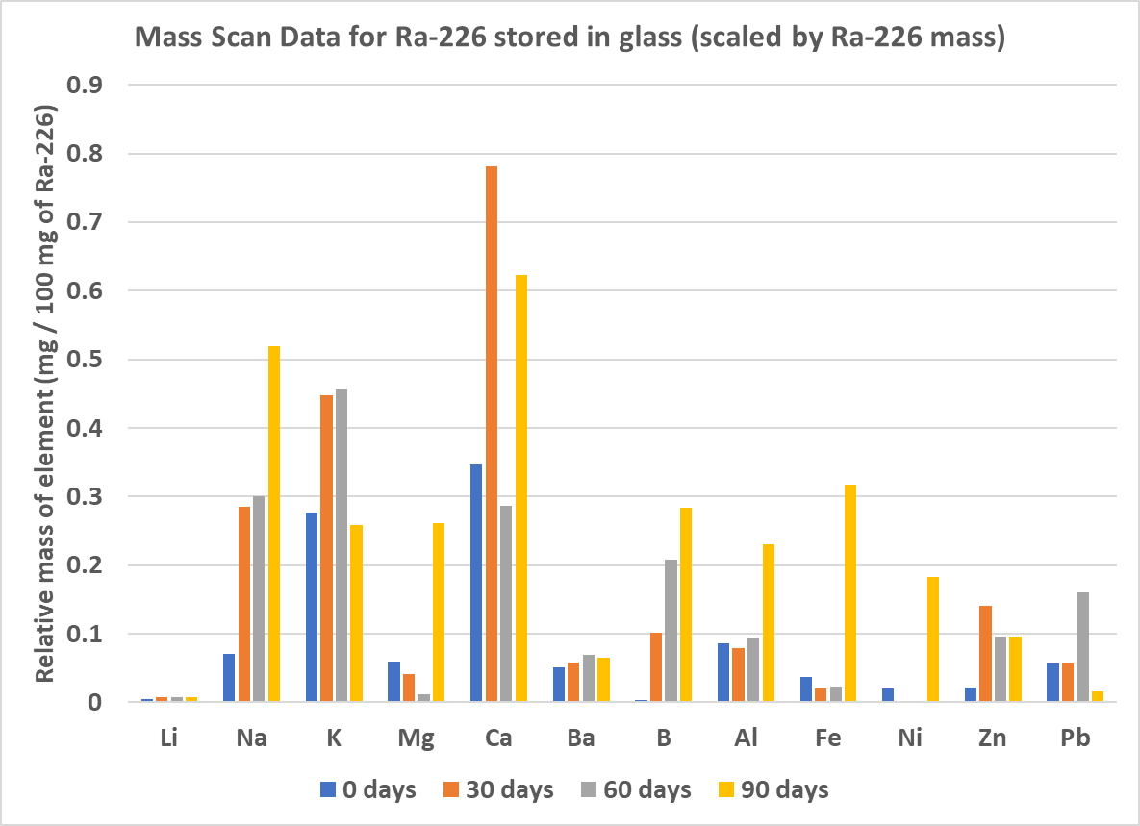
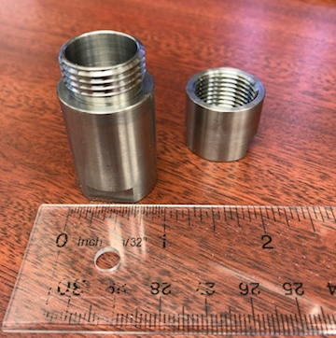
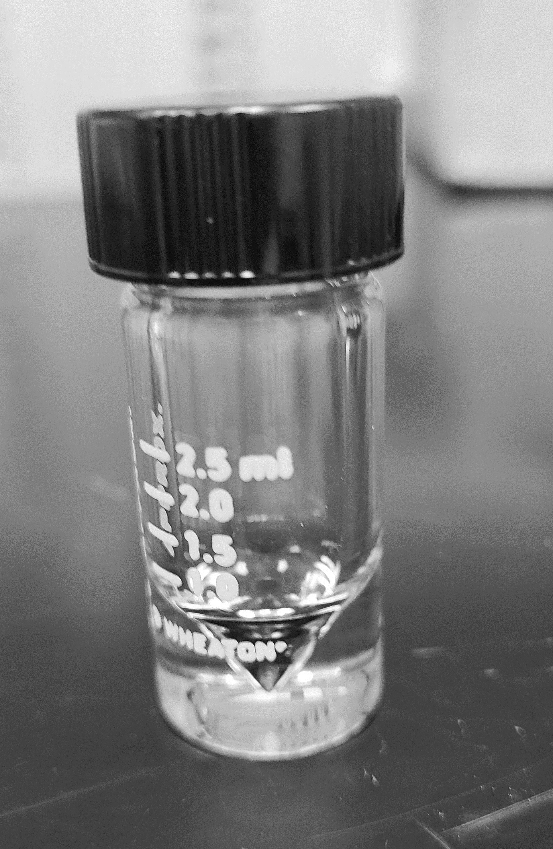
Storing ²²⁶Ra
Purified ²²⁶Ra is stored in the hot cell in a low-molarity nitric acid solution in a borosilicate glass flask until needed
For R&D shipments, aliquots of this solution are dispensed into either glass vials or Zircaloy vials and evaporated to dryness as solid radium nitrate
²²⁶Ra dissolved in low-molarity nitric acid
Prior to target fabrication, ²²⁶Ra is purified to a strict material specification, including
  >99% radionuclidic purity
  limits on ‘cold’ element contamination

Slide 12
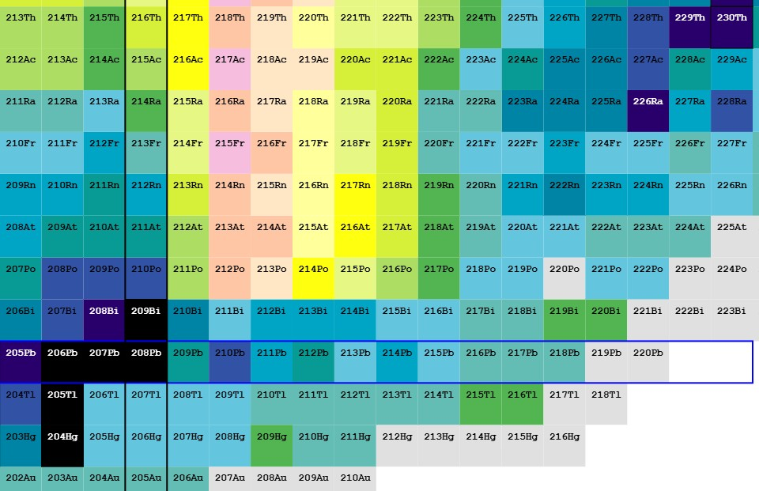
²²⁶Ra decay chain
²²⁶Ra (T_{½} = 1600 y)
5 α-decays
4 β-decays
Long-lived daughters
  ²²²Rn (T_{½} = 3.8 d)
  ²¹⁰Pb (T_{½} = 22.2 y)
  ²¹⁰Bi (T_{½} = 5.0 d)
  ²¹⁰Po (T_{½} = 138.4 d)
terminates in ²⁰⁶Pb
90
89
88
87
86
85
84
83
82
81
80
124 126 128 130 132 134 136 138 140

Slide 13
²²⁷Ac decay chain
²²⁷Ac (T_{½} = 21.77 y)
5 α-decays
3 β-decays
Long-lived daughters
  ²²⁷Th (T_{½} = 18.7 d)
  ²²³Ra (T_{½} = 11.4 d)
terminates in ²⁰⁷Pb
90
89
88
87
86
85
84
83
82
81
80
124 126 128 130 132 134 136 138 140

Slide 14
²²⁸Th decay chain
²²⁸Th (T_{½} = 1.91 y)
5 α-decays
2 β-decays
Long-lived daughters
  ²²⁴Ra (T_{½} = 3.63 d)
terminates in ²⁰⁸Pb
90
89
88
87
86
85
84
83
82
81
80
124 126 128 130 132 134 136 138 140

Slide 15
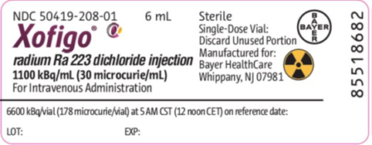
Medical uses for these alpha-emitters
²²⁷Ac (t_{1/2} = 21.7 a) is the parent isotope of ²²³Ra (t_{1/2} = 11.4 d) the active pharmaceutical ingredient in Xofigo®
  Provides both prolonged survival and palliative effects
Xofigo (²²³Ra dichloride) is approved worldwide for the treatment of castration-resistant prostate cancer with bone metastases
Another decay daughter of ²²⁷Ac is being used in an application called TTC (targeted thorium conjugates)
²²⁷Th (t_{1/2} = 18.7 d) is being studied for treatment of solid and blood tumors (e.g., ovarian, breast, prostate, colorectal, …)
²²⁸Th (t_{1/2} = 1.91 a) is the parent isotope of ²²⁴Ra (t_{1/2} = 3.6 d) which then decays to ²¹²Pb and ²¹²Bi
²¹²Pb is being studied in several clinical trials to treat neuroendocrine tumors solid tumor via targeted alpha therapy
²¹²Pb can also be used in conjunction with ²⁰³Pb as an imaging agent to create a theranostic pair
²²⁴Ra is being studied for direct use in several cancer types that have metastasized to the bone
These clinical trials are very encouraging and subsequently, the demand for ²²⁸Th is increasing exponentially
²²⁹Th (t_{1/2} = 7920 y) can also be produced via irradiation of ²²⁶Ra targets in HFIR
This long-lived isotope decays by α-emission to ²²⁵Ac (t_{1/2} = 9.9 d)
Clinical trails with ²²⁵Ac are in progress to treat solid and blood tumors via targeted alpha therapy techniques

Slide 16

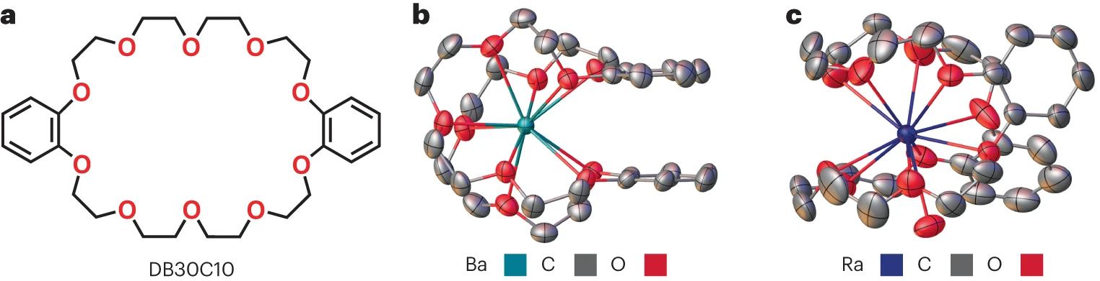
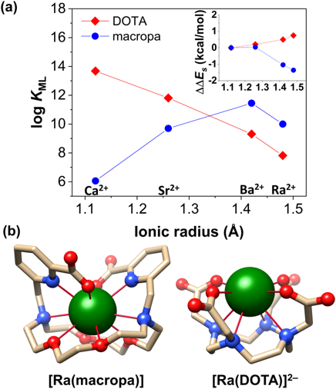
Recent chemistry publications with ²²⁶Ra
Ba and Ra single crystal structures prepared with the DB30C10 ether macrocycle
“… results emphasize the disparate coordination chemistries of Ra²⁺ and Ba²⁺, such that using Ba²⁺ as a non-radioactive surrogate to model the behaviour of Ra²⁺ in studies must be done with caution.”
From a DOE Office of Science Highlight, illustrating the 11-coordinate structure of radium (different from the 10-coordinate structure observed for barium).
F.D. White, N.A. Thiele, M.E. Simms, and S.K. Cary, Structure and bonding of a radium coordination compound in the solid state. Nature Chemistry 16, 168–172 (2024).
A.S. Ivanov, M.E. Simms, V.S. Bryantsev, P.D. Benny, J.R. Griswold, L.H. Delmau, and N.A. Thiele, Elucidating the Coordination Chemistry of the Radium Ion for Targeted Alpha Therapy. Chemical Communications 58, 9938-9941 (2022).

Slide 17
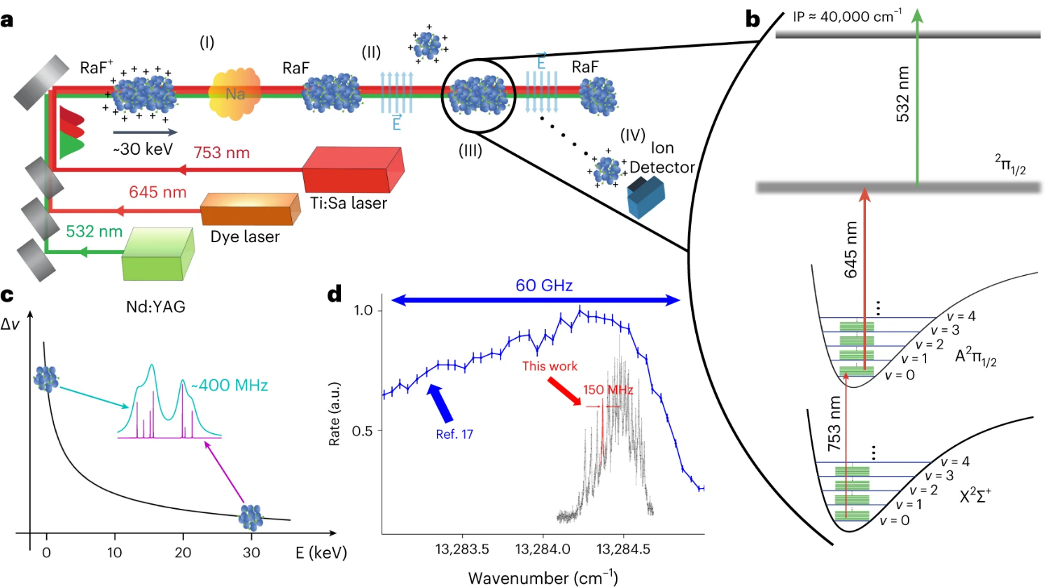
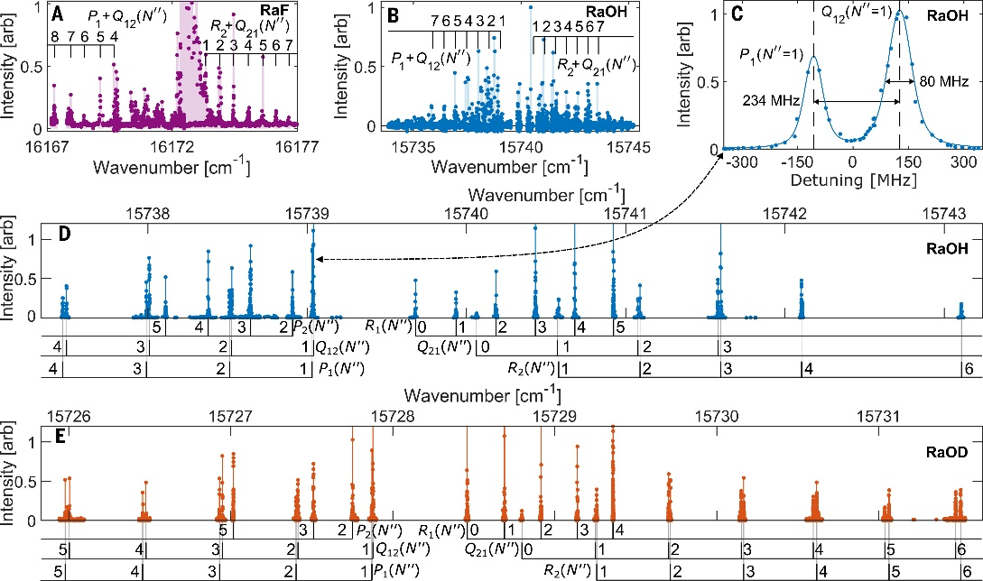
Recent publications on laser spectroscopy of ²²⁶Ra
“… high-resolution laser spectroscopy of radium monohydroxide, monodeuteroxide, and monofluoride molecules (²²⁶RaOH, ²²⁶RaOD, and ²²⁶RaF) in a tabletop apparatus by combining trace radioactive target production protocols, optically driven chemistry in a cryogenic buffer gas, and low-background spectroscopic detection methods.”
“… nuclear octupole deformation of certain radium isotopes massively boosts the sensitivity of radium monofluoride molecules to symmetry-violating nuclear properties.”
“… measurements of the rovibronic structure of radium monofluoride molecules, which allow the determination of their laser cooling scheme.”
C.J. Conn, et al., Production and spectroscopy of cold radioactive molecules. Science 393, 319-323 (2026).
S.M. Udrescu, et al., Precision spectroscopy and laser-cooling scheme of a radium-containing molecule. Nat. Phys. 20, 202–207 (2024).

Slide 18
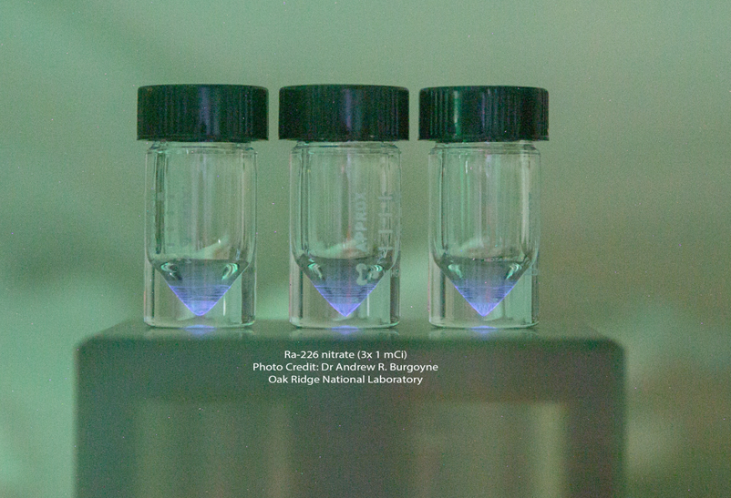
Thanks for your attention
Cherenkov radiation from dispensed ²²⁶Ra in glass vials (1 mCi each)

