Slide 1
Accelerator Production of Radioisotopes
RADIS 2026, August 25, 2026
Justin Griswold
Radioisotope Science and Technology Division

Slide 2
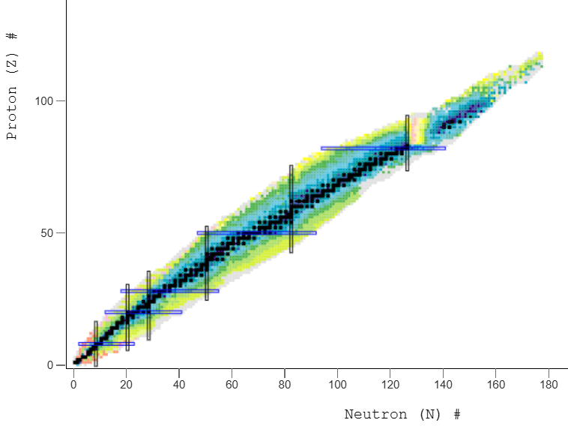
The basics…
Proton-rich → Accelerators
Neutron-rich → Reactors
Fusion…
Some day
Notes:
Reactors are particularly effective for producing neutron-rich radionuclides, while accelerators provide access to many proton-rich radionuclides.
Exceptions to every rule. The distinction is not absolute, but it illustrates why reactors and accelerators provide complementary production capabilities.
Accelerators can access production pathways that are difficult or impossible to reach through reactor irradiation alone.

Slide 3
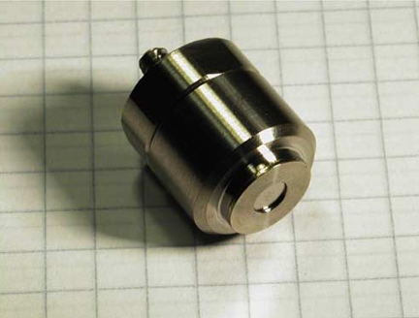
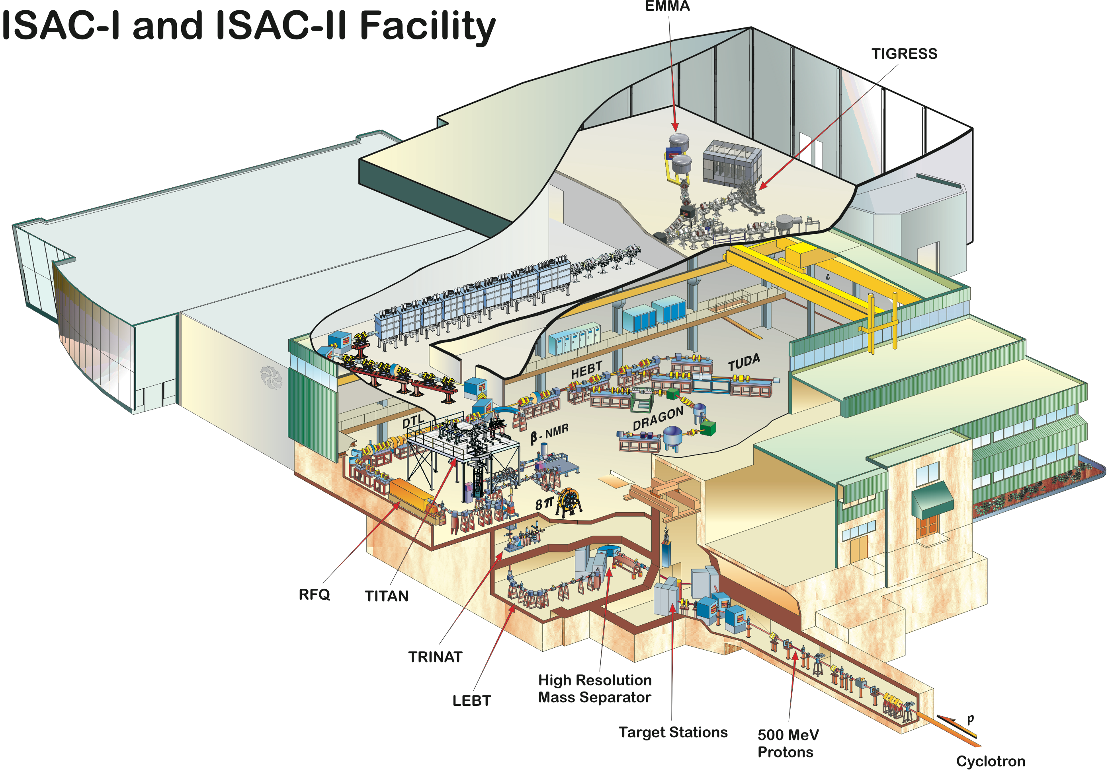
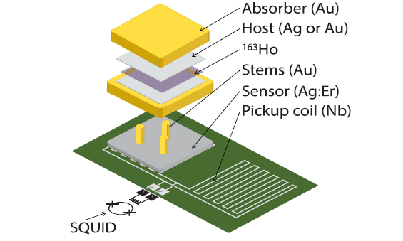
Physics experiments need more than an isotope - they need a usable product
Na-22 Transportable Source
Ho-163 Detector-integrated
K-37 Facility coupled
Longer-lived (t_{1/2} = 2.6 y) sealed positron source.
Very long-lived source (t_{1/2} = 4570 y) integrated into detectors for neutrino experiments.
Very short-lived source (t_{1/2} = 1.2 s) that requires isotope separation online for various physics experiments.
R. Krause-Rehberg et al. / Nucl. Instr. and Meth. in Phys. Res. B 221 (2004) 165–167
F. Adam et al. (ECHo Collaboration), Phys. Rev. Lett. 136 (2026) 121801.
ISAC-I and ISAC-II Facility at TRIUMF
Notes:
Producing the desired radionuclide is only the first step; the definition of a usable product depends on the experiment.
Na-22 can be fabricated as a transportable sealed source. Ho-163 must be integrated directly into specialized detectors. Short-lived K-37 requires production and separation at the experimental facility.
The isotope, final product form, production facility, and experiment must be treated as one connected system.

Slide 4
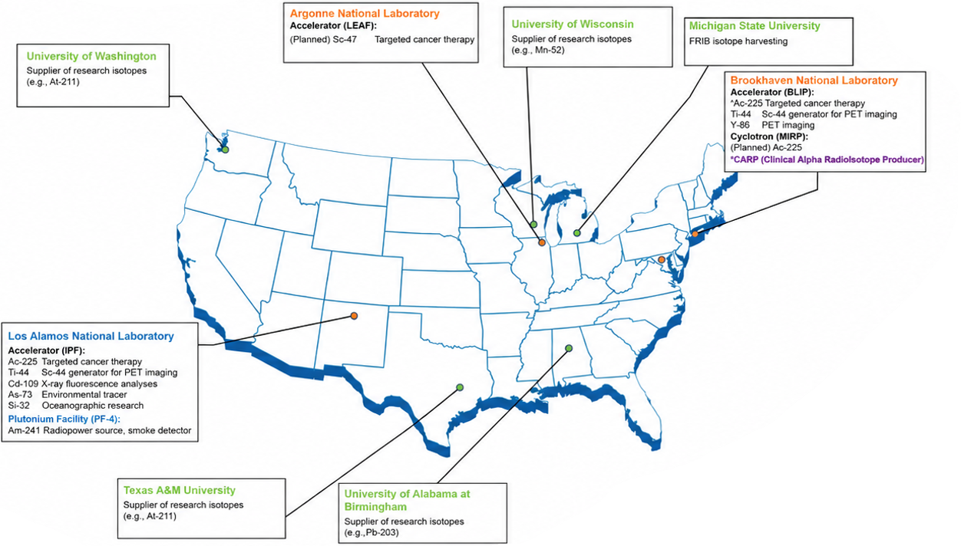
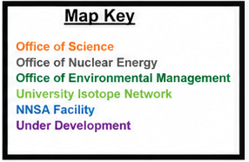
Department of Energy Isotope R&D and Production Program Accelerator Sites
Department of Energy Isotope R&D and Production Program Accelerator Sites
Notes:
The DOE Isotope R&D and Production Program supports a distributed network of national laboratory, academic, and user facilities.
Each facility provides different particles, energies, currents, target capabilities, and radiochemistry expertise.
Together, these facilities form a portfolio capable of supporting radionuclides and development needs that would not justify a dedicated facility individually.

Slide 5
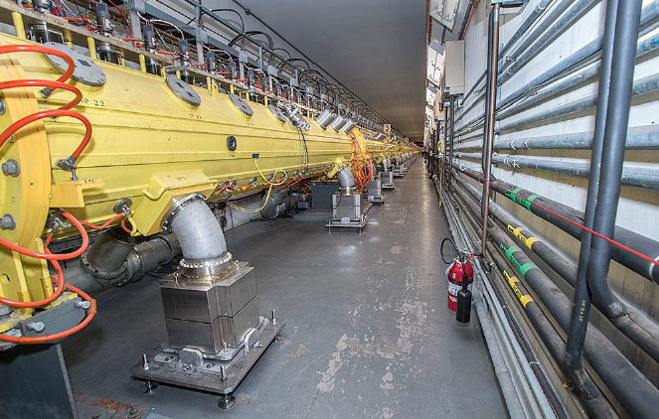
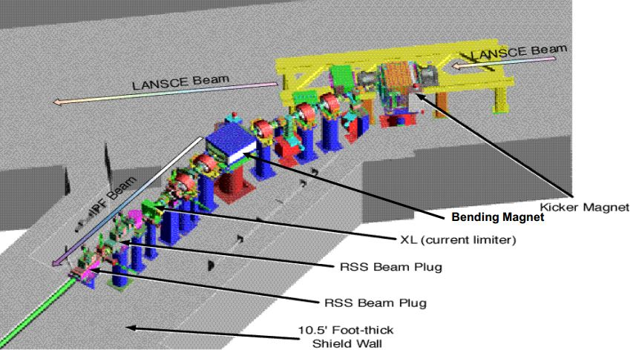
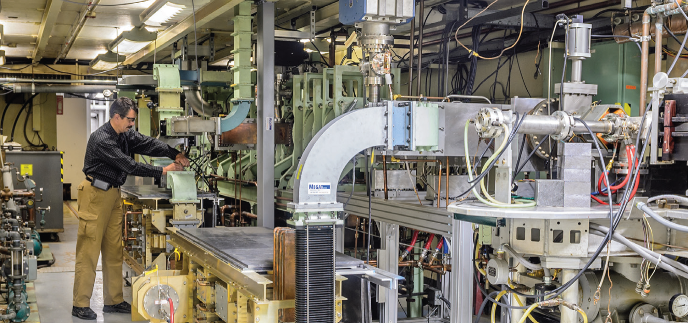
Isotope Production Accelerators at National Laboratories
Facility | Particle | Beam Energy | Maximum Average Current | Isotopes Produced
Brookhaven Linac Isotope Producer – BNL | Proton | 66 - 200 MeV | 165 μA | Ti-44, Y-86
Isotope Production Facility – LANL | Proton | 100 MeV | 275 μA | Ti-44, Cd-109, As-73, Si-32
Low-Energy Accelerator Facility – ANL | Electron | 20 – 50 MeV | 500 μA | Sc-47
Brookhaven Linac – supplies BLIP, AGS, RHIC
Schematic of IPF at LANSCE
Electron linac at LEAF
Notes:
Brookhaven and Los Alamos provide high-energy, high-current proton irradiation capabilities.
Argonne’s electron linac provides access to photonuclear production routes.
The usable capability includes much more than the accelerator: beam transport, target stations, cooling, shielding, remote operations, radiochemistry, quality control, and experienced personnel are all required.

Slide 6
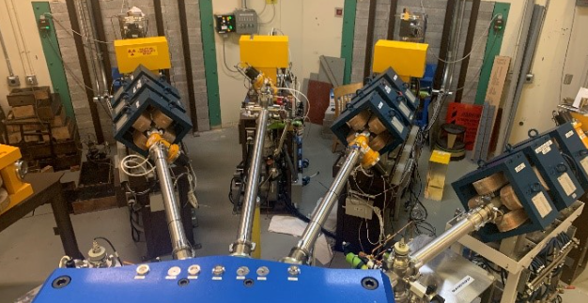
Academic and user facilities provide the isotope-production R&D layer
UAB
​U. of Washington
Texas A&M​
​U. of Wisconsin
​MSU-FRIB
TR-24 cyclotron
16-24 MeV protons
Produce Pb-203, Sr-89, Cu-64, Sc-43/47, Co-55, Mn-52, among others
Up to 300 μA
MC-50 cyclotron
p, d, He-3, alpha particles
Routinely produce At-211 (t_{1/2} = 7.2 hrs) with 29 MeV alpha particles
Up to 50 μA
K150 cyclotron
p, d, He-3, alpha, heavier ions
Routinely produce At-211 with 29 MeV alpha particles
Up to 50 μA
RDS 112 and GE PETtrace cyclotrons
Protons up to 16 MeV and deuterons up to 8 MeV
Produce Mn-52, Cu-64, Y-86, As-72, Br-76/77, Zr-89, and various PET isotopes
Superconducting heavy-ion linac
Stable heavy ions up to U-238
200-300 MeV/u
Current dependent on ion species
Various by-product radionuclides
​
​
​
​
MC-50 Cyclotron beamlines at University of Washington Medical Center
These universities play a critical role in developing the workforce of the future.
Notes:
Academic and user facilities provide flexible schedules, unusual particles, and opportunities for iterative research and development.
UAB provides high-current proton irradiation; Washington and Texas A&M offer multiparticle capabilities; Wisconsin operates several medical and research cyclotrons; and FRIB enables isotope harvesting.
These facilities are well suited for cross-section measurements, target development, irradiation demonstrations, separation development, and workforce training.

Slide 7
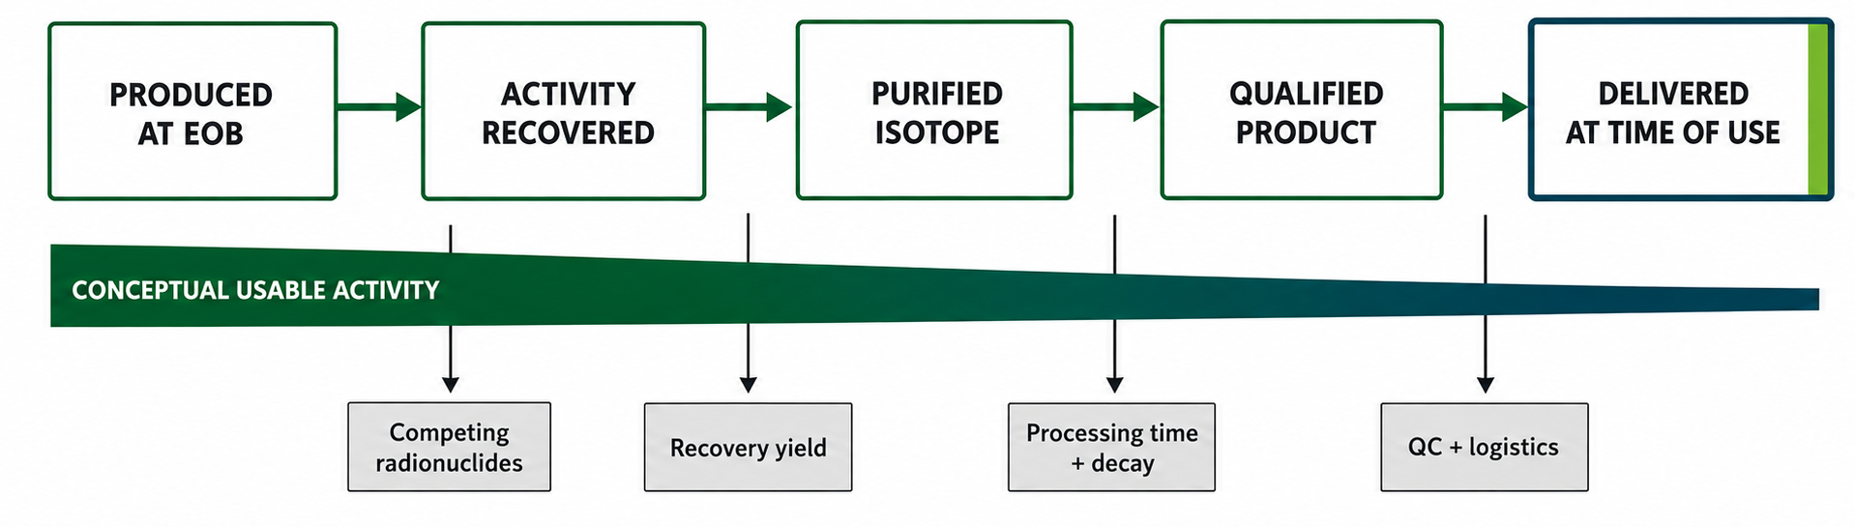
A high production yield does not guarantee a usable isotope…
Competing Radionuclides
Recovery Yield
Processing Time + Decay
Quality Control + Logistics
Reduce radionuclidic purity and the usable fraction.
Target dissolution and transfers are not lossless.
Chemistry, assay, and decay reduce activity at delivery.
Sampling, release, packaging, and shipment consume time and material.
Notes:
Activity at end of bombardment is only the starting point.
Competing radionuclides reduce usable purity. Dissolution, transfers, and separations reduce recovery. Processing, decay, quality control, packaging, and transportation create additional losses and delays.
The meaningful quantity is the qualified activity delivered in the required form at the time of use.

Slide 8
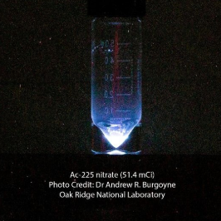
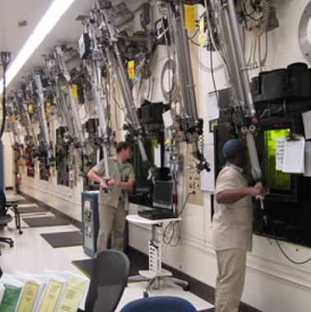
Small demand can require large, specialized infrastructure
The amount requested may be small while the capability required is national in scale.
DOESN’T NECESSARILY SCALE WITH
Physics Demand
Few sources
Irregular schedules
Custom purity/form
Production Burden
Specialized beam
Difficult targets
Remote handling, chemistry, potential QA
Notes:
A physics experiment may need only a small quantity, but production can still require national-scale capabilities.
Irregular demand and custom product specifications may require specialized beams, difficult targets, remote handling, shielded processing, complex chemistry, and qualification.
Shared, multipurpose infrastructure is often necessary because the production burden does not scale directly with the quantity requested.

Slide 9



Commercial accelerators add capability - but require a sustainable market
Superconducting electron linacs producing high energy photons
Integrated accelerator, target, radiochemistry, and distribution platform
Early stages of Ac-225 production
Up to 70 MeV cyclotrons
Production, quality, regulatory, and logistics capabilities
Currently producing Ac-225, Cu-64, and Ga-68
IBA Rhodotron electron beam accelerators to generate high energy photons
Currently focusing on Ac-225 and Cu-67 production
Commercial viability generally requires:
Demonstrated route
Stable specifications
Predictable demand
Proven economics
Notes:
Commercial organizations add production capacity, repeatable operations, quality systems, and distribution capabilities.
NorthStar, Niowave, and SpectronRx illustrate several commercial accelerator approaches.
Commercial viability generally requires a demonstrated production route, stable specifications, predictable demand, and proven economics.
National laboratories and universities can reduce the technical risk before successful routes transition toward commercial scale.

Slide 10
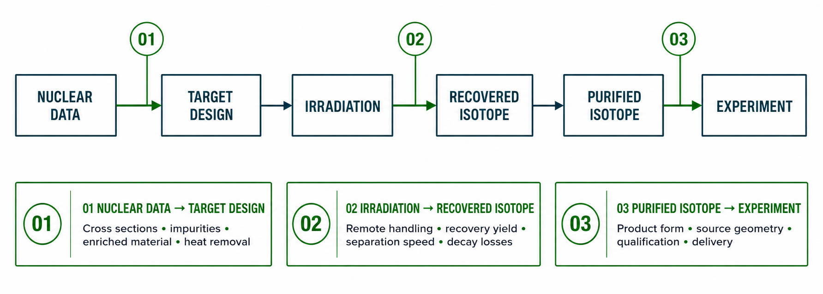
The most consequential R&D problems opportunities occur at the interfaces
These interface problems opportunities are shared research questions, and natural points for cross-institution training.
Notes:
Many of the most consequential R&D challenges occur between major production steps.
Nuclear data must translate into a practical target. Irradiation conditions must account for recovery and processing. The purified isotope must satisfy the experiment’s product-form and delivery requirements.
These interfaces are natural points for collaboration, shared research, and cross-institution workforce development.

Slide 11
Some final thoughts…
Begin with the end in mind – What is the required purity, product form, quantity, geometry, delivery time, etc…?
Those requirements can help define the production route, target, irradiation parameters, chemical/mass separation scheme, qualification, and logistics
A radioisotope is engineered across the entire production chain
National laboratories and academic facilities (primarily) provide complimentary capabilities across this chain
Notes:
Begin with the end use: define the required purity, product form, quantity, geometry, and delivery time.
Use those requirements to work backward through the production route, target, irradiation, separation, qualification, and logistics.
A usable radioisotope product is engineered across the entire production chain.
The goal is not simply to make a radionuclide; it is to deliver the right radionuclide, in the right form, at the time and place where it can be used.

Slide 12
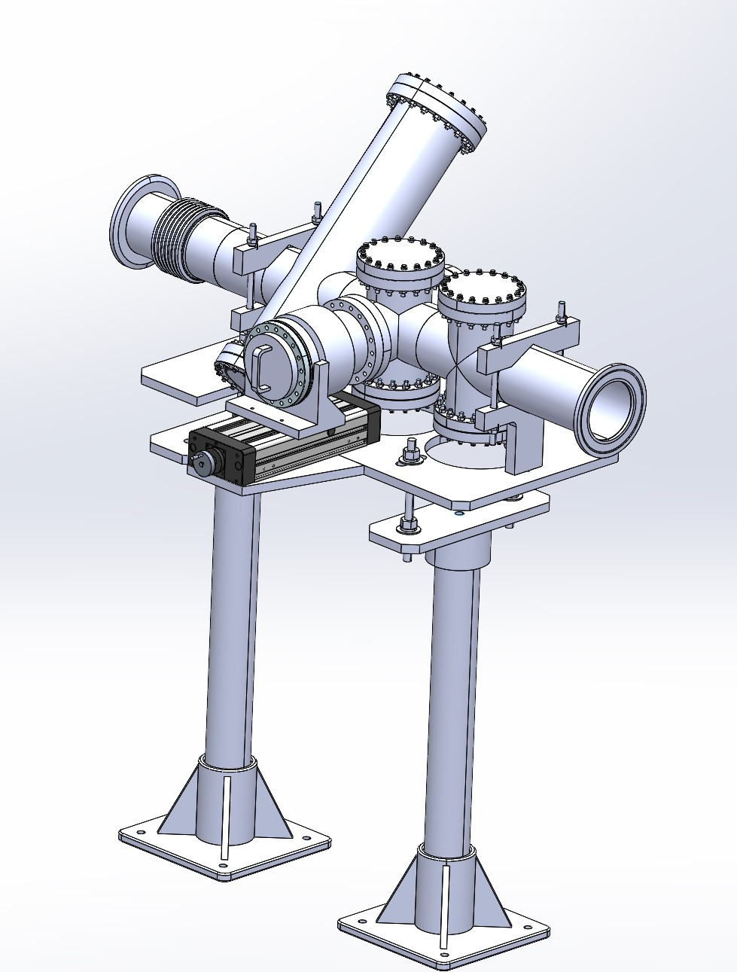
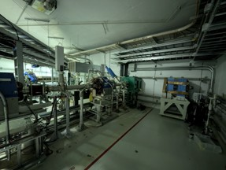
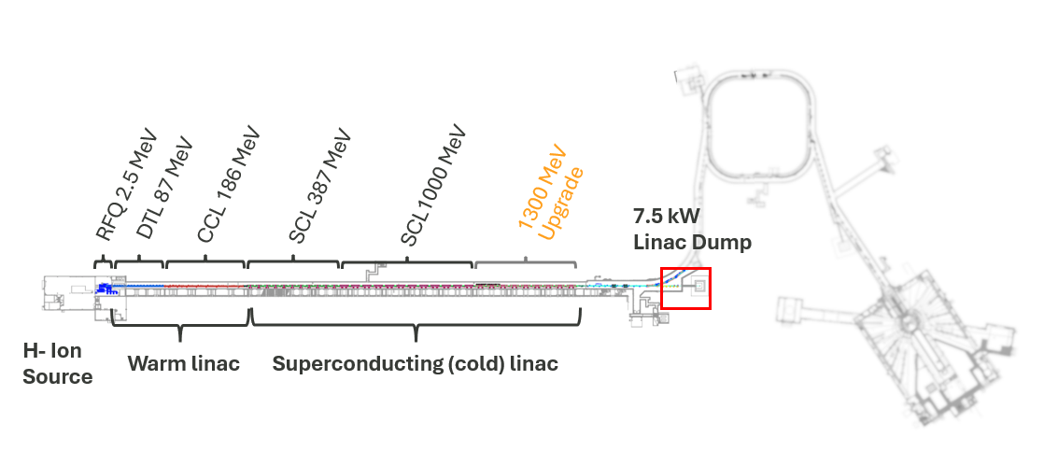
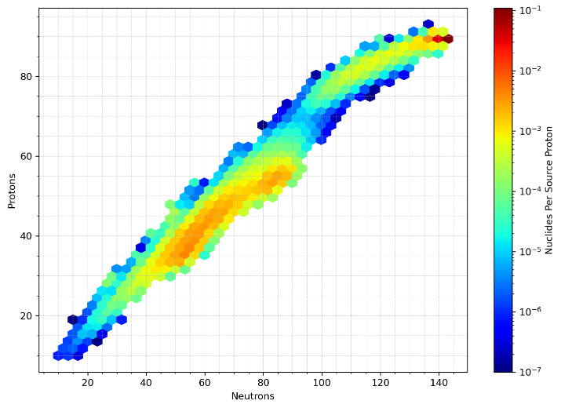
Coming soon to an accelerator near you!
New test station at SNS linac beam dump (1.3 GeV protons)
Up to 7 kW of beam (3.36 x 10¹⁵ protons/sec) will be available with a tunable beam spot size (nominal 4 mm x 4 mm)
Targeting first beam on target in 2027 or 2028
Planned location of the new test station at the SNS Linac Beam dump
Conceptual design of the target station
Sample of nuclides generated with 1.3 GeV protons incident upon thorium target

Slide 13
References
[1] National Nuclear Data Center, “NuDat 3.0: Nuclear Structure and Decay Data,” Brookhaven National Laboratory, NNDC NuDat 3.0.
[2] International Atomic Energy Agency, “Live Chart of Nuclides—Advanced Version”, IAEA Live Chart.
[3] National Nuclear Data Center, “Evaluated Nuclear Structure Data File: Na,” Brookhaven National Laboratory, including y, NNDC Na record.
[4] National Nuclear Data Center, “Evaluated Nuclear Structure Data File: Ho electron-capture decay,” including y, ENSDF Ho evaluation.
[5] National Nuclear Data Center, “Evaluated Nuclear Structure Data File: K decay,” including s, ENSDF K evaluation.
[6] R. Krause-Rehberg, N. van der Walt, L. Büttner, and F. Börner, “A Na positron source for use in UHV,” Nucl. Instrum. Methods Phys. Res. B 221, 165–167 (2004)
[7] F. Adam et al. (ECHo Collaboration), “Improved Limit on the Effective Electron Neutrino Mass with the ECHo-1k Experiment,” Phys. Rev. Lett. 136, 121801 (2026), APS article.
[8] TRIUMF, “ISAC-II—Isotope Separator and Accelerator,” TRIUMF virtual facility tour
[9] J. M. D’Auria et al., “The ISAC Radioactive Ion Beam Facility at TRIUMF,” TRIUMF ISOL/ISAC facility description.
[10] U.S. Department of Energy Isotope Program, “Isotope Production Network,” National Isotope Development Center, DOE production-network map

Slide 14
References
[11] U.S. Department of Energy Isotope Program, “Accelerator Facilities,” National Isotope Development Center, DOE accelerator-facility specifications
[12] Brookhaven National Laboratory, “Medical Isotope Research and Production Program,” BNL MIRP/BLIP
[13] Los Alamos National Laboratory, “Isotope Production Facility,” LANL IPF
[14] Los Alamos National Laboratory, “LANSCE Facilities,” LANSCE accelerator and beamline overview
[15] Argonne National Laboratory, “Low-Energy Accelerator Facility,” LEAF facility page and LEAF technical brochure
[16] University of Wisconsin–Madison Medical Physics, “Radionuclide Distribution,” UW cyclotron-produced radionuclides
[17] Texas A&M University Cyclotron Institute, “K150 Operations and Development,” Progress Report 2022–2023, K150 operating report.
[18] Texas A&M University Cyclotron Institute, “Production of Astatine-211 at the Cyclotron Institute,” Progress Report 2019–2020, At-211 production report.
[19] Facility for Rare Isotope Beams, “Isotope Harvesting,” Michigan State University, FRIB isotope-harvesting program
[20] E. P. Abel et al., “Isotope harvesting at FRIB: Additional opportunities for scientific discovery,” J. Phys. G 46, 100501 (2019), DOI: 10.1088/1361-6471/ab26cc.

Slide 15
References
[21] International Atomic Energy Agency, Cyclotron Produced Radionuclides: Principles and Practice, Technical Reports Series No. 465 (IAEA, Vienna, 2008), full report.
[22] International Atomic Energy Agency, Good Management Practices of Cyclotron Based Gallium-68 Radiopharmaceuticals (IAEA, Vienna, 2024), IAEA publication page.
[23] Nuclear Science Advisory Committee Isotopes Subcommittee, Meeting Isotope Needs and Capturing Opportunities for the Future: The 2015 Long Range Plan for the DOE-NP Isotope Program (U.S. Department of Energy, 2015), full report.
[24] U.S. Department of Energy Isotope Program, Isotope Research, Development, and Production (2016), DOE program brochure.
[25] NorthStar Medical Radioisotopes, “Copper-67,” NorthStar Cu-67 program
[26] NorthStar Medical Radioisotopes, “Actinium-225,” NorthStar Ac-225 program
[27] NorthStar Medical Radioisotopes, “NorthStar Confirms Successful Routine Commercial-Scale Ac-225 Production,” Jan. 2026, company announcement.
[28] Ion Beam Applications, “NorthStar Medical Radioisotopes and IBA Sign Agreement for Two Additional Rhodotron Electron-Beam Accelerators,” IBA announcement.
[29] Niowave, Inc., “Science and Engineering,” superconducting electron-linac and radiochemistry capabilities

Slide 16
References
[30] Niowave, Inc., “Medical Isotopes,” Niowave isotope-production program
[31] Niowave, Inc., “Niowave Marks 20 Years of Advancing Medical Radioisotope Production,” company history and Ac-225 production status.
[32] SpectronRx, “SpectronRx—Radiopharmaceutical Development, Manufacturing, and Distribution,” official company site and corporate capabilities brochure
[33] Ion Beam Applications, “Cyclone 70,” 70-MeV cyclotron specifications and Cyclone 70 brochure
[34] Oak Ridge National Laboratory, “ORNL B-Roll,” ORNL media collection
[35] Oak Ridge National Laboratory, “Isotope Science and Engineering Directorate Media Library,” ORNL ISED media library
[36] A. R. Burgoyne, “Ac-225 nitrate, 51.4 mCi,” Oak Ridge National Laboratory photograph.

Slide 17
Thank you!

