Slide 1
Bridging Supply and Science: How NIDC Connects Researchers to Critical Isotopes
Karen Sikes, NIDC Director
Radioactive Isotopes for Fundamental Physics Workshop
August 25, 2026

Slide 2
Presentation Objectives:
Introduce Workshop participants to the National Isotope Development Center (NIDC)
Demonstrate how NIDC currently supports the DOE IRP network
Share ways that strive to provide the research community with critical isotopes

Slide 3
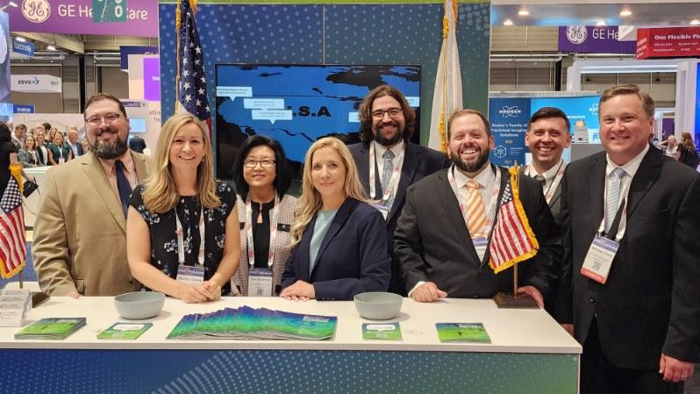
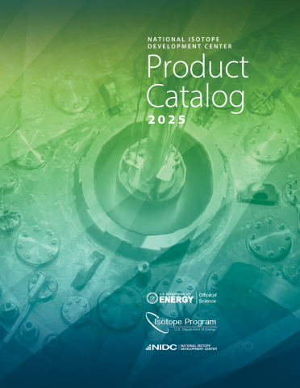
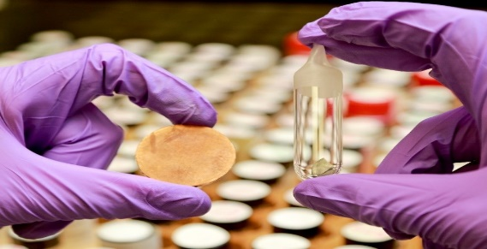
NIDC Quick Facts
We are the “business arm” of the DOE Office of Isotope R&D and Production (IRP), offering numerous key corporate services
Daily interaction with the IRP staff in Washington, DC, area
Primary interface to hundreds of research and commercial isotope customers
15 staff members all physically located at the Oak Ridge National Laboratory

Slide 4

NIDC Corporate Services
Product Distribution
Financial Management
Business Systems
Customer Engagement
Communications & Outreach
Logistics
Market Research & Analysis
Quality Assurance & Regulatory Affairs
Production Planning

Slide 5


DOE IRP / NIDC Relationship
DOE Office of Isotope R&D and Production
(Federal Agency)
Overarching Strategy and Vision
MANAGEMENT DIRECTION AND OVERSIGHT
SETS PROGRAM-WIDE POLICY AND DIRECTION
PRIORITIZES AND ALLOCATES RESOURCES
DETERMINES ISOTOPE MARKETS TO PURSUE
COORDINATES WITH OTHER GOV’T AGENCIES
FOSTERS PUBLIC / PRIVATE PARTNERSHIPS
National Isotope Development Center
(Non-Federal Entity / Contractor)
Corporate Services to DOE IRP
ACTS AS PRIMARY CUSTOMER INTERFACE
MANAGES ISOTOPE QUOTES AND ORDERS
COORDINATES PRODUCTION/ DELIVERY ACROSS NETWORK
OFFERS MARKET RESEARCH INSIGHTS
ENGAGES COMMUNITY ON INDUSTRY NEEDS

Slide 6
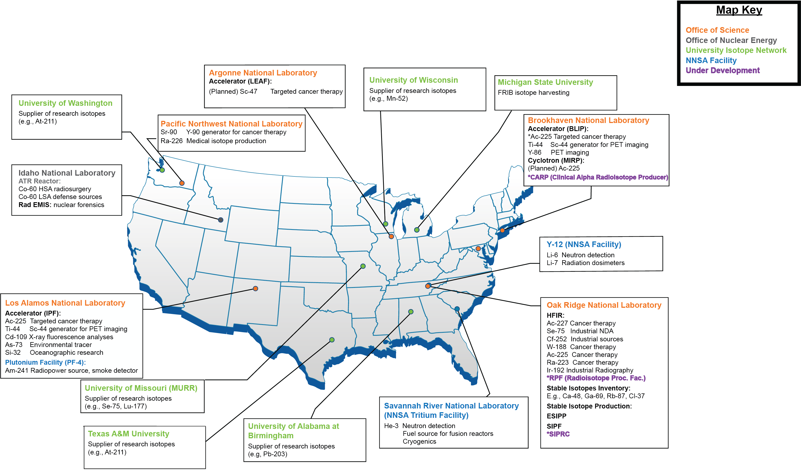
The NIDC coordinates production and distribution of isotopes across an expansive production network

Slide 7
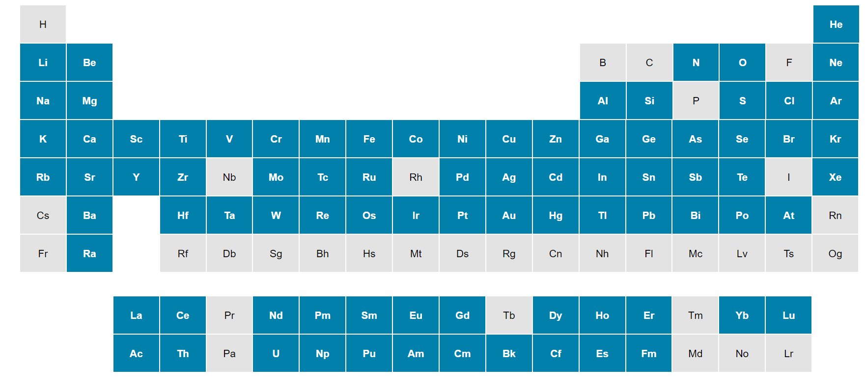
The DOE IRP offers one of the most comprehensive isotope product catalogs in the world
NIDC Website: www.isotopes.gov

Slide 8
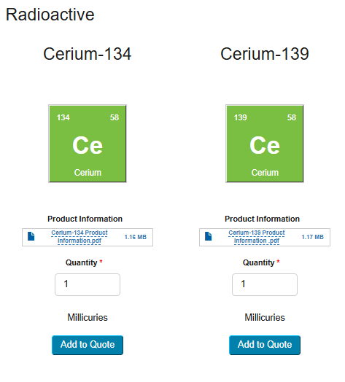
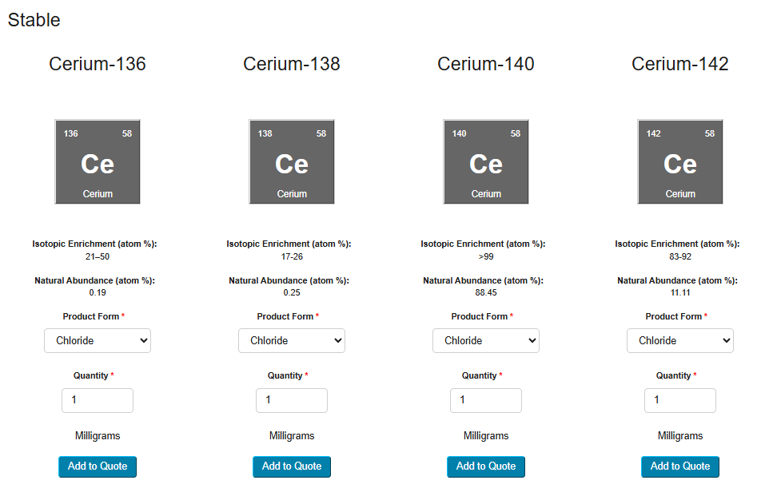
Let’s Take Cerium-139…

Slide 9
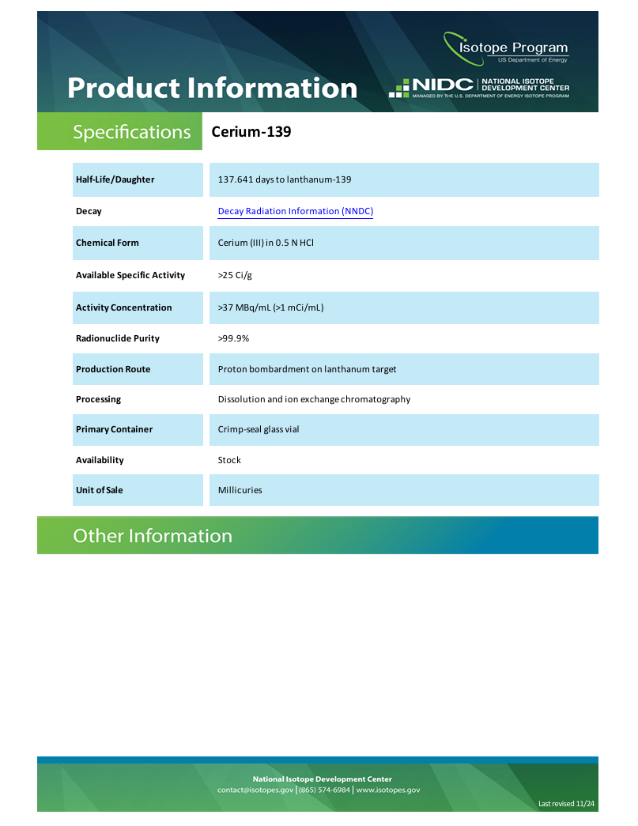
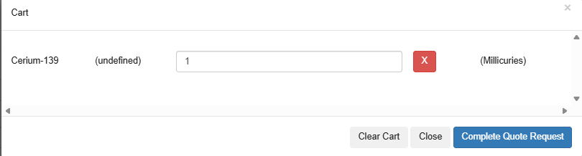
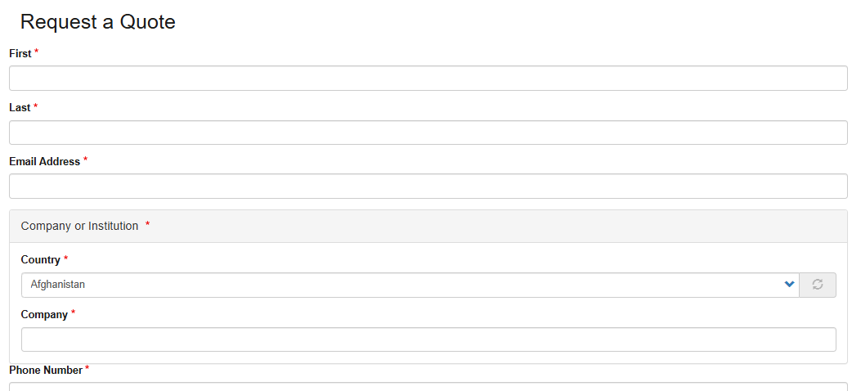
Take a Closer

Slide 10
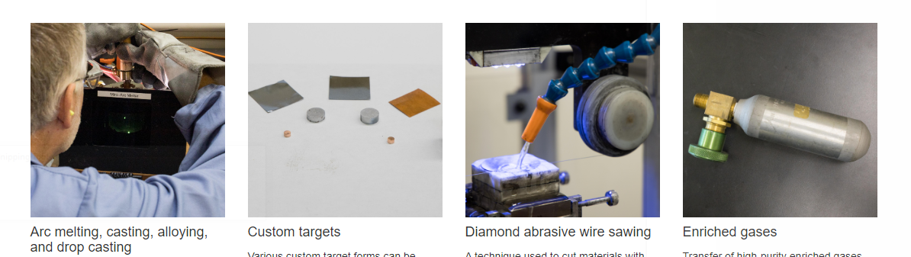
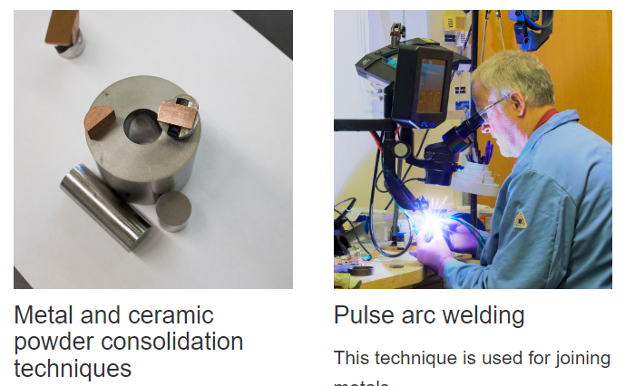
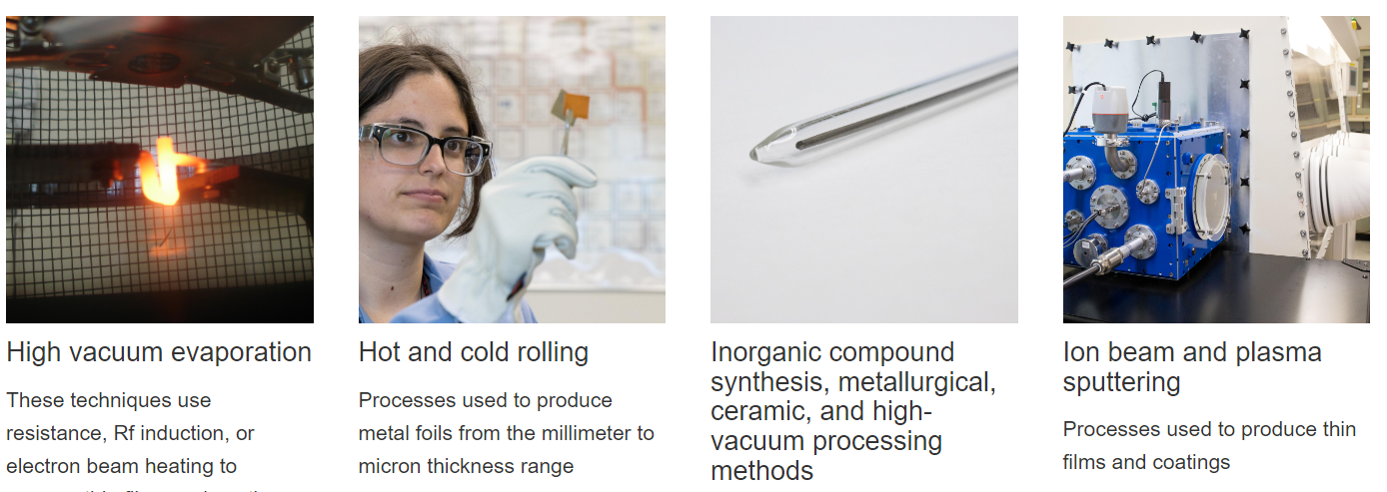
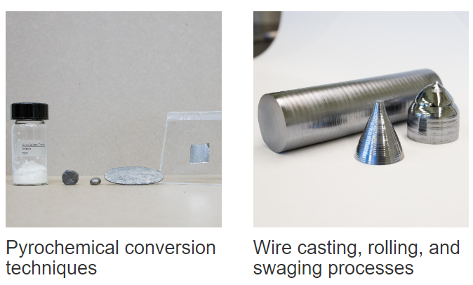
The NIDC also arranges various technical services to achieve customer’s desired chemical or physical form

Slide 11
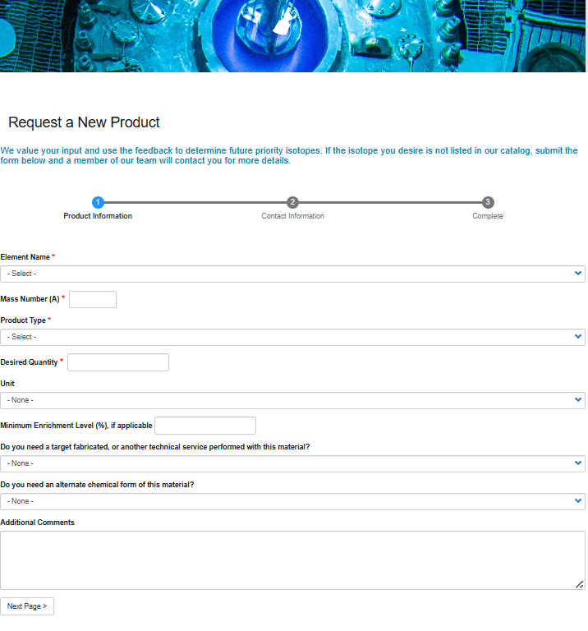
Can’t find what you are looking for?

Slide 12
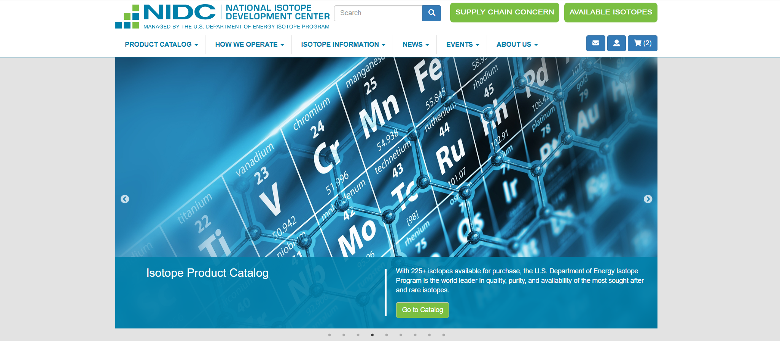
NIDC Website: www.isotopes.gov

Slide 13
We assist our customers every step of the way through the order process
Prepare Customer Quote
Process Customer Order
Billing information
Radioactive Material License Review
Issue Order Fulfillment Instructions
Product specs and quantity
Track Delivery
Order Close-out
Inventory levels (current and upcoming)
Internal Approvals
Customer End Use Info
Technical services (if applicable)
Purchase Order
Export Control Approval
Packaging requirements
“Ship To” recipient info
Set ship date
Licensing limitations
Send shipping docs
Create and send invoice
Track shipment progress
Reconcile inventory
Follow up on future needs
Solicit customer feedback
Monitor delinquent invoices (if applicable)

Slide 14
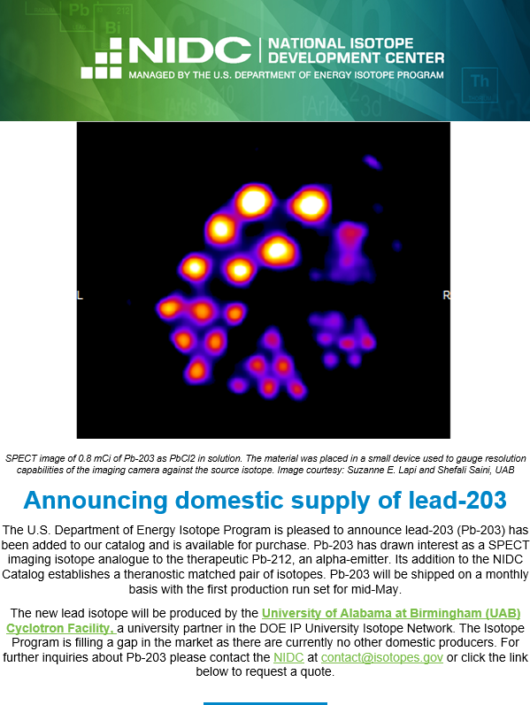
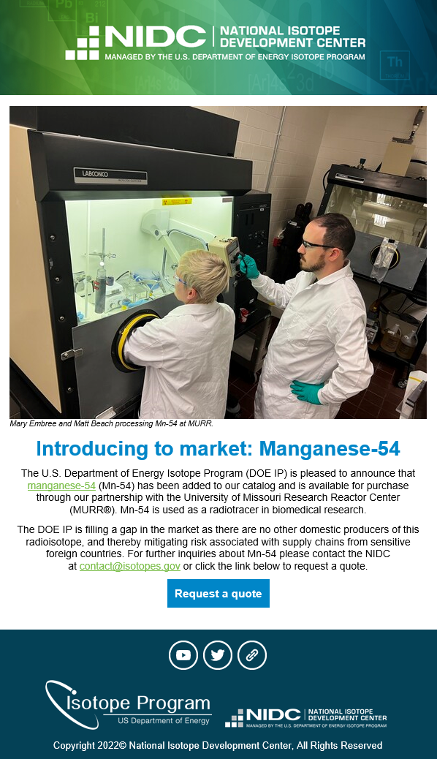
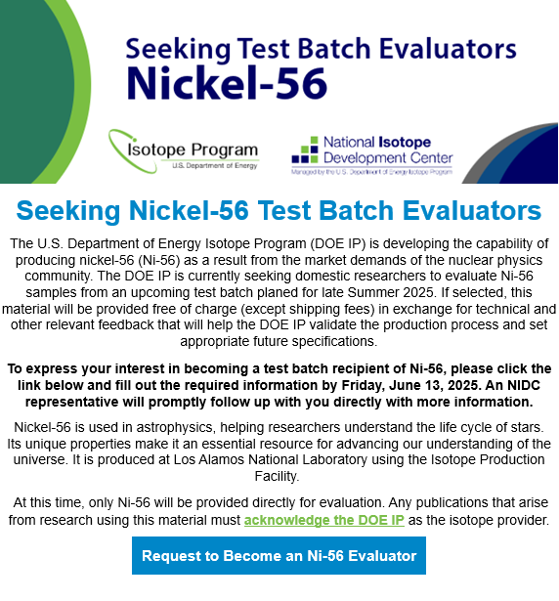
We advertise new product availability within the DOE IRP network

Slide 15


