Slide 1
OFFICE OF SCIENCE
The Fundamental Symmetries Program within the DOE Office of Science
Paul Sorensen
Program Manager, Nuclear Physics

Slide 2
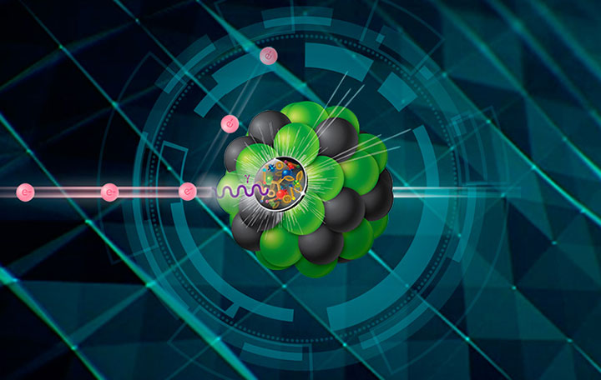
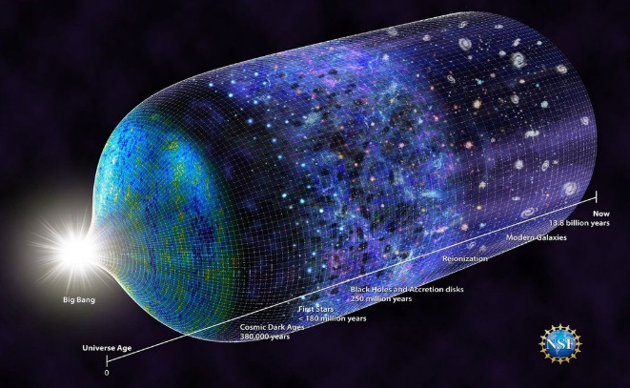
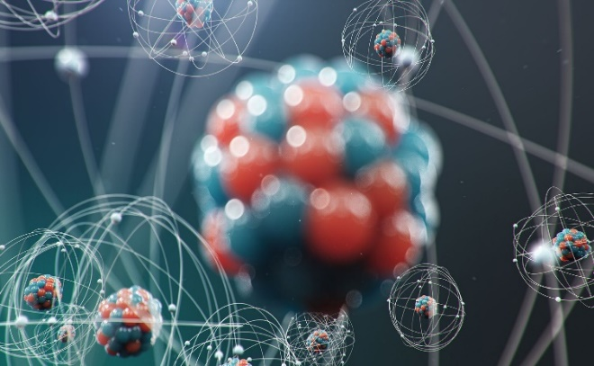
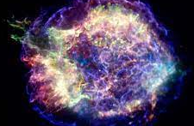
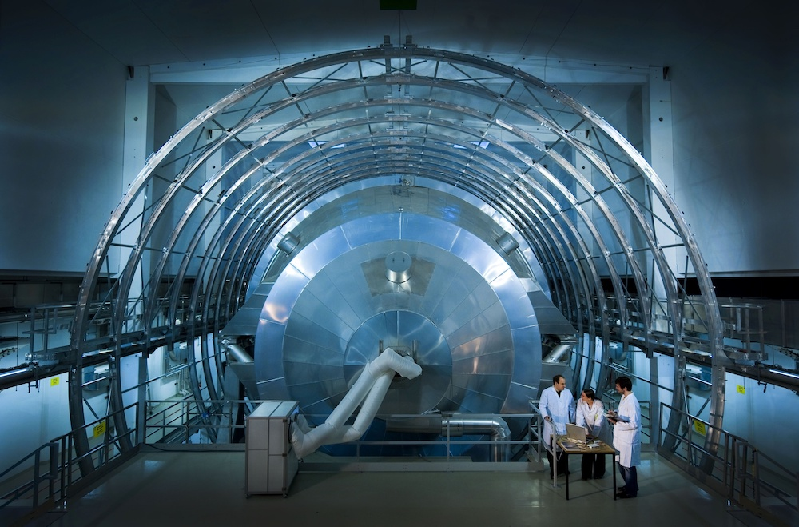
Nuclear Physics
One of the enduring mysteries of the universe is the nature of matter—what are its basic constituents and how do they interact to form the elements and the properties we observe? The mission of the Nuclear Physics (NP) program is to solve this mystery by discovering, exploring, and understanding all forms of nuclear matter.
NP supports three broad topic areas:
  QCD: hadrons and dense and hot nuclear matter in the cosmos and the lab (RHIC, CEBAF, EIC)
  Nuclei and Nuclear Astrophysics (FRIB, ATLAS), and
  Fundamental Symmetries
QCD
Nuclei Nuclear Astrophysics
Fundamental Symmetries
Emergence of Hadron Properties from QCD, Hot and Dense Nuclear or Gluonic Matter
Structure of the Atomic Nucleus and the
Birth of Nuclei in Astronomical Processes
Probing Universal Laws in Nuclear Decays, the Origin of Matter, and Neutrino Mass

Slide 3
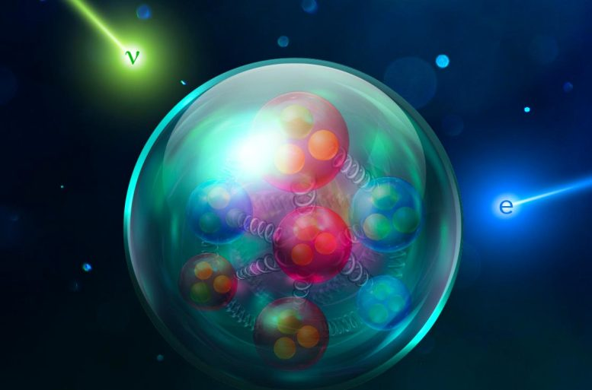
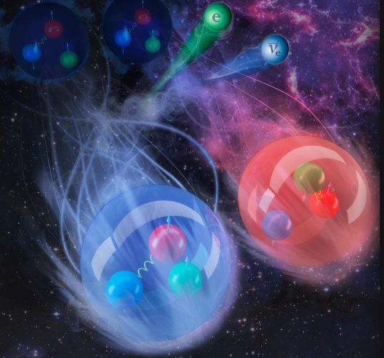
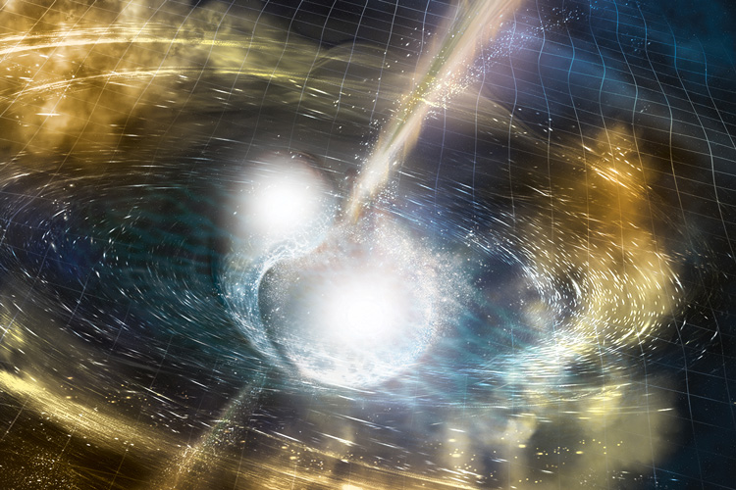
The Nucleus as an Observatory
The atomic nucleus, with its extreme density and complex constituent interactions, offers a unique probe into the nature of the universe. The nucleus as an observatory
enables searches into higher density regions of physics
provides a window on the strong and weak forces
allows us to probe the symmetries of nature
plays a central role in the evolution of the universe and in our origin story
Credit: JLab
Credit: Andy Sproles/ORNL
Nature 551, November 2017 (Springer Nature)

Slide 4
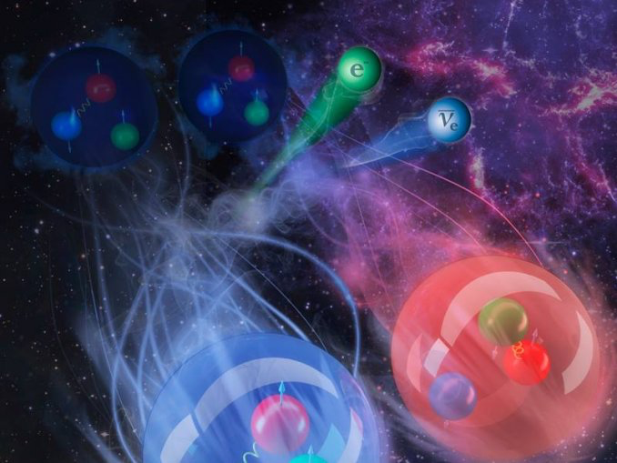
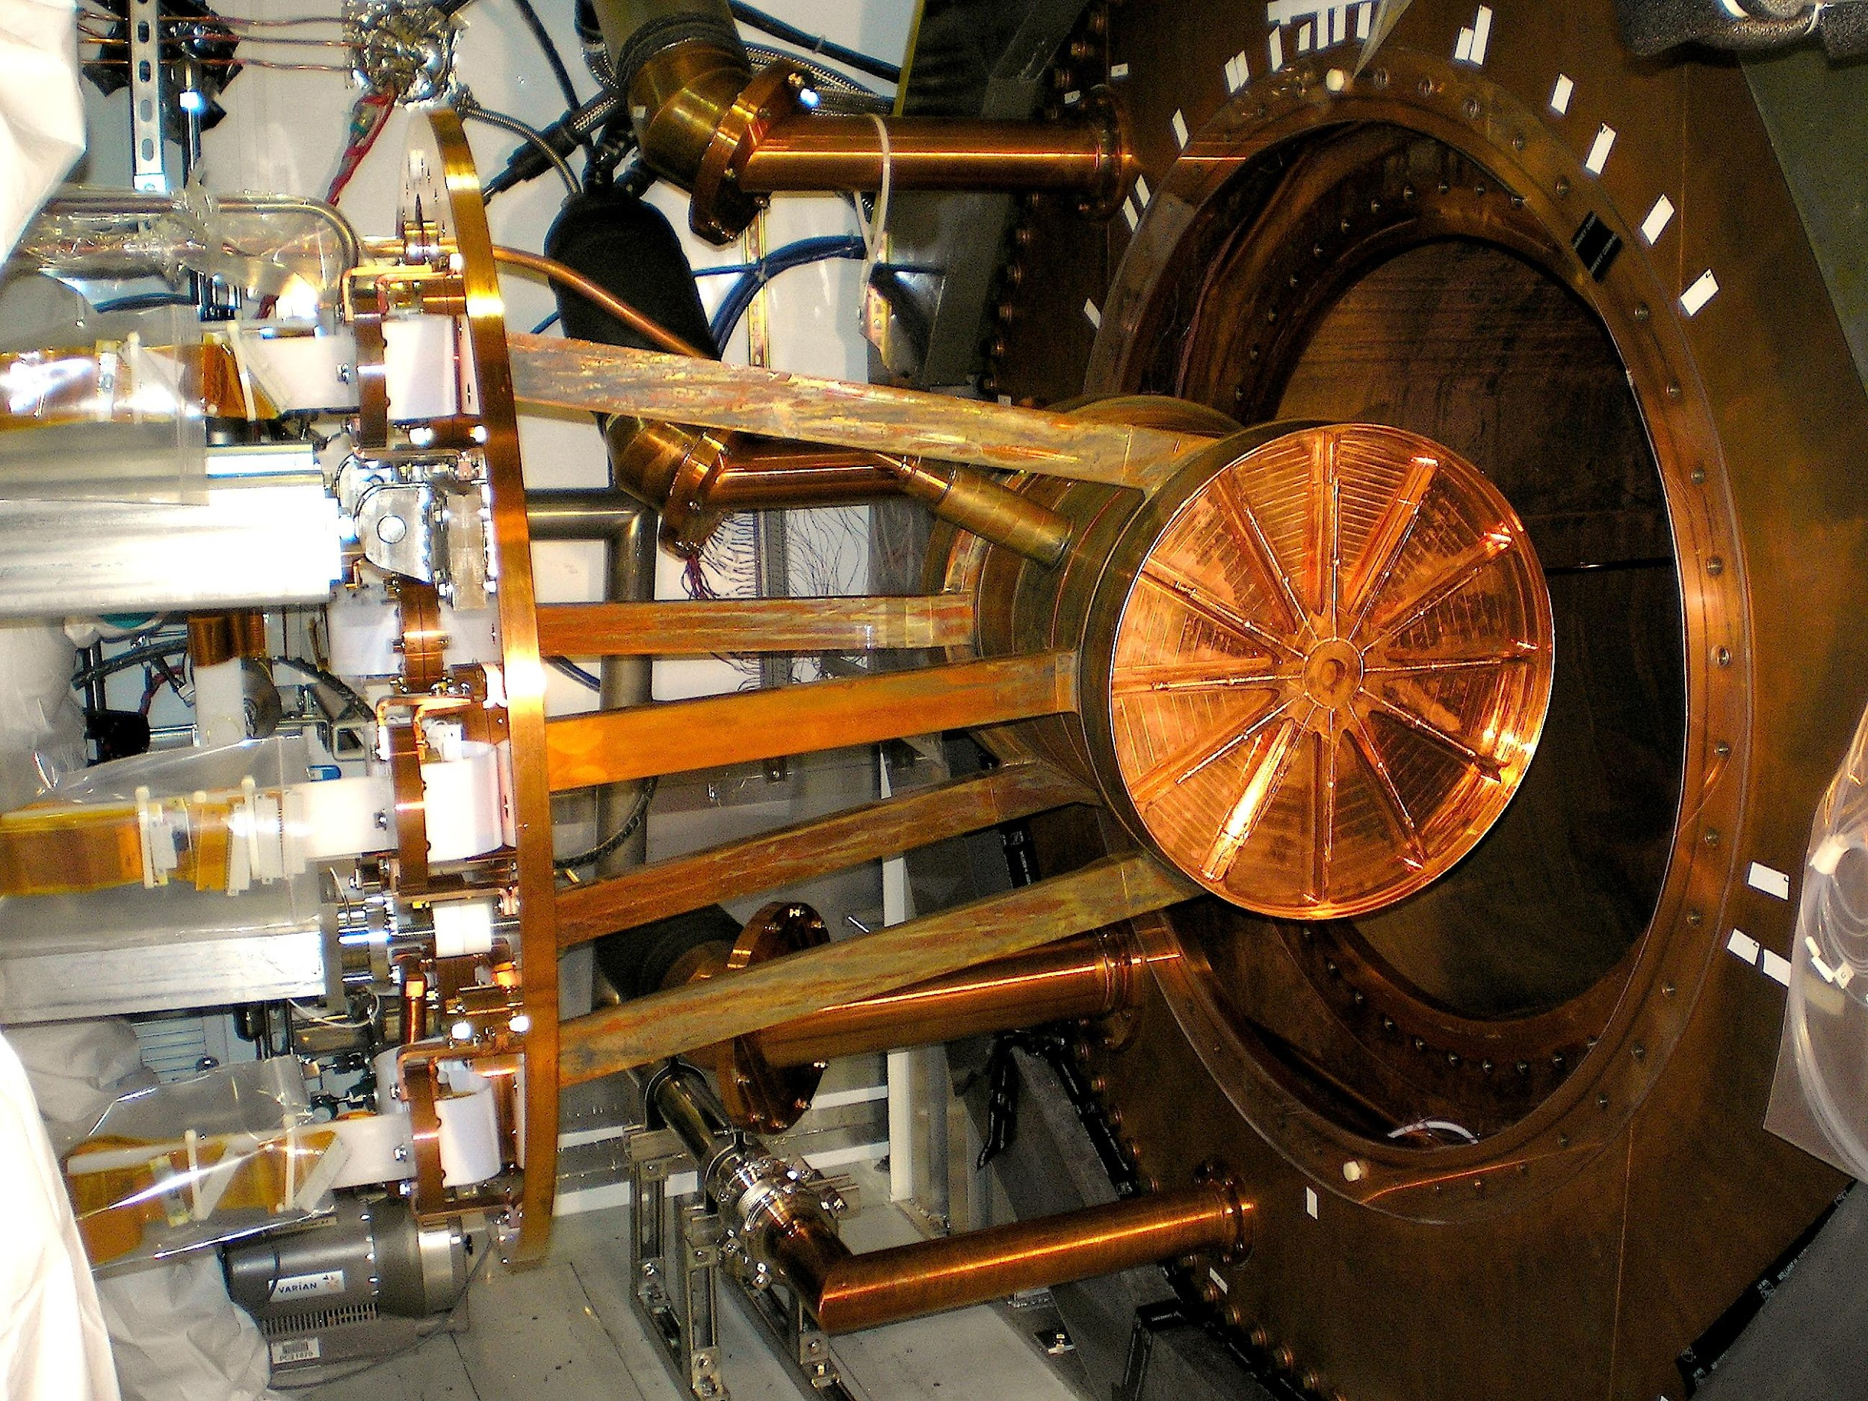
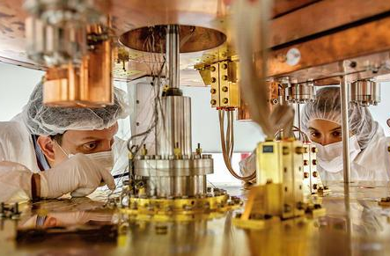
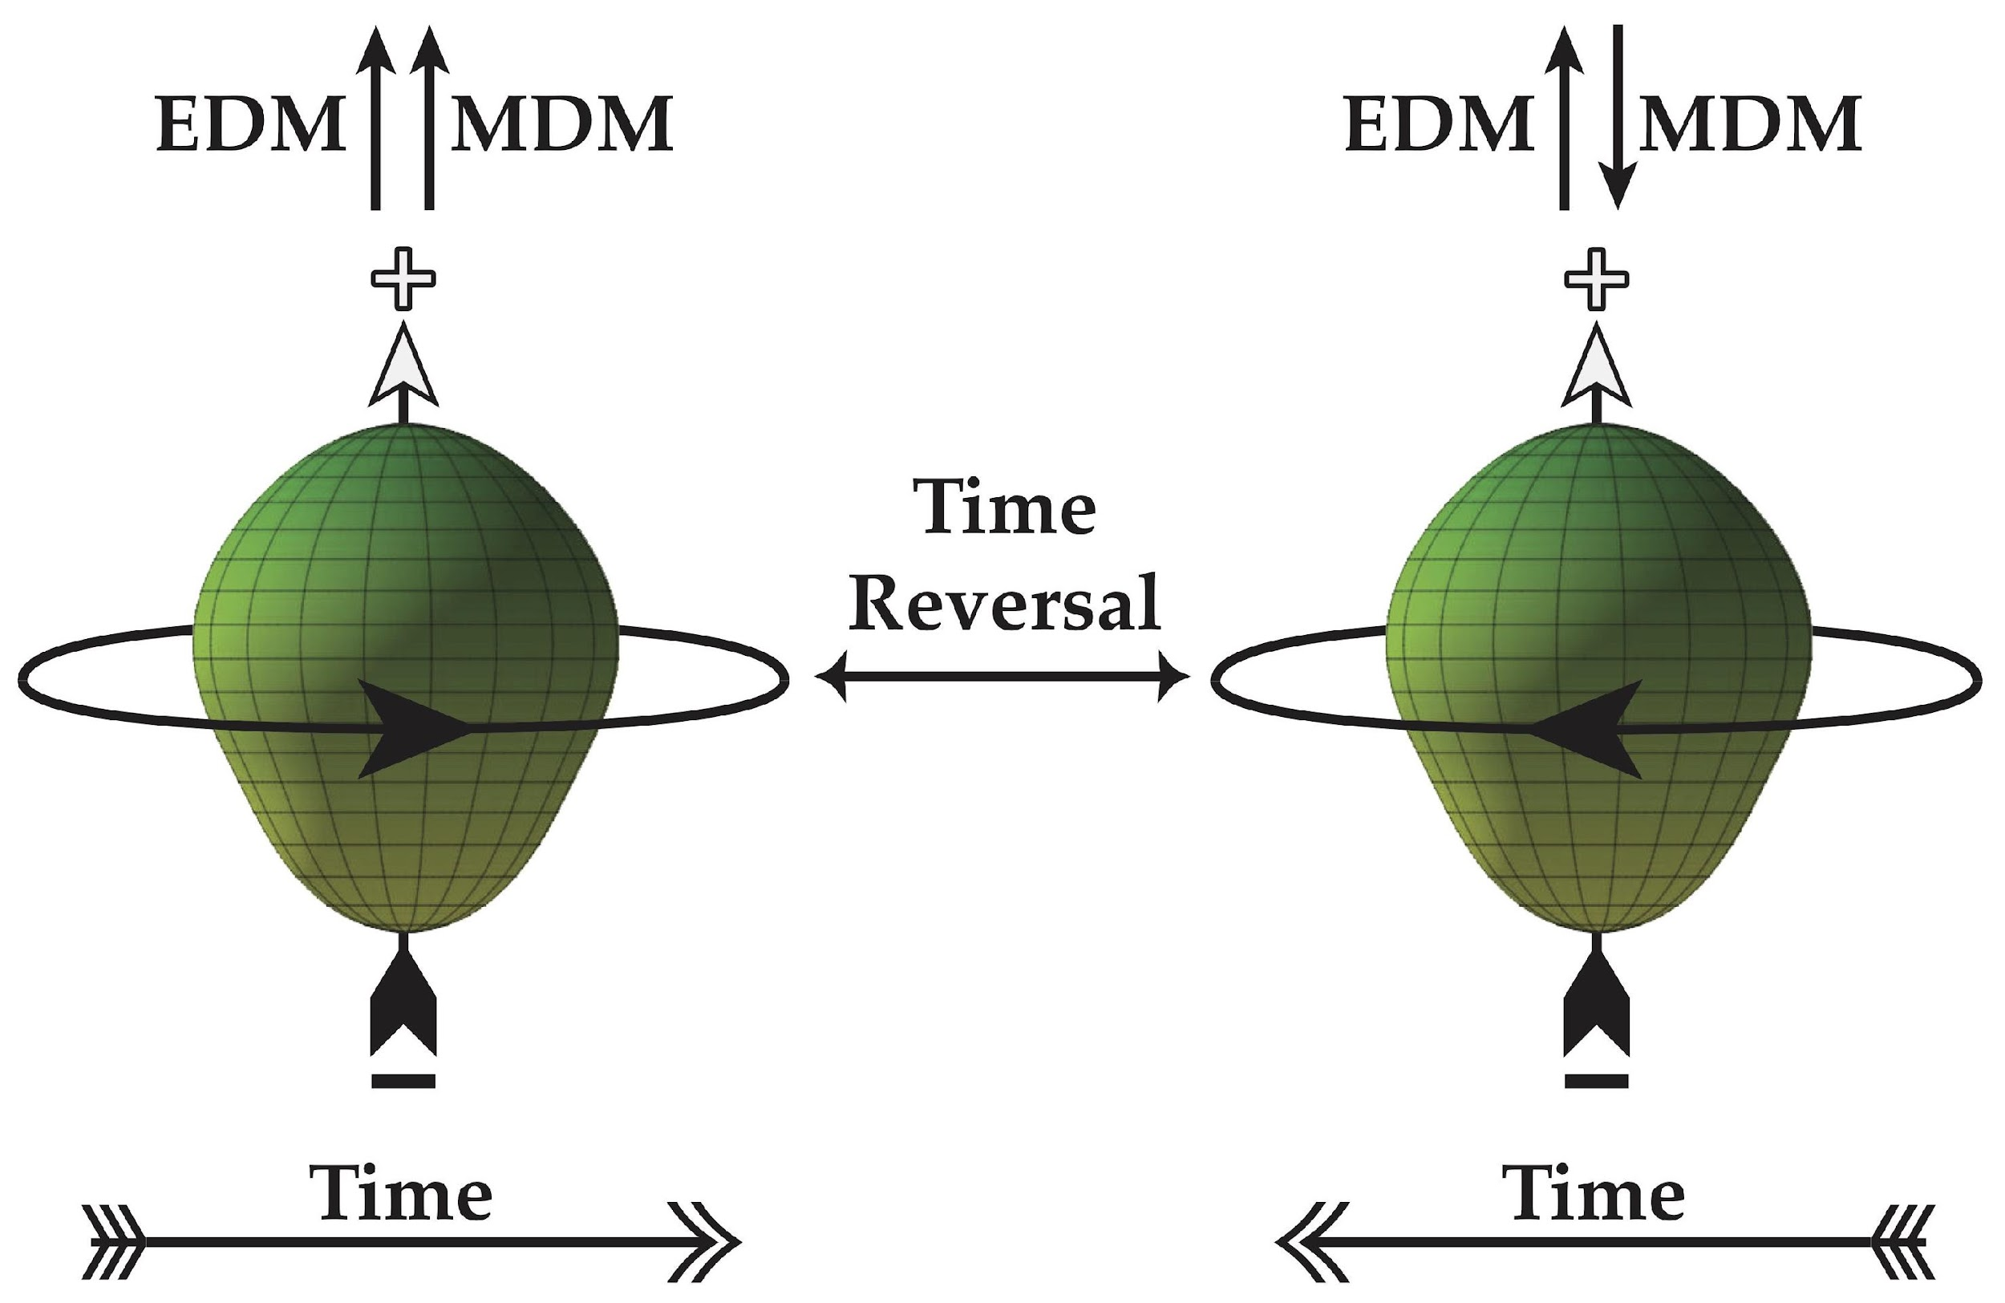
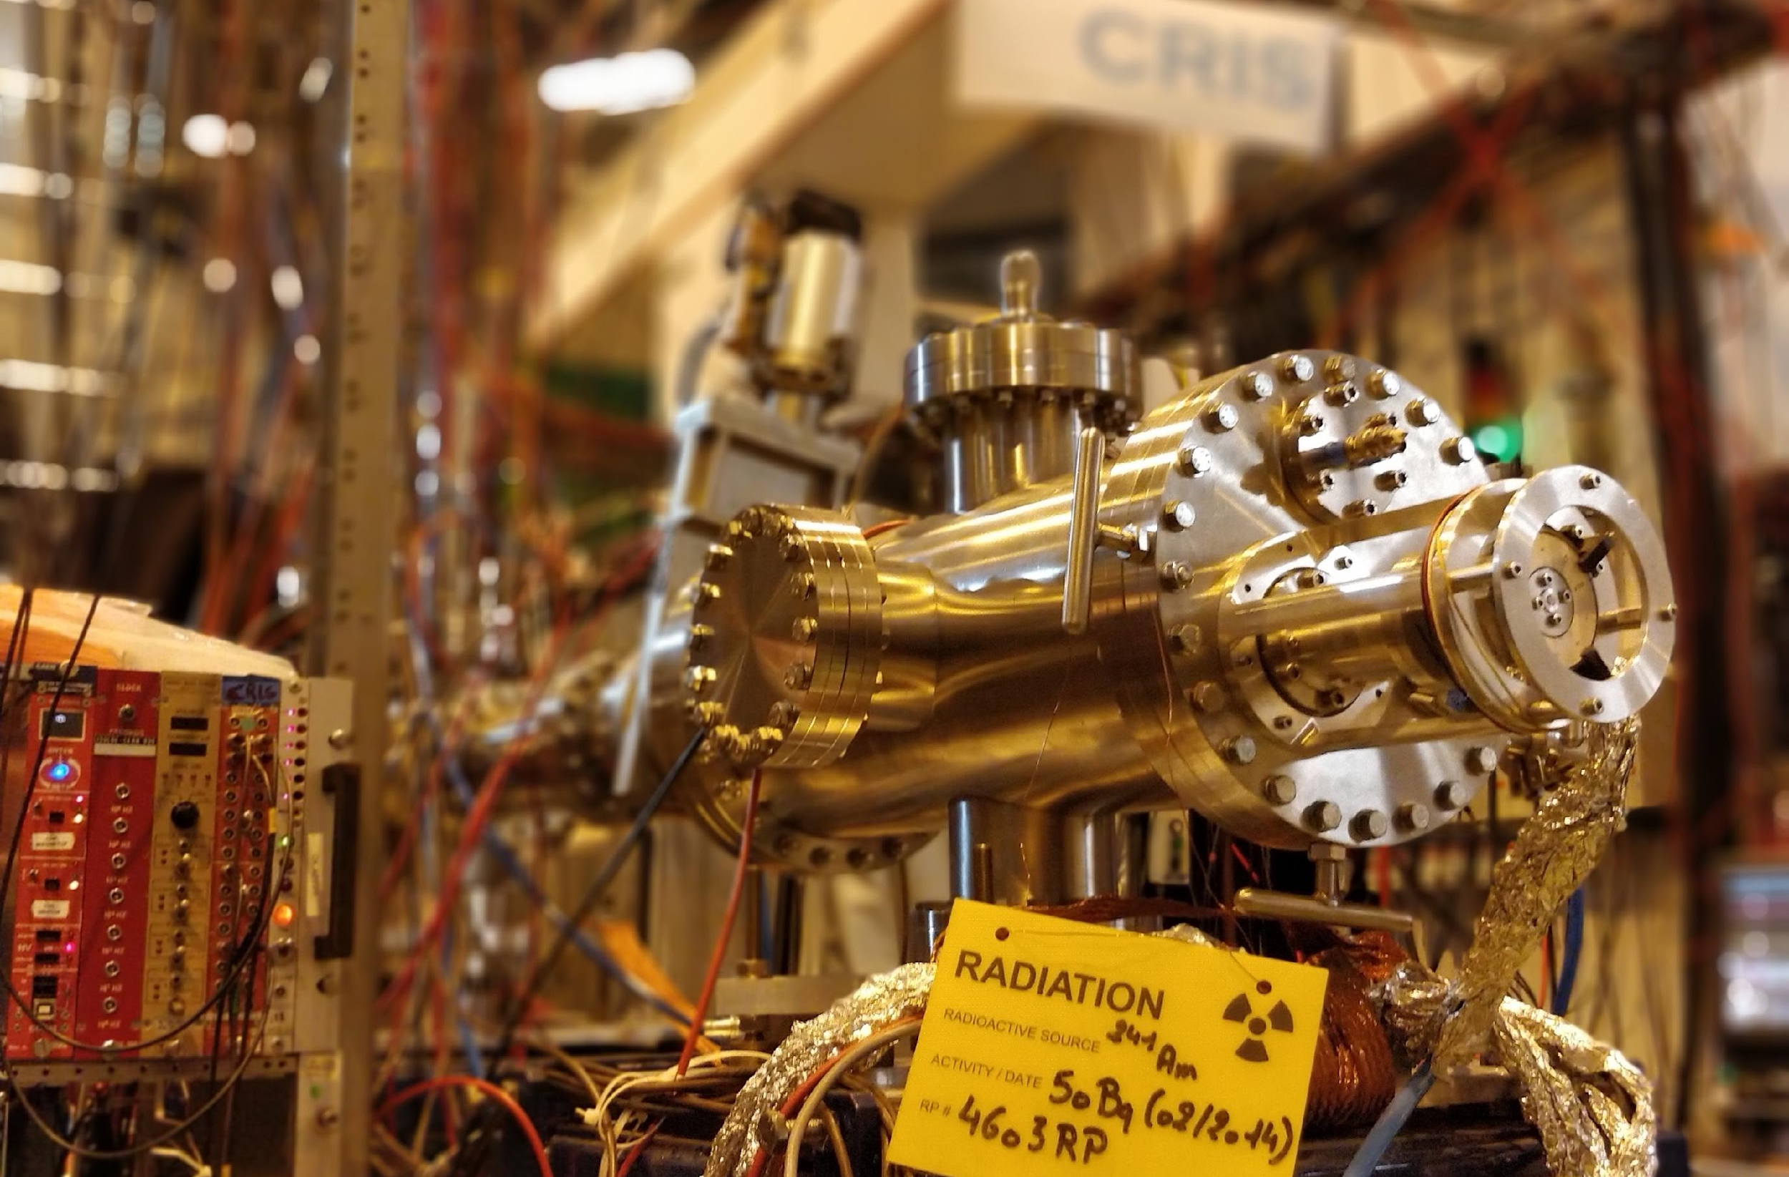
DOE-NP: Fundamental Symmetries Subprogram
Uses nucleons, nuclei, and their decays to probe the symmetries of nature: why is there more matter than antimatter, and what particles and interactions remain undetected. The program consists of three broad research areas
  β-decay of neutrons or nuclei to probe neutrino mass and CKM unitarity.
  ββ-decay to search for the creation of matter through lepton number violating decays.
  Search for CP symmetry violating properties of neutrons and nuclei (e.g. Electric Dipole Moments).
Major work sites include neutron facilities (SNS@ORNL, LANSCE@LANL, NCNR@NIST), underground labs (LNGS, SNOLab, CanFranc), beam lines (FRIB, CENPA, TAMU, TRIUMF), and university labs.
Experiments range from small ~$500k to very large ~$500M.
β Decay/EC
ββ Decay
EDM and CP Violation
KATRIN, Project-8, BeEST, UCNτ, NAB, SALER@FRIB, TAMUTrap, He-6 CRES
LEGEND-200, LEGEND-1000, CUORE, CUPID, NEXT, SNO+, LXe
nEDM@LANL, XeEDM, Molecular EDMs w/ CRIS@ISOLDE, Ra225, CeNTREX

Slide 5
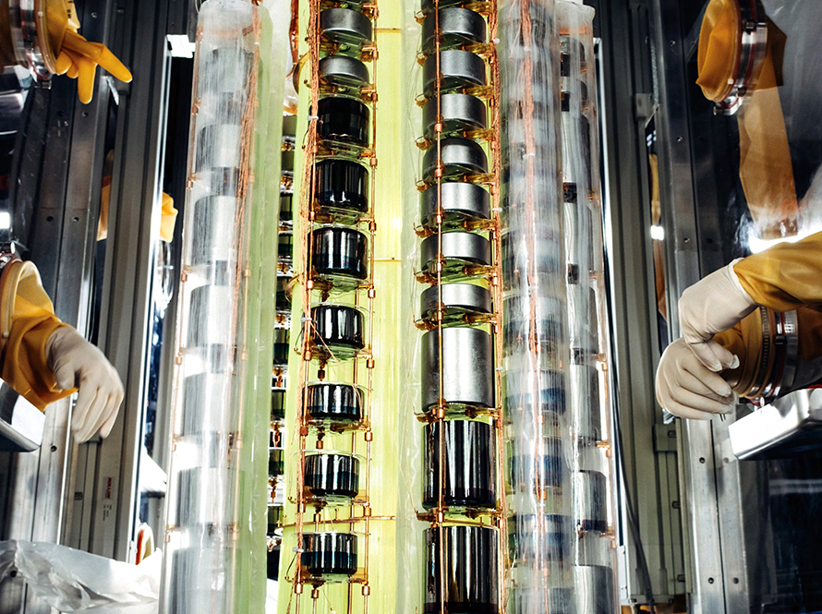
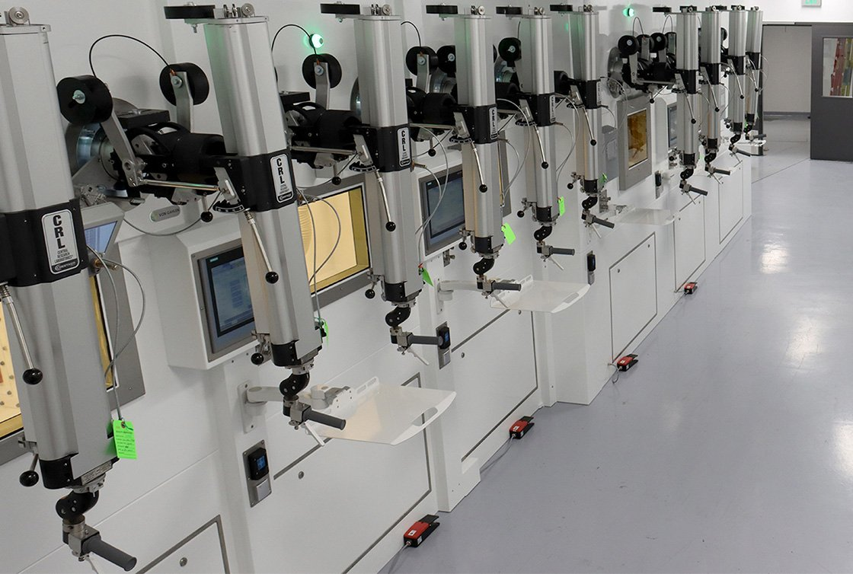
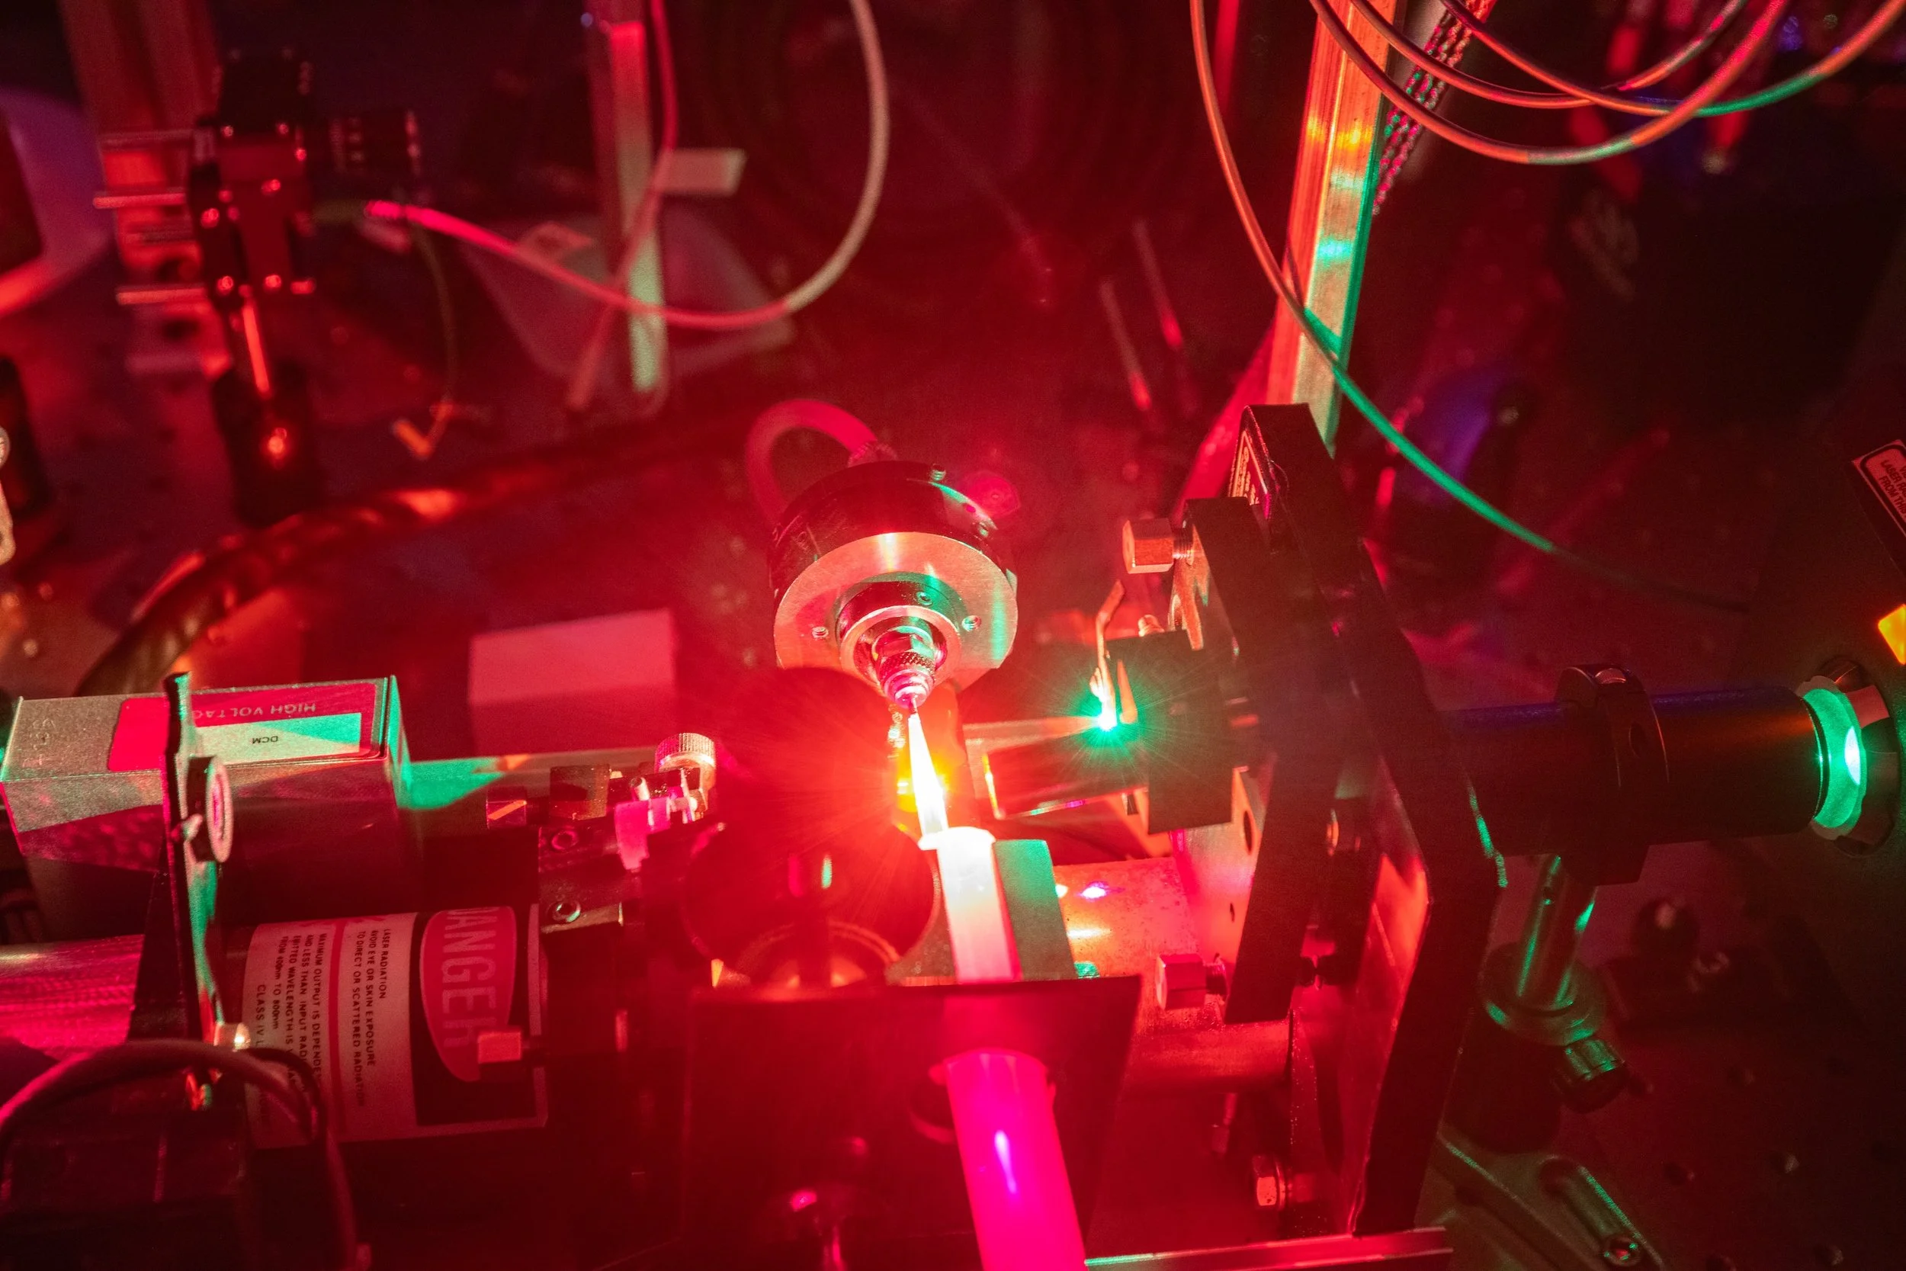
A Roadmap to Discovery
Guiding principles for the Fundamental Symmetries program: Preference given to experiments that
                have good reach in mass-scale, covering substantial new territory
                address known limitations of the Standard Model
                are interpretable (mean more than “the SM is incomplete”), and
                have a well-defined theoretical basis or expectation.
          Extraordinary new physics opportunities are emerging through advances in our ability to
            study extremely rare events and detect very weak signals,
            abundantly produce stable and radioactive isotopes,
            optically manipulate atoms and nuclei, and
            control and quantify uncertainties on theoretical calculations.
LEGEND-200
FRIBs Isotope Harvesting Vault
CalTech, Hutzler Lab

Slide 6
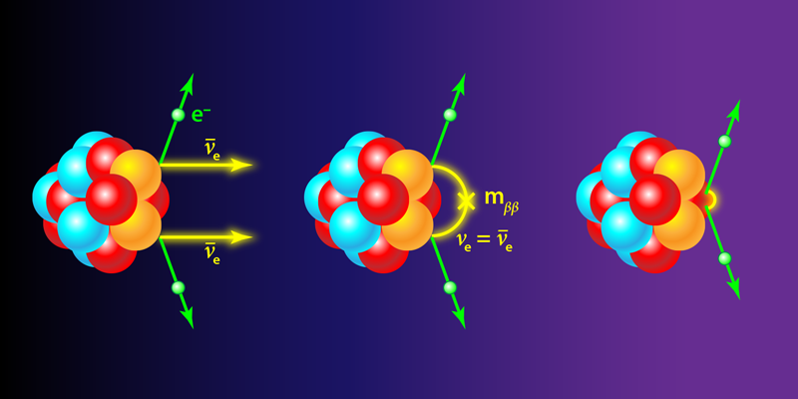
The Nucleus as an Observatory: Double Beta Decay
1) The universe is made mostly of matter. 2) Neutrinos have mass. The simplest standard model extension that explains 1) and 2) creates a Majorana neutrino and violates lepton number conservation making 0νββ possible. Does 0νββ exist in nature?
The observation of 0νββ 1) represents an unambiguous discovery of lepton number violation, 2) establishes that there is a Majorana component to the neutrino mass, and 3) establishes the neutrino mass scale. NB: low energy CP violation like δ_{CP}^{PMNS} or EDMs is not needed for leptogenesis.
Credit: APS/Alan Stonebraker
Neutrinoless Double Beta Decay, 2023 LRP Whitepaper

Slide 7
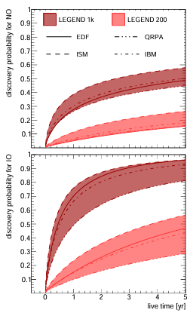
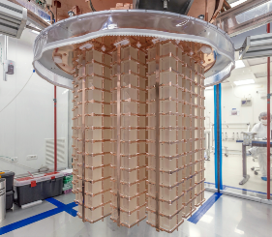
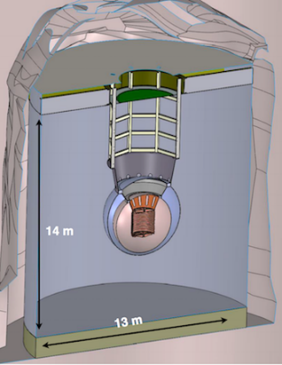
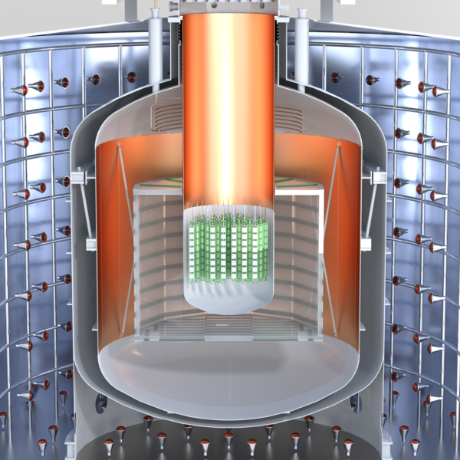
0νββ : Top Priority for New Experiment Construction in the Nuclear Science Long Range Plan
Roughly $20.0M has been allocated since 2020 to explore three technologies: CUPID, LEGEND-1000, nEXO, and; supporting conceptual design and R&D.
In December 2024, LEGEND-1000 selected as the first priority for NP investment. (est. cost $500 M)
A multi-pronged campaign to detect neutrinoless double beta decay is an international enterprise.
Funding agencies representatives from Canada, France, Germany, Spain, United Kingdom, and the U.S. (DOE and NSF) are working to establish a framework for continued coordination.
If neutrinos are Majorana, LEGEND-1000 has a 95% or 50% discovery potential for inverted or normal mass ordering respectively.
Three proposed technologies:
Scintillating bolometry (CUPID, Li²Mo⁴ crystals with enriched ¹⁰⁰Mo)
Enriched ⁷⁶Ge crystals (LEGEND-1000) – 1st priority for NP support
Liquid Xenon TPC (nEXO)
TeO₂ Crystals from CUORE
Isotope availability and cost remain a determinant of what is possible.

Slide 8
NP Project Status
Project | Location |  | Status | Cost | CD-4
Construction Projects
Electron-Ion Collider (EIC) | BNL | BNL | CD-3B | $1.7B to $2.8B (Est) | Q1 FY36 (Est)
Major Items of Equipment
Gamma Ray Energy Tracking Array (GRETA) ^{Fully Funded, Delegated} | LBNL | LBNL | CD-4A | $58.3M (TPC) | Q2 FY28
Measurement of a Lepton-Lepton Electroweak Reaction (MOLLER) ^{Fully Funded} | TJNAF | TJNAF | CD-2/3 | $48.66M (TPC) | Q4 FY28
High Rigidity Spectrometer (HRS) High Transmission Beam Line (HTBL) SPectrometer Section (SPS) | MSU | MSU | CD-2/3 CD-3A | $49.7M (TPC) $65.5M - $87.3M (Est) | Q3 FY30 Q2 FY32 (Est)
Ton Scale Neutrinoless Double Beta Decay (TS-NLDBD) Near-term LEGEND-1000 | ORNL | ORNL | CD-0 | $409M to $665M (Est) | TBD

Slide 9
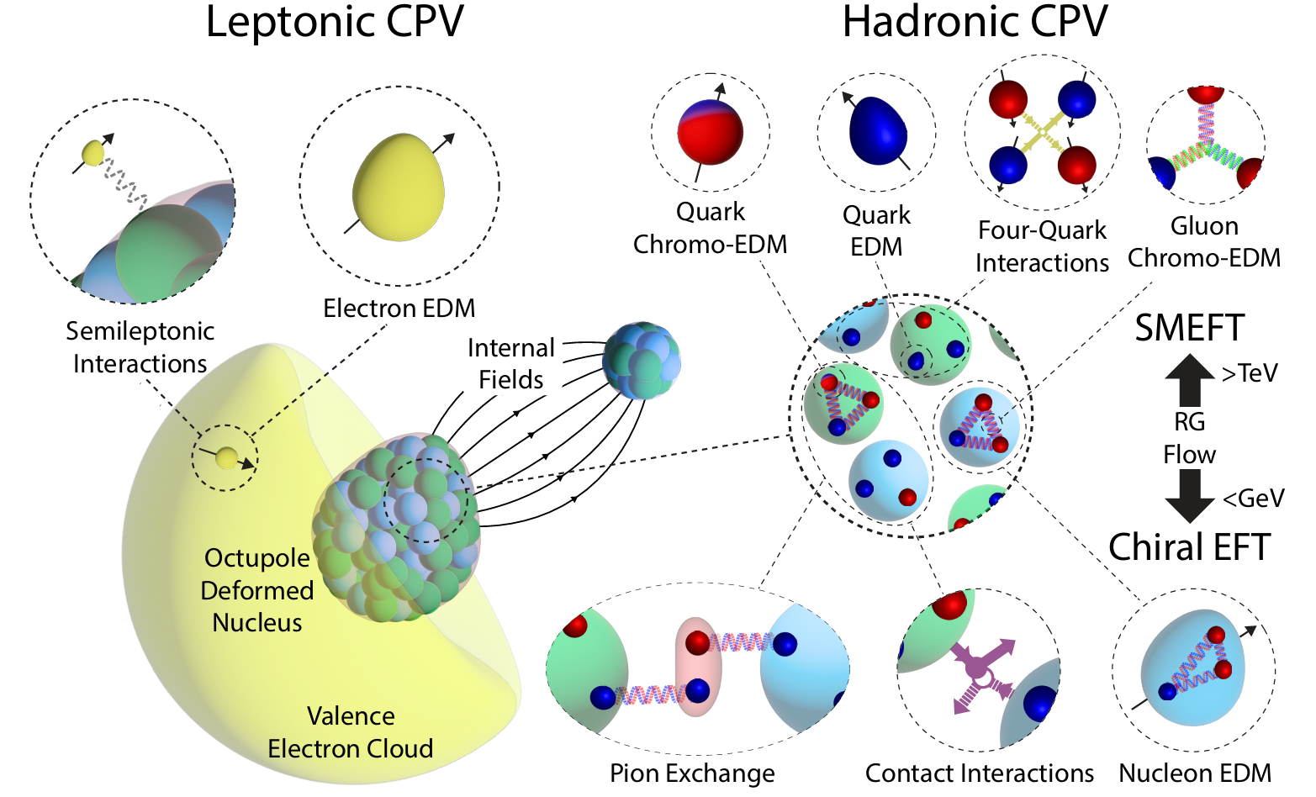
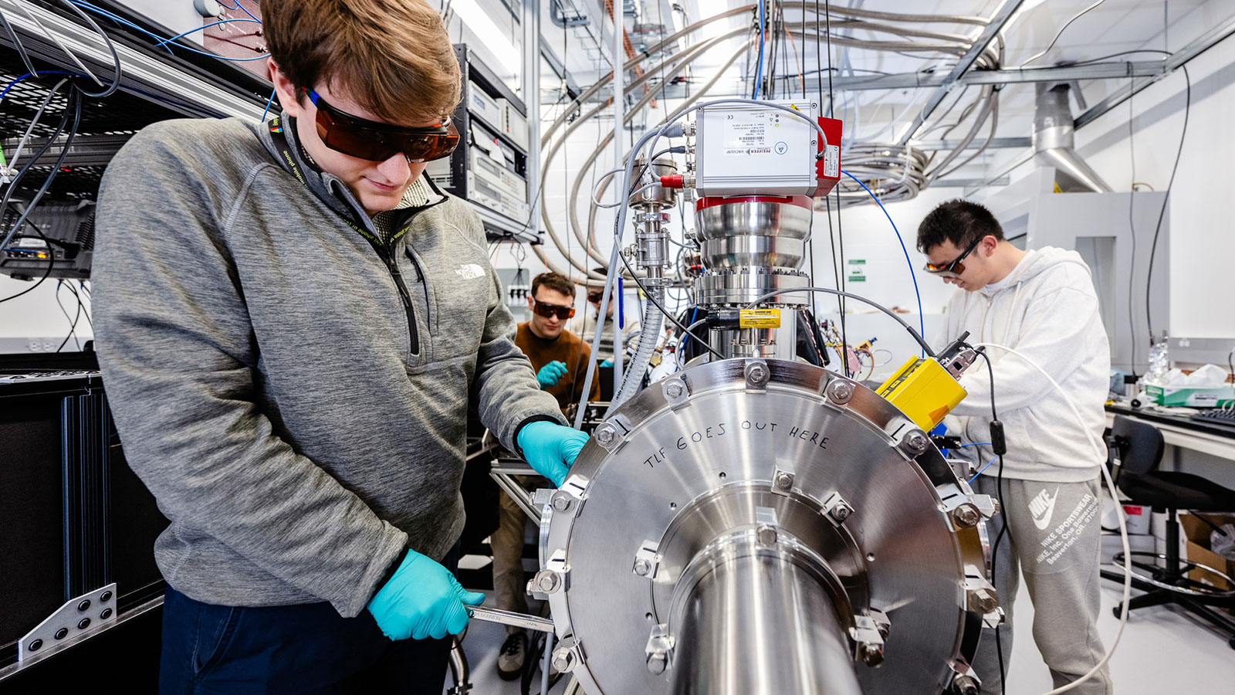
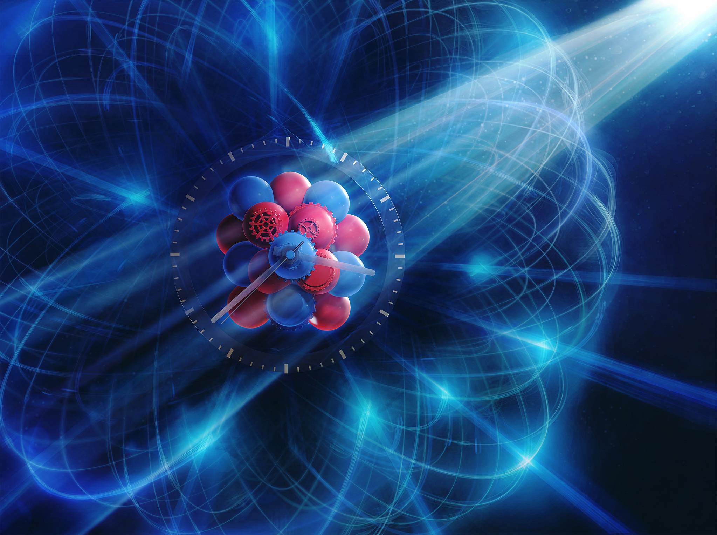
The Nucleus as an Observatory: EDMs
Why is there more matter than antimatter? Many sources of CP violation can be probed in table-top nuclear physics experiments. Experiments are made possible by the availability of isotopes and advanced techniques for producing, controlling, and interacting with atoms, molecules, and nuclei.
CeNTREX team members at ANL
Image credit: Tobias Wüstefeld/Ralf Röhlsberger
A. Jadbabaie, S. Ebadi, R.F. Garcia Ruiz, N. R. Hutzler, A. M. Jayich, and J. T. Singh

Slide 10
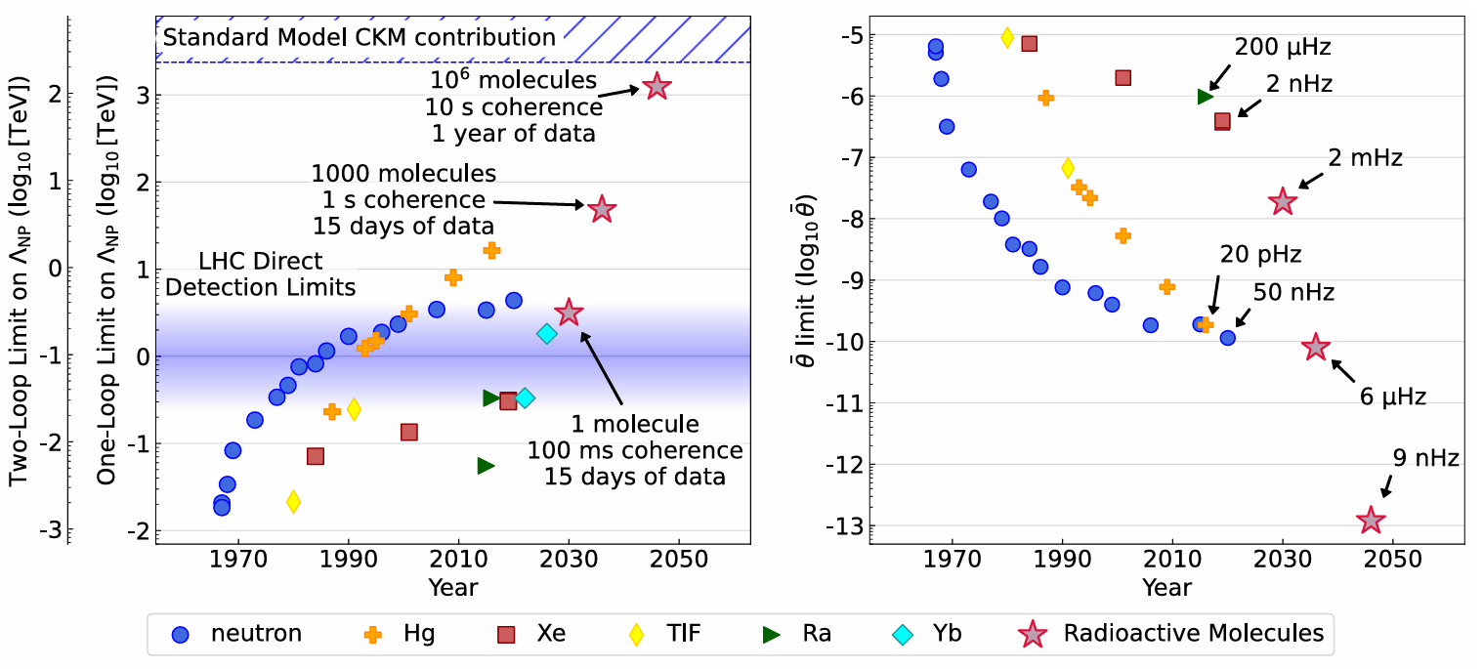
The Nucleus as an Observatory: EDMs
Radioactive molecules can provide a pathway to rapid sensitivity gains toward PeV scales. Potentially discovering or eliminating many theories (left-right symmetric models, composite Higgs, leptoquark models). Provides a near-definitive test of electroweak baryogenesis.
Major efforts in this area: Ra225@ANL, RaX Collaboration, +QIS awards.
A. Jadbabaie, S. Ebadi, R.F. Garcia Ruiz, N. R. Hutzler, A. M. Jayich, and J. T. Singh

Slide 11
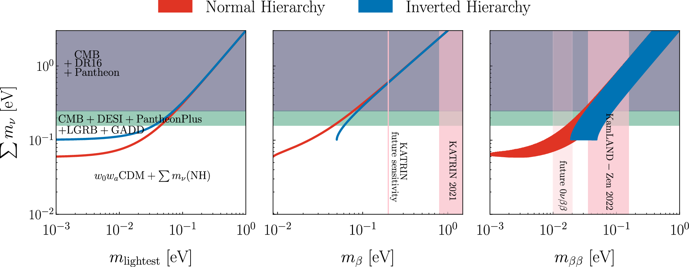
The Nucleus as an Observatory: β-Decay (m_{v})
Cosmic evolution: Neutrino mass measurements are needed to break the degeneracy in cosmology models between the curvature of space Ω_{K}, the dark energy equation of state ω, and the sum of the neutrino masses Σm_{ν}. FS scope: KATRIN, Project-8, and 0vBB
LEGEND-1000
Project-8 Goal
Adapted from: Du, GH., Wu, PJ., Li, TN. et al. Eur. Phys. J. C 85, 392 (2025). https://doi.org/10.1140/epjc/s10052-025-14094-0

Slide 12
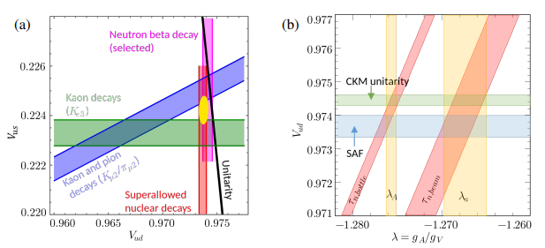
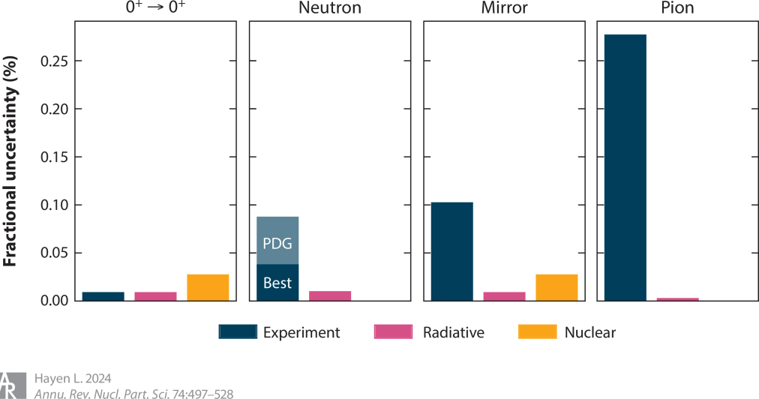

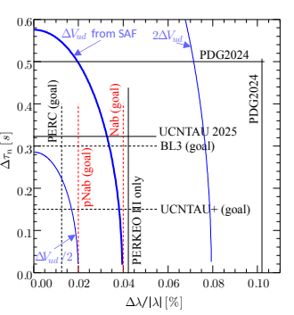
The Nucleus as an Observatory: β-Decay (CKM)
Cirigliano et al., Phys.Lett.B 838 (2023) 137748 and Yoo et al., Phys. Rev. D 108 (2023) no.3, 034508.
V_{ud} requires neutron lifetime and beta decay correlations: experimental precision of 0+ decays are not helpful given radiative and nuclear uncertainties.
Neutrons provide most reliable V_{ud} anchor but there are several experimental discrepancies. We need the precision of SAF but from neutrons.
Within the FS program, NAB/pNAB (ORNL) provide λ_{A} and λ_{a}, and UCNτ+ (LANL) and BL3 (NSF) will deliver V_{ud} with small experimental and theoretical errors.

Slide 13
Current Fundamental Symmetries PIs
John Wilkerson, Reico Henning, Julieta Gruszko (UNC),
Murad Sarsour (GSU),
Jaideep Singh (MSU),
Ronald Fernando Garcia Ruiz (MIT), John Doyle (Harvard), Nicholas Hutzler (CalTech),
Kyle Leach (Mines),
Yan Zhou (UNLV),
Yury Kolomensky/Gabriel Orebi Gann (UCBerkeley),
Krishna Kumar (UMass Amherst),
Andreas Piepke (UAlabama),
Nadia Fomin (UTenn),
David Hertzog, Jason Detwiler, Alejandro Garcia, Elise Novitski (UW),
Ricardo Alarcon (ASU),
Paul Huffman, Albert Young, Matt Green (NCSU),
Phil Barbeau (Duke)
Luiz De Viveiros Souza Filho (PSU),
Giorgio Gratta (Stanford),
Ben Jones (UTA),
Emine Altuntas (OU),
Maynard Dewey, Pieter Mumm, Jeff Nico, Shannon Hoogerheide (NIST),
Yuri Efremenko (UTenn),
Ethan Brown (RPI),
William Terrano (ASU),
David DeMille (UChicago),
Liang Yang (UCSD),
Diana Parno (CMU),
Michelle Dolinski (Drexel),
Elise Novitski (UW),
Joshua Klein (UPenn),
Thomas O'Donnell (Virginia Tech),
Karsten Heeger, Reina Maruyama, David Moore (Yale),
Bradley Plaster (UK),
Benjamin Monreal (CWRU),
Lindley Winslow, Joe Formaggio (MIT).
Sherry Yennello, Dan Melconian (TAMU)
Information available at: https://pamspublic.science.energy.gov/webpamsexternal/interface/awards/awardsearchexternal.aspx
Plus 10 groups at 8 National Labs: ANL, BNL, LBL, LANL, LLNL, PNNL, ORNL, SLAC

Slide 14
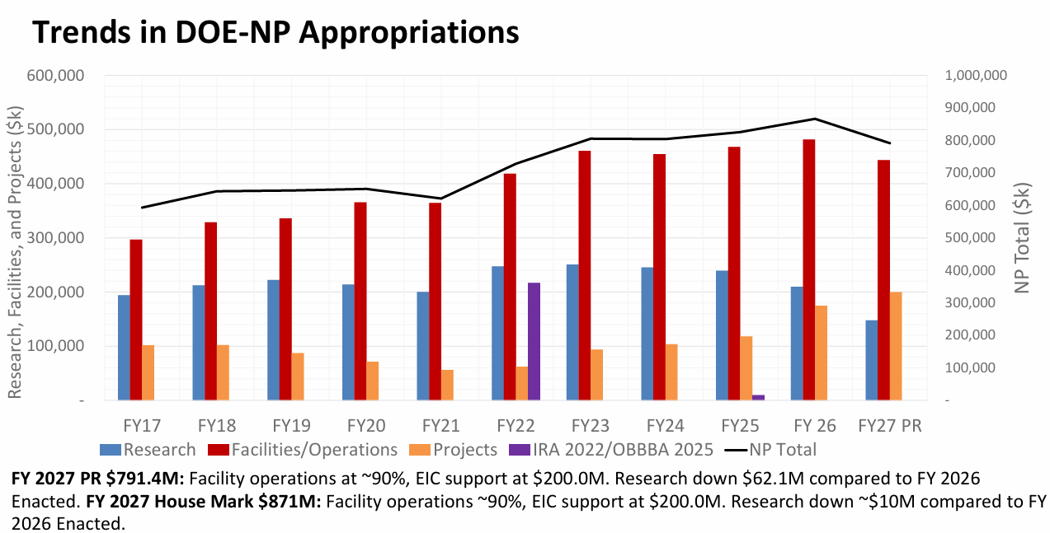

Slide 15
Conclusions
The atomic nucleus, with its extreme density and complex constituent interactions, offers a unique probe into the nature of the universe.
Extraordinary new physics opportunities are emerging within Fundamental Symmetries that address some of the most pressing issues in physics.
Funding new efforts is challenging, but the program will always endeavor to support the best pathway to discovery.
Fundamental Symmetries remains a high-priority area and will be an important component of HENP.

Slide 16
Deputy Director for Science Programs
Advanced Scientific Computing Research
Basic Energy
Sciences
Biological & Environmental Research
Fusion Energy
Sciences
High Energy and
Nuclear Physics
Workforce Development for Teachers & Scientists
Computational Science and Research Partnerships
Chemical Sciences, Geosciences, and Biosciences
Integrated Program
Management
Research
Fusion Energy Research
Physics Research
Communications & Public Affairs
Materials Sciences and Engineering
Facilities and Enabling Technologies
Enabling Technologies and Partnerships
Facilities
Accelerator and Technology
Office of Scientific & Technical Information
Advanced Computing Technology
Scientific User
Facilities
Facilities and
Projects

