Slide 1
Workshop Goals
Xing Wu
On behalf of the RadIs Workshop organizing committee:
Leah Broussard, Matthias Heinz, Jaideep Singh, Xing Wu

Slide 2
Access to Isotopes Accelerates Innovation!
Benefit to the Nation:
  Workforce Development
  Compact Precision Timekeeping (Nuclear Clocks)
  Quantum Information with Radioactive Qubits
  Discovery Science (Electric Dipole Moments, Nuclear Recoils, Neutrinos...)
Production
Separation
Integration
Application
Nuclear
Atomic/Molecular/Optical
DOE IRP

Slide 3
Access to Isotopes Accelerates Innovation!
Benefit to the Nation:
  Workforce Development
  Compact Precision Timekeeping (Nuclear Clocks)
  Quantum Information with Radioactive Qubits
  Discovery Science (Electric Dipole Moments, Nuclear Recoils, Neutrinos...)
Benefit to the DOE IRP: New Mutually Beneficial Scientific Collaborations
Radiochemistry
Production
?Separation
?Integration
Application
Nuclear
Atomic/Molecular/Optical
DOE IRP

Slide 4

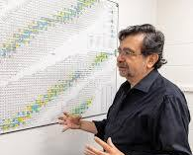
Background of this Workshop: How We Got Here.
(A More Personalized View)
When I started as a junior faculty, there seems a LOT of exciting science can be done – but only if we have access to particular rare isotopes
After chatting with Alfredo Galindo-Uribarri @ ORNL, it became clear that many people in the fundamental physics community are facing the same issue
At the same time, ORNL does produce a lot of the rare isotopes that can enable the scientific discoveries in the fundamental physics community.
Me
Alfredo

Slide 5
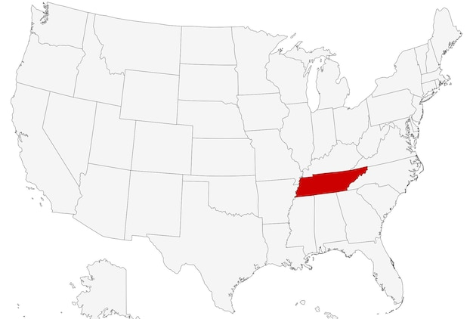





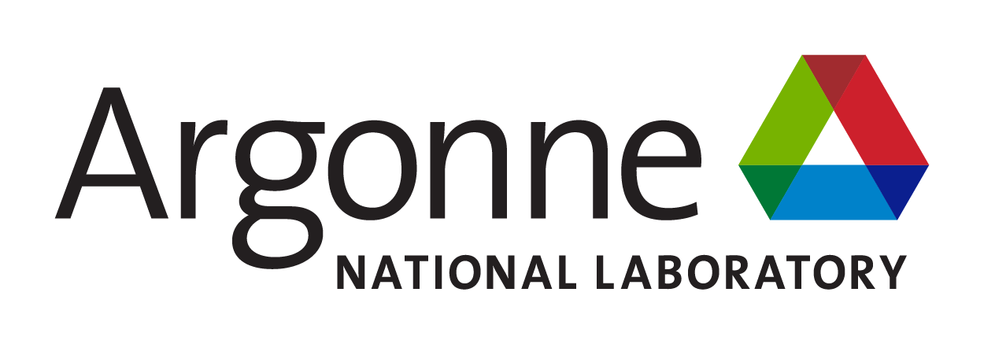



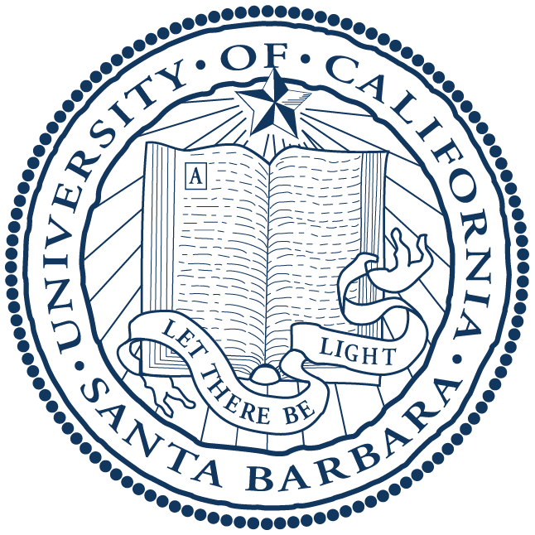






ONRL Could Be the Center of Mass
Isotope Production facility at ORNL
Stanford
Princeton
UCSB

Slide 6
Charge Items of RadIs Workshop 2026
A short whitepaper:
  it will articulate the benefits to the nation, the isotope community, and also needs and priorities required for fundamental physics research which create new demands for rare isotopes.
Joint Funding Opportunities:
  Isotope, fundamental physics, and both
Workforce Development:
  Investing in People to Drive Joint Discovery; Shaping the Next Generation of Physics & Isotope Leaders
Next Workshop?
  This whole thing is a new joint effort, and these three days won’t be enough. Maybe a lot of updates in a year from now

Slide 7

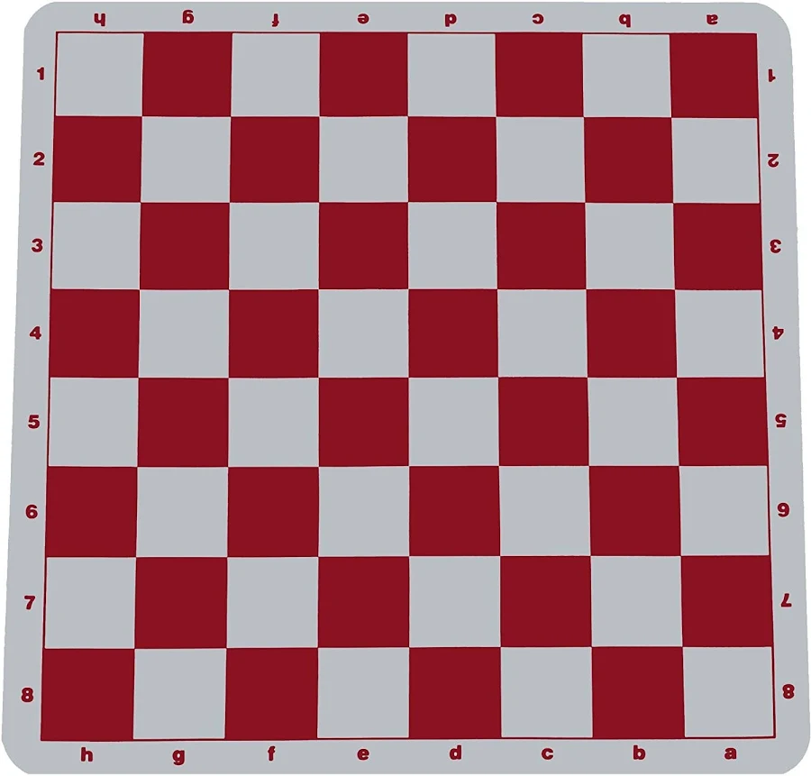
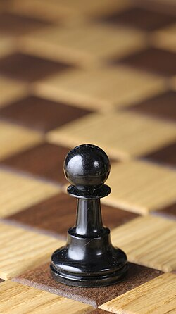
We are Moving One Step Each Time, But Will Get There!

Slide 8
Code of Conduct (APS)
Meeting participants are expected to conduct themselves in accordance with the core principles of the American Physical Society code of conduct for scientific meetings, which reads:
"It is the policy of the American Physical Society (APS) that all participants, including attendees, vendors, APS staff, volunteers, and all other stakeholders at APS meetings will conduct themselves in a professional manner that is welcoming to all participants and free from any form of discrimination, harassment, or retaliation. Participants will treat each other with respect and consideration to create a collegial, inclusive, and professional environment at APS Meetings. Creating a supportive environment to enable scientific discourse at APS meetings is the responsibility of all participants.
Participants will avoid any inappropriate actions or statements based on individual characteristics such as age, race, ethnicity, sexual orientation, gender identity, gender expression, marital status, nationality, political affiliation, ability status, educational background, or any other characteristic protected by law. Disruptive or harassing behavior of any kind will not be tolerated. Harassment includes but is not limited to inappropriate or intimidating behavior and language, unwelcome jokes or comments, unwanted touching or attention, offensive images, photography without permission, and stalking.
Point of contact: Matthias Heinz (heinzmc@ornl.gov), Rachel Goins (goinsra@ornl.gov)

Slide 9
A Few More Words on Logistics
Whiteboards around: to collect ideas, thoughts during coffee breaks, for you to put down request FOR the Discussion Sessions
Facility Tours at 2pm onwards on Thursday, Aug 26
  High Flux Isotope Reactor (HFIR)
  Hot Cell Facility
  Sign up with Rachel Goins (goinsra@ornl.gov)

Slide 11
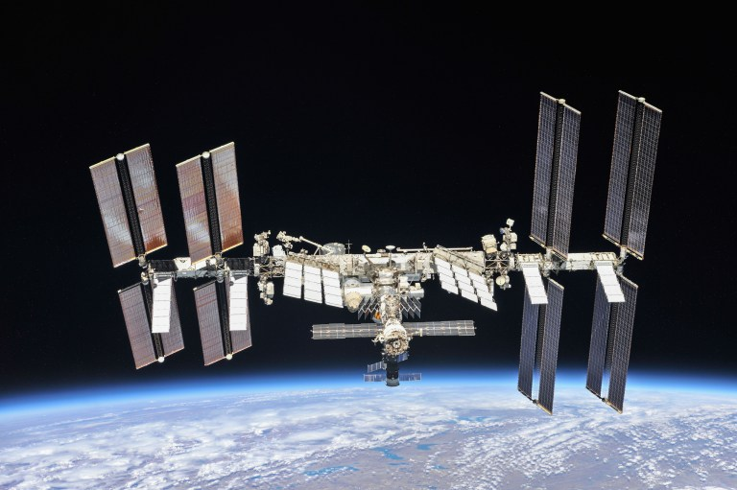
Beyond the Horizon: Uniting Isotope & Fundamental Physics
The ISS is a testament to what humanity achieves when we work together.

