Slide 1
RADIS Workshop
August 25, 2026 | Oak Ridge
Marcel Demarteau (demarteau@ornl.gov)
Oak Ridge National Laboratory

Slide 2
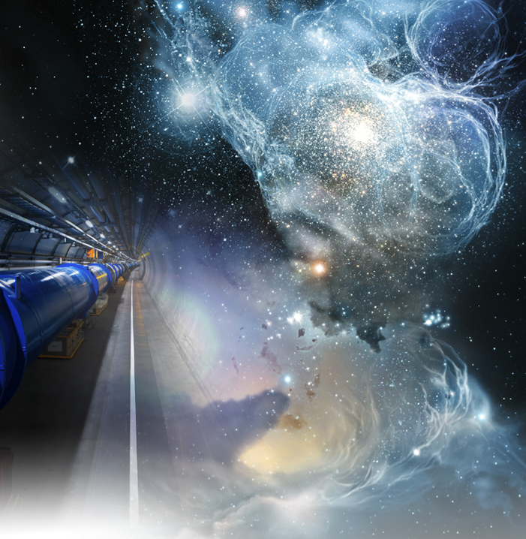
Community and Core Mission
In the broadest sense, the community is defined by a shared mission:
To discover the fundamental
constituents of matter and the
forces that govern their interactions.
Although there are many different approaches to answer these questions, with faint boundaries between them, they are all unified by the same quest.
It is an inclusive and large community!
Notes:
How did the universe come to be, how does it hold together and how will it evolve?

Slide 3
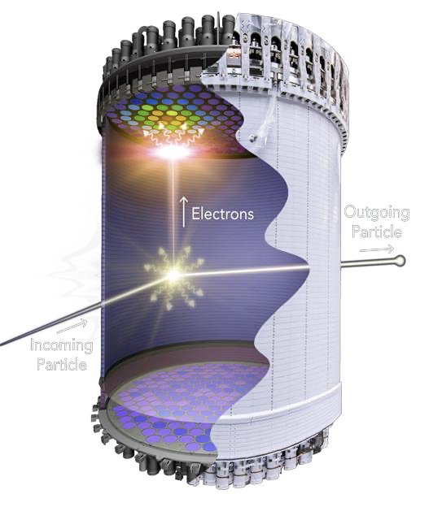
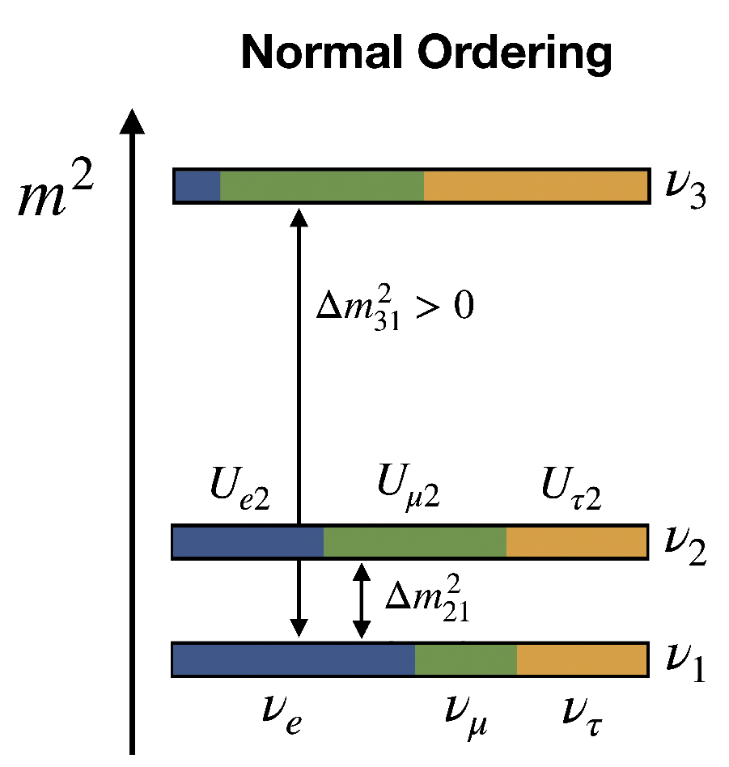
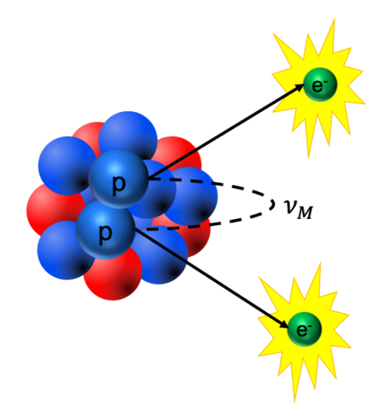
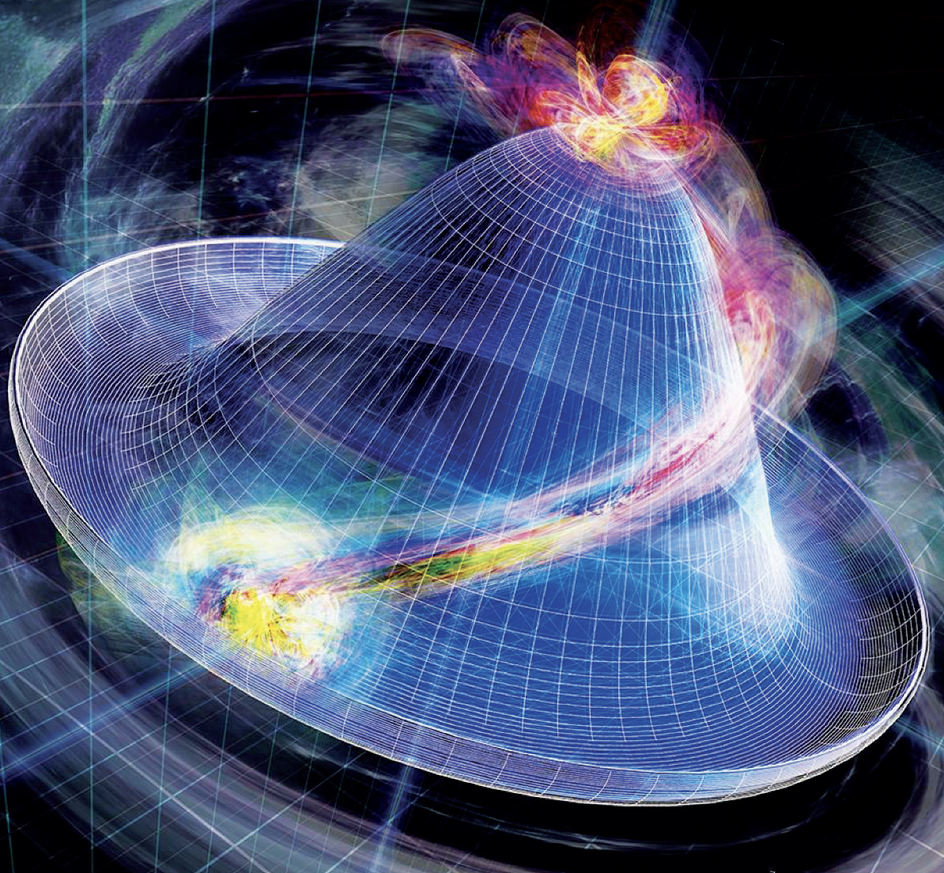
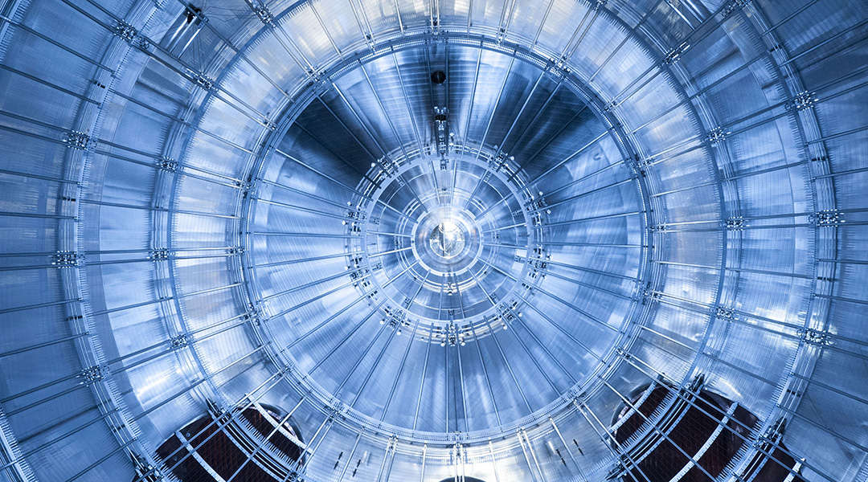
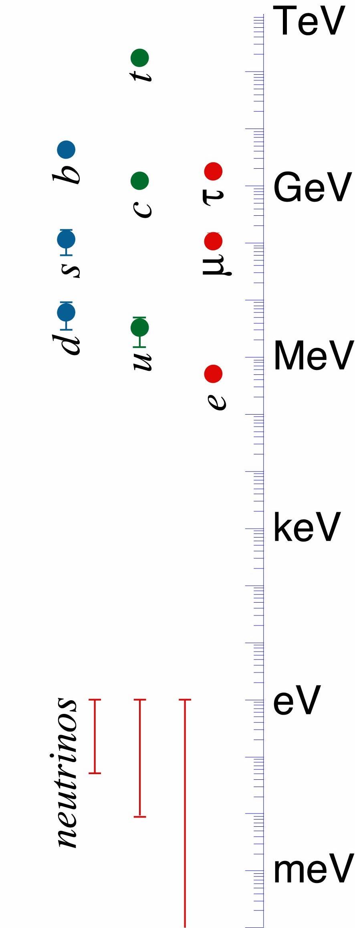
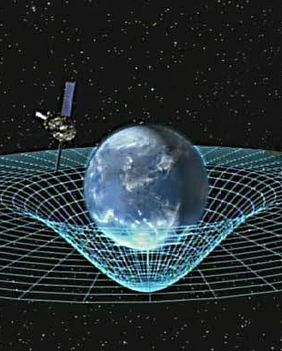
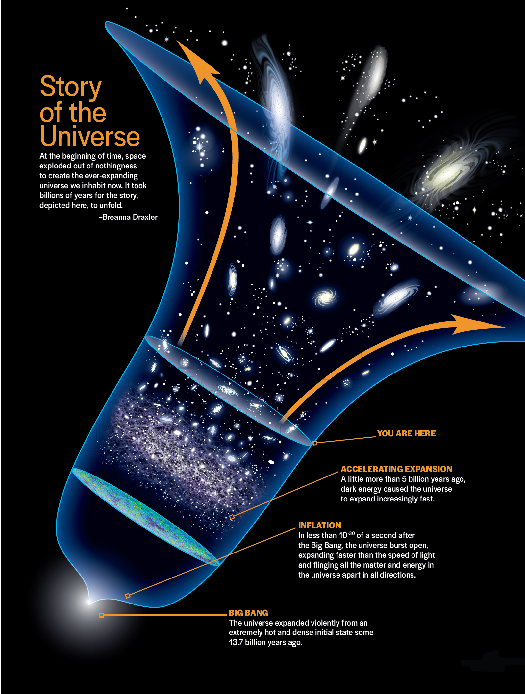
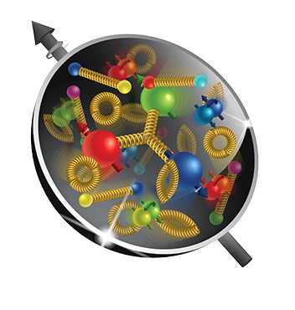
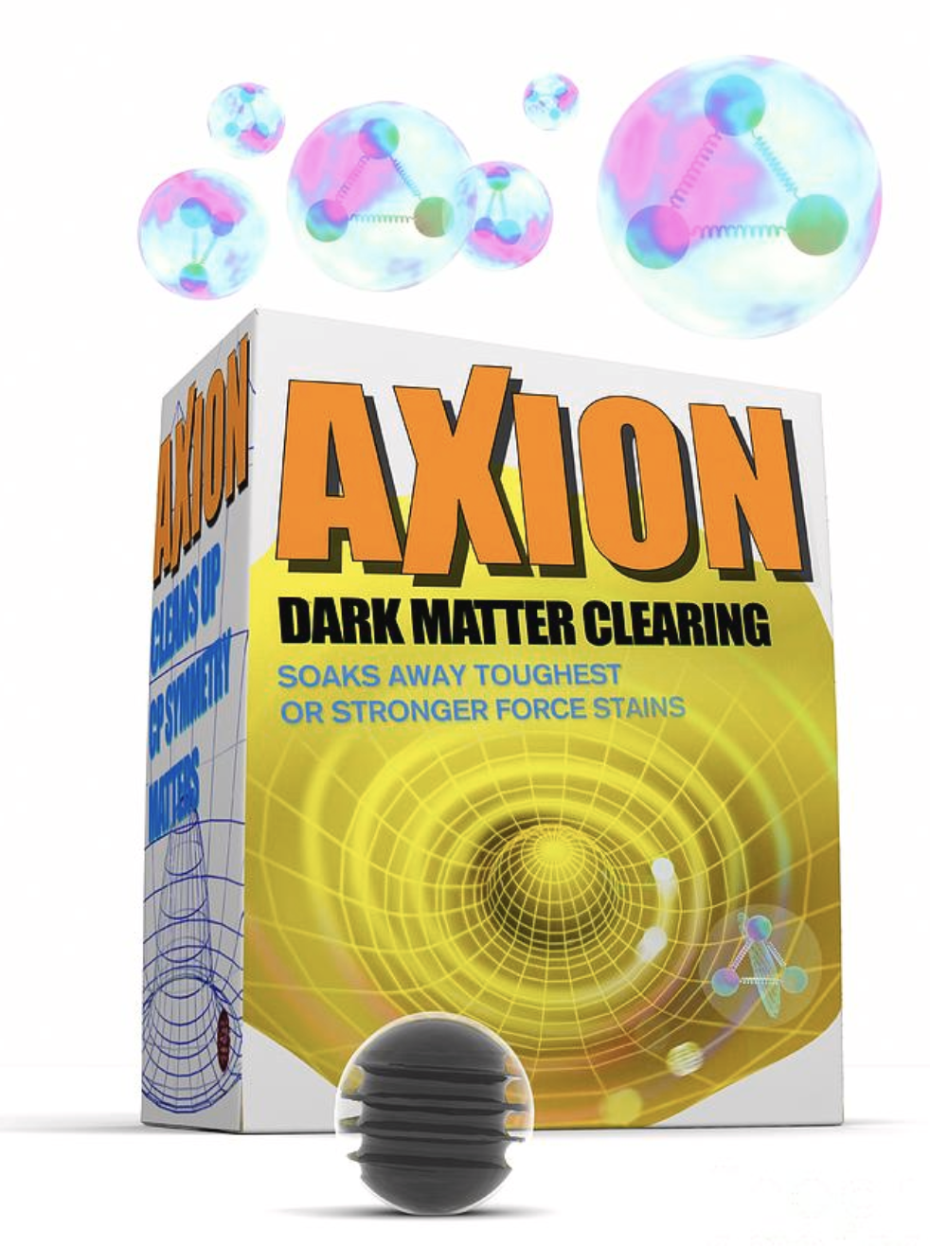
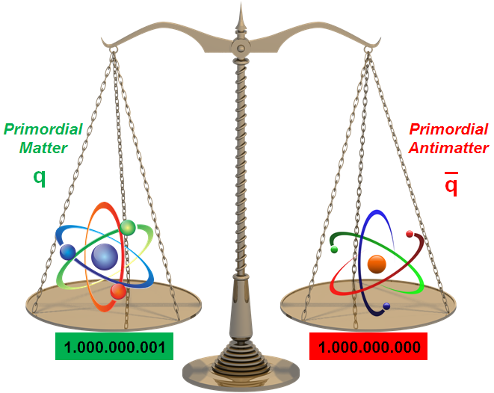
The Many Puzzles
Spin 0 Higgs
and its role
Neutrino mass ordering
and CP violation
Neutrino mass and
its mass generation
Nature of the neutrino
Dark Matter
Quantum
Gravity
Cosmic Inflation and
dark energy
Mass Gap
and QCD
θ-QCD problem
Matter – Antimatter
Asymmetry
Credit: H. Ritsch & M. Renn

Slide 4
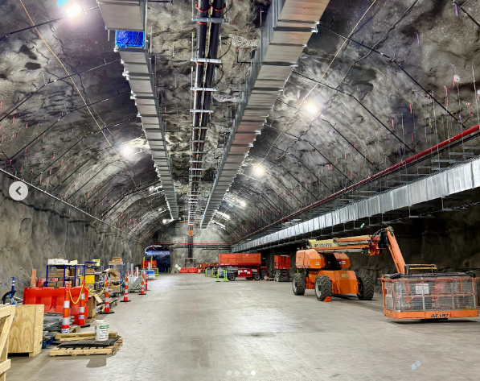
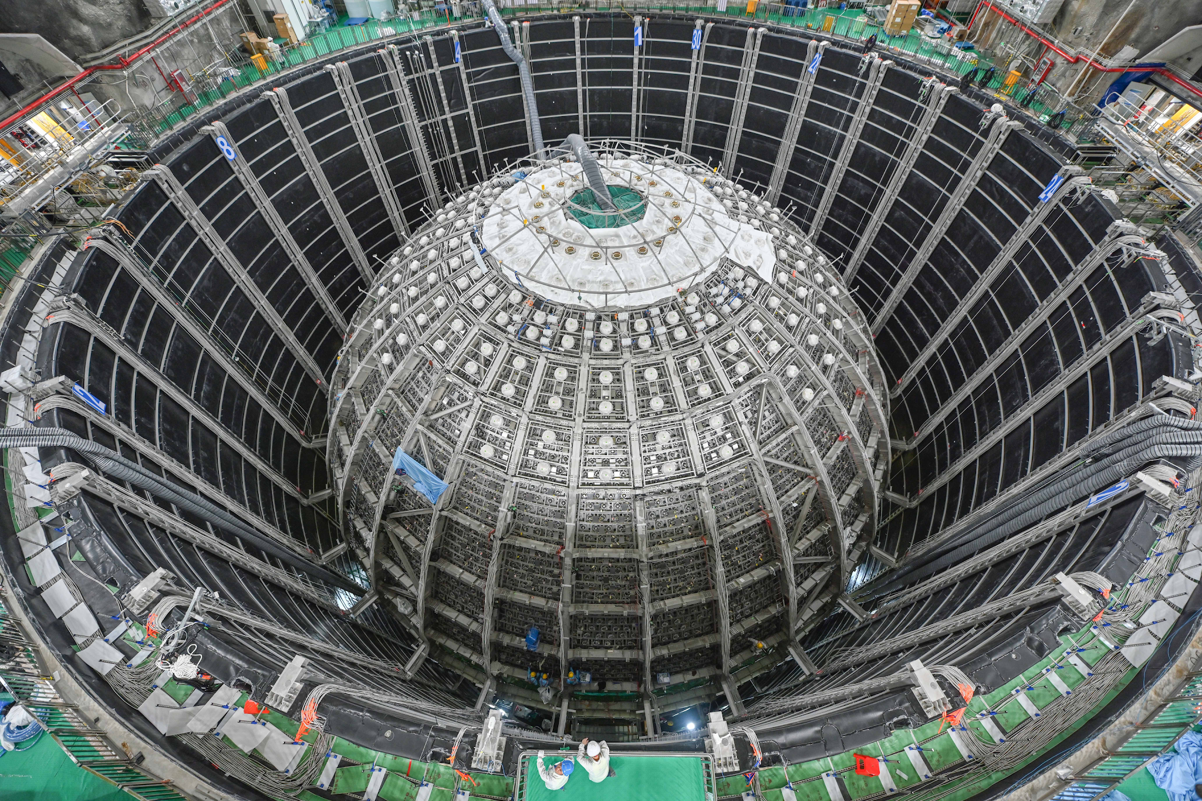
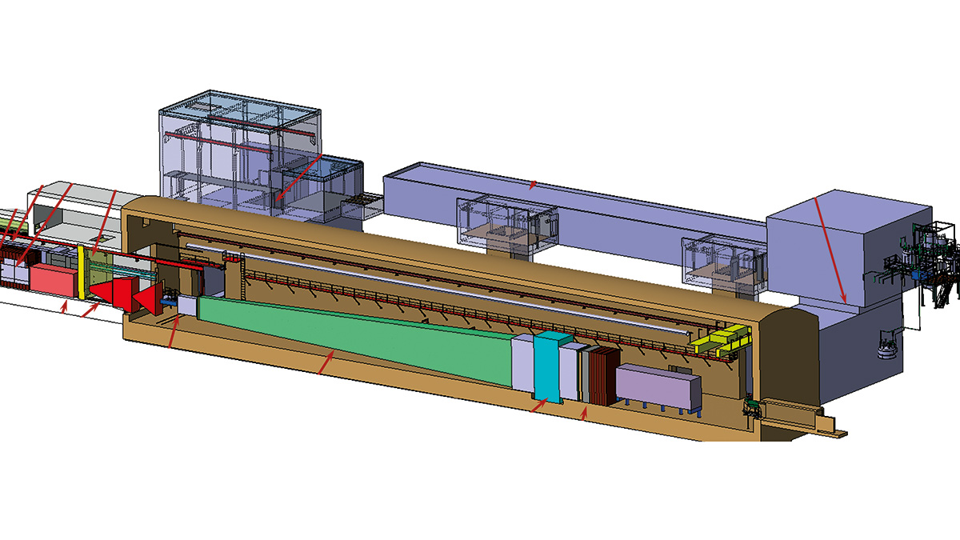
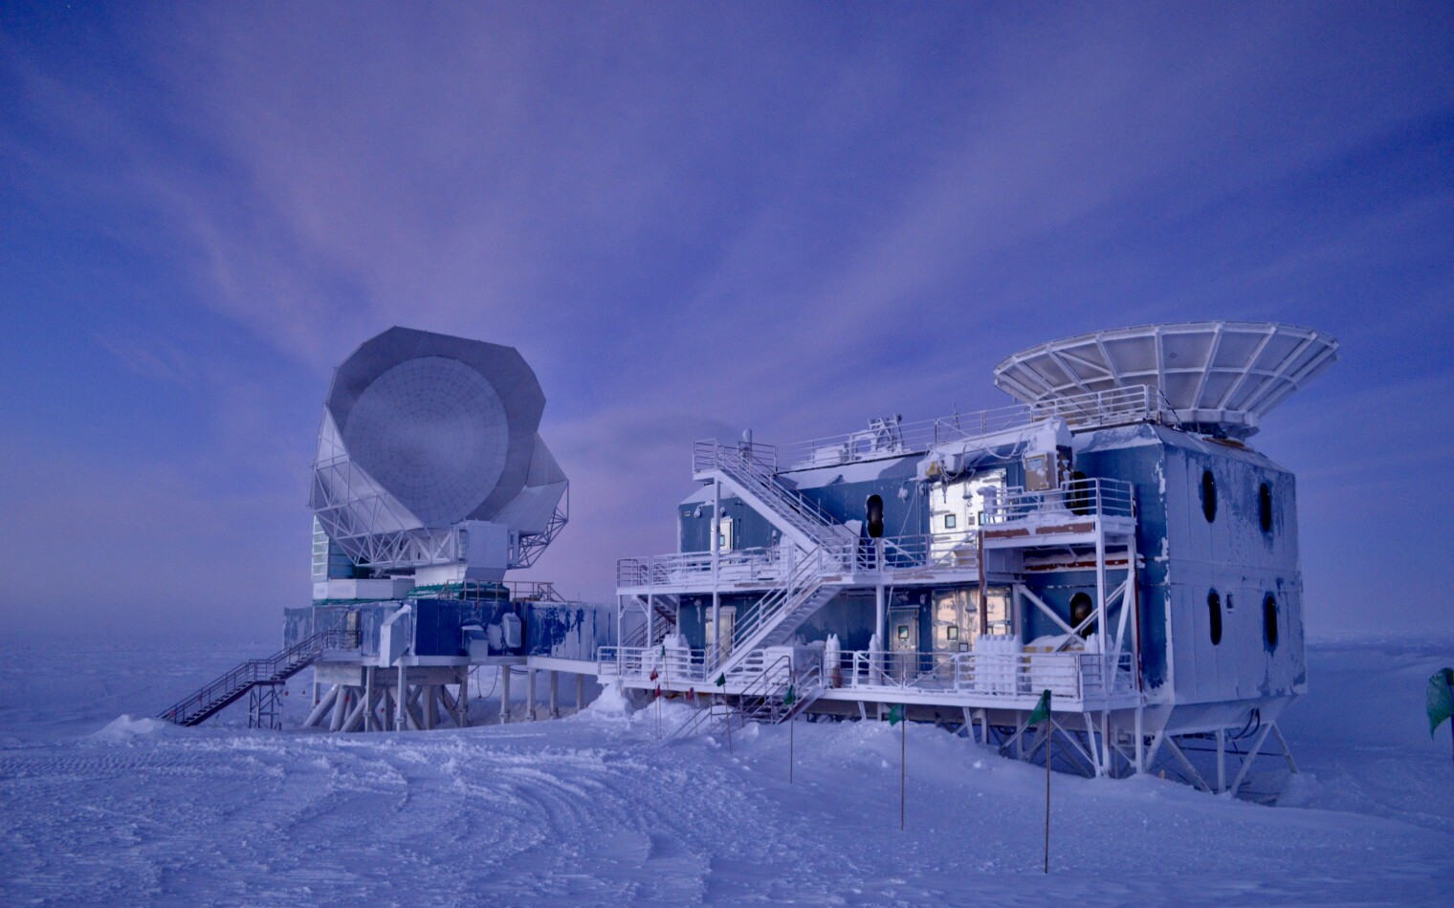
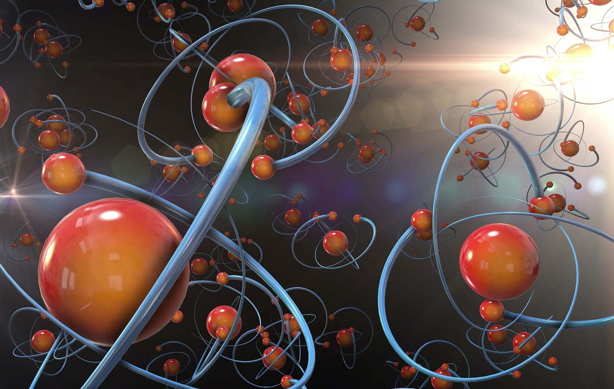
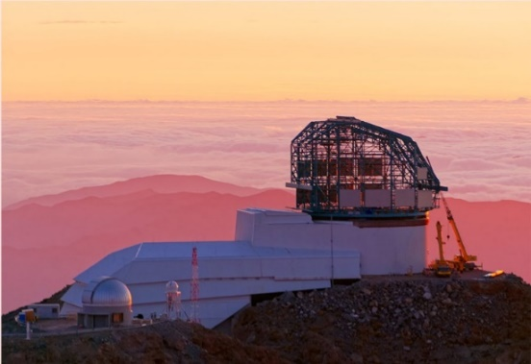
Approaches
Colliders
Underground
Fixed Target
Reactor
EDM
CMB
Radio Molecules
Optical Telescopes
+ many, many more

Slide 5
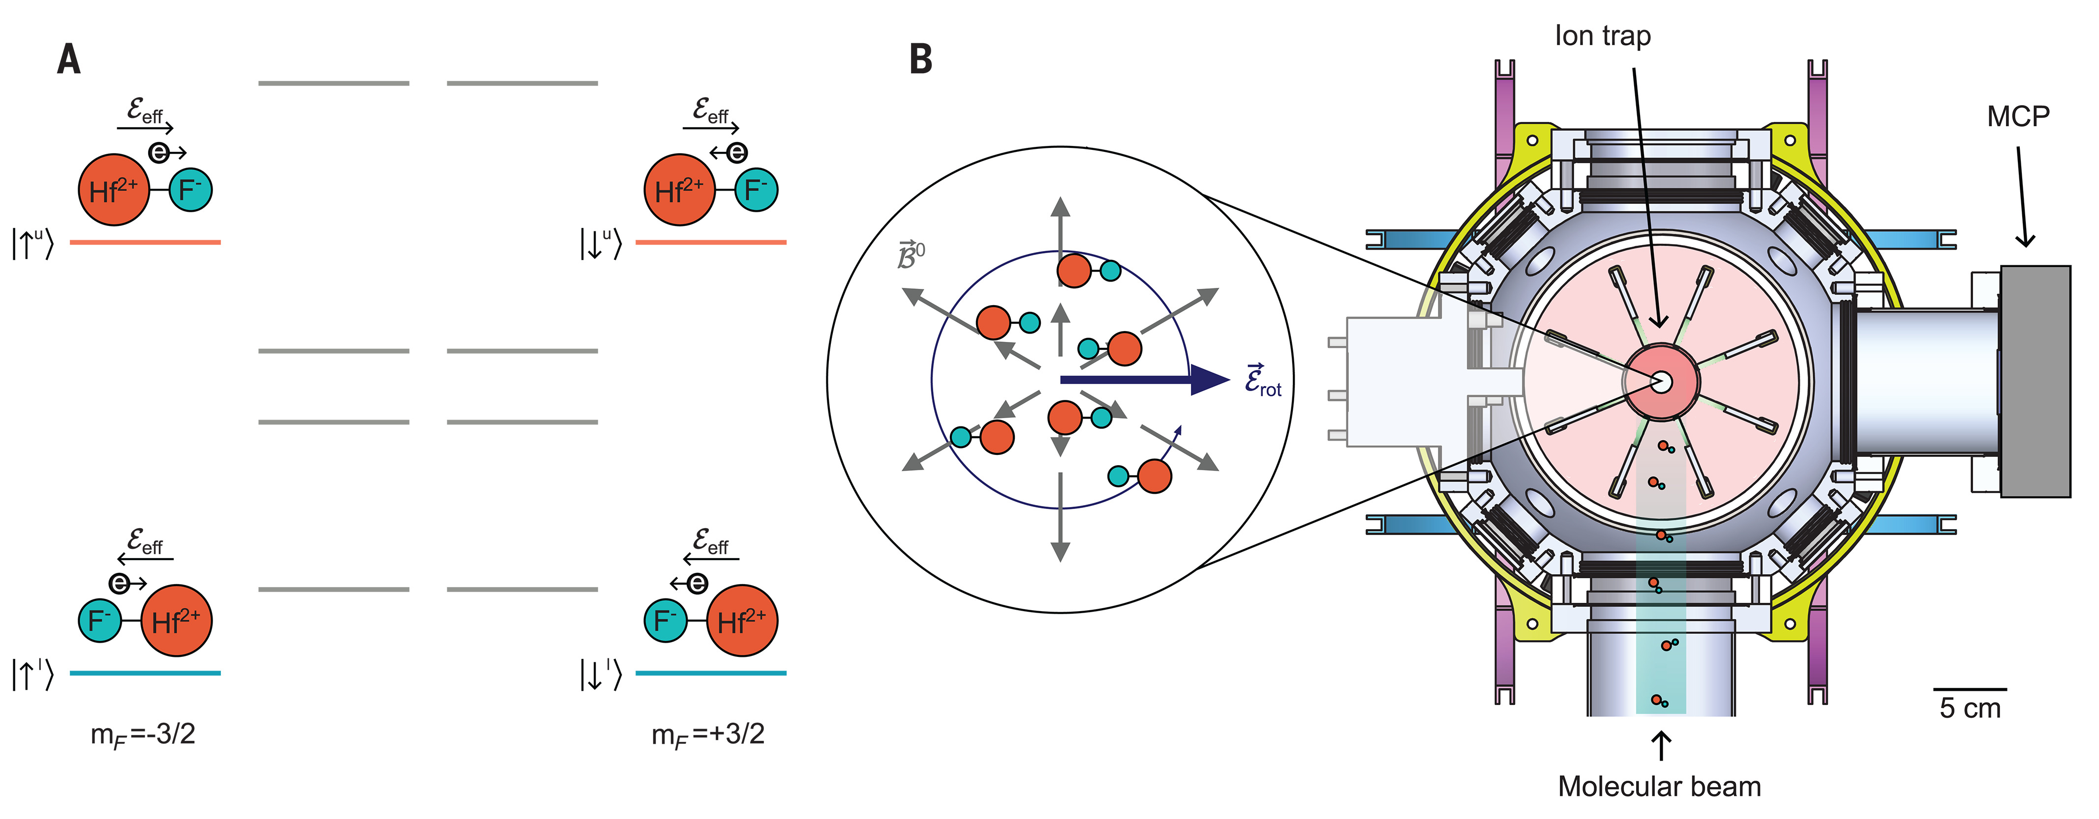
HfF⁺ molecular ions
d_{e} < 4.1 10⁻³⁰ e cm (90% CL)
Jun Ye, Eric Cornell
“We can interpret our new limit on de as M ≳ (g/√a) 40 TeV. For new particles with g² of order α ∼ 1/137, this bound is an order of magnitude greater than the largest-mass particles that can be directly detected at the Large Hadron Collider.”
Roussy, T. S. et al. An improved bound on the electron’s electric dipole moment. Science 381, 46–50 (2023).

Slide 6
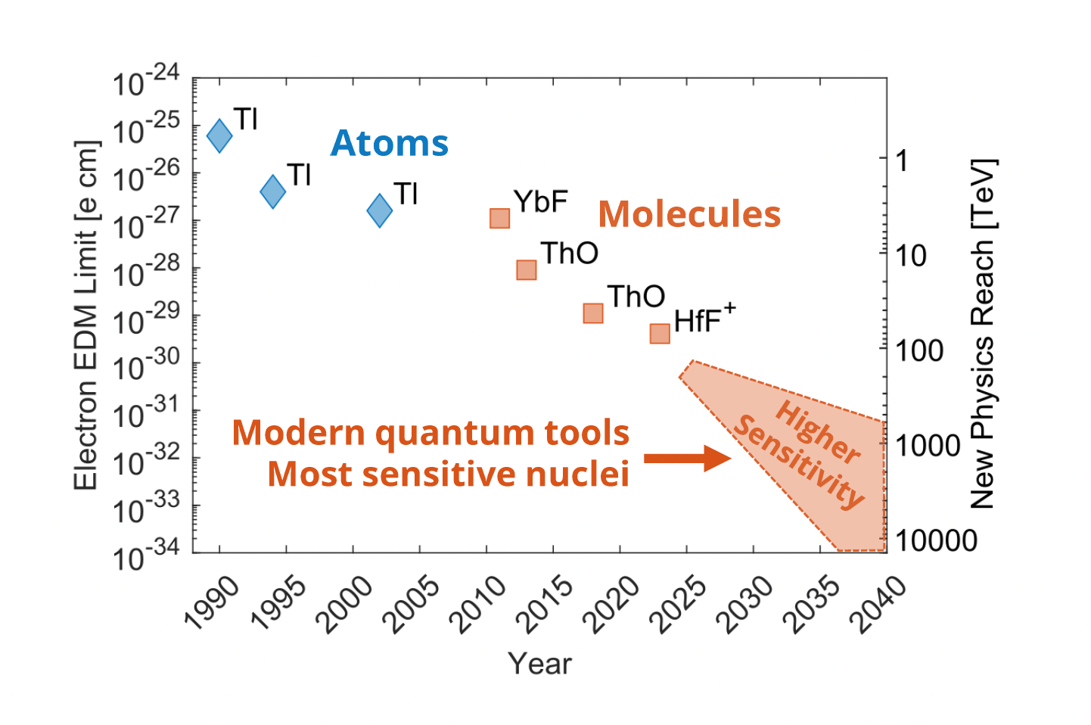
Our Representation
From: Nick Hutzler

Slide 7
Can We Learn From The Collider Community ?

Slide 8
Can We Learn From The Collider Community ?

Slide 9
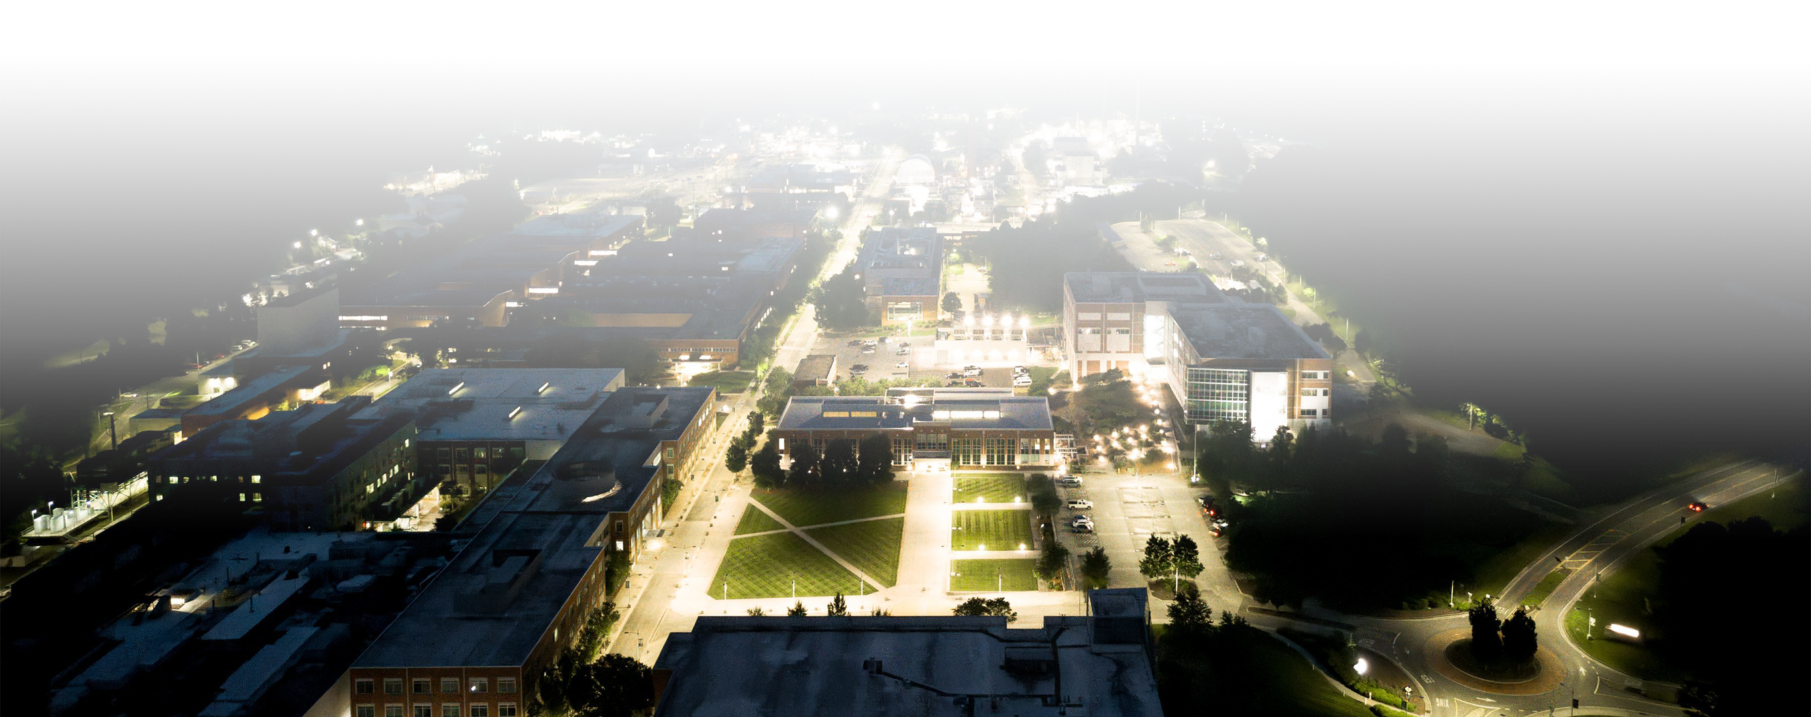
Have a great workshop!
9

