Slide 1
Fitting Problem in the NN’ Experiment
Mubi Khan
University of Kentucky

Slide 2
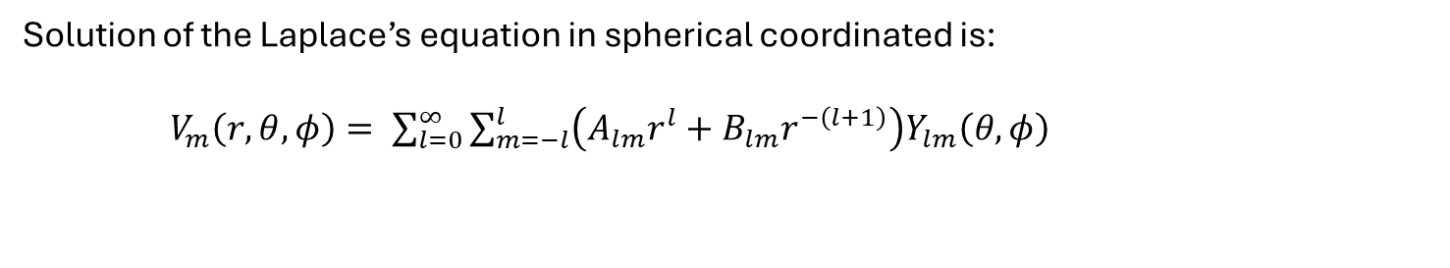
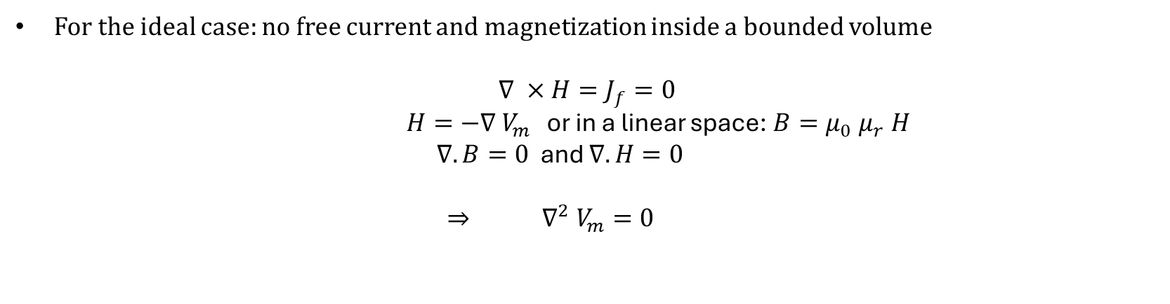
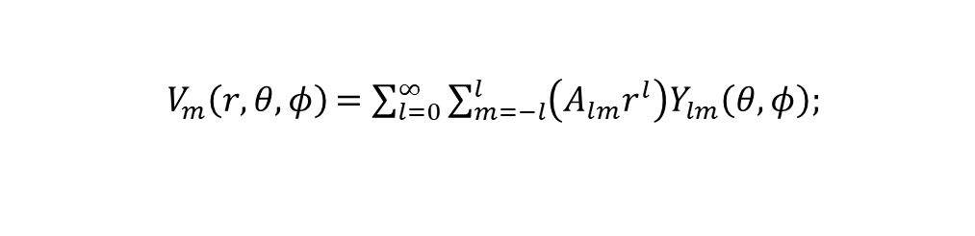
The Objective: To figure out the magnetic field inside the magnet within the uncertainty limits.
For the ideal case: no free current and magnetization inside a bounded volume
$$∇ ×H=J_{f}=0$$
$H=−∇ V_{m }$ or in a linear space: $B=μ_{0} μ_{r} H$
$∇. B=0$ and $∇.H=0$
$⇒$ $∇^{2} V_{m}=0$
Solution of the Laplace’s equation in spherical coordinated is:
$V_{m}\left(r, θ, φ\right)= \sum_{l=0}^{∞}{\sum_{m=−l}^{l}{\left(A_{lm}r^{l}+B_{lm}r^{−\left(l+1\right)}\right)Y_{lm}\left(θ, φ\right)}}$
-1
$V_{m}\left(r, θ, φ\right)$ $=\sum_{l=0}^{∞}{\sum_{m=−l}^{l}{\left(A_{lm}r^{l}\right)Y_{lm}\left(θ, φ\right); } }$
For inside the sphere
-2

Slide 3
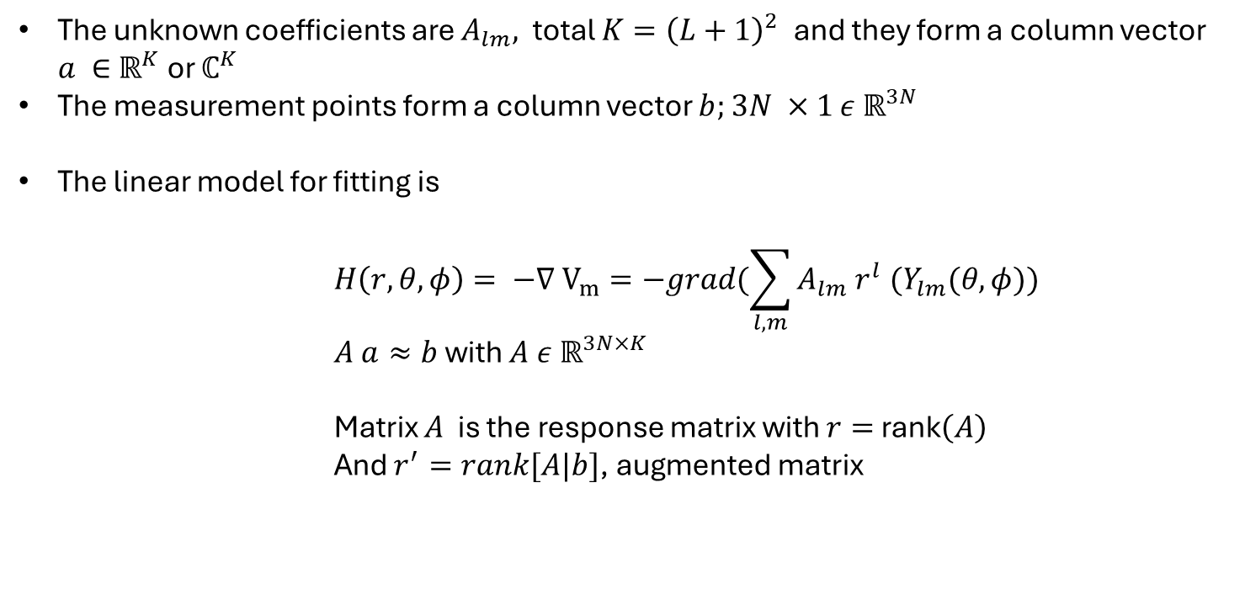
Also, once a magnetic scalar potential is defined on a closed surface like a sphere, then the magnetic field everywhere inside that surface is uniquely determined (Uniqueness theorem)
We figure out this magnetic scalar potential by fitting the measured points (~250 in total and ~750 for the three components) around the magnets [Done by Evan and Alina already!]
The unknown coefficients are $A_{lm},$ total $K={\left(L+1\right)}^{2}$ and they form a column vector $a ∈$ $ℝ^{K}$or $ℂ^{K}$
The measurement points form a column vector $b;$ $3N ×1$ $ε ℝ^{3N}$
The linear model for fitting is
          $$H\left(r, θ, φ\right)= −∇ V_{m}=−grad(\sum_{l, m}{A_{lm} r^{l} {(Y}_{lm}(θ, φ))}$$
          $A a≈b$with $A ε ℝ^{3N×K}$
          Matrix $A$ is the response matrix with $r=$rank$\left(A\right)$
          And $r^{′}=rank[A|b]$, augmented matrix

Slide 4
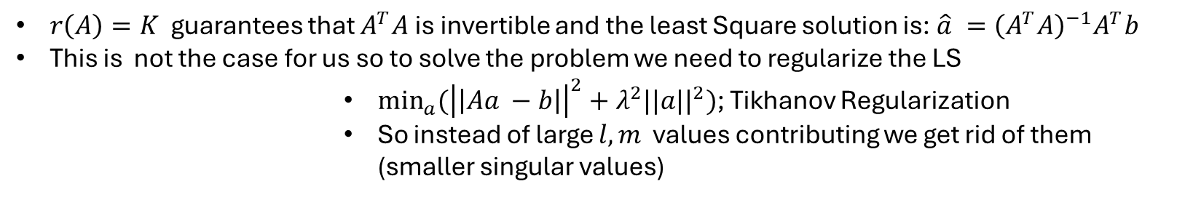

Problems with this approach:
$$3N>K$$ | No Exact Solution (One Least Square Solution when $r\left(A\right)$= $K$) | More equations than unknowns
$r\left(A\right)=K$ guarantees that $A^{T}A$is invertible and the least Square solution is: $\hat{a} ={\left(A^{T}A\right)}^{−1}A^{T}b$
This is not the case for us so to solve the problem we need to regularize the LS
            ${\min_{a}{({\left|\left|Aa −b\right|\right|}^{2}+λ^{2}||a||}}^{2})$; Tikhanov Regularization
            So instead of large $l, m$ values contributing we get rid of them (smaller singular values)
solution

Slide 5
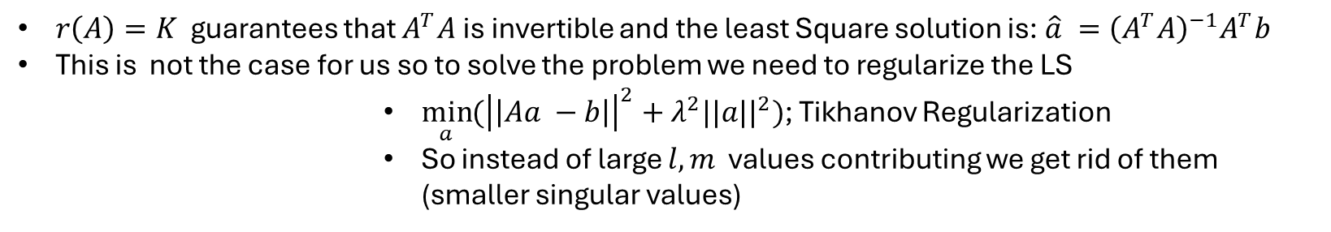
Problems with this approach:
$$3N>K$$ | No Exact Solution (One Least Square Solution when $r\left(A\right)$= $K$) | More equations than unknowns
$r\left(A\right)=K$ guarantees that $A^{T}A$is invertible and the least Square solution is: $\hat{a} ={\left(A^{T}A\right)}^{−1}A^{T}b$
This is not the case for us so to solve the problem we need to regularize the LS
            ${\min_{a}{({\left|\left|Aa −b\right|\right|}^{2}+λ^{2}||a||}}^{2})$; Tikhanov Regularization
            So instead of large $l, m$ values contributing we get rid of them (smaller singular values)
solution

Slide 6
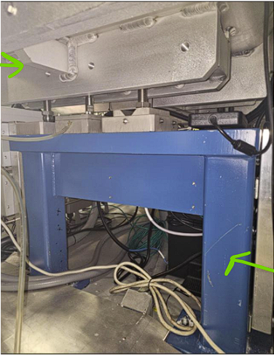
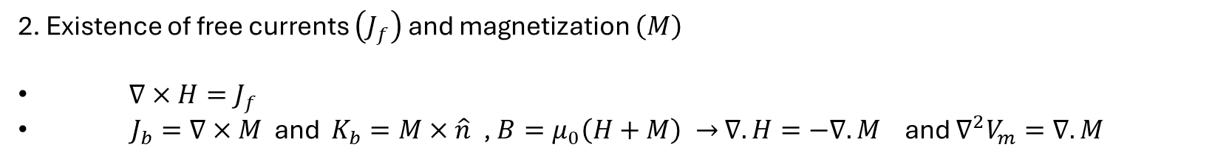
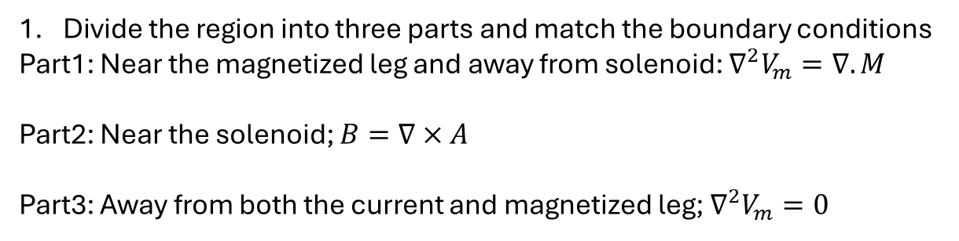
Problems with this approach:
2. Existence of free currents $\left(J_{f}\right)$ and magnetization $\left(M\right)$
$∇×H=J_{f}$
$J_{b}=∇×M$ and $K_{b}=M×\hat{n}$, $B=μ_{0}\left(H+M\right) →$ $∇.H=−∇.M$ and $∇^{2}V_{m}=∇. M$
Divide the region into three parts and match the boundary conditions
Part1: Near the magnetized leg and away from solenoid: $∇^{2}V_{m}=∇. M$
Part2: Near the solenoid; $B=∇×A$
Part3: Away from both the current and magnetized leg; $∇^{2}V_{m}=0$
Solution
# Since we only care about volume inside the solenoids we should first check the penetration power of the magnetized leg inside of the solenoid
From Evan

Slide 7
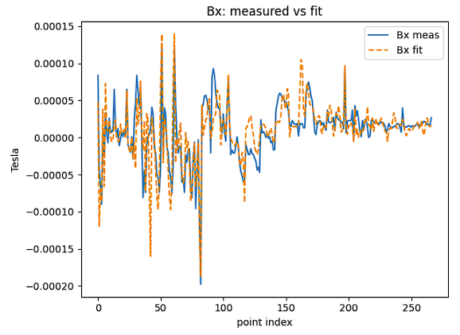
Initial result of the fit with assumption of no free charge and no magnetization and l_max = 18

Slide 8
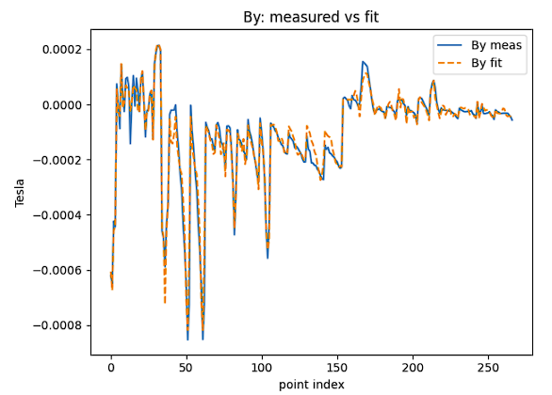
Initial result of the fit with assumption of no free charge and no magnetization and l = 18

Slide 9
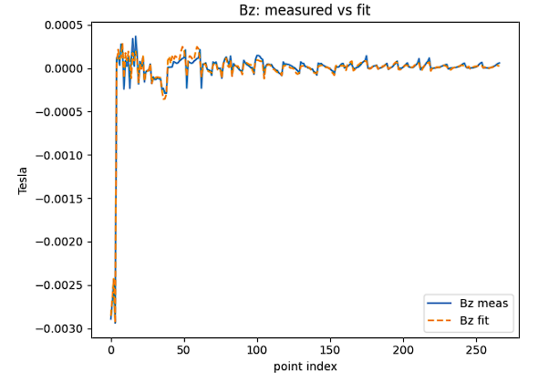
Initial result of the fit with assumption of no free charge and no magnetization and l = 18

