Slide 1
Coordinated Unmanned Platforms for Autonomous Search Missions (CANINES)
August 27th, 2025 | INMM Annual Meeting
Kalie Knecht, John Sparger, Peter Sobel, Jason Karcz, Nicholas Prins, and Michael Willis

Slide 2
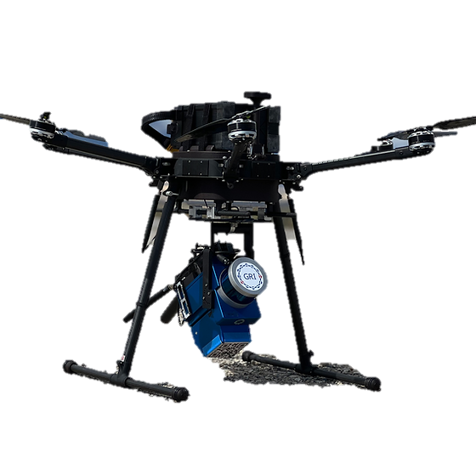
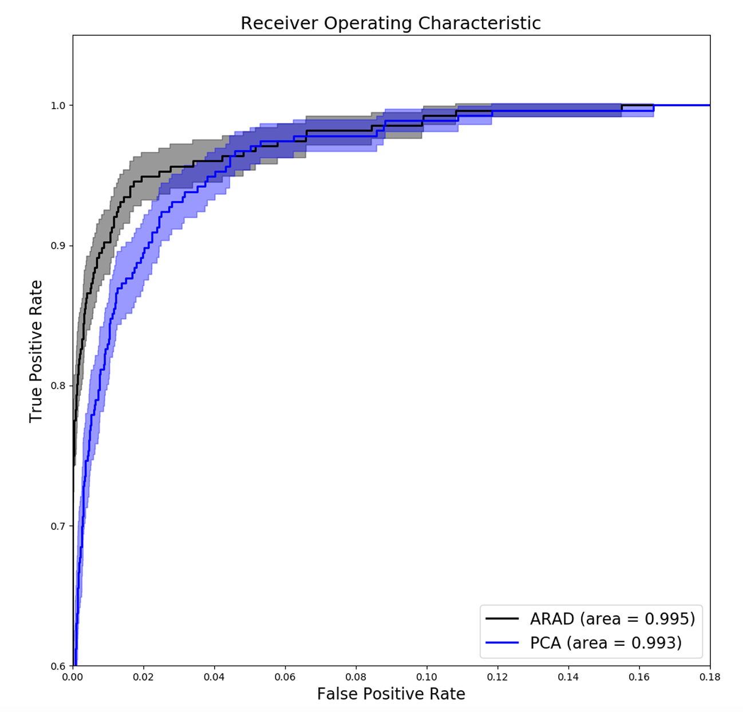
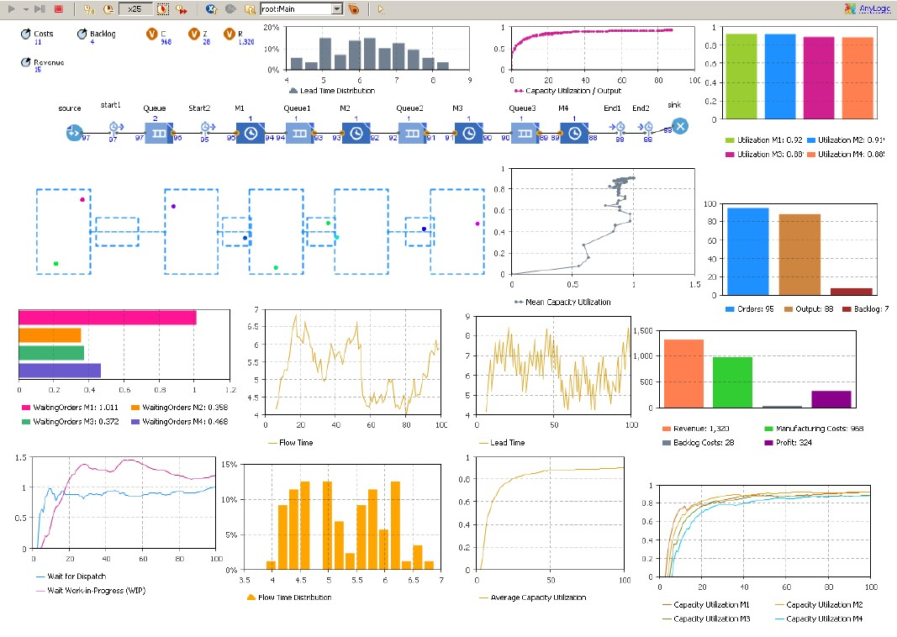
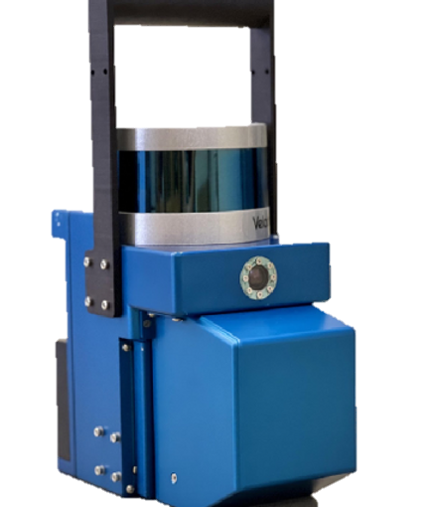
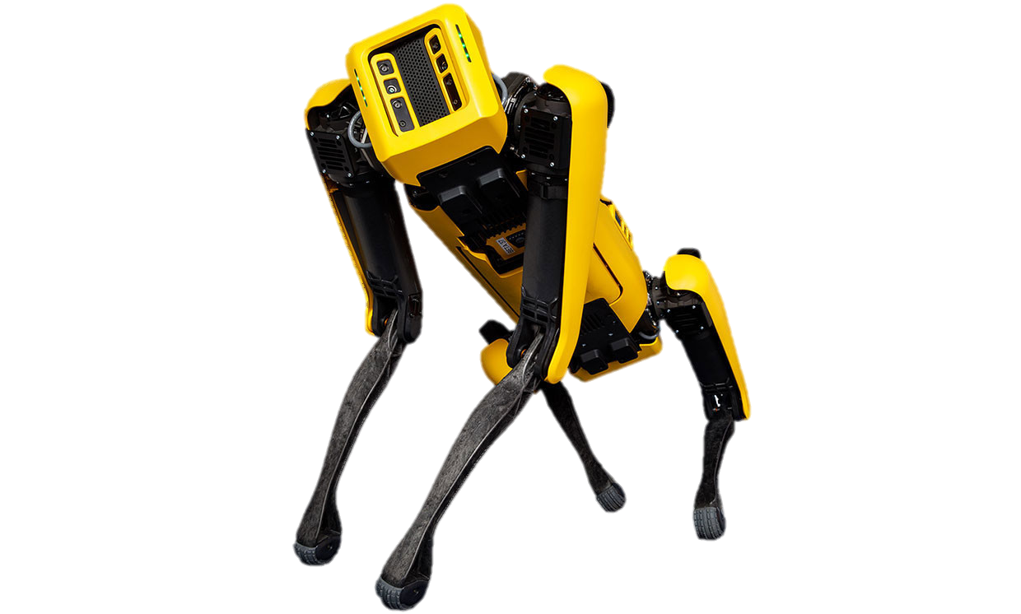
Motivation
Emergency response and radiological source search applications require rapid, accurate threat assessment to ensure public safety.
Traditional methods are time-consuming and expose operators to hazardous environments.
Recent advancements in robotics, machine learning (ML), and artificial intelligence (AI) present an opportunity to improve source search capabilities without endangering personnel.
Goal: Develop an autonomous radiological search capability by integrating real-time sensing, mapping, and AI-driven decision-making.
Autonomous Unmanned Vehicles
Radiation
and Contextual Sensors
Algorithm Development and Implementation[1]
Agent-based Modeling and Planning [2]
[1] J. Ghawaly et. al., “Characterization of the Autoencoder Radiation Anomaly Detection (ARAD) model”, Engineering Applications of Artificial Intelligence, vol. 111, 2022. Available: https://doi.org/10.1016/j.engappai.2022.104761
[2] D. Ivanov, Operations and Supply Chain Simulation with AnyLogic: Decision-Oriented Introductory Notes for Master Students, 2nd ed. Berlin, Germany: Berlin School of Economics and Law, 2017.

Slide 3
CANINES System
Boston Dynamics SPOT Quadruped [1]:
EAP2 Payload (Navigation/mapping)​
Localization and Mapping Platform​ (LAMP) [2]:
Suite of contextual sensors: LiDAR, camera, and inertial measurement unit (IMU)​
LAMP-Mapper: CLLBC (Cs₂LiLaBr₄.₈Cl₁.₂:Ce) detector​
LAMP-Imager: M400 CZT (cadmium zinc telluride) Compton imager​ from H3D Inc. [3]
Onboard computer for performing simultaneous localization and mapping (SLAM) and real-time radiation mapping.
Spot mounted with EAP2 and LAMP-Imager
[1] Boston Dynamics. Spot. https://bostondynamics.com/products/spot/.
[2] Gamma Reality Inc. LAMP™. https://www.gammareality.com/lamp.
[3] H3D Inc. M400 Custom Integrable Detector Module. https://h3dgamma.com/m400.php.

Slide 4
Radiation Mapping and Imaging
Portable radiation detection systems can be equipped with contextual sensors to allow free-moving 3D gamma-ray imaging through a method called Scene Data Fusion (SDF).
SLAM is performed using Google Cartographer [1] to construct a 3D map of the environment and track the robot’s position as it collects radiation data in real time.
The map is discretized into a voxel grid, which serves as the imaging space for the 3D radiation reconstruction.
3D Radiation Image generated by the LAMP-Mapper identifying radiation hotspot in source cabinet
[1] W. Hess et al. “Real-Time Loop Closure in 2D LIDAR SLAM.” in Proc. IEEE Int. Conf. Robot. Auto., pages 1271–1278, 2016.

Slide 5
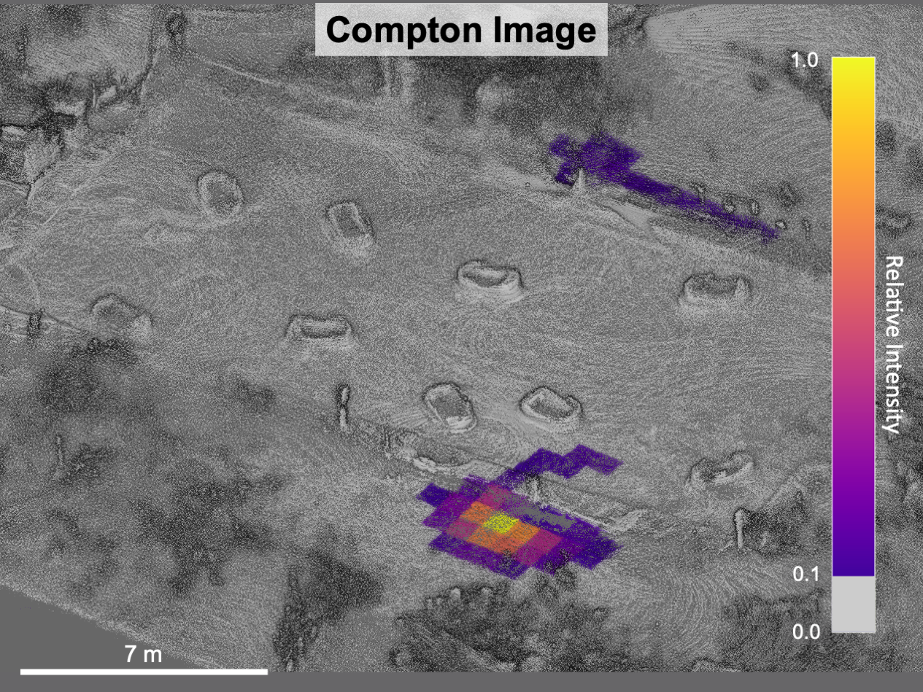
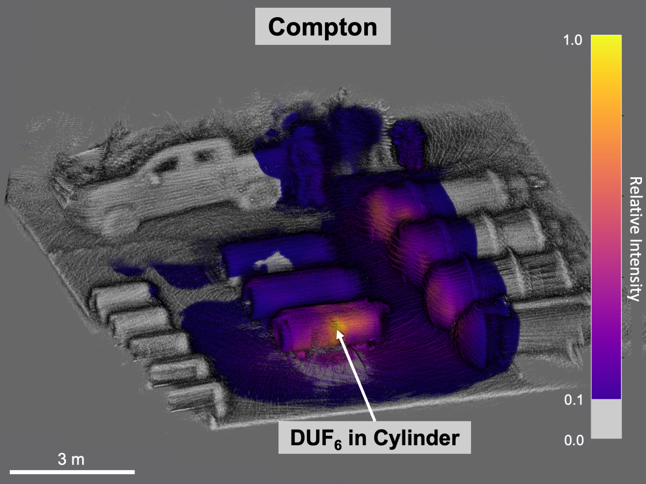
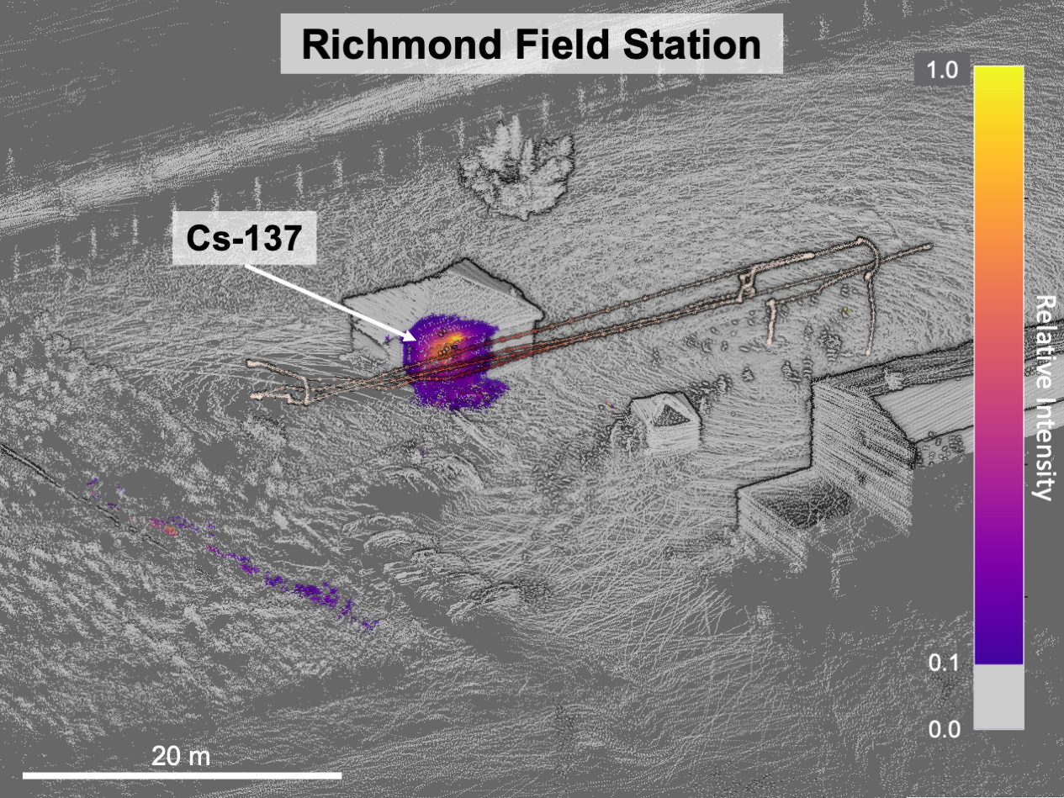
Scene Data Fusion Applications
Contamination Mapping [1][2]
Safeguards [2][3]
Source Search [2]
Pripyat Amusement Park
Paducah Site
[1] K. Knecht et al., "3D Compton Imaging of Distributed Sources around the Chernobyl Nuclear Power Plant," 2021 IEEE NSS/MIC, Piscataway, NJ, USA, 2021, pp. 1-4, doi: 10.1109/NSS/MIC44867.2021.9875432.
[2] K. Knecht, "Enhanced use of Contextual Data for Quantitative Gamma-Ray Imaging in Nuclear Safeguards Applications." UC Berkeley. ProQuest ID: Knecht_Berkeley_0028E_23142.
[3] J. Hecla and K. Knecht et al., "Polaris-LAMP: Multi-Modal 3-D Image Reconstruction With a Commercial Gamma-Ray Imager," in IEEE TNS, vol. 68, no. 10, pp. 2539-2549, Oct. 2021, doi: 10.1109/TNS.2021.3110162.

Slide 6
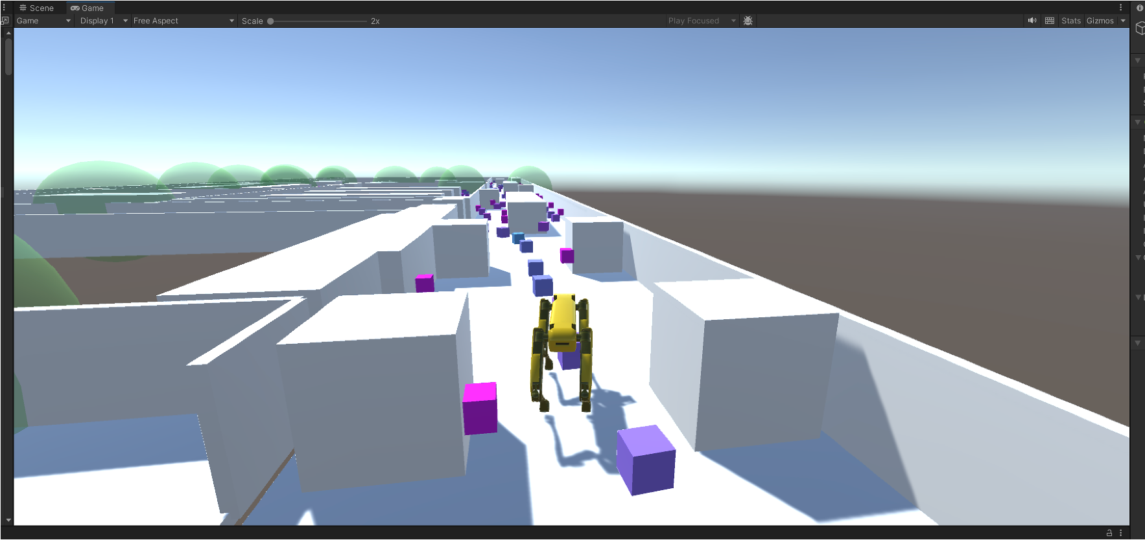
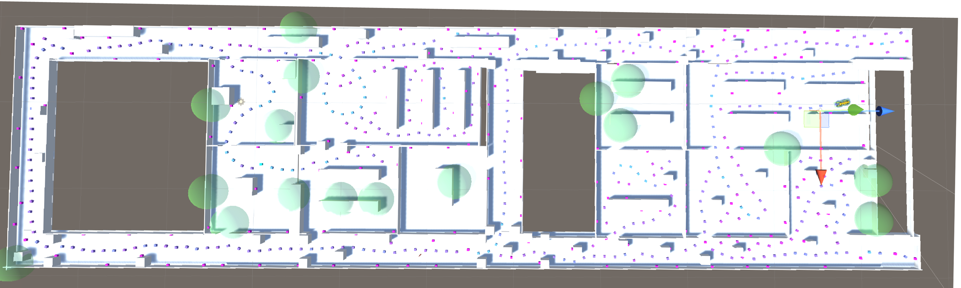
Reinforcement Learning
Reinforcement Learning is a type of ML where an agent learns to make decisions by interacting with an environment and receiving rewards or penalties based on its actions.
RL agent trained in the Unity game engine using Unity’s ML-Agents toolkit [1].
Rewarded for exploring, penalized for colliding with objects.
Limited ability to adapt, no semantic scene understanding.
Breadcrumbs and frontier markers from simulated building exploration in Unity
[1] A. Juliani et al., “Unity: A general platform for intelligent agents,” arXiv preprint arXiv:1809.02627, 2020.

Slide 7
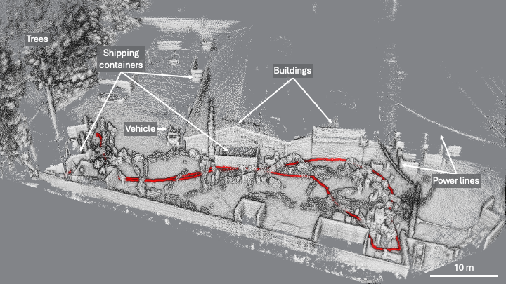
Reinforcement Learning Results
SPOT’s walking path in an outdoor scene
3D Radiation Image generated while SPOT autonomously explored an indoor scene

Slide 8
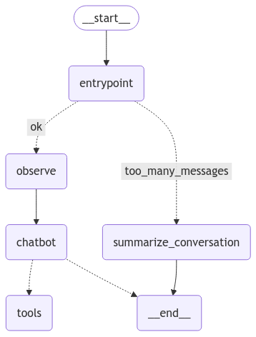
Agentic AI
Agentic AI agents are Large Language Models (LLMs) that:
Control their own execution loop
Use external tools and subroutines
For example, an agent could
Pull images from the robot’s cameras
Perform path planning
Send messages to human operators
Agentic AI enables context-aware decision-making using perception and language models.
It can interpret scenes, select goals, and support interactive updates through a chatbot-style interface.
Basic flow diagram of an agentic AI system

Slide 9
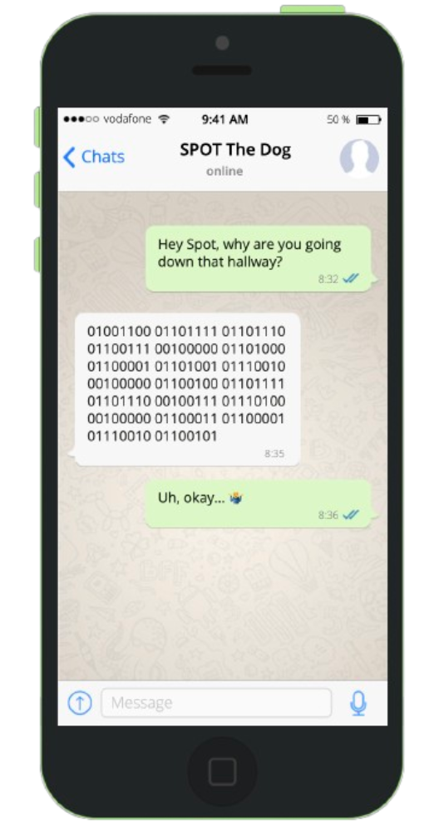
Why Bring LLMs into the Picture?
While black box algorithms like reinforcement learning are effective for autonomous navigation, they can make it difficult to:
Understand why a specific action was taken
Predict future actions
Adapt behavior to new mission parameters
LLMs offer an opportunity to reason, orchestrate, and explain behavior in a format that is understandable by operators.

Slide 10
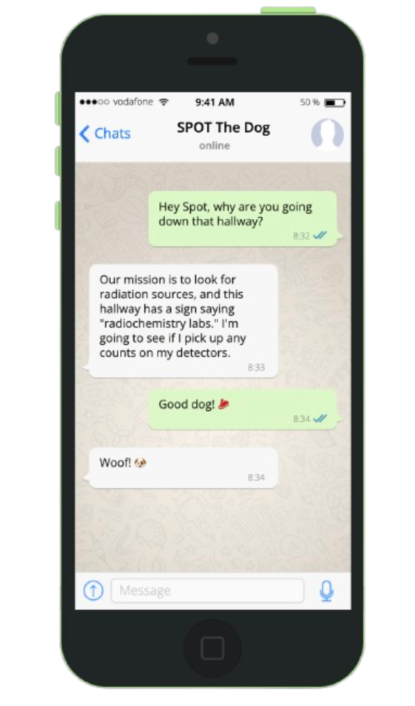
Why Bring LLMs into the Picture?
While black box algorithms like reinforcement learning are effective for autonomous navigation, they can make it difficult to:
Understand why a specific action was taken
Predict future actions
Adapt behavior to new mission parameters
LLMs offer an opportunity to reason, orchestrate, and explain behavior in a format that is understandable by operators.

Slide 11
Agentic AI Architecture
Sensor Inputs
Perception Layer
Language Models
Decision Layer
Execution Layer
Camera
LiDAR map
Radiation data
Semantic segmentation
Image captioning (Florence-2 [1])
Qwen2.5 [2] and Mistral-Small [3]
Scene understanding
Goal planning
LangGraph [4] coordinates perception and reasoning layers
Selects next action or queries operator
Sends goal to path planner (A*, Dijkstra)
Spot executes path
[1] Microsoft, “Florence-2: Advancing a unified representation for vision tasks,” Hugging Face, 2024. [Online]. Available: https://huggingface.co/microsoft/Florence-2-base
[2] Qwen Team, Alibaba Cloud, “Qwen2.5: A series of large language models,” GitHub, 2024. [Online]. Available: https://github.com/QwenLM/Qwen2.5
[3] Mistral AI, “Mistral Small 3: A compact language model,” Mistral.ai, 2024. [Online]. Available: https://mistral.ai/news/mistral-small-3
[4] LangChain Inc., “LangGraph,” GitHub, 2024. [Online]. Available: https://github.com/langchain-ai/langgraph

Slide 12
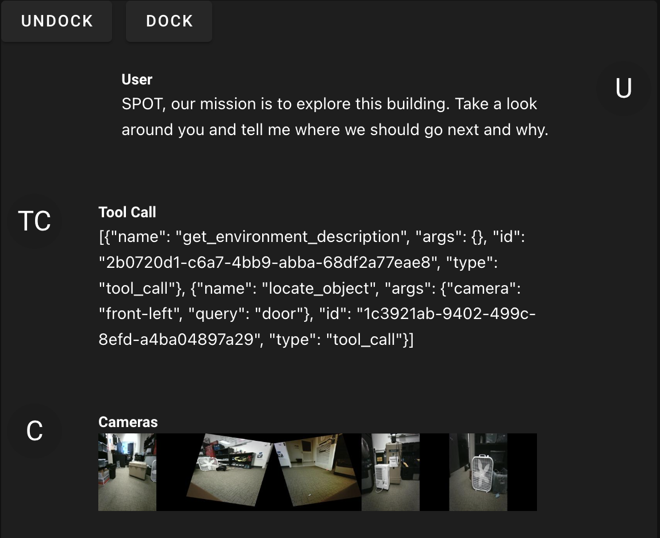
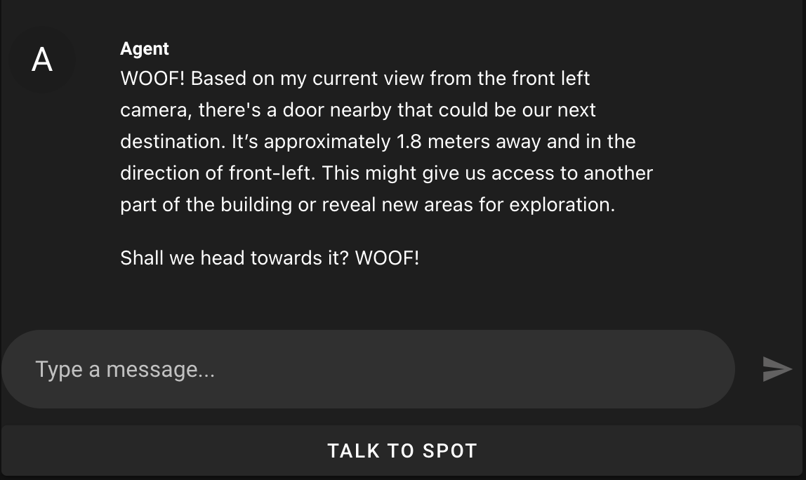
Chat Client
We developed a chat client to interact with SPOT as he explores
You can chat with SPOT interactively via text or voice
The chat visualizes his tool calls and sensor inputs for you
SPOT can respond using text-to-speech (TTS) voice
Notes:
so we havea. chat client where we basically tell SPOT his mission, so hey spot, our mission is to explore this building, take a look around you and tell me where we should go next

Slide 13
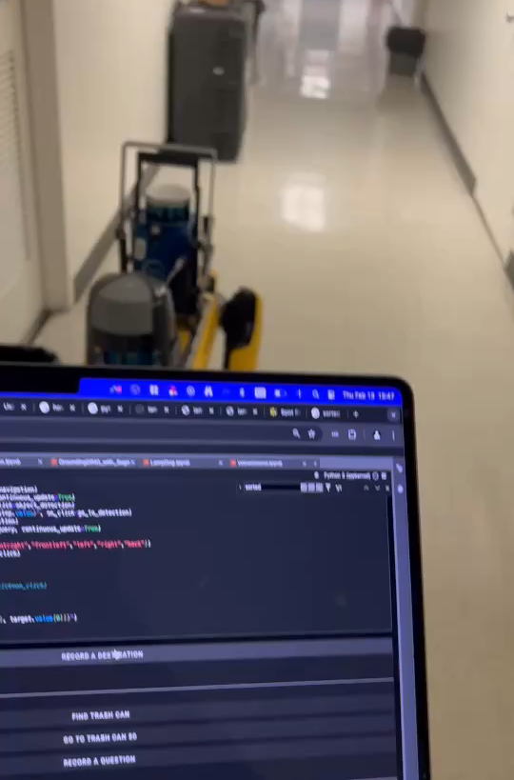
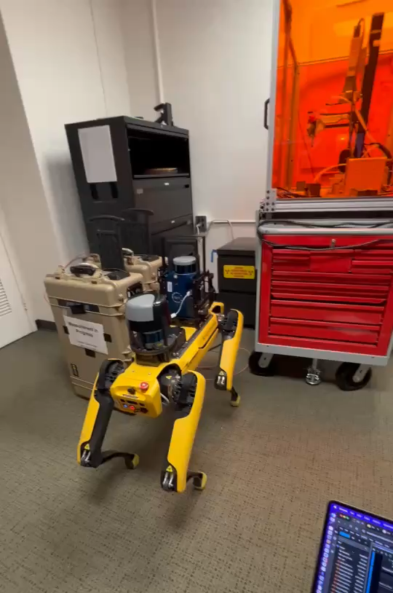
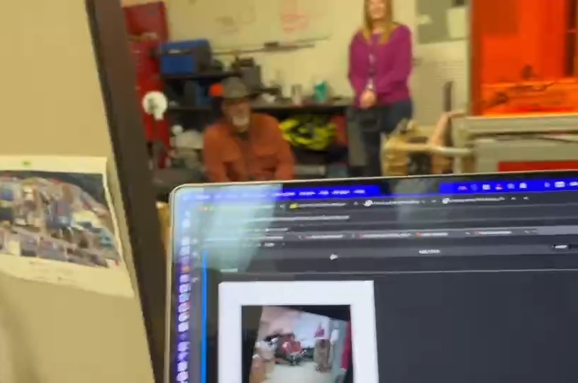
Agentic AI Results
SPOT describing what is in a scene
SPOT navigating to a fire extinguisher in response to verbal instruction
SPOT reading a sign

Slide 14
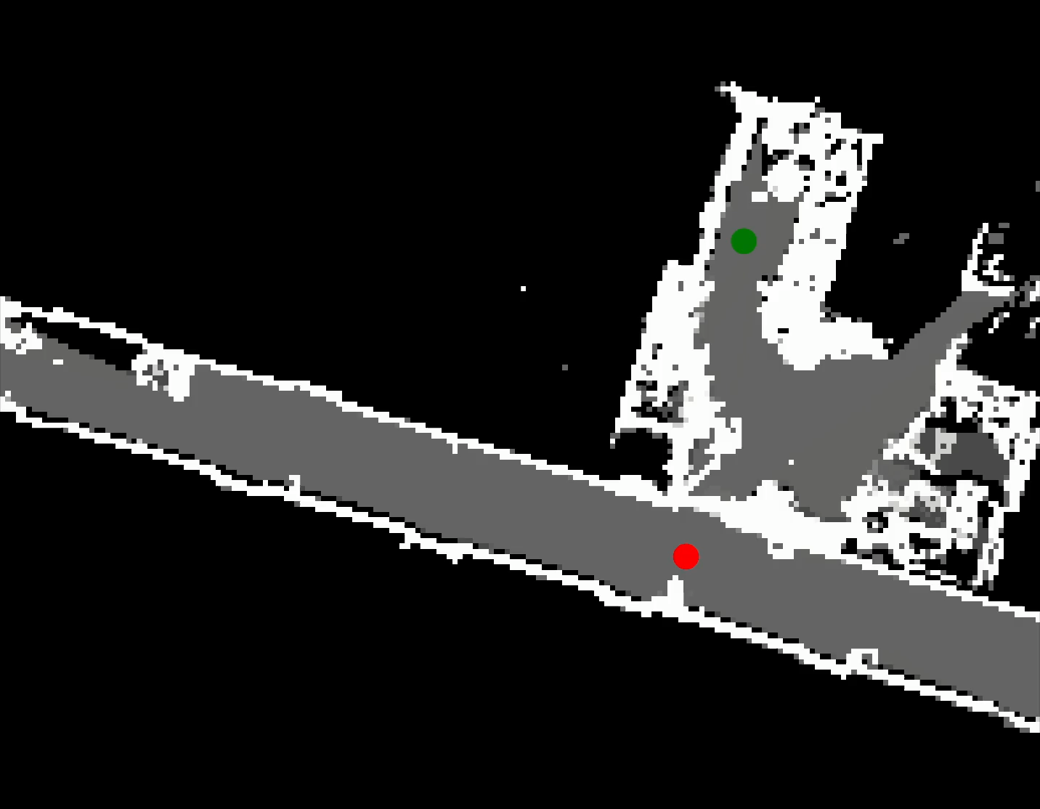
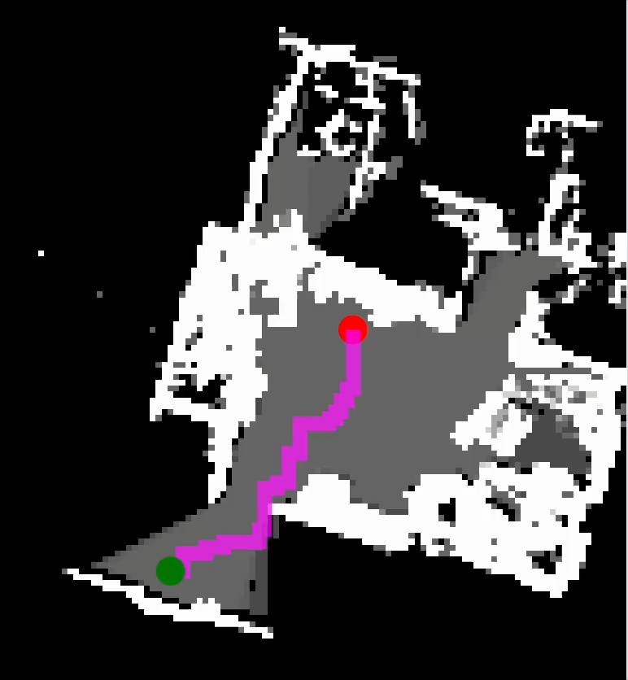
Path Planning
Occupancy grid updated in real-time to reflect dynamic changes in the environment (e.g., doors opening, people moving)
Path planning algorithms (e.g., A*, Dijkstra) operate on the updated grid to compute collision-free routes.
Replanning is triggered as the occupancy map changes, enabling responsive and adaptive navigation.
Occupancy grid updating with door opening
Planned path updating to avoid moving obstacle

Slide 15
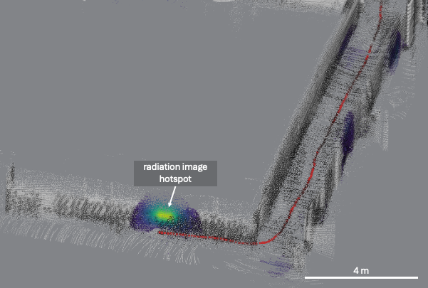
Integration of Radiation Data with Agentic AI
SPOT’s path (red) navigating to a hot spot in a 3D radiation reconstruction

Slide 16
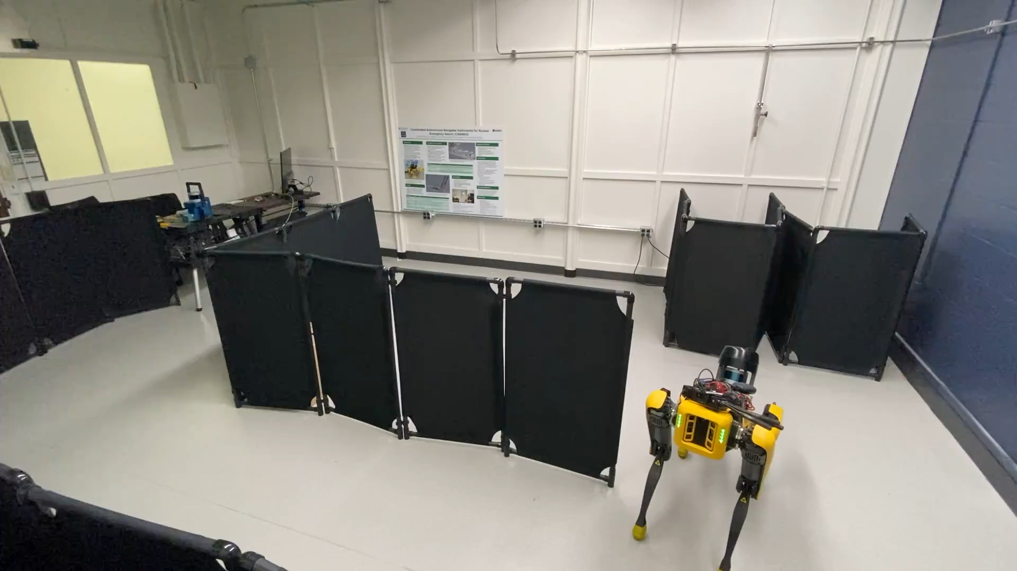
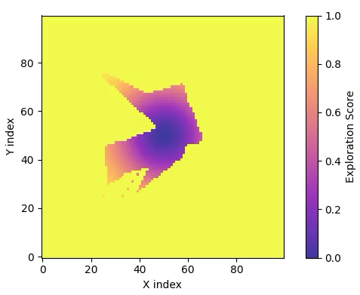
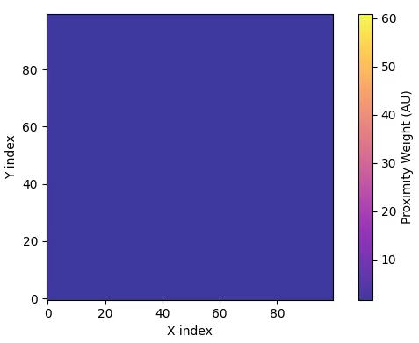
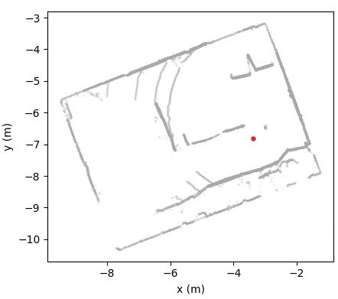
Integration of Radiation Data with Agentic AI
LiDAR-based occupancy grid defines which cells are navigable.
Exploration map weight decreases in cells that SPOT explores.
Proximity map reconstructed from counts detected in each cell.
Autonomy map is a weighted combination of exploration and proximity maps.
Component weights are tunable for adaptive mission planning.
Video recording of measurement (7x speed)
Exploration weight
Proximity map weight
Path of SPOT in red

Slide 17
Conclusions
Demonstrated real-world autonomous navigation using LiDAR and camera-based 3D mapping.
Integrated LAMP-Imager for 3D radiation mapping and source localization.
Developed flexible autonomy framework compatible with multiple sensor types.
System supports adaptive mission logic through real time integration of radiation and exploration data.
Future work:
Multi-agent collaboration with additional SPOT units and UAS platforms.
Continued improvement of contextual and radiation data fusion to refine autonomous decision-making.

Slide 18
Acknowledgements
Thank you to Brandon Longmire, Andrew Rowe, and Lance Drouet for integrating the radiation detector with SPOT.
This research was supported by the U.S. National Nuclear Security Administration (NNSA) Office of Defense Nuclear Nonproliferation Research and Development within the U.S. Department of Energy under Contract AC05-00OR2272.

