Slide 1
Recreation of B-Field Environment at GP-SANS
Evan Michael 1/13/2026 UTK

Slide 2
Background
We need to fully understand the probability of transmission during the experiment
The probability calculation is affected by any uncertainty in the magnitude of the “step” in current/magnetic field in the magnets between scans (i.e. step uncertainty broadens FWHM / lowers peak of probability distribution of transmission)
The uncertainty is primarily an effect of how well the Mu Metal shields the magnets from outside magnetic field perturbations
To study the effects of perturbations in the experiment, we recreated the magnetic environment present at GP-SANS (as of 6/29/2025), with perturbations originating from guide box supports

Slide 3
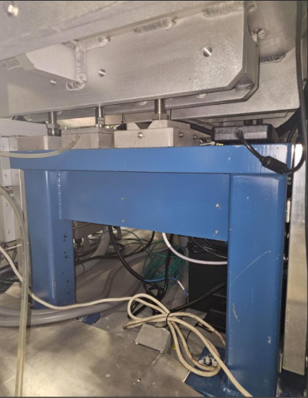


Guide Box Support
Guide box (boxes along beam line, two of which containing our magnets)
Magnetized supports (Likely source of perturbing magnetic field)

Slide 4
Autodesk Inventor Work
Autodesk Inventor – 3D CAD software for modeling and assembling
Used to create a 3D model recreation of the Samsung S23 Ultra used for magnetic field measurements
Placed a copy at each B-field measurement position along 3D file of Cold Guide Hall beamline
Defined custom coordinate system based on existing beamline geometry to define x,y,z coordinate of each phone placement, creating a catalogue

Slide 5
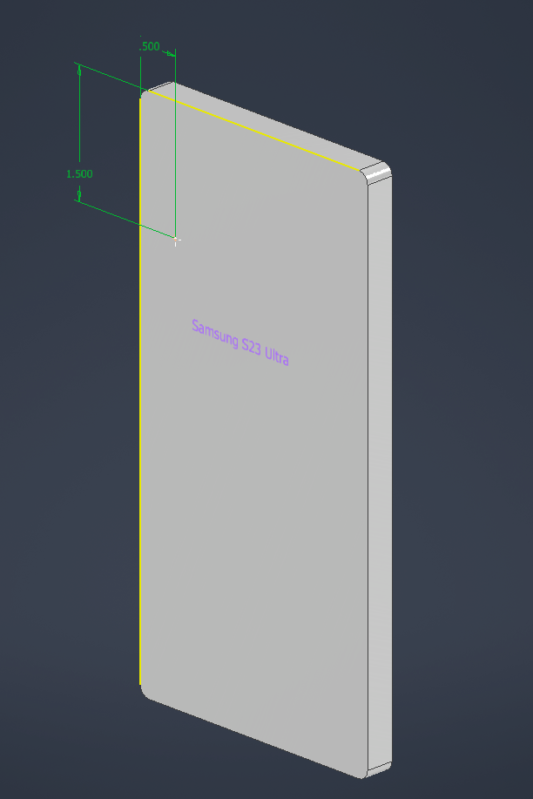
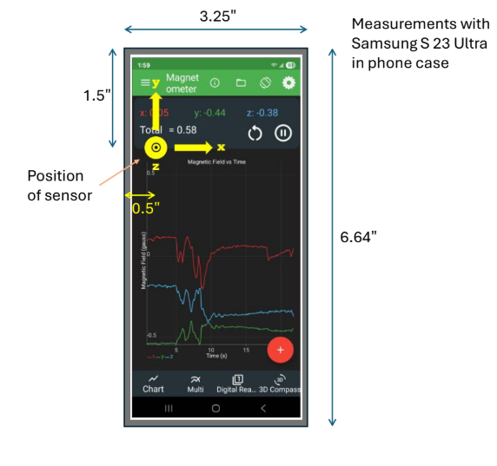
Samsung S23 Ultra
Dr. Kamyshkov’s personal phone, used to record magnetic field at various positions along the beamline
Work point placed on 3D model to represent the magnetic sensor of the S23 Ultra for most accurate mapping of B-field data to position

Slide 6
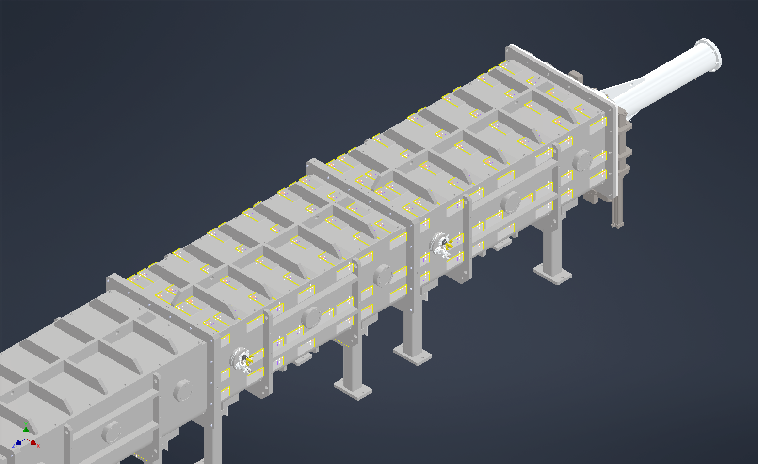
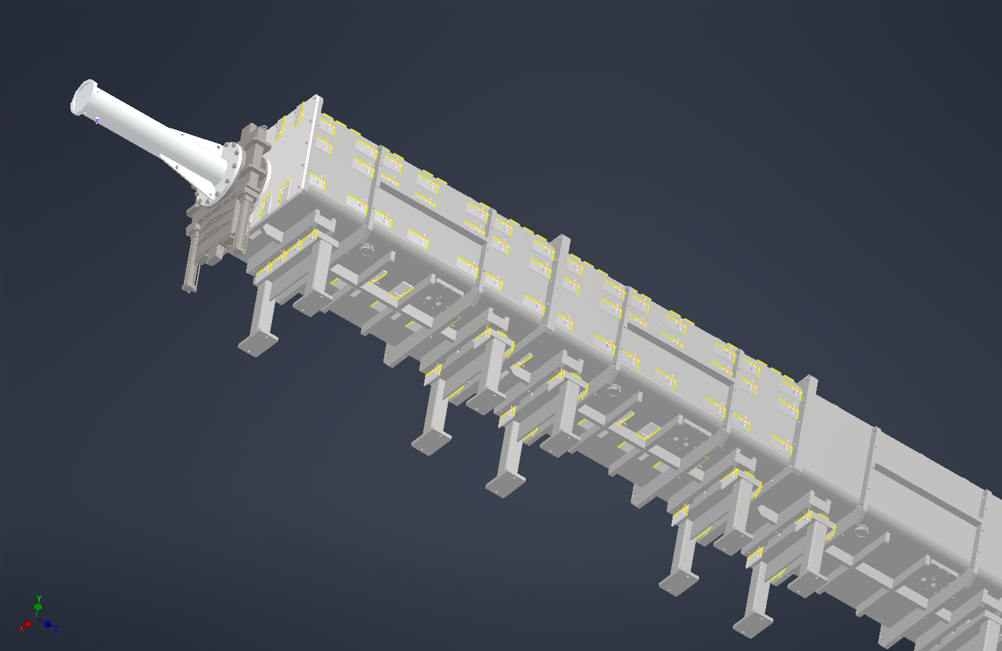






Phones Placed Along Beamline File
Top, ladder-side view
Bottom, wall-side view

Slide 7
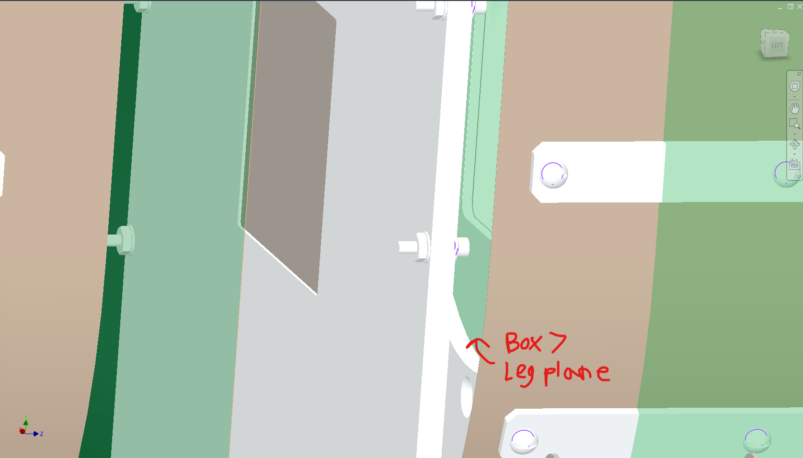
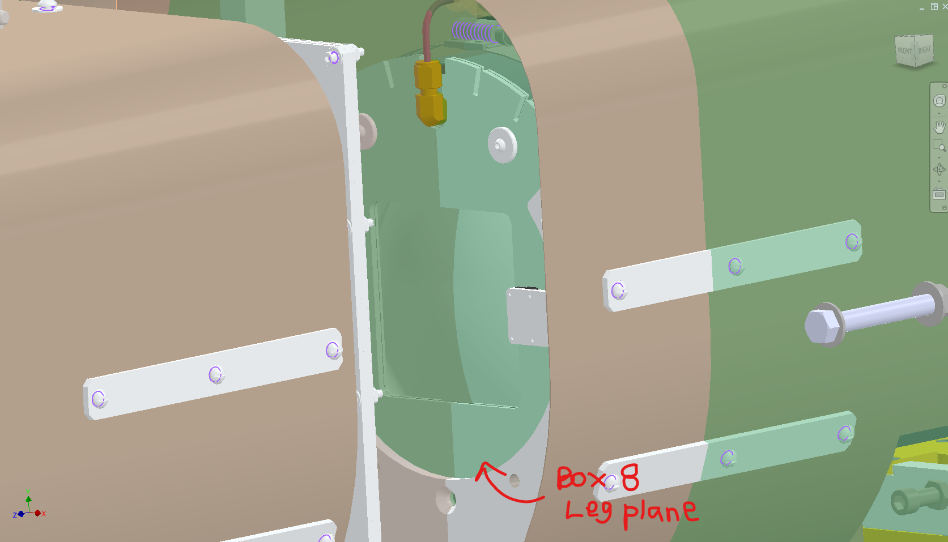
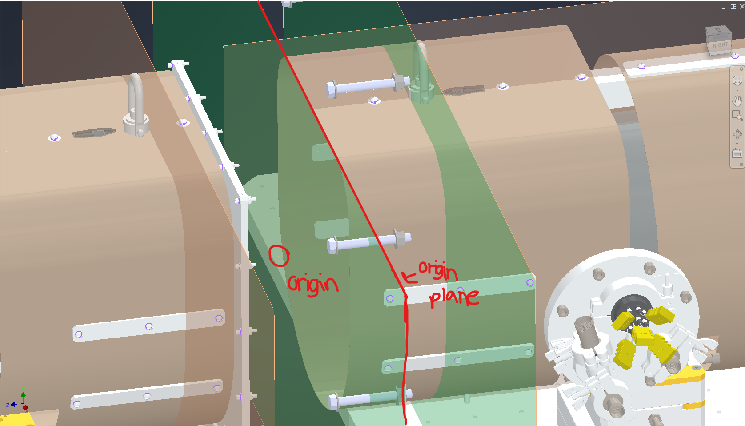
Defining New Coordinates
- Defined two “leg planes” in the guide boxes #7 and #8 on the magnets within each.
Created additional plane at midpoint between leg planes, and then placed a work point at the intersection of “origin plane” and the vertical middle plane of the magnets, creating origin of new coordinate system
Positive x-direction toward the wall side, positive y-direction towards the ceiling, and positive z-direction along beam path

Slide 8
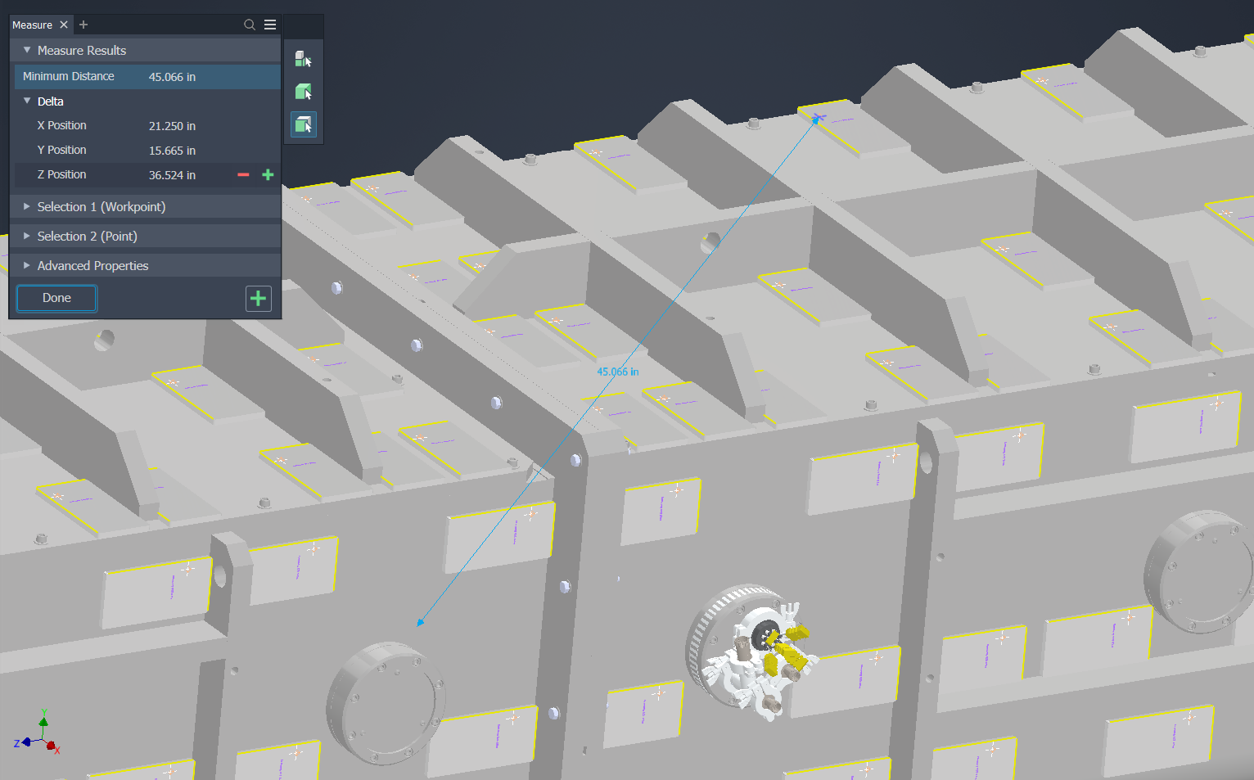
Measurement Process
Select measurement origin point and select “measure” tool
Select desired phone’s work point as second point for measurement
Read change in file coordinates as coordinates of custom system, making positive or negative as necessary

Slide 9
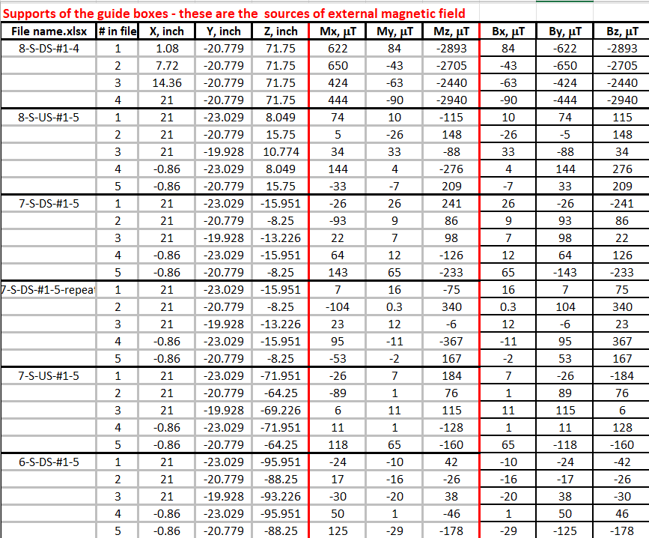



Coordinate Re-orientation
Measurement of the positions of the phone and the measurement of the magnetic field were taken in two different coordinate systems.
Re-oriented the values and axes of the B-field measurements to align with the coordinate system of the position catalogue.
Changed horizontal axis to vertical, vertical to axial, etc. Values changed to negative if required.

Slide 10


Coordinate Systems
Coordinate System of B-field readings
Coordinate System of position catalogue

Slide 11
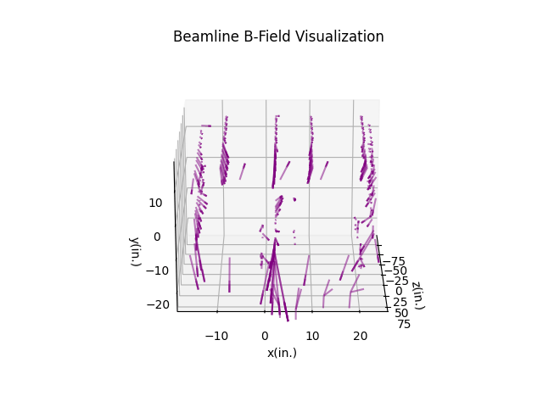
Combining Data
(m)
From the re-oriented magnetic field data, we can create a 3D visualization of the magnetic field in the form of vectors originating at the position of their measurement
Shown here as a short animation. Vectors scaled down (linearly) for visual clarity
Vector behavior at lower y-coordinates support suspicion of the beam supports causing a perturbation in the environment. Box 8 shows stronger activity than Box 7.
(m)
(m)

