Slide 1
NN’ Progress Log
Mubi Khan
University of Kentucky
Sep 8, 2025

Slide 2
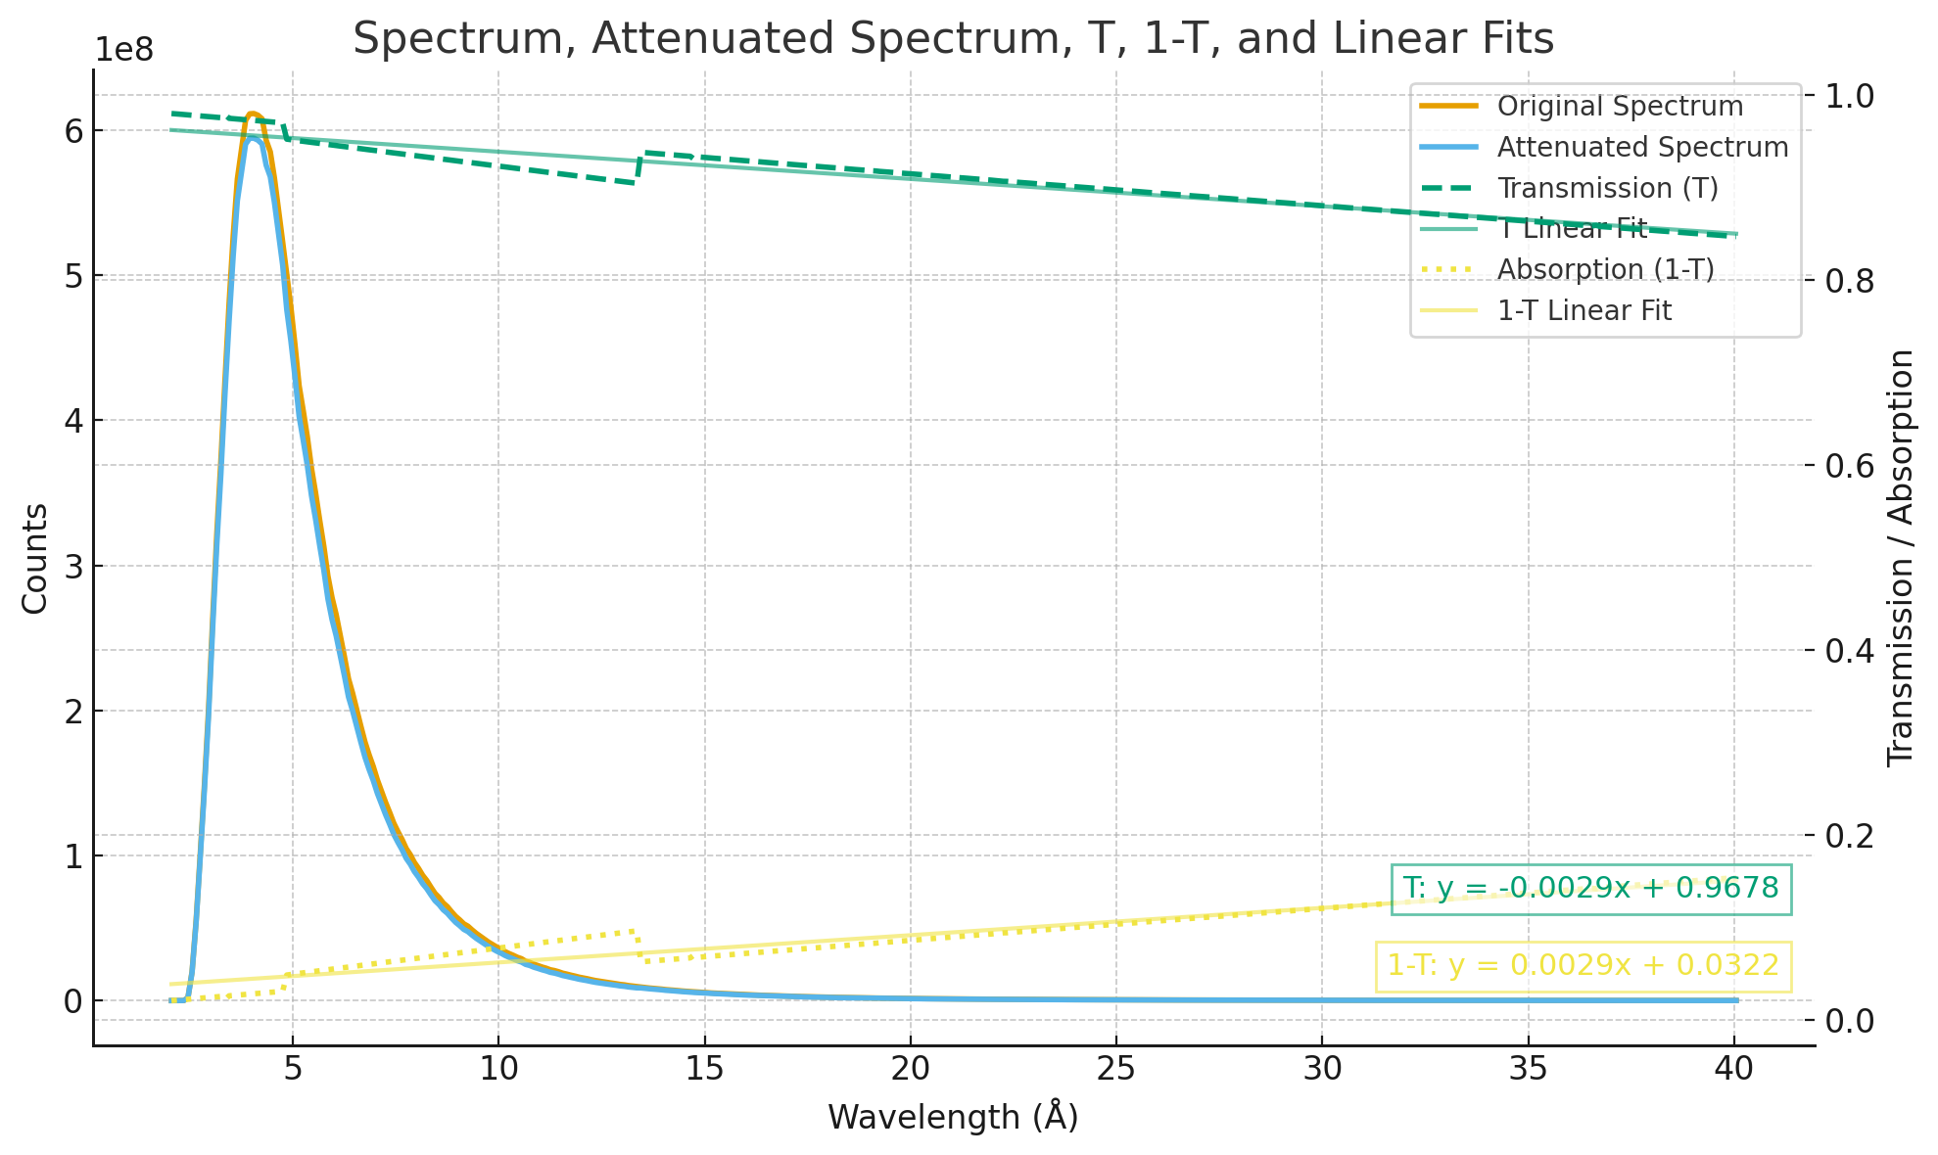
Using NIST Calculator for Transmission Efficiency for Al2O3

Slide 3
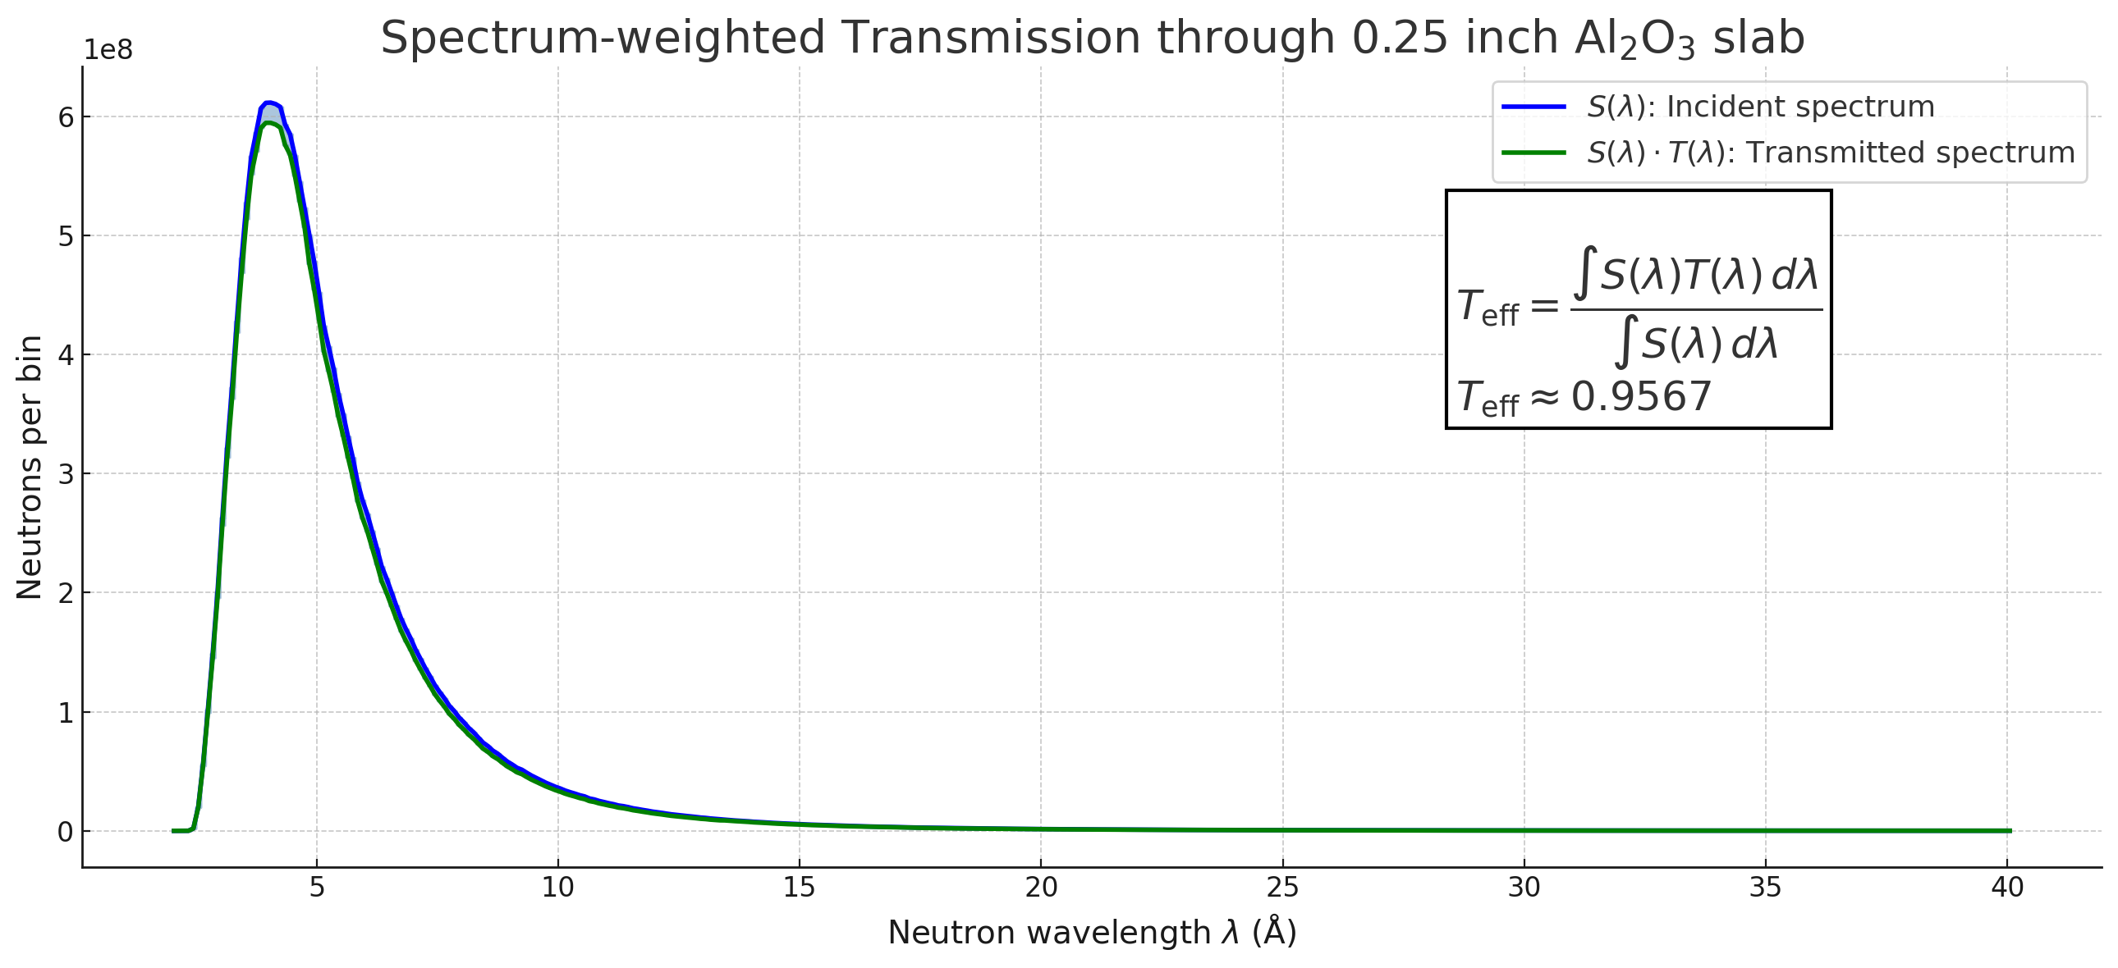

Slide 4
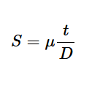
Shielding Factor Table
Shielding Factor | Degaussing Done | Effective μ according to the theoretical SF formula
25.92 | No | ~17551
292 | Yes | ~200,000
Shielding Factor, S for an idealized case of a transverse magnetic field and a cylindrical shielding
t, and D are the thickness and diameter of the shield

Slide 5
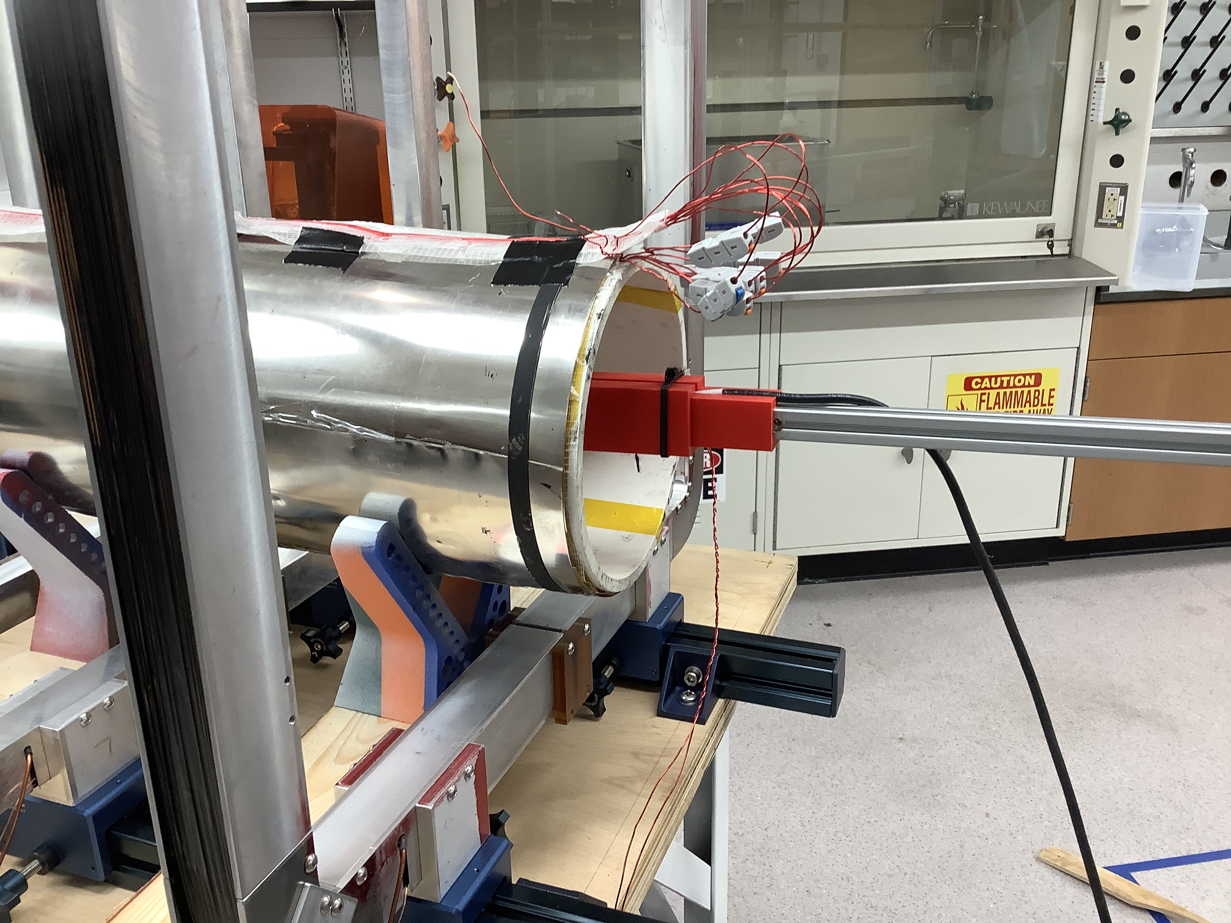
Shielding Factor Table
Current | Degaussing | Shielding Factor
On (0.072 A) | Yes (was done before the current was turned on) | 4.8
On (0.072) | Y (done with the current on) | 2.1
SF is defined as the ratio of the transverse field only when there is no shielding to when there no shielding

