Slide 1
NN’ Progress Log
Mubi Khan
University of Kentucky
Aug 25, 2025

Slide 2
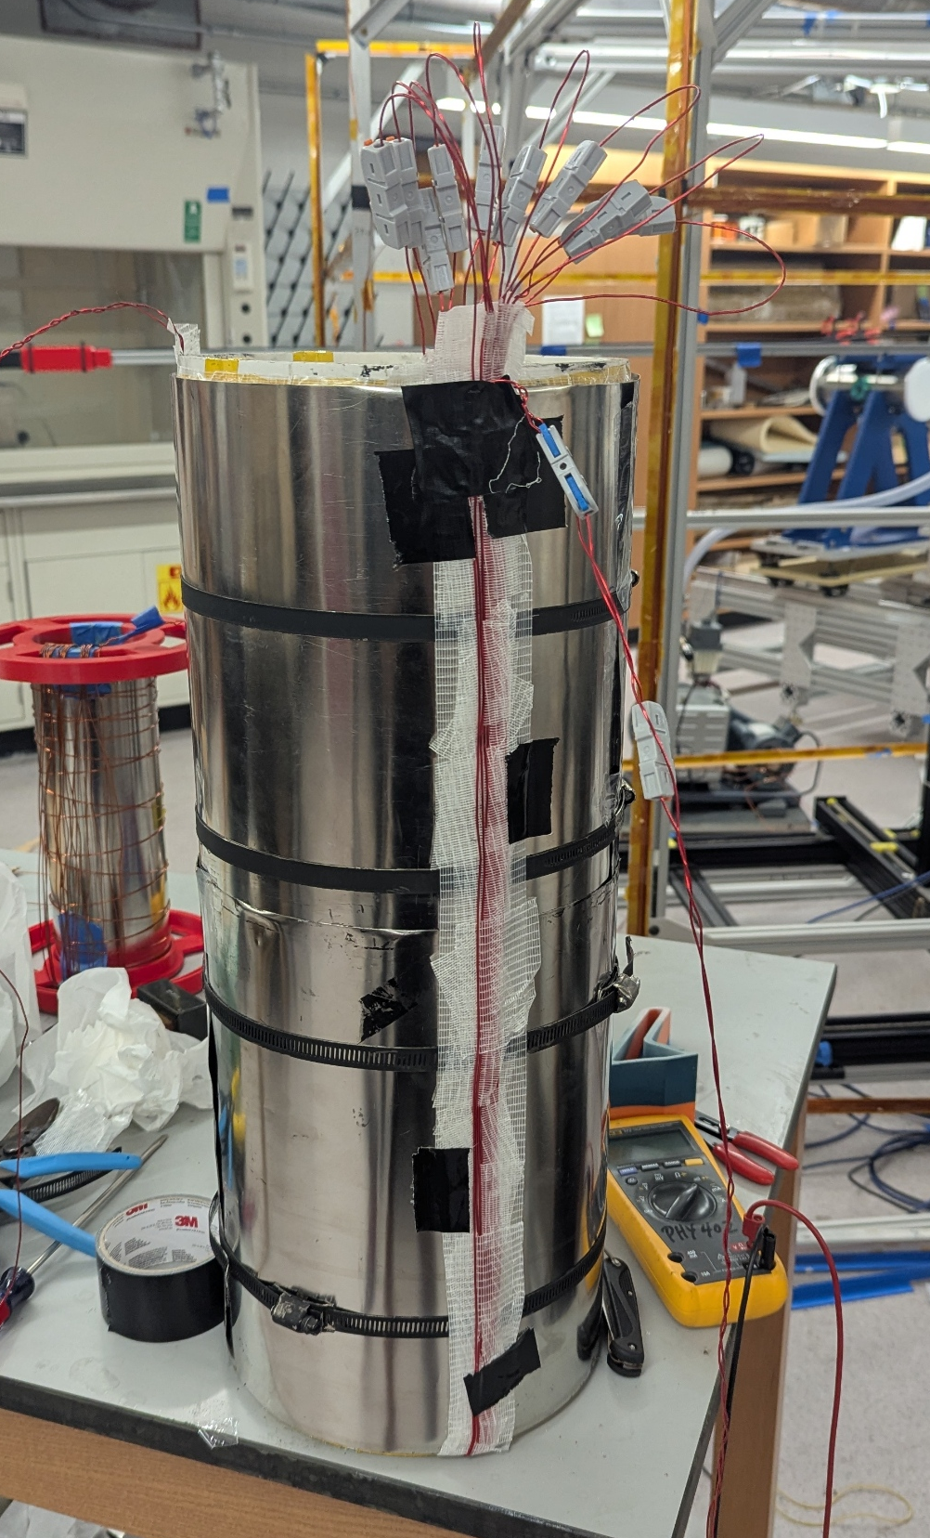
Total resistance = 0.5 Ohms
No short circuit – tested
Total measured resistance ≈ measured resistance

Slide 3
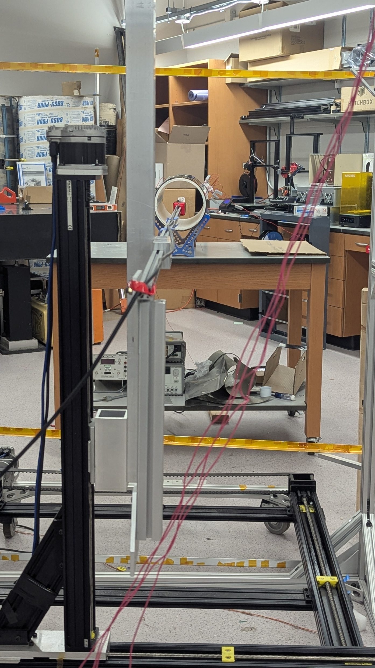
Shielding Factor using Earth’s B and Degaussing profile
~ 41 μ T
The mapper was positioned so that the axial component of the b/g is very small (~ 1.2 μ T)
Degaussing profile:
  V_pp = 1 Volt
  f = 0.5 Hz
  Number of cycles = 1000 (about 16.5 mins)
  Linear decay

Slide 4
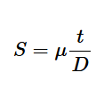
Shielding Factor Table
Shielding Factor | Degaussing Done | Effective μ according to the theoretical SF formula
25.92 | No | ~17551
292 | Yes | ~200,000
Shielding Factor, S for an idealized case of a transverse magnetic field and a cylindrical shielding
t, and D are the thickness and diameter of the shield

Slide 5
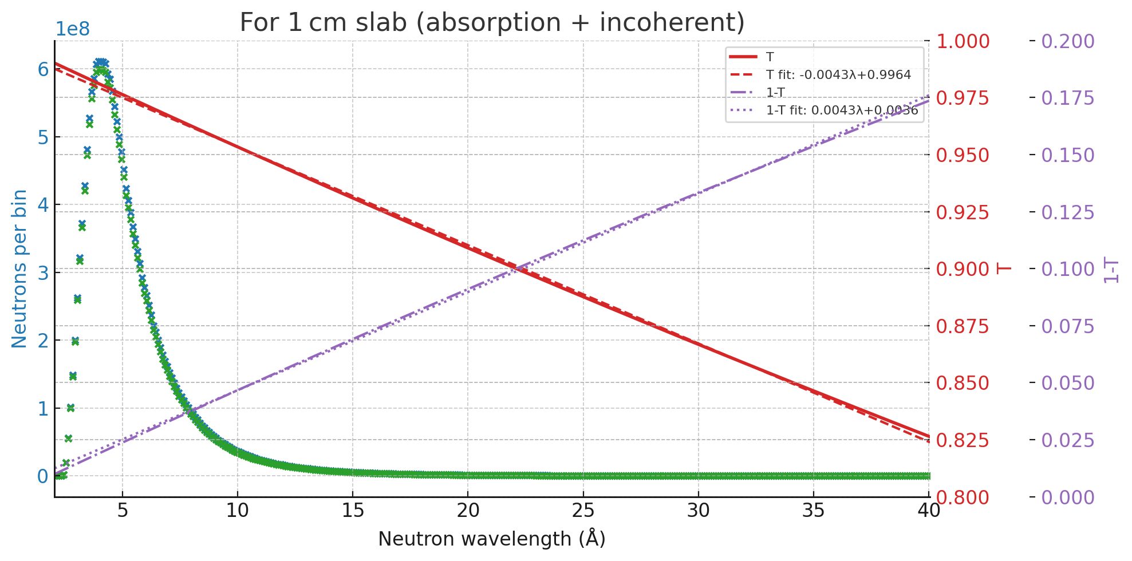
Using NIST Calculator for Transmission Efficiency for Si

Slide 6
