Slide 1
NN’ Progress
Mubi Khan
University of Kentucky

Slide 2
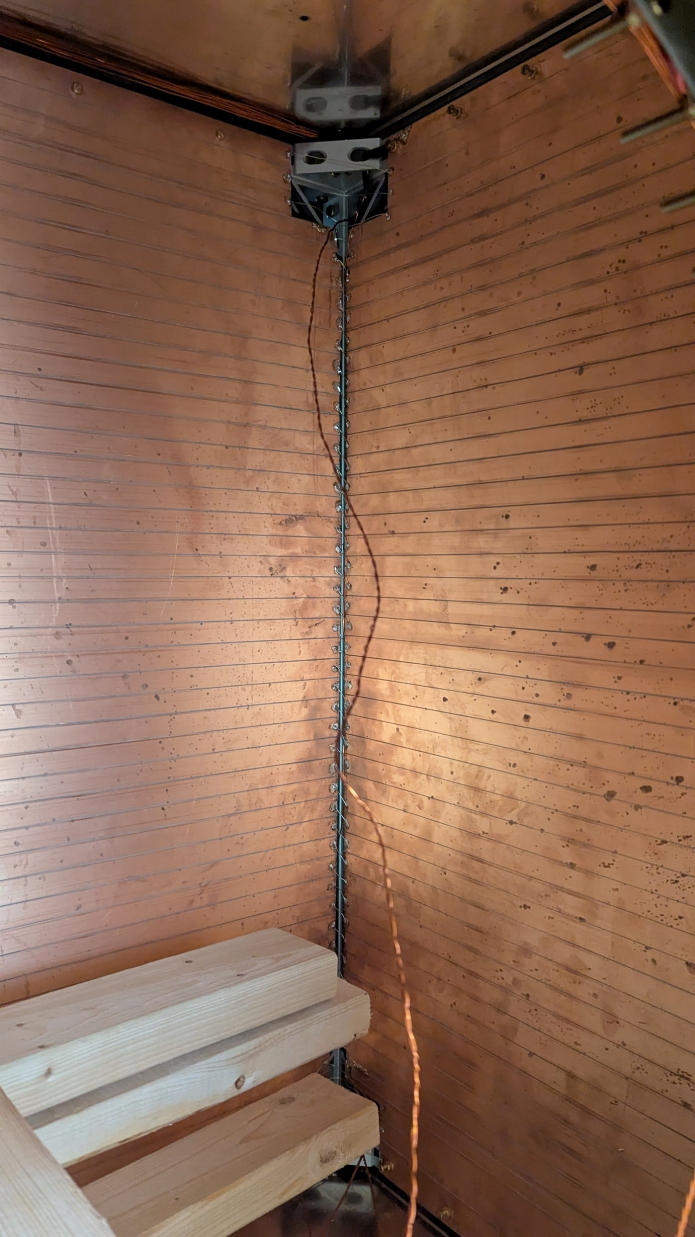
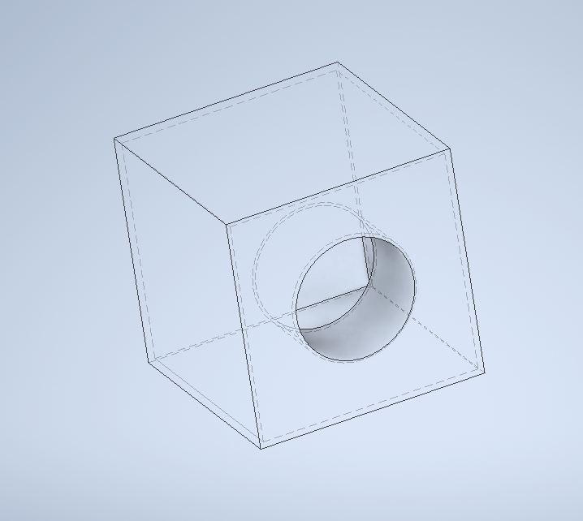
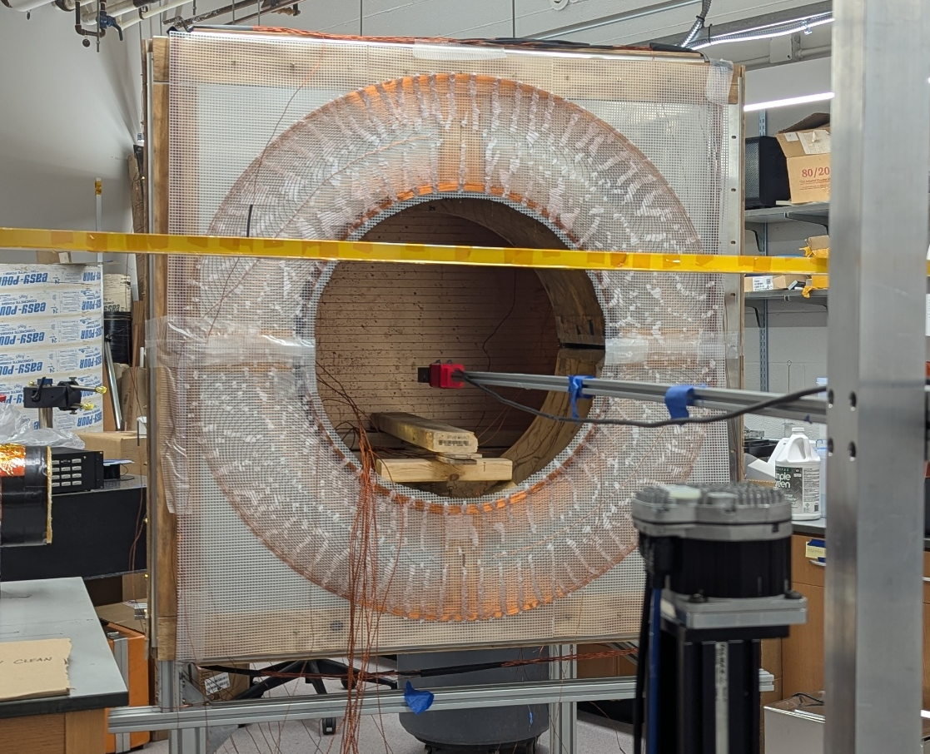
Using the box to generate a transverse magnetic field
43 x 43 inch square box
It has inner windings to generate uniform fields, essentially a square solenoid
It as an opening to insert the objects
Total turns, and other electromagnetic properties unknown right now
CAD design
Front View
Inside grooved windings

Slide 3

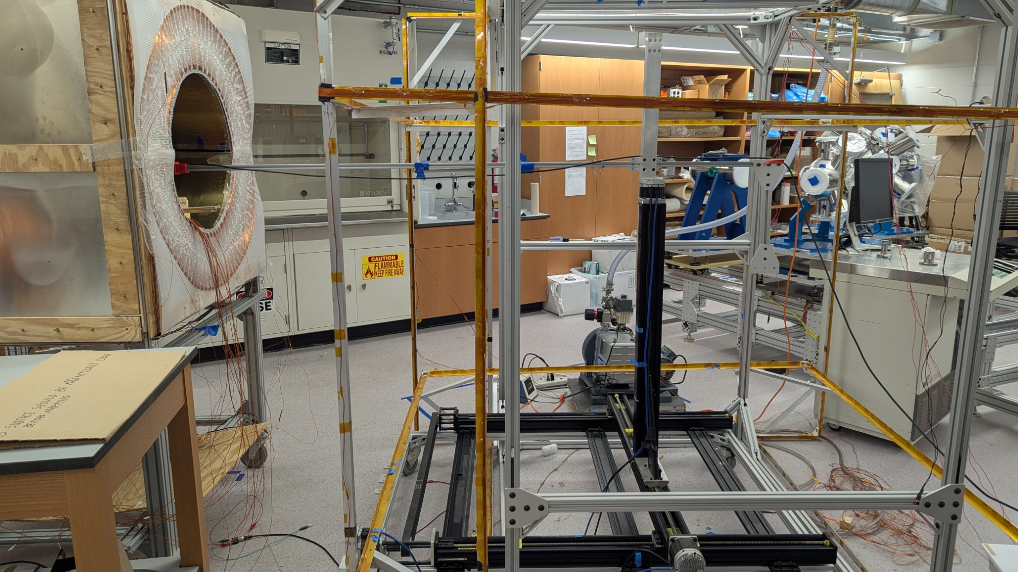
X
Y
Z
Mapping Coordinates
Z
Y
x

Slide 4
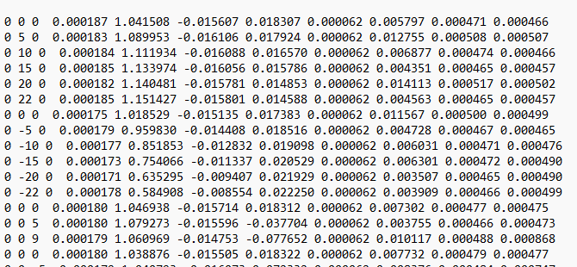
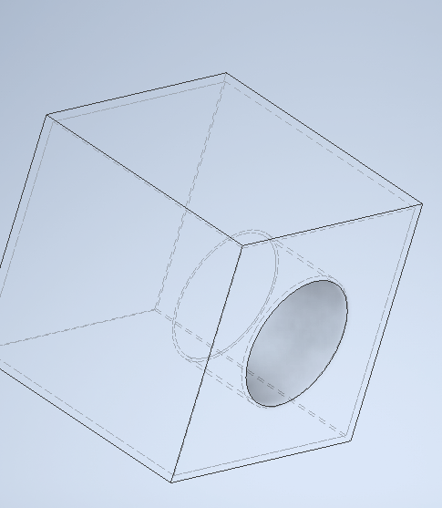
Magnetic Field File Format according to the magnetometer axes
These are the voltage values: 100 microT per Volt
-Bx | Bz | By
(0, 0, 0): center of the box
Notes:
The coordinate axes transform to the magnetometer axes as following
x goes to – X
Y goes to Z
and Z goes to Y

Slide 5
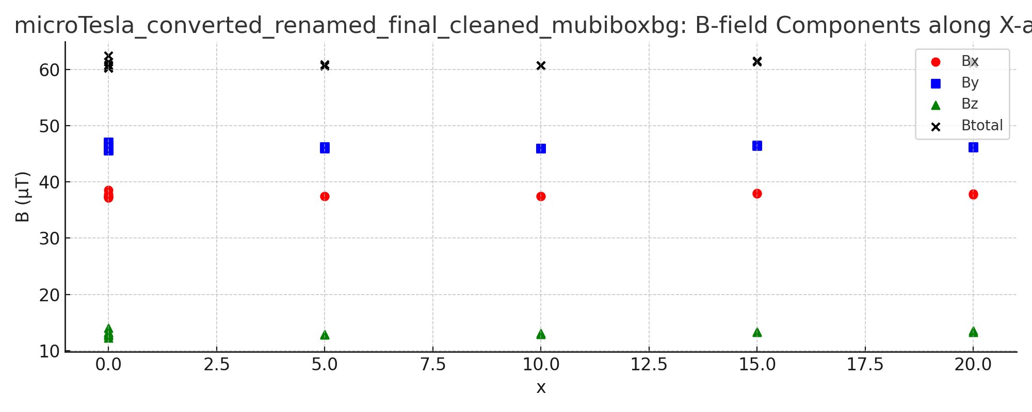
Background only; 0 Volts along X axis; Plot1
Y
Z
X
(0, 0, 0): center of the box

Slide 6
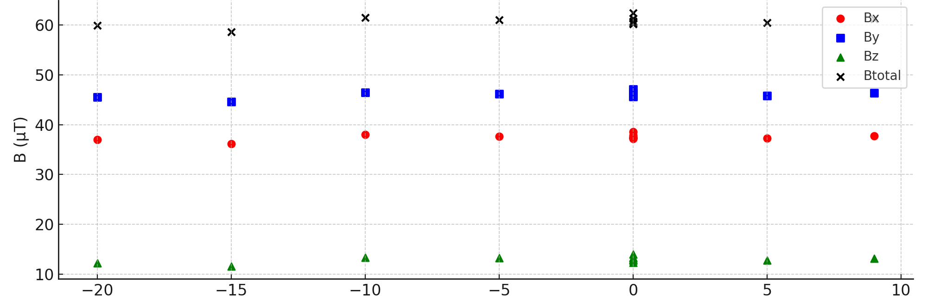
Background only; 0 Volts along Y axis; Plot 2
Y
Z
X
Y
(0, 0, 0): center of the box

Slide 7
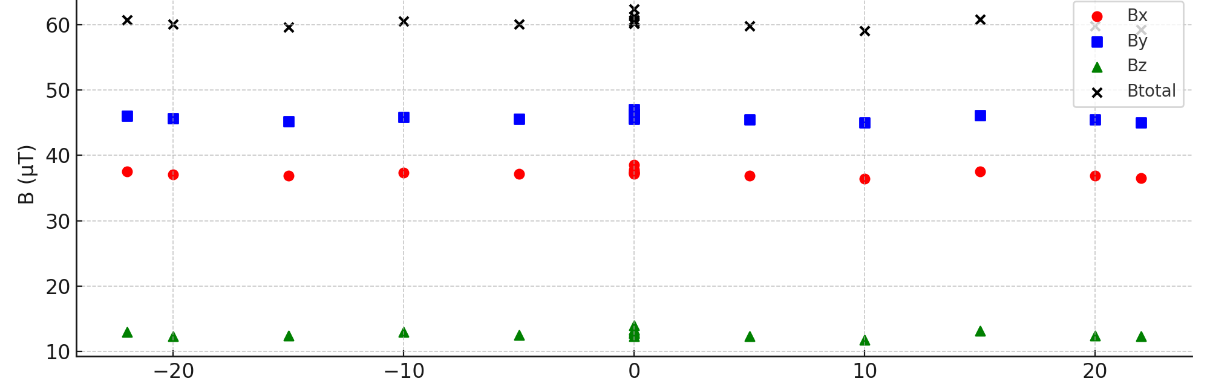
Background only; 0 Volts along Z axis; Plot 3
Y
Z
X
Z
(0, 0, 0): center of the box

Slide 8
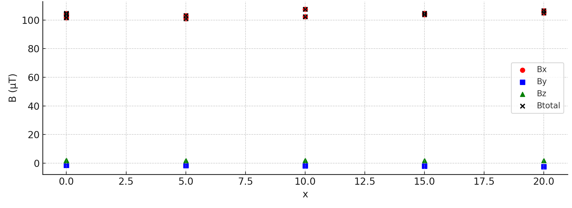
For 15 Volts along X axis; plot 4
B total is close to Bx magnitude
Y
Z
X
(0, 0, 0): center of the box

Slide 9
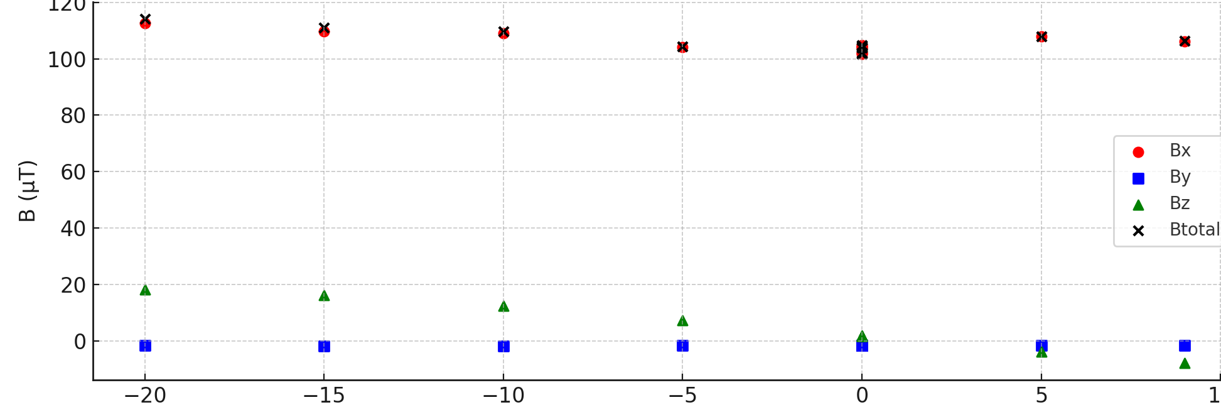
For 15 Volts along Y axis; plot 5
B total is close to Bx magnitude
Y
Z
X
Y
(0, 0, 0): center of the box

Slide 10
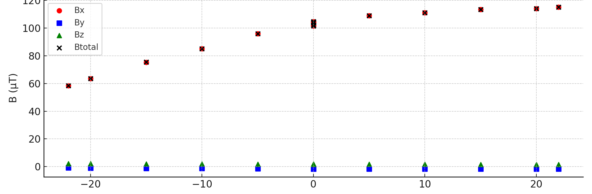
For 15 Volts along Z axis; plot 6
B total is close to Bx magnitude
Y
Z
X
Z
(0, 0, 0): center of the box

Slide 11
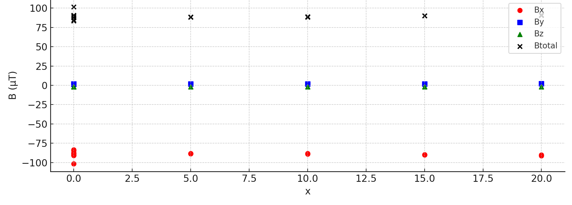
For - 15 Volts along X axis; plot 7
B total is close to Bx magnitude
Y
Z
X
(0, 0, 0): center of the box

Slide 12
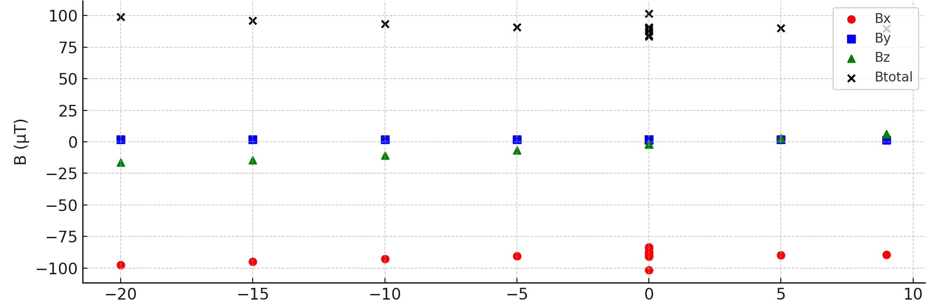
For - 15 Volts along Y axis; plot 8
B total is close to Bx magnitude
Y
Z
X
Y
(0, 0, 0): center of the box

Slide 13
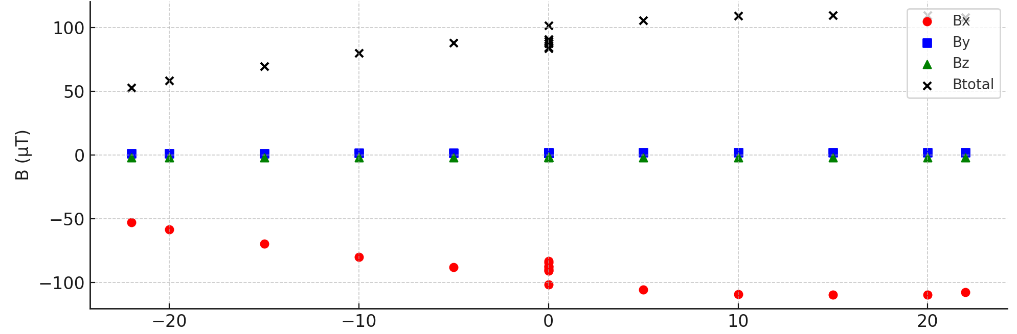
For - 15 Volts along Z axis; plot 9
B total is close to Bx magnitude
Y
Z
X
Z
(0, 0, 0): center of the box

Slide 14
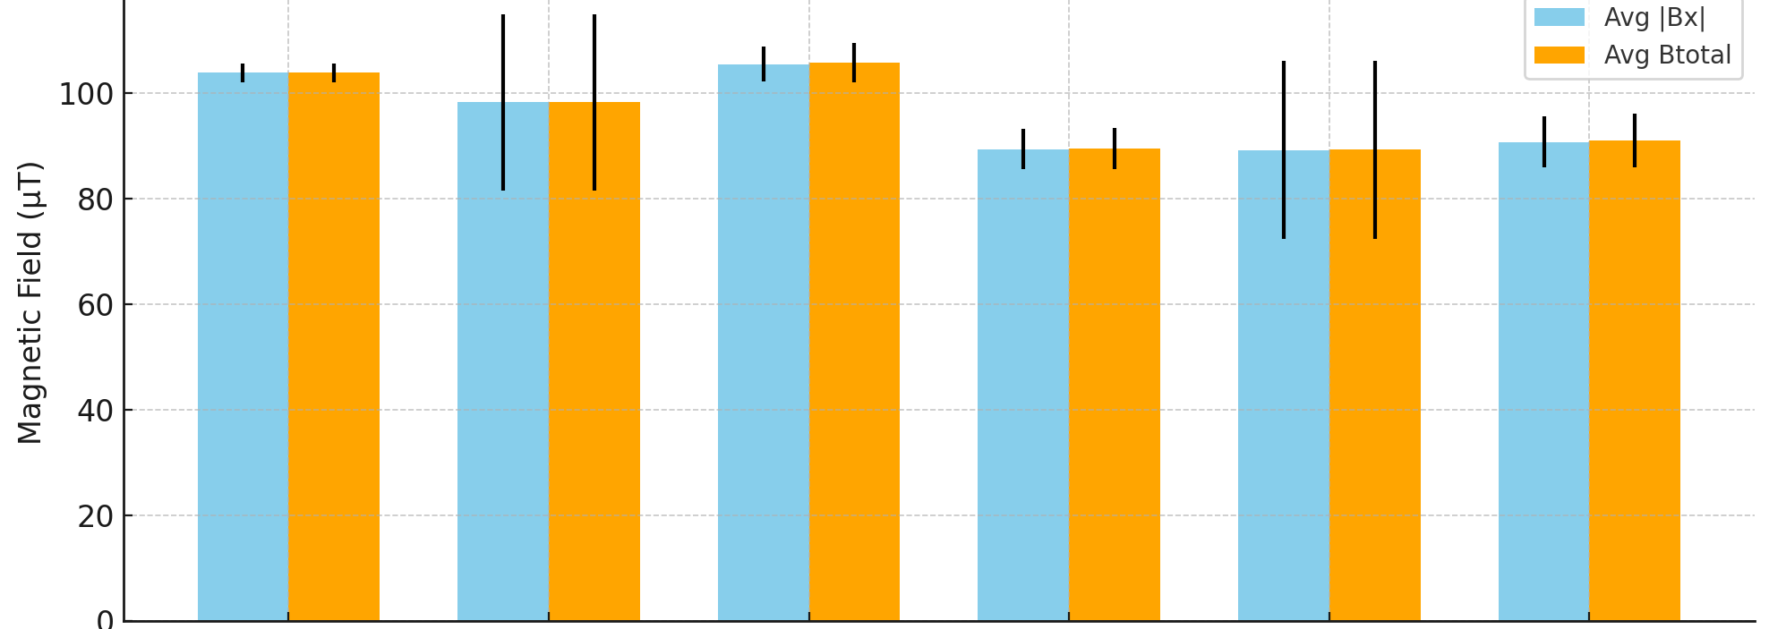
Result of the mapping
Bottom line is that the x component is the major component of the total magnetic field.
This means it is a good candidate to do shielding factor measurement for a transverse magnetic field as shown by the plot below
When the prototype will be inserted in the box if the axis of the prototype is parallel to the opening it will be subjected to a transverse field
+ 15 V
- 15 V

Slide 15
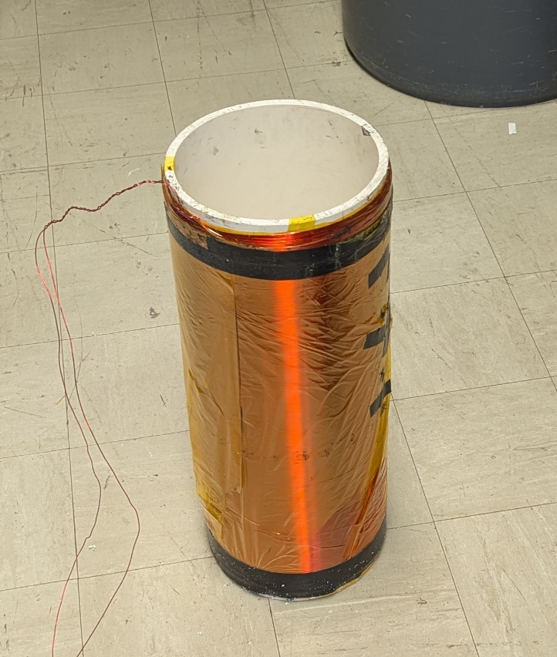
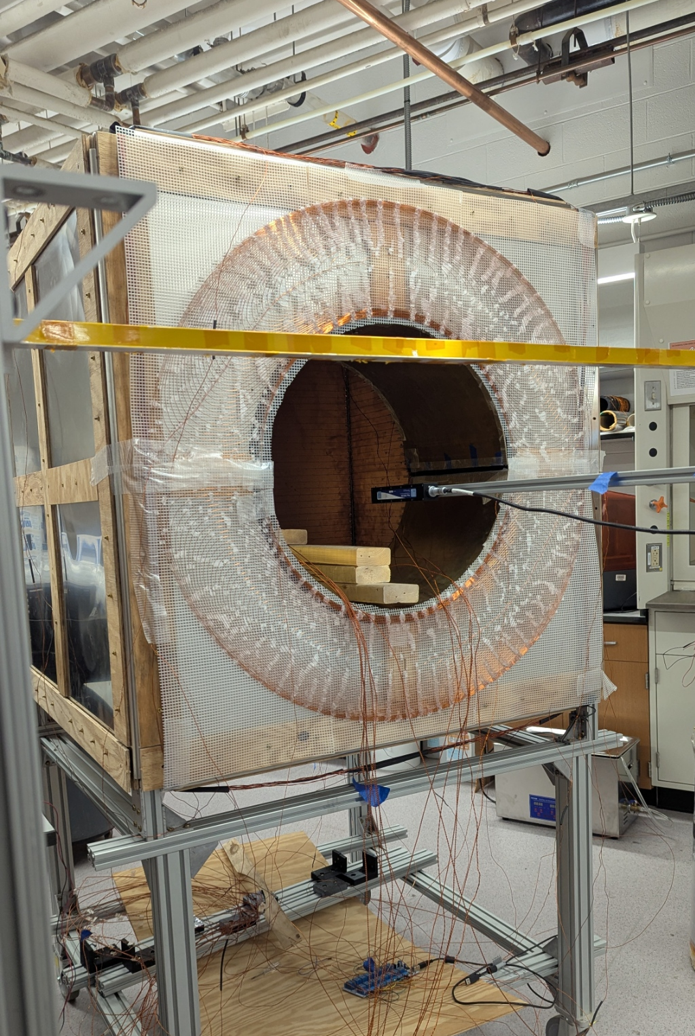
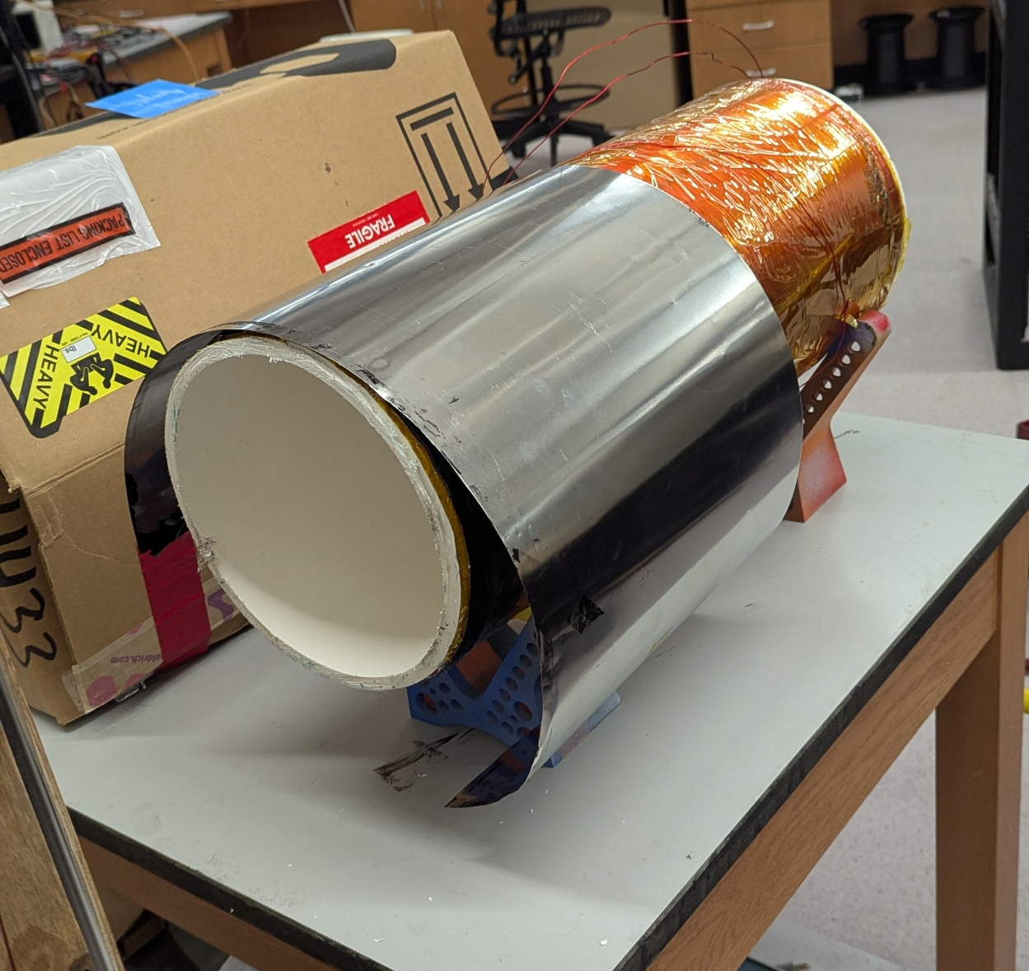
Procedure
Cut the excess cylinder
Measure the resistance to ensure no short circuit present
Take the background field measurement of the box with zero current
Take the background field measurement of the box with a known current
Map the magnetic field and calculate the volume and line average of the magnetic field components
Repeat step 4 and 5 for the current in the opposite direction
Insert the coil in the box subjecting it to the background magnetic field
Repeat step 5 for both the polarities
Wrap the mumetal around the prototype
Repeat steps 4 and 5 for the both the polarities
Make both longitudinal and transverse degaussing coils
Degauss mumetal only longitudinally, map, and calculate averages
Degauss only transversely, map, and calculate the averages
Degauss both at the same time, map, and calculate the averages
* At each step I will be running simulations in COMSOL to see how much simulations differ from the experiment

Slide 16
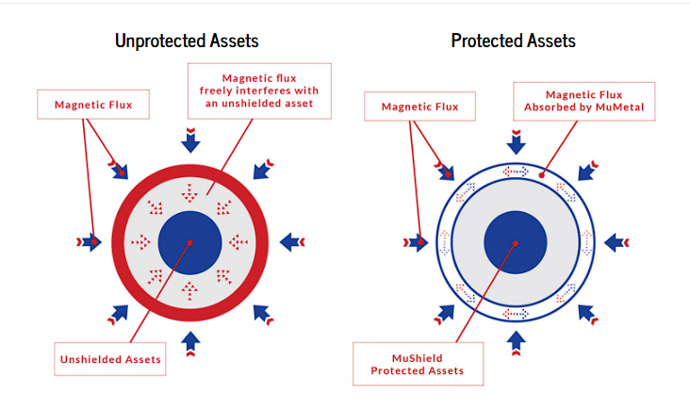
Degaussing Process
High relative permittivity is needed for high shielding
mumetal.com

Slide 17
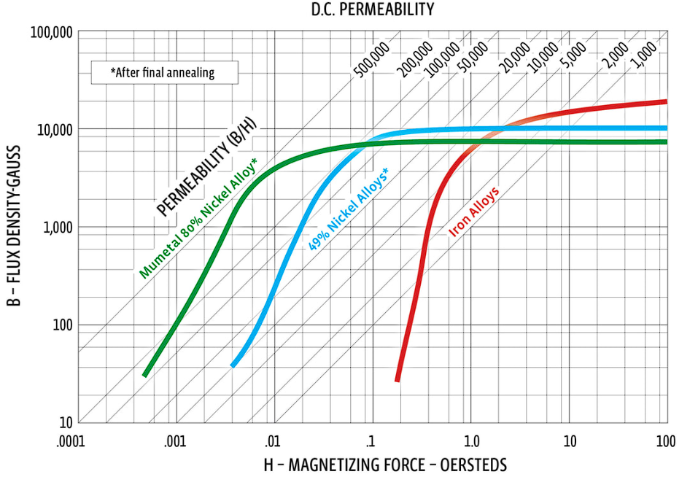
Degaussing Process
Plateau = saturation region
μ = slope of this curve; μ=ΔΒ/ΔH
We need to have the mumetal to operate at high slope region and away from saturation
mu-metal.com
0.79577 A/m
7.9577 A/m
79.577 A/m

Slide 18
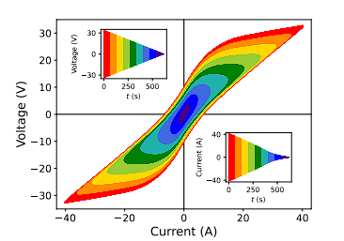
Degaussing Process
Plateau = saturation region
μ = slope of this curve; μ=ΔΒ/ΔH
We need to have the mumetal to operate at high slope region and away from saturation
mu-metal.com
https://arxiv.org/pdf/2309.16877
0.79577 A/m
7.9577 A/m
79.577 A/m

Slide 19
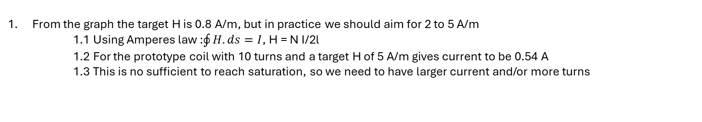
Degaussing Process
From the graph the target H is 0.8 A/m, but in practice we should aim for 2 to 5 A/m
1.1 Using Amperes law :$\oint{H.ds}=I$, H = N I/2l
1.2 For the prototype coil with 10 turns and a target H of 5 A/m gives current to be 0.54 A
1.3 This is no sufficient to reach saturation, so we need to have larger current and/or more turns
+
Degausssig wire with N turns
-
Length = l

Slide 20
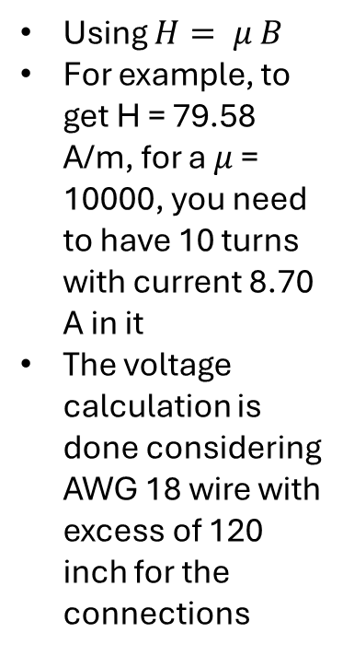
Parameters to accomplish saturation of B = 10, 000 Gauss
For μ | Req H (A/m) | Turns N | Current I and Voltage
10000 | 79.58 | 10 | 8.70 A (2.64 V)
 |  | 20 | 4.35 A (2.36 V)
 |  | 50 | 1.74 A (2.19 V)
Using $H= μ B$
For example, to get H = 79.58 A/m, for a $μ$ = 10000, you need to have 10 turns with current 8.70 A in it
The voltage calculation is done considering AWG 18 wire with excess of 120 inch for the connections
For μ | Req H (A/m) | Turns N | Current I and Voltage
30000 | 26.53 | 10 | 2.90 A (0.88 V)
 |  | 20 | 1.45 A (0.79 V)
 |  | 50 | 0.58 A (0.73 V)
For μ | Req H (A/m) | Turns N | Current I and Voltage
50000 | 15.92 | 10 | 1.74 A (0.53 V)
 |  | 20 | 0.87 A (0.47 V)
 |  | 50 | 0.35 A (0.44 V)

Slide 21
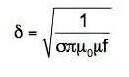
Degaussing Process
2. Eddy current increase with frequency and can block the magnetic field from reaching the inner volume, so we need to figure out correct frequency for degaussing
2.1 Using skin depth formula:
f (Hz) | δ@ μ = 10000 | δ@ μ = 30000 | δ@ μ = 50000
0.1 | 1.59 mm | 0.92 mm | 0.71 mm
0.5 | 0.71 mm | 0.41 mm | 0.32 mm
1.0 | 0.50 mm | 0.29 mm | 0.23 mm
5.0 | 0.22 mm | 0.13 mm | 0.10 mm
10 | 0.16 mm | 0.092 mm | 0.071 mm
50 | 0.071 mm | 0.041 mm | 0.032 mm
100 | 0.050 mm | 0.029 mm | 0.023 mm
This gives the frequency range for degaussing a layer of 0.3 mm thickness

Slide 22
Degaussing Process
3. Total degaussing time:
3.1 Magnetically Shielded Room (MSR) room in nEDM experiment is degaussed for about 21min (https://arxiv.org/pdf/2307.07225)
3.2 One time they ran for 60 sec at 50 Hz and 1000 cycles
f (Hz) | δ@ μ = 10000 | δ@ μ = 30000 | δ@ μ = 50000
0.1 | 1.59 mm | 0.92 mm | 0.71 mm
0.5 | 0.71 mm | 0.41 mm | 0.32 mm
1.0 | 0.50 mm | 0.29 mm | 0.23 mm
5.0 | 0.22 mm | 0.13 mm | 0.10 mm
10 | 0.16 mm | 0.092 mm | 0.071 mm
50 | 0.071 mm | 0.041 mm | 0.032 mm
100 | 0.050 mm | 0.029 mm | 0.023 mm
This gives the frequency range for degaussing a layer of 0.3 mm thickness (our case)

Slide 23
Final Degassing Profile 1
Number of turns = 10
Starting Voltage = 0.88 V
At frequency of 0.5 Hz
Total run time = 2000 sec (33 min) Note that this might result in heating problems in the NN’ magnets although it might not be an issue for the prototype. A study in run time v/s Shielding Factor might be needed.

Slide 24
Final Degassing Profile 1
Number of turns = 10
Starting Voltage = 0.88 V
At frequency of 0.5 Hz
Total run time = 2000 sec (33 min) Note that this might result in heating problems in the NN’ magnets although it might not be an issue for the prototype. A study in run time v/s Shielding Factor might be needed.

Slide 25
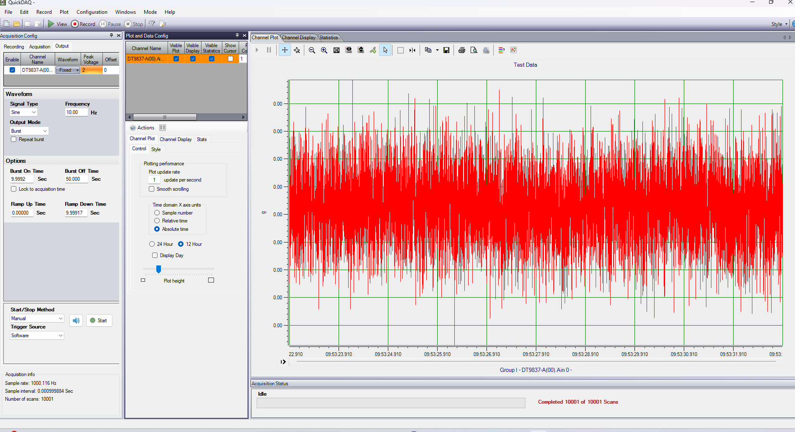
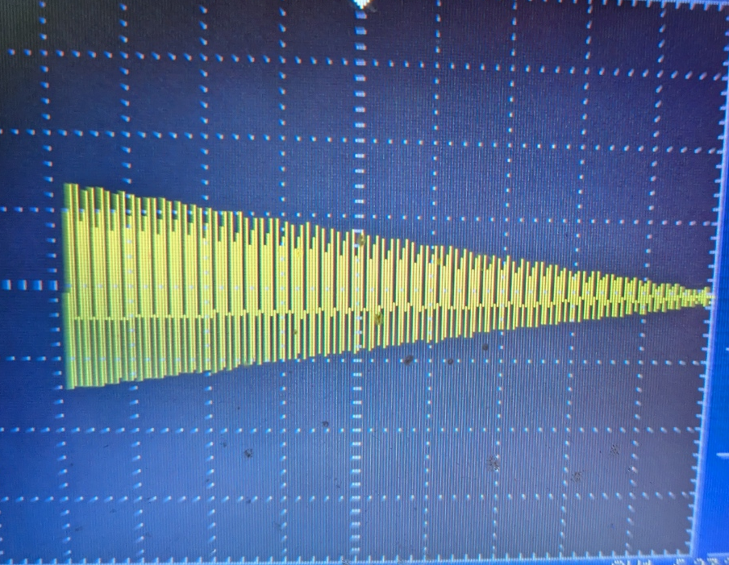
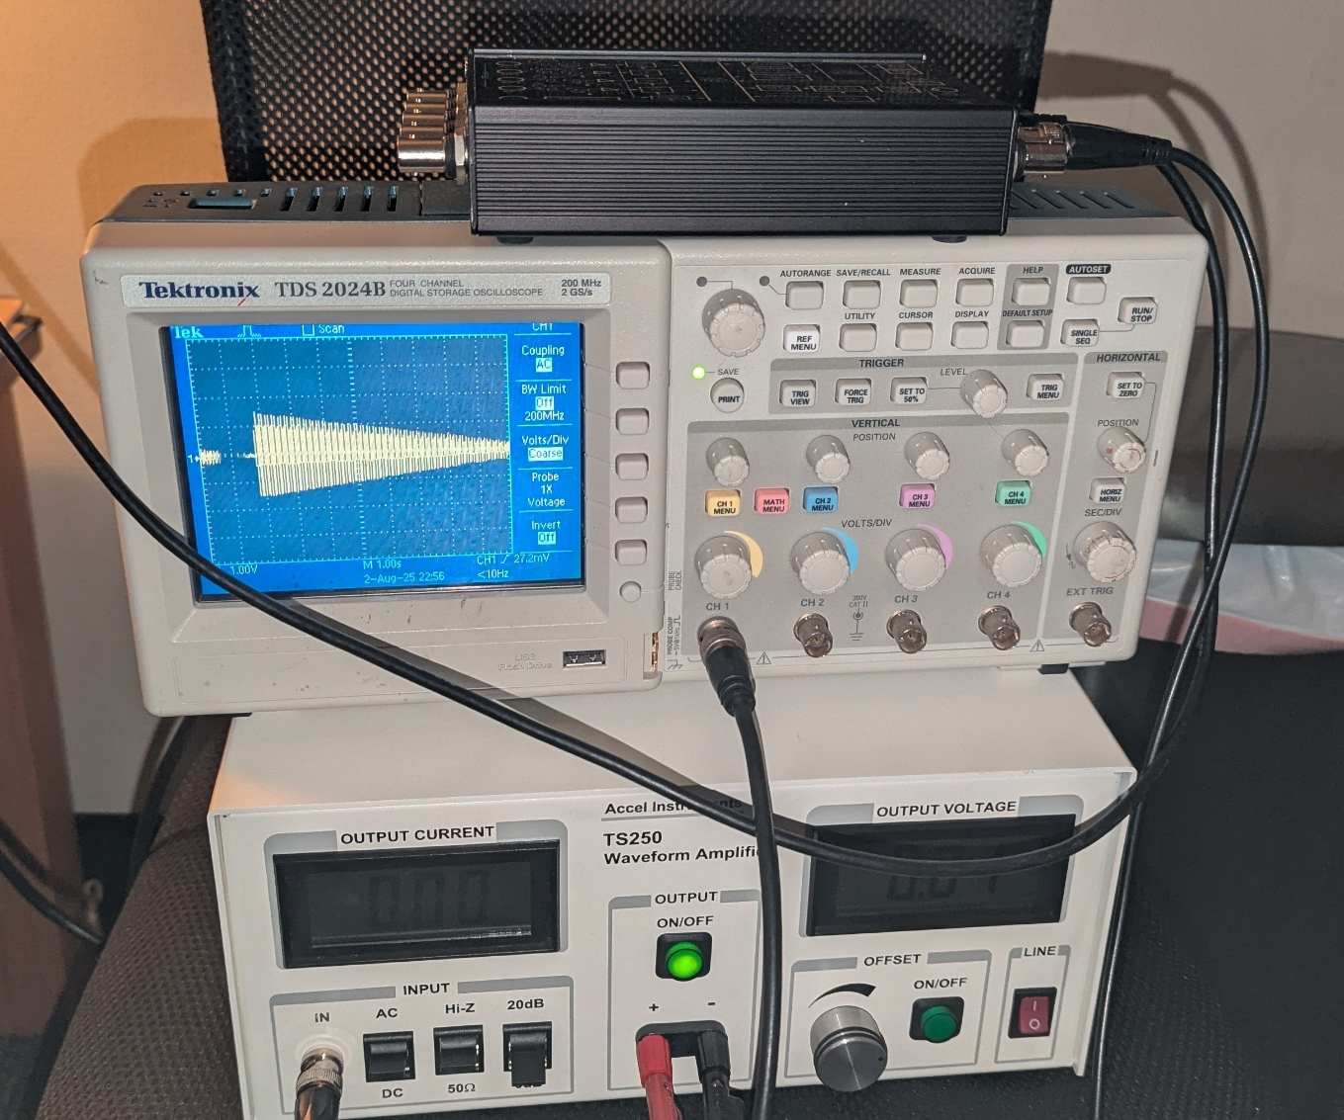
Change of Plan
Not able to generate an exponentially decaying waveform with the current setup
Upon further research it was found that using a trail software a linear waveform can be generated
QuickDAQ Free Trial Version
DT9873A DAQ Unit
TS250 Amplifier
Example Waveform generated

Slide 26
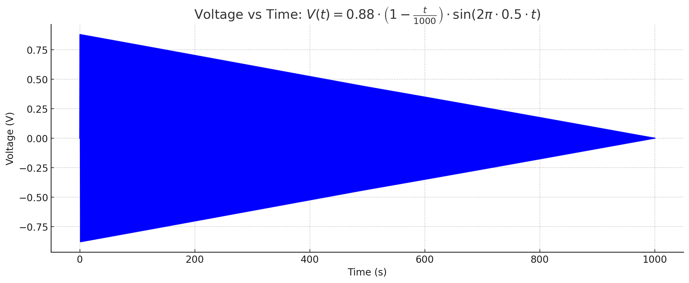
Final Final Degassing Profile 1
Number of turns = 10
Starting Voltage = 0.88 V
At frequency of 0.5 Hz
Total number of cycles = 1000
Total run time = 2000 sec (33.3 min) Note that this might result in heating problems in the NN’ magnets although it might not be an issue for the prototype. A study in run time v/s Shielding Factor might be needed.
Next step:
After degaussing coil is manufactured, test this profile and measure the shielding factor

Slide 27
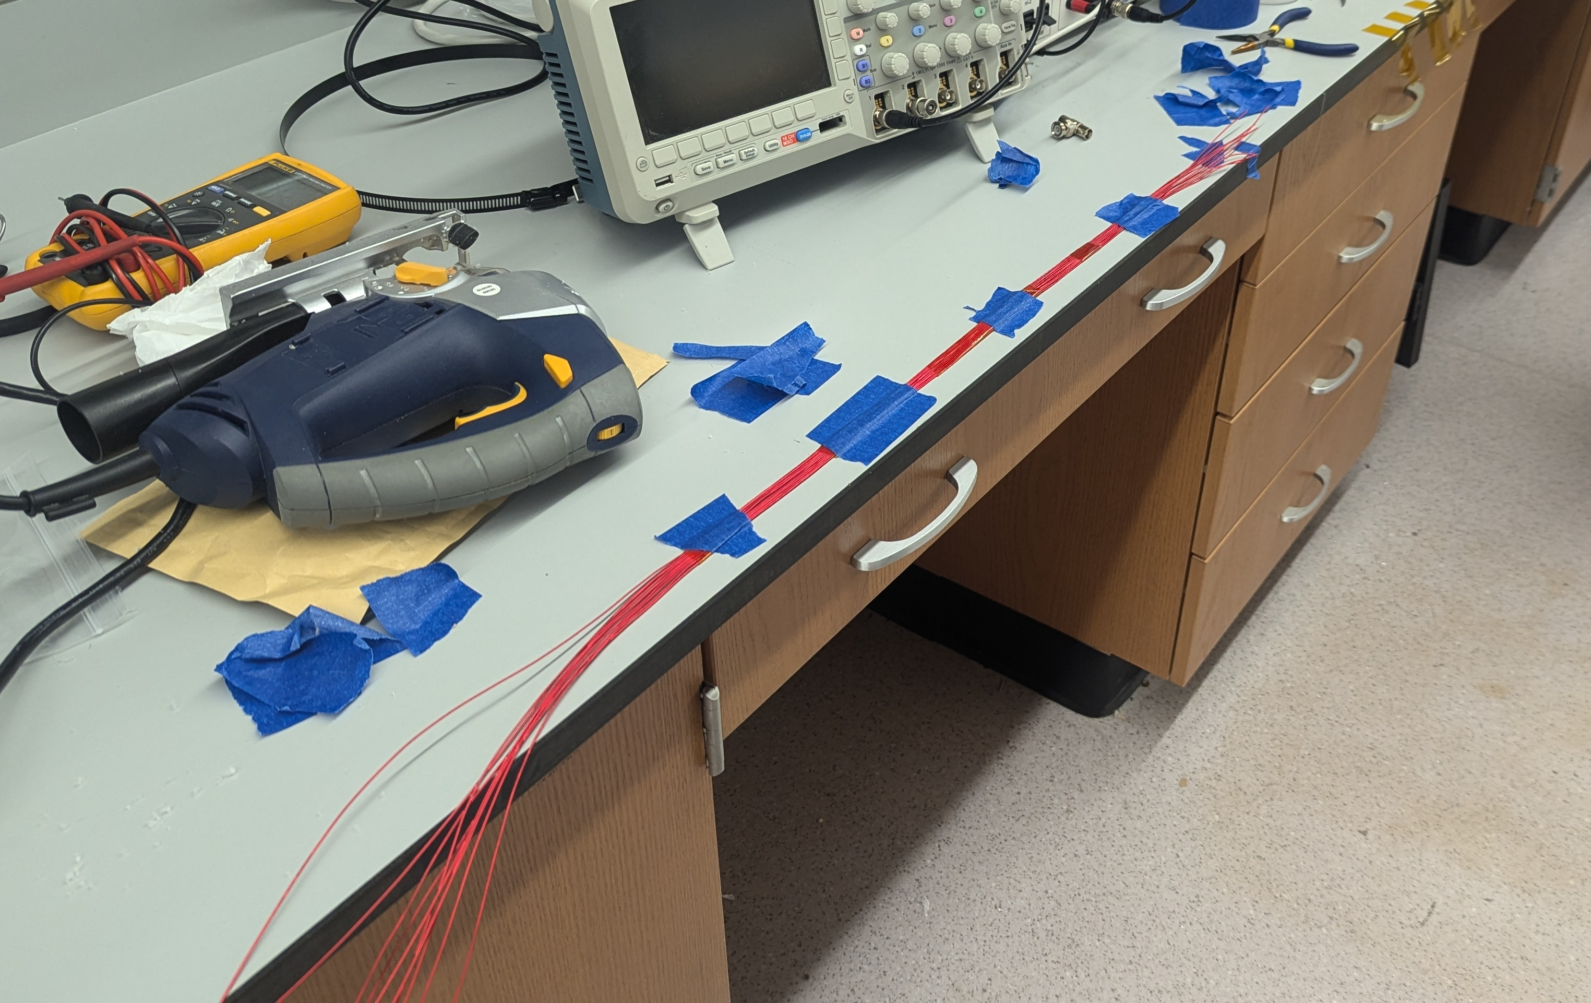
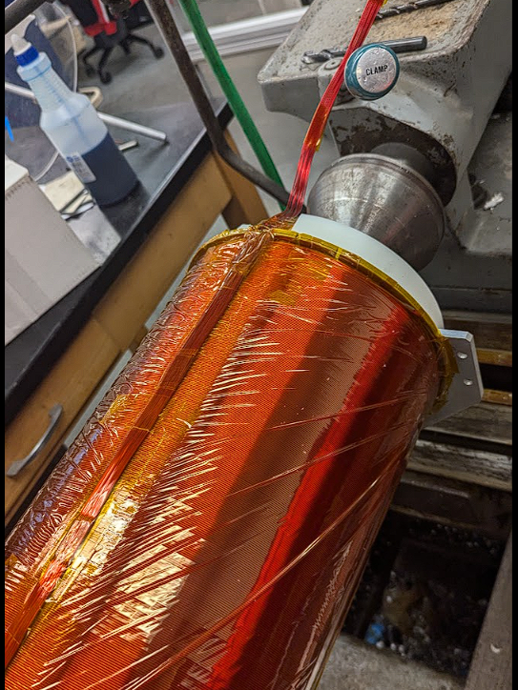
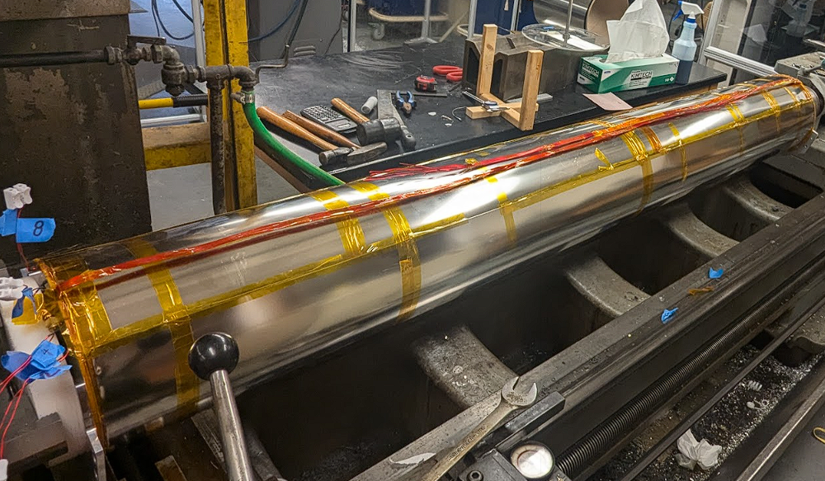
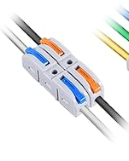
Making of the degaussing coil
Connectors from Amazon
I am planning to follow the same procedure as I followed for the NN’ magnets

Slide 28
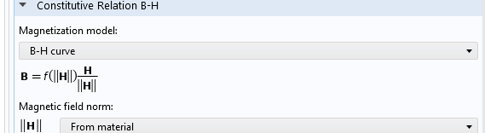
Goal: Solve problems with mu non-linearly in COMSOL
By default, COMSOL uses the magnetization model where it uses a linear relationship between B and H: B = μ H, with μ being constant
This makes COMSOL reliable for a known value of μ and away from the saturation region
For a more reliable simulation we need to solve the problems non- linearly:

