Slide 1
Mubi Khan
University of Kentucky
July 21st NN’ meeting

Slide 2
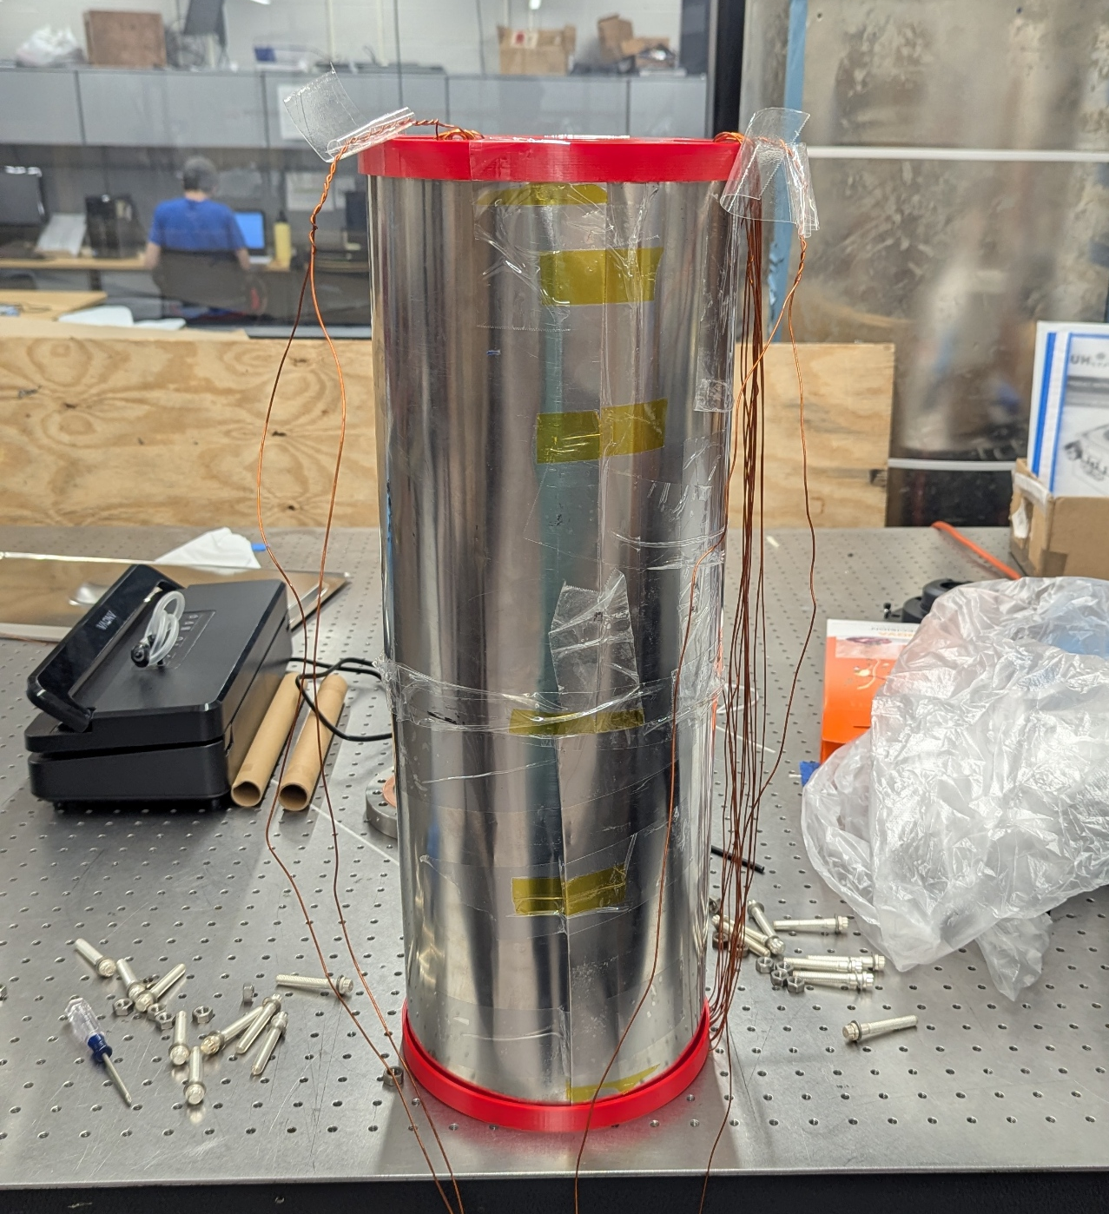
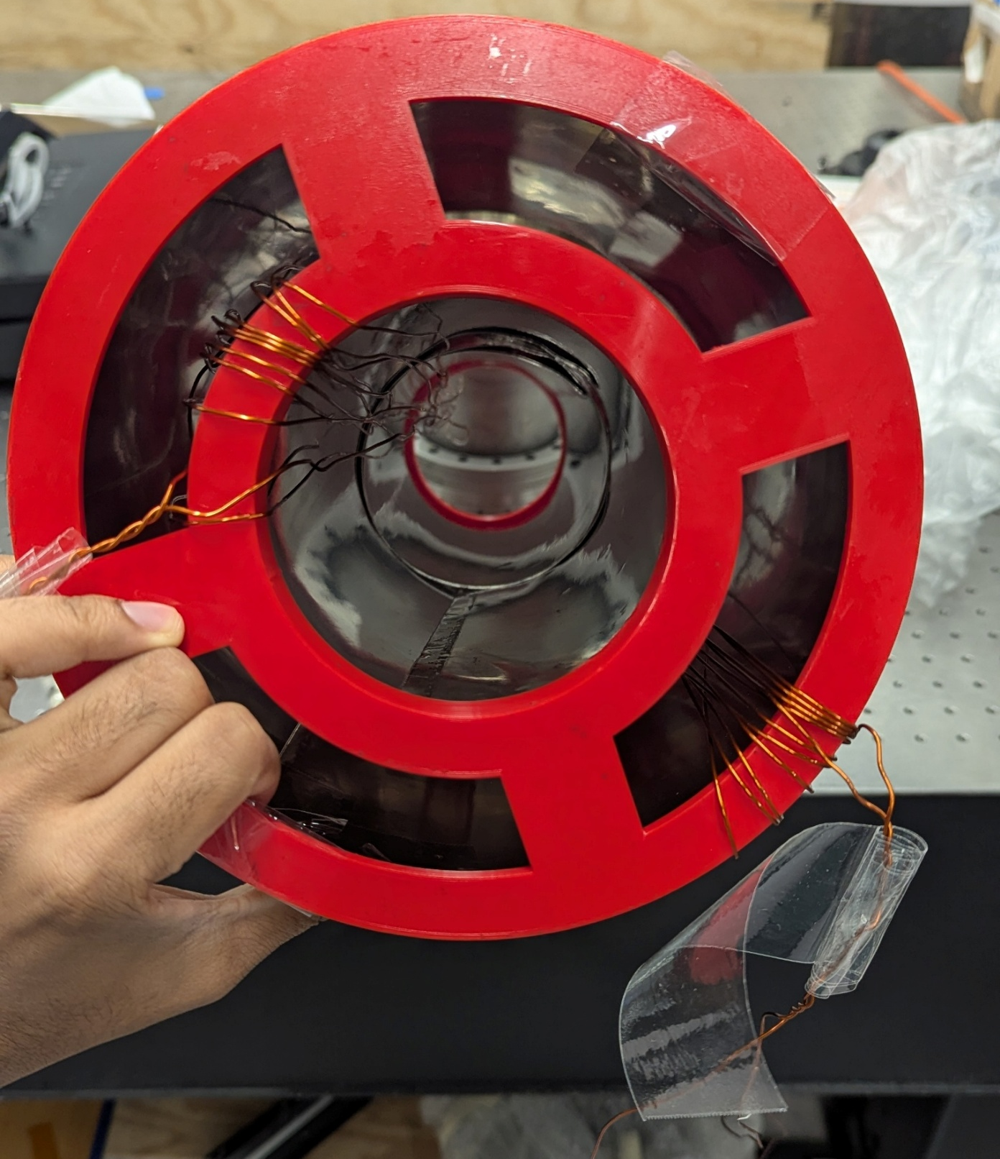
COMSOL vs Exp for two concentric degaussed mumetal cylinders with overlap of 2 inches
 | Comsol | Exp | Theory
Shielding Factor | 6091 for mu = 60000 | 500 | 6050 (mu= 30000)
Degaussing wire resistance=0.3 Ohms
This is when mumetal is degaussed

Slide 3
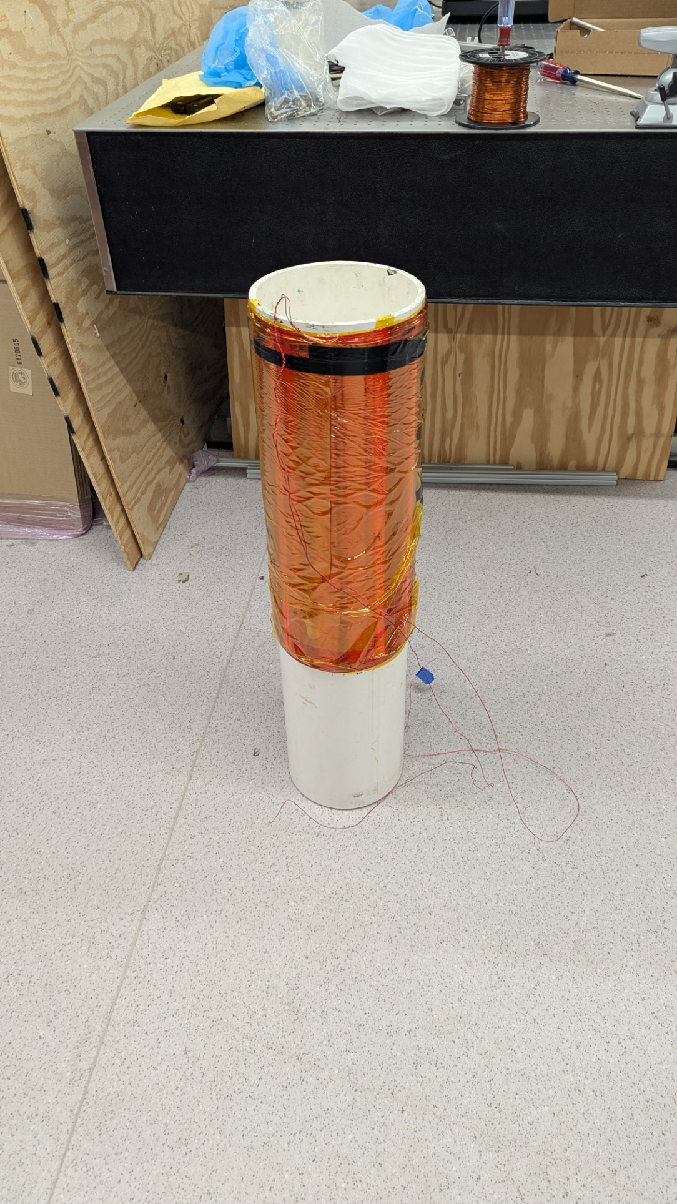
Validating COMSOL using Prototype Cylinder
Objective: To test the reliability of the simulations (comsol.
In order to do that we need to do a controlled experiment with a similar solenoid.
I plan to use a magnet which was built prior to the nn’ magnets.
It was made as a prototype to the nn’ magnets.

Slide 4
Validating COMSOL using Prototype Cylinder
Specifications:
AWG 18 wire
Diameter = 8.75 in
Length = 21.5 in
Turn density = 24 turns per inch
Total turns = 516
Total resistance = 30.5 Ohms
Total 4 layers
Total calculated resistance = 30.13 Ohms
Total measured resistance = 30.5 Ohms

Slide 5
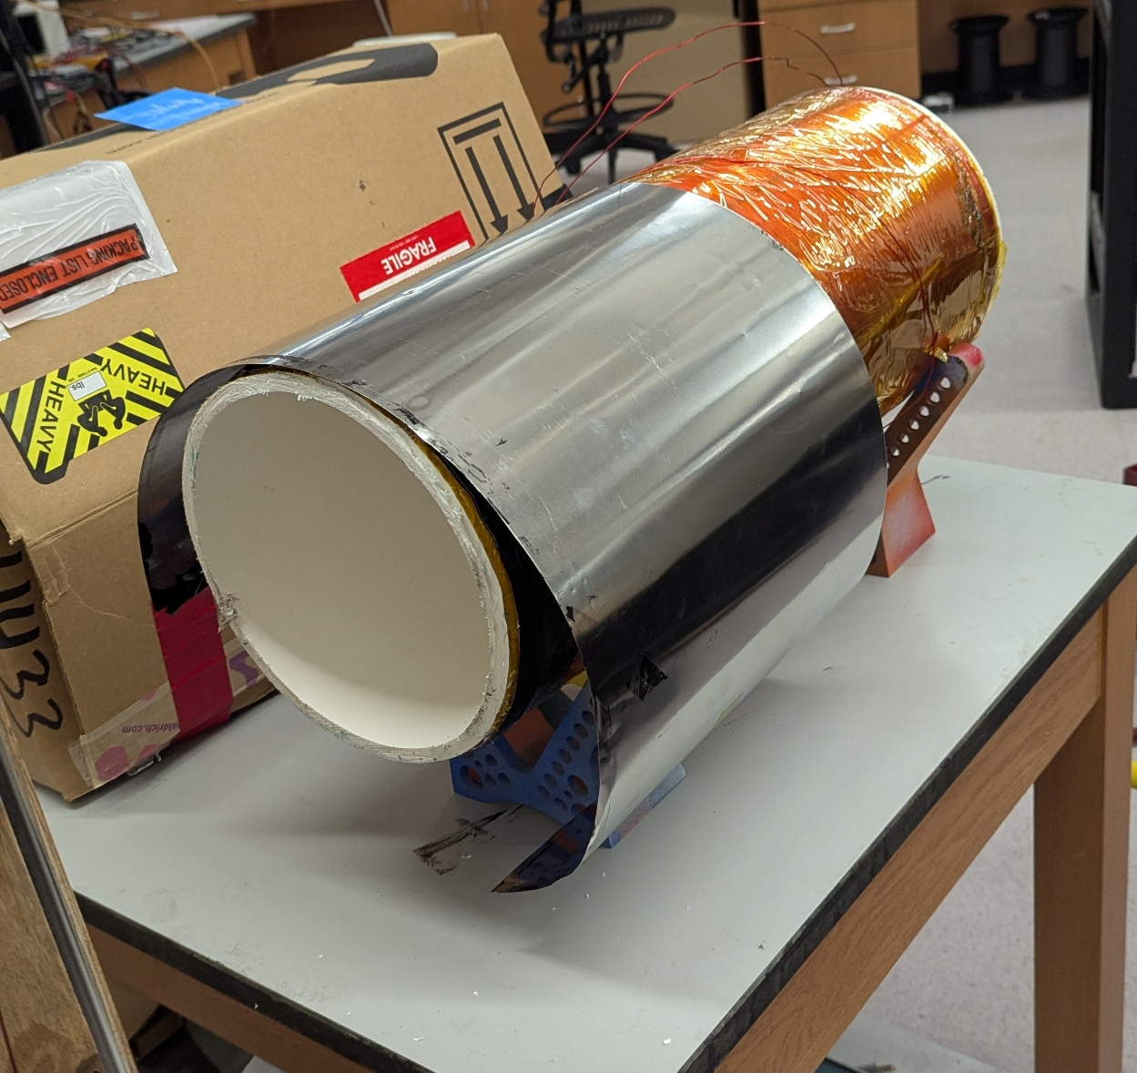
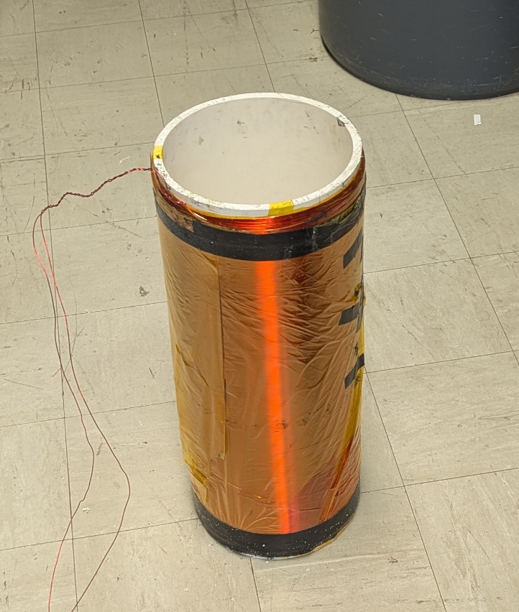
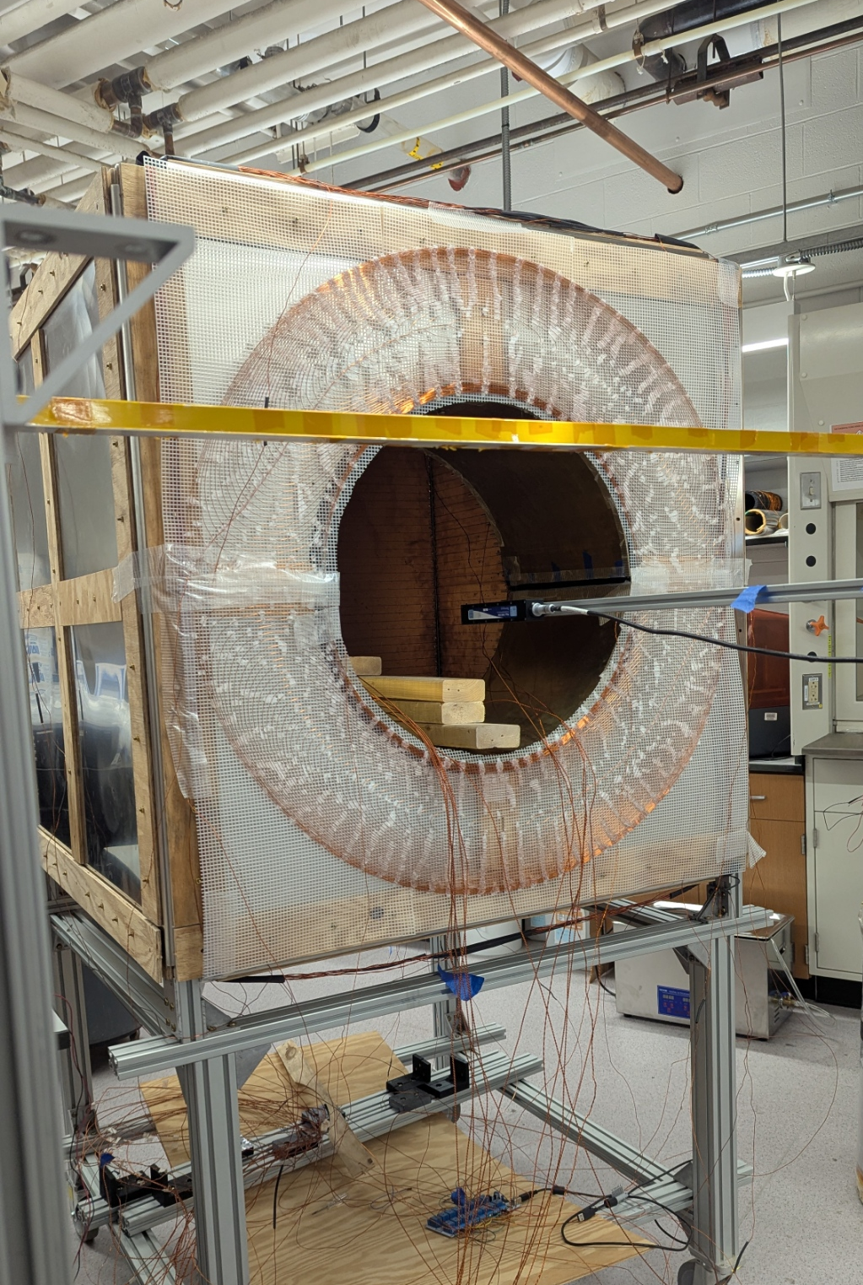
Procedure
Cut the excess cylinder
Measure the resistance to ensure no short circuit present
Take the background field measurement of the box with zero current
Take the background field measurement of the box with a known current
Map the magnetic field and calculate the volume and line average of the magnetic field components
Repeat step 4 and 5 for the current in the opposite direction
Insert the coil in the box subjecting it to the background magnetic field
Repeat step 5 for both the polarities
Wrap the mumetal around the prototype
Repeat steps 4 and 5 for the both the polarities
Make both longitudinal and transverse degaussing coils
Degauss mumetal only longitudinally, map, and calculate averages
Degauss only transversely, map, and calculate the averages
Degauss both at the same time, map, and calculate the averages
* At each step I will be running simulations in COMSOL to see how much simulations differ from the experiment

