Slide 1
Mubasshir Khan
University of Kentucky
NN’ Meeting July 14th

Slide 2
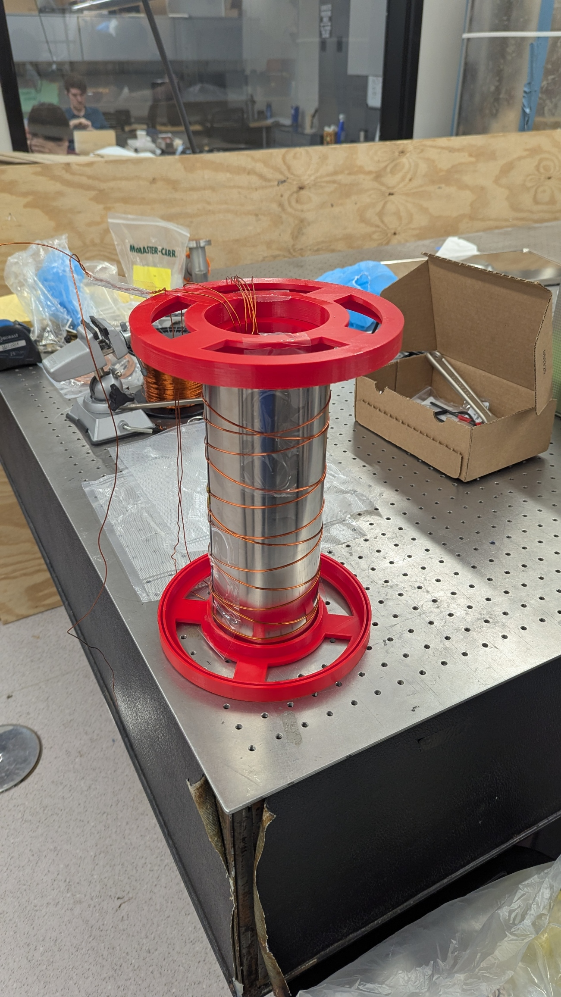
Goal: get a realistic value of mu
Simulation of a 4inch diameter cylinder with a bilayer mumetal of total thickness 0.024 inches or 0.6 mm

Slide 3
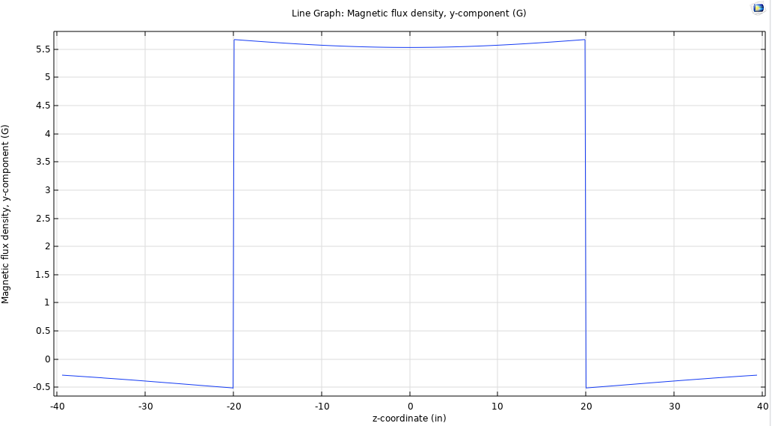
Goal: get a realistic value of mu
Field profile is plotted on the right from COMSOL

Slide 4
COMSOL vs Exp for not degaussed mumetal
 | Comsol | Exp | Theory
Shielding Factor | 161 (mu = 30000) | 35 | 181 (mu = 30000)
* This is when mumetal is not degaussed

Slide 5
COMSOL vs Exp for degaussed mumetal
 | Comsol | Exp | Theory
Shielding Factor | 293 (mu = 55000) 319 (mu = 60000) | 307 | 181 (mu= 30000)
This is when mumetal is degaussed
Degaussing parameters: 10Hz and 10 V with linear decay
Degaussing wire resistance=0.3 Ohms

