Slide 1
Evaluation of Coded-Aperture Gamma-Ray Imaging for Treaty Accountable Item Characterization
Klaus Ziock
J. Daughhetee
Irakli Garishvili
Frank Gonzalez
Kyle Schmitt

Slide 2
Verification: What does it mean?
Ideally an inspection conducted under a treaty regime will provide certainty that a Treaty Accountable Item (TAI) is as claimed.
Ideally this means one wants to measure observables directly related to a TAI’s functionality.
Materials
  Isotopics
  Accessible through gamma-ray spectroscopy
Material Distributions
  Shapes
  Dimensions
  Accessible through gamma-ray imaging
But there are sensitivity concerns on these observables
Project Goal: Understand what can be learned/verified from an imaging-based inspection

Slide 3
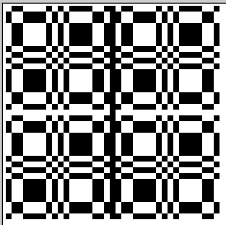





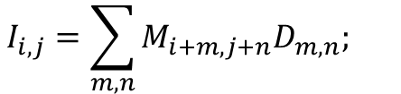

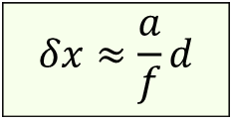
Coded-aperture imaging¹
In coded-aperture imaging a shadow mask is used to encode the scene onto a position-sensitive detector.
This allows one to generate images with radiation not amenable to mirrors or lenses.
The image can be recreated using cross-correlation:
$$I_{i,j}=\sum_{m,n}{M_{i+m,j+n}D_{m,n}; }$$
$$M_{k,l}=\left\{\begin{aligned}1, if mask open \\ −1, if mask closed\end{aligned}\right.$$
$$δx≈\frac{a}{f}d$$
$$δIi,j≈\sqrt{N}$$
¹E.E. Fenimore, T.M. Cannon, Appl Optics, 17, 337, 1978.

Slide 4
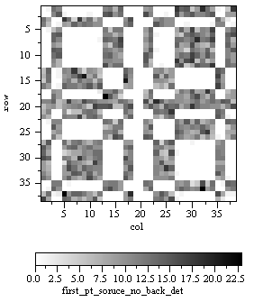
Mask/Anti-Mask Imaging
Image encoded as count-rate variations
Variations not due to the mask cause artifacts
Measure by collecting equal time mask and inverse or anti-mask data
  Use an anti-symmetric mask for this
Removes non-mask background
  Image with both data sets
Provides robust imaging
Provides in situ
background subtraction!

Slide 5
“Full-deconvolution,” spectrally resolved pixels
Basic Image generation
Detector
Image
Detector can be broken
Into different energy bins
Generate an image in each
Energy bin, then add
Notes:
By making an image with each spectral bin, I get a “data-cube” that allows me to generate the spectrum from a given pixel.

Slide 6
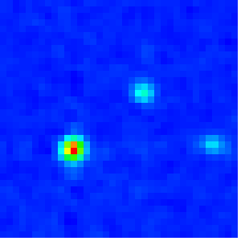

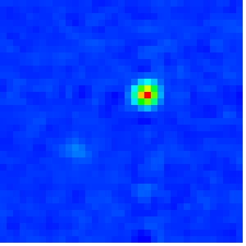
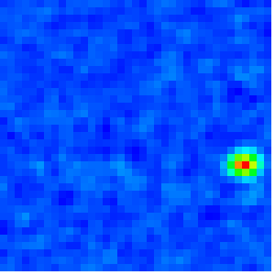
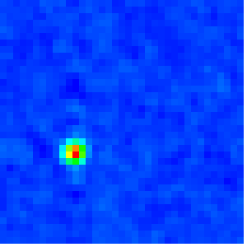
Spectral Region of Interest (sROI)
90-450 keV
⁵⁷Co120-124 keV
²³²U 237-249 keV
¹³³Ba 354-358 keV

Slide 7
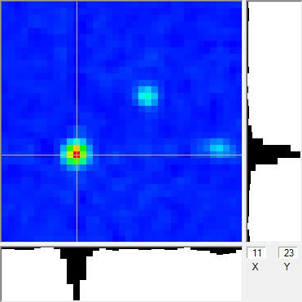
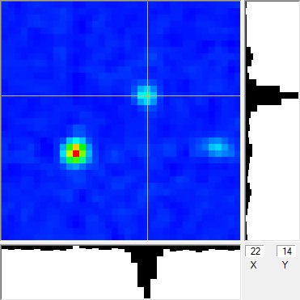
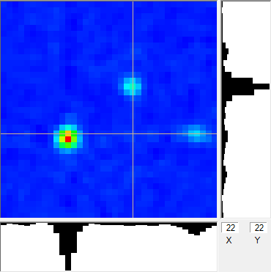
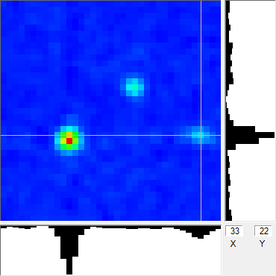
Area Region of Interest (aROI)

Slide 8
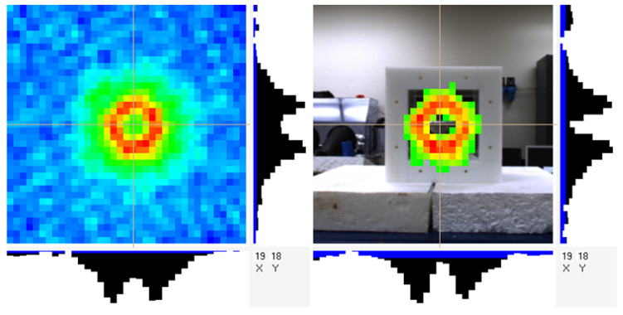

Complex Object Imaging
See both radio isotopes and overlying materials
Overlying materials are visible due to scattering of primary radiation

Slide 9
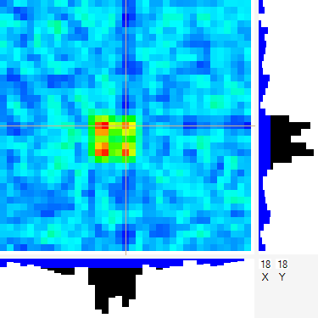
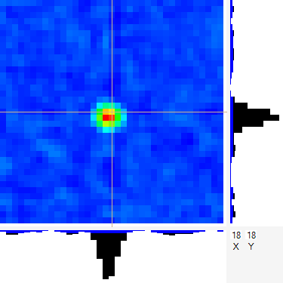
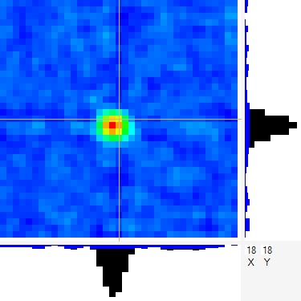
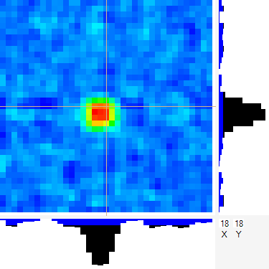
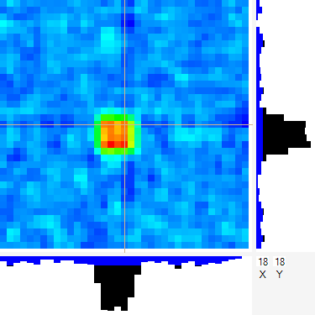
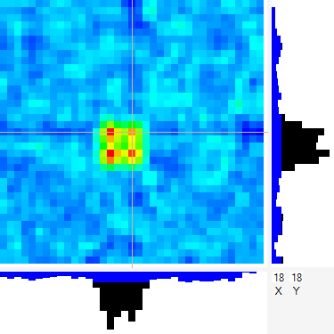

Spatial Resolution
1.7
Can’t see structures smaller than $δx≈\frac{a}{f}d$
4, point sources progressively expanded from contact
  Sources ~ 0.4 Resolution elements
  ~ 0.4 Resolution elements
  ~ 1.7 Resolution elements
0.4
0.6
0.8
1.0
1.2
1.5

Slide 10
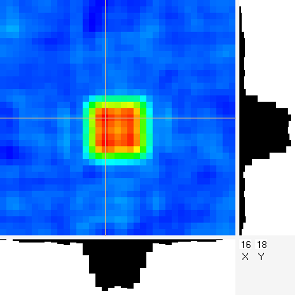
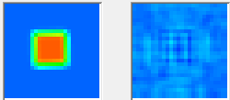
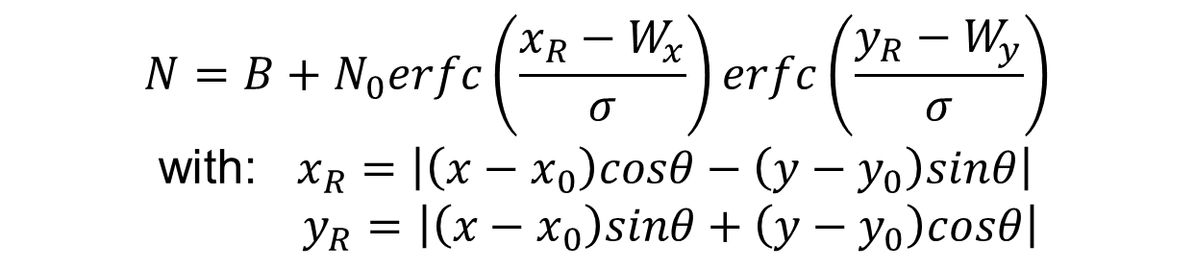
Prior information can provide higher-resolution information
Fits to global shapes can be more precise
Fit
16 Hours
$$N={B+N}_{0}erfc\left(\frac{x_{R}−W_{x}}{σ}\right)erfc\left(\frac{y_{R}−W_{y}}{σ}\right)$$
with: $x_{R}=\left|\left(x−x_{0}\right)cosθ−\left(y−y_{0}\right)sinθ\right|$
$y_{R}=\left|\left(x−x_{0}\right)sinθ+\left(y−y_{0}\right)cosθ\right|$
Residual
Config. | Block Size (Pixels) | Fit Size (Pixels) |  | Pixels / Block
 |  | X | Y | X | Y
2 × 1 | 4.41 | 8.80 | 4.52 | 4.4 ± .028 | 4.52 ± .064
2 × 2 | 4.41 | 8.76 | 8.75 | 4.38 ± .018 | 4.38 ± .018
2 × 2 | 4.44 | 8.73 | 8.76 | 4.37 ± .018 | 4.38 ± .028
But systematic
uncertainties remain
60 min of data, with uncertainties from bootstrap sampling of events at random

Slide 11

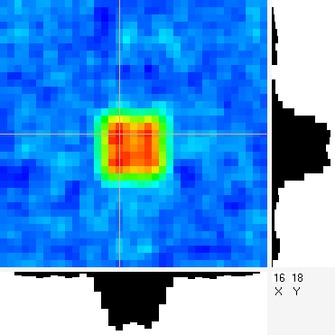
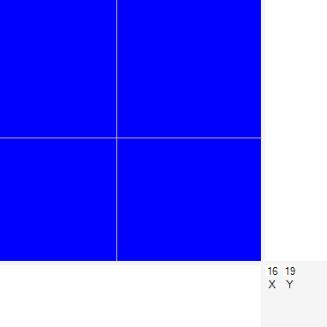

Bootstrap sample
List mode data represents a reasonable ensemble of what the world throws at the detector
  ~ 1.5 ×10⁸ events
Throw all of the events into a big bucket
pull events out one by one and image
with replacement
Run to desired statistics
1 hour

Slide 12
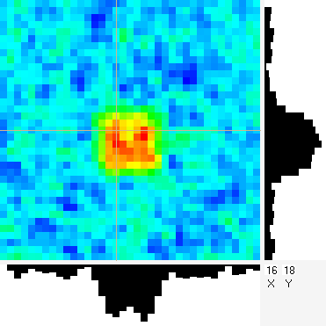
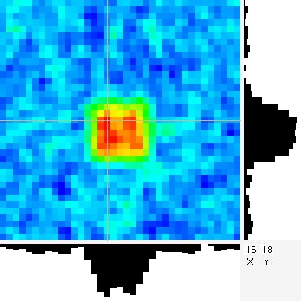
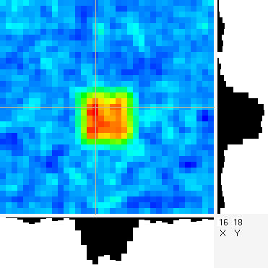


Sample Bootstrap Fit Results
Results versus “time”
7.5 min
15 min
30 min
60 min
120 min
X, Y location
X, Y Half Width
Amplitude

Slide 13
Potential Scenarios: Confirmation of the absence of SNM
Is an object or region free of Special Nuclear Materials (SNM)
  This could be based on detecting gamma-ray emissions: Spectroscopy
Scenario 1: Non-nuclear confirmation
  collect data to verify no gamma emissions
Scenario 2, Sweep “source-free” region
  verify no sources are present in a locale where further work is planned; disassembly, destruction, etc.
Why imaging?
  Allows spectroscopy without a separate background-only measurement.
  Perform near other SNM without concerns about contaminating the measurement.
  The minimum detectable leakage flux allows quantitative determination of how much material could be hidden.
  Direct or down-scattered radiation from a shielded source could be imaged to determine material distribution, serving as a deterrent to cheating.

Slide 14
Potential Scenarios: Spectral TAI confirmation
Scenario 3: Spectral TAI confirmation
  Use gamma-ray spectroscopy to validate a TAI
  Collect spectra with an imager set so it cannot resolve TAI internal structure
  Intrusiveness concerns with spectroscopy must be addressed
Why Imaging?
  Inherently background-subtracted imaged (aROI) spectra allows such measurements to be performed in proximity to other SNM.
  Imaged spectra (aROI) could allow multiple TAIs to be measured simultaneously.
  Requires:
    Imager spatial resolution treats TAIs as a point source
    TAIs are sufficiently separated to allow non-overlapping aROIs

Slide 15
Spectroscopic Configurations
Source 2.1 μCi @ 2.3 m, Back Source 10 μCi, @ 2.7 m
Ideal
Ideal Background
Overall Rate 60.7 Hz
Overall Rate 56.1 Hz
Realistic
Realistic Background
Overall Rate 67.5 Hz
Overall Rate 64.4 Hz

Slide 16
Spectroscopic Configurations
Ideal
Ideal Background
Realistic
10% Signal
5% Signal
20% Signal
15% Signal

Slide 17
Spectroscopic Configurations
Background
Realistic
Perturbation
20% Signal
15% Signal
10% Signal
0% Signal
5% Signal

Slide 18
Imaging Configurations
Ideal
Perturbation

Slide 19
Imaging Configurations
Realistic
Perturbation

Slide 20
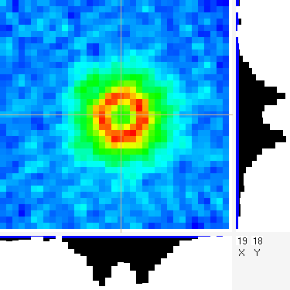
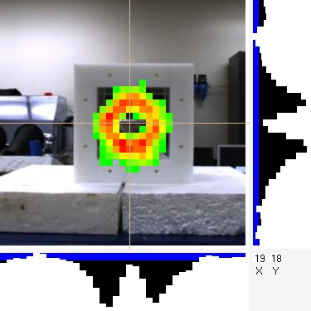
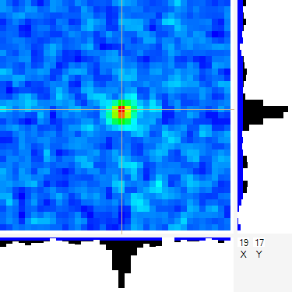
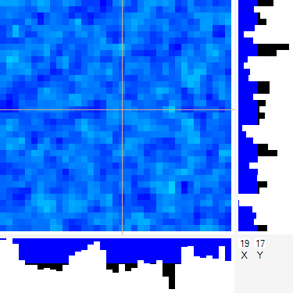
Potential Scenarios: Confirmation a TAI has been altered
Scenario 4: TAI destruction, removal of high explosive
  Validate that low-Z material in proximity to SNM has been removed
Scenario 5: SNM removal
  Validate that SNM has been removed from a TAI
Why Imaging?
  Simultaneous confirmation of both the absence of HE and the TAI-like presence of SNM.
  Confirmatory measurements of the lack of SNM could be performed to a known statistical precision.
  Measurements/work can be performed near other SNM. (e.g. it could be performed at one end of an SNM storage area).

Slide 21
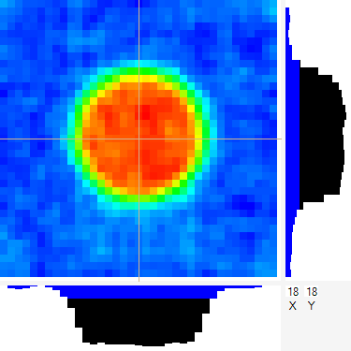
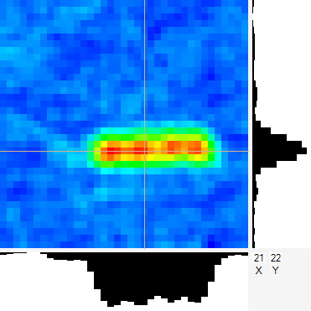
Potential Scenarios: Confirmation a TAI has been altered
Scenario 6: SNM destruction
  Verify SNM distribution from a TAI has been sufficiently altered to preclude its reuse.
Why Imaging?
  The measurement represents a direct probe as to whether or not a TAI was destroyed.
  New material distribution will likely be less sensitive, allowing the use of higher spatial resolution to discourage cheating.

Slide 22
Potential Scenarios: Confirmation of a TAI
Scenario 7: TAI confirmation
  Validate that an item is a TAI based on its material distribution
Why Imaging?
  Provides direct confirmation of an attribute related to its material distribution and any relevant declarations
  Template or first principles approach

Slide 23
Conclusions
Passive gamma-ray imaging can be tailored to provide
  Ruler-verifiable spatial resolution
  Specific spectral resolution (detector-dependent)
  In situ background-subtracted (imaged) spectra
  Quantitative measure of residual source material
These allow inspection scenario classes:
  Confirmation of the absence of SNM
  Spectral TAI confirmation
  Confirmation that a TAI has been altered
  Confirmation of a TAI
Additional research is required to
  Fully understand systematic uncertainties of material distributions
  Automated analysis routines
  Information-barrier technology

