Slide 1
Mubasshir Khan
University of Kentucky
June 3, 2025

Slide 2
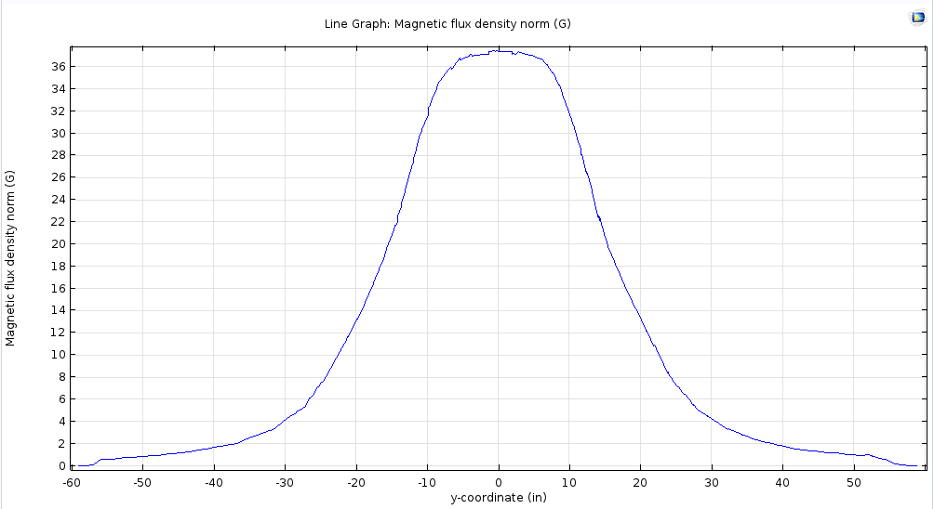
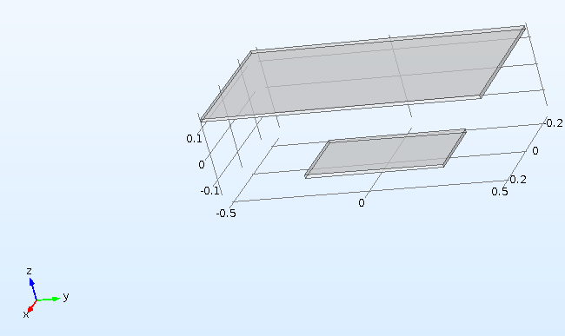
“Background Magnetic Field” Profile
In COMSOL these plates are used to generate the background field on the right. Suitable magnetic scalar potential is given to manufacture the field.

Slide 3
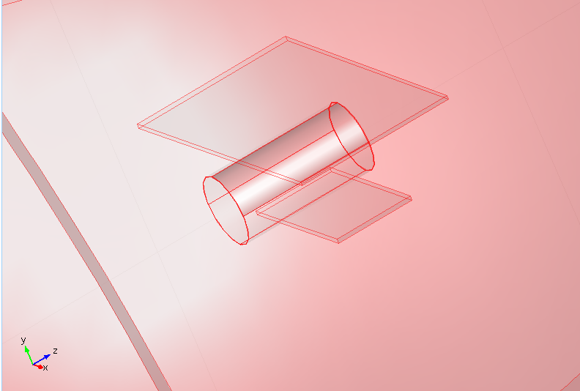
Makeshift COMSOL Simulation
The simulation with all the details can take up hours to run and hence is not practical for our purpose now. So, instead of that a modified makeshift model is run where we only consider one magnet of 1/4th the length of the original magnets to see the effects of the background field and study the shielding.
Plates to produce the background field.
* In addition to this the total mu-metal thickness is taken to be 1.2 mm which is twice of the actual thickness. This is done to save computation cost and time, since this makes the mesh more forgiving. This means that in the end upon comparing we will have to keep this in mind.

Slide 4
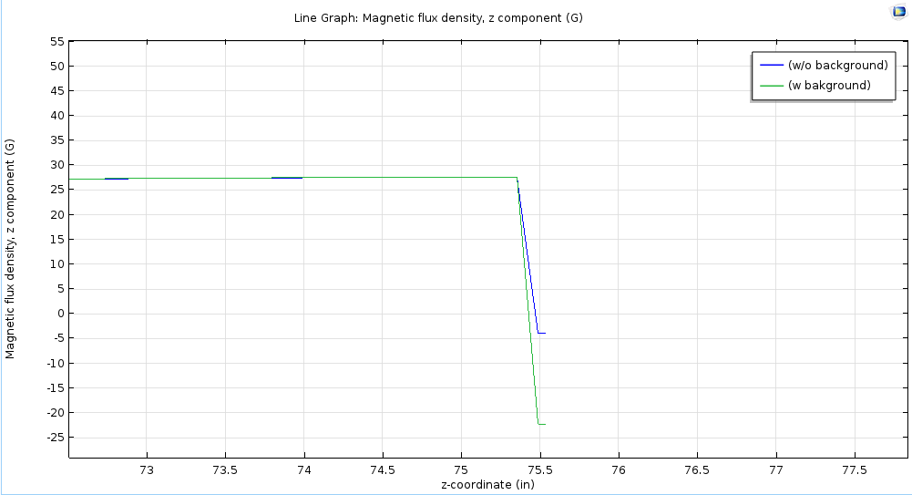
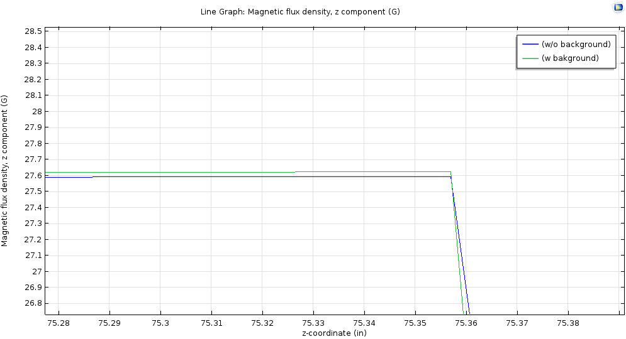
Magnetic field averages along the axis with and without the background
w/o background | W background | Difference | Adjusted difference because of twice the mu-metal thickness used in the simulations | Adjusted Average
27.010 | 27.011 | 0.001 | 0.002 | 27.002
Averages neglecting this, and also neglecting the other side
Note: the averages are calculated neglecting the two end regions.

Slide 5
More pictures

Slide 6
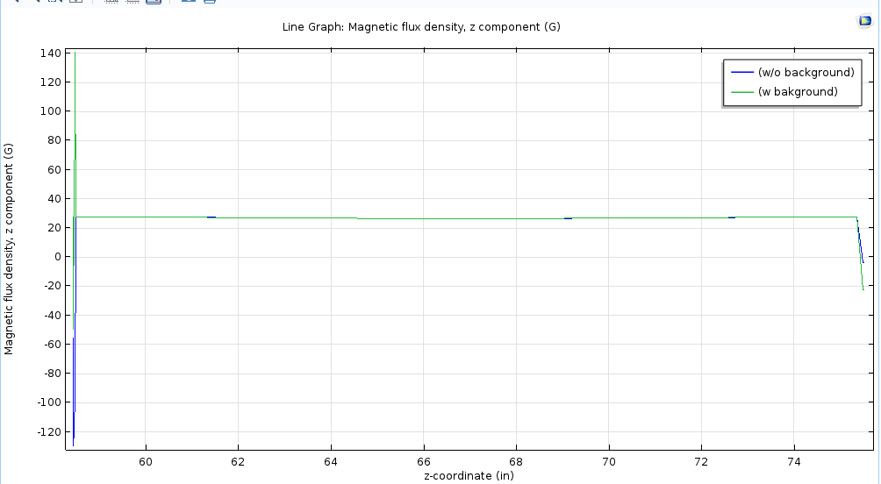
More pictures

