Slide 1
Mubi Khan
March 10 2025

Slide 2
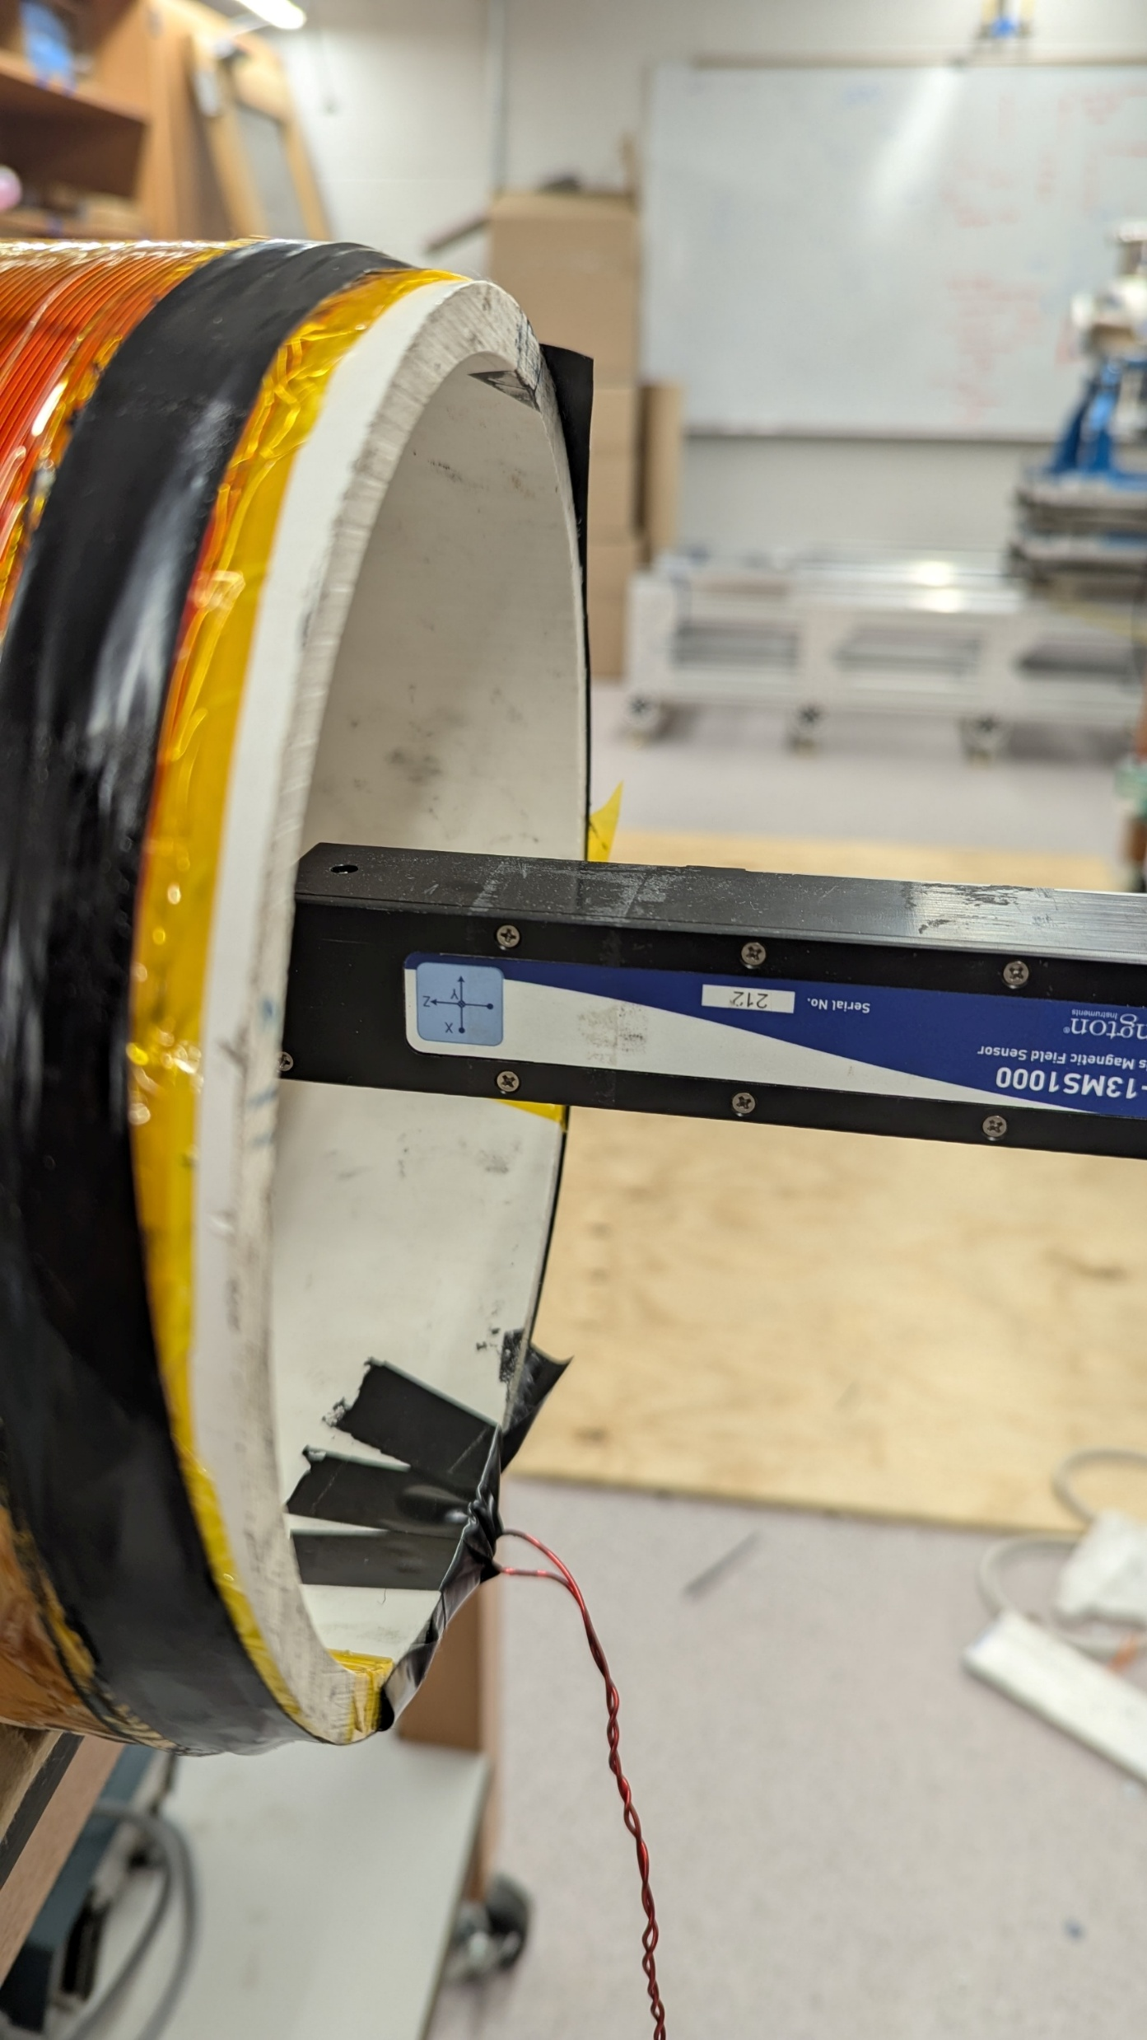
Point 1 is 50 cm to the right from the right edge, 2 is at the edge, and 3 is at the middle
+
I= 0.15 A
Z
Y
.
3
2
1
60.5 cm
No mu metal
X
-
Position | Bx (μT) | By (μT) | Bz (μT) | B_total(μT)
1 | 41.82 | -7.28 | -12.43 | 44.23
3 | 32.82 | -4.48 | -649.30 | 650.14
2 | 41.99 | -8.32 | -14.00 | 45.03
Calculated field for 0.15 A is 650μT in the middle

Slide 3
No mumetal new measurements
This is config 1
Point 1 is 60.5 cm to the right from the right edge, 2 is at the edge, and 3 is at the middle
+
I= 0.20 A
Z
Y
.
3
2
1
50 cm
No mu metal
X
-
Coil specification
1. Turn density: 10 cm^-1
2. Current: 0.2 A
3. Length: 54 cm
4. Resistance: 29.5 Ohms
Config 2 is when the polarity is reversed

Slide 4
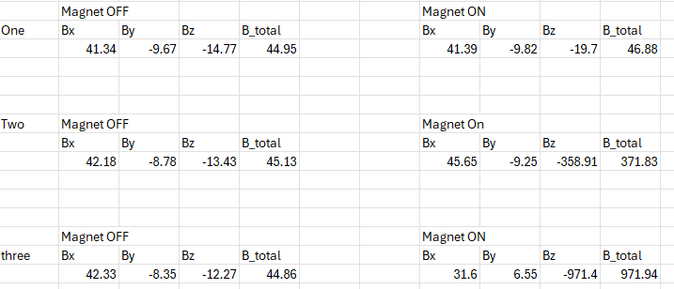
Config 1
Background
Calculation shows about 500 microT

Slide 5
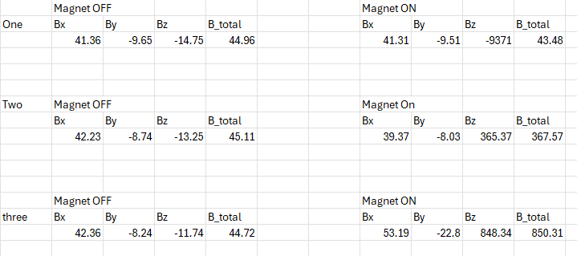
Config 2 (reversed polarity)
Background
Calculation shows about 500 microT

