Slide 1
Progress with precise on-pixel time stamping and event selection with Timepix4 and Picopix
M. Campbell¹, X. Llopart,
on behalf of the Medipix4 Collaboration and the Picopix design team
CERN, EP Department
1211 Geneva 23
Switzerland
¹ Honorary Professor at Glasgow University
Notes:
I am going to talk about the hybrid pixel detector readout chips that have been designed at CERN in the framework of the Medipix2 and 3 collaborations.

Slide 2
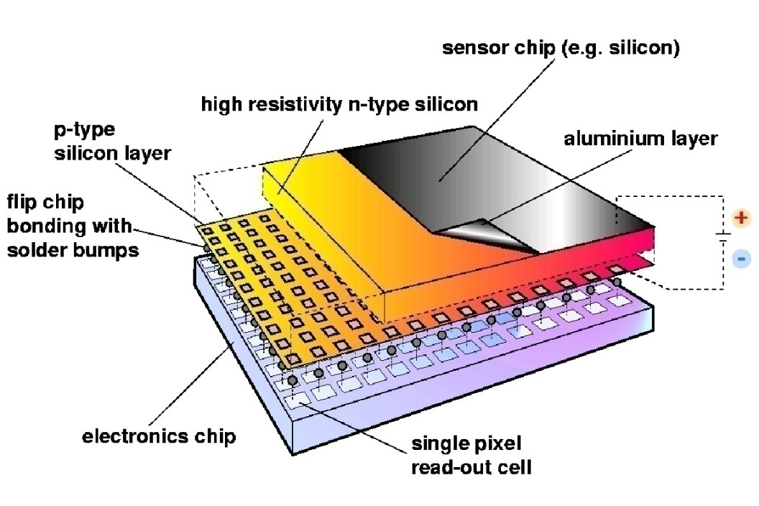
Hybrid Silicon Pixel Detectors
Noise-hit free images possible (high ratio of threshold/noise)
Standard CMOS can be used (follow industry)
Sensor material can be changed (Si, GaAs, CdTe..)
Semiconductor sensor can be replaced by a gas gain grid or MCP
Permits novel fast sensor topologies
Notes:
Mention signal generation Add X section?

Slide 3
Outline
The Medipix and Timepix family timeline
Timepix4 description
Timepix4 characterisation
Progress with Through Silicon Via processing
Picopix
Some personal observations
Summary and Conclusion

Slide 4
Medipix2 (1999 -> ) | Medipix3 (2005 -> ) | Medipix4 (2016 -> )
Albert-Ludwig Universität Freiburg, Germany | Albert-Ludwig Universität Freiburg, Germany | CEA, Paris, France
CEA, Paris, France | AMOLF, Amsterdam, The Netherlands | CERN, Geneva, Switzerland
CERN, Geneva, Switzerland | Brazilian Light Source, Campinas, Brazil | DESY-Hamburg, Germany
Czech Academy of Sciences, Prague, Czechia | CEA, Paris, France | Diamond Light Source, England, UK
ESRF, Grenoble, France | CERN, Geneva, Switzerland | IEAP, Czech Technical University, Prague, Czeciah
IEAP, Czech Technical University, Prague, Czech Republic | DESY-Hamburg, Germany | IFAE, Barcelona, Spain
IFAE, Barcelona, Spain | Diamond Light Source, England, UK | JINR, Dubna, Russian Federation
Mid Sweden University, Sundsvall, Sweden | ESRF, Grenoble, France | NIKHEF, Amsterdam, The Netherlands
MRC-LMB Cambridge, England, UK | IEAP, Czech Technical University, Prague, Czech Republic | University of California, Berkeley, USA
NIKHEF, Amsterdam, The Netherlands | KIT/ANKA, Forschungszentrum Karlsruhe, Germany | University of Canterbury, Christchurch, New Zealand
University of California, Berkeley, USA | Mid Sweden University, Sundsvall, Sweden | University of Geneva, Switzerland
Universität Erlangen-Nurnberg, Erlangen, German | NIKHEF, Amsterdam, The Netherlands | University of Glasgow, Scotland, UK
University of Glasgow, Scotland, UK | Univesridad de los Andes, Bogota, Columbia | University of Houston, USA
University of Houston, USA | University of Bonn, Germany | University of Maastricht, The Netherlands
University and INFN Section of Cagliari, Italy | University of California, Berkeley, USA | University of Oxford, England, UK
University and INFN Section of Pisa, Italy | University of Canterbury, Christchurch, New Zealand | INFN, Italy
University and INFN Section of Napoli, Italy | Universität Erlangen-Nurnberg, Erlangen, German | Chinese Spallation Neutron Source, Dongguan City,China
 | University of Glasgow, Scotland, UK | Brazilian Light Source, Campinas, Brazil
 | University of Houston, USA | Philippines Nuclear Research Institute, Manila, Philippines
 | University of Leiden, The Netherlands | Czech Academy of Sciences, Prague, Czech Republic
 | Technical University of Munich, Germany | Univeristy of Tennessee, Knoxville, USA
 | VTT Information Technology, Espoo, Finland

Slide 5
Commercial Partners
COLLABORATION NAME | Medipix2 |  |  | Medipix3 |  | Medipix4
ASICS | Medipix2 | Timepix | Timepix2 | Medipix3 | Timepix3 | Medipix4 | Timepix4
ADVACAM s.r.o., CZ | X | X | X | X | X |  | X
Amsterdam Scientific Instruments, NL | X | X |  | X | X |  | X
Kromek, UK | X | X | X |  | X
Malvern-Panalytical, NL | X | X |  | X
MARS Bio Imaging, New Zealand |  |  |  | X
PITEC, Brazil |  |  | X | X |  |  | X
Quantum Detectors, UK |  |  |  | X |  |  | X
Sequent Logic, USA |  |  |  |  |  |  | X
Sydor Technologies, USA |  |  |  |  |  |  | X
Thermo Fischer Scientific, CZ |  |  |  |  |  |  | X
X-ray Imaging Europe, Germany | X | X
X-spectrum, Germany |  |  |  | X |  |  | X
X = commercial licensee X = R and D licensee

Slide 6
Motivation for Medipix/Timepix Developments
Hybrid pixel detectors for the LHC are designed to do one thing extremely well
Tag each traversing particle to one bunch crossing (25ns)
On-chip (or on-pixel) hit buffering and selection (only triggered events are read out)
Tolerate extreme radiation environment
The Medipix/Timepix chips were intended to use the same technology for other applications
Not so Application Specific Integrated Circuit
The Medipix family aims primarily at high flux spectroscopic X-ray imaging
The Timepix family is better suited to detecting single particles
The experience gathered has led to innovative solutions for the LHC machine and experiments (VELOpix, Picopix etc)

Slide 7
The Medipix and Timepix ASICs - Timeline
Collaboration | 2003 | 2006 | 2013 | 2014 | 2017 | 2018 | 2020 | 2022 | 2025?
Medipix2 | Medipix2 | Timepix |  |  |  | Timepix2
Medipix3 |  |  | Medipix3 | Timepix3
Medipix4 |  |  |  |  |  |  | Timepix4 | Medipix4
LHCb |  |  |  |  | VELOpix |  |  |  | Picopix
Medipix chips aim at energy sensitive photon counting and typically use frame-based readout
Timepix chips are more oriented towards single particle detection

Slide 8
The Medipix and Timepix ASICs - Timeline
Collaboration | 2003 | 2006 | 2013 | 2014 | 2017 | 2018 | 2020 | 2021 | 2026?
Medipix2 | Medipix2 | Timepix |  |  |  | Timepix2
Medipix3 |  |  | Medipix3 | Timepix3
Medipix4 |  |  |  |  |  |  | Timepix4 | Medipix4
LHCb |  |  |  |  | VELOpix |  |  |  | Picopix
Medipix chips aim at energy sensitive photon counting and typically use frame-based readout
Timepix chips are more oriented towards single particle detection
This talk will focus on the Timepix4 and Picopix chips

Slide 9
Timepix4
 |  |  | Specifications
Technology |  |  | 65nm – 10 metal
Pixel Size |  |  | 55 x 55 µm
Pixel arrangement |  |  | 4-side buttable 512 x 448
Sensitive area |  |  | 6.94 cm²
Readout Modes | Data driven (Tracking) | Mode | ToT and ToA
 |  | Event Packet | 64-bit
 |  | Max rate | <3.58 Mhits/mm²/s
 |  | Max pix rate | 10.6kHz/pixel
 | Frame based (Imaging) | Mode | CRW: PC (8 or 16-bit)
 |  | Frame | Full Frame (without pixel addr) CRW (8-bit / 16-bit) Up to 44 KHz frame @8b
 |  | Max count rate | ~800 Ghits/cm²/s
TOT energy resolution |  |  | < 1Kev
Time resolution (bin size) |  |  | ~200ps
Readout bandwidth |  |  | ≤163 Gbps (16 x 10.24 Gbps)
Target global minimum threshold |  |  | <500 e⁻

Slide 10

Timepix4 Floorplan
24700 µm
WB_TOP (900 um)
TSV_TOP (460 um)
q
TSVs
28160 µm (512 x 55 µm)
29960 µm
TSV_MID (920 um)
24640 µm (448 x 55 µm)
13158.4 µm
(256 x 51.4 µm)
TSVs
TSV_BOT (460 um)
WB_BOT (900 um)

Slide 11
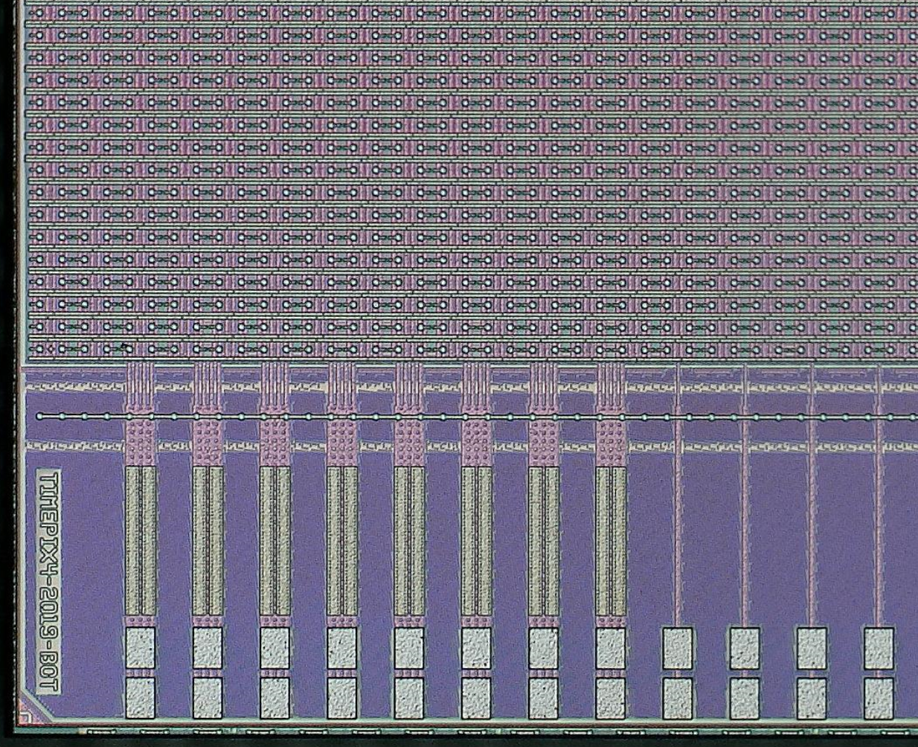
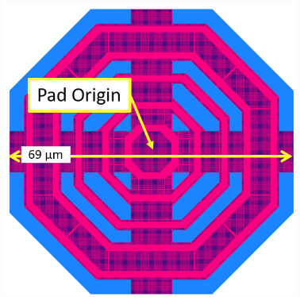
Timepix4 Bottom left detail
BOTTOM Matrix
BOTTOM Periphery
460 µm
Dicing lane #1
BOTTOM
WB Extender
Dicing lane #2

Slide 12
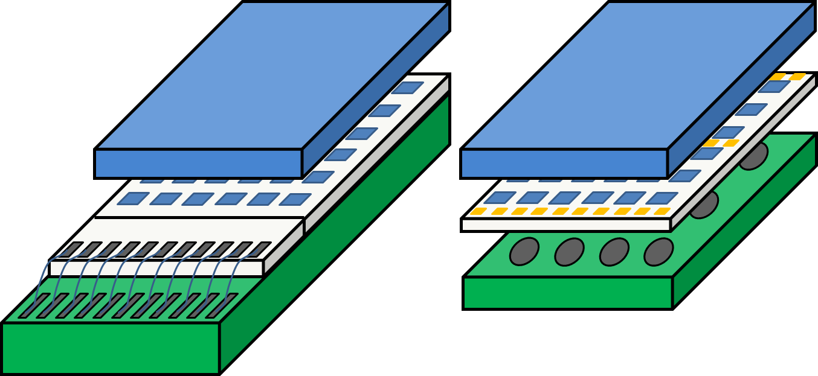
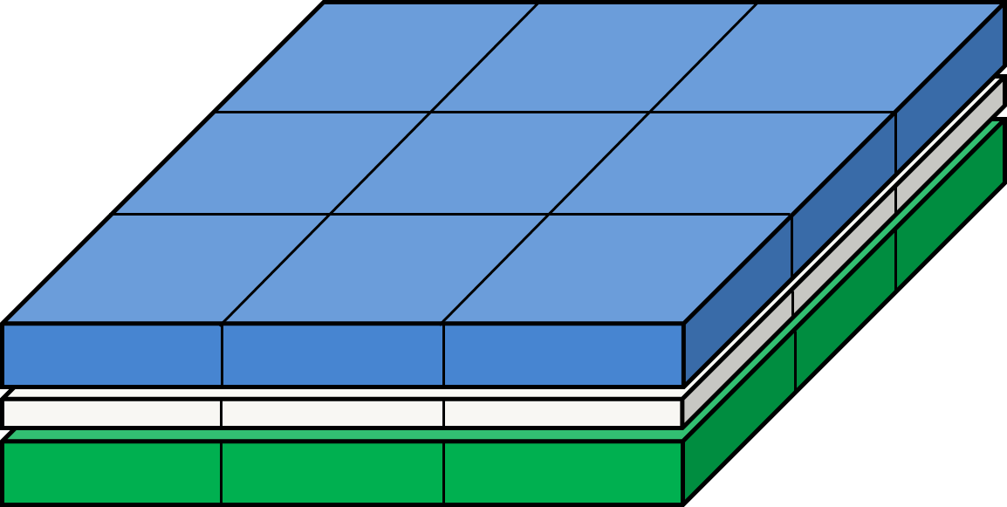
Tiling larger areas
Sensor
FC
FC
BGA
ASIC
Wire Bonding
PCB
Target to build large area detectors by combining smaller modules.
The through-silicon vias (TSVs) is the key technology for this paradigm shift.
Timepix4s use on-chip interposer for bump to pixel redistribution layer (RDL).
The detector is fully sensitive: even above the peripheral circuit and I/O pads.

Slide 13
Timepix4 Pixel Schematic
1 pixel
8 pixels
32 pixels
Front-end
Front-end
Super pixel
SPG
8-bits
Leakage
Current
compensation
Counters
&
Latches
 | bits
ADDR | 9
ToA | 16
ufToA_r | 4
ufToA_f | 4
fToA_r | 5
fToA_f | 5
ToT | 12
Pileup | 1
8-bits
Clock
local
Sync
Readout
ADB
Input
pad
2.5fF
Synchronizer
&
Clock gating
Preamp
TestBit
~50mV/ke⁻
MaskBit
14-bits
VCO
@640MHz
8-bits
8
5-bit Local
Threshold
4
3fF
640MHz
TpA
TpB
Time stamp
OP Mode
Control
voltage
Data out
to EOC
clock
(40MHz)
Global threshold

Slide 14
Pixel Operation in TOA & TOT [DD]
Tpeak < 25ns
Preamp Out
Disc Out
Clk (40MHz)
Global TOA (16-bit)
65533
65534
65535
0
1
2
3
4
VCO Clk (640MHz)
FTOA_R (4 bits)=7
FTOA_F (4 bits)=11
TOA (16-bit)
X
65534
TOA (16 bits)=65534
TOT Clk (40MHz)
TOT (10 bits) =4
UFTOA_Start (4-bits)
X
0
UFTOA_Stop (4-bits)
X
8

Slide 15
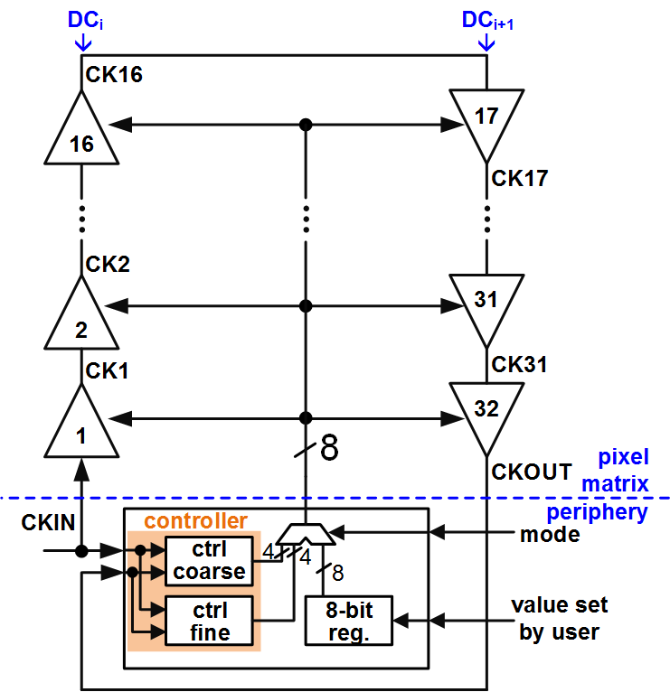
Full digital double column DLL [448 dDLL: 224 Top Matrix and 224 Bottom Matrix]
iWoRID 2018
X. Llopart et al 2019 JINST 14 C01024
ADB
output buffer
in
coarse
delay
section
fine
delay
section
out
14
15
ctrl_coarse
ctrl_fine
Measured in Timepix4v2
Timepix4 ~23 mW/cm² @40MHz clock with a 100 ps_{rms}
Timepix3 ~100mW/cm² @40MHz clock with ~1.2ns skew
Dynamic digital power consumption is distributed across the clock period

Slide 16
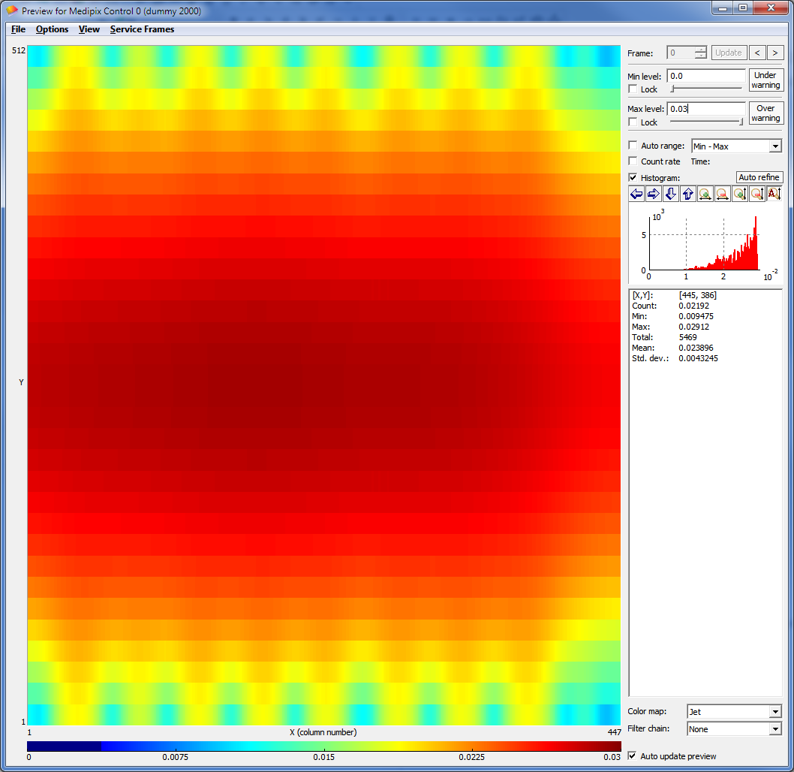
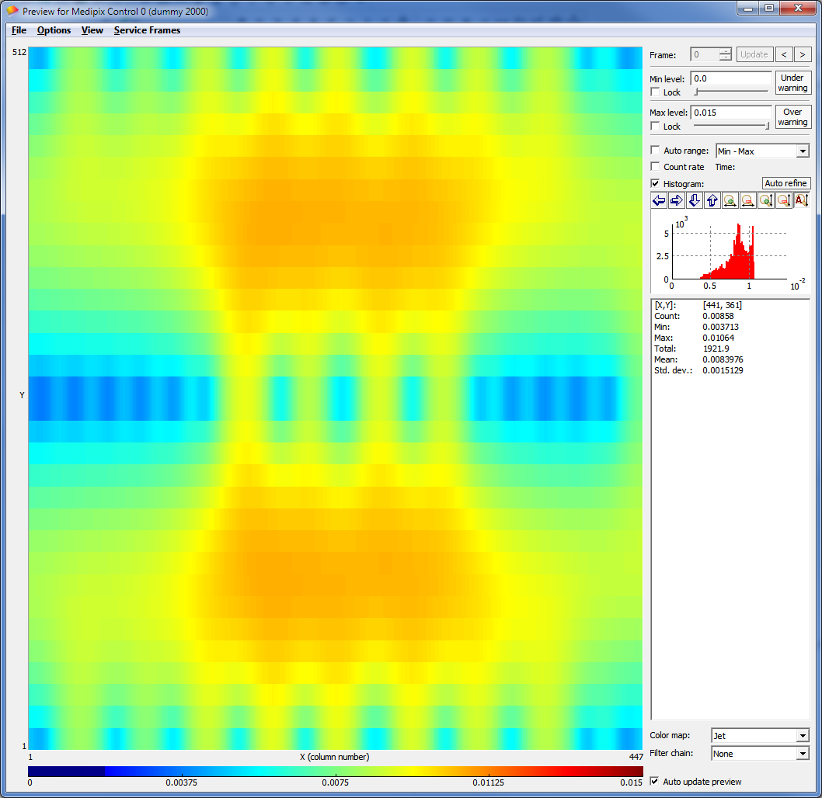
Analog (static) power supply distribution
 | Total I (chip) |  | 2 WB | 3 TSV
Nominal Analog Power [10 µA/pixel] | ~2300 mA | V_{drop} [VDDA-GNDA] | 19.6 mV | 6.9 mV
 |  | Imax pad | 60 mA | 57 mA
Low Analog Power [1 µA/pixel] | ~230 mA | V_{drop} [VDDA-GNDA] | 1.96mV | 0.69mV
 |  | Imax pad | 6 mA | 5.7 mA
2 sets of wire bonds
With TSVs

Slide 17
Timepix4 submissions
Timepix4v0
~17 FTEE
Full mask engineering run
6 wafers received
Timepix4v1
4 BEOL masks changed
Small test VCO chip
6 wafers received
Timepix4v2
4 FEOL + 4 BEOL masks changed
19 wafers received
Timepix4v3
2 BEOL masks changed
25 wafers received
+ 50 wafers (2024)
Q4 2019
Q3 2020
Q2 2021
Q3 2022
Chip is operational
Improved RDL shielding in peripheries
640MHz in peripheries recovered
TDC and High speed links working as expected
Further improvement in RDL shielding in peripheries
Chip at its production version
Larger IO Pads
Chip at its production version
Excess noise coupling from peripheries to FE
640 MHz clock in edge peripheries
VCO not oscillating at nominal frequency
VCO not oscillating at nominal frequency

Slide 18
Analog pixel summary measureament
Preliminary results
FE settings in nominal power mode
Pixels on top of peripheries not described here
Ctest=3.2 fF assumed
 | Electron collection |  | Holes collection
 | High Gain | Low Gain | High Gain | Low Gain | Log Gain
Pixel gain | ~35.8mV/ke- | ~20.5mV/ke- | ~34.5mV/ke- | ~20.5mV/ke- | ~20.5mV/ke-
Gain variation | <2% | <2% | <2% | <2% | <2%
ENC | ~65 e⁻_{rms} | ~80 e⁻_{rms} | ~65 e⁻_{rms} | ~80 e⁻_{rms} | ~80 e⁻_{rms}
Amplitude Linearity | < 7 ke- | < 12 ke- | < 7ke- | < 13 ke- | < 7ke-
Threshold Eq | < 35 e⁻_{rms} | < 60 e⁻_{rms} | < 35 e⁻_{rms} | < 60 e⁻_{rms} | tbd
Min Threshold | < 450 e⁻ | < 650 e⁻ | < 450 e⁻ | < 650 e⁻ | tbd
TOT Energy resolution (Si) (@ Qin < ~2ke-) | <1.5 keV_{FWHM} | tbd | <1.5 keV_{FWHM} | tbd | tbd
TOA bin size | ~160 ps (instead of 195 ps)
TOA resolution (@Qin>~7ke-) | <100 ps_{rms} | tbd | <100 ps_{rms} | tbd | tbd

Slide 19
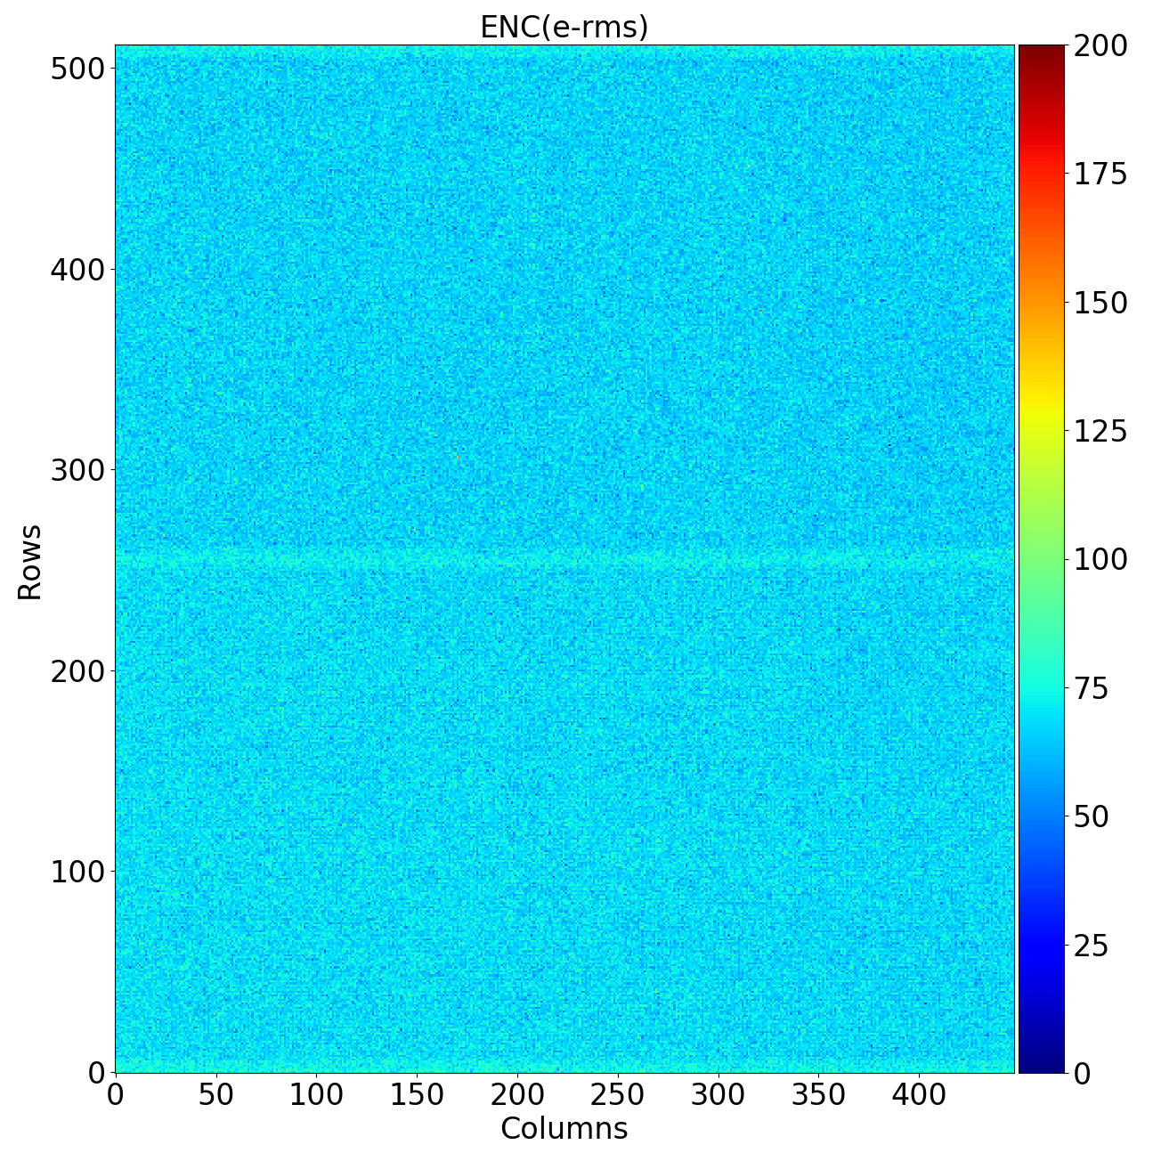
Timepix4v2 ENC

Slide 20
Timepix4v1/2: Number of Noisy pixels (>1 count) in DD

Slide 21
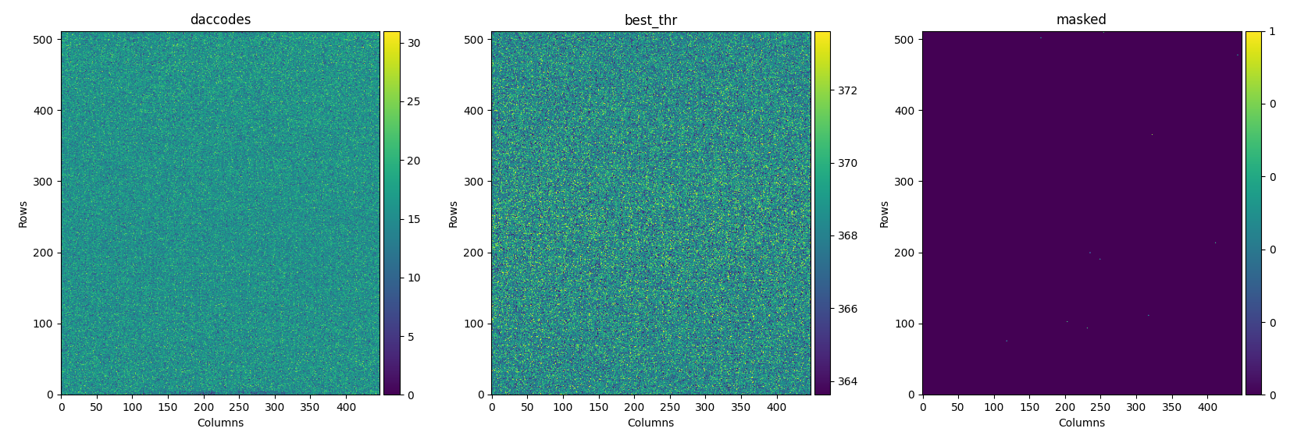
Equalization matrix [PC24bit mode, e- collection high gain]
All pixels responding (448x512)
11 pixels masked
No observable systematic across matrix

Slide 22
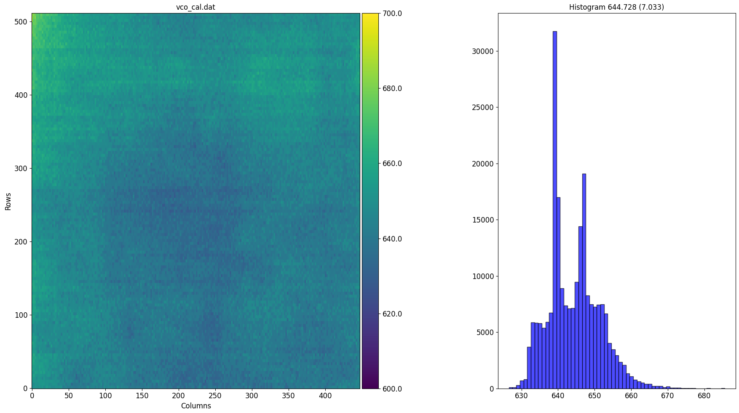
Timepix4 2D VCO distribution (MHz)
Measured VCO oscillation frequency in Timepix4 using on chip Test Pulse circuitry
Most of measured dispersion across chip due to power supply distribution (VCO design sensitivity of 1MHz/mV)
VCO Calibration is required to get to the designed time resolution (~60psrms)
Large improvement expected with TSVs
700
650
600
600 700

Slide 23
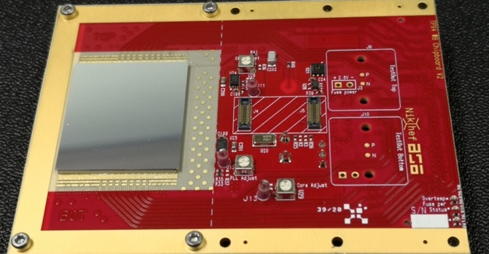
Timepix4 assembly (300μm Si sensor)

Slide 24
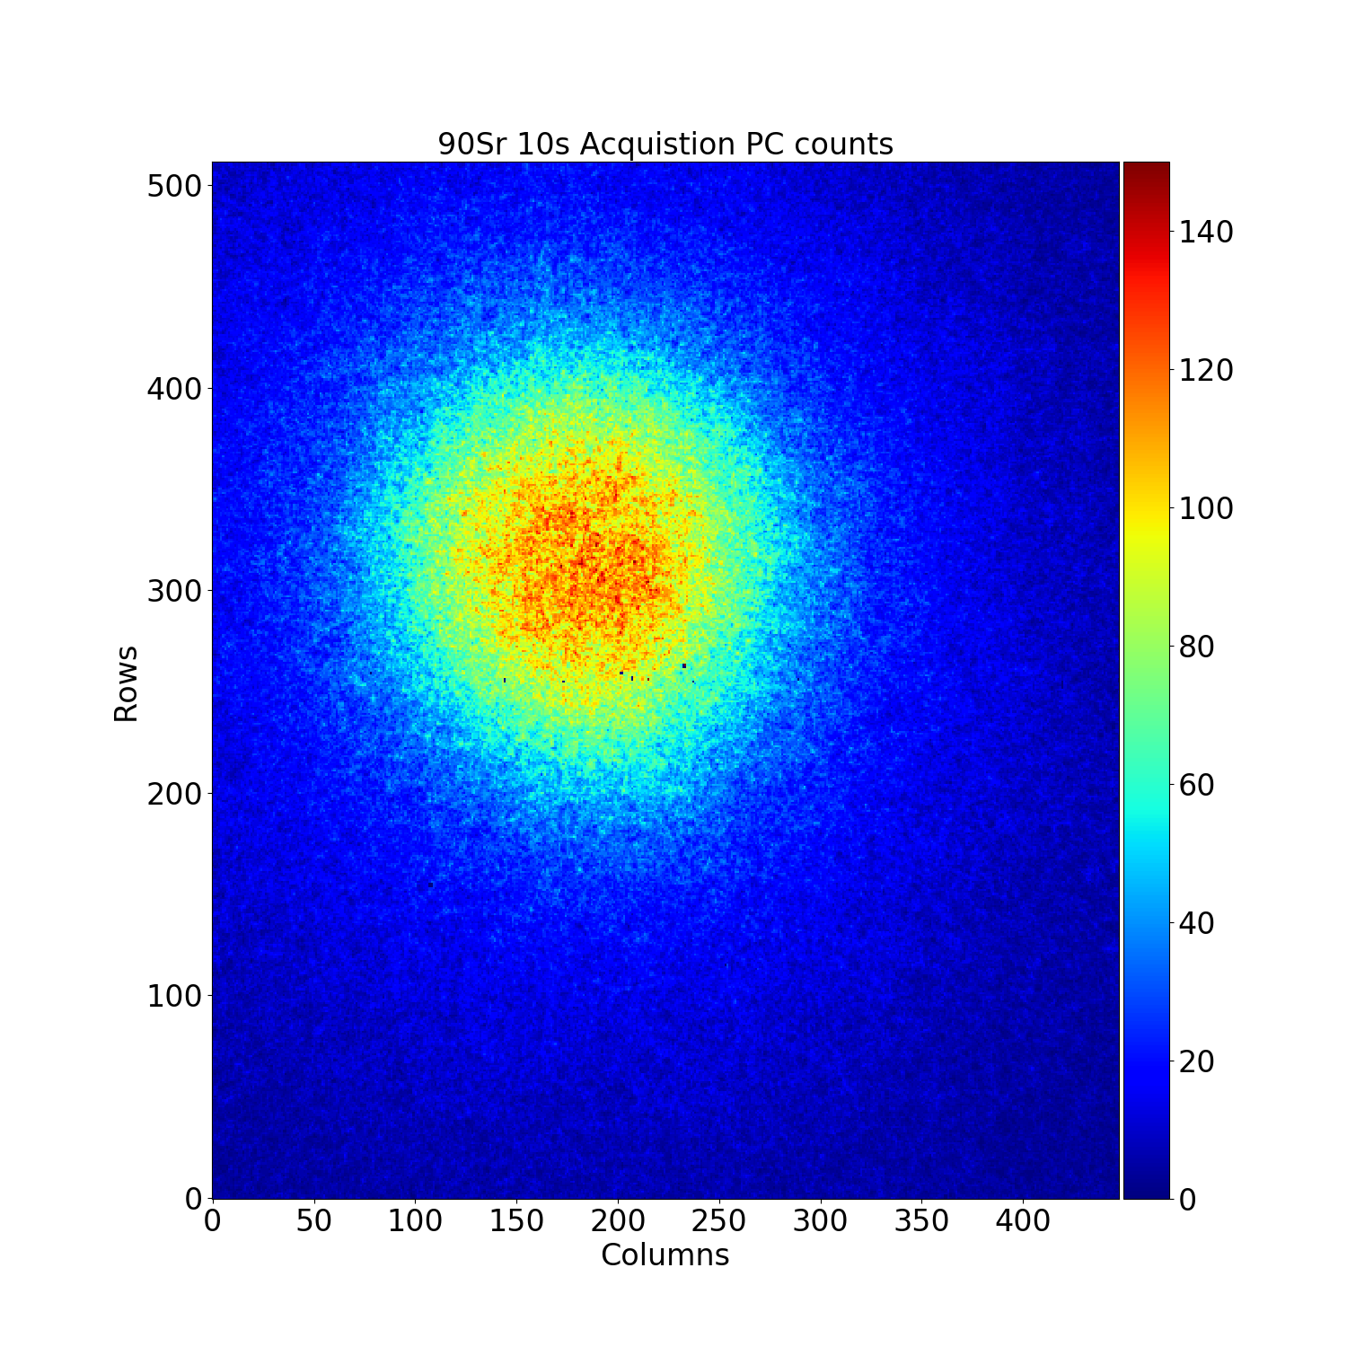
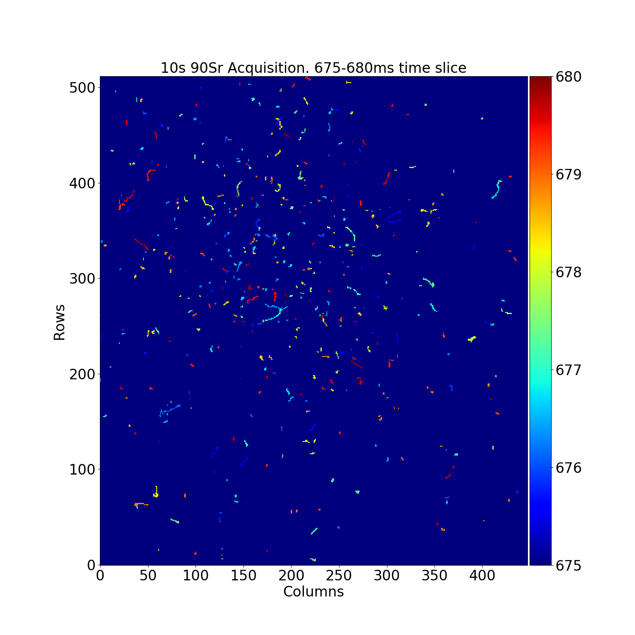
Timepix4 – works! ☺
10 s exp. ⁹⁰Sr
5 ms timeslice
Threshold ~ 800e⁻
6.1 M packets @ 5 Gbps

Slide 25
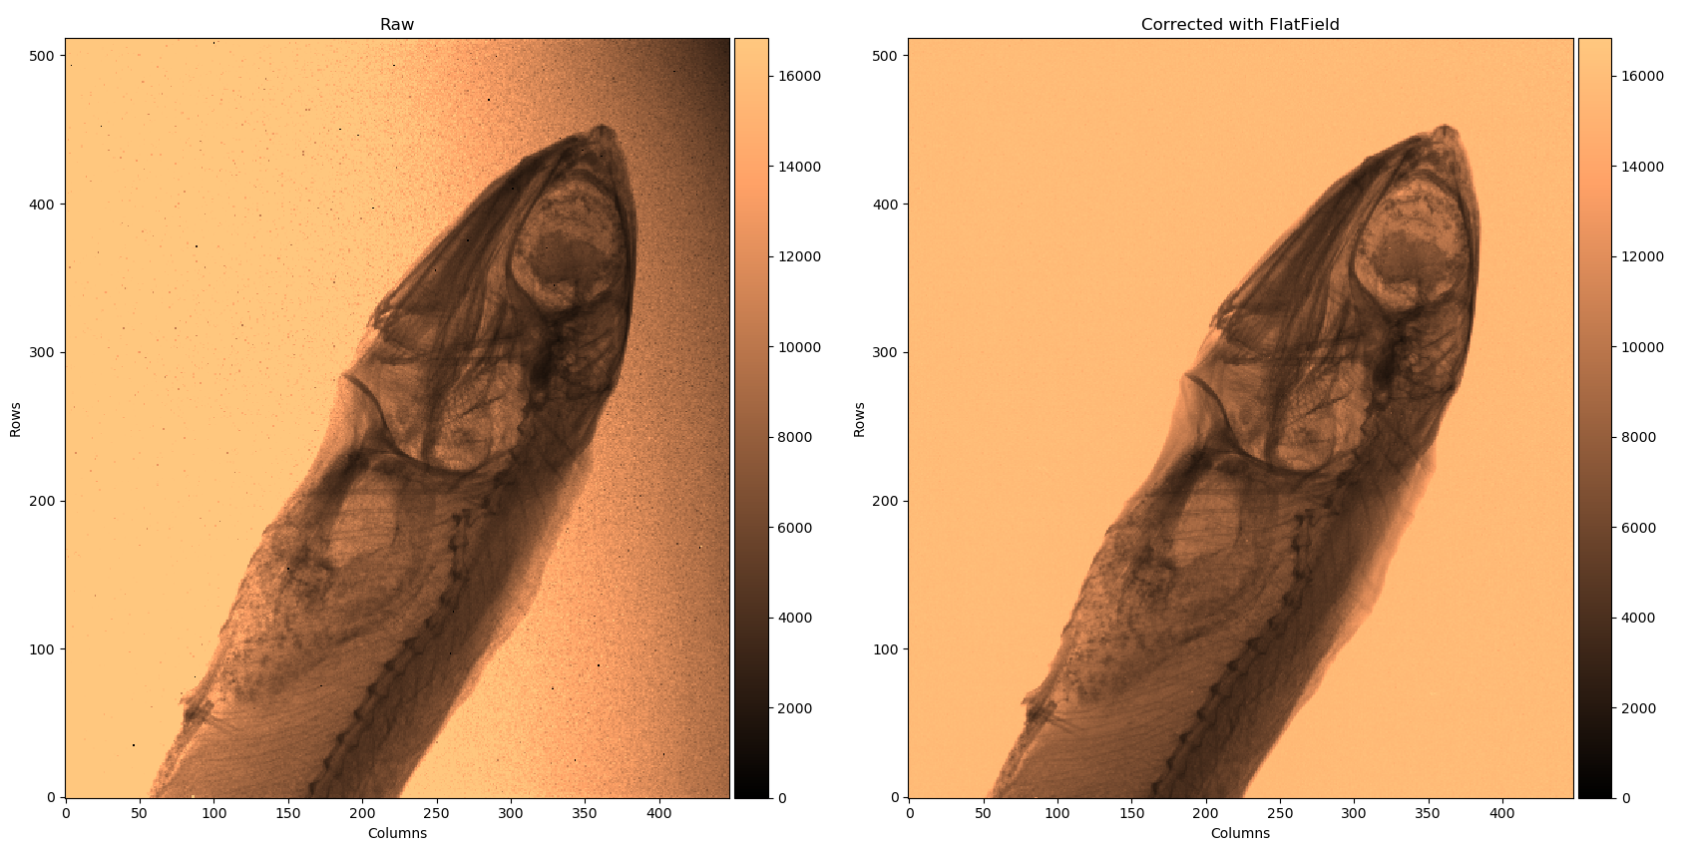
Photon counting image Timepix4
Timepix4 paper:
X. Llopart et al 2022 JINST 17 C01044

Slide 26
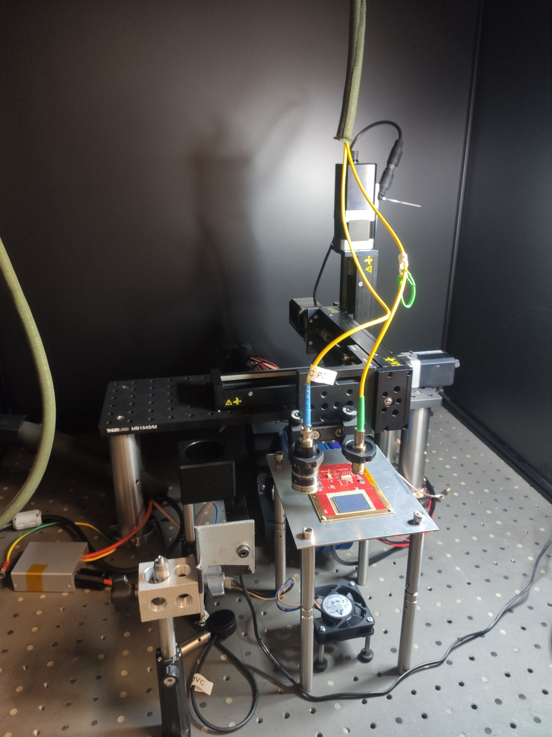
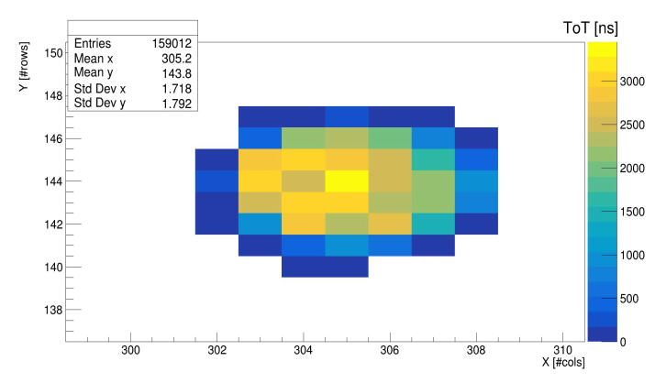
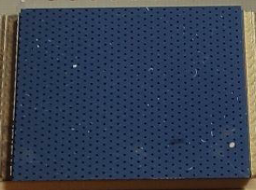
Timing resolution measurements of Timepix4V2 assembly with picosecond laser setup
Setup:
Timepix4v2 bonded to a 100 μm n-on-p Si detector:
Biased at -150 V
Metallization with holes pattern
Pulsed Diode Laser PDL 800-B:
1060 nm
Trigger simultaneously sent to laser and Timepix4 Trigger input
σ = 1.4 pixel = 77 μm
most of the charge is released in 4-5 pixels
Wide range of released charge covered
Measurement:
After TOT timewalk correction and VCO calibration:
Single pixel resolution of 111 ± 1 ps
Cluster timing resolution of σToAAvg = 49 ± 1 ps
R.Bolzonella (INFN Ferrara)

Slide 27
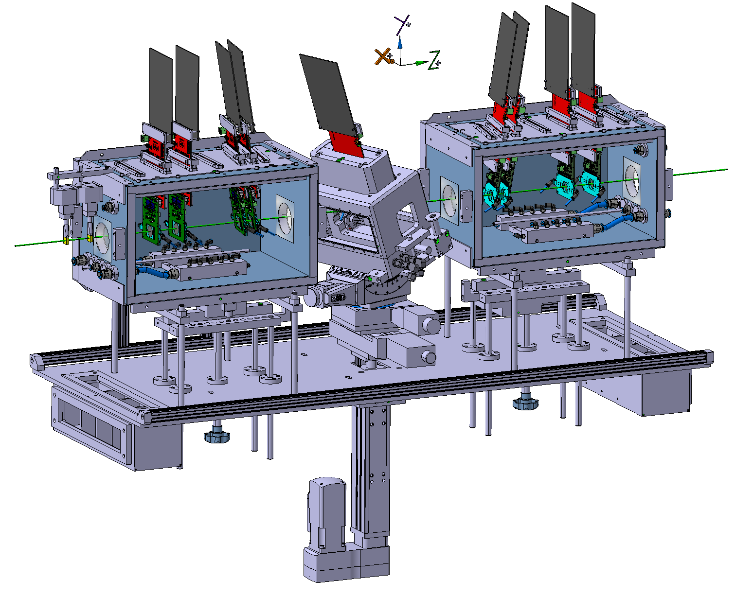
Timepix4 telescope
K. Akiba et al. arXiv:2503.15207v1 [hep-ex] 19 Mar 2025

Slide 28
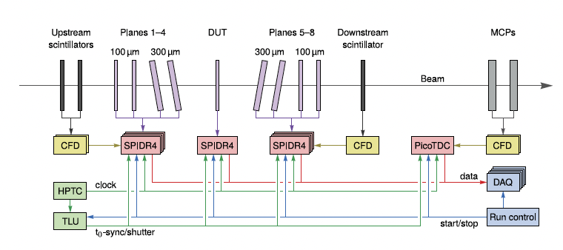
Timepix4 telescope
K. Akiba et al. arXiv:2503.15207v1 [hep-ex] 19 Mar 2025

Slide 29
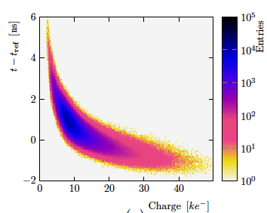
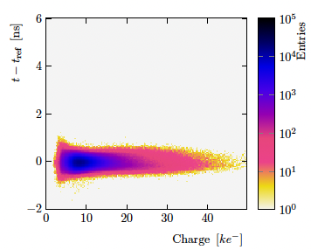
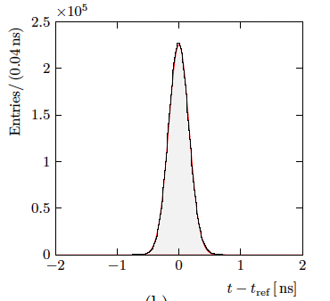
Timewalk correction – all pixels
Single plane (100 μm sensor)
Temporal resolution 175 ps
K. Akiba et al. arXiv:2503.15207v1 [hep-ex] 19 Mar 2025

Slide 30
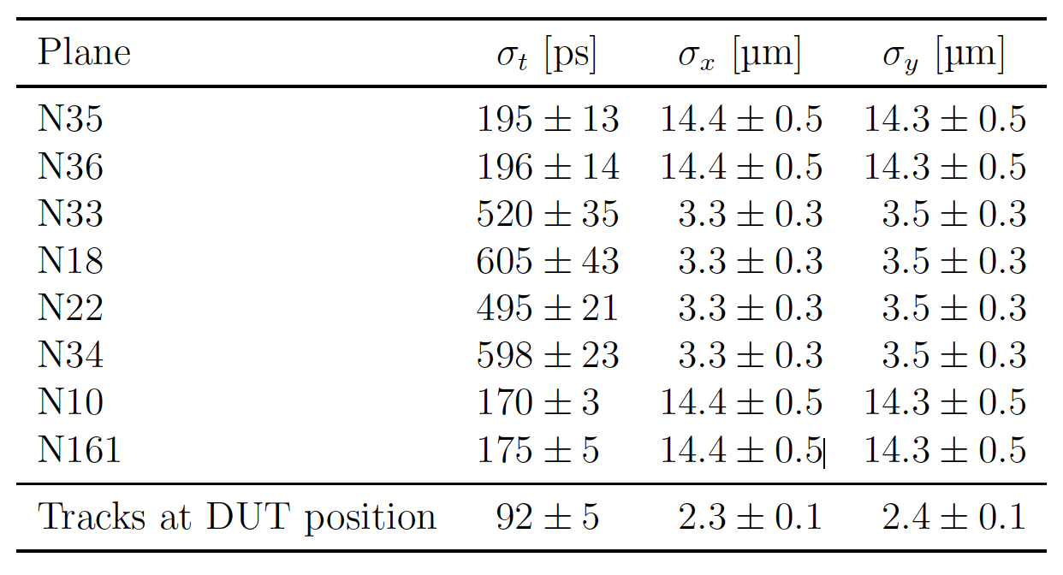
Timepix4 telescope summary
Telescope was operated at 2 x 10⁶ particles per second (highest possible at CERN SPS) with <1% loss in efficiency
K. Akiba et al. arXiv:2503.15207v1 [hep-ex] 19 Mar 2025

Slide 31
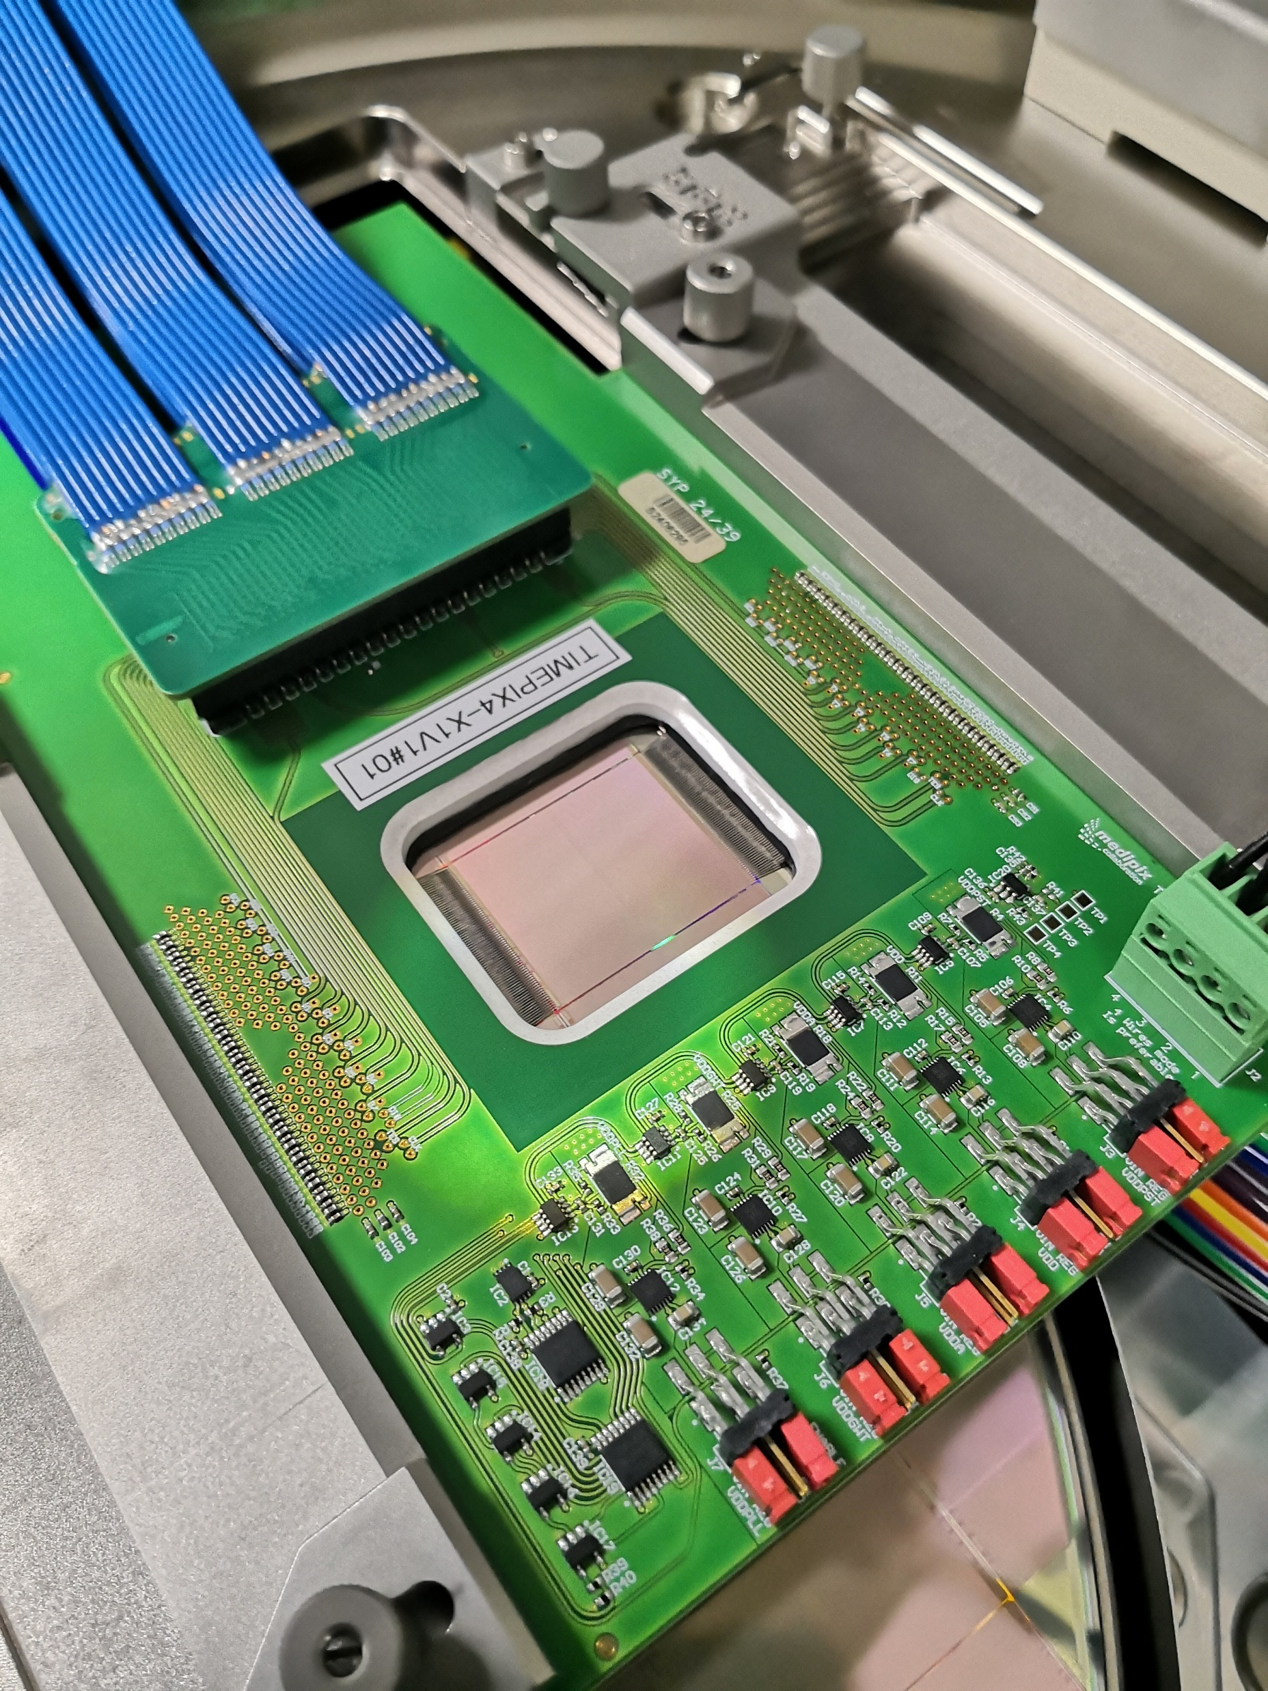
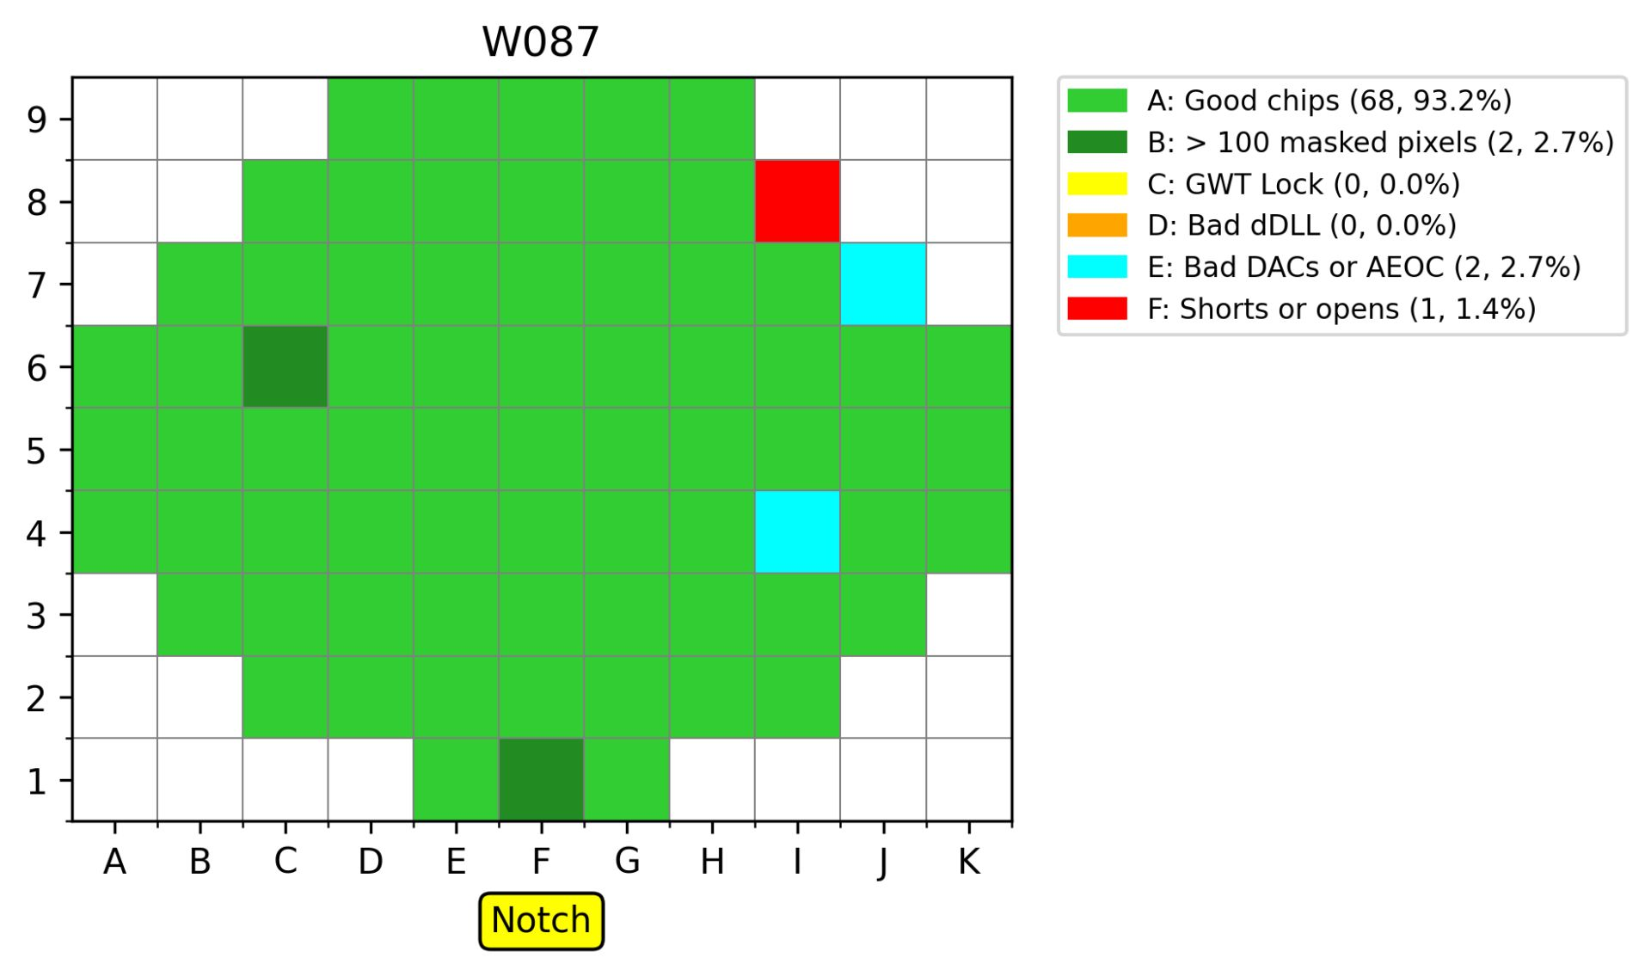
Timepix4 Wafer Probing
Tested > 35 Wafers
Average yield of >85%
Jerome Alozy et al.

Slide 32

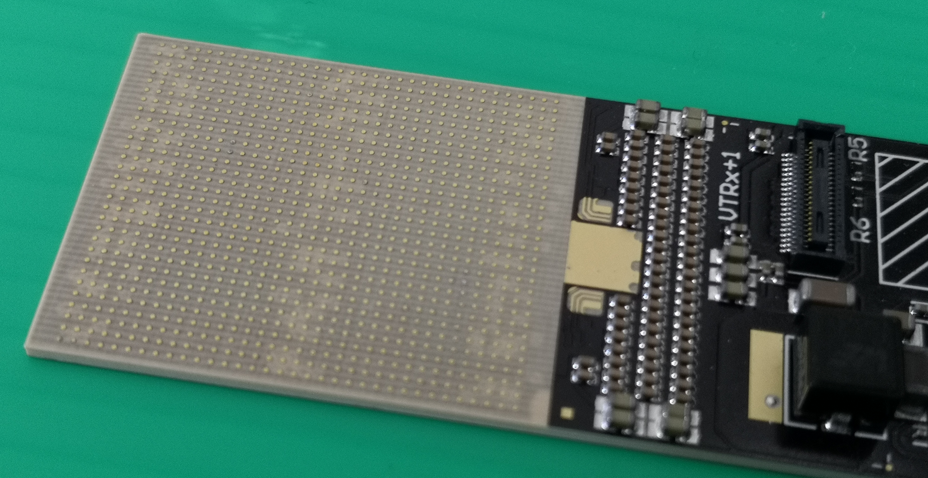
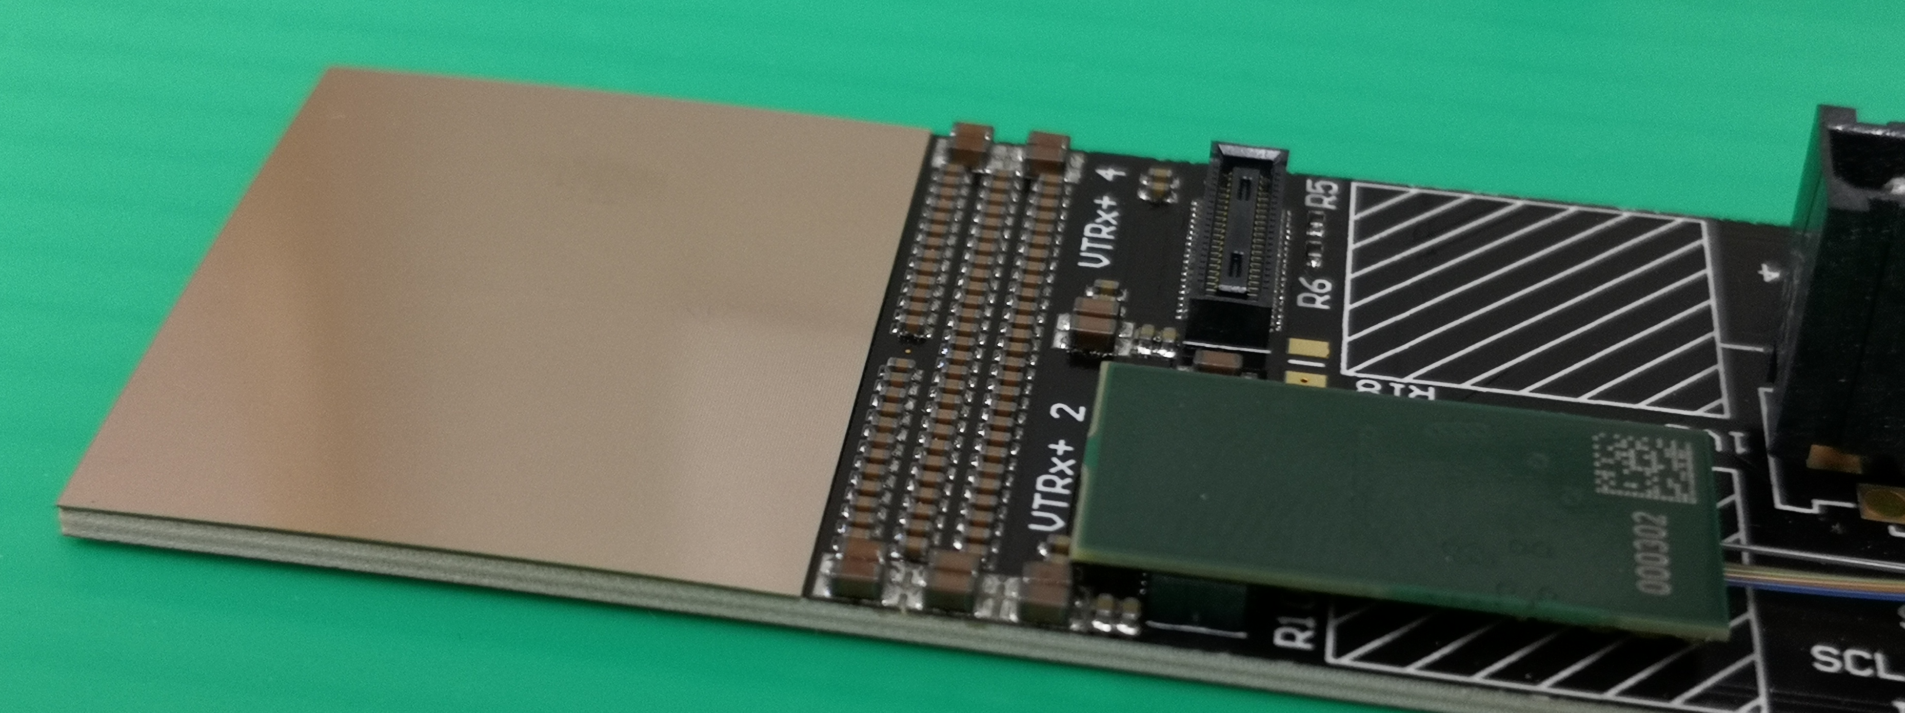
Timepix4 Through-Silicon-Via (TSV)
Redistribution Layer + UBM designed at CERN
Launched a multisite production (2 European and 1 Asian)
Using Timepix4V0, V1 (as setup wafers) V2 and V3 as “gold” wafers
Expected to receive ~300 Timepix4v3 with TSVs this month
Rear side view of TPIX4 wuth RDL
Naked finger board
Finger board with TSV processed Timepix4
Fran Piernas, Jerome Alozy et al.

Slide 33
Examples of applications outside of HEP
X-ray materials analysis with diffraction
Photon counting cameras at synchrotrons
Time resolved cameras at synchrotrons
X-ray non-destructive testing
X-ray dosimetry - dosepix chip development
Waste sorting using X-rays
Low Energy Electron Microscopy
Transmission electron microscopy
Dose deposition tracking in hadron therapy
Numerous satellite systems dedicated to space weather observation

Slide 34
The Picopix project
PicoPix is a large-scale hybrid pixel tracking particle detector designed in 28nm CMOS:
Large area → 3-side buttable with 384 x 256 pixel array
Spatial resolution → square pixel size of 50 μm
Time measurements → <50 ps_{rms} per Hybrid (ASIC + Sensor)
Radiation hardness → < 1 Grad with full TMR (Triple Modular Redundancy) logic design
Data reduction → On-chip programmable event clustering, veto, filtering and sorting
Event rate → Up to 96 events/chip/25ns → ≤3.84∙10⁹ events/chip
High speed serializer → Data-driven readout with up-to 4 x 25.6 Gbps fast links
Design Approach:
Built from gained experienced from previous hybrid pixel detectors tracking detectors designed in EP-ESE-ME:
Timepix (2007) → Timepix3 (2013) → Velopix1 (2016) → Timepix4 (2020)
CERN and Nikhef design team
Directly profiting from CERN EP-RD program:
WP5.3: Intelligence on detector, WP5.2: IP blocks, WP5.5: 3D interconnects
WP6: High Speed links

Slide 35
Potential Applications of PicoPix
LHCb VELO Upgrade 2 & Fast-Sensor R&D
High-precision tracking for High-Luminosity LHC (HL-LHC)
Timing resolution below 50 ps to distinguish multiple collisions
Radiation-hard hybrid silicon sensors for extreme environments
SY-BI Beam Loss Monitoring
Bunch-by-bunch beam loss detection
Improved diagnostics for LHC and future e⁺e⁻ colliders
Medipix3 Collaboration (Medical & Industrial Applications)
Hadron therapy beam monitoring in cancer treatment
X-ray diffraction & electron microscopy for material science
Single-layer Compton cameras for homeland security and SPECT imaging
Quantum sensing using entangled particle detection

Slide 36
Picopix Floorplan
Pixel Matrix
384 x 256
(pixel size 50μm x 50μm)
12.8 mm
19.2 mm
Periphery
<3.5mm
SPRINT
SPRINT = Silicon Photonics Radiation-tolerant Integrated Transmitter

Slide 37
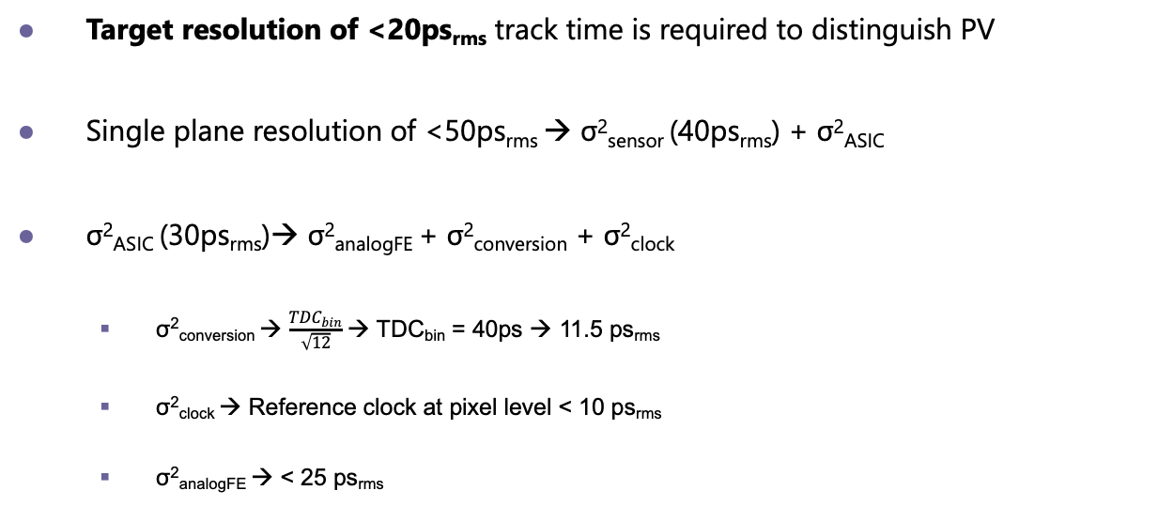
Timing
Target resolution of <20ps_{rms} track time is required to distinguish PV
Single plane resolution of <50ps_{rms} → σ²_{sensor} (40ps_{rms}) + σ²_{ASIC}
σ²_{ASIC} (30ps_{rms})→ σ²_{analogFE} + σ²_{conversion} + σ²_{clock}
σ²_{conversion} → $\frac{{TDC}_{bin}}{\sqrt{12}}$ → TDC_{bin} = 40ps → 11.5 ps_{rms}
σ²_{clock} → Reference clock at pixel level < 10 ps_{rms}
σ²_{analogFE} → < 25 ps_{rms}

Slide 38
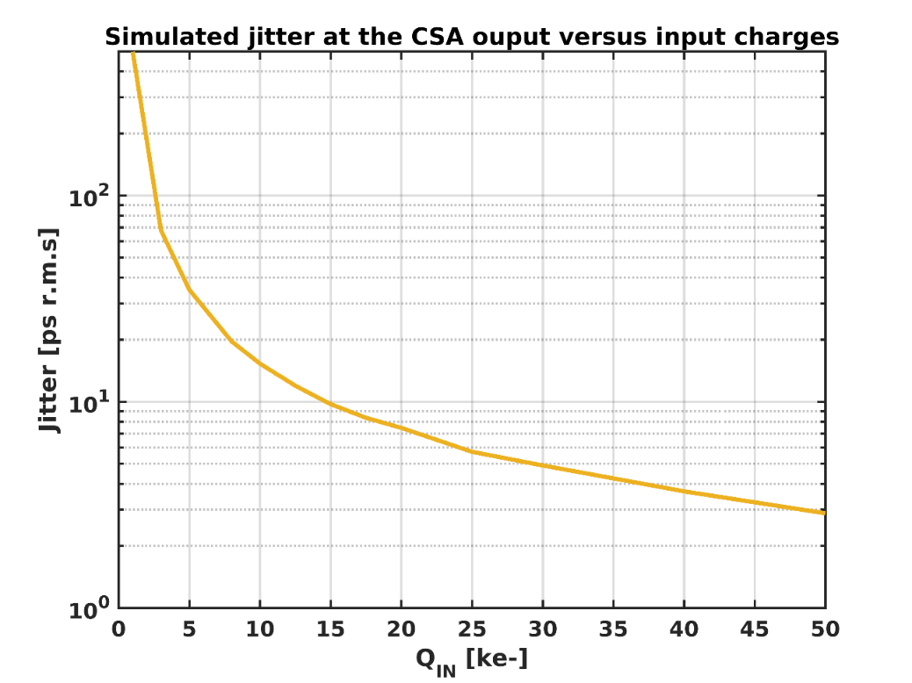
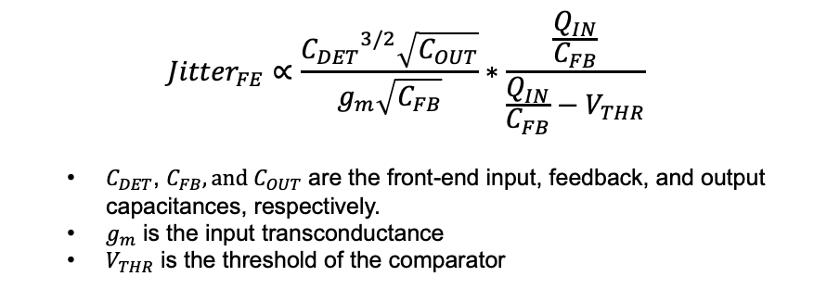
Fundamental limits to time resolution in analog front-end
$${Jitter}_{FE}∝\frac{{C_{DET}}^{3/2}\sqrt{C_{OUT}}}{g_{m}\sqrt{C_{FB}}}∗\frac{\frac{Q_{IN}}{C_{FB}}}{\frac{Q_{IN}}{C_{FB}}−V_{THR}}$$
$C_{DET}$, $C_{FB}, and{ C}_{OUT}$ are the front-end input, feedback, and output capacitances, respectively.
$g_{m}$ is the input transconductance
$V_{THR}$ is the threshold of the comparator
→ Minimize the front-end output capacitance.
→ Maximize the input charge and decrease the threshold.
→ Increase the analog pixel power consumption, but a large power drop over the ASIC worsens the timing performances!
→ The front-end input capacitance must be minimized, which depends on the choice of the sensor, pixel pitch…
R.Ballabriga, The Timepix4 analog front-end design: Lessons learnt on fundamental limits to noise and time resolution in highly segmented hybrid pixel detectors https://doi.org/10.1016/j.nima.2022.167489

Slide 39
Picopix front-end
Front-end: Charge Sensitive Amplifier
Front-end: Quenching element, regeneration circuit
Notes:
A Charge Sensitive Amplifier (CSA) is an electronic circuit designed to convert an input charge (from a sensor or detector) into a proportional voltage output. It is especially common in radiation detection where detectors deliver small charge in response to incident particles.
It presents a low input impedance and a gain (Volts/Charge) which is determined by the inverse of the value of the feedback capacitor (1/CF).

Slide 40
Picopix Architecture
PIXEL REGION
FULL ASIC
Region
Region
Region
Region
SUPER-PIXEL
•••
PIXEL
PIXEL
•••
•••
•••
•••
•••
•••
Region
Region
Region
Region
PIXEL
PIXEL
•••
Region
Region
Region
Region
TDC
•••
ARBITRATION
SHARED LOGIC
EoC
EoC
EoC
EoC
Data manager
2 x 2 pixels
Slow-control
Control
Packet processor
Peri logic
Clock distribution logic
Event sorter and builder
digital PLL
High speed links
2 x 8 super pixels
96 x 16 pixel regions

Slide 41
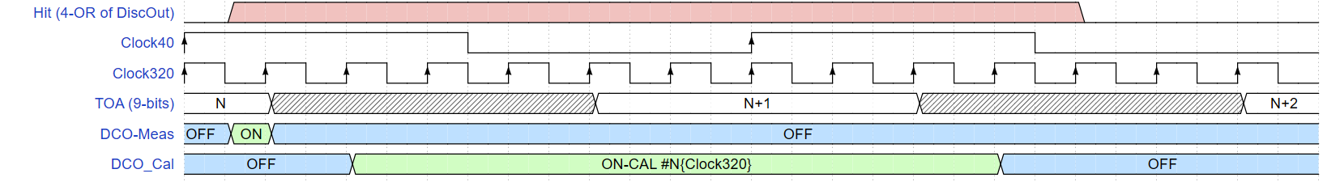
Picopix Time Measurement → 1 TDC every 4 pixels
Free running Digital Control Oscillator
Period 400ps (2.5GHz)
UFTOA: ~30-40 ps bin derived from state of inner nodes of VCO
Auto-calibrated TDC at each measurement:
P, V, T, Rad and On-chip variations on a large-scale chip are critical for this resolution
Clock40 designed as an improved precision Timing Clock Tree with Digital DLL (~10 ps clock skew)
Clock320 used to operate the TDC faster. 1 Measurement in <50ns (Timepix4 was ~300ns)

Slide 42
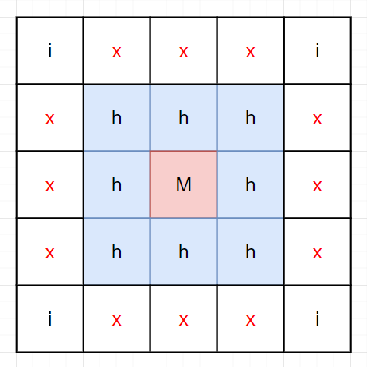
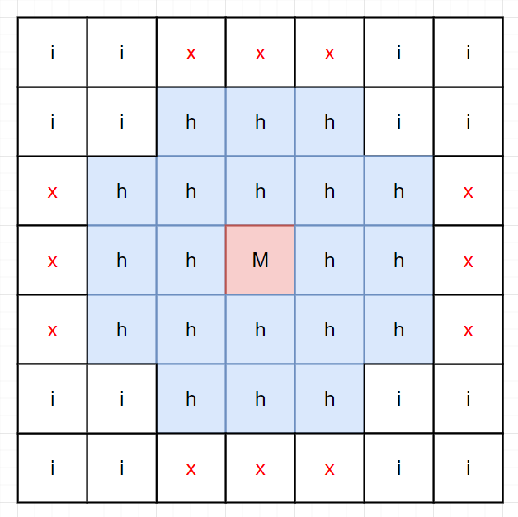
On pixel event processing ➞ Data reduction
Data filtered already at the level of the pixel-array
Bandwidth reduction towards the periphery
Significant power and IR-drop reduction
Further reduction and compression in the periphery
3x3 Veto
5x5 Veto
Arbitration logic (from Medipix3/4)
Transmit only Master pixel packet (can be disabled)
ToA on master provide the highest resolution
Design status: RTL complete
Hit-Map:
Hit-Map of all the pixels around the master
Or Hit-Map of the super-pixels around the master (when transmitting all ToT)
Design status: RTL complete
Advanced on-pixel data filtering:
ToT range
ToA range
Hit-Map shape (single pixel, 2, 2x2,…)
5x5 is an added mode
Hitmap is always 8bits !

Slide 43
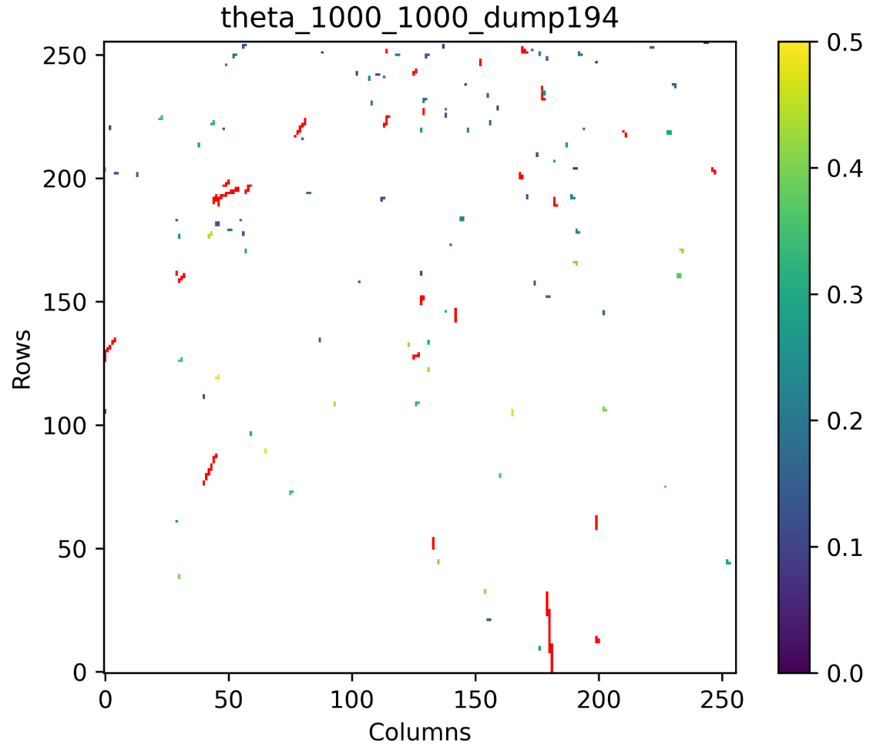
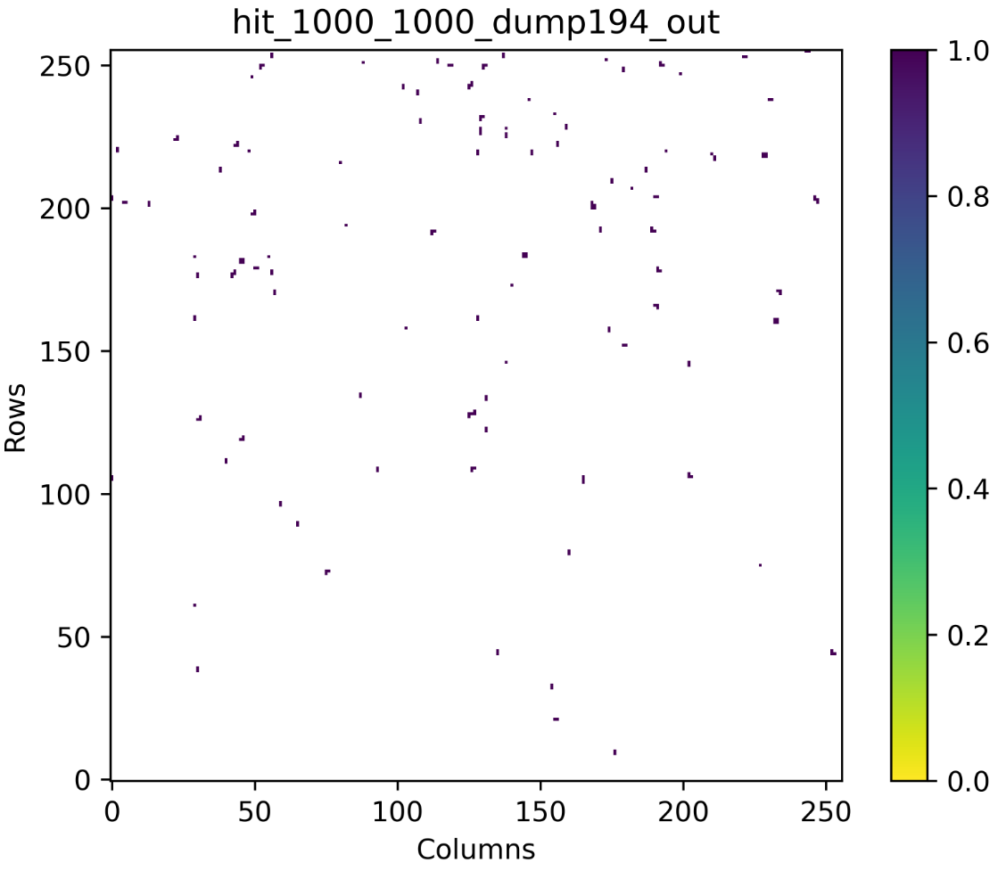
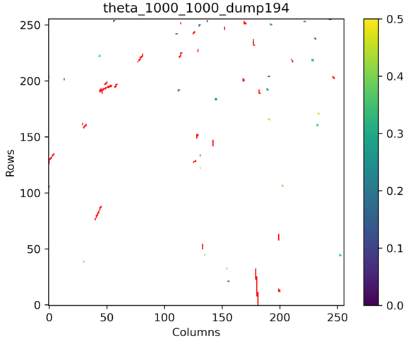
On pixel event processing ➞ Data reduction
Data filtered already at the level of the pixel-array
Bandwidth reduction towards the periphery
Significant power and IR-drop reduction
Further reduction and compression in the periphery
Clustering and filtering
Filtering disable
Filtering large clusters
Filtering small clusters
Design Status: RTL complete

Slide 44
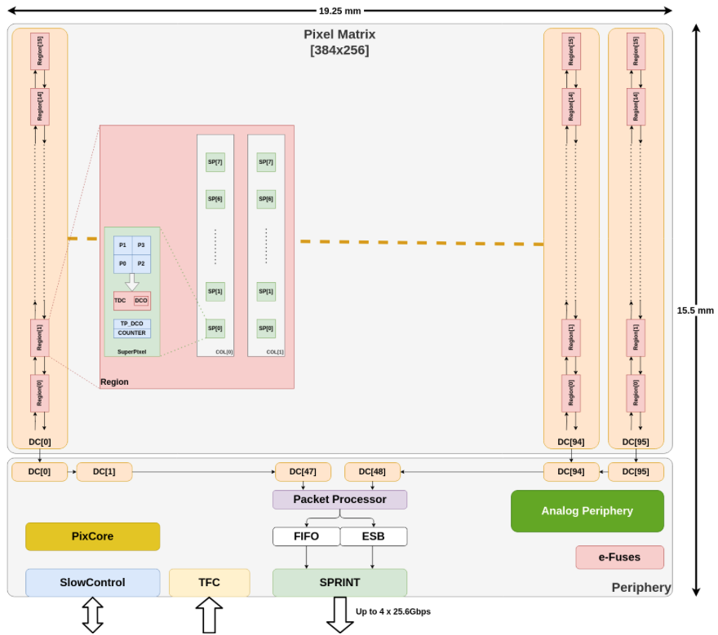
Periphery data-path
PACKET PROCESSOR
Full Time calibration:
DLL clock skew calibration (Row and Column)
Unique time-walk correction (programable LUT 32x32)
TOA event calibration (24.4ps bin)
10b or 6b fine-time output
Built-in TOA extender up to 32-bits(@40MHz)
Digital T0Sync shift adjustment (24.4ps bin and 100ns range)
Event Filtering:
Configurable TOT range
Configurable TOA range
Hitmap shape (single pixels, L shape, + shape,…)
On-chip XY decoding
Single packet formatting:
To Sorter: 24-bit, 36-bit, 72-bit
To FIFO: 72b_PC_iTOT, 72b_raw and Jumbo

Slide 45
Picopix operating modes
Main data-driven readout modes implemented:
TRACKING MODE
Tracking mode | The packet includes: ▪ MASTER ADDRESS ▪ ULTRA-FINE TOA ▪ HIT-MAP
Tracking + ToT | The packet includes: ▪ MASTER ADDRESS ▪ ULTRA-FINE TOA ▪ HIT-MAP ▪ TOT OF ALL THE PIXELS
CLUSTER FILTERING
Filter large clusters | Clusters large than 3x3 around master
Filter small clusters | Clusters smaller than 3x3
No filtering | Transmits all clusters
MASTER EXTRACTION | Tracking mode | Tracking mode + ToT
Send cluster master | Full 3X3 Hit-Map around master pixel | Full 3x3 Hit-Map around the super-pixel simplifying the off-chip re-clustering
Send all super-pixels | Local 2x2 Hit-Map within super-pixel
EVENT PACKET | Tracking mode |  | Tracking mode + ToT
 | Packet size | Max N of packets | Packet size | Max N of packets
Raw data format | 72 bits out-of-order | 1.28 GEVENTS s⁻¹ (32 Bx⁻¹) | 144 bits out-of-order | 640 MEVENTS s⁻¹ (16 Bx⁻¹)
Standard format | 36 bits SORTED | 2.56 GEVENTS s⁻¹ (64 Bx⁻¹) | 72 bits SORTED | 1.28 GEVENTS s⁻¹ (32 Bx⁻¹)
Reduced- format | 24 bits SORTED | 3.84 GEVENTS s⁻¹ (96 Bx⁻¹)

Slide 46
Some personal observations
The success of Timepix4 is based on a collaborative model where institutes agree to fund a generic development
Access to high end and ‘standard vanilla’ CMOS makes this possible and affordable
High volume bump deposition provider reduces bumping costs by almost an order of magnitude. Similarly, TSV processing becomes possible (and relatively cheap) if high volume producers can be found
The old HEP model of 1 (or even multiple) ASICs per sub-detector is dead because of design complexity and engineering run cost.
New funding models (such as proposed by Picopix) show a way forward
However, to reach sustainable solutions in future the HEP community will need to reach out beyond its present silo (as the Medipix Collaborations have done)
https://indico.cern.ch/event/1439855/contributions/6461557/

Slide 47
Summary and Conclusions
The Timepix family of chips spans 20 years. Each generation provides improved time stamping
Timepix4 can tag hits in bins of 195ps after careful calibration and is 4-side buttable
Picopix implements a number of architectural novelties permitting improved performance and ease of use
Compatible with various sensors including SPADs
Improved time stamping (40ps TDC time bin)
Optional programmable on-pixel data filtering
Optional on-chip time walk and clock skew correction
Optional on-chip packet sorting
The HEP community needs to find a new model for working with others to enable future developments

Slide 48
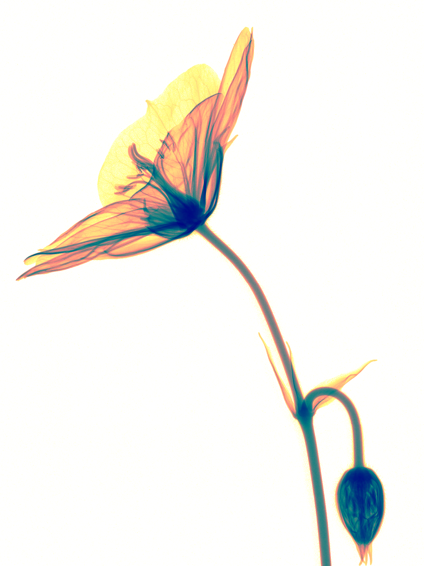

Thank you for your attention!
Timepix4 paper:
X. Llopart et al 2022 JINST 17 C01044
Medipix3RX images: S. Procz et al.

