Slide 1

Status of the smartpixels project
corrinne mills
on behalf of the smartpixels team
Vertex workshop
August 28, 2025

Slide 2
Overview
The cluster shape in the pixel detector contains information about the particle trajectory
smartpixels uses that to filter out low-momentum tracks and/or regress the track parameters (position and angle)
Physics-motivated data reduction on the ASIC: read out a subset of clusters instead of individual pixel hits
  Can we get around bandwidth constraints on the pixel pitch?
  What if we could put pixel info in the first layer of the trigger?
Outline
  How does it work?
    First implementation: demonstration of transverse momentum (p_{T}) filter in simulation
  But really, can it work in real life?
    Results from testing the algorithm on a physical ASIC
    Dependence on detector configuration
    Radiation damage and noise
  Regression algorithm and working towards a pixel trigger

Slide 3
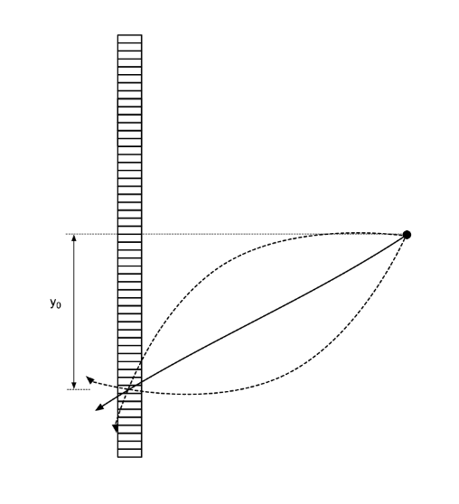
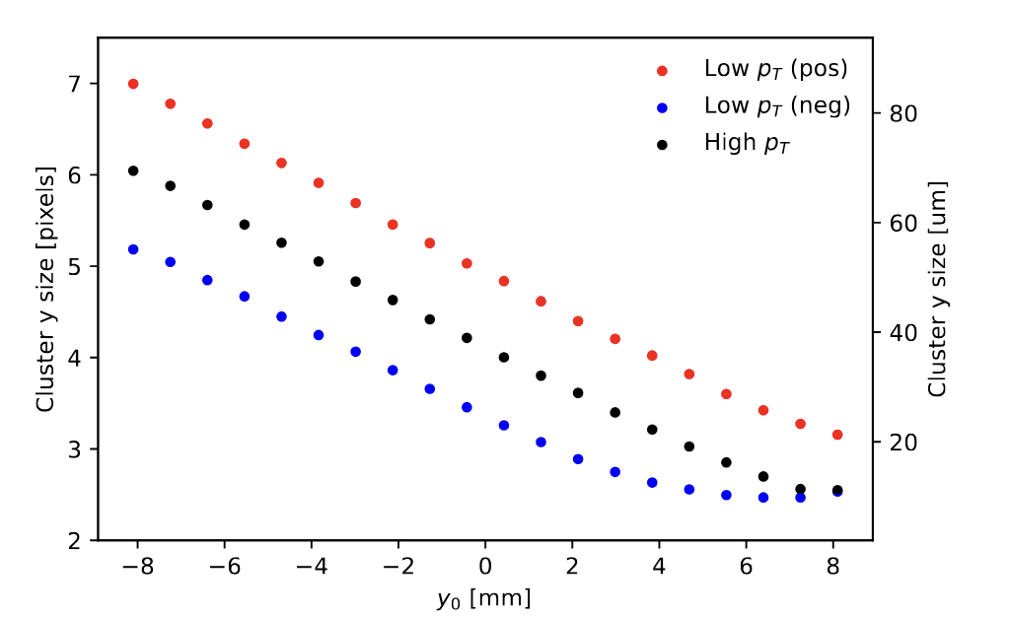
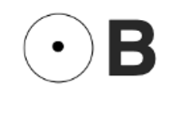
smartpixels analyze clusters on-chip
Cluster shape depends on angle, momentum, position in the detector in a nontrivial but predictable way
y₀
β

Slide 4
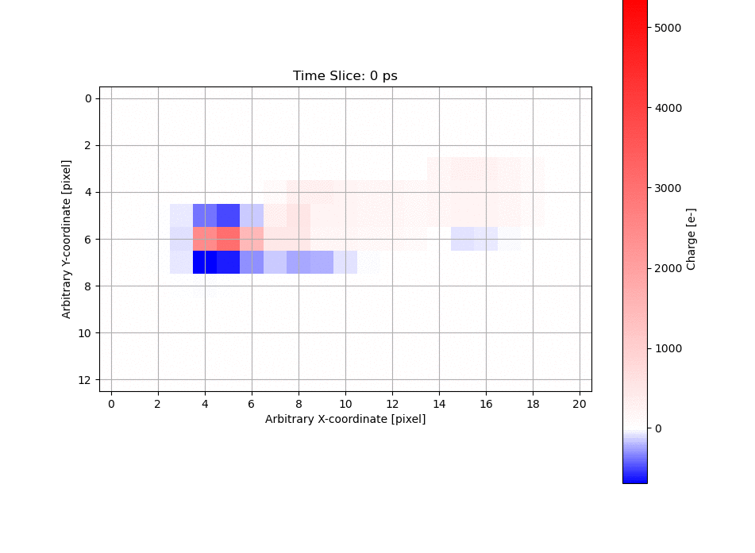
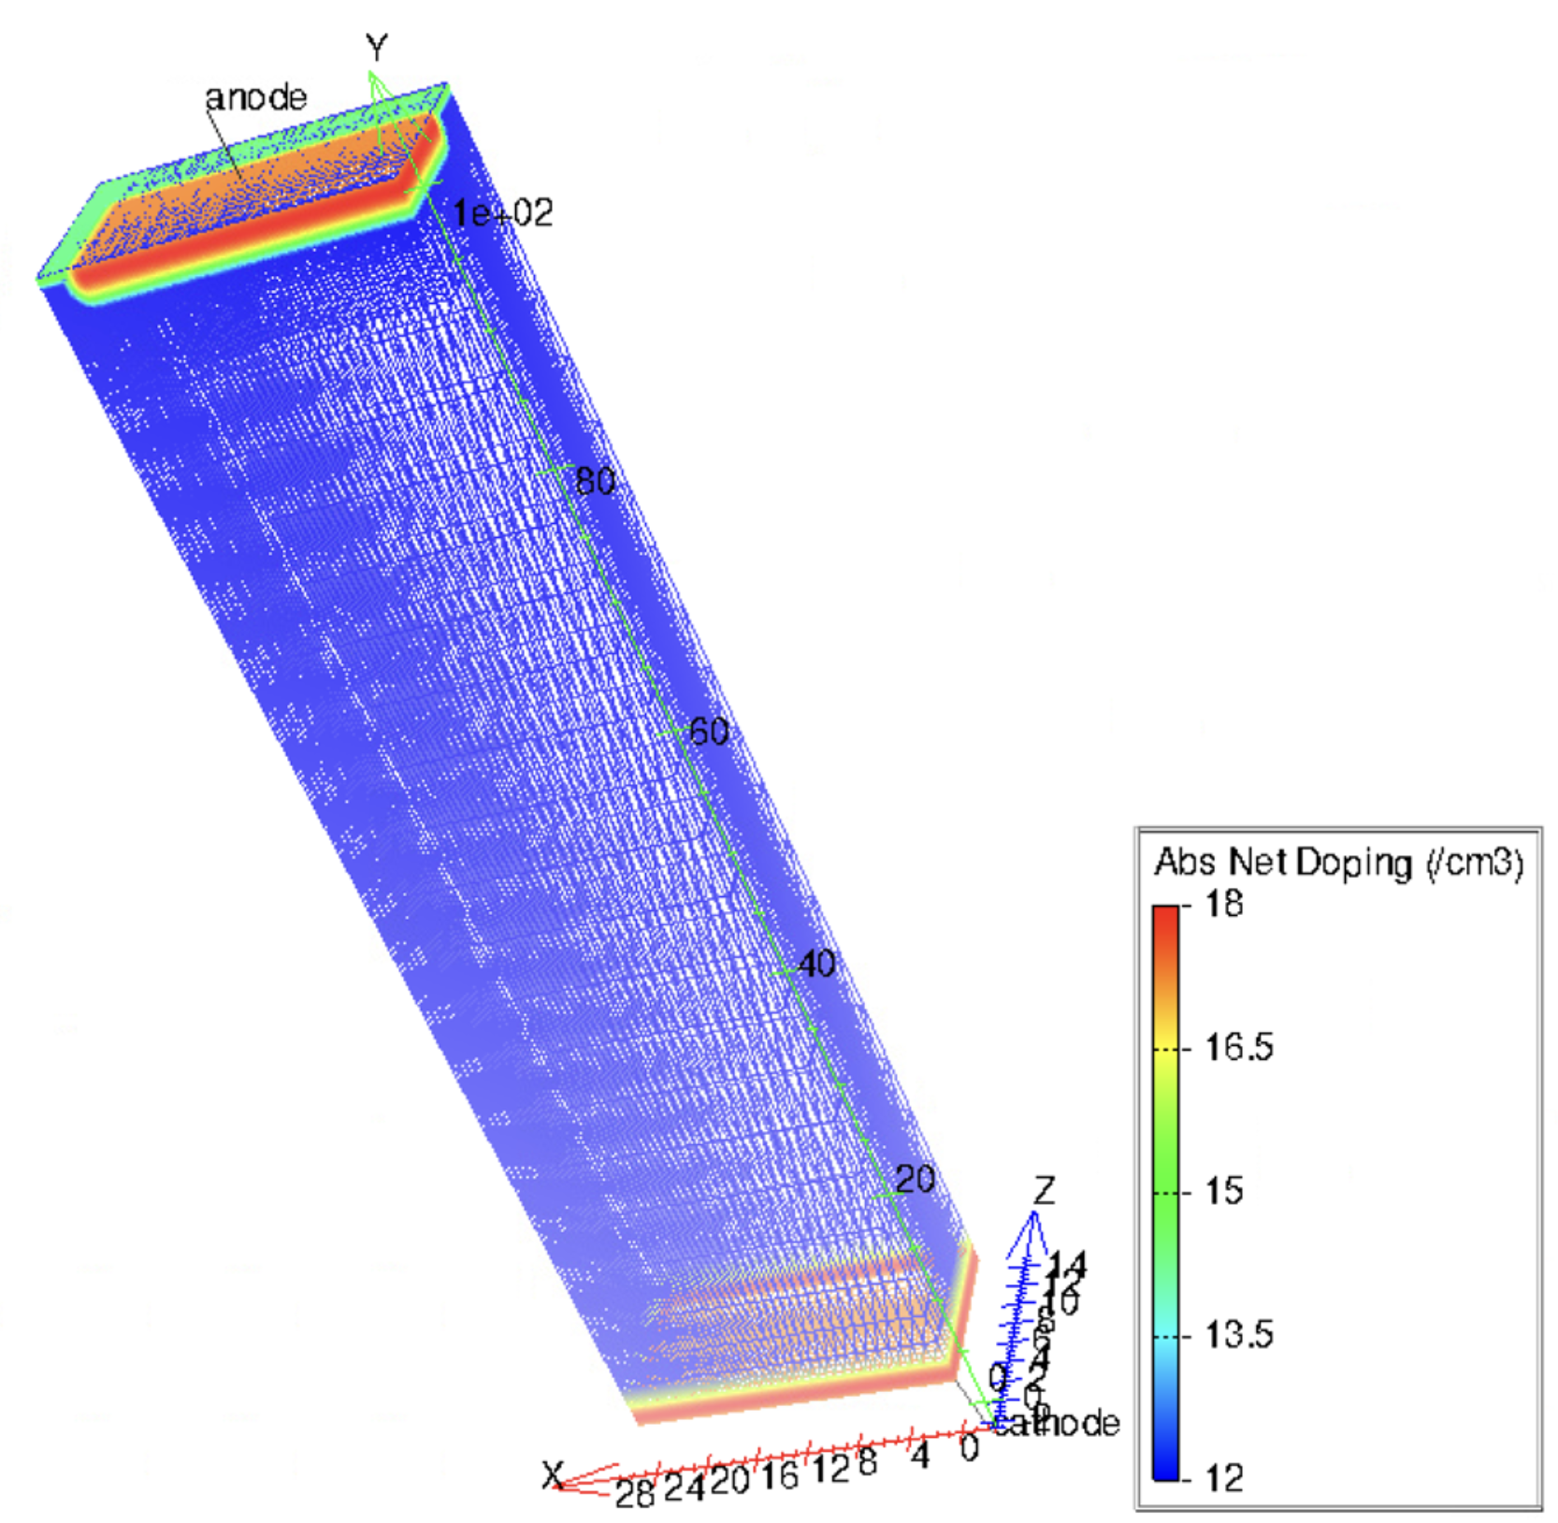
Training data: simulation
ML is only as good as its training data
Input to simulation:
Doping profile of ¼ pixel
0.1625 mm
1.05 mm
“Futuristic” 50 x 12.5 μm² pitch pixels (100 μm thickness)
TCAD simulation of semiconductor structures
PixelAV to produce realistic energy patterns in detector
Training data at https://zenodo.org/records/10783560
image credits: Danush Shekar and the smartpixels team
4
Notes:
The machine learning needs something to learn _from_

Slide 5
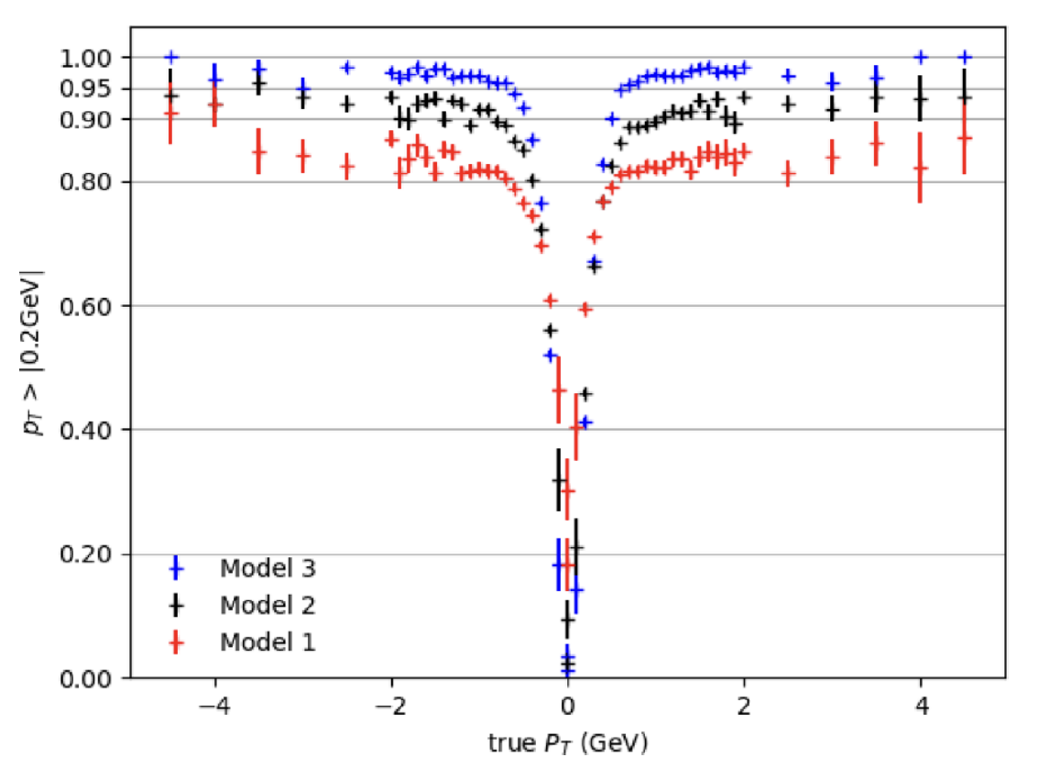
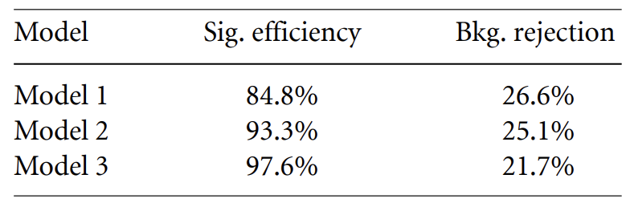
First step: p_{T} filter at full precision
Train fully-connected, feed-forward network
Test selection of input features
  Cluster size (in bending directly) only
  Projected cluster shape, integrated over 4 ns
  Eight “snapshots” of cluster shape in 200 ps intervals, showing evolution of cluster
Key metrics:
  Efficiency (tracks with true p_{T} > 2 GeV correctly identified as high p_{T})
  Background rejection (tracks with true p_{T} < 2 GeV correctly identified as low p_{T})
  Data reduction (all tracks classified as low p_{T})
fraction categorized as high p_{T}
Model 2 selected as benchmark for compromise between performance and simplicity
Jieun Yoo et al 2024 Mach. Learn.: Sci. Technol. 5 035047

Slide 6
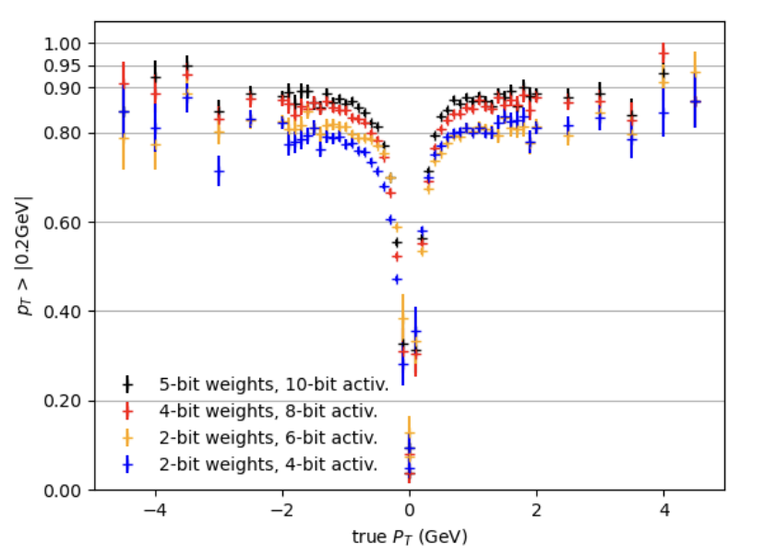
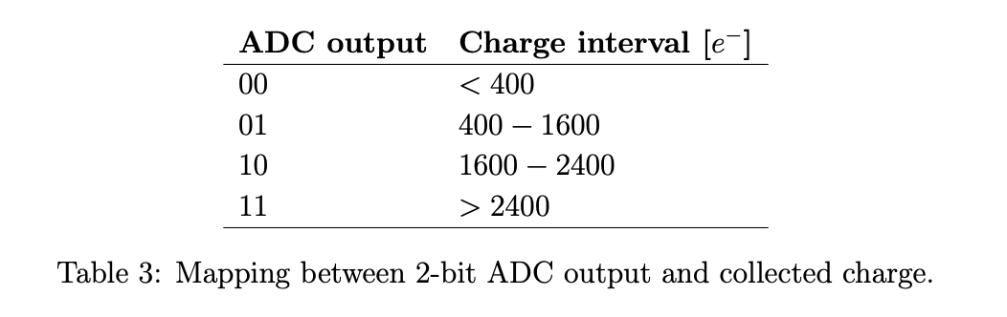
Digitization and simulated performance
Digitization
  Of charge: 2-bit “flash” ADC
  Of weights and activation: choose 4-bit weight + 8-bit activation
Preliminary estimate: 54-75% data reduction
  Includes single-pixel hits (noise), loopers, and low-pT tracks rejected by the algorithm
  Most rejection comes from “untracked” clusters
    55-60% of data, work ongoing to understand these better
  Based on simulation, hope to look at min-bias and testbeam data in the future
Jieun Yoo et al 2024 Mach. Learn.: Sci. Technol. 5 035047

Slide 7
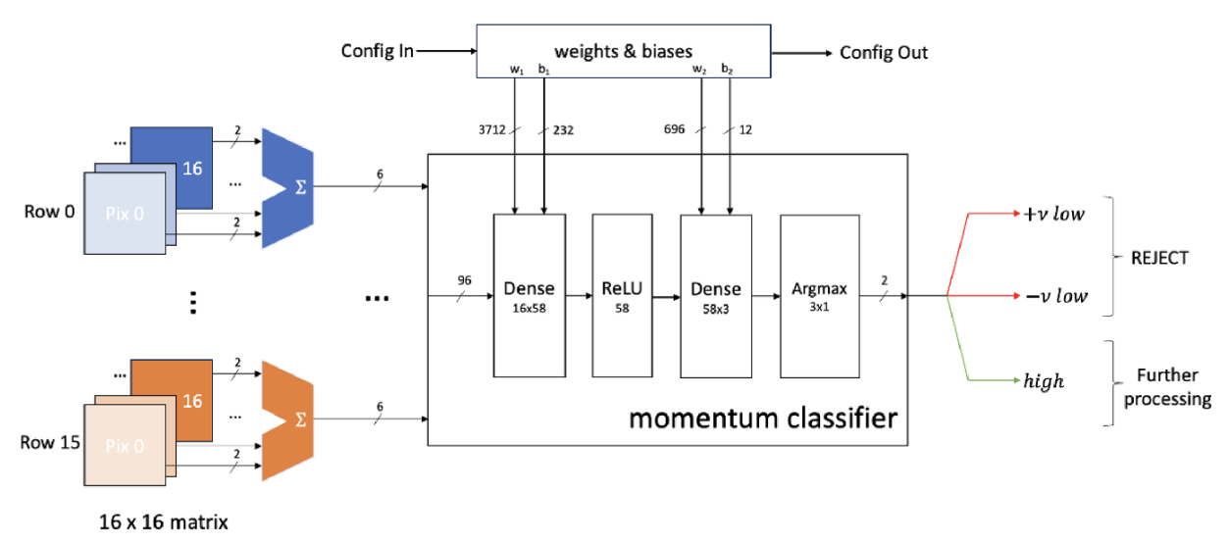
Implementable network
Jieun Yoo et al 2024 Mach. Learn.: Sci. Technol. 5 035047

Slide 8
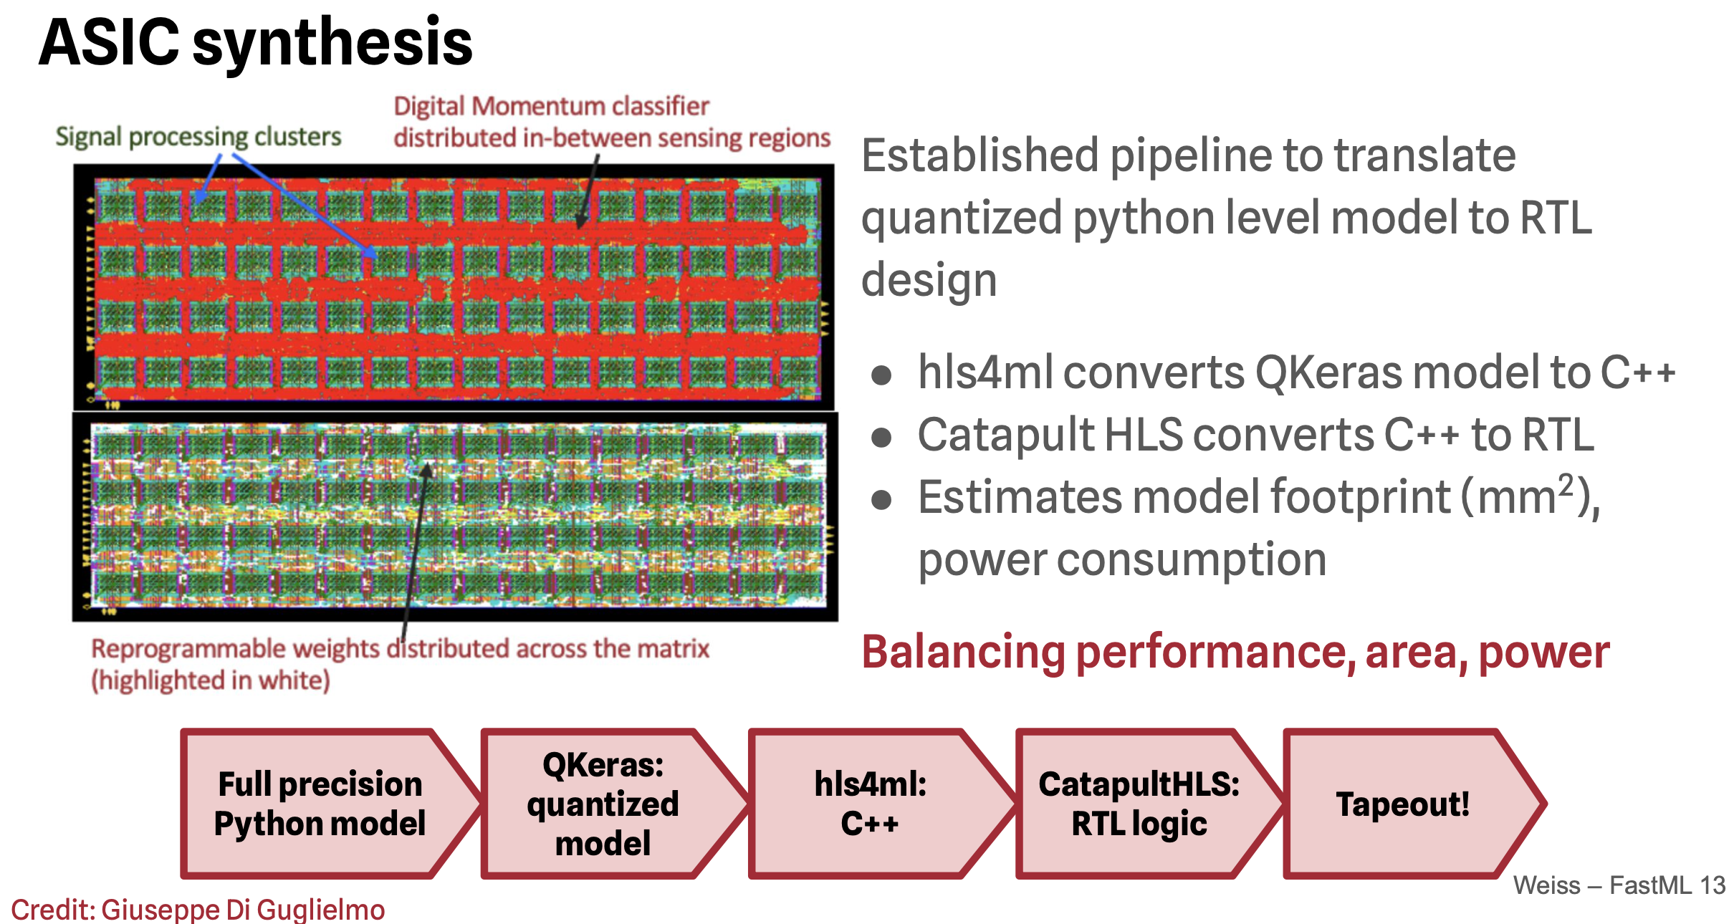
First smartpixels tapeout with network
credit: Giuseppe Di Guglielmo, Ben Weiss

Slide 9
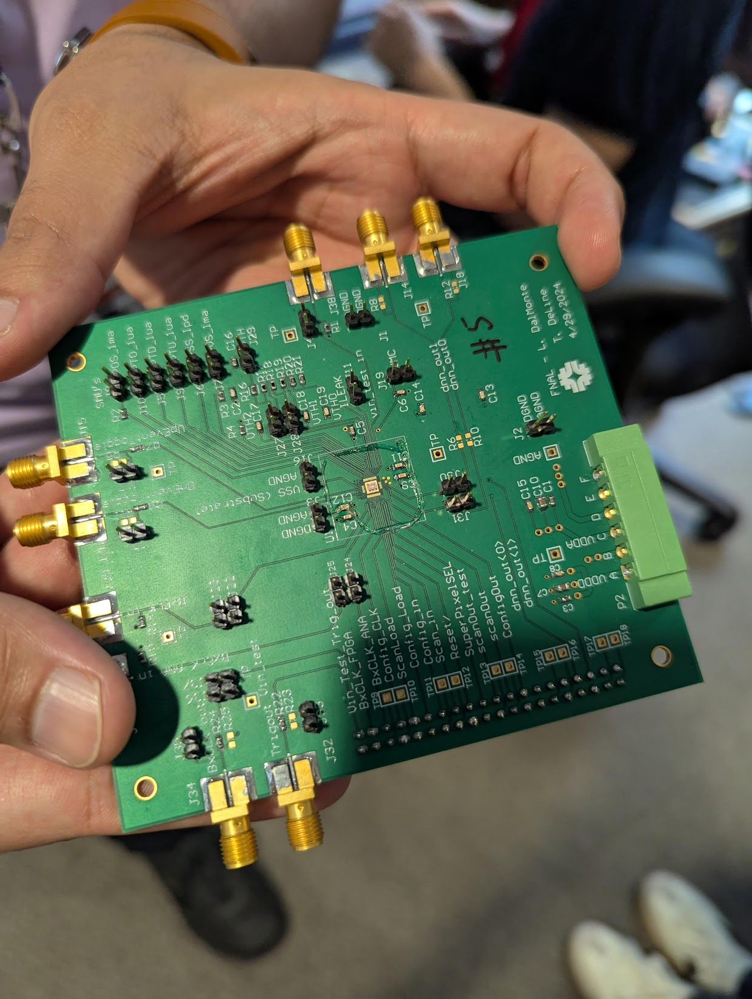
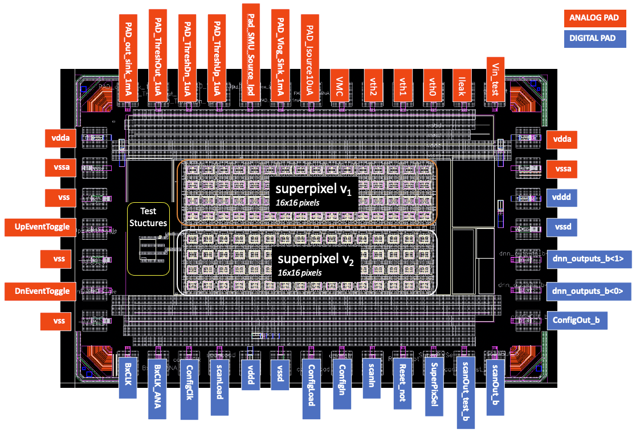
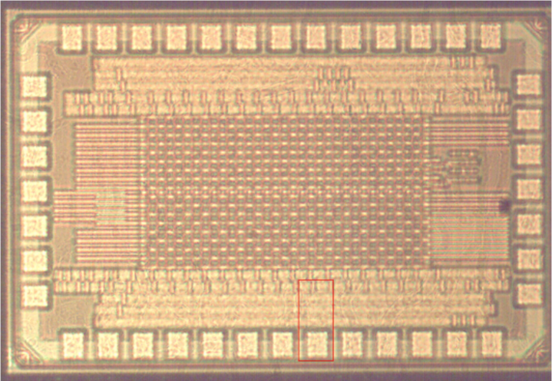
First test of network in hardware
28 nm radiation-hard CMOS
Analog front end and benchmark filter algorithm implemented as part of the digital logic
Two “superpixels” = 8x32 pixel arrays (2 ADC vers.)
credit: Ben Parpillon

Slide 10
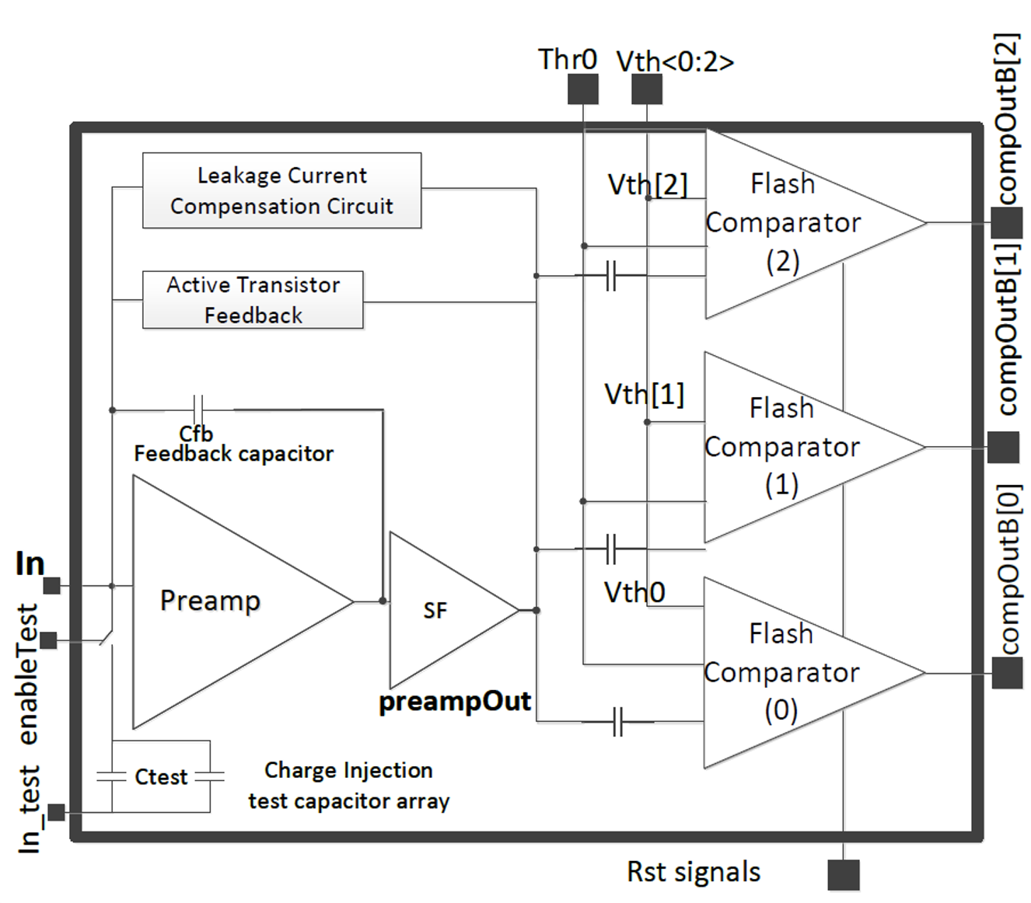
Front-End Pixel Overview
25µm × 25µm pixel sizes
Power about ~6.25uW [majority of it used at the front-end] per pixel
AC coupled 40MSPS in-pixel 2-bit flash ADC
  insensitive to pile-up
2-bit ADC:
  version 1: Single ended
  version 2: Differential
Charge injection cap array ( 2 or more) for injecting different signals across the pixel matrix for testing Neural network performance
Auto-Zero (AZ) in every pixel for threshold correction
Test Structures exploring non-AZ options
CSA
2-bit flash ADC
B. Parpillon, A. R. Trivedi and F. Fahim, "Readout IC with 40 MSPS in-pixel ADC for future vertex detector upgrades of Large Hadron Collider," 2023 IEEE International Symposium on Circuits and Systems (ISCAS), Monterey, CA, USA, 2023, pp. 1-5, doi: 10.1109/ISCAS46773.2023.10182033
Credit: Anthony Badea and Ben Parpillon
2024 CPAD
FERMILAB-CONF-24-0838-CMS
Notes:
Everything is in the text think

Slide 11
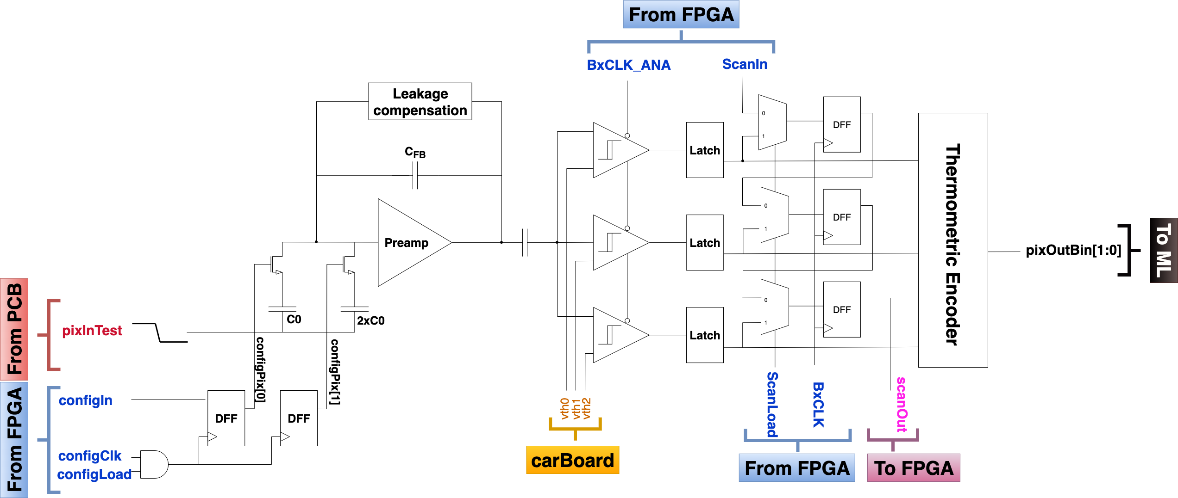
ASIC analog front-end characterization
S-curve for 3-bits from arbitrary pixel
Analog front end
Three comparators correspond to 2-bit flash ADC
For each pixel, three S-curves, which can be fit to extract the mean and the sigma (ENC)
credit: Anthony Badea, Ben Parpillon, Danush Shekar

Slide 12
ASIC front-end characterization
Distribution of threshold values
per-pixel s-curve
Q_{TH} = 77.5 e-
ENC = ~55 e-
Threshold dispersion Q_{TH} across pixels
Combine S-curve fit results across all pixels to obtain threshold dispersion (Q_{TH}) and Equivalent Noise Charge (ENC).
Threshold distribution has larger tails than expected. Two issues identified:
1. Degradation of injected pulse characteristics across pixel matrix due to parasitic RC components
2. High leakage currents on 3 V_{TH} bias lines -> IR drop -> change in V_{TH}
Improvements planned for future ASIC iterations!
credit: Anthony Badea, Ben Parpillon, Danush Shekar

Slide 13
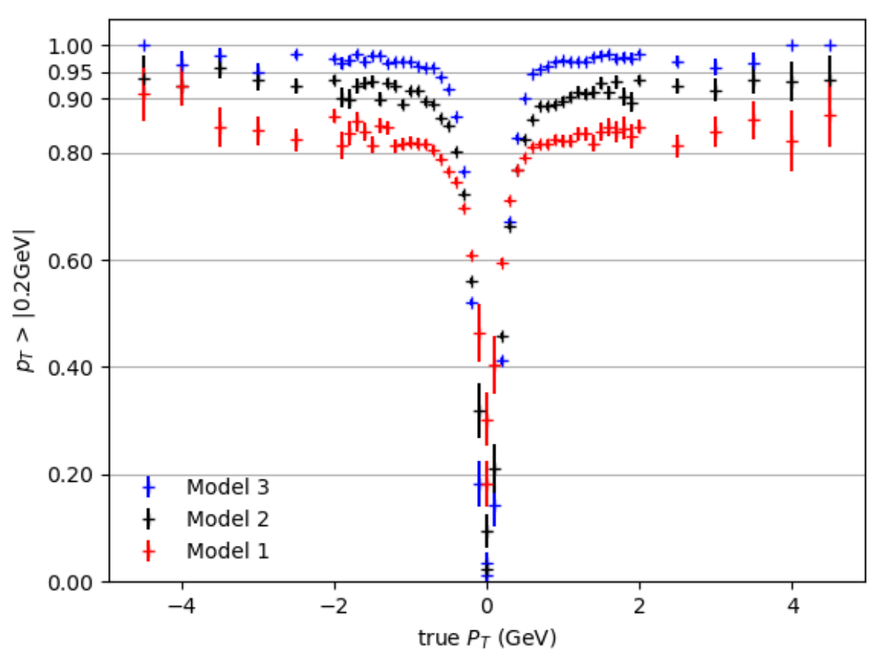
Towards verifying classification on ASIC
Reproducing the efficiency is one of the objectives from ongoing chip-test measurements
Caveat: No noise injected in simulations, unavoidable in experiment. How do we deal with noise?
Measure noise profile from experiments, and
inject noise at simulation level
Increase noise threshold in pixels of chip (Quick, but comes with a cost: lose cluster charges)
Pursuing both strategies, with work ongoing
credit: Anthony Badea, Ben Parpillon, Danush Shekar

Slide 14
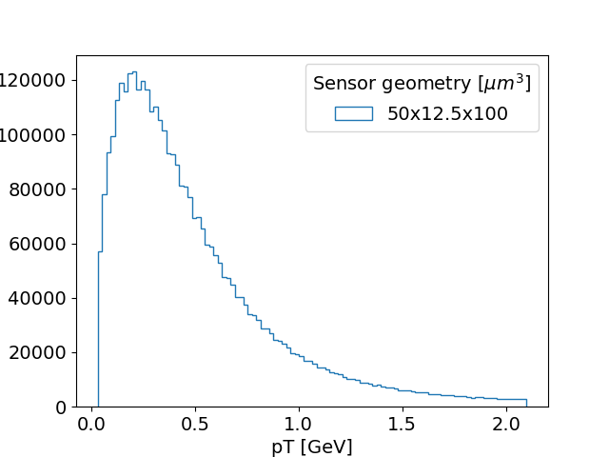
Towards verifying classification on ASIC
Reproducing the efficiency is one of the objectives from ongoing chip-test measurements
Workflow:
1. Use simulation data to get realistic clusters
“Dataset 14” contains sensor output (21x13 pixels) for 2M events where kinematic properties of the incident particles are taken from fitted tracks in CMS 13 TeV collision data.
Transverse-momentum (p_{T}) distribution of tracks from dataset 14
credit: Anthony Badea, Ben Parpillon, Danush Shekar

Slide 15
Towards verifying classification on ASIC
Reproducing the efficiency is one of the objectives from ongoing chip-test measurements
Workflow:
1. Use simulation data to get realistic clusters
2. Quantize data at fixed thresholds
ADC output | Charge interval [e-]
00 | < x₁
01 | x₁ – x₂
10 | x₂ – x₃
11 | > x₃
The charge from each pixel is discretized emulating an analog-to-digital converter.
The baseline quantized model uses a 2-bit quantization represented by the following table for fixed threshold [x₁, x₂, x₃]:
credit: Anthony Badea, Ben Parpillon, Danush Shekar

Slide 16
Towards verifying classification on ASIC
Reproducing the efficiency is one of the objectives from ongoing chip-test measurements
Workflow:
1. Use simulation data to get realistic clusters
2. Quantize data at fixed thresholds
3. Obtain subset of data for a fixed y-local range [0.00, 1.35 mm)
To optimize ASIC requirements and to fit the network on-chip, instead of passing y-local information to the network, algorithm is re-trained for each y-local bin.
credit: Anthony Badea, Ben Parpillon, Danush Shekar

Slide 17
Towards verifying classification on ASIC
Reproducing the efficiency is one of the objectives from ongoing chip-test measurements
Workflow:
1. Use simulation data to get realistic clusters
2. Quantize data at fixed thresholds
3. Obtain subset of data for a fixed y-local range [0.00, 1.35 mm)
4a. Evaluate performance of pre-trained model (Keras and QKeras) on this subset for comparison
4b. Convert subset data to ASIC inputs and pulse ASIC
(~40 hrs of data-taking for 300k events)
Each input charge profile was loaded onto the ROIC by configuring
charge-injection for each pixel.
The injected charge propagates through the analog circuit and is summed into a y-profile.
This profile is passed to the digital neural network for further calculations.
credit: Anthony Badea, Ben Parpillon, Danush Shekar

Slide 18
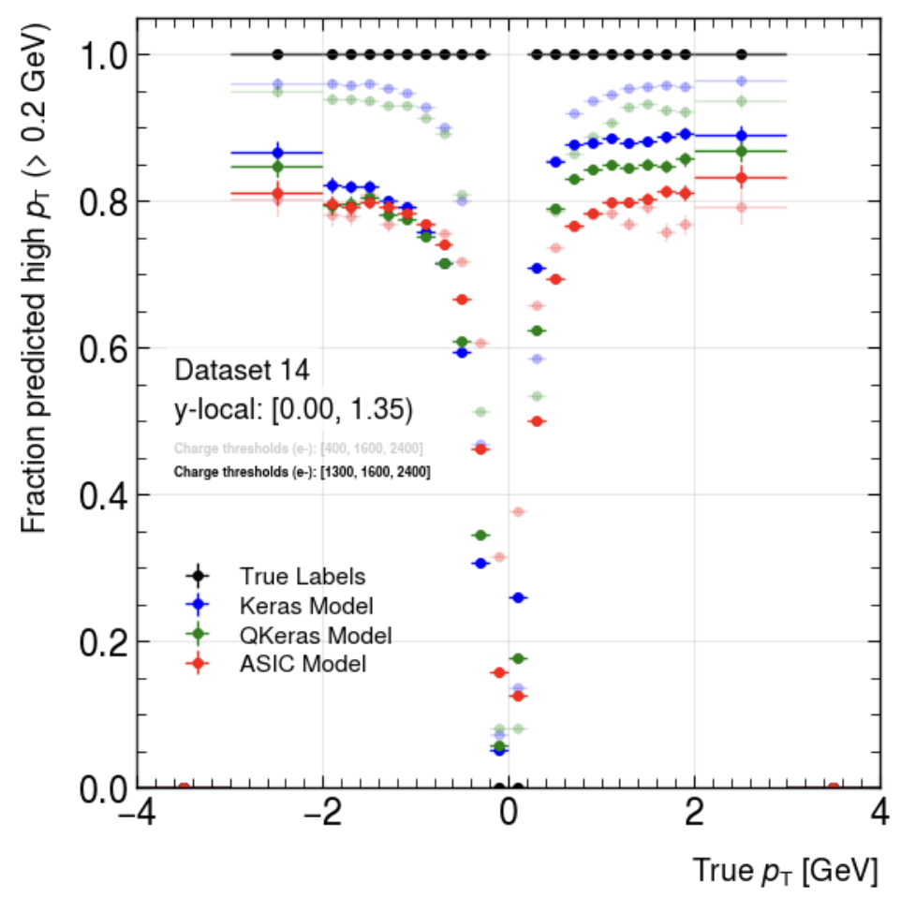
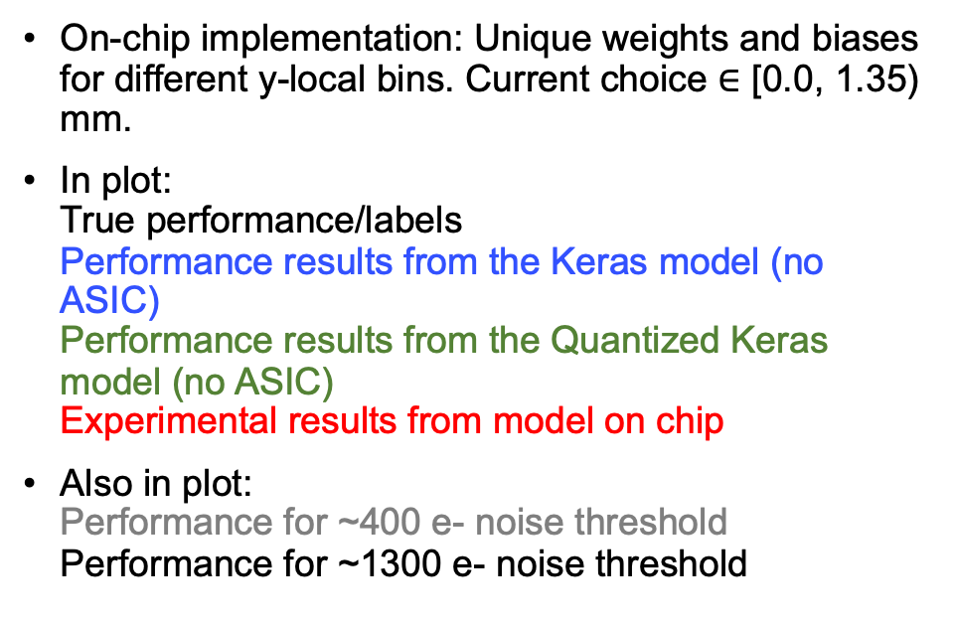
Measured classification performance
On-chip implementation: Unique weights and biases for different y-local bins. Current choice $∈$ [0.0, 1.35) mm.
In plot:
True performance/labels
Performance results from the Keras model (no ASIC)
Performance results from the Quantized Keras model (no ASIC)
Experimental results from model on chip
Also in plot:
Performance for ~400 e- noise threshold
Performance for ~1300 e- noise threshold
credit: Anthony Badea, Ben Parpillon, Danush Shekar

Slide 19
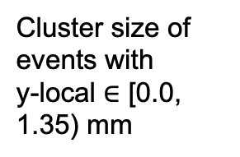
Measured classification performance
Increasing threshold (slightly) improves performance in experimental results (due to lower noise levels) but lowers performance in simulation (due to loss in charge information).
Asymmetry arises from actual asymmetry in cluster size and its interaction with threshold
Cluster size of events with
y-local $∈$ [0.0, 1.35) mm
credit: Anthony Badea, Ben Parpillon, Danush Shekar

Slide 20
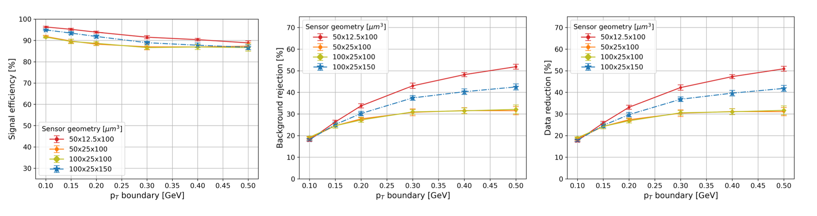
Dependence on sensor geometry
Benchmark default 12.5 x 50 μm² sensor pitch and 100 μm thickness
Reran TCAD and pixelAV simulations with different pixel pitch and re-trained the algorithm
Reminder:
Signal efficiency = fraction of tracks with p_{T} > 2 GeV that are classified as high p_{T}.
Background rejection = fraction of tracks with p_{T} < 2 GeV that are classified as low p_{T}.
Data reduction = total fraction of tracks rejected
Key observations
  Benchmark has highest performance
  CMS HL-LHC geometry (100 x 25 x 150 μm³) performs well due to pitch/depth ratio
  Non-bending pitch doesn’t matter
plots: Danush Shekar

Slide 21
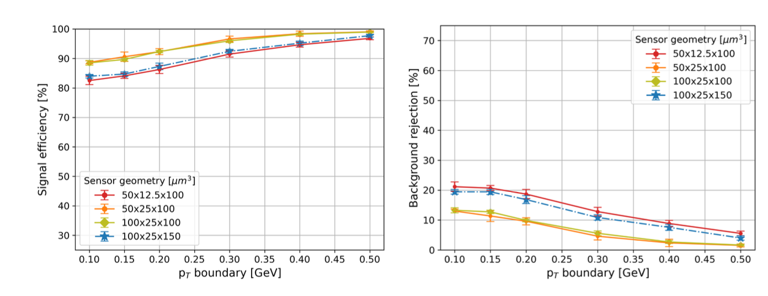
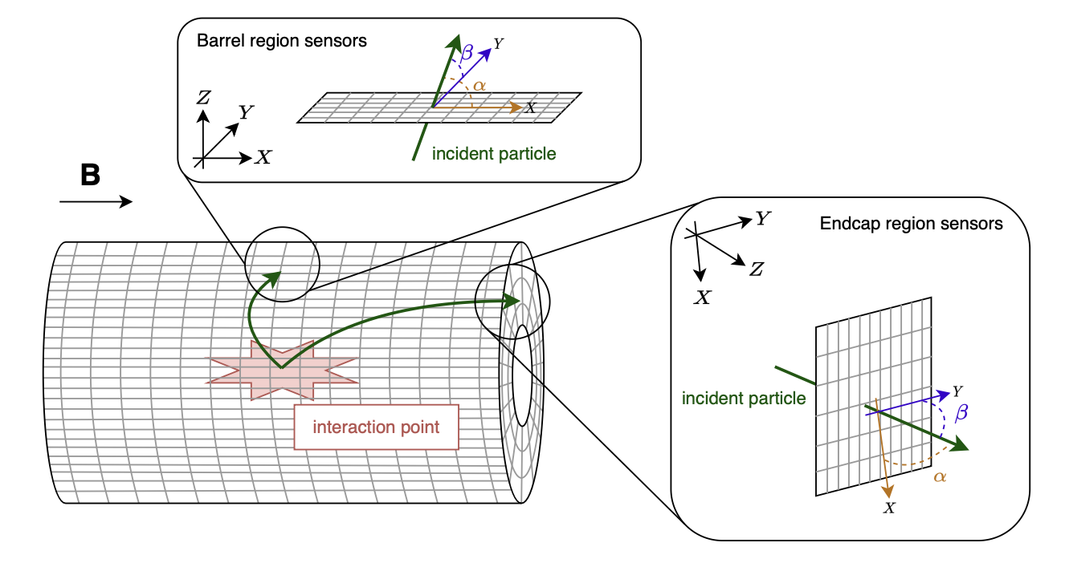

Can it work in the endcaps?
No Lorentz drift ($\vec{E}∥\vec{B}$)
Smaller clusters
Efficient for high-p_{T} particles, though slightly worse for benchmark training boundary of 0.20 GeV
Poor background rejection (compare ~30% for benchmark)
plots and figure: Danush Shekar

Slide 22
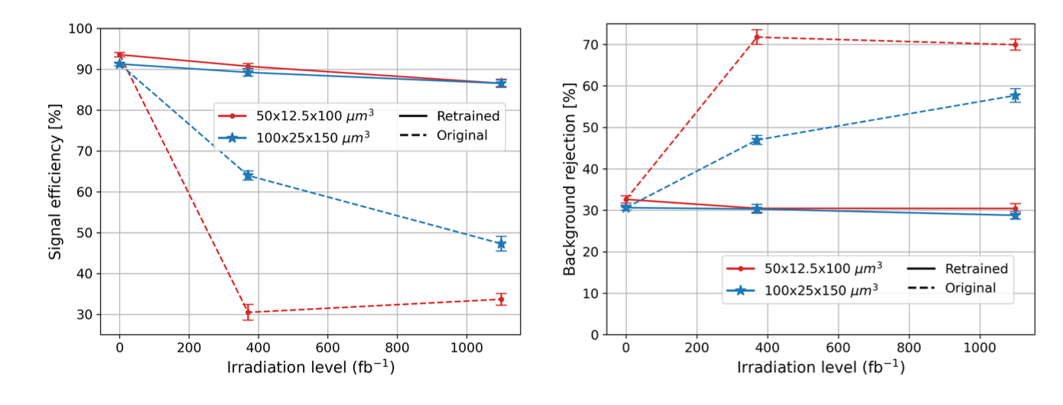
Retraining can mitigate radiation damage
HL-LHC will reach unprecedented radiation levels, highest in barrel pixel layer 1, 3 cm from collisions
Generate datasets with simulated radiation damage (models from PixelAV)
  3.3 x 10¹⁵ n_{eq}/cm² (370 fb⁻¹ (Run 3) at Layer 1)
  1.0 x 10¹⁶ n_{eq}/cm² (1100 fb⁻¹ (half of HL-LHC) at Layer 1)
Retraining (new weights, same structure) recovers most performance for both benchmark and HL-LHC sensor geometry, and will be possible for an eventual detector
plots: Danush Shekar

Slide 23
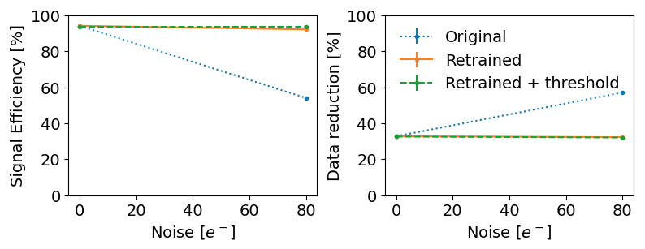
Promising first results on noise
Noise is complex, but we start out with a simple model: for each pixel, sample from a gaussian of mean 0 and sigma of 80 electrons, then add the result to the charge for that pixel
Unsurprisingly, performance degrades with added noise but can be recovered through retraining and application of a charge threshold
plots: Ben Weiss and Jennet Dickinson

Slide 24
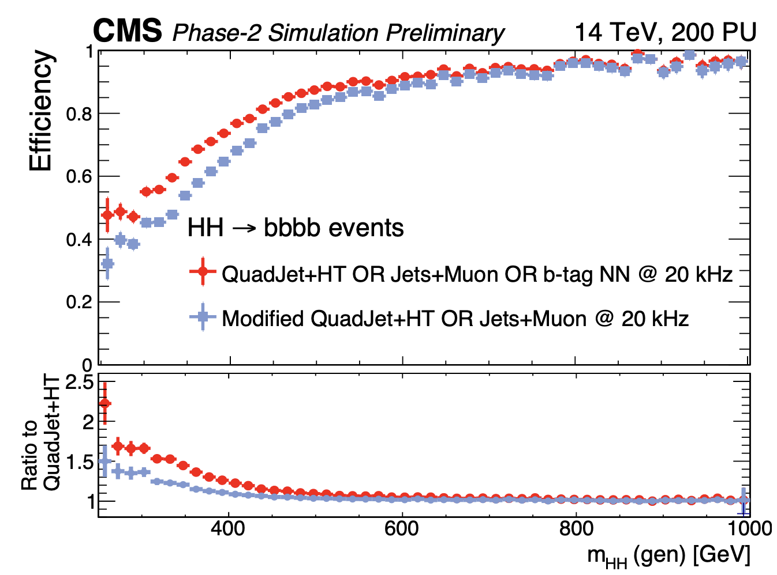
Physics case: Level-1 b-tagging
CMS will have a track trigger at L1 for HL-LHC, based on outer tracker layers
  Even at much higher radius than pixels, effective b-tagging in the trigger
Headline physics at HL-LHC, HH→ 4b, relies on jet triggers, and b-tagging improves them dramatically
  Benefit concentrated at low m_{HH}, most relevant for λ_{hhh} measurement
Pixel hits will improve this, impact across CMS physics program
  Potential for other capabilities including vertex-specific isolation and impact parameter cuts on leptons
improvement at low m_{HH}
  Adding sum of jet tag scores to HT+jets+muon trigger cocktail improves efficiency 67 → 73% per-event for m_{HH} < 500 GeV, only 0.6% increase in trigger rate
CMS-DP-2022-021

Slide 25
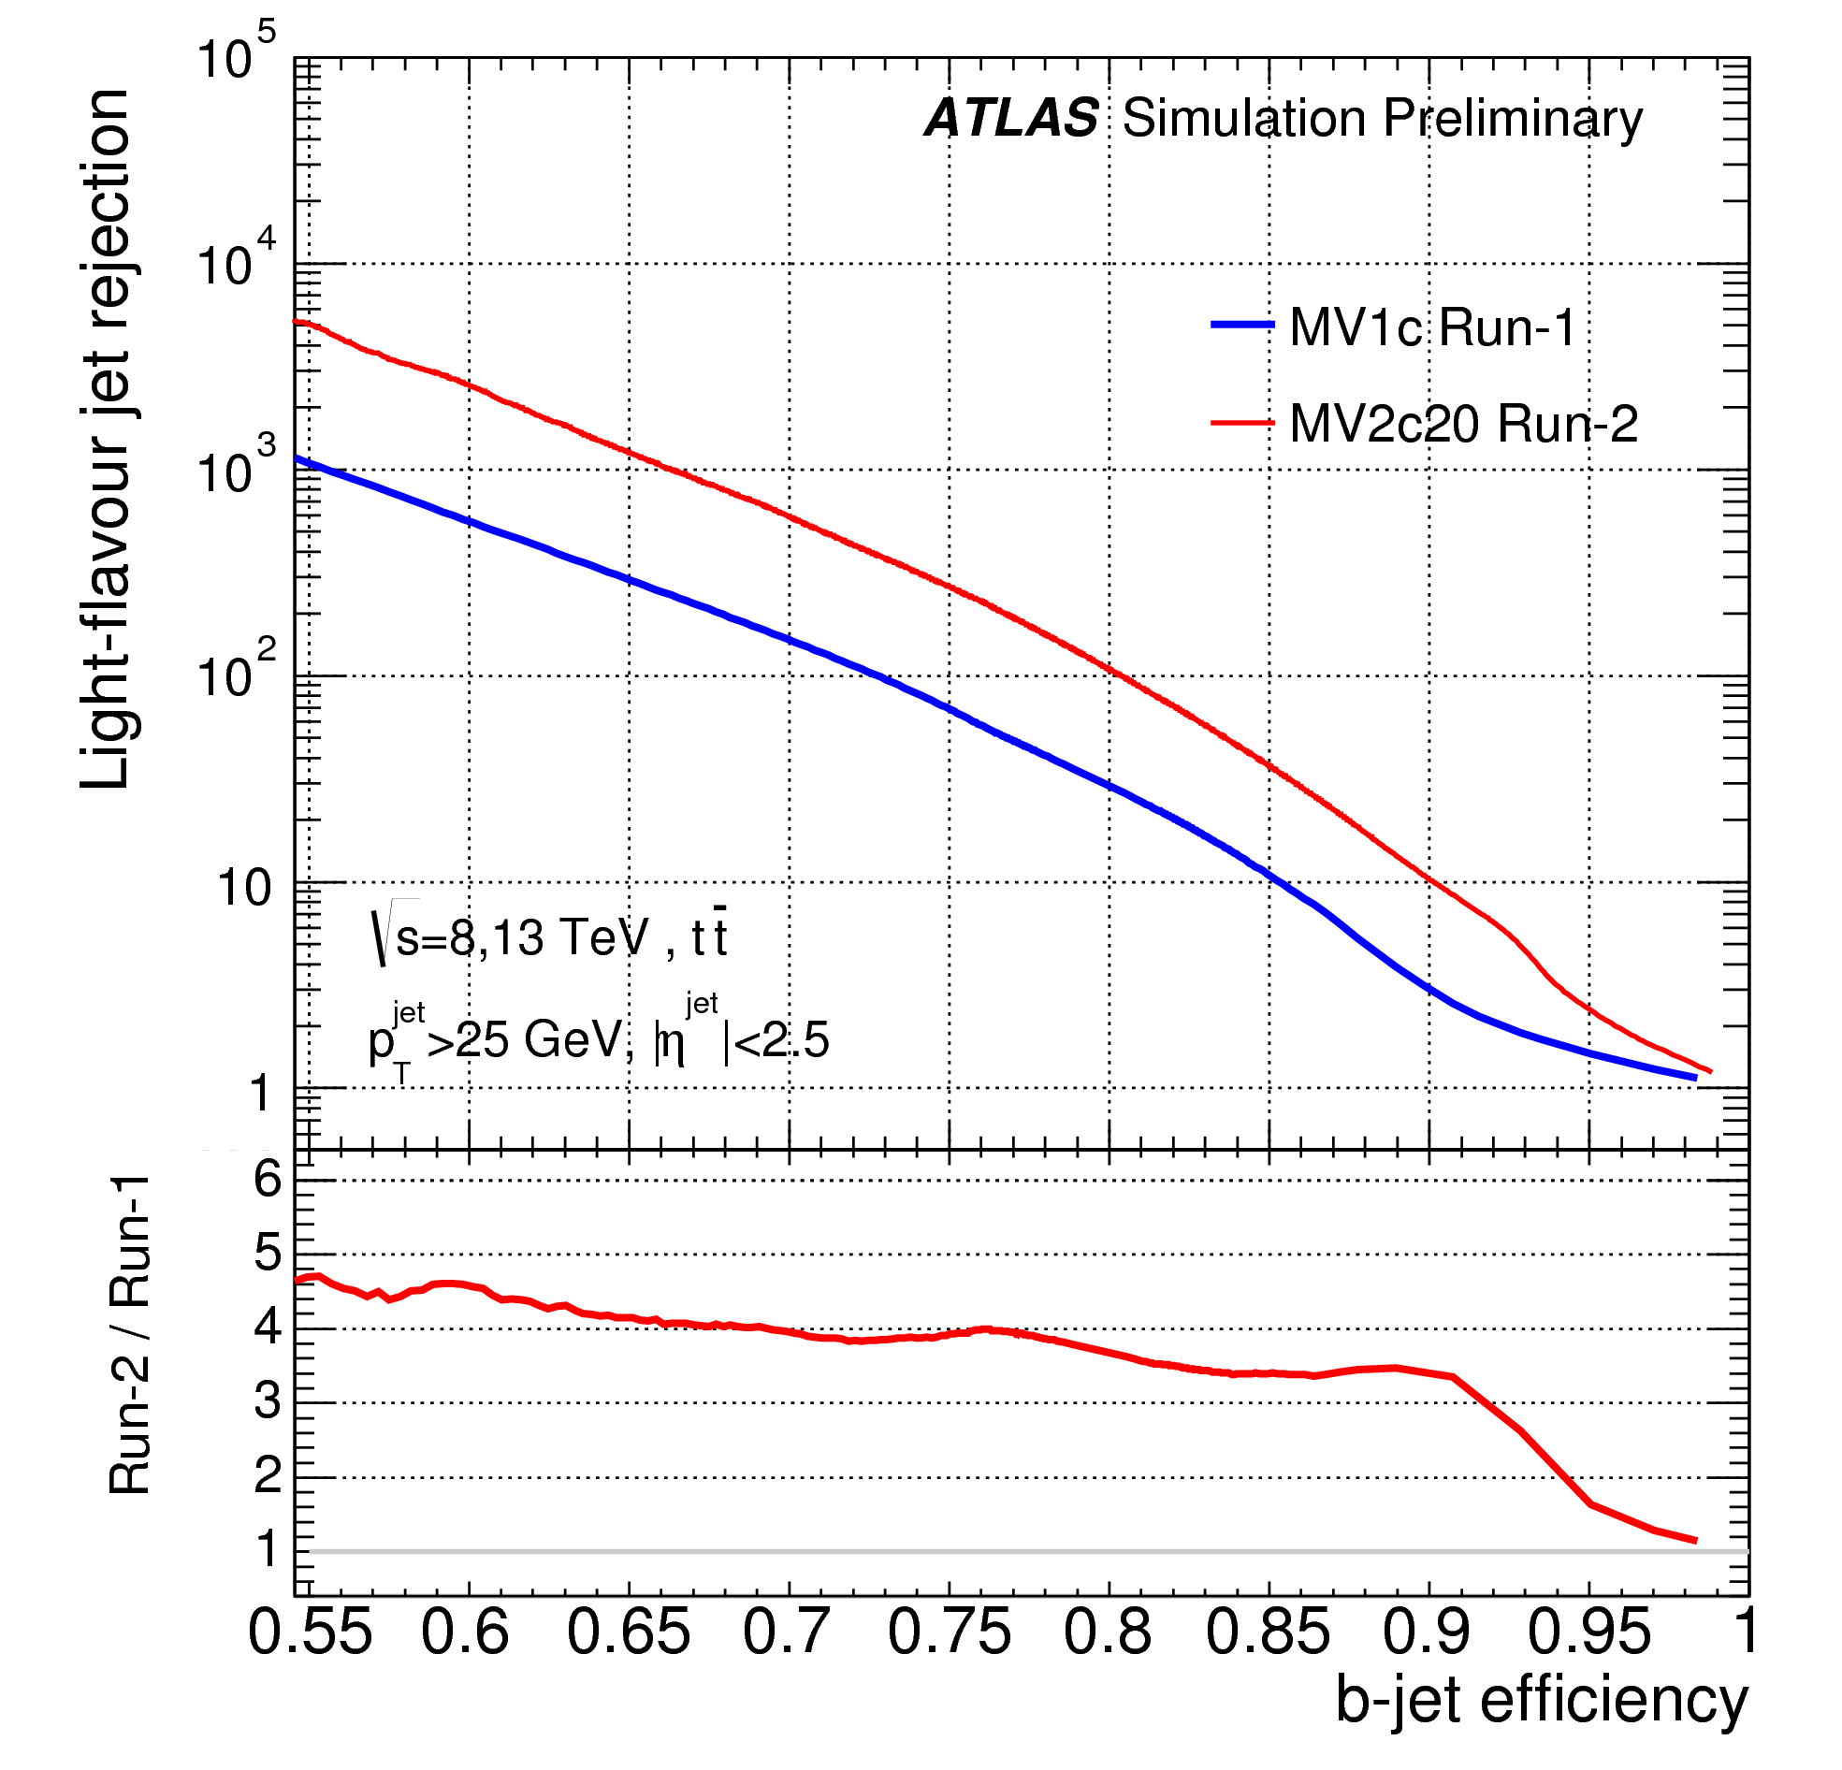
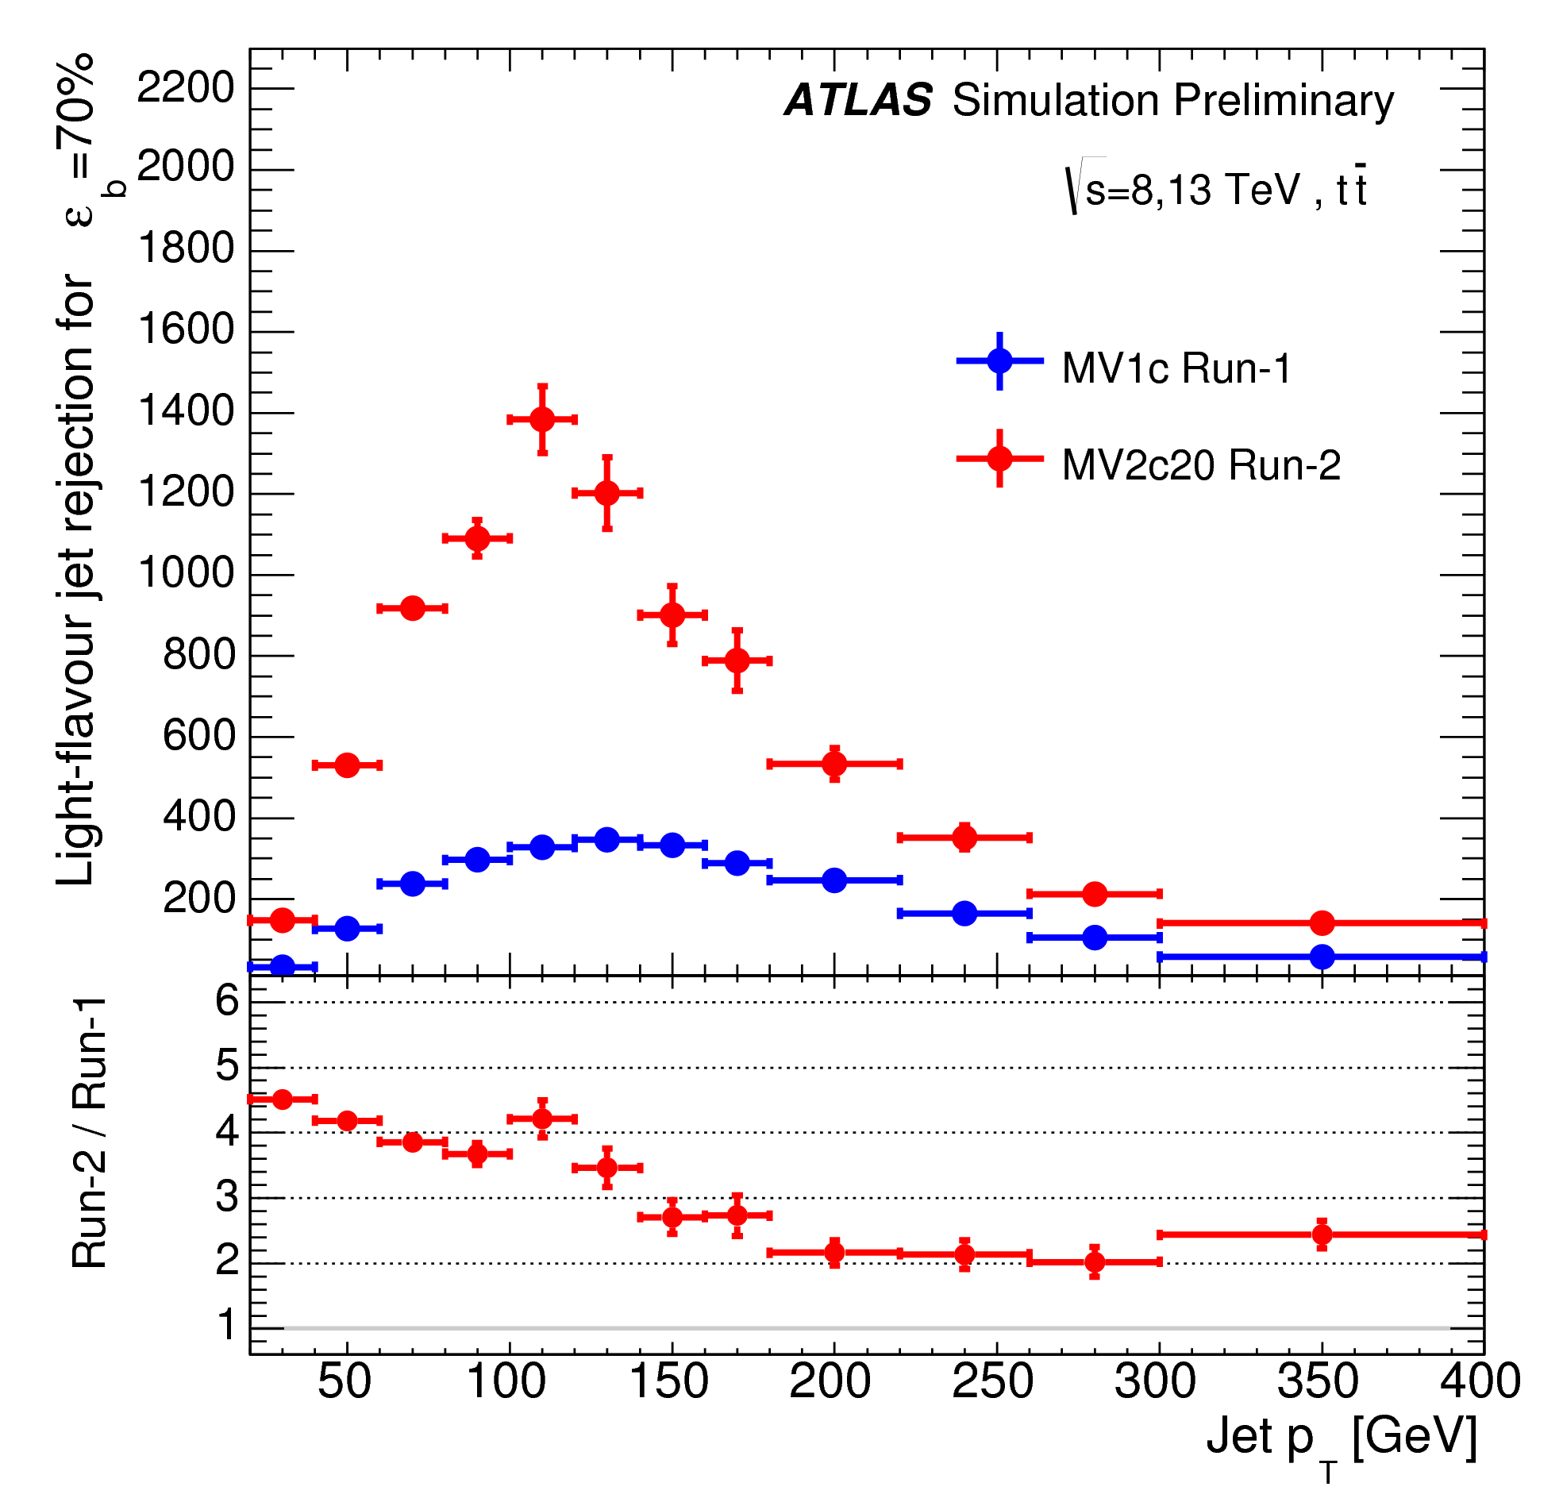
Relevant example: ATLAS IBL
“Insertable Barrel Layer” placed between previous innermost layer in 2014
Improvement in b-tagging, particularly at lower p_{T}
These plots include algorithmic effects, too, but:
Getting closer to the beam, even by a little bit, matters
ATL-PHYS-PUB-2015-022

Slide 26
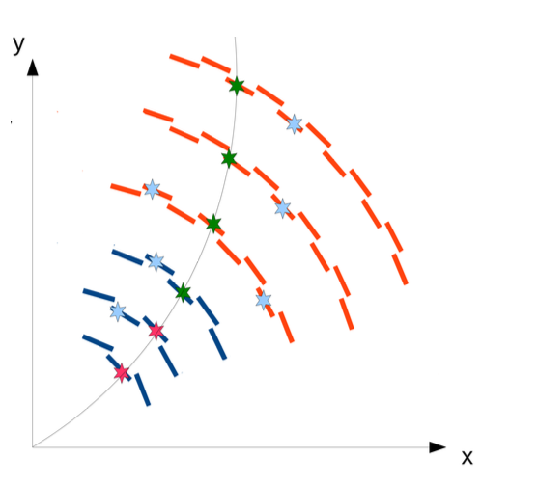
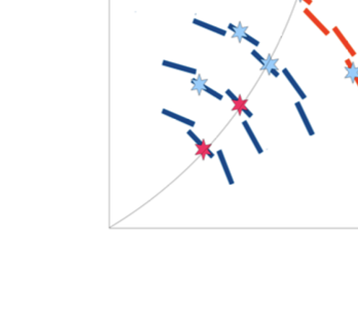
How might pixels work in L1?
CMS HL-LHC L1 tracking uses “tracklets” from p_{T} layers that point out to the rest of the OT
Combinatorics in busy HL-LHC environment will be formidable, “outside-in” tracking may be best bet
Position and direction info from the cluster reduces combinatorics by rejecting clusters in the search road but pointing in the wrong direction → regression of track parameters
Notes:
Obs

Slide 27
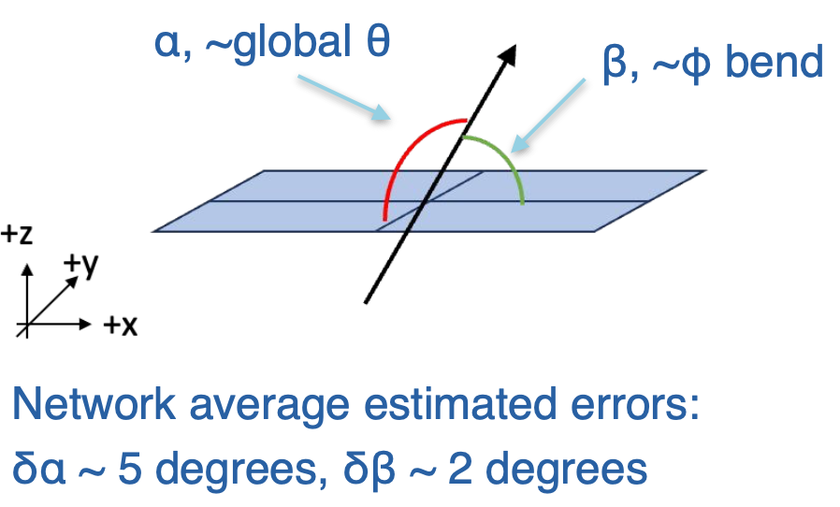
Track parameter regression works
Use time-sliced information with convolutional layers to predict not just local position and angles but their uncertainties as well.
Colors represent hls4ml synthesized (orange cross-hatched) vs. QKeras (blue) – both quantized
https://arxiv.org/abs/2312.11676

Slide 28
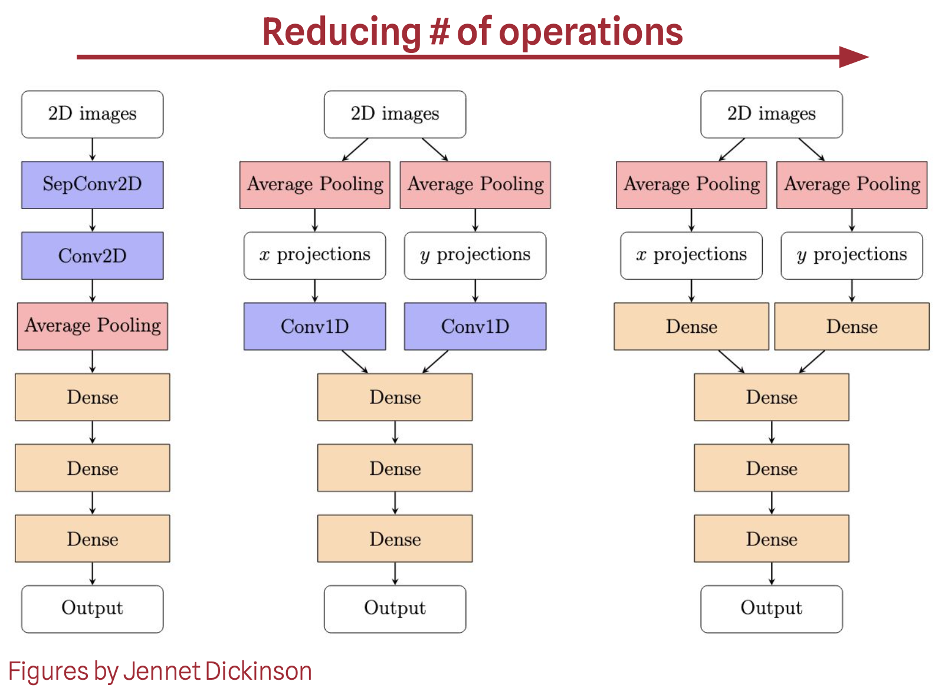
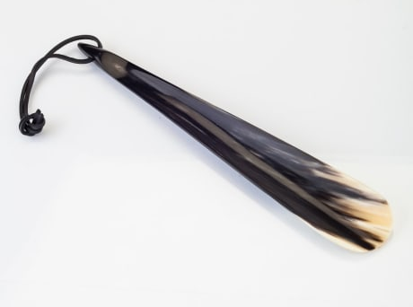
Putting the regression model on an ASIC
Same design flow as filter algorithm: QKeras → hls4ml → Siemens Catapult
Successful synthesis with 45 nm CMOS
Work towards 28 nm process with better latency, initiation interval
  New features needed in hls4ml
  Reduce complexity (and therefore floorspace) of model
    tradeoff with performance needs study
we’ll find the right shoehorn
Notes:
L: “we'll find whatever does the job well enough for the L1 trigger”

Slide 29
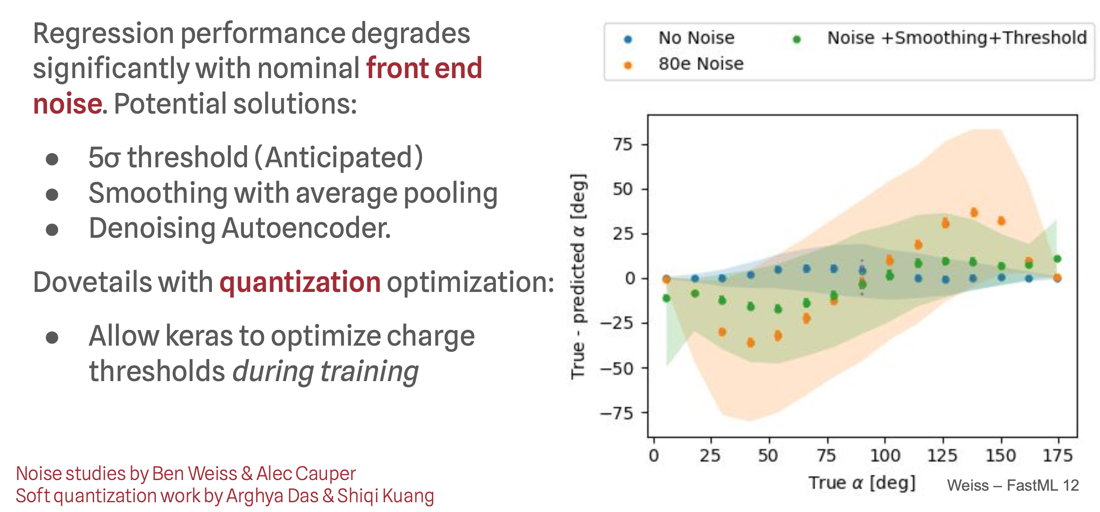
Regression and realism: noise
Noise is potentially a significant issue for the regression, which needs information from small-charge pixels. Can’t yet recover no-noise performance but just starting to explore mitigation:
Preliminary
Notes:
Meanwhile, we’re asking a lot of the same questions with the regression network as the filter

Slide 30
Summary and next steps
Program has branched out from initial demonstration to increasingly realistic simulation, hardware testing, and development of more powerful algorithms (regression)
  Simulation studies show resilience against noise and radiation damage
  Bench testing demonstrates:
    Good performance of analog front-end, with some understood issues to be addressed in next iteration
    p_{T} filter model has been successfully transferred to hardware
  Progress on regression model, which could allow inclusion of pixel data in L1 trigger
Next steps:
  Physics case for pixels in the trigger
    hh→4b and beyond
    Better understand data rates and integration to L1 track trigger (CMS-specific)
  Continue exploring design space for regression and aim at tapeout in next 1-2 years
  Continue developing ROIC testing and improving simulation
    Definitive test of particle reconstruction will be in beam

Slide 31














The smartpixels team
Fermi National Accelerator Laboratory: Abhijith Gandrakota, Benjamin Parpillon, Chinar Syal, Douglas Berry, Farah Fahim, Gauri Pradhan, Giuseppe Di Guglielmo, James Hirschauer, Jennet Dickinson, Lindsey Gray, Nhan Tran, Ron Lipton
Cornell University: Jennet Dickinson, Ben Weiss
Johns Hopkins University: Dahai Wen, Morris Swartz, Petar Maksimovic
Northeastern University: Nick Manganelli
Northwestern University: Manuel Blanco Valentin
Oak Ridge National Laboratory: Aaron Young, Shruti R. Kulkarni
Purdue University: Mia Liu, Arghya Das
University of Chicago: Karri DiPetrillo, Anthony Badea, Carissa Kumar, Emily Pan, Rachel Kovach-Fuentes, Aidan Nicholas, Eliza Howard, Eric You
University of Colorado Boulder: Jannicke Pearkes, Ricardo Silvestre
University of Illinois Chicago: Corrinne Mills, Danush Shekar, Jieun Yoo, Mohammad Abrar Wadud
University of Illinois Urbana-Champaign: Mark S. Neubauer, David Jiang
University of Kansas: Alice Bean

Slide 32
backup

Slide 33
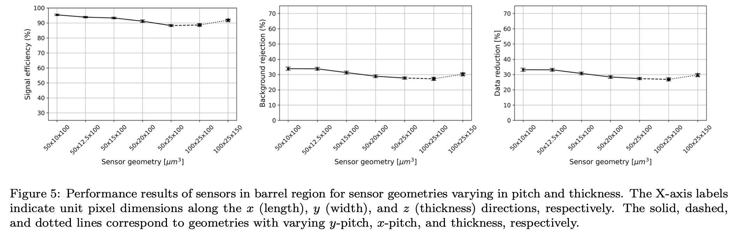
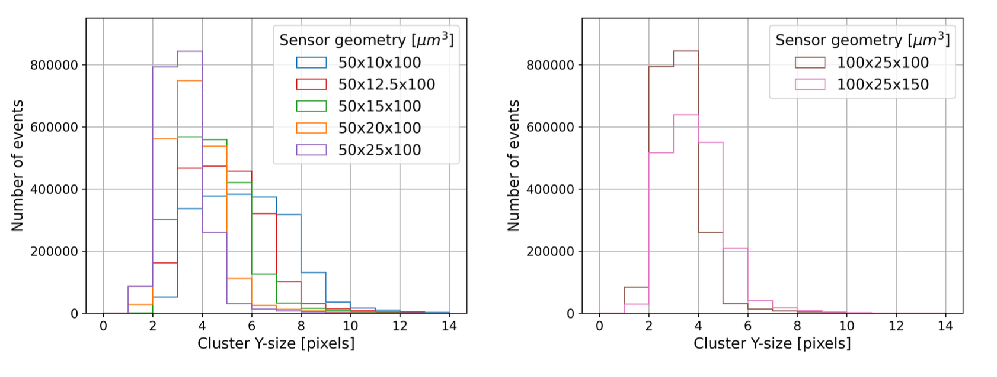
More on sensor geometry

Slide 34
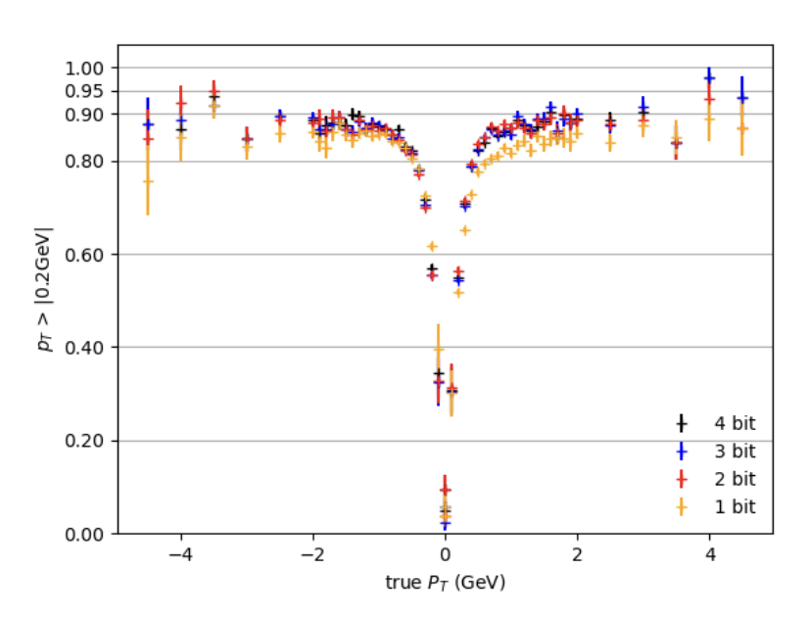
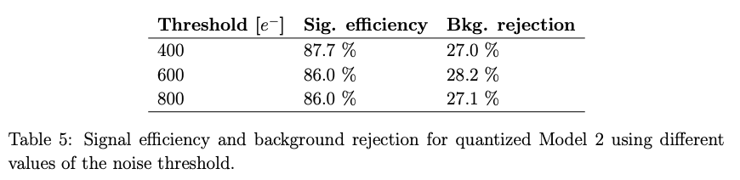
More on the filter
performance vs ADC bits for charge digitization (Model 2)
https://arxiv.org/abs/2310.02474

Slide 35
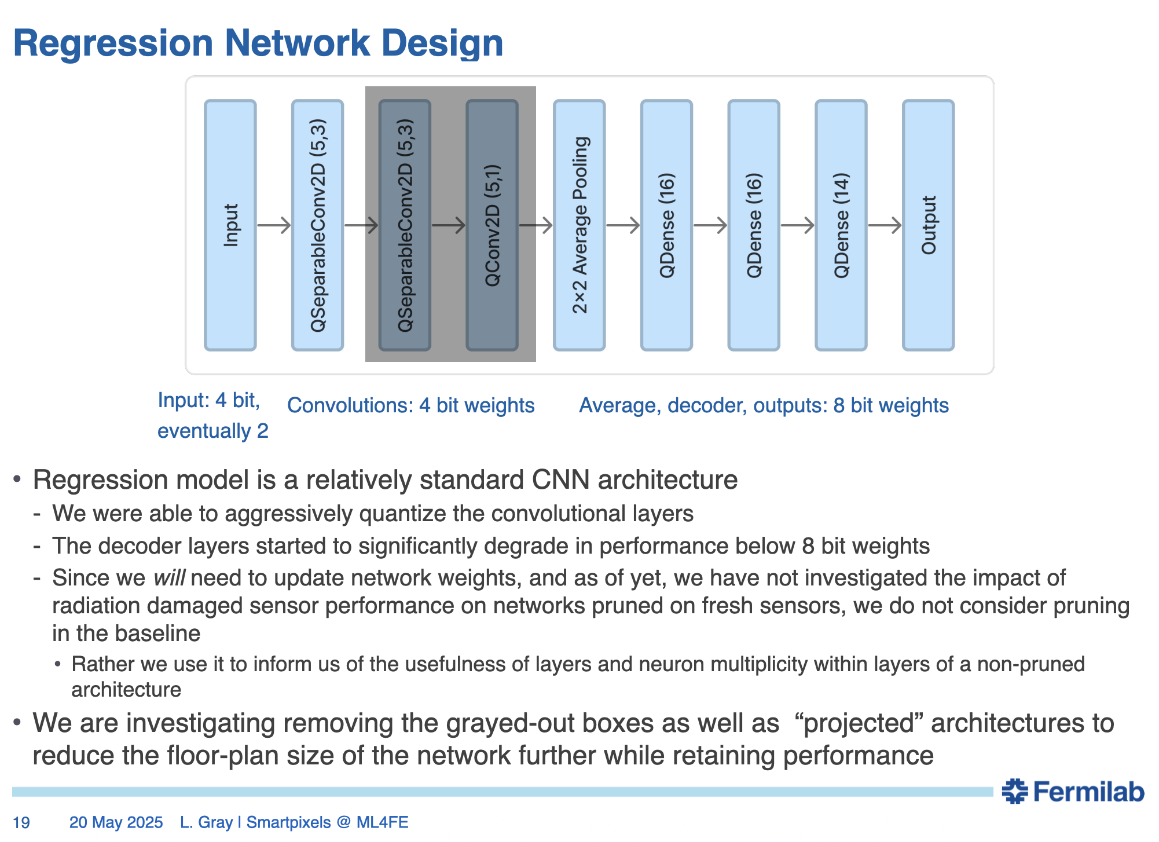
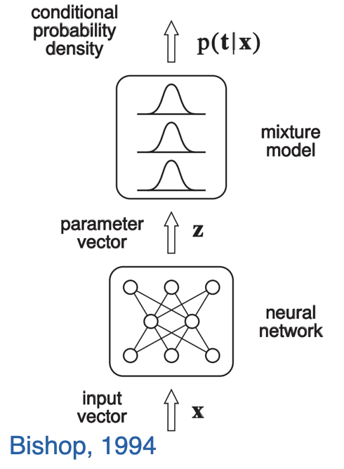
More on the regression network

Slide 36
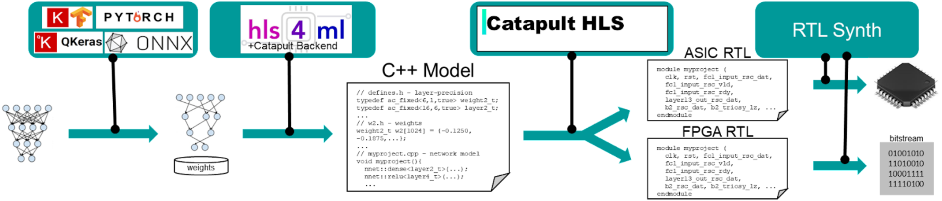
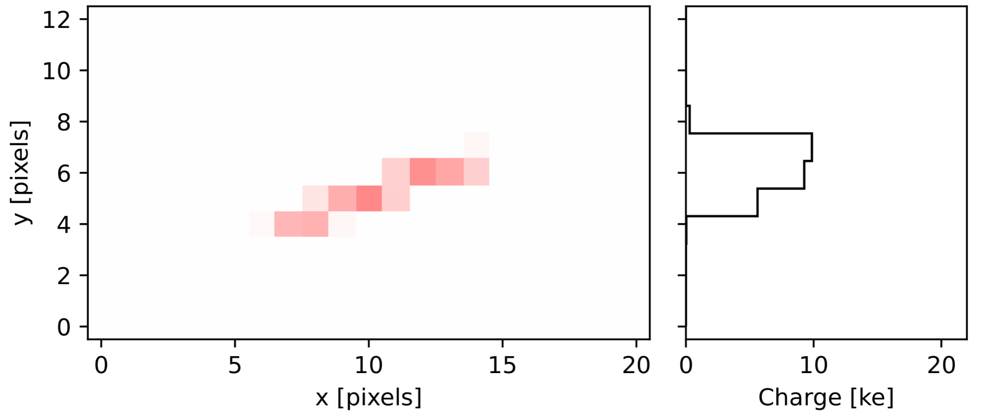
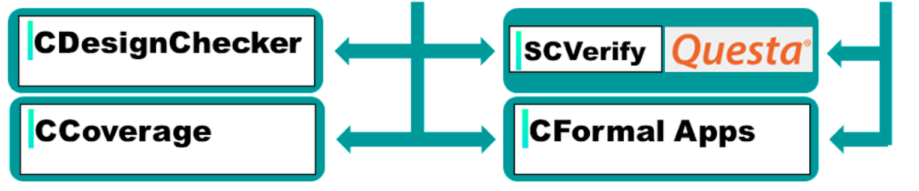
HLS-based hardware design flow
Model Development
Optimization
Quantization
Training
Model Conversion
Parallelism
I/O Style/BRAM
C++ Model Gen
AC Datatypes
AC Math/Linebuffer
High-Level Synthesis
Micro-Architecture
Memory Opt
Pipelining
PPA
ASIC or FPGA Target
RTL Synthesis
Timing Closure
Gate Netlist/ Bitstream
Pre-HLs Validation
Static Checks
Code Coverage
(100-1000x faster than RTL coverage)
Post-HLS Validation
C vs RTL Simulation
RTL Coverage
UVM Support
Credit: Giuseppe Di Guglielmo
2024 CPAD
FERMILAB-CONF-24-0838-CMS
Notes:
Siemens Catapult HLS come with a full suite for verification that includes (don't say the name of the tools but just tentatively what they do)
CDesignChecker, static verification on the C++ code
CCoverage, code coverage on the C++ specifications [X]
SCverify/Questa, simulation-based verification (both C++ and C++/RTL simulation) [X]
CFormalApps, formal verification
Those are a bunch of tools for which we had normal or temporary licenses (I marked with [X] what we have permanently)
QKeras does quantization-aware training, give a certain model trained with a software traditional ML framework (Tensorflow/Keras), QKeras introduce in the flow the fact that weights/biases are represented with fewer bits in a fixed-point representation rather than a floating point representation as in Tensorflow/Keraas. This way the QKeras trained model will be something that is more easily ported in hardware.
If you instead were using a normal Tensorflow/Keras approach and then post training quantize the model, you would loose overall precision/quality in the model
The 70% fidelity between C++ and python comes from some tuning of the accumulators, in the sense at the time of the design, QKeras produce the bit precision of weights, biases, and activation functions, it does not tell us what is the size of accumulators (for each layer)
4:23
you may need that extra fine tuning to make the QKeras and C++ be "close enough"
let's say you have something like a = [1, 3, 5], w = [2, 3, 6], b = 4 the C++ code is more or less
acc = b;
for (i = 0; i < 3; i++)
acc += a[i] * b[i];
4:25
now QKeras tells us the bit precision (fixed point) for w and b
4:25
the bit precision of the inputs a is given
4:26
acc has to be fine tuned, too big, we consume in resources, too small, we overflow or get lost of precision
4:26
Giuseppewe are having improvements in both hls4ml and Catapult to handle it, but at the time I had to fine tune it manually

Slide 37
ASIC front-end characterization
Distribution of threshold values
Leakage current vs VTH
High leakage current reduces supplied V_{TH} at some pixels by 50% (simulation result)
Q_{TH} = 77.5 e-
ENC = ~55 e-
Threshold dispersion Q_{TH} across pixels
This effect trickles down to impact S-curve results
Tails in threshold distribution observed.
Two issues identified:
1. Degradation of injected pulse characteristics across pixel matrix due to parasitic RC components
2. High leakage currents on 3 V_{TH} bias lines -> IR drop -> change in V_{TH}
Improvements planned for future ASIC iterations!
Notes:
Bottom right figure: Non-linear region at low Vth is understood. The linear region is directly proportional to the conversion gain of the analog front-end

Slide 38
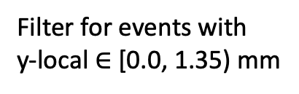
Measured classification performance
Cluster size impacted by factors like track properties, Lorentz force from electric field of silicon sensor and external magnetic field, etc.
Filter for events with
y-local $∈$ [0.0, 1.35) mm
Arbitrarily chosen thresholds to help explain observed trends

Slide 39
Measured classification performance

Slide 40
Measured classification performance
Upon increasing threshold, high p_{T} cluster size is similar to (no-threshold) low p_{T} cluster size.

Slide 41
Measured classification performance

Slide 42
Measured classification performance
Note that the positive high p_{T} cluster size is at a higher value than the negative counterpart.
Upon increasing threshold, positive high p_{T} cluster size is similar to (no-threshold) negative high p_{T} cluster size.

