Slide 1


Monolithic active pixel sensors based on TPSCo 65 nm imaging technology: an overview of results and future challenges
Giacomo Ripamonti
The work presented here covers the activities of the CERN EP R&D WP1.2 team and benefited from massive contributions from the ALICE and monolithic CMOS sensor communities

Slide 2
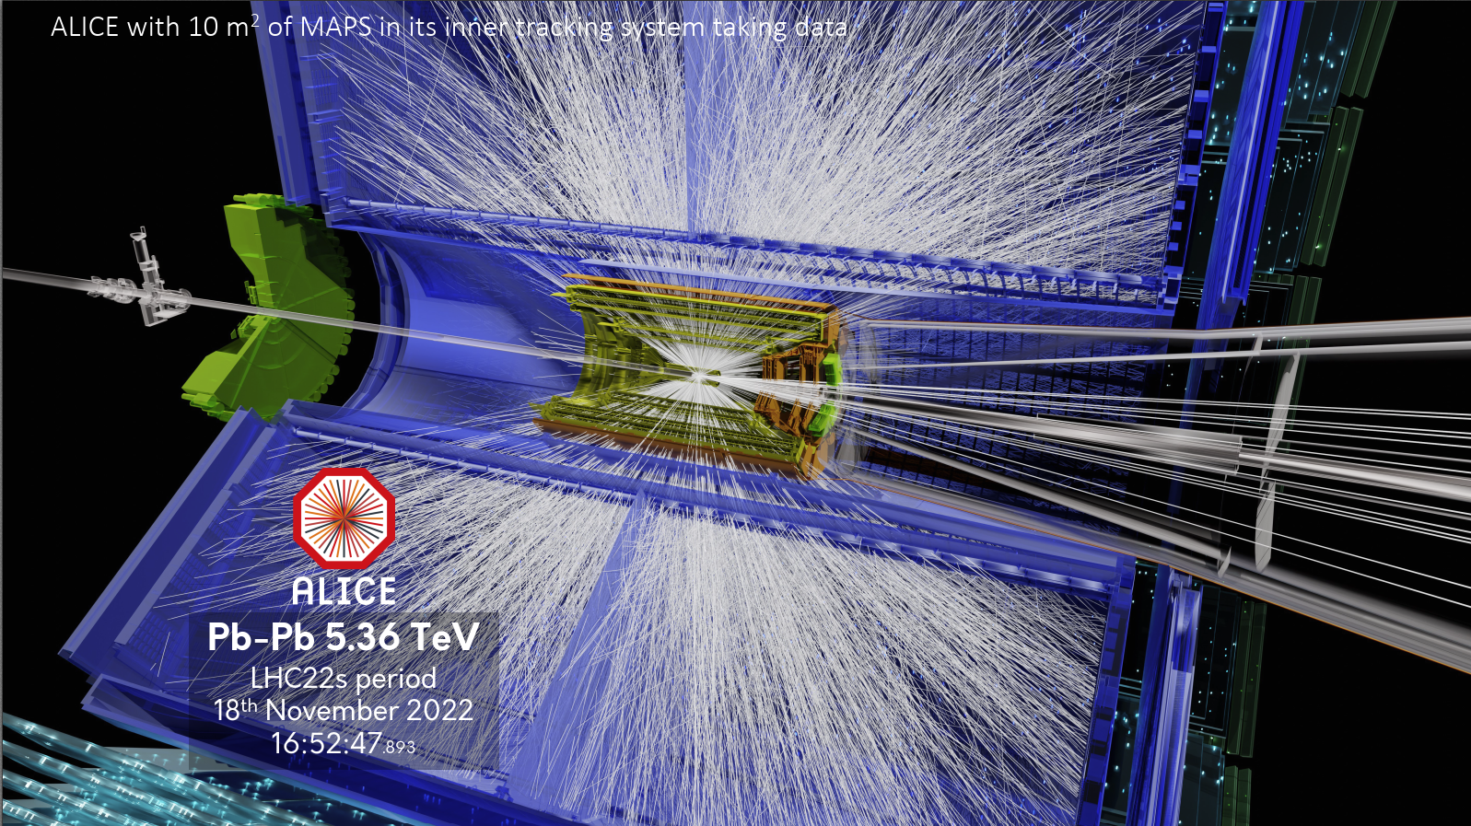
Monolithic active pixel sensors
Monolithic active pixel sensors (MAPS) are crucial for current and future High Energy Physics detectors, due to their minimal material budget, low power consumption and low cost per unit area.
ALICE Inner Tracking System 2 (ITS2) is the first detector based on MAPS deployed at CERN.
The ALPIDE CMOS sensor for the ITS2 was implemented in the TowerJazz 180 nm imaging CMOS technology.

Slide 3
Monolithic active pixel sensors
Monolithic active pixel sensors (MAPS) are crucial for current and future High Energy Physics detectors, due to their minimal material budget, low power consumption and low cost per unit area.
ALICE Inner Tracking System 2 (ITS2) is the first detector based on MAPS deployed at CERN.
The ALPIDE CMOS sensor for the ITS2 was implemented in the TowerJazz 180 nm imaging CMOS technology.
More details on ITS2 in Jiyoung’s talk:
J. Kim, “ALICE ITS2: Performance and Operational Experience”

Slide 4
R&D for monolithic active pixel sensors
CERN EP R&D WP 1.2 targets the development of monolithic CMOS sensors for future HEP detectors in sub-100 nm technologies to achieve smaller pixel pitch, higher data rate, increased radiation tolerance and fabrication of wafer-scale sensors on 300 mm wafers.
The first technology retained is the TPSCo 65 nm, and significant development in this technology was carried out in collaboration with the ALICE experiment for the upgrade of its vertex detector, ITS3.

Slide 5
R&D for monolithic active pixel sensors
CERN EP R&D WP 1.2 targets the development of monolithic CMOS sensors for future HEP detectors in sub-100 nm technologies to achieve smaller pixel pitch, higher data rate, increased radiation tolerance and fabrication of wafer-scale sensors on 300 mm wafers.
The first technology retained is the TPSCo 65 nm, and significant development in this technology was carried out in collaboration with the ALICE experiment for the upgrade of its vertex detector, ITS3.
Main goals and activities:
Design of wafer-scale stitched sensor (application in ITS3)
Investigate new concepts for CMOS sensors:
  Porting of hybrid pixel detector architecture into monolithic (Hybrid-to-Monolithic, H2M)
Performance optimization for future applications
  Fast timing
  Low power
  Radiation tolerance
Provide support and access to TPSCo 65 nm imaging technology

Slide 6
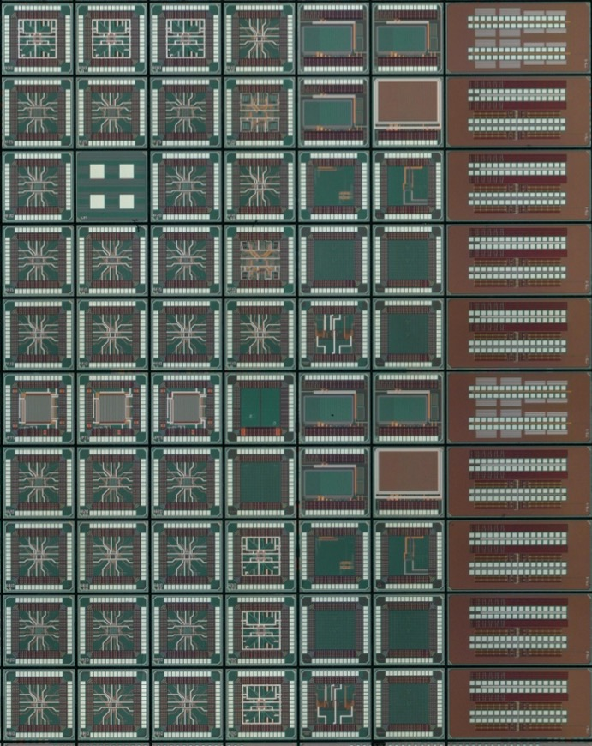
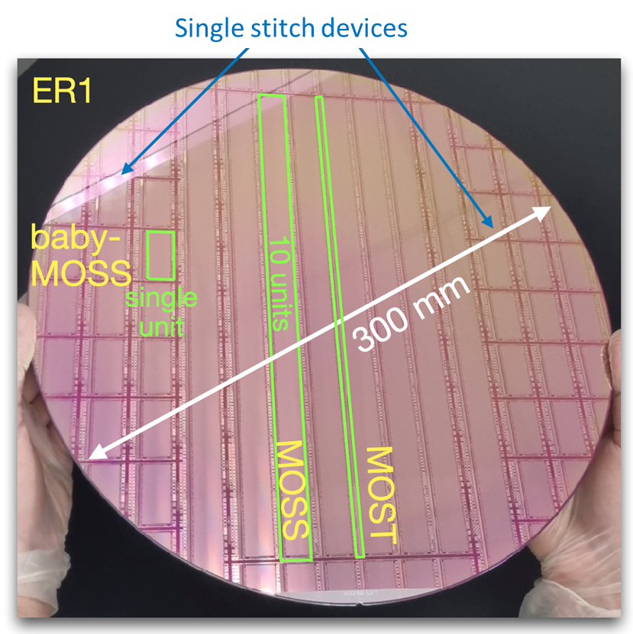

Projects timeline (TPSCo 65 nm)
MOSAIX
  MPR2
  Shared engineering run
  WP 1.2 “rail”
  MLR1 (Multy-Layer Reticle, Dec 2020):
  Learn about the technology, characterize pixels, transistors and building blocks
  ER1 (Engineering Run, Dec. 2022):
  Prove we can design wafer-scale stitched sensors
  ER2 (Q2 2025):
  Full-scale stitched sensor prototype for ALICE ITS3
  ALICE “rail”
  ER3 (2026):
  Stitched sensor production for ITS3 (ALICE-specific)

Slide 7
Projects timeline (TPSCo 65 nm)
MOSAIX
  MPR2
  Shared engineering run
  WP 1.2 “rail”
  MLR1 (Multy-Layer Reticle, Dec 2020):
  Learn about the technology, characterize pixels, transistors and building blocks
  ER1 (Engineering Run, Dec. 2022):
  Prove we can design wafer-scale stitched sensors
  ER2 (Q2 2025):
  Full-scale stitched sensor prototype for ALICE ITS3
  ALICE “rail”
  ER3 (2026):
  Stitched sensor production for ITS3 (ALICE-specific)
  1.5 x 1.5 mm² test chips
  >50 chiplets from: DESY, IPHC, RAL, NIKHEF, CPPM, Yonsei, CERN

Slide 8
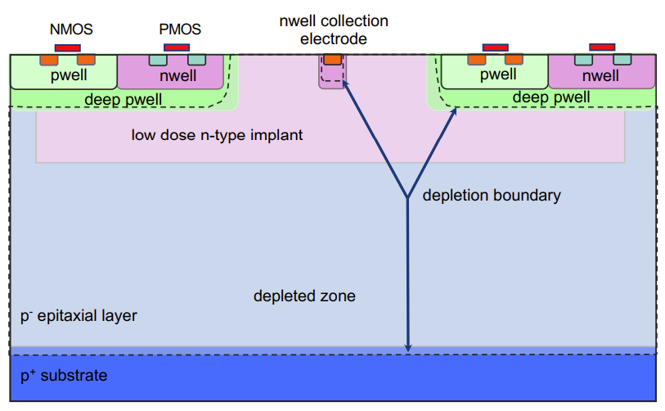
Sensor cross section
Sensor development in TPSCo 65 nm built on experience with TowerJazz 180 nm
gap
gap
Pixel pitch

Slide 9
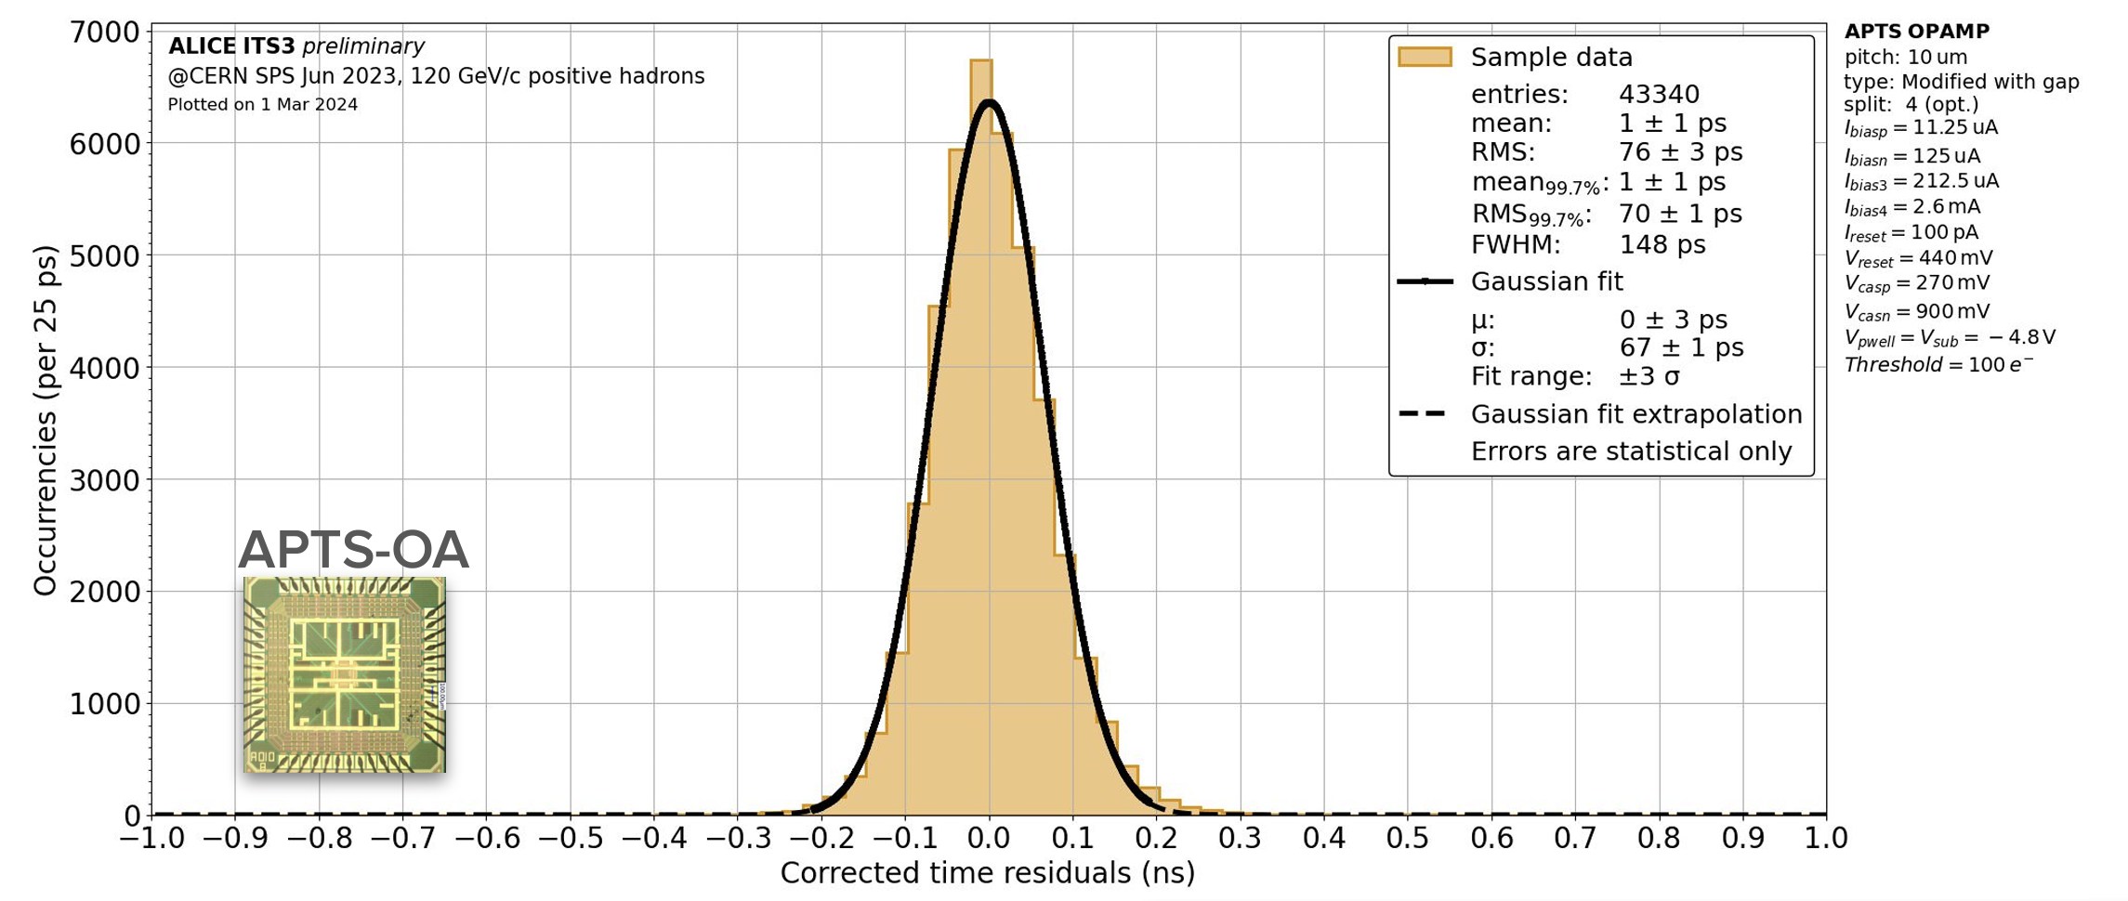
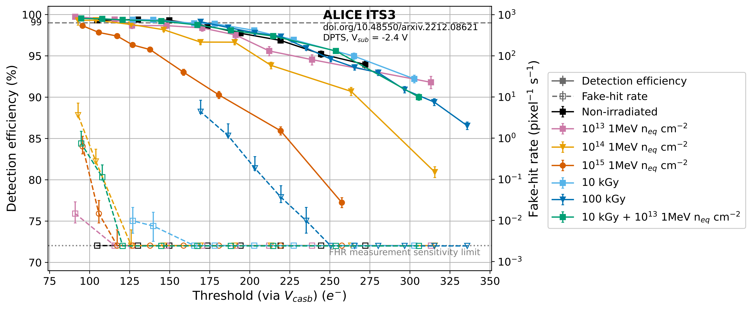
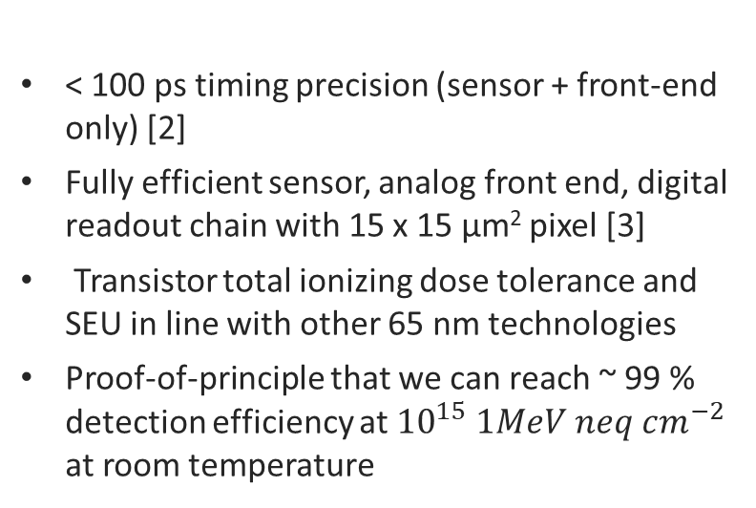
MLR1: learning on sensor, front-end and readout
Lessons learned from MLR1:
< 100 ps timing precision (sensor + front-end only) [2]
Fully efficient sensor, analog front end, digital readout chain with 15 x 15 μm² pixel [3]
Transistor total ionizing dose tolerance and SEU in line with other 65 nm technologies
Proof-of-principle that we can reach ~ 99 % detection efficiency at ${10}^{15} 1MeV neq cm^{−2}$ at room temperature
[1] “Characterization of analogue Monolithic Active Pixel Sensor test structures implemented in a 65 nm CMOS imaging process”. In: Nucl. Instr. and Meth. A 1070 (2025), 169896. doi: 10.1016/j.nima.2024.169896.
[2] “Time performance of Analog Pixel Test Structures with in-chip operational amplifier implemented in 65 nm CMOS imaging process”, In: Nucl. Instr. and Meth. A 1070 (2025), 170034. doi: 10.1016/j.nima.2024.170034.
[3] “Digital pixel test structures implemented in a 65 nm CMOS process” , In: Nucl. Instr. and Meth. A 1070 (2025), 168589. doi: 10.1016/j.nima.2024.168589.

Slide 10
Projects timeline (TPSCo 65 nm)
MOSAIX
  MPR2
  Shared engineering run
  WP 1.2 “rail”
  MLR1 (Multy-Layer Reticle, Dec 2020):
  1.5 x 1.5 mm² test chips
  Learn about the technology, characterize pixels, transistors and building blocks
  ER1 (Engineering Run, Dec. 2022):
  Prove we can design wafer-scale stitched sensors
  MOSS (1.4 x 25.9 cm)
  MOST (0.25 x 25.9 cm)
  Hybrid-To-Monolithic (H2M)
  51 chiplets from: DESY, IPHC, RAL, NIKHEF, SLAC, INFN, CERN
  ER2 (Q2 2025):
  Full-scale stitched sensor prototype for ITS3
  ALICE “rail”
  ER3 (2026):
  Stitched sensor production for ITS3 (ALICE-specific)

Slide 11
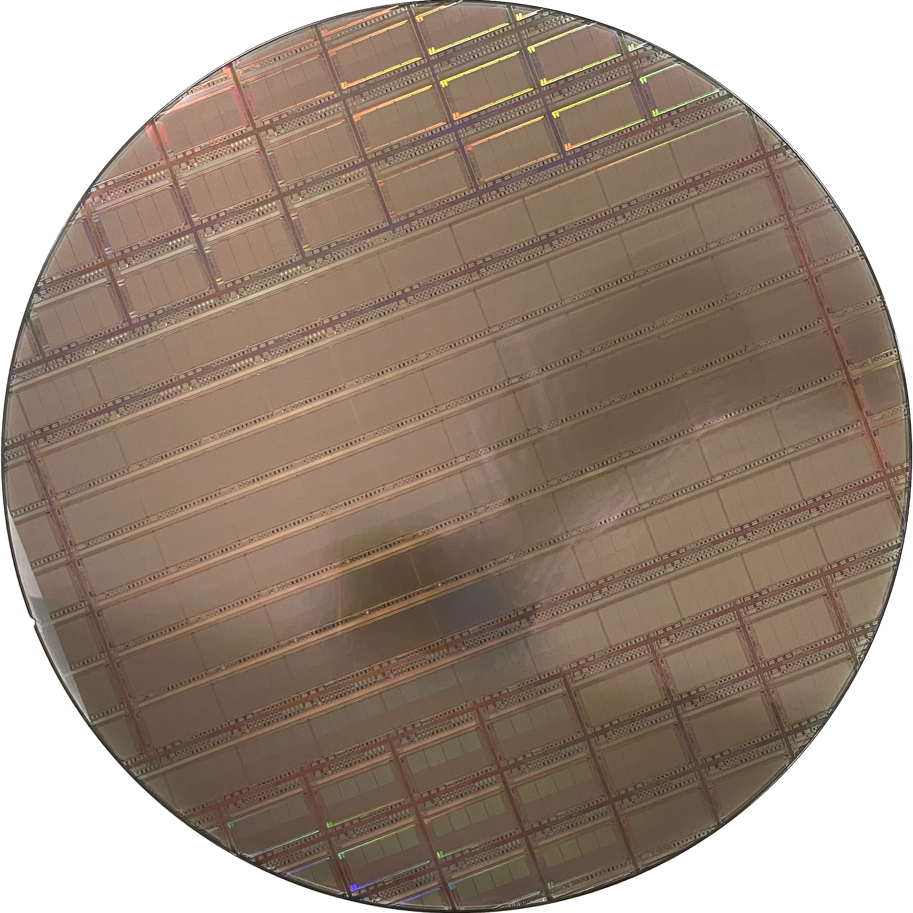
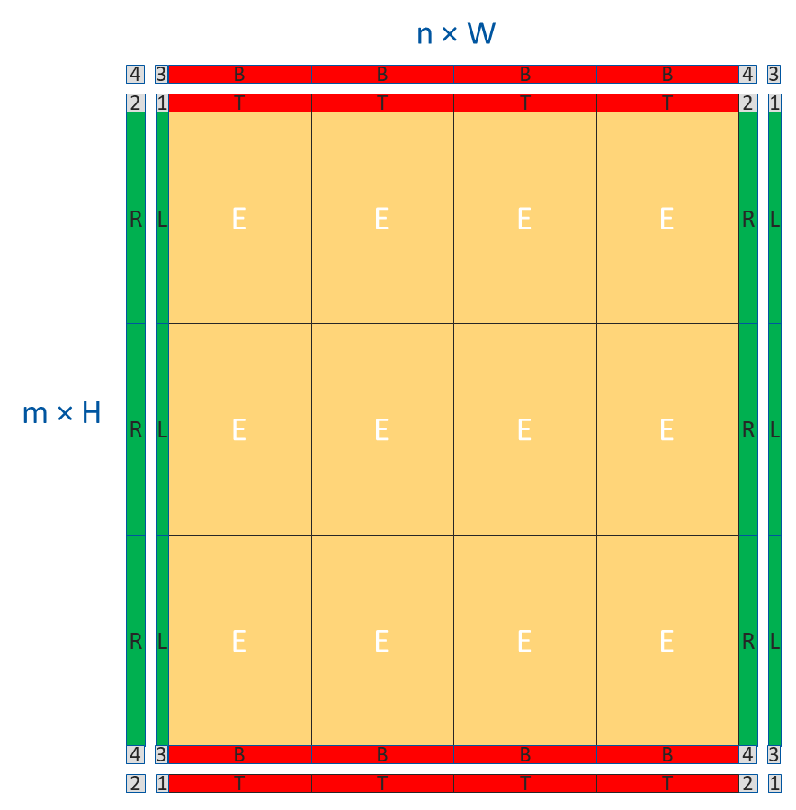
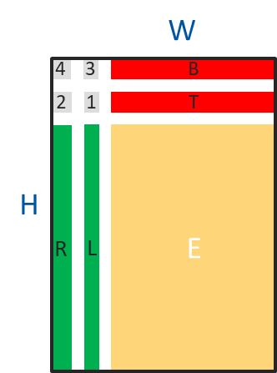
ER1: learning stitching and handling procedures
Two wafer-scale stitched sensor chips
  MOSS (Monolithic Stitched Sensor)
  MOST (Monolithic Stitched Sensor with Timing)
MOSS
MOST
Stitched circuit on wafer
ER1 300mm wafer
Design Reticle size
Design Reticle (typ. 2x3 cm)

Slide 12
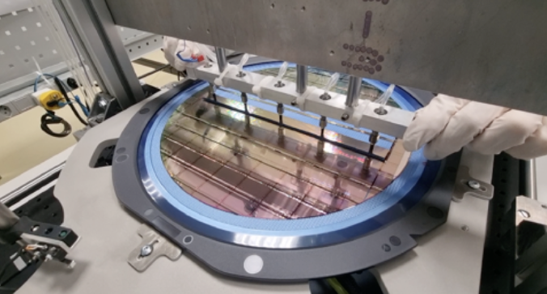
ER1: learning stitching and handling procedures
Two wafer-scale stitched sensor chips
  MOSS (Monolithic Stitched Sensor)
  MOST (Monolithic Stitched Sensor with Timing)
MOSS
MOST
Stitched circuit on wafer
ER1 300mm wafer
Design Reticle size
Design Reticle (typ. 2x3 cm)
Lots of learning on chip handling
Several small test chips (1.5 mm × 1.5 mm)
  H2M, PLL, pixel prototypes, fast serial links, SEU test chips, …
MOSS picking

Slide 13
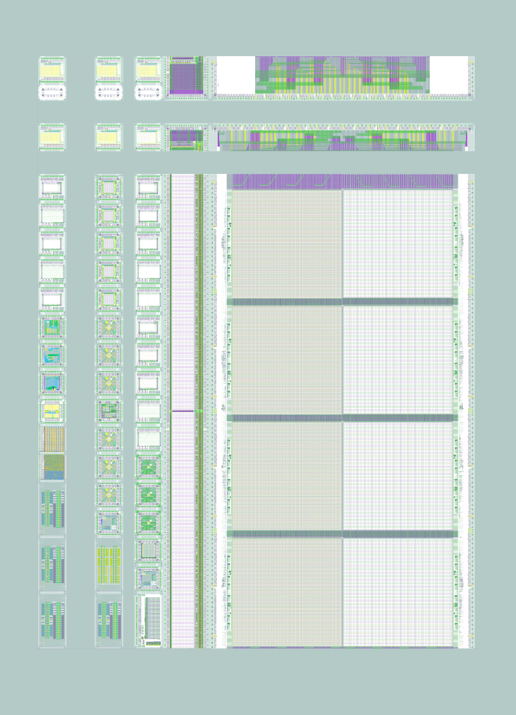
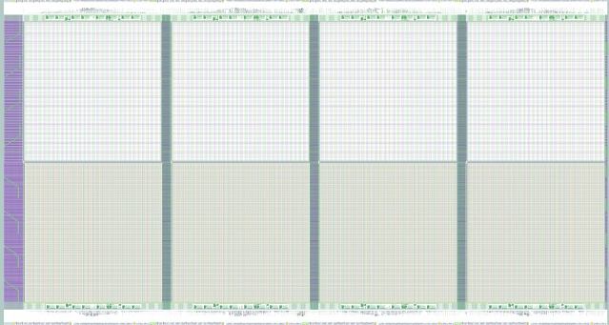
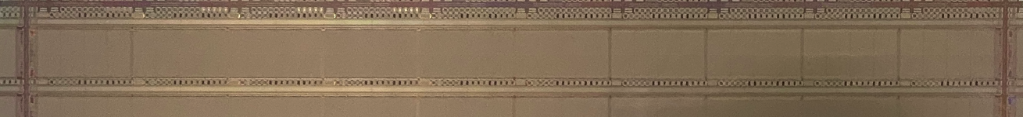
MOSS (Monolithic Stitched Sensor)
  “Full-size” prototype for ALICE ITS3
  14 mm × 259 mm, 6.72 Mpixels
  Conservative design and layout, study yield and uniformity
MOSS
(1 of 6)
MOSS building blocks:
  Repeated Sensor Unit (hosting pixel matrices, each RSU can be powered, controlled and read-out independently or from the Left Endcap)
  Left Endcap (allows to provide power, control and read data from the short edge, as required by ITS3)
  Right Endcap (allows to provide power from the short edge)
ER1 300mm wafer
Two pixel pitches (22.5 µm and 18 µm) to study the effects of layout density
Reticle
14 mm
1
2
3
4
5
6
7
8
9
10
259 mm

Slide 14
MOSS tests
Testing of MOSS carried out entirely by the ALICE community.
MOSS design has proven to be fully functional. Some short circuits observed related to a new, project-specific metal stack offered by the foundry, understood and addressed in a collaborative effort with the foundry, not expected in future runs.
Test beam results: ITS3 requirements in terms of efficiency and fake-hit rate met, also post-irradiation (radiation load estimated for ITS3 is ~ 400 krad, ~ 4 x 10¹² 1 MeV n_{eq}/cm²).
More details in Livia’s talk:
L. Terlizzi, “ALICE Inner Tracking System 3 overview: from MOSS and MOST to the full-size MOSAIX sensor prototype ”
10

Slide 15
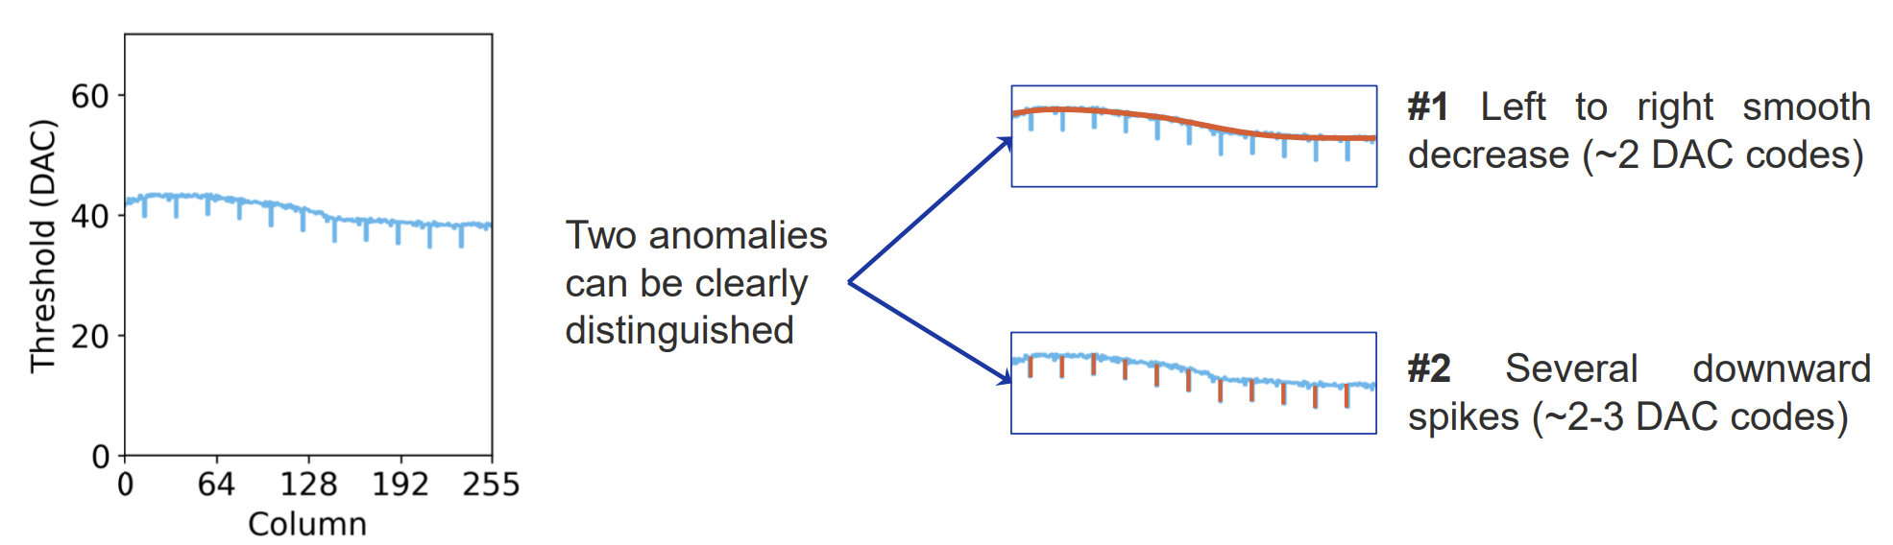
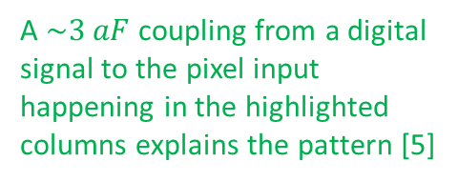
MOSS – Learnings on matrix uniformity and couplings
Pixel threshold measured using on-pixel pulsing (charge injected by applying a voltage step to a capacitor connected to the pixel input)
Voltage drop in the pulsing voltage explains this [5]
A $\sim 3 aF$ coupling from a digital signal to the pixel input happening in the highlighted columns explains the pattern [5]
Lots of learning from the test campaign of MOSS that have guided the design of its successor.
[5] S. Emiliani et al. “Investigation of non-idealities of pulsing circuitry in the ALICEITS3 MOSS monolithic sensor”. In: Journal of Instrumentation 19.12 (Dec. 2024), p. C12021. doi: 10.1088/1748-0221/19/12/C12021

Slide 16
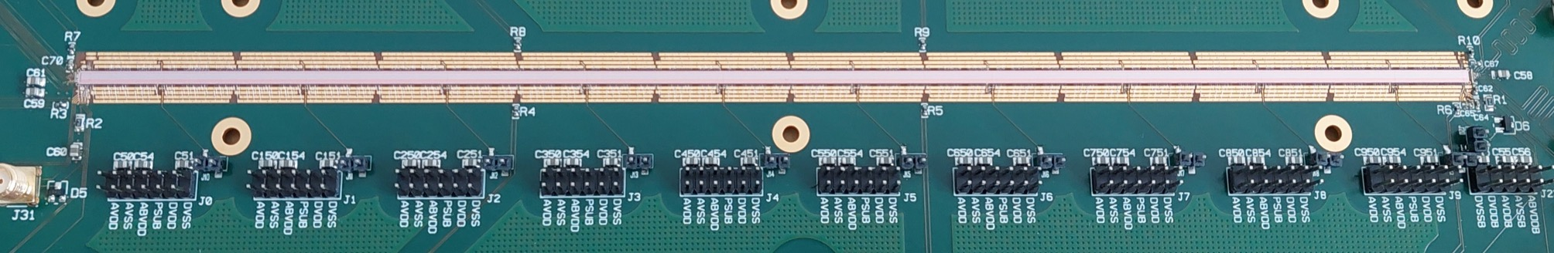
MOST (Monolithic Stitched Sensor with Timing)
MOST
MOST other stitched sensor on ER1
  259 x 2.5 mm
  18 micron pixel pitch
Main differences with MOSS
  Powering: global power distribution with power switches to switch off faulty parts, very densely designed circuit
  Asynchronous, hit-driven readout for timing information + low power consumption
  High-speed data transmission on chip
  Reverse bias is applied to the sensor via the front-end
ER1 300mm wafer
MOST on carrier board
Significant testing effort, also at NIKHEF, more details in [6]
25.9 cm
[6] M. Selina. “Exploring ALICE ITS3 MOST: Early Results on Power Segmentation and Asynchronous Readout for Timing in a Monolithic Stitched Sensor”. In: Eleventh Workshop on Semiconductor Pixel Detectors for Particles and Imaging (Strasbourg, November 2024), https://arxiv.org/pdf/2504.13696

Slide 17
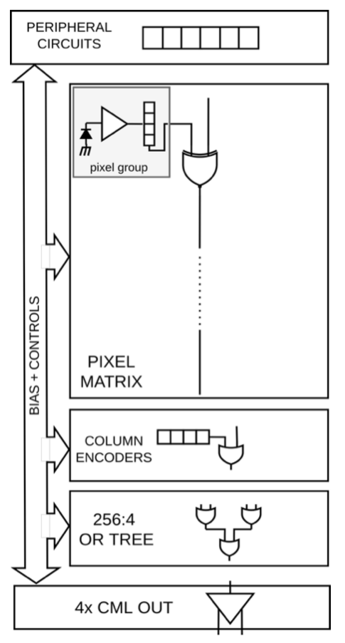
MOST: asynchronous readout
Groups of 4 pixels
As soon as a pixel is hit, its address is shipped through a global data line to the column encoders
The column encoders append the column address, and the data are shipped out through a CML driver
global data line
The asynchronous readout of MOST allows to study to what degree the timing is preserved in the long-distance transmission

Slide 18
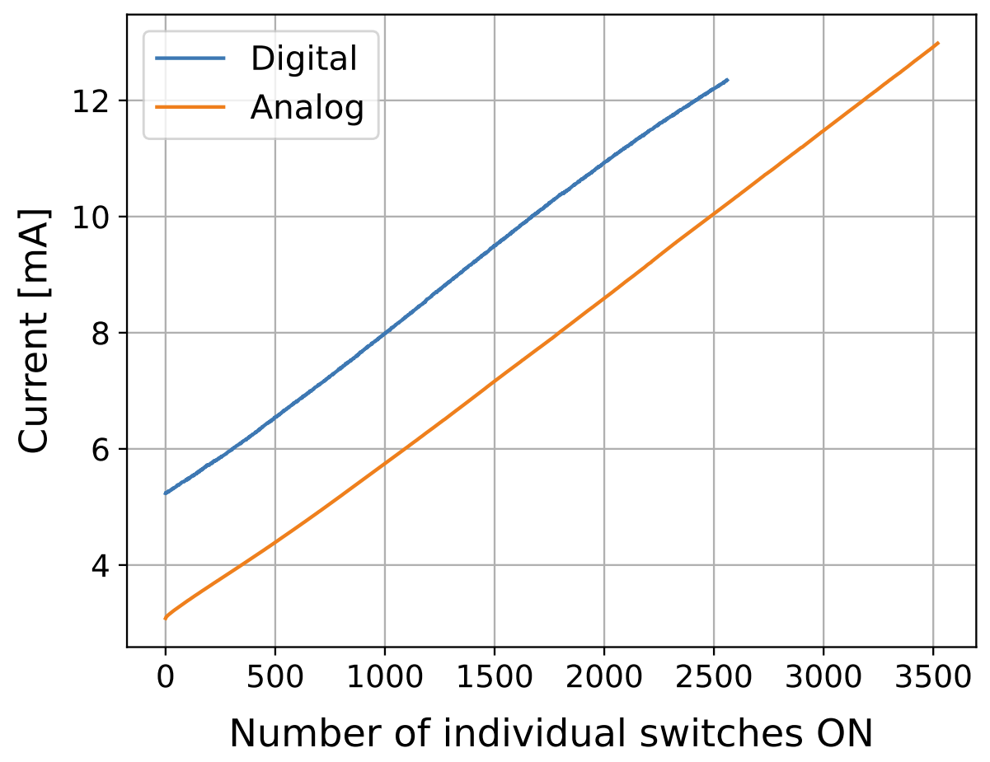
MOST: yield & powering
If MOST can be powered (functional global power network), fully functional
  In that case pixel yield better than 99.98 %, despite the highly-dense layout. This result paves the way for high-density, large-area designs
MOST current consumption vs. powered pixel groups (powered through power switches)

Slide 19


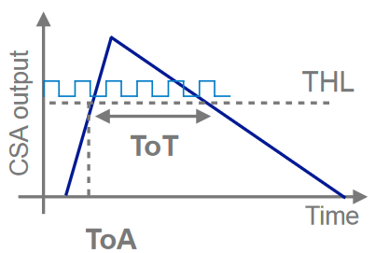
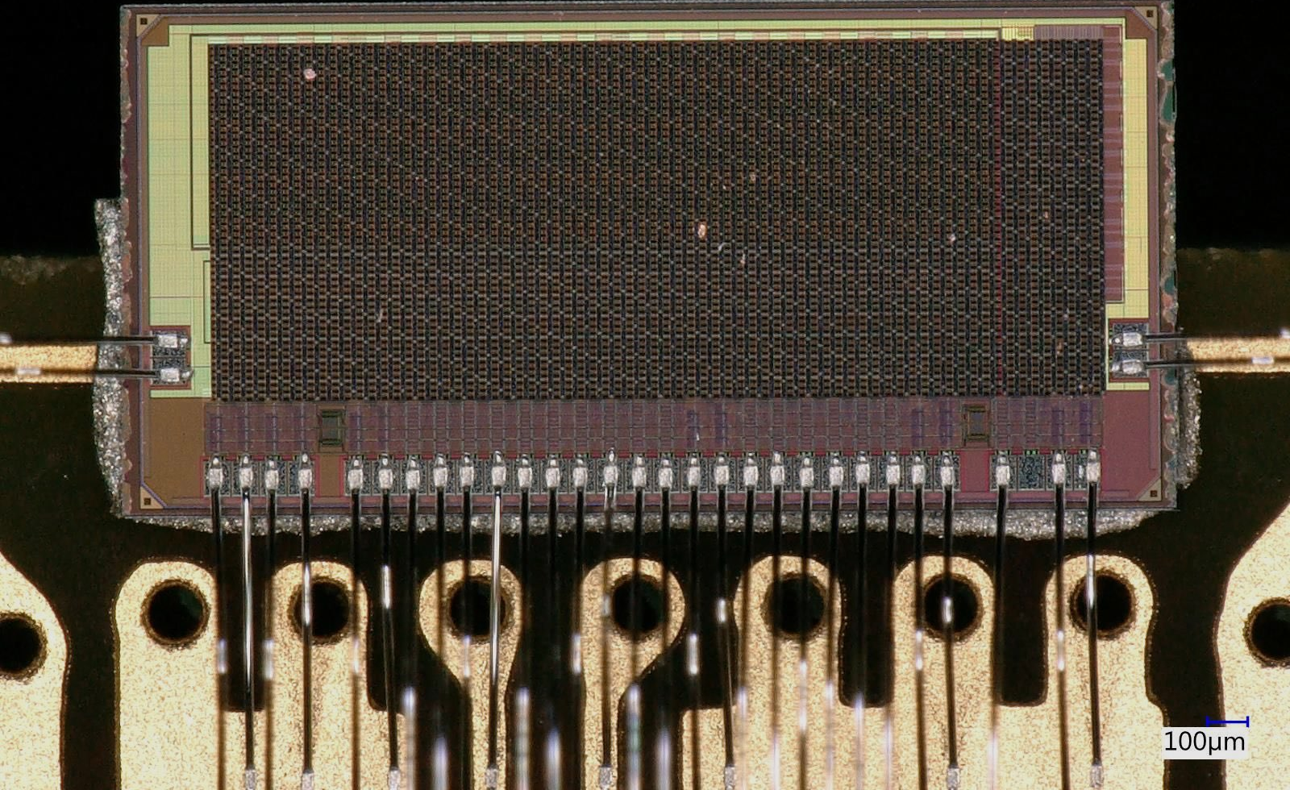

H2M (Hybrid-to-Monolithic)
Technology demonstrator designed by WP 1.2, DESY and IFAE
Ports a hybrid pixel detector architecture into a monolithic chip
4 Non-simultaneous acquisition modes
• 8 bit ToT,
• 8 bit ToA (100 MHz clock - 10 ns binning),
• counting (#number of hits above threshold),
• triggered.
Readout: 40 MHz clock, frame-based without zero-suppression.
Active area outside of the chipboard to reduce material budget
  Pixel pitch: 35 µm in 64x16 pixel matrix
  Total thickness: ~ 50 µm (epi ~10 µm)
[7] S. Ruiz Daza at al. “The H2M Monolithic Active Pixel Sensor - characterizing non-uniform in-pixel response in a 65 nm CMOS imaging technology”. In: Eleventh Workshop on Semiconductor Pixel Detectors for Particles and Imaging (Strasbourg, November 2024), https://arxiv.org/abs/2502.06573

Slide 20
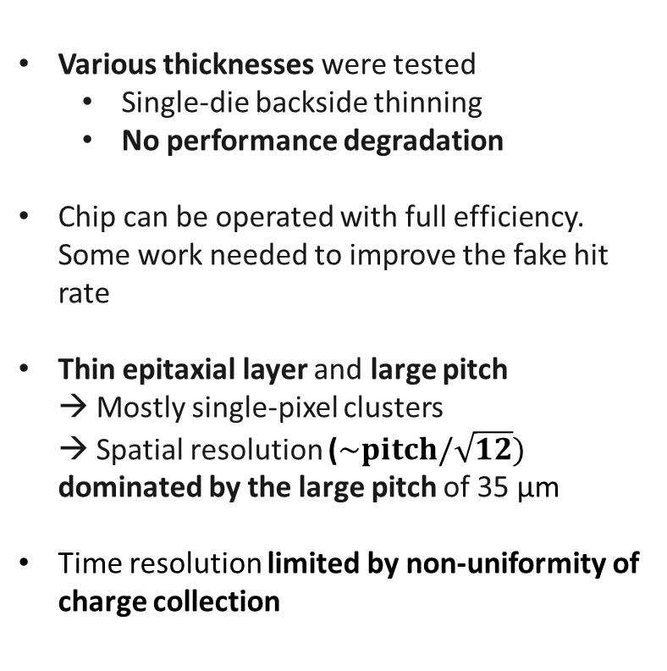
H2M - Global performance results
Total chip thickness
Efficiency and Fake hit rate
Cluster size
Various thicknesses were tested
  Single-die backside thinning
  No performance degradation
Chip can be operated with full efficiency. Some work needed to improve the fake hit rate
Thin epitaxial layer and large pitch → Mostly single-pixel clusters → Spatial resolution ($\sim pitch/\sqrt{12})$ dominated by the large pitch of 35 μm
Time resolution limited by non-uniformity of charge collection
Bias: -1.2V
Bias: -1.2V
Efficiency
Fake hit rate
Time resolution
Spatial resolution
Bias: -1.2V

Slide 21
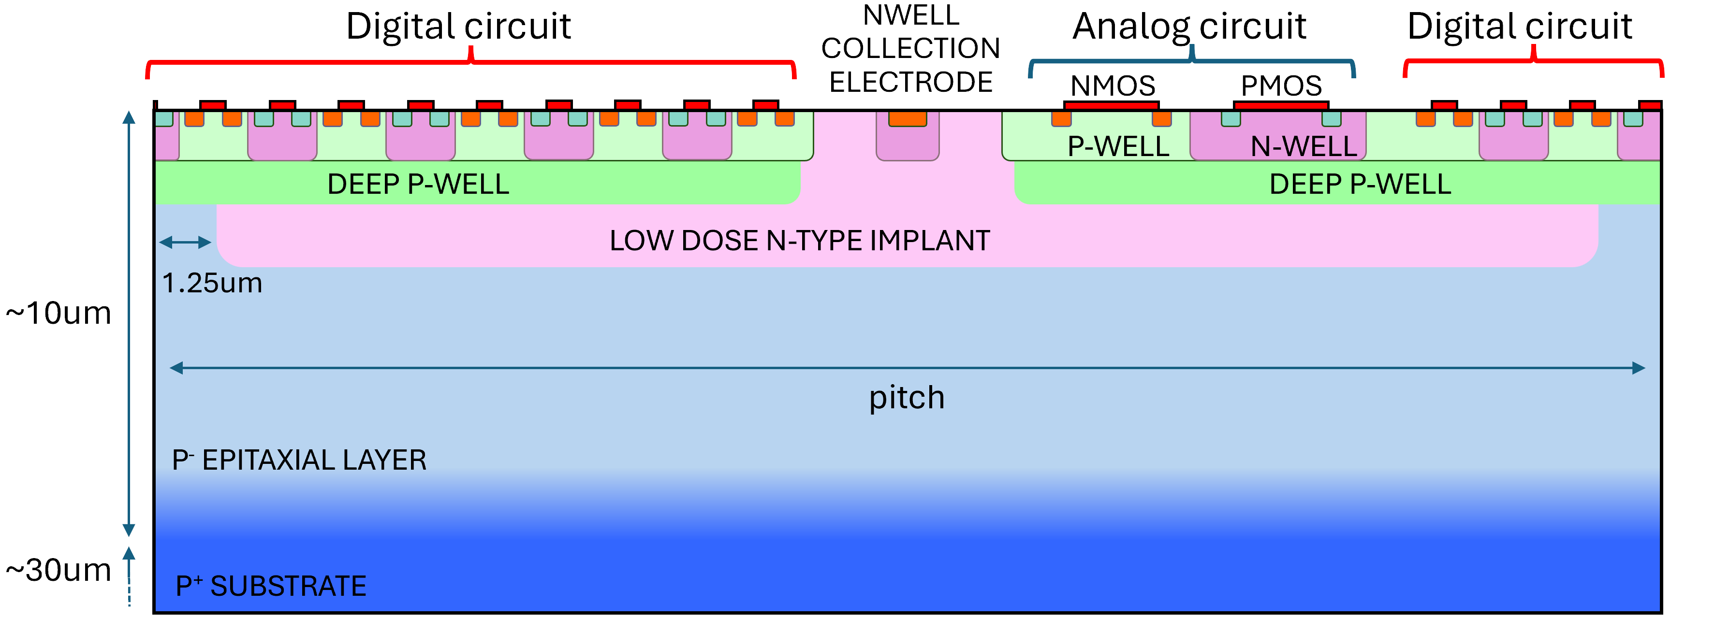
H2M - Non-uniform in-pixel response
Measured time residual
Measured efficiency
Related to the size and location of the n-wells of the circuitry, leading to localized low-field regions with slower charge collection
Mitigated with optimized operating parameters (larger sensor bias, lower threshold, lower reset current)
Confirmed in simulation (TCAD + Monte Carlo + Spice) [8]
[8] C. Lemoine et al. “Impact of the circuit layout on the charge collection in a monolithic pixel sensor”. In: Eleventh Workshop on Semiconductor Pixel Detectors for Particles and Imaging (Strasbourg, November 2024), https://arxiv.org/abs/2503.21853

Slide 22
H2M - Non-uniform in-pixel response
Measured time residual
Measured efficiency
Related to the size and location of the n-wells of the circuitry, leading to localized low-field regions with slower charge collection
Mitigated with optimized operating parameters (larger sensor bias, lower threshold, lower reset current)
Confirmed in simulation (TCAD + Monte Carlo + Spice) [8]
This effect led to useful learnings on the challenges to design “large” efficient pixels
New simulation strategies have been devised to understand the issue: crucial tool for future developments
[8] C. Lemoine et al. “Impact of the circuit layout on the charge collection in a monolithic pixel sensor”. In: Eleventh Workshop on Semiconductor Pixel Detectors for Particles and Imaging (Strasbourg, November 2024), https://arxiv.org/abs/2503.21853

Slide 23

Projects timeline (TPSCo 65 nm)
MOSAIX
  MPR2
  Shared engineering run
  WP 1.2 “rail”
  MLR1 (Multy-Layer Reticle, Dec 2020):
  1.5 x 1.5 mm² test chips
  Learn about the technology, characterize pixels, transistors and building blocks
  ER1 (Engineering Run, Dec. 2022):
  Prove we can design wafer-scale stitched sensors
  ER2 (Q2 2025):
  Full-scale stitched sensor prototype for ITS3
  MOSAIX (1.9 x 26.6 cm)
  $\sim$30 chiplets from: IPHC, SLAC, CPPM, BNL, INFN, Universität Heidelberg, CERN
  ALICE “rail”
  ER3 (2026):
  Stitched sensor production for ITS3 (ALICE-specific)

Slide 24
MOSAIX (MOnolithic Stitched Active pIXel)
MOSAIX is the full-size, full-functionality, stitched sensor prototype for ALICE ITS3. 22.8 x 20.8 µm pixels, 9.97 Mpixels.
MOSAIX inherits some of its features from MOSS (synchronous read-out, conservative layout) and MOST (power segmentation, data transmission on chip), but it includes many more complex functionalities.
Unprecedented level of integration and complexity in HEP, ~ 3 bn transistors
266 mm
1
2
3
4
5
6
7
8
9
10
11
12
tile
19 mm
Left Endcap
8x 10.24 Gb/s serializers
lpGBT frame encoding
12-bit monitoring ADC
Repeated Sensor Unit
Hosts the pixel matrices
Segmented into 12 tiles, each tile can be powered down individually
12 variants of analog front-end (1 per tile)
Repeated Sensor Unit
Right Endcap
data
…
power
power
control
160 Mb/s on-chip data transmission
[9] P. Vicente Leitao. “Development of the MOSAIX chip for the ALICE ITS3 upgrade”. In: Topical Workshop for Electronics in Particle Physics (Glasgow, September 2024).

Slide 25
MOSAIX (MOnolithic Stitched Active pIXel)
MOSAIX is the full-size, full-functionality, stitched sensor prototype for ALICE ITS3. 22.8 x 20.8 µm pixels, 9.97 Mpixels.
MOSAIX inherits some of its features from MOSS (synchronous read-out, conservative layout) and MOST (power segmentation, data transmission on chip), but it includes many more complex functionalities.
Unprecedented level of integration and complexity in HEP, ~ 3 bn transistors
266 mm
1
2
3
4
5
6
7
8
9
10
11
12
tile
19 mm
Left Endcap
8x 10.24 Gb/s serializers
lpGBT frame encoding
12-bit monitoring ADC
Repeated Sensor Unit
Hosts the pixel matrices
Segmented into 12 tiles, each tile can be powered down individually
12 variants of analog front-end (1 per tile)
data
More details in Jelena’s talk:
J. Lalic, “ALICE ITS3 MOSAIX stitched wafer-scale sensor –Implementation challenges and solutions”
power
control
[9] P. Vicente Leitao. “Development of the MOSAIX chip for the ALICE ITS3 upgrade”. In: Topical Workshop for Electronics in Particle Physics (Glasgow, September 2024).

Slide 26
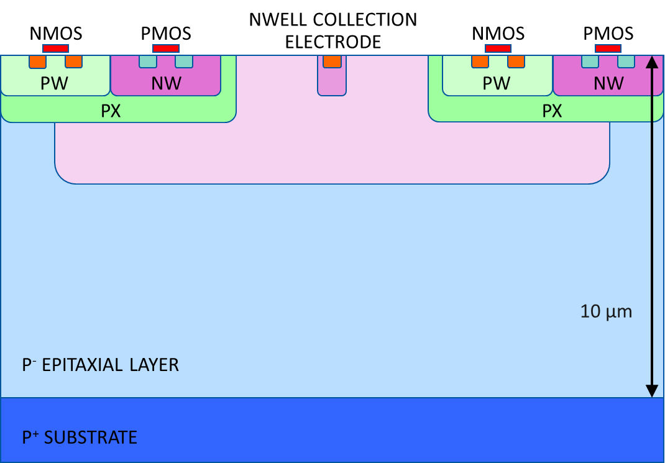
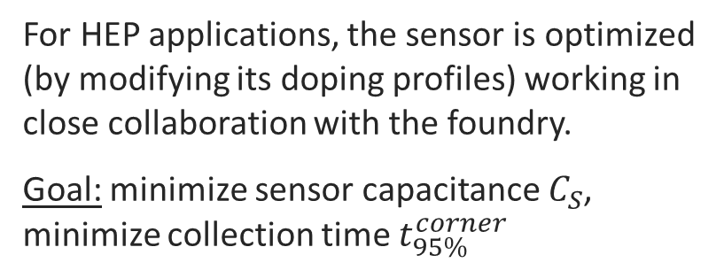
Sensor optimization for MOSAIX
Standard doping profiles
For HEP applications, the sensor is optimized (by modifying its doping profiles) working in close collaboration with the foundry.
Goal: minimize sensor capacitance $C_{S}$, minimize collection time $t_{95\%}^{corner}$
Used in ER1
New doping profiles for ER2
log scale
An additional sensor split for developments beyond ITS3 is also included in ER2
[10] G. Borghello. “Optimization of monolithic pixel sensors for high energy physics applications using 3D TCAD simulations”. In: Eleventh Workshop on Semiconductor Pixel Detectors for Particles and Imaging (Strasbourg, November 2024).

Slide 27
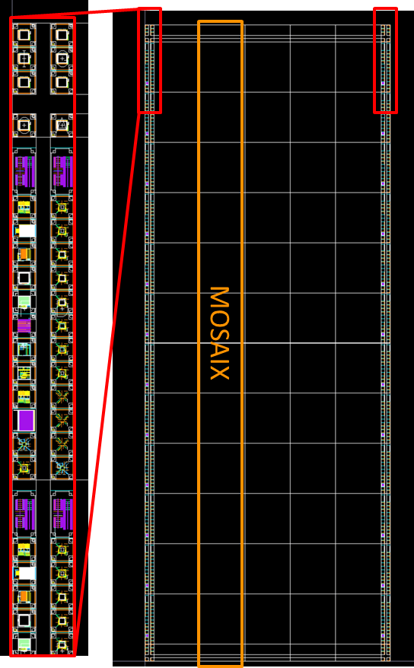
ER2: status and plans towards ER3
Chip placement on wafer (ER2)
ER2 (including MOSAIX and ~30 chiplets from IPHC, SLAC, CPPM, BNL, INFN, Universität Heidelberg, CERN) submitted in July 2025
Chiplets will be used to test circuitry and sensor optimization
The testing campaign on MOSAIX will identify the best sensor (3 variants) + front-end (12 variants) combination
The final version of MOSAIX is foreseen to be submitted in 2026 (ER3)
chiplets

Slide 28
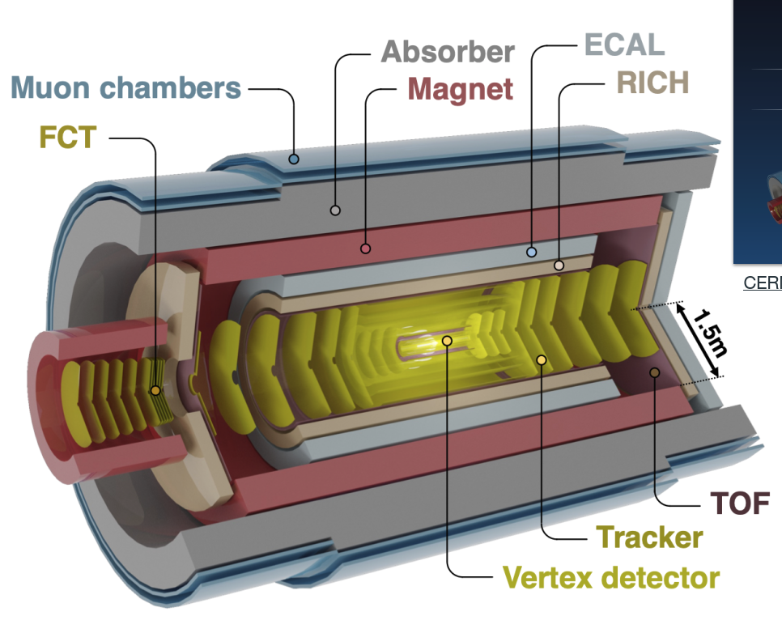
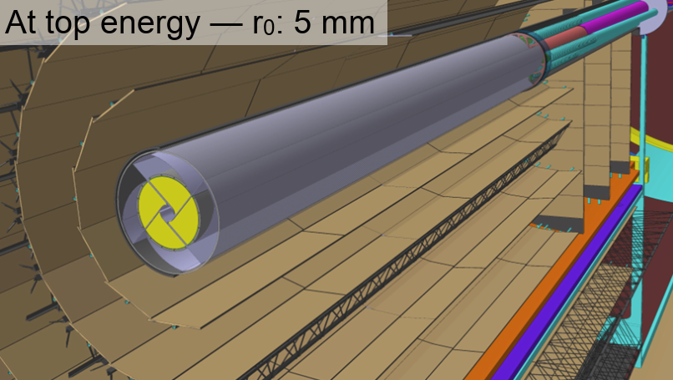
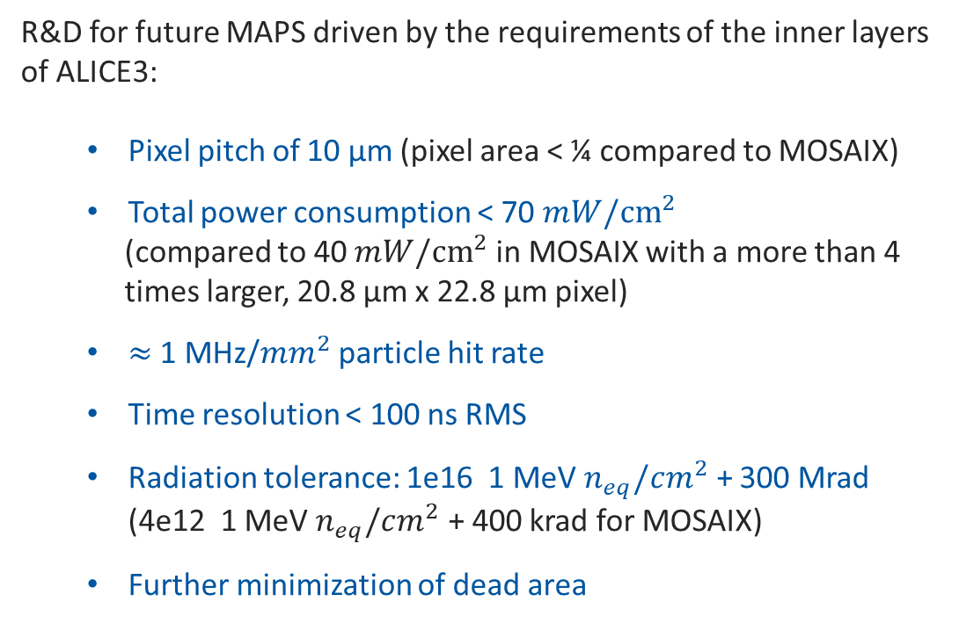

Challenges for detectors beyond ITS3
Monolithic active pixel sensors are foreseen to be used in future HEP detectors (ALICE3, FCC-ee detectors, …).
ALICE 3
R&D for future MAPS driven by the requirements of the inner layers of ALICE3:
  Pixel pitch of 10 µm (pixel area < ¼ compared to MOSAIX)
  Total power consumption < 70 $mW/{cm}^{2}$
  (compared to 40 $mW/{cm}^{2}$ in MOSAIX with a more than 4
  times larger, 20.8 µm x 22.8 µm pixel)
  $≈$1 MHz/$mm^{2}$ particle hit rate
  Time resolution < 100 ns RMS
  Radiation tolerance: 1e16 1 MeV $n_{eq}/cm^{2}$ + 300 Mrad (4e12 1 MeV $n_{eq}/cm^{2}$ + 400 krad for MOSAIX)
  Further minimization of dead area
MAPS
Vertex detector: $r_{0}$ = 5 mm for innermost layer

Slide 29
Developments towards ALICE3
A sensor optimized for 10 µm pitch to address the ALICE3 vertex detector needs has been designed and prototyped in ER2
Standard doping profiles
Optimized doping profiles targeting application in vertex detector of ALICE3
Front-end circuits that achieve improved speed for the same power compared to MOSAIX and fit in a 10 µm x 5 µm area including the collection electrode are in development
Readout architectures that minimize the power consumption are being studied
Further minimization of the dead area needed: effort to design a periphery-less sensor with biasing and read-out circuitry embedded in the pixel matrix

Slide 30
Support for TPSCo 65 nm imaging technology
WP 1.2 provides access and support to TPSCo 65 nm
Design
PDK (Physical Design Kit) for analog designs, DDK (Digital Design Kit) for digital designs, implementation flow, design rules (DRC/LVS decks from the foundry, customized/extended at CERN)
Libraries for digital design, padring, sensor layout …
Special design rules for special layers needed for sensor/pixel matrix
Review of chiplets and suggestions for improvement/corrections
Interface with the foundry
Technical and commercial, see also admin
Admin
Procurement, offers, etc
NDA, export declarations, compliance letters, etc
Need more work on design sharing

Slide 31
Take home messages
WP 1.2 in synergy with the ALICE experiment demonstrated the feasibility of stitched monolithic CMOS sensors for HEP applications (MOSS, MOST)
The design of the MOSAIX stitched sensor prototype for the new ALICE vertex detector (ITS3) has been finalized. It features unprecedented integration and complexity in the HEP community.
The H2M project demonstrated the feasibility of porting hybrid pixel detector architecture into a monolithic chip. It also successfully demonstrated the sensor functionality for thicknesses < 50 µm and highlighted the challenges of designing “large” pixels
R&D activities for detectors beyond ITS3 are being ramped up, driven by requirements of vertex detector of ALICE3
WP 1.2 provides access and support to the TPSCo 65 nm imaging technology. WP 1.2 is starting the organization of MPR2 (Multi-Project Run, TPSCo 65 nm), gathering interest from HEP institutes and preparing the administrative framework.
Link with experiments foreseeing large detectors is important, as foundries are ultimately interested in volume

Slide 32
Backup

Slide 33
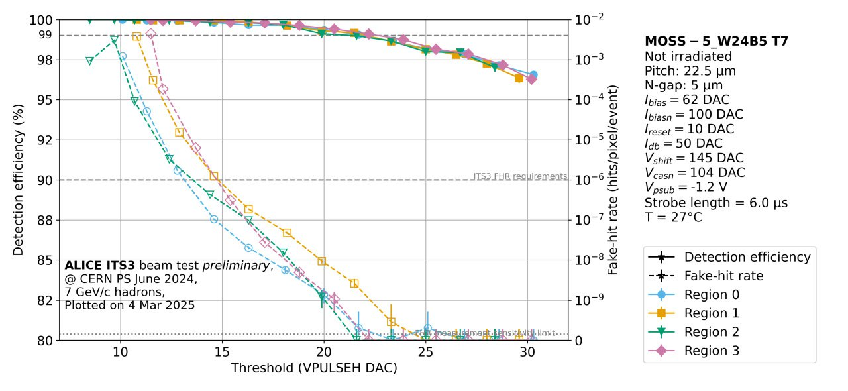
MOSS – test beam results
ITS3 Detection efficiency requirement
Operating margin
ITS3 Fake Hit Rate requirement
Before irradiation: good operating margin.
After irradiation: satisfactory operating margin at the radiation load estimated for ITS3 (~ 400 krad, ~ 4 x 10¹² 1 MeV n_{eq}/cm², see [4]).
[4] L. Terlizzi. “Characterization of silicon Monolithic Stitched Sensors (MOSS) for the ALICE ITS3 for the LHC Run 4”. In: Eleventh Workshop on Semiconductor Pixel Detectors for Particles and Imaging (Strasbourg, November 2024).

Slide 34
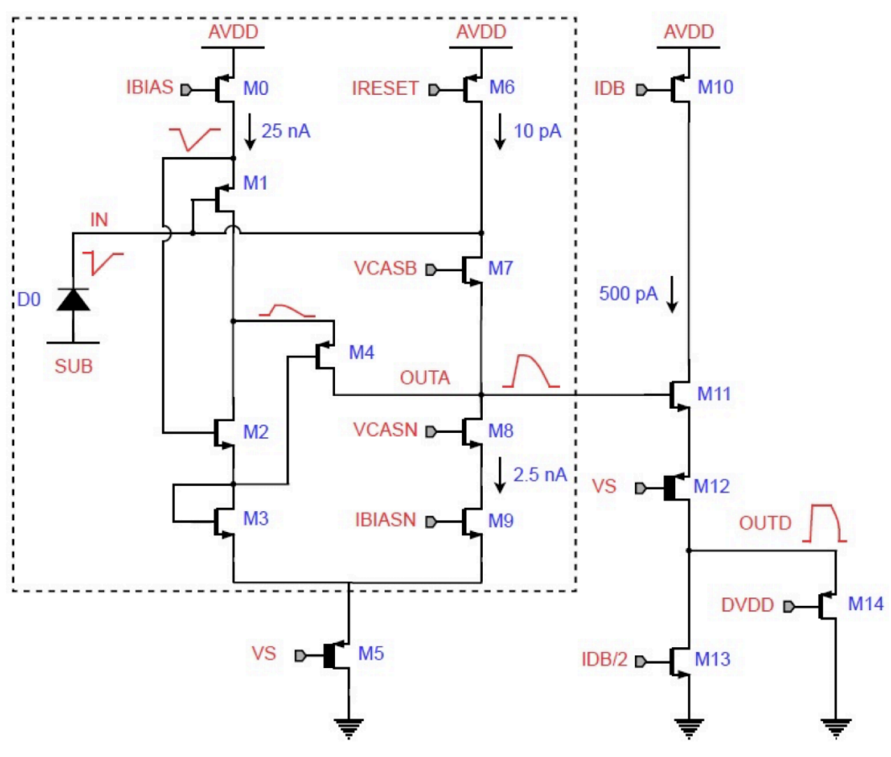
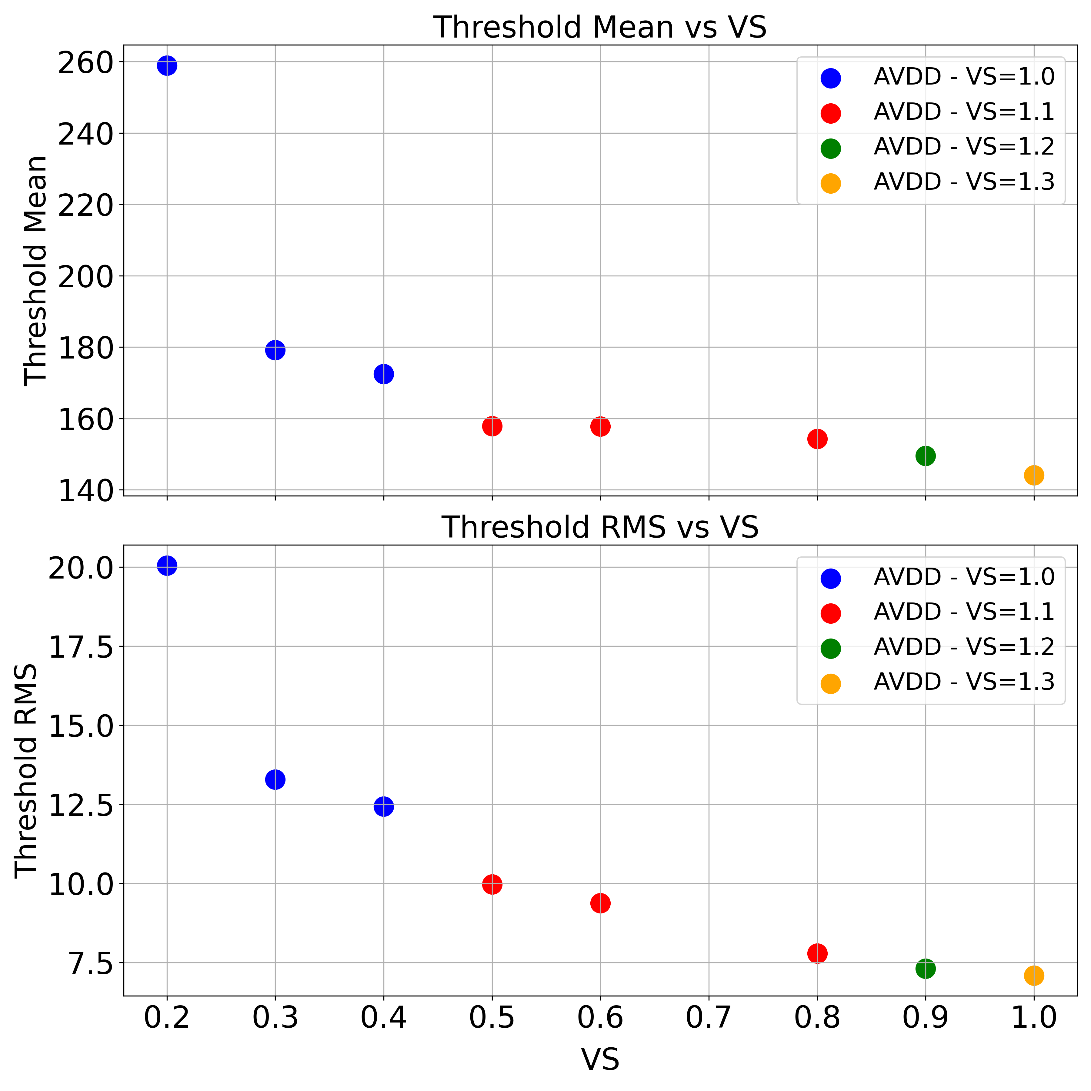
MOST: front end and reverse substrate bias
A larger VS increases the reverse bias of the sensor: the circuit ground can be tied to the substrate, greatly simplifying the design.
Increasing VS may require a larger AVDD, leading to larger power consumption.
Front-end schematic
Increasing VS reduces the threshold and the threshold mismatch
Notes:
Take picture from paper

Slide 35
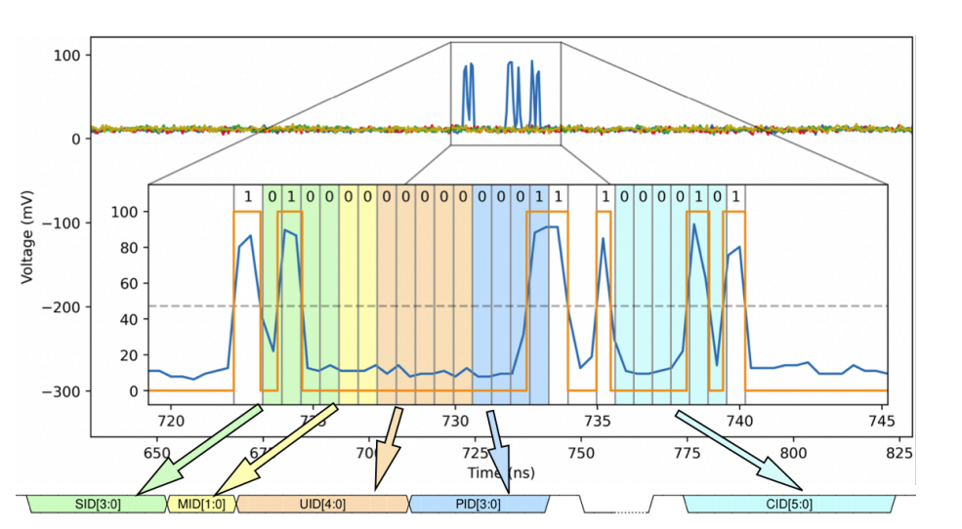
MOST: asynchronous readout
Groups of 4 pixels
As soon as a pixel is hit, its address is shipped through a global data line to the column encoders (asynchronous, the aim is to preserve timing information)
The column encoders append the column address, and the data are shipped out through a CML driver
global data line
SID: Stitched Unit address, MID: Matrix ID, UID: Unit ID, PID: Pixel ID, CID, Column ID
The asynchronous readout of MOST allows to study to what degree the timing is preserved in the long-distance transmission

Slide 36
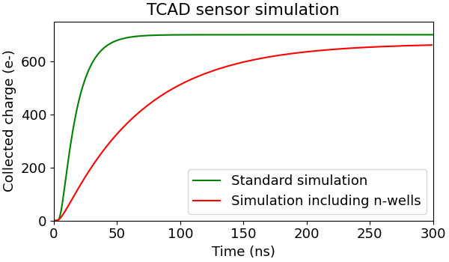
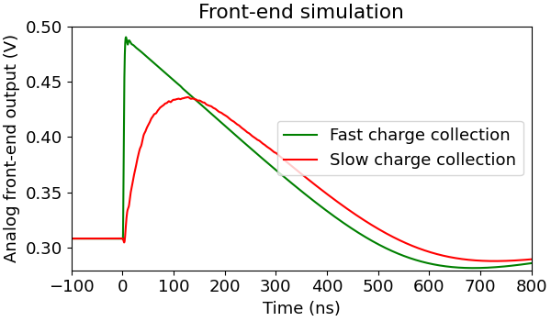
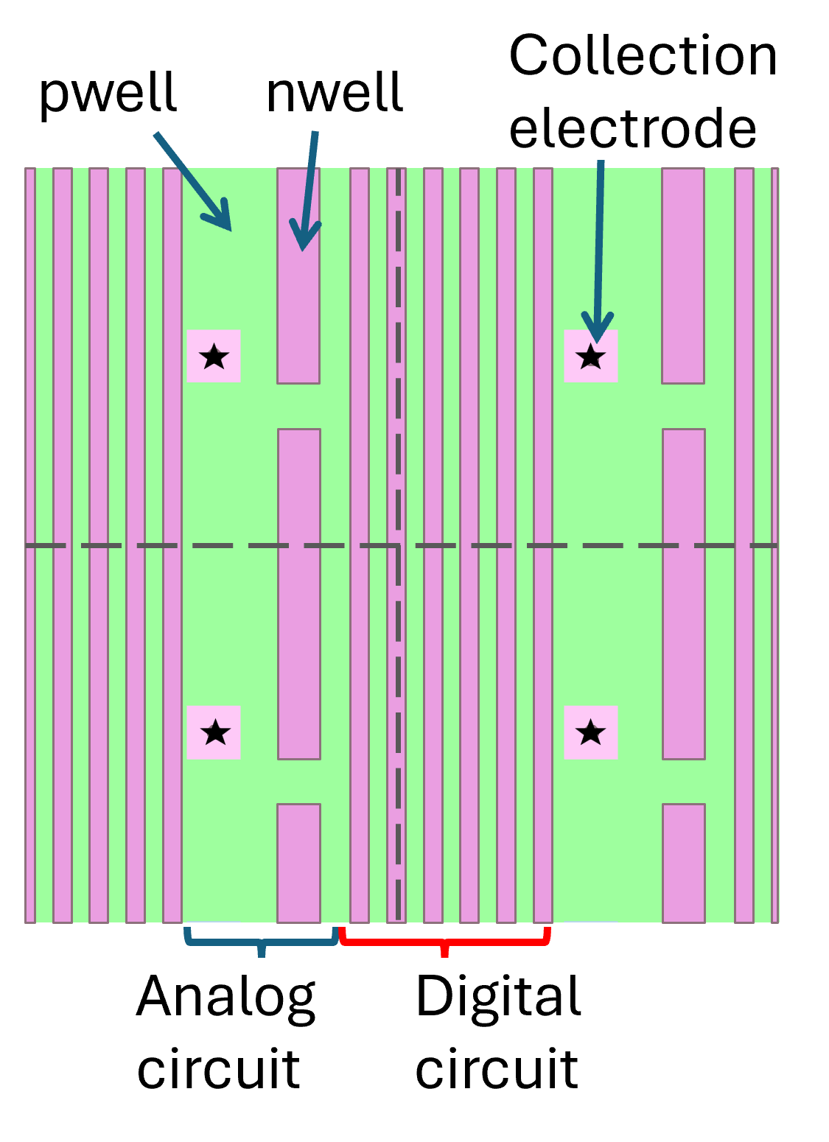
H2M - Non-uniform in-pixel response
Ballistic deficit
Slower charge collection
Related to the size and location of the n-wells of the circuitry, leading to localized low-field regions with slower charge collection
Mitigated with optimized operating parameters (bias, threshold,
…)
Confirmed in simulation
Measured time residual
Measured efficiency
[8] C. Lemoine et al. “Impact of the circuit layout on the charge collection in a monolithic pixel sensor”. In: Eleventh Workshop on Semiconductor Pixel Detectors for Particles and Imaging (Strasbourg, November 2024), https://arxiv.org/abs/2503.21853

Slide 37
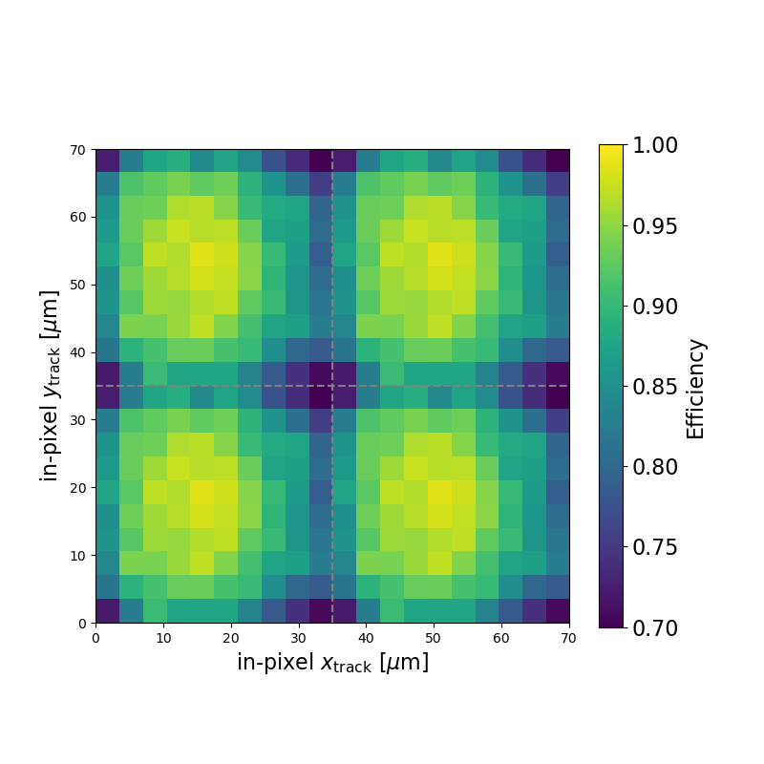
H2M - Simulation
Geant4
Incident particles
Sensor geometry
TCAD
Electric field
Monte Carlo
Current pulse
FE simulation
Analog front end output
Sentaurus
Allpix²
Spectre
Simulation exploited to understand and reproduce the non uniform pixel response.
Qualitative matching with measurements.
Simulated efficiency
Measured efficiency
Enable simulation at design stage, potentially avoiding future issues

Slide 38
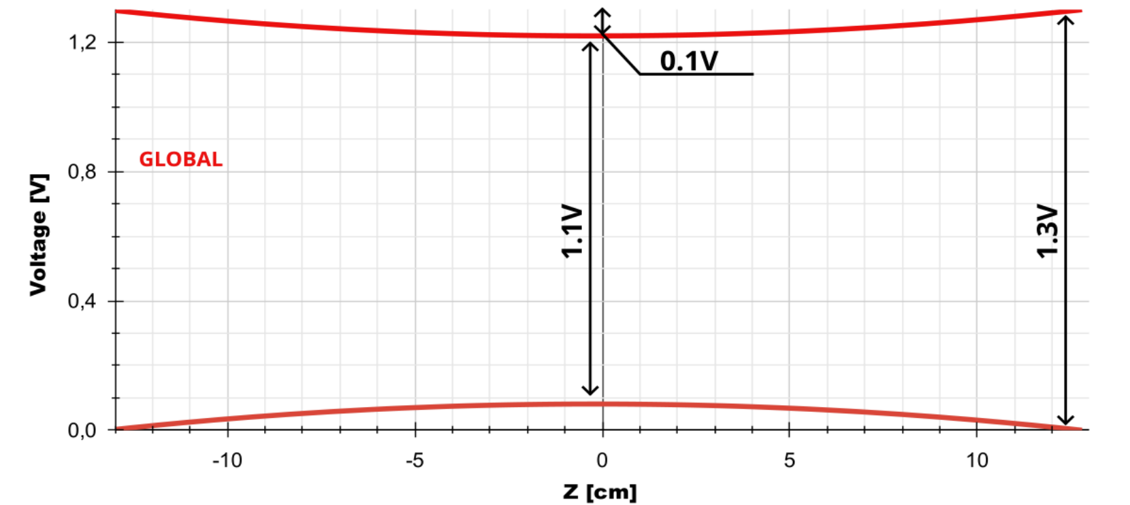
MOSAIX: on-chip power distribution
Power is supplied only from the short edges of MOSAIX in ITS3, and an acceptable on-chip supply voltage drop could not be achieved with the metals used for MLR1 and ER1 runs.
A custom metal stack has been provided by the foundry, including an additional thick metal layer and the replacement of two metal layers with thicker ones.
VDD-VSS=1.3 V
MOSAIX
VDD-VSS=1.3 V
Simulated worst-case supply voltage drops with new metal stack, real power grid of MOSAIX [7]
[11] S. Bugiel. “Power distribution over the wafer-scale monolithic pixel detector - MOSAIX for ALICE ITS3”. In: Topical Workshop for Electronics in Particle Physics (Glasgow, September 2024).

Slide 39
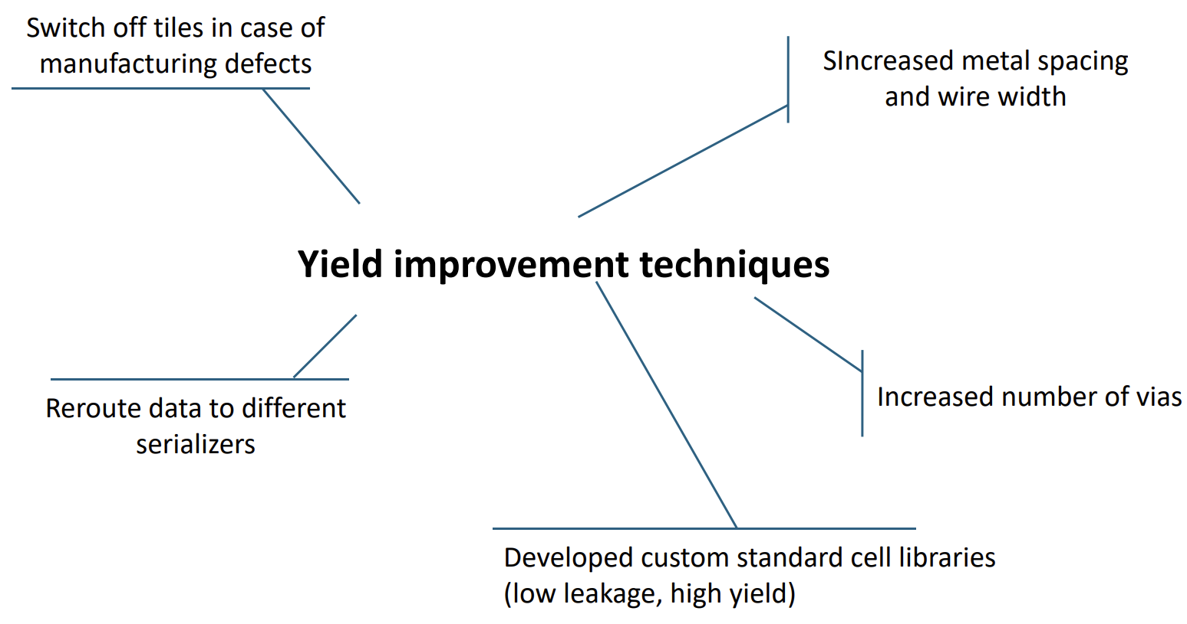
MOSAIX: design for yield
Techniques have been extensively used to achieve high manufacturing yield and deal with defects.
[9] P. Vicente Leitao. “Development of the MOSAIX chip for the ALICE ITS3 upgrade”. In: Topical Workshop for Electronics in Particle Physics (Glasgow, September 2024). [11] S. Bugiel. “Power distribution over the wafer-scale monolithic pixel detector - MOSAIX for ALICE ITS3”. In: Topical Workshop for Electronics in Particle Physics (Glasgow, September 2024).

