Slide 1

The CMS Tracker Upgrade for Phase-2: meeting the challenges of the HL-LHC
Matteo Magherini
on behalf of the CMS Group

Slide 2
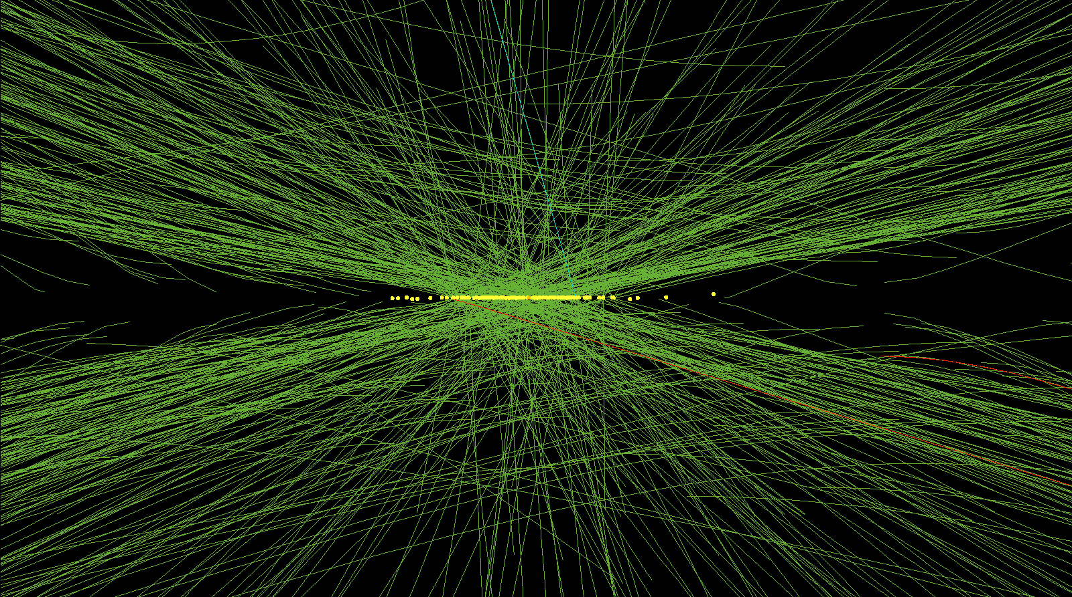
High PU event @ LHC in 2012

Slide 3
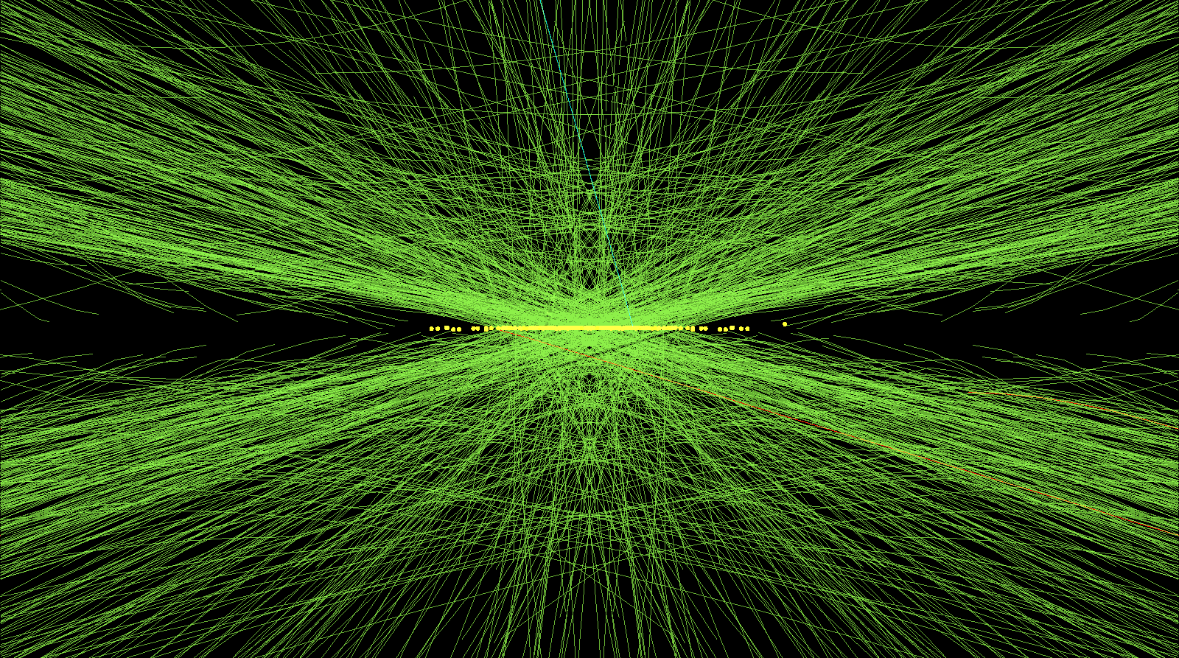
High PU event @ LHC now

Slide 4
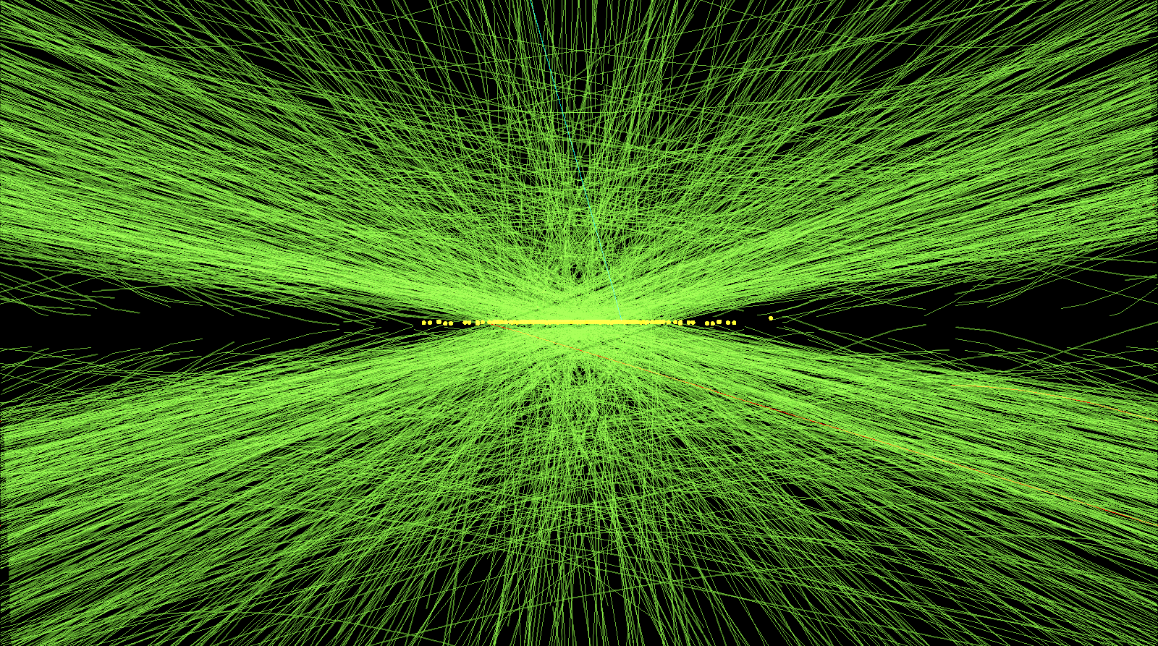
Average event @ HL-LHC

Slide 5
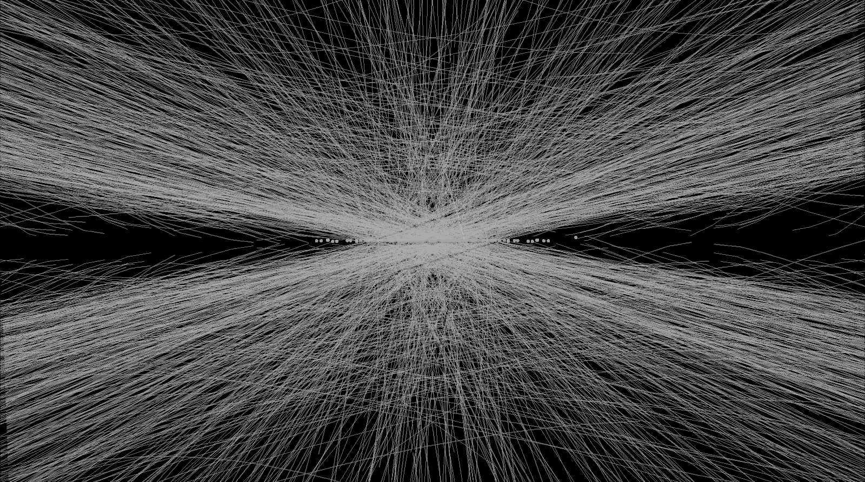
Average event @ HL-LHC
Expected Pile-up: 200 events/25 ns ~4 times LHC
Instanteous peak luminosity: 5-7.5x10³⁴cm⁻²s⁻¹ : ~4 times LHC
Dose & fluence ~10 times LHC

Slide 6
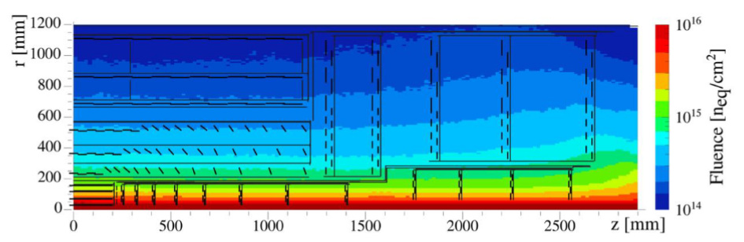
High Luminosity requirements
Radiation tolerance: full efficiency up to 3000 fb⁻¹
Reduced material budget: calorimeters and overall event reconstruction performance enhancement
Extended tracking acceptance: meets CMS physics program needs
Increased granularity: efficient tracking with high PU level
Contribution to L1 trigger: anticipate selection to mitigate inefficiencies from high pileup
Notes:
lower channel occupancy under percent level (per mille level) must be achieved in the OT (IT).

Slide 7
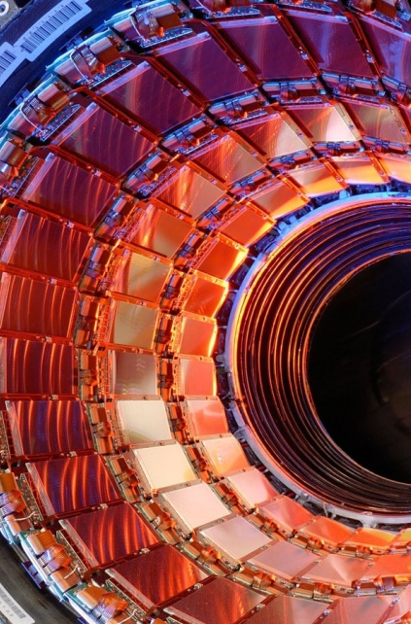
Current CMS Tracker Limitations
End of Run 3: strip tracker overloaded by radiation damage (leakage current & full depletion voltage limitations)
Occupancy: would need higher granularity to cope with HL-LHC 4x higher rate
Readout: impossible to contribute to L1 trigger
Full tracker replacement!
Notes:
lower channel occupancy under percent level (per mille level) must be achieved in the OT (IT).

Slide 8
Ph2 CMS Tracker – Outer Tracker Contribution to L1 Trigger
~10 cm

Slide 9

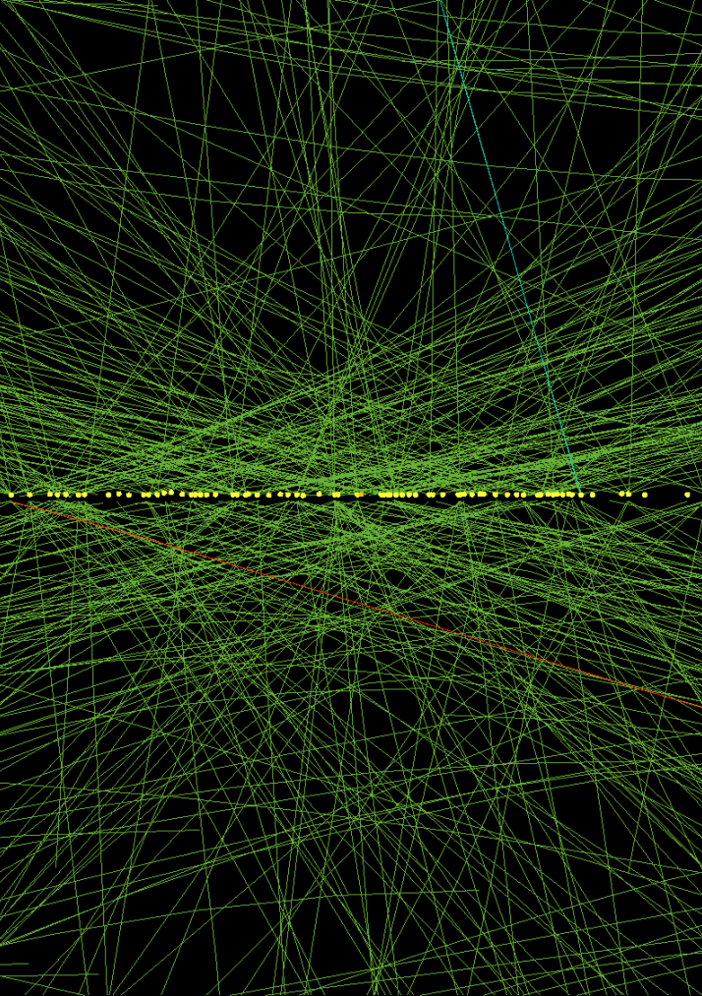
Ph2 CMS Tracker – Outer Tracker Contribution to L1 Trigger
~1 cm

Slide 10
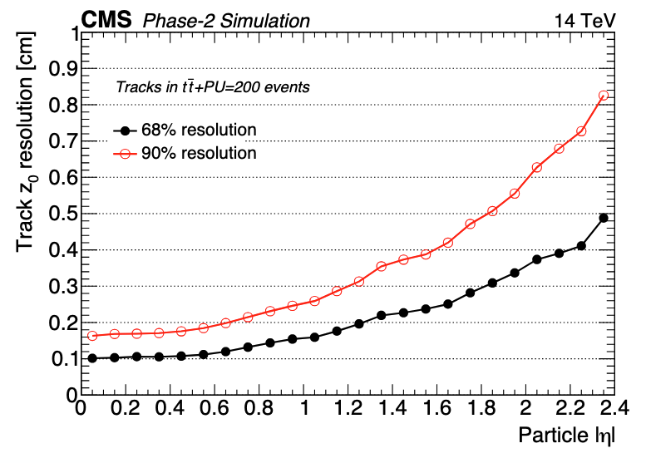
Ph2 CMS Tracker – Outer Tracker Contribution to L1 Trigger
Contribution to L1 trigger via track reconstruction from Outer Tracker
750 kHz L1 trigger rate ~ 7 times LHC
12.5 μs L1 latency
Resolution of approx 1 mm
Allows us to mitigate Pile-Up combinatorics by two orders of magnitude
~0.1 cm

Slide 11
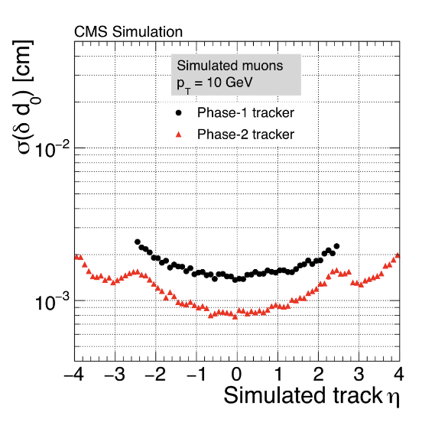
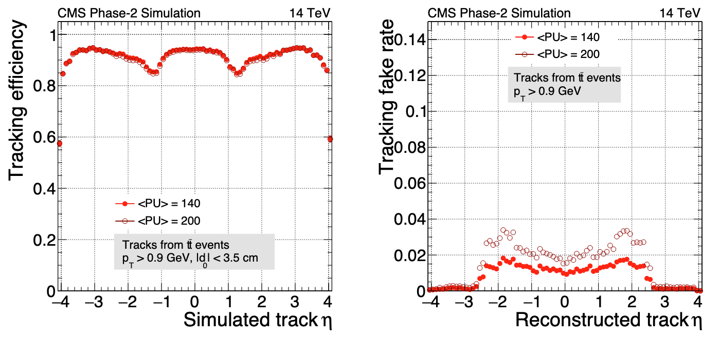
Ph2 CMS Tracker – Performance
Improvement in resolution with the whole tracker
High tracking efficiency @ 200 PU and low Fake Rate

Slide 12
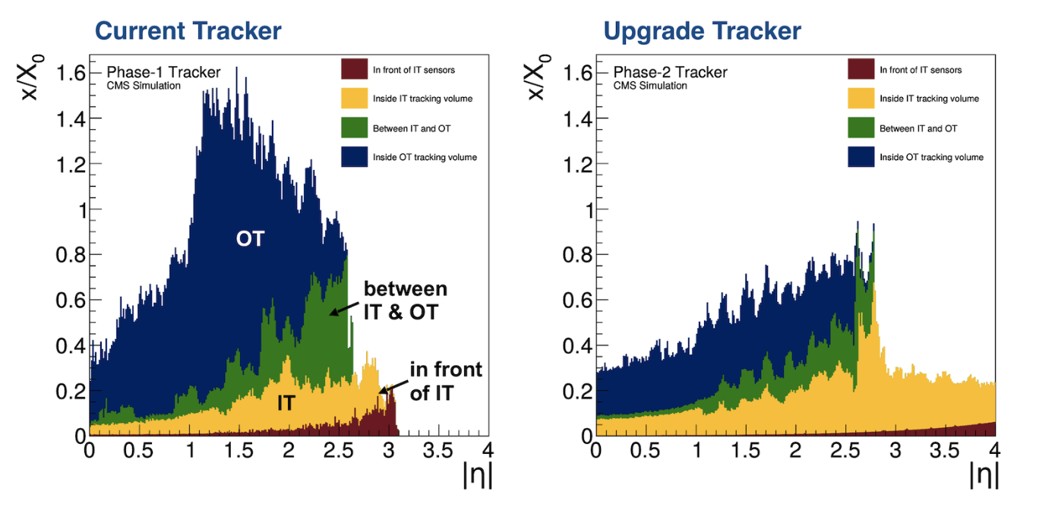
Ph2 CMS Tracker – Material budget
Lighter materials, CO2 cooling, optimized service routing

Slide 13
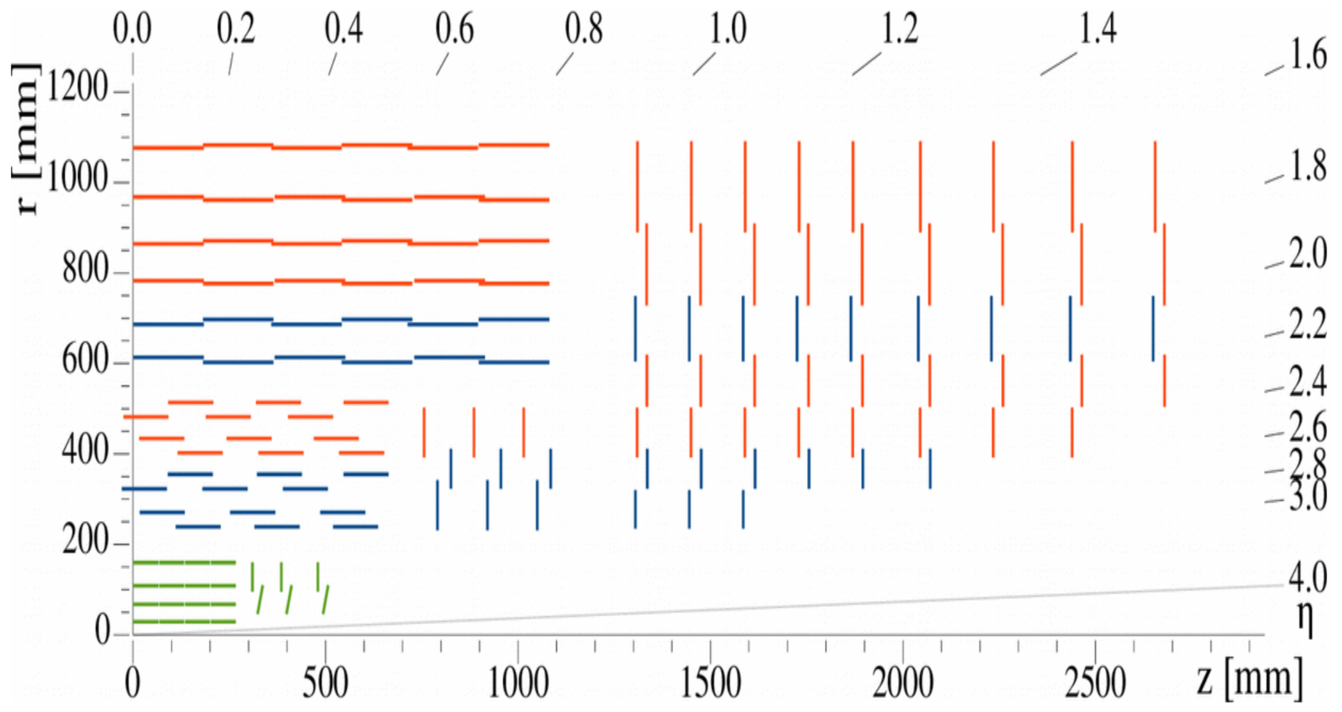
From Phase 1 to…

Slide 14
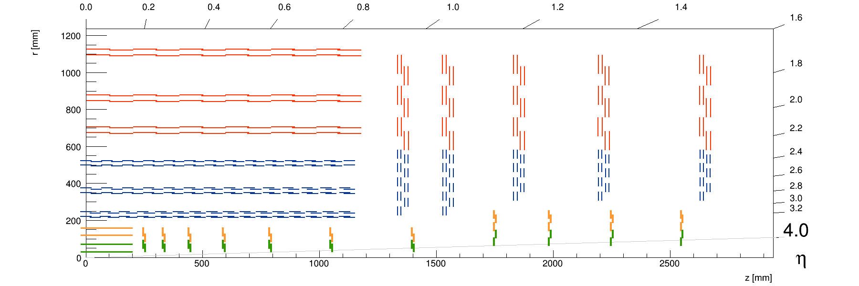
Phase 2 Tracker

Slide 15
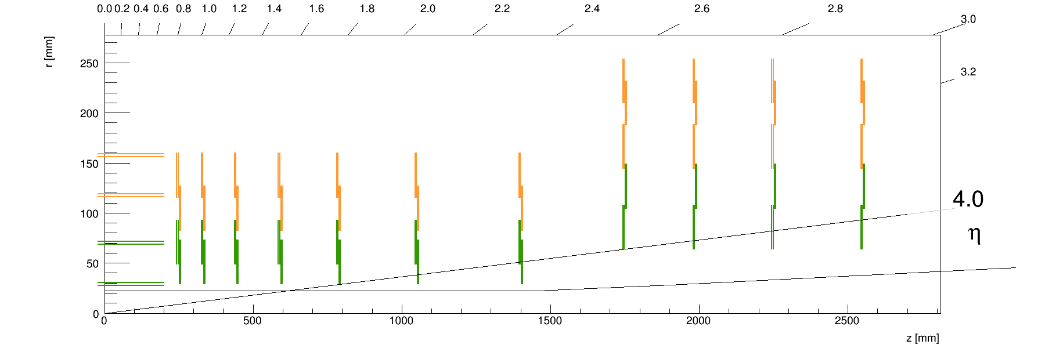
Inner Tracker

Slide 16
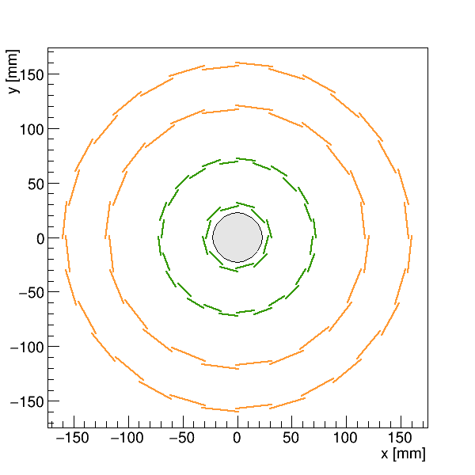
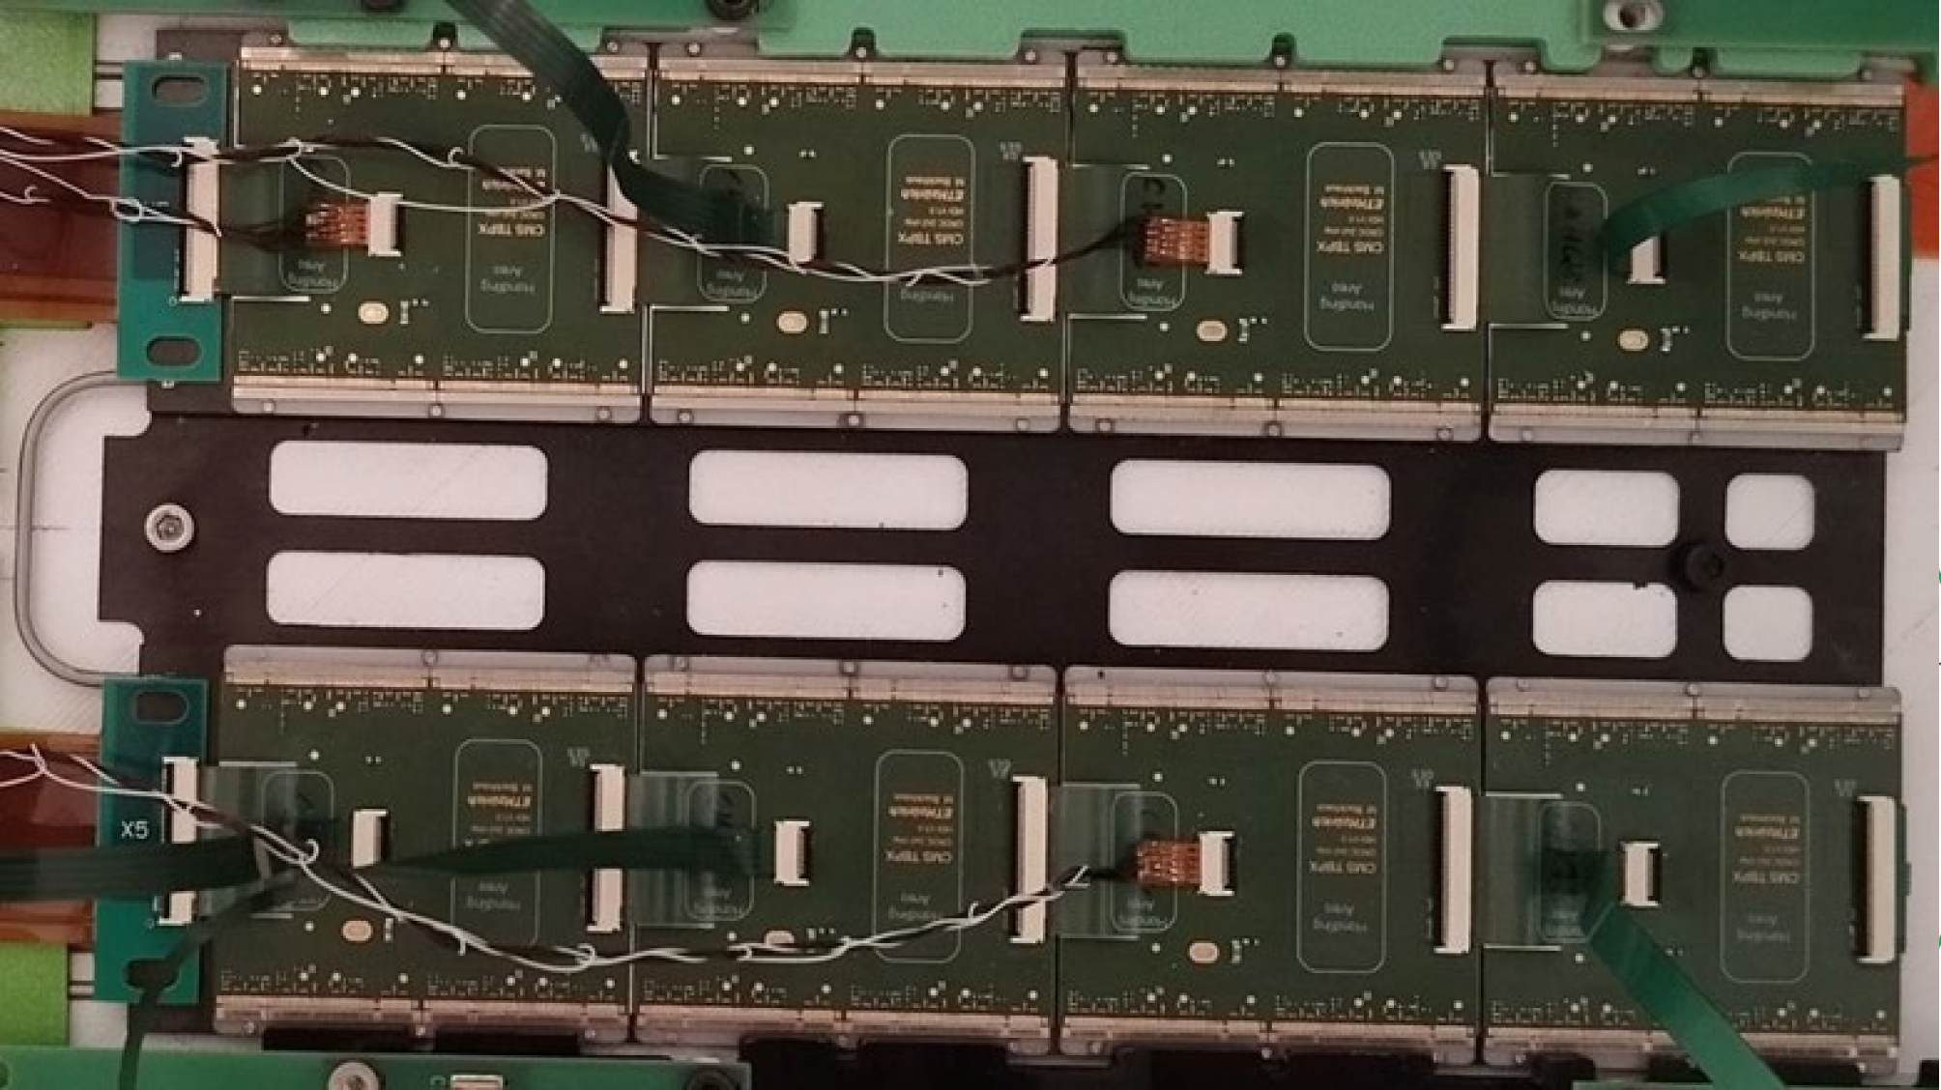
Inner Tracker – Tracker Barrel Pixel (TBPX)
Notes:
Barrel (TBPX)
➢ 4 layers
➢ 756 modules
3D sensors in layer 1

Slide 17
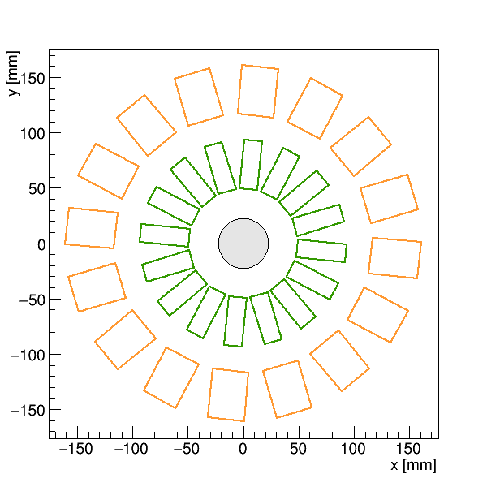
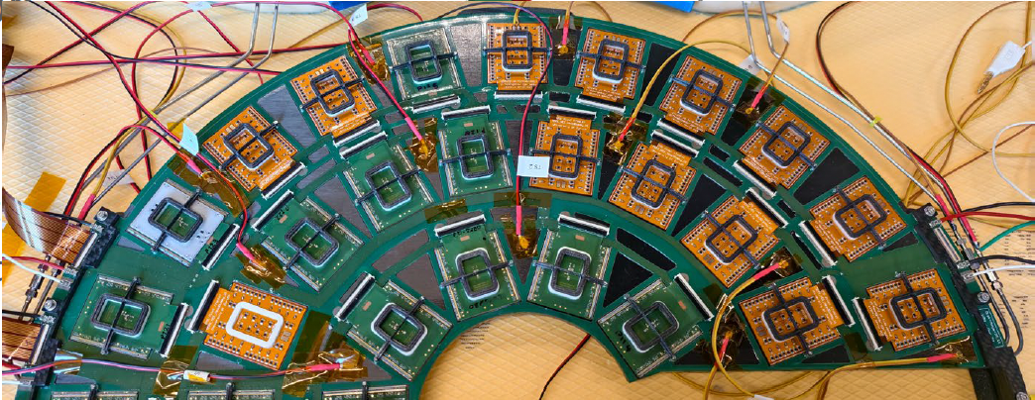
Inner Tracker – Tracker Forward Pixel (TFPX)
Notes:
Forward disks (TFPX)
➢ 2 sides x 8 disks x 4 rings
➢ 1728 modules
➢ 1x2 modules in rings 1,2
➢ 2x2 modules in rings 3,4,5

Slide 18
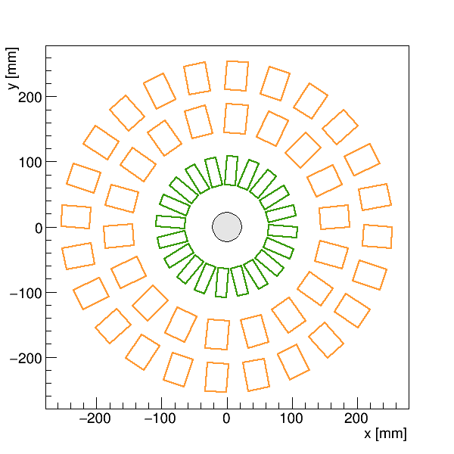
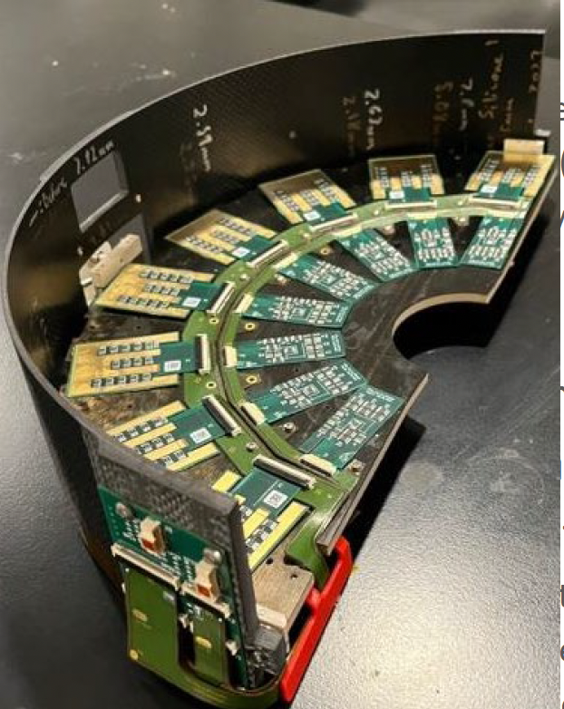
Inner Tracker – Tracker Endcap Pixel (TEPX)
Notes:
Endcaps (TEPX)
➢ 2 sides x 4 disks x 5 rings
➢ 1408 modules
➢ 2x2 modules everywhere
➢ Ring 1 used for luminosity
measurement

Slide 19
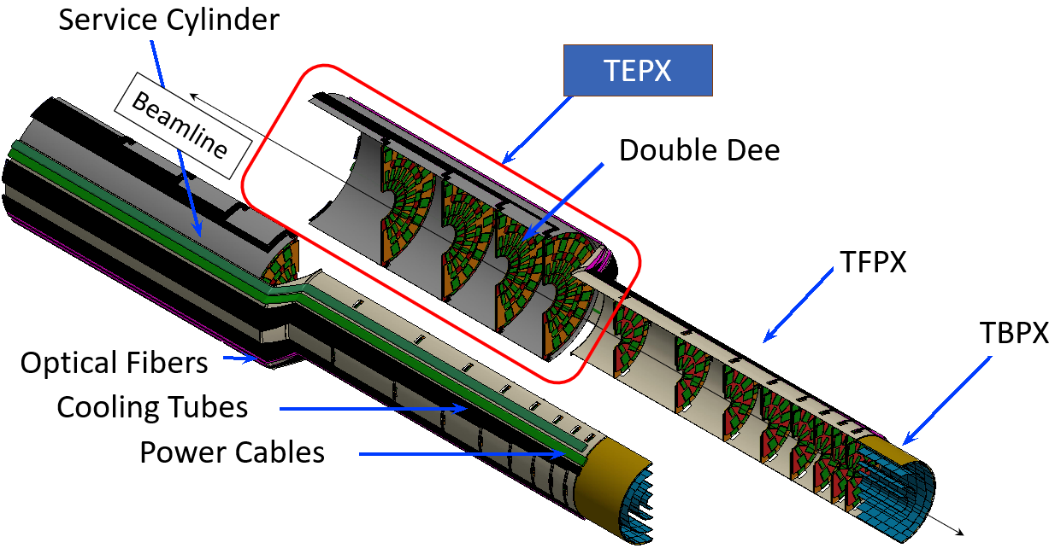
Mechanical Support
Details on mechanics:
Pierre Rose’s talk on Wednesday!
Carbon fibre structures with embedded cooling pipes
Flat disk geometry (replaces turbine design)
CO₂ evaporative cooling at −35 °C via 1.8 mm stainless steel pipes (168 loops)

Slide 20
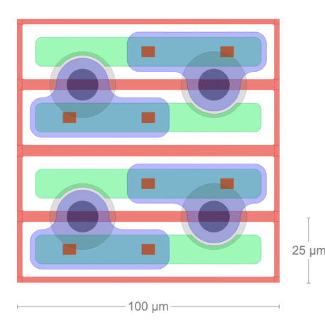
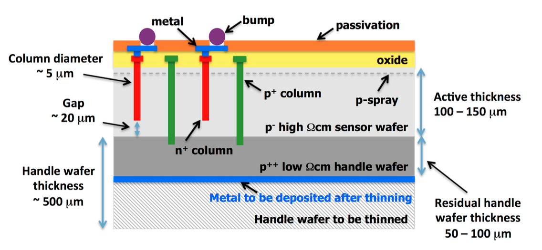
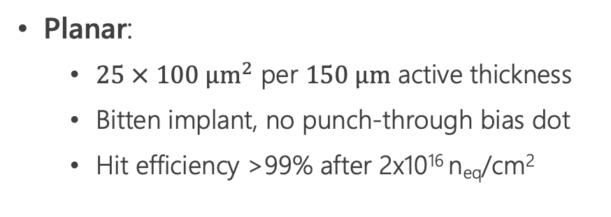
IT sensors
Planar:
$25 × 100 μm^{2}$ per $150 μm$ active thickness
Bitten implant, no punch-through bias dot
Hit efficiency >99% after 2x10¹⁶ n_{eq}/cm²
3D sensors:
Better performances for radiation damage
Lower depletion voltage
Hit efficiency > 98% after 1.8×10¹⁶ n_{eq}/cm²

Slide 21
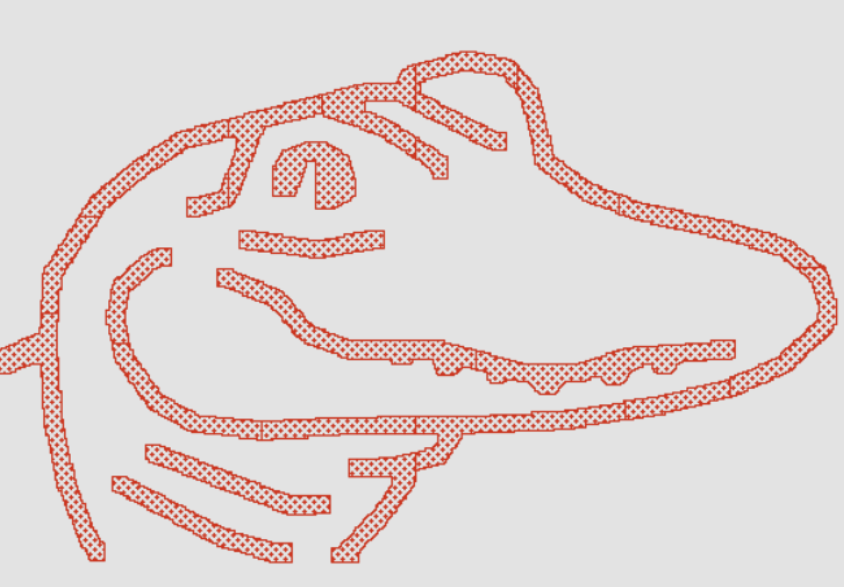
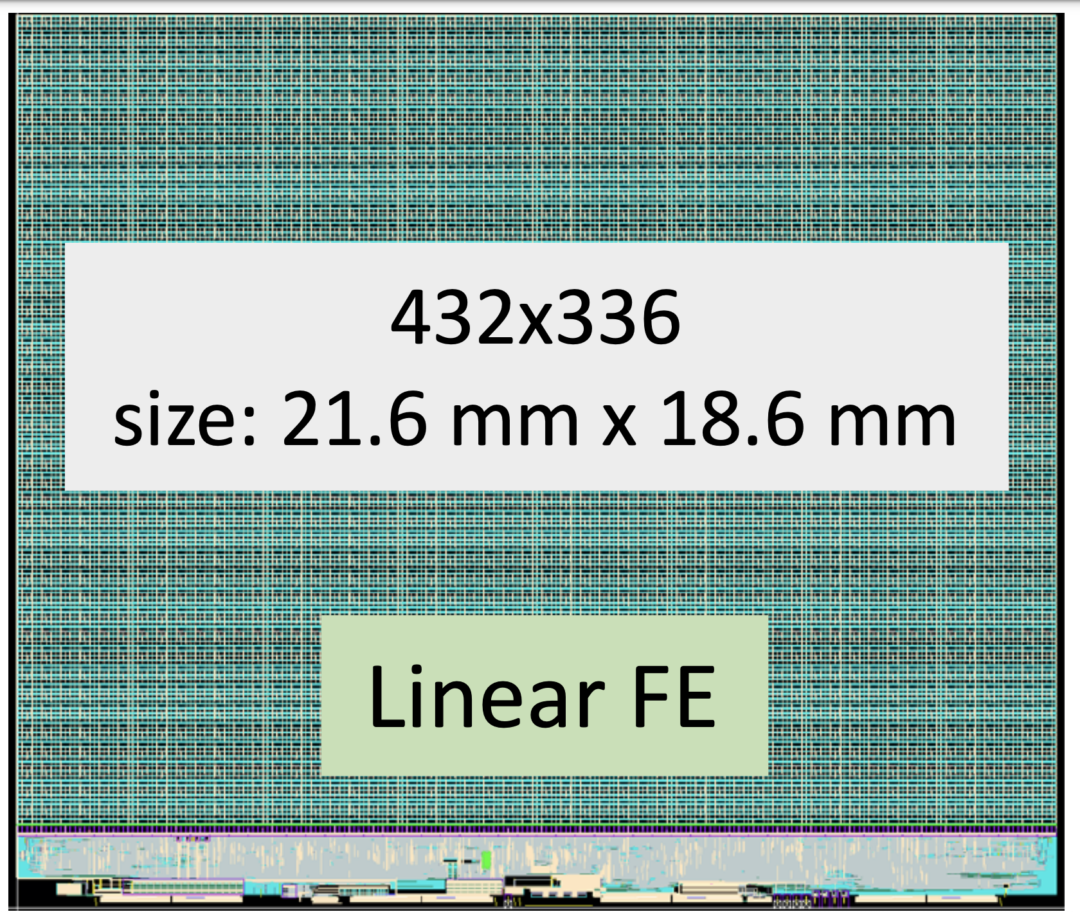
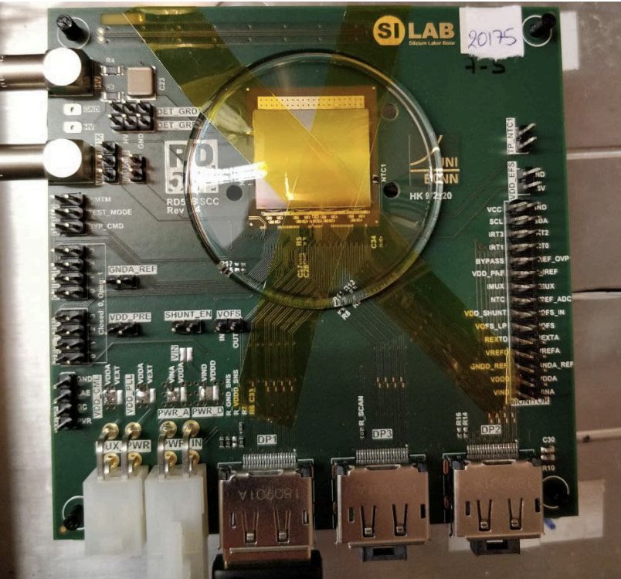
CMS Readout Chip (CROC)
ASIC based on CMOS 65nm technology (CERN RD53 project) → CMS flavor of RD53 ROC: C-ROC
Radiation tolerant up to 1 Grad
Low power consumption < 1 W/cm2
Trigger rate of 750 kHz
Output bandwidth 1-4 x 1.28 Gbps
Analog FE linear architecture (ToT linear wrt charge)
4 bit digital readout with selectable 6-to-4-bit dual slope ToT mapping for charge compression (elongated clusters, heavy ionizing particles)

Slide 22
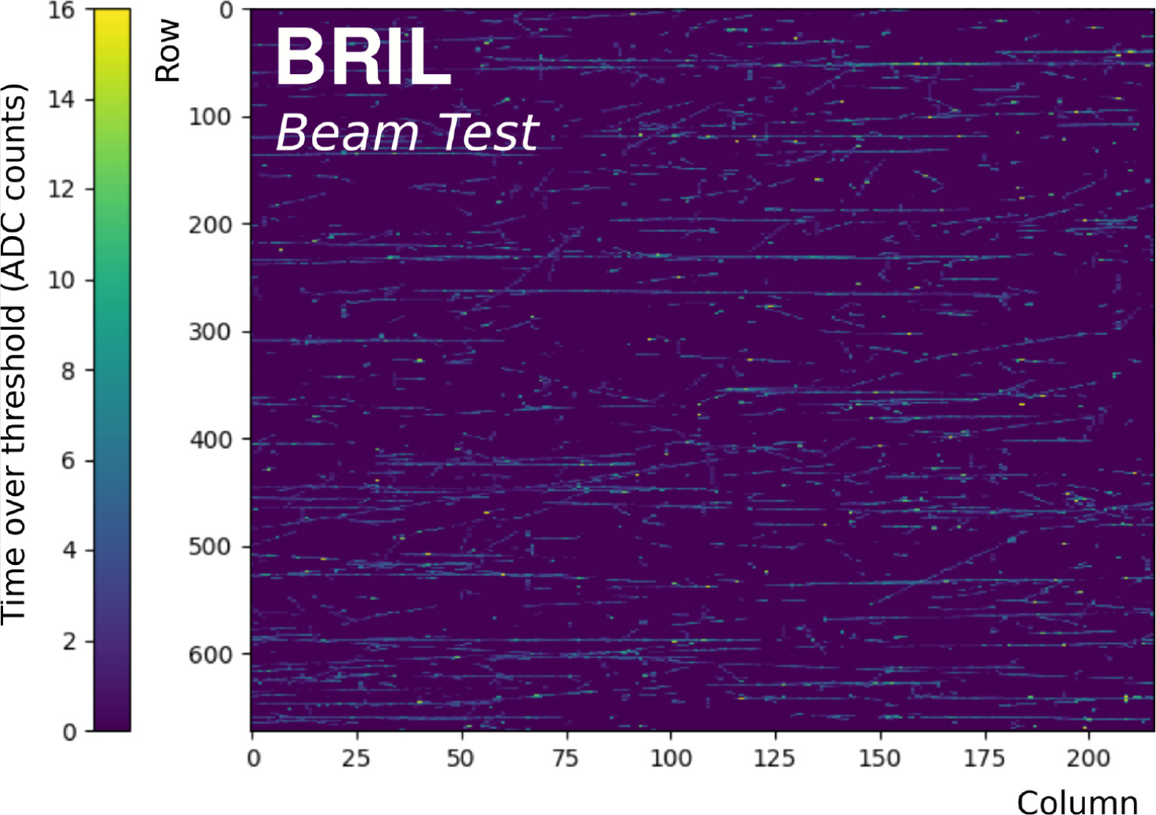
IT + BRIL test beams
2024 joint test beam between CMS Luminosity Group (BRIL) and Inner Tracker → read out CROC v1 with legacy DAQ board
Accumulated long clusters (tracks) in the Si-pixel module with its plane rotated by 5° with respect to the beamline. The color indicates the uncalibrated 4-bit time over threshold values that the counters output. Ref: https://doi.org/10.1016/j.nima.2025.170663

Slide 23
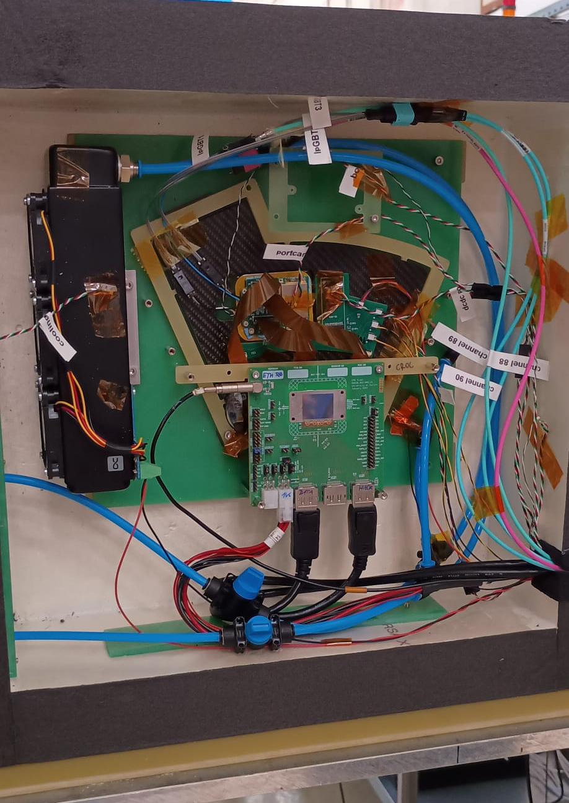
IT + BRIL test beams
2024 joint test beam between CMS Luminosity Group (BRIL) and Inner Tracker → read out CROC v1 with legacy DAQ board
Ongoing (now!) joint IT + BRIL TB → first time DAQ with final board!

Slide 24
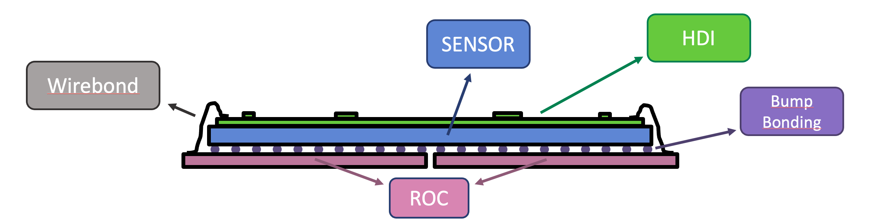
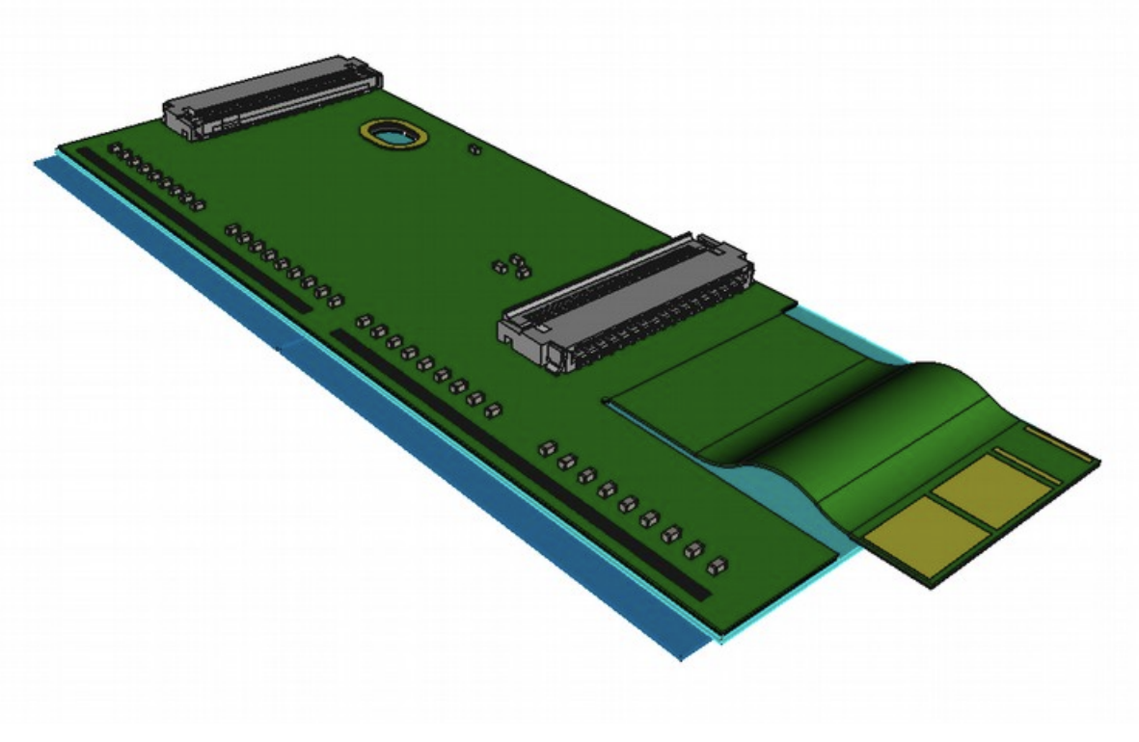
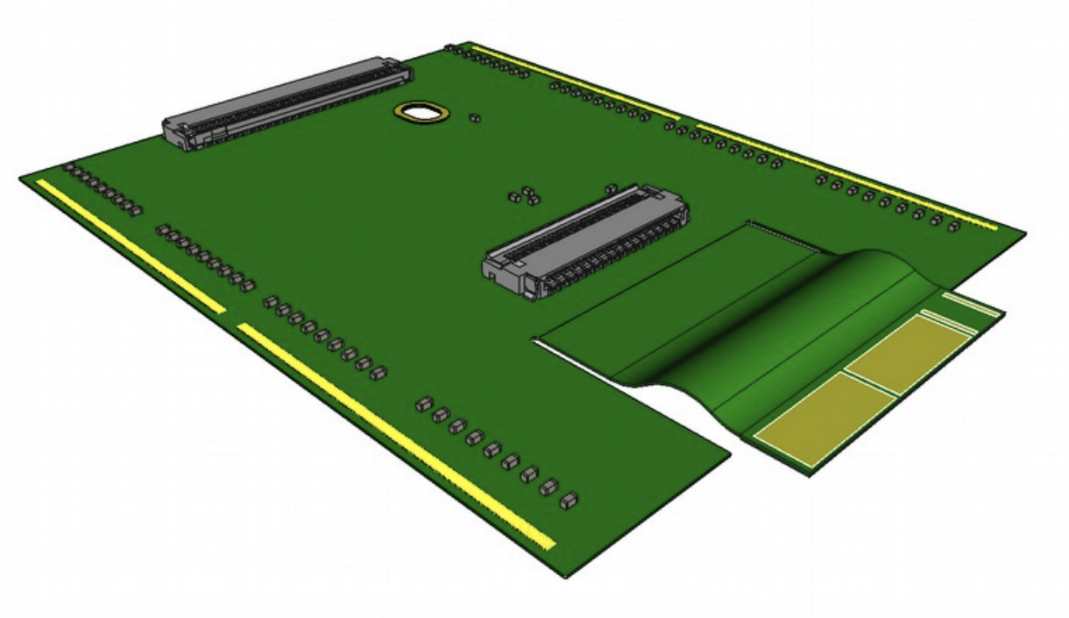
IT Modules
1x2 2x2

Slide 25
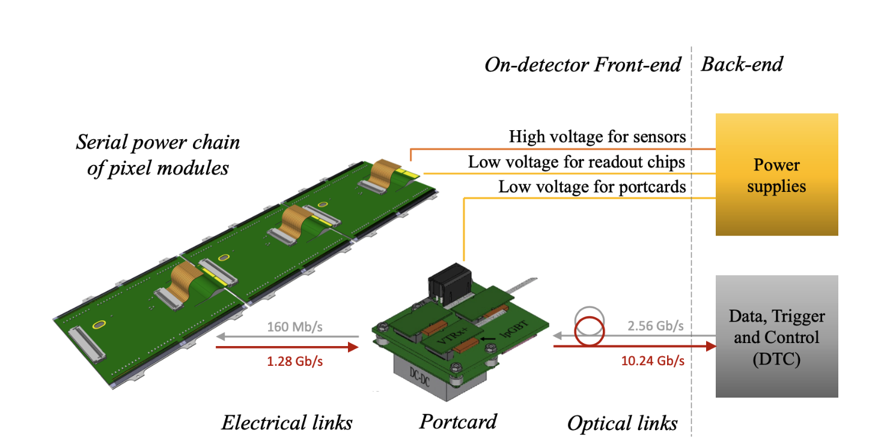
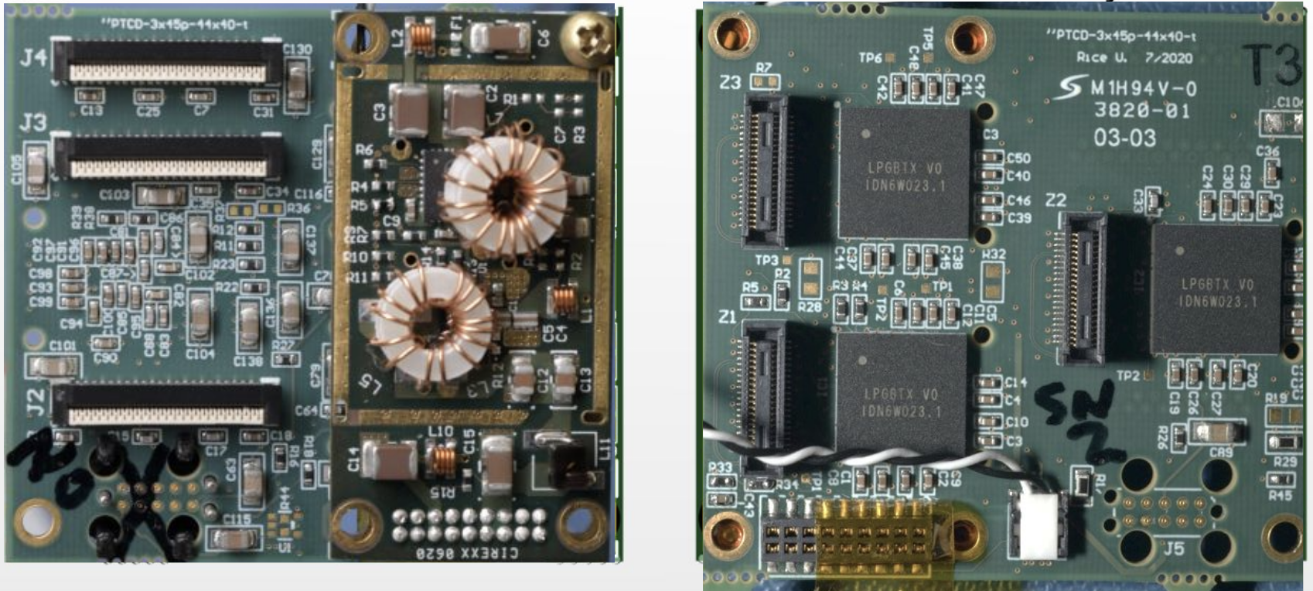
Readout Architecture
Communication electronics on dedicated Portcard (optoelectronic service board)
A portcard hosts 3 × lpGBTs and VTRx+ links, powered via cascaded DC-DC converters
Up to 6 electrical uplinks at 1.28 Gb/s (module → lpGBT), with data formatting for rate reduction
1 electrical downlink at 160 Mb/s (lpGBT → module)

Slide 26
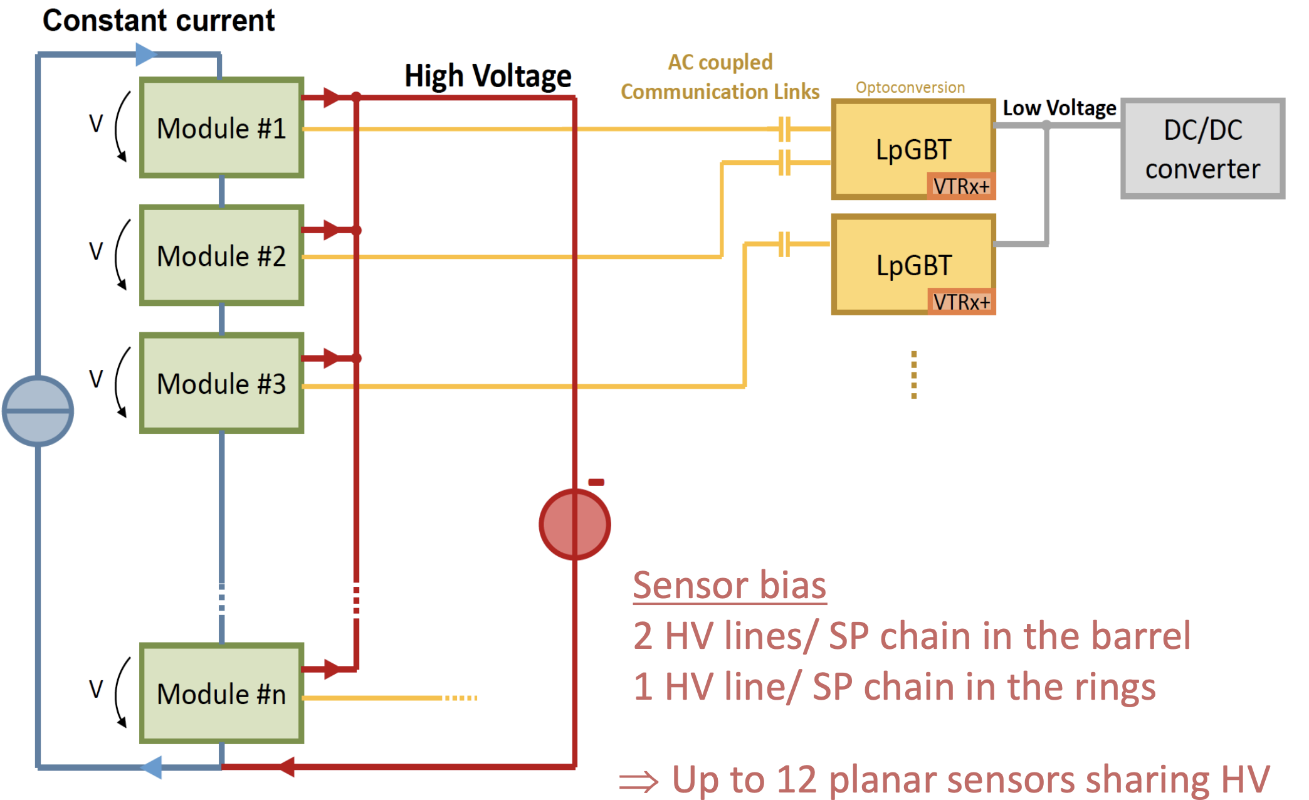
Powering the IT
Supplying 50 kW with minimal cable mass – Serial Powering
576 serial power chains, each with up to 12 modules in series
Modules in series; chips inside each module powered in parallel (4 A for 1×2 modules, 8 A for 2×2 modules)
Each chip has a shunt-LDO for voltage regulation at constant current
Sensor bias follows the power chain with a single return line.

Slide 27

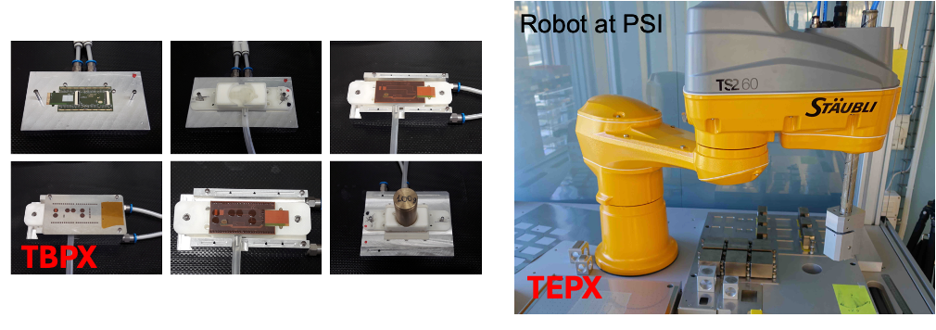
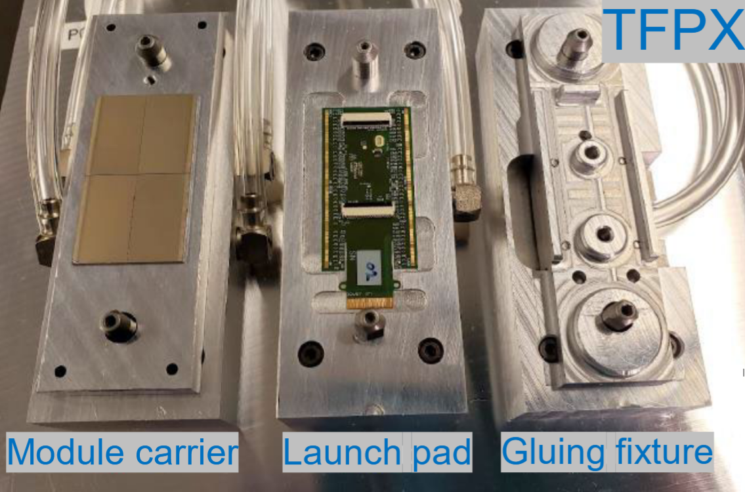
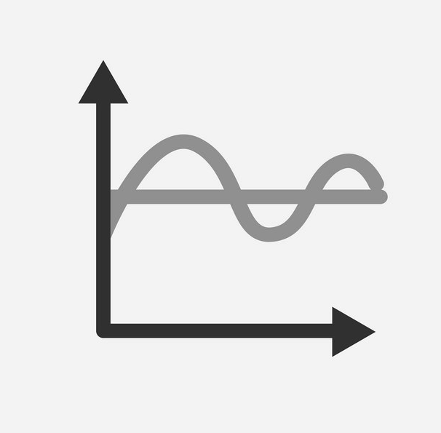
Integration - assembly
TBPX manual assembly with Jigs
TFPX assembly with gantry
TEPX full robot arm

Slide 28
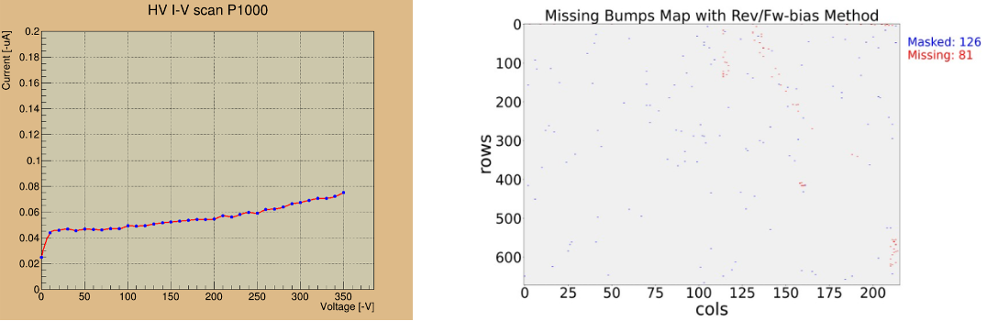
Integration – Quality Control
More in Mauro di Nardo’s talk on Thursday!
IV curves testing
Basic functionalities of the chips tested with Ph2_ACF software
Automated QC procedure with Panthera/Felis+Dirigent+GUI

Slide 29
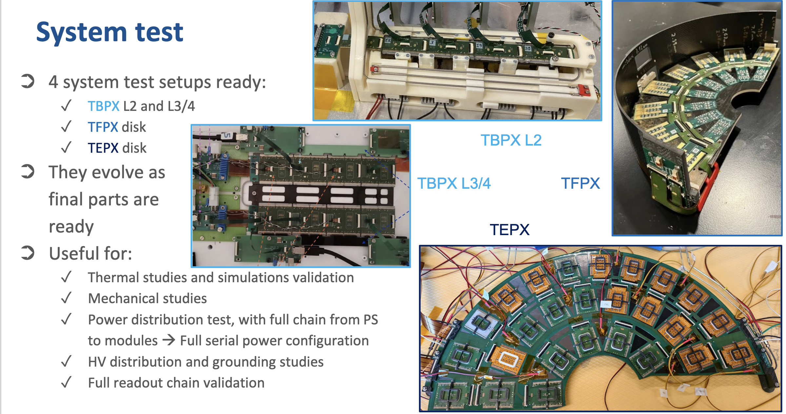
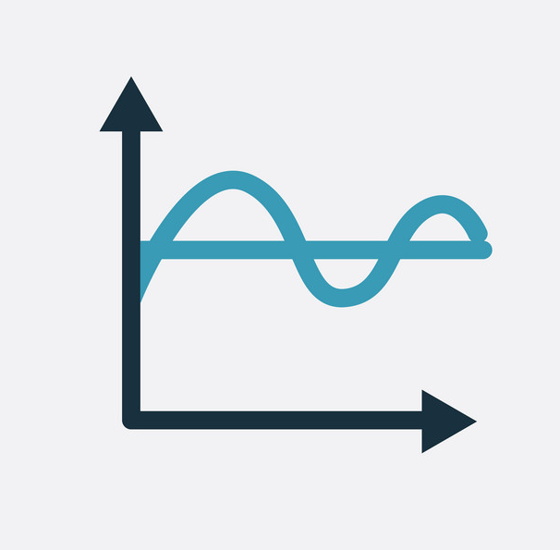
Integration – System test
4 different setups with final integration structures
TBPX for L2 and L3/4
TFPX disk
TEPX disk
Thermal and mechanical studies
Power distribution tests
Full DAQ chain tests

Slide 30
Outer Tracker

Slide 31
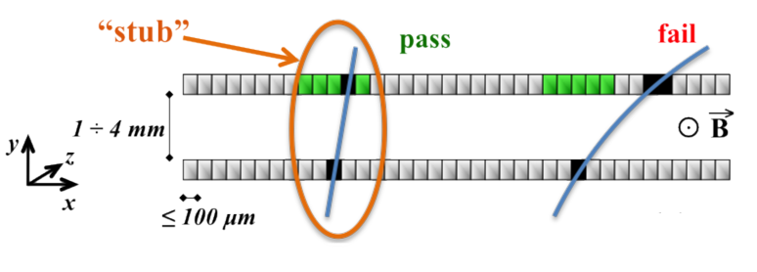
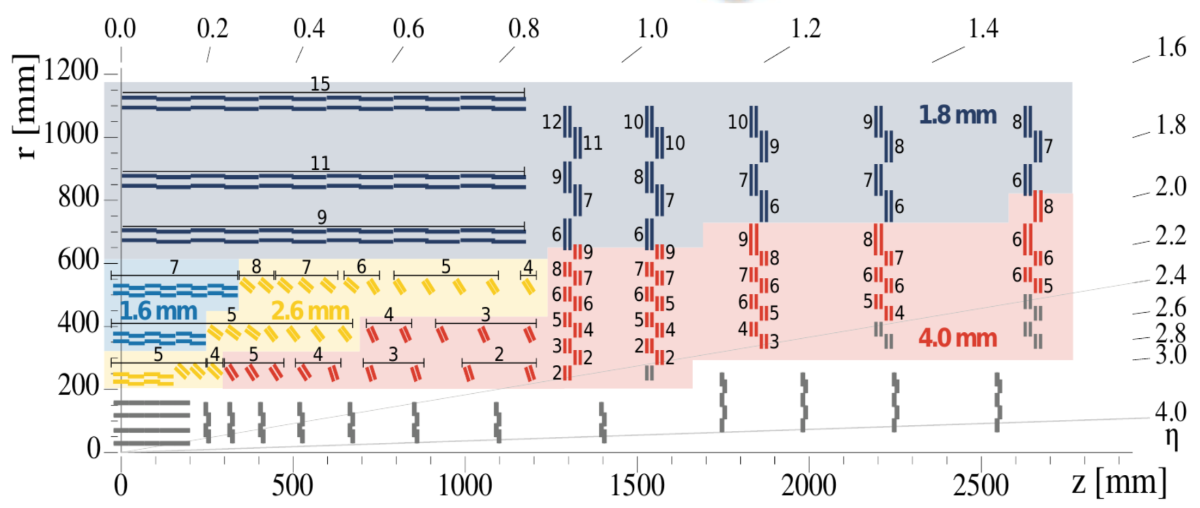
Outer Tracker – pT modules
p_{T} selection at readout level in order to reduce the L1 tracking input data size
pT modules
Two silicon sensors with small spacing in a module
Flex hybrid in order to get data from both sensors to one ASIC → Select track «stubs»
Different sensor spacing for different detector region
Tunable correlation windows
Inner Tracker

Slide 32
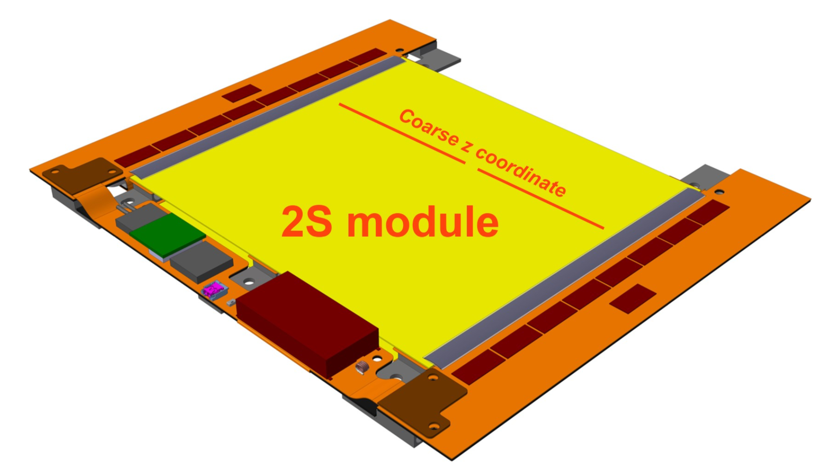
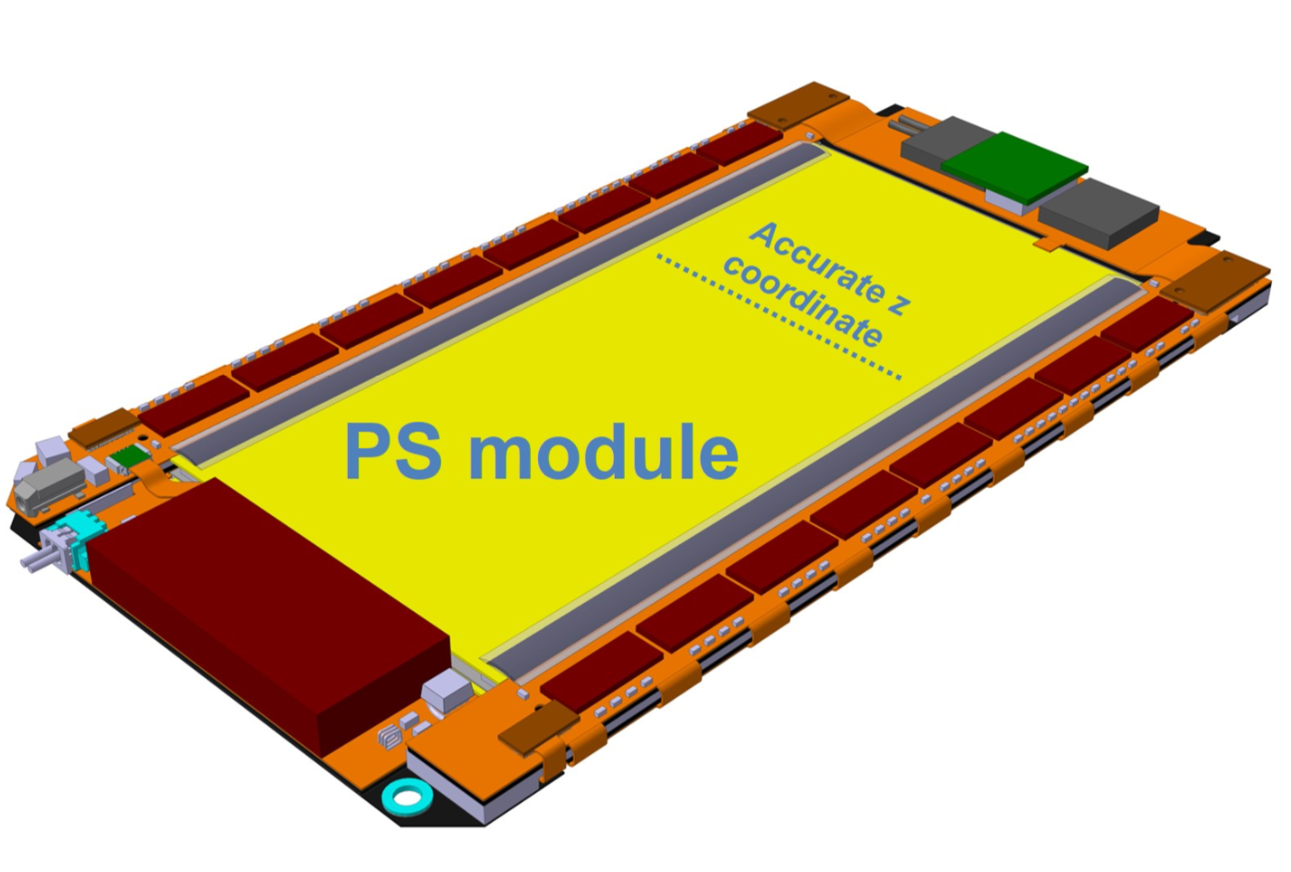
Outer Tracker – pT modules
2S Modules
2 different spacings: 1.8 & 4 mm
2 micro strip sensors with 5 cm x 90 um strips
Sensor dimension: 10cm x 10 cm
Two columns of 1016 strips
PS Modules
3 different spacing : 1.6mm & 2.6mm & 4mm
Strip sensor (2.5cm x 100μm strips) + Macro Pixel sensor (1.5 mm x 100 μm pixels)
Sensor dimension 5cm x 10 cm (two column of 960 strips + 32x960 pixels)

Slide 33
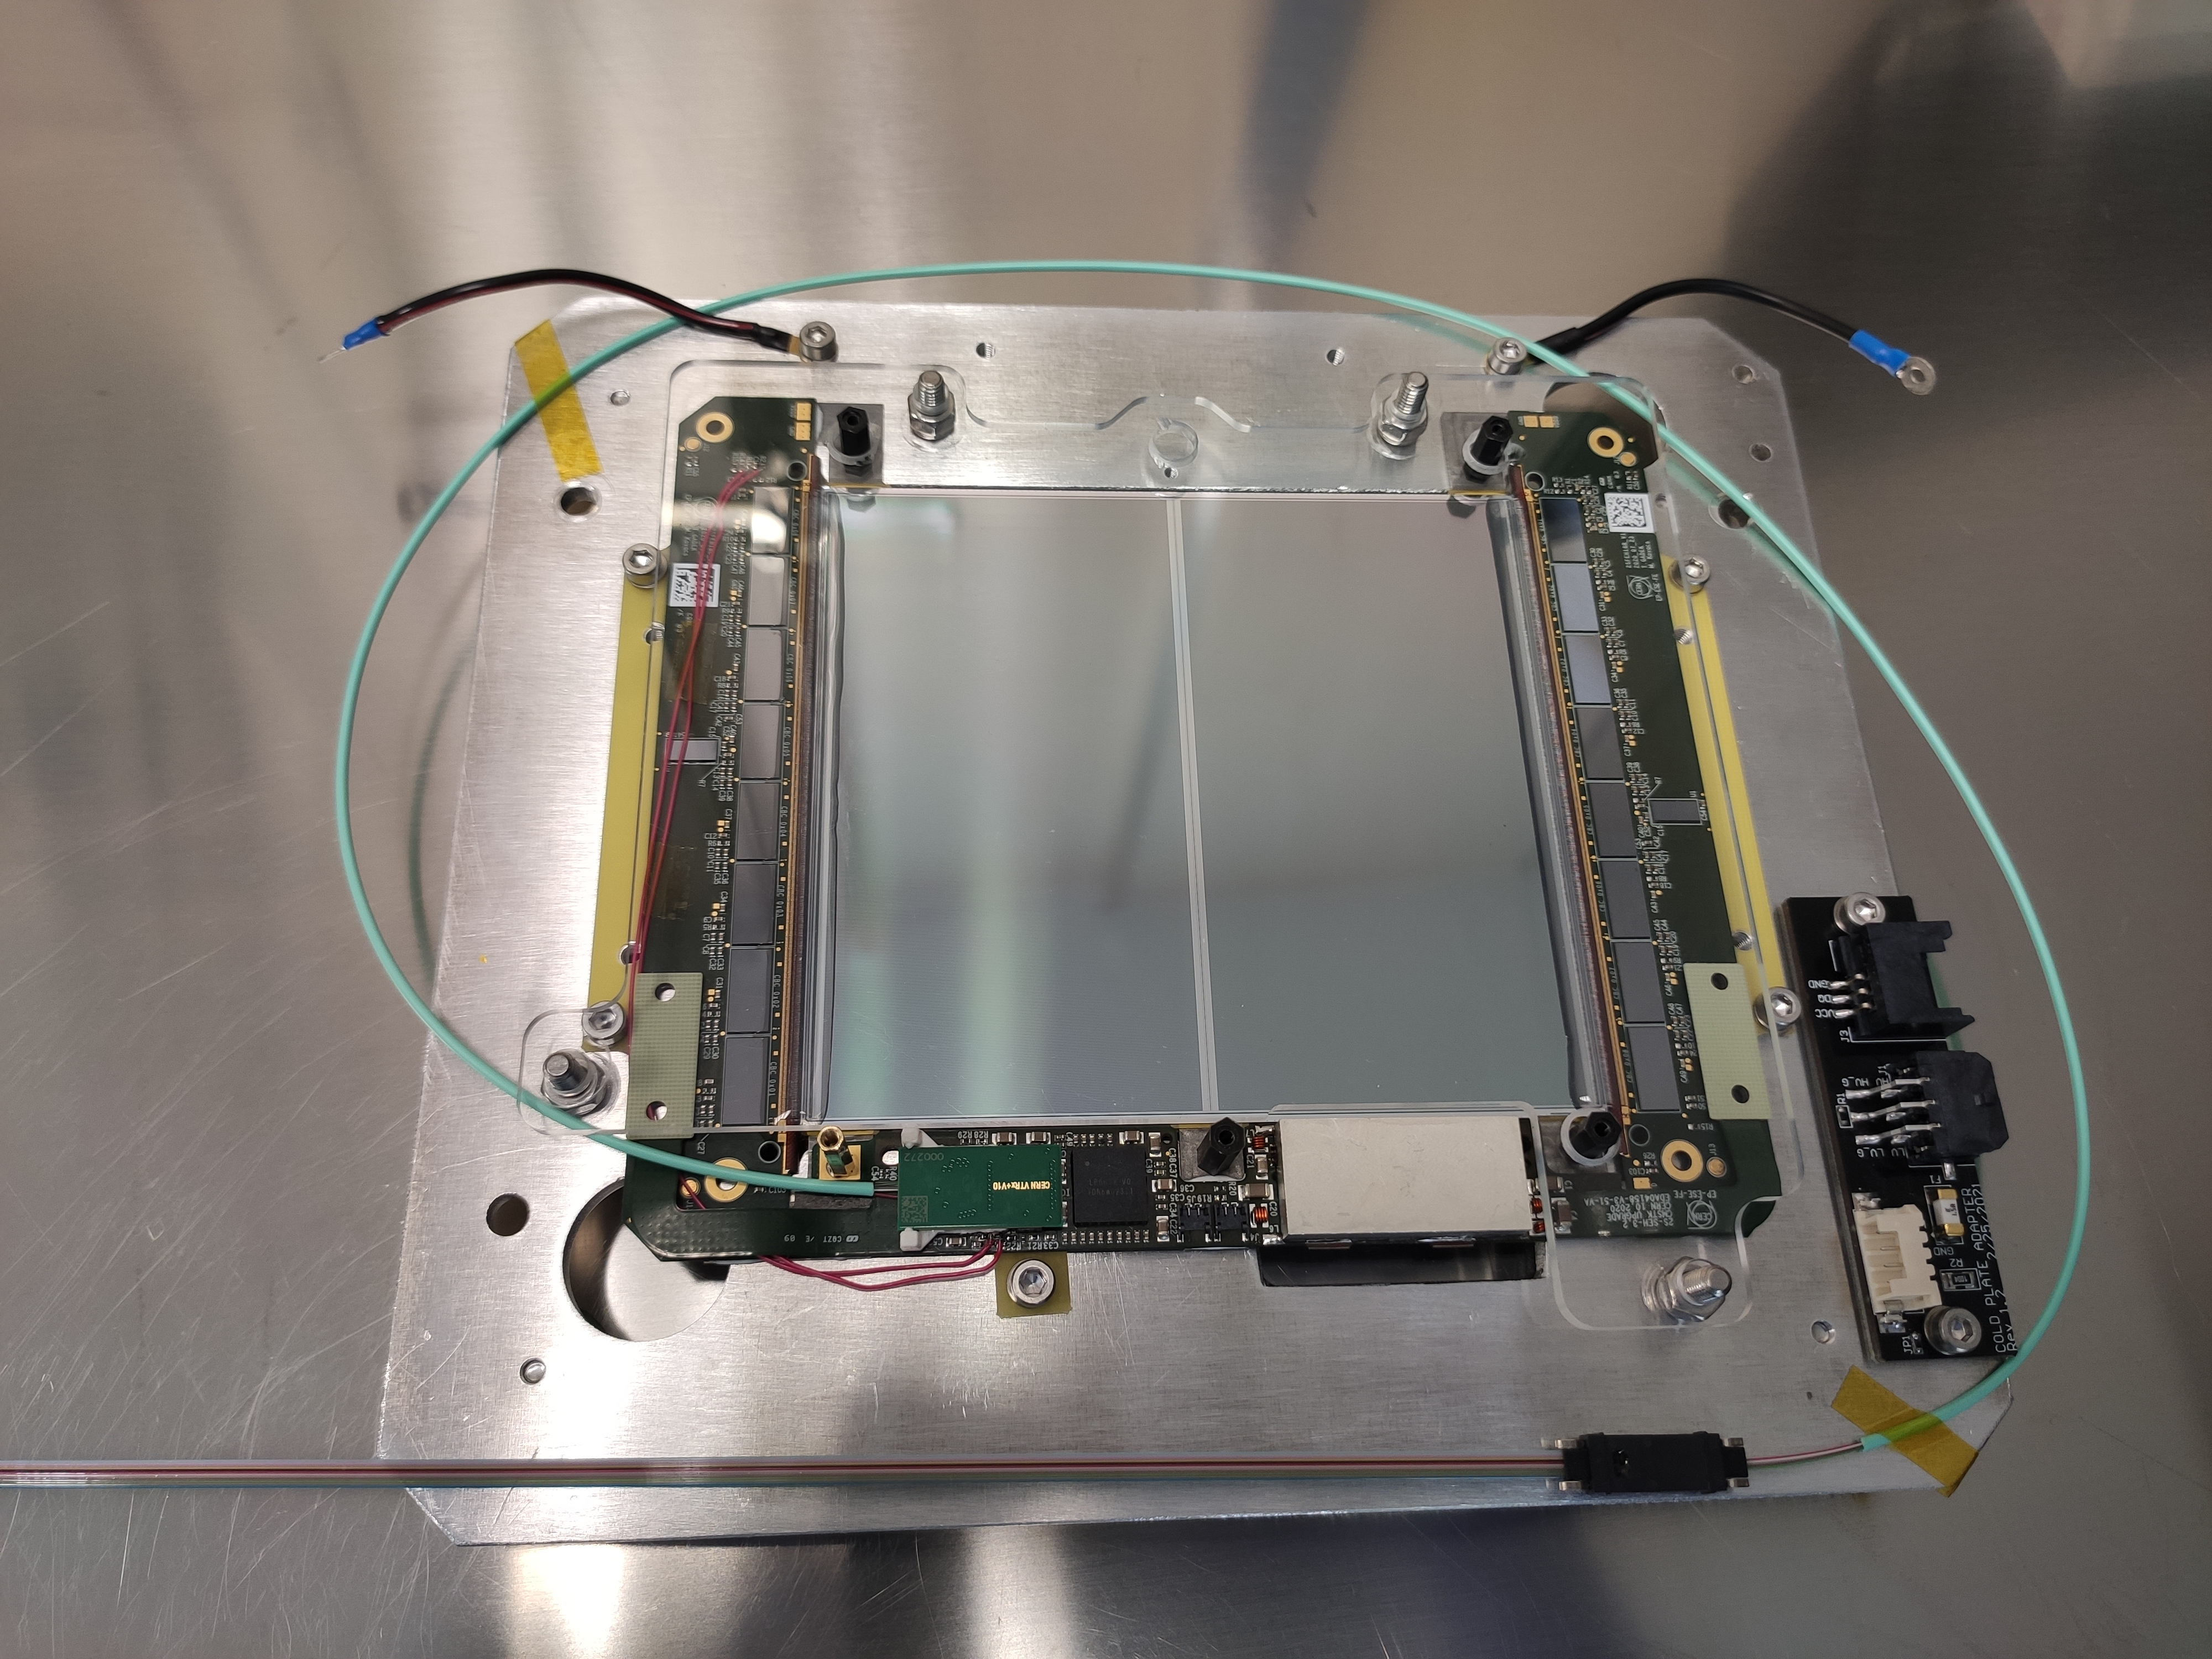
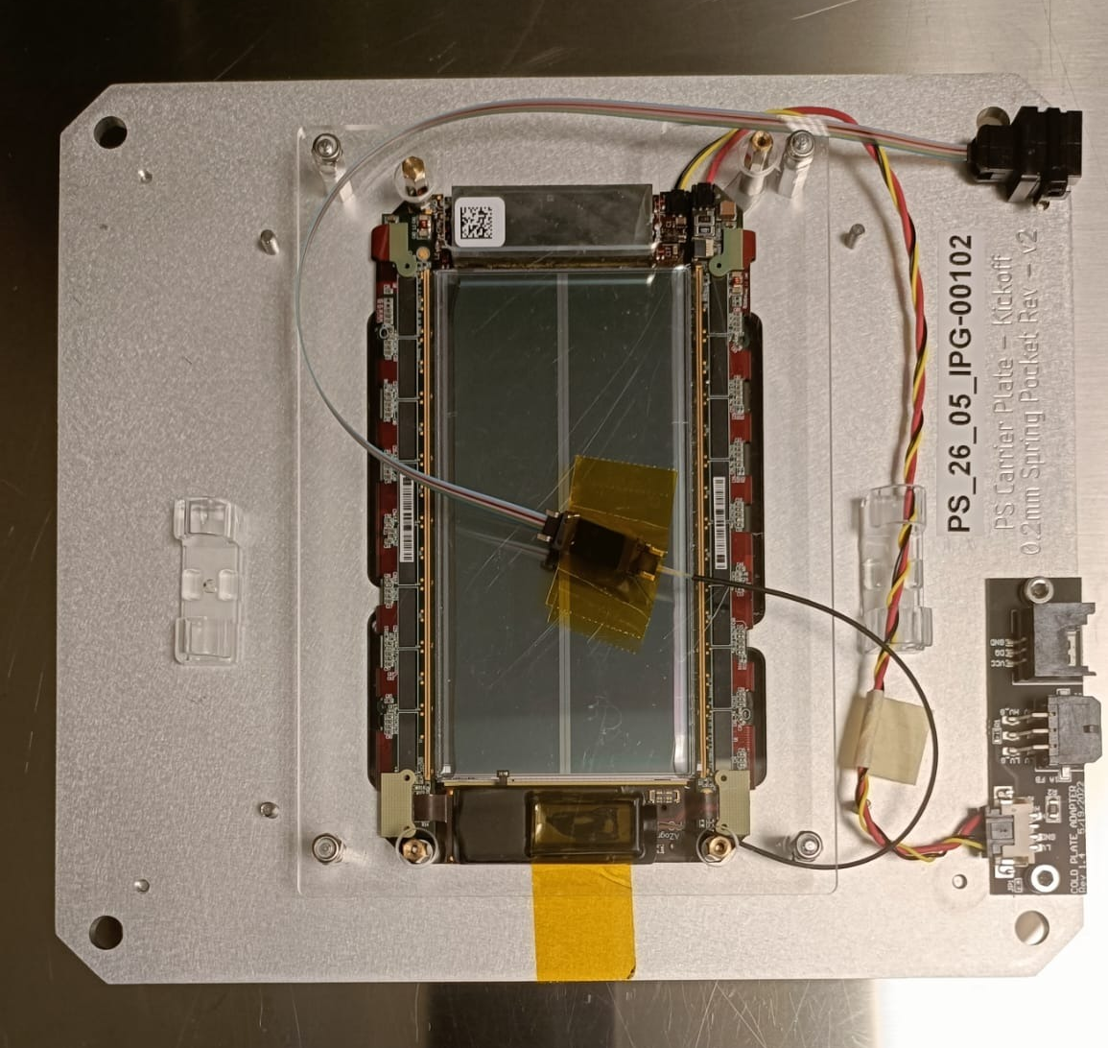
Outer Tracker – pT modules
2S Modules
2 different spacings: 1.8 & 4 mm
2 micro strip sensors with 5 cm x 90 um strips
Sensor dimension: 10cm x 10 cm
Two columns of 1016 strips
PS Modules
3 different spacing : 1.6mm & 2.6mm & 4mm
Strip sensor (2.5cm x 100μm strips) + Macro Pixel sensor (1.5 mm x 100 μm pixels)
Sensor dimension 5cm x 10 cm (two column of 960 strips + 32x960 pixels)

Slide 34
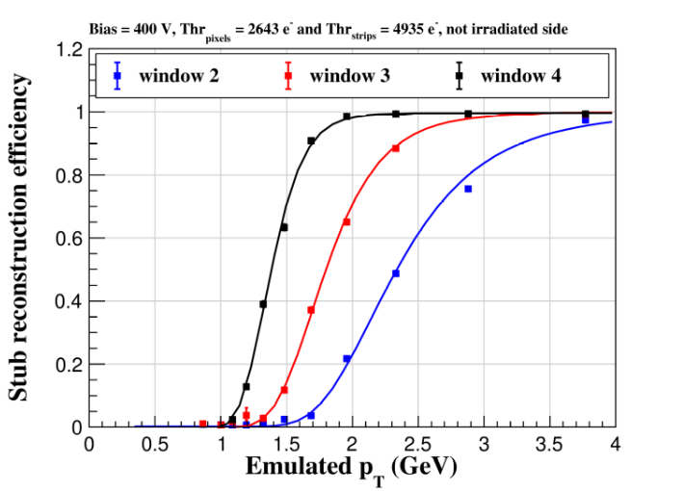
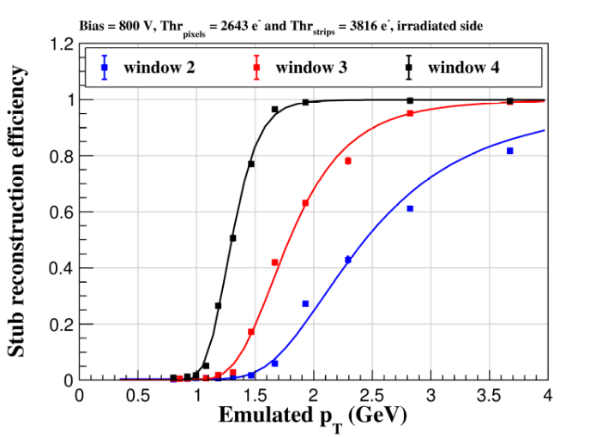
Latest Test Beam with PS modules
2024 Fermilab TB: PS-module with 1.6 mm spacing was tested before and after irradiation at a fluence slightly higher than expected for the HL-LHC end of life scenario. Comparable performance have been found before and after irradiation
Nicolò Salimbeni, Tredi 2025

Slide 35
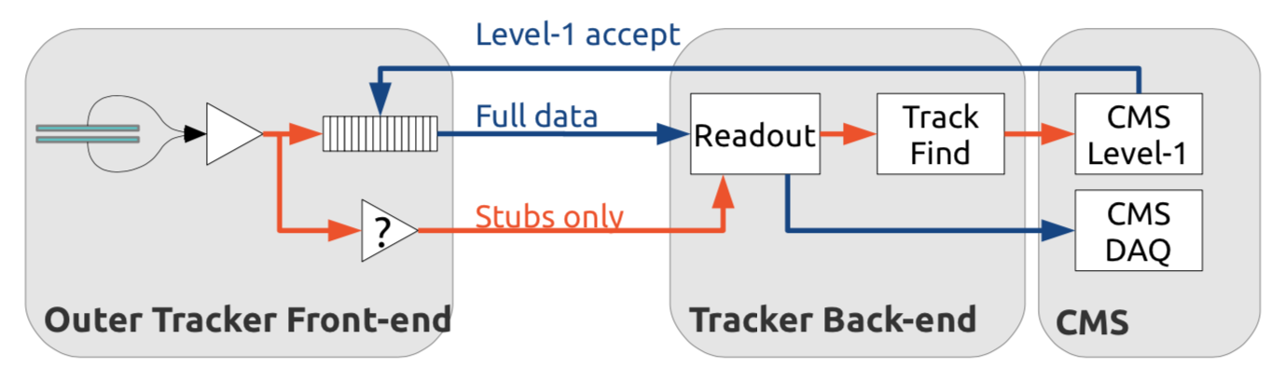
Outer Tracker Final DAQ Chain

Slide 36

Outer Tracker Final DAQ Chain

Slide 37

ShepHerd’s RunControl framework
Phase-2 tracker online software will be based on the ShepHerd’s RunControl framework (jointly developed by L1T & tracker). High level architecture:
Run Control – Global layer
1 instance responsible for the whole tracker
Web GUI for people + network API for CMS top-level run control application
Shep – Off-board supervisor
1 instance per subsystem (e.g. TF, OT, IT)
Web GUI for people + network API for RUNControl
Herd – On board controller
1 instance per board
Single common .exe with board/subsys agnostic network api; loads board/subsys specific plugin
Notes:
RunControl

Slide 38





DTC-Plugin: tk-fe-daq
Library providing control and calibrations for OT and IT modules on DTC
Extra attention to deployability, testing, possibility to complete computation on the System On Module for the DTC
Temperature and Current Monitoring
Continuous monitoring and storage in database, with communication to centralDaq
Single Event Upset (SEU) Detection and Correction
Once spotted SEUs, reconfiguration is needed
Setting Modules in Data-Taking mode
Ability to configure the modules to correctly output data (stable setup after alignment and calibrations)
Module Calibration Routines
Ability to run calibration routines to check the goodness of data, account for possible shifts in calibration and degration of the modules

Slide 39


Integration – Assembly
More in Dimitra Andreou’s talk on Thursday!

Slide 40


Integration – QC
IV characterization + basic chips functionalities + noise measurements
48 thermal cycles from 20°C to –35°C with tests in between
Analysis of the results through Ph2_ACF, Gipht and POTATO software

Slide 41

Integration – System test
Integration centers assemble modules in planks, rings, dees, ladders
TEDD Dee assembly test: 13 2S and PS modules
PS modules affected by prototype-specific known issue
Noise on modules: no significant increase after mounting on DEE
Lea Stockmeier, TIPP, 2023

Slide 42

Integration – System test
Integration centers assemble modules in planks, rings, dees, ladders
2S ladders prototype, more being built right now
Prototype Phase-2 tracker PSU
No significant noise increase on the ladder
Lea Stockmeier, TIPP, 2023

Slide 43


Cosmic Rack
Up to 12 2S ladders
Scintillator+ PMT → Trigger + position of cosmic rays
Assemble and integrate the full final DAQ chain, with track finding and offline data processing
scintillator
scintillator

Slide 44




Integration Testing
Reception test of individual ladder/ring
Mechanical integration
Pressure & leak tests → Connect to services & CO₂
Cooling segment test: ~ 500 modules on 1 CO2 manifold
Basic communication with DTC (ShepHerd + tk-fe-daq)
Powering
Integrity
Variation in noise due to integration
Backend system scaling: first time with > 1 DTC worth of modules!

Slide 45


Slide 46

Timeline

Slide 47
Conclusions
CMS Tracker will be fully replaced for High Luminosity LHC: Outer Tracker contribution to L1 trigger and performance improvement with 200 PU events
Production stared: for both Inner and Outer Tracker, QA & QC developed and in good shape to support full production
Support infrastructure in place: mechanical, powering, and cooling systems are under active test and evaluation
Integration for System Test: with module production kicking on, first assembled mechanical structure are being built and tested
DAQ development on final boards: quick development to support and validate the system test integration

