Slide 1
Improving Neutron Spin Tracking Algorithms
David Mathews

Slide 2
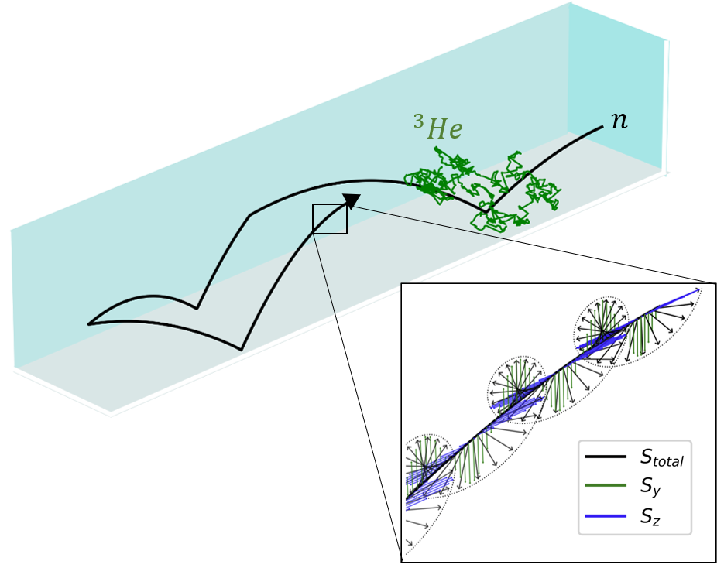
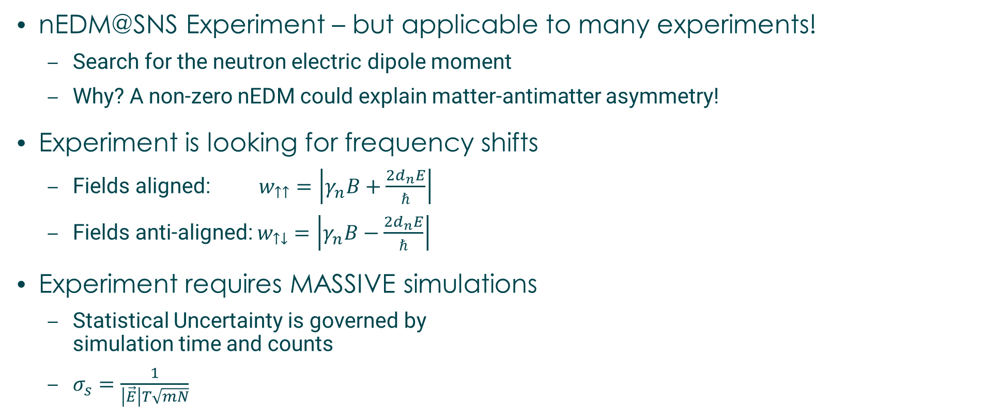
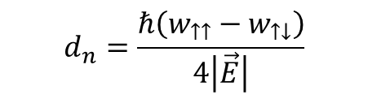
Motivation for Algorithm Development
nEDM@SNS Experiment – but applicable to many experiments!
Search for the neutron electric dipole moment
Why? A non-zero nEDM could explain matter-antimatter asymmetry!
Experiment is looking for frequency shifts
Fields aligned: $w_{↑↑}=\left|γ_{n}B+\frac{2d_{n}E}{ℏ}\right|$
Fields anti-aligned: $w_{↑↓}=\left|γ_{n}B−\frac{2d_{n}E}{ℏ}\right|$
Experiment requires MASSIVE simulations
Statistical Uncertainty is governed by simulation time and counts
$σ_{s}=\frac{1}{\left|\vec{E}\right|T\sqrt{mN}}$
$$d_{n}=\frac{ℏ\left(w_{↑↑}−w_{↑↓}\right)}{4\left|\vec{E}\right|}$$

Slide 3
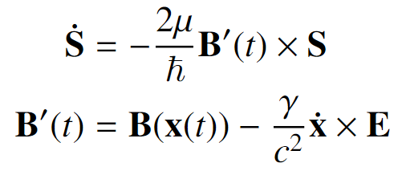
How hard are these simulations?
Physics List
Keep track of position and spin of each particle
Handle wall interactions
Gravity, Field Gradients, Etc
Difficulty lies in the scale of the problem
Precision goals of experiment: 10nHz sensitivity
Base precession frequency is around 100Hz
Need to be sensitive to 100 parts per TRILLION
2 experimental modes
Free precession : ~50 million particles for 1000 seconds
Spin dressing : ~2 billion particles for 1000 seconds

Slide 4
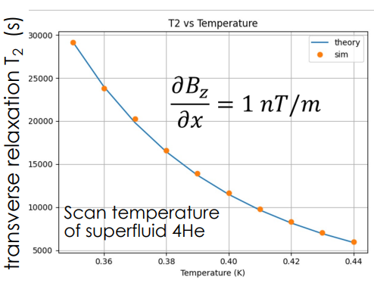
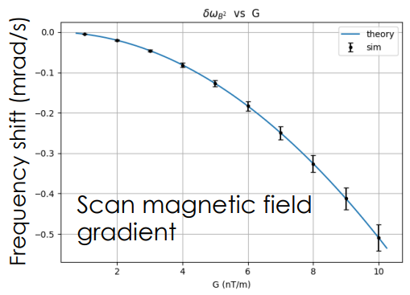
Where we started
C++ based code
Analytically solves for trajectories
Used Boost Library RKF78 integrator for spin integration
Solving BMT Equations for spin
Assume geometry of our cells – no STL files
Analytic field gradients
Matches theory where it should!
But theory models are only applicable under certain conditions
Low velocity in large box, linear gradients, etc

Slide 5

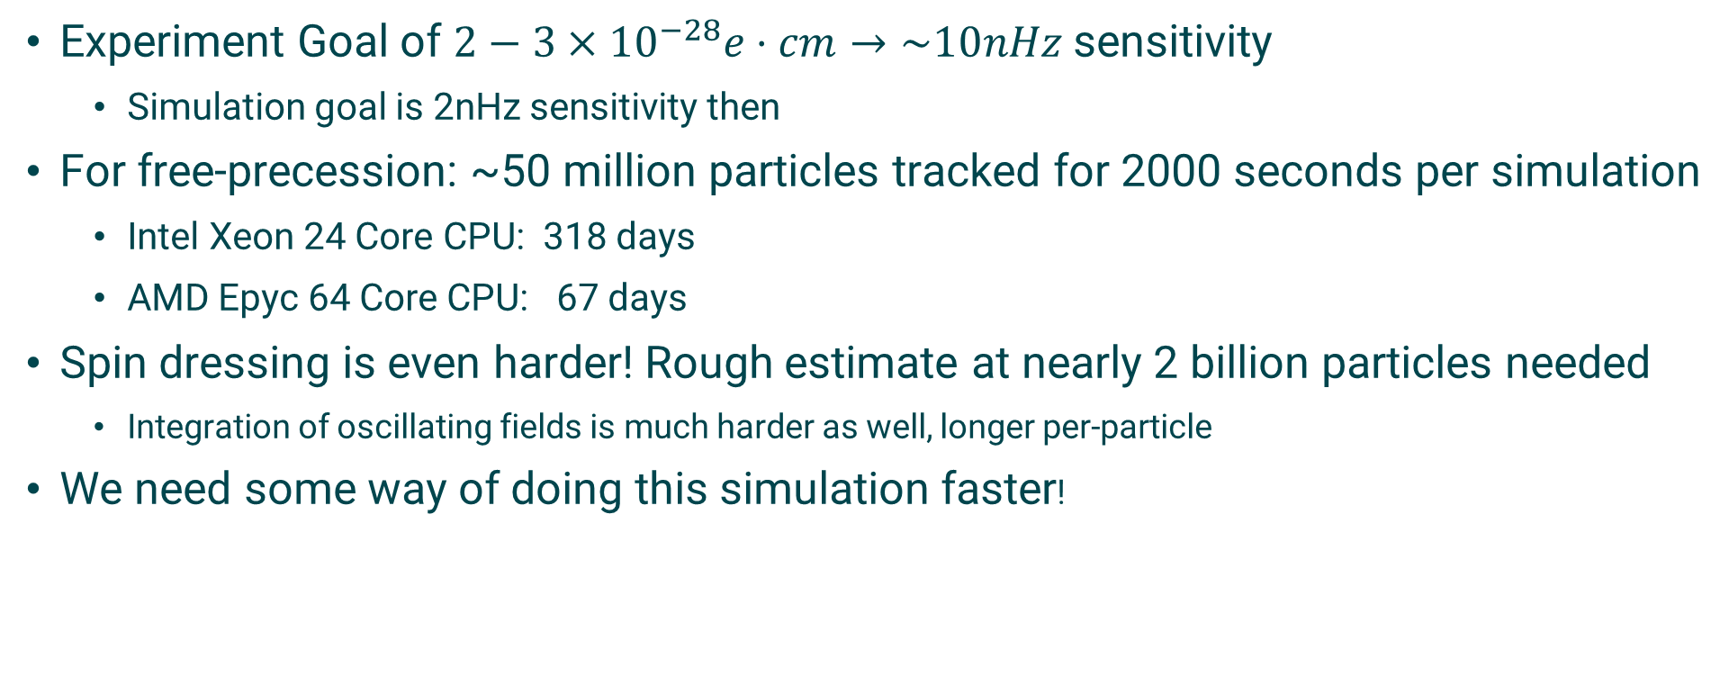
Scale Requirements – 10^7 or 10^9 particles!
Experiment Goal of $2−3×{10}^{−28}e⋅cm→\sim 10nHz$ sensitivity
Simulation goal is 2nHz sensitivity then
For free-precession: ~50 million particles tracked for 2000 seconds per simulation
Intel Xeon 24 Core CPU: 318 days
AMD Epyc 64 Core CPU: 67 days
Spin dressing is even harder! Rough estimate at nearly 2 billion particles needed
Integration of oscillating fields is much harder as well, longer per-particle
We need some way of doing this simulation faster!

Slide 6
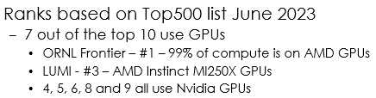
Two Methods of Improving Performance
Bigger / Faster Computing Hardware
Main push here is switching to using GPUs
Most of the most powerful computers are primarily GPUs now
Improve Algorithmic Performance
Improving the spin integration algorithm itself

Slide 7
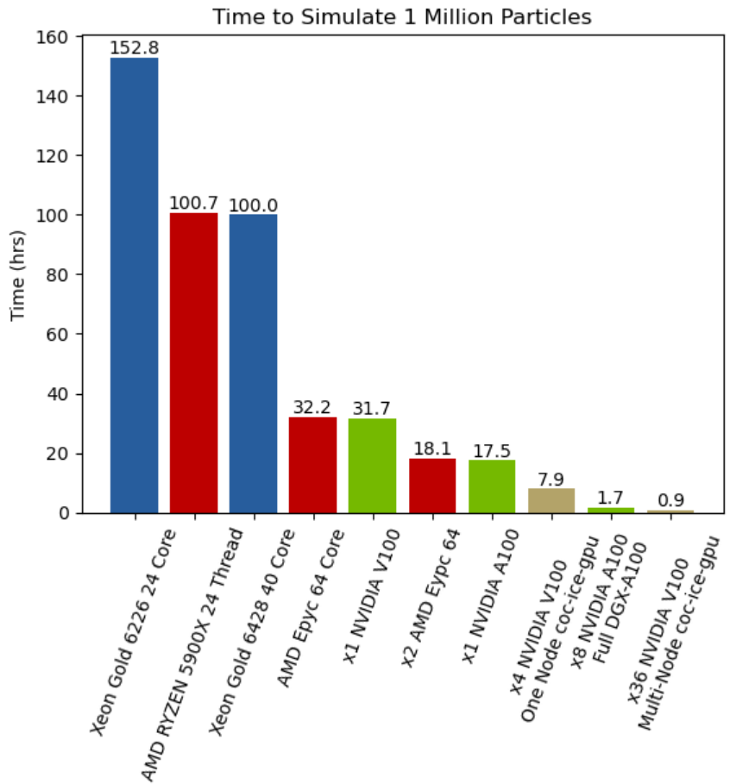
Migration to GPU
Participated in a Hackathon at Georgia Tech sponsored by Nvidia
Matt Morano, Jordan O’Kronley, and I
Adjustments to the code
Replaced Boost RKF78 with custom DOP853 implementation
Implemented our own RNG function
Independent states per-particle
For a 2nHz sensitive simulation
Xeon Gold 6226 24 Core – 318 days
Nvidia V100 – 66 days
Nvidia A100 – 36 days
x36 Nvidia V100s – 45 hours!
Big thank you to the hackathon mentors!
1 Nvidia A100 GPU beats 2 64-Core CPUs!

Slide 8
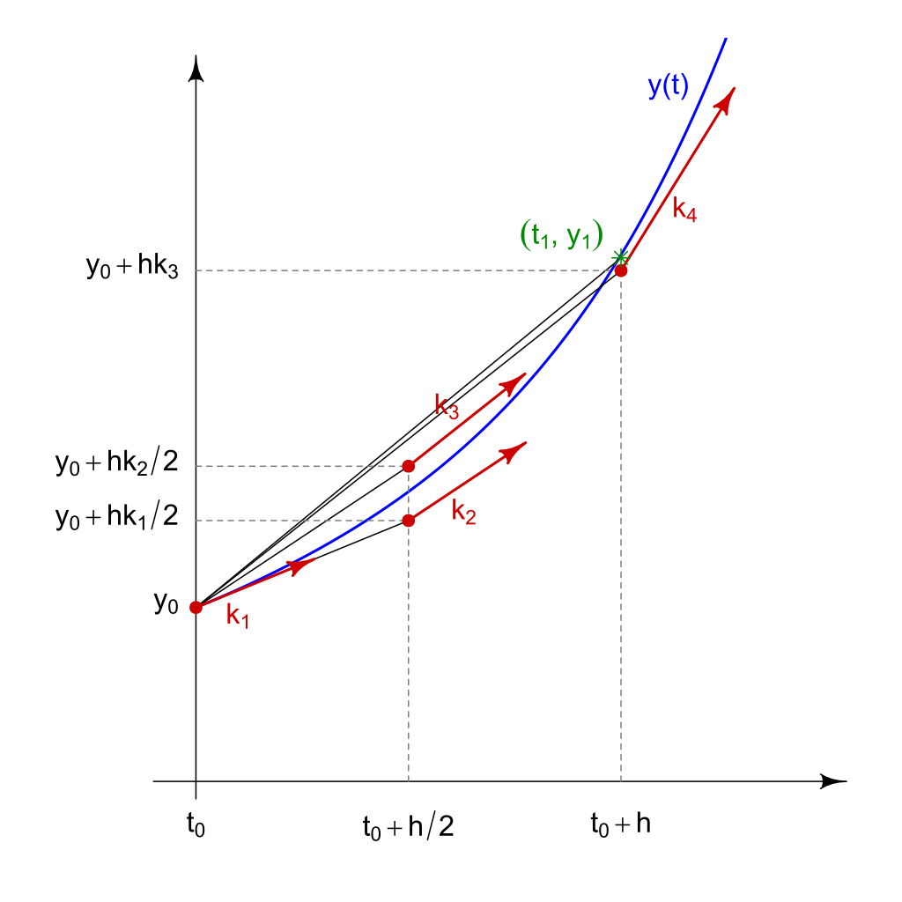
Improving the Spin Tracking Algorithm
Why are we so focused on Spin Integration being slow?
Simulations with spin tracking enabled are 230X slower!
Commonly used by other software in the field
Our Software – 8th order Runge-Kutta method (RK)
PENTrack - uses Boost library odeint – 5th order RK method
MCUCN - 5th order Runge-Kutta-Fehlberg method
Kassiopeia – supports a variety of Runge-Kutta methods
How do these routines work?
Evaluate the differential equation at multiple points
Weight the contribution of each sample location in the final output
Image from https://en.wikipedia.org/wiki/Runge%E2%80%93Kutta_methods

Slide 9
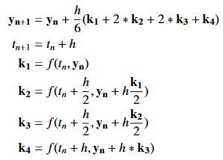
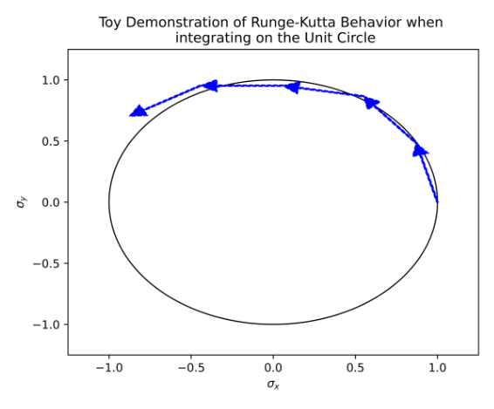
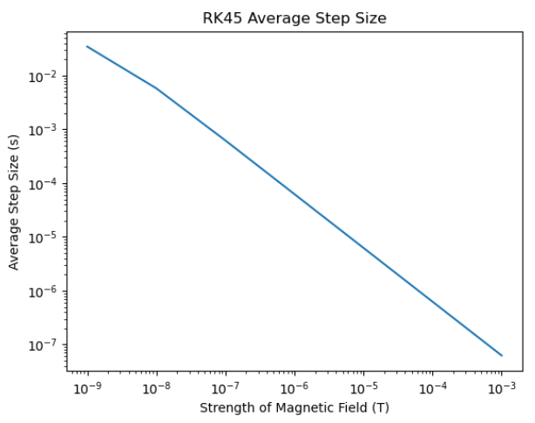
Example of a Runge Kutta Routine : RK4
Each step builds off the last
Not necessarily ideal for spin integration!
Doesn’t preserve spin vector as a unit vector for example!
Requires tiny step sizes to maintain precision

Slide 10
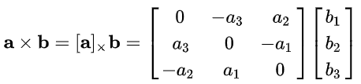
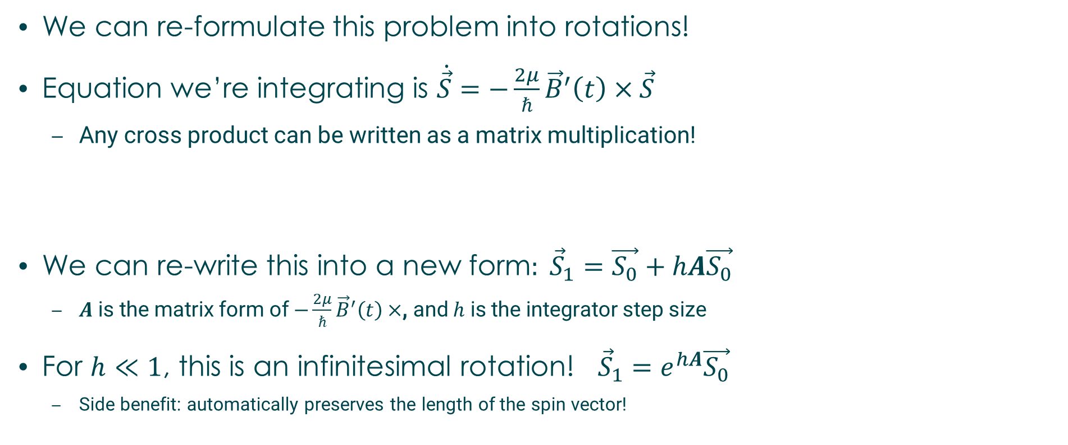
How can we make this faster?
We can re-formulate this problem into rotations!
Equation we’re integrating is $\dot{\vec{S}}=−\frac{2μ}{ℏ}{\vec{B}}^{′}\left(t\right)×\vec{S}$
Any cross product can be written as a matrix multiplication!
We can re-write this into a new form$: {\vec{S}}_{1}=\vec{S_{0}}+hA\vec{S_{0}}$
$A$ is the matrix form of $−\frac{2μ}{ℏ}{\vec{B}}^{′}\left(t\right)×$, and $h$ is the integrator step size
For $h≪1$, this is an infinitesimal rotation! ${\vec{S}}_{1}=e^{hA}\vec{S_{0}}$
Side benefit: automatically preserves the length of the spin vector!

Slide 11
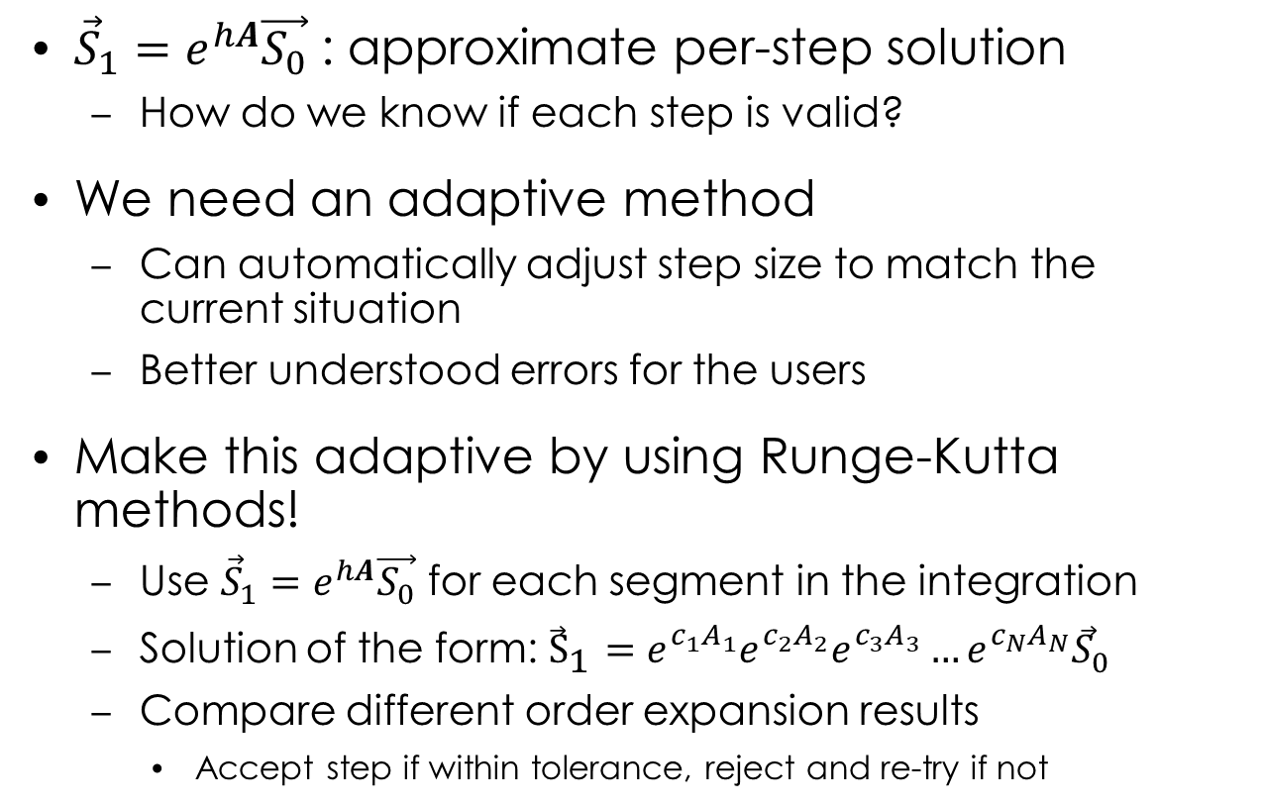
How do we handle errors now?
${\vec{S}}_{1}=e^{hA}\vec{S_{0}}$ : approximate per-step solution
How do we know if each step is valid?
We need an adaptive method
Can automatically adjust step size to match the current situation
Better understood errors for the users
Make this adaptive by using Runge-Kutta methods!
Use ${\vec{S}}_{1}=e^{hA}\vec{S_{0}}$ for each segment in the integration
Solution of the form: ${\vec{S}}_{1}=e^{c_{1}A_{1}}e^{c_{2}A_{2}}e^{c_{3}A_{3}}…e^{c_{N}A_{N}}{\vec{S}}_{0}$
Compare different order expansion results
Accept step if within tolerance, reject and re-try if not

Slide 12
How well does this work?
Implemented the rotation matrix method using quaternions for RKF45
Two test modes – 16384 particles, Nvidia A100, 100 second simulation time
Free-precession – constant holding magnetic field
Spin-dressing – constant holding field + perpendicular oscillating field
Spin Integrator | Free-Precession | Spin-Dressing
DOP853 (8th order Runge-Kutta method) | 35.4 seconds | 881 seconds
RK45 Rotation Using Quaternions | 0.8 seconds | 3258 seconds
Why such a large performance difference?
Rotation matrices are the exact solution for no gradient, but method does not handle gradients well

Slide 13
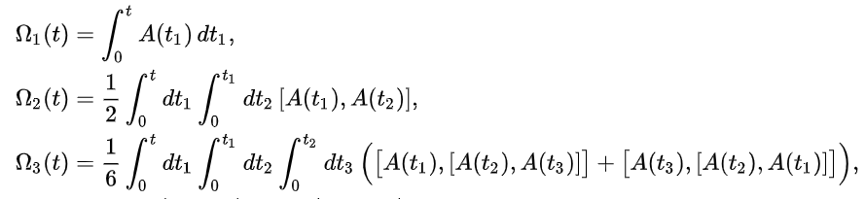
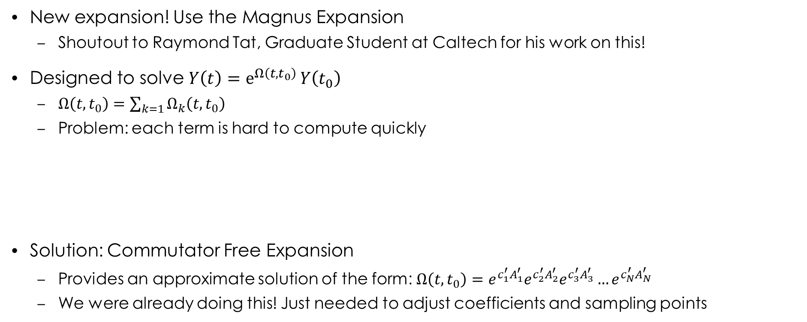
How can we better handle field gradients?
New expansion! Use the Magnus Expansion
Shoutout to Raymond Tat, Graduate Student at Caltech for his work on this!
Designed to solve $Y\left(t\right)=e^{Ω\left(t, t_{0}\right)}{Y\left(t_{0}\right)}$
$Ω\left(t, t_{0}\right)=\sum_{k=1}{Ω_{k}\left(t, t_{0}\right)}$
Problem: each term is hard to compute quickly
Solution: Commutator Free Expansion
Provides an approximate solution of the form: $Ω\left(t, t_{0}\right)=e^{{c_{1}^{′}A}_{1}^{′}}e^{c_{2}^{′}A_{2}^{′}}e^{c_{3}^{′}A_{3}^{′}}…e^{c_{N}^{′}A_{N}^{′}}$
We were already doing this! Just needed to adjust coefficients and sampling points
“High-order commutator-free exponential time-propagation
of driven quantum systems” - https://arxiv.org/pdf/1102.5071

Slide 14
How well does this work?
This works remarkably well!
Slightly slower in the simplest cases due to extra overhead
Significantly faster with field gradients!
Far more stable in varying fields
Step size doesn’t collapse to nanosecond level as easily
Spin Integrator | Free-Precession | Spin-Dressing
DOP853 (8th order Runge-Kutta method) | 35.4 seconds | 881 seconds
RK45 Rotation Method | 0.8 seconds | 3258 seconds
MagnusCFET Method | 3.9 seconds | 134 seconds
16384 particles, Nvidia A100, 100 second simulation time

Slide 15
Where do we stand now?
Developed 2 new integration routines
Can extend these easily to different orders
Both matching theory predictions when applicable
Runge-Kutta with Quaternions
Up to 40x faster than 8th order Runge-Kutta in low-field gradient regions
MagnusCFET Routine
Consistently 5-10x faster than 8th order Runge-Kutta routines
Better performance in every test so far!

Slide 16
What are we currently working on?
Spin Dressing is terrifying
This would take the entirety of Frontier ~1.5 hours PER SIMULATION
Assuming each MI250X on Frontier = 1 Nvidia A100 (Probably somewhere between 1 and 1.5X faster is realistic)
And we aren’t going to have access to Frontier any time soon… and neither will other nEDM experiments
Scaling the previous numbers to time to a single 2nHz sensitive dataset on a Nvidia A100 GPU
Spin Integrator | Free-Precession | Spin-Dressing
DOP853 (8th order Runge-Kutta method) | 12.5 days | 12500 days
RK45 Rotation Method | 0.3 days | 46000 days
MagnusCFET Method | 1.4 days | 1900 days

Slide 17
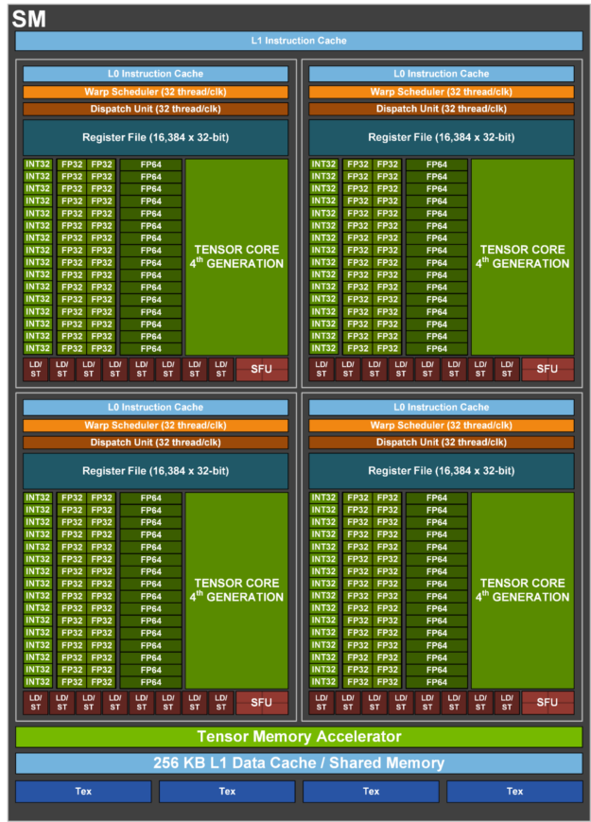
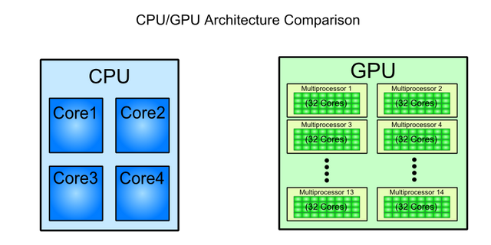
Ongoing work – GPU Optimization
Better optimizing the GPU code
We successfully ported the code, but didn’t optimize particularly well
Many cases of warp divergence!
Each “core” in a multiprocessor on the GPU should be in lock-step with the others
We don’t even use the tensor cores!

Slide 18
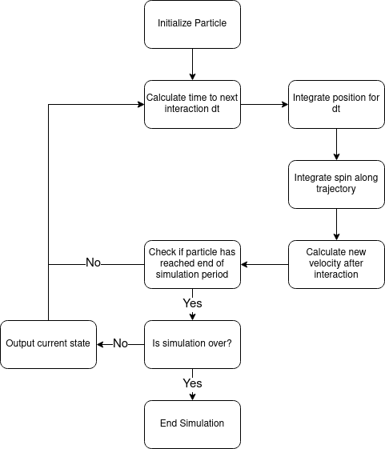
Zooming in on Warp Divergence
Logic Flow Per Particle
Issue has to do with synchronization
One warp MUST step through in unison
Adaptive integration routines break this behavior, so what do we do?
Current plan is to set particles in the same warp to use the smallest calculated step size
Want to keep each particle on the same step in the process as much as possible
Still working on this, requires a significant overhaul to the code

Slide 19
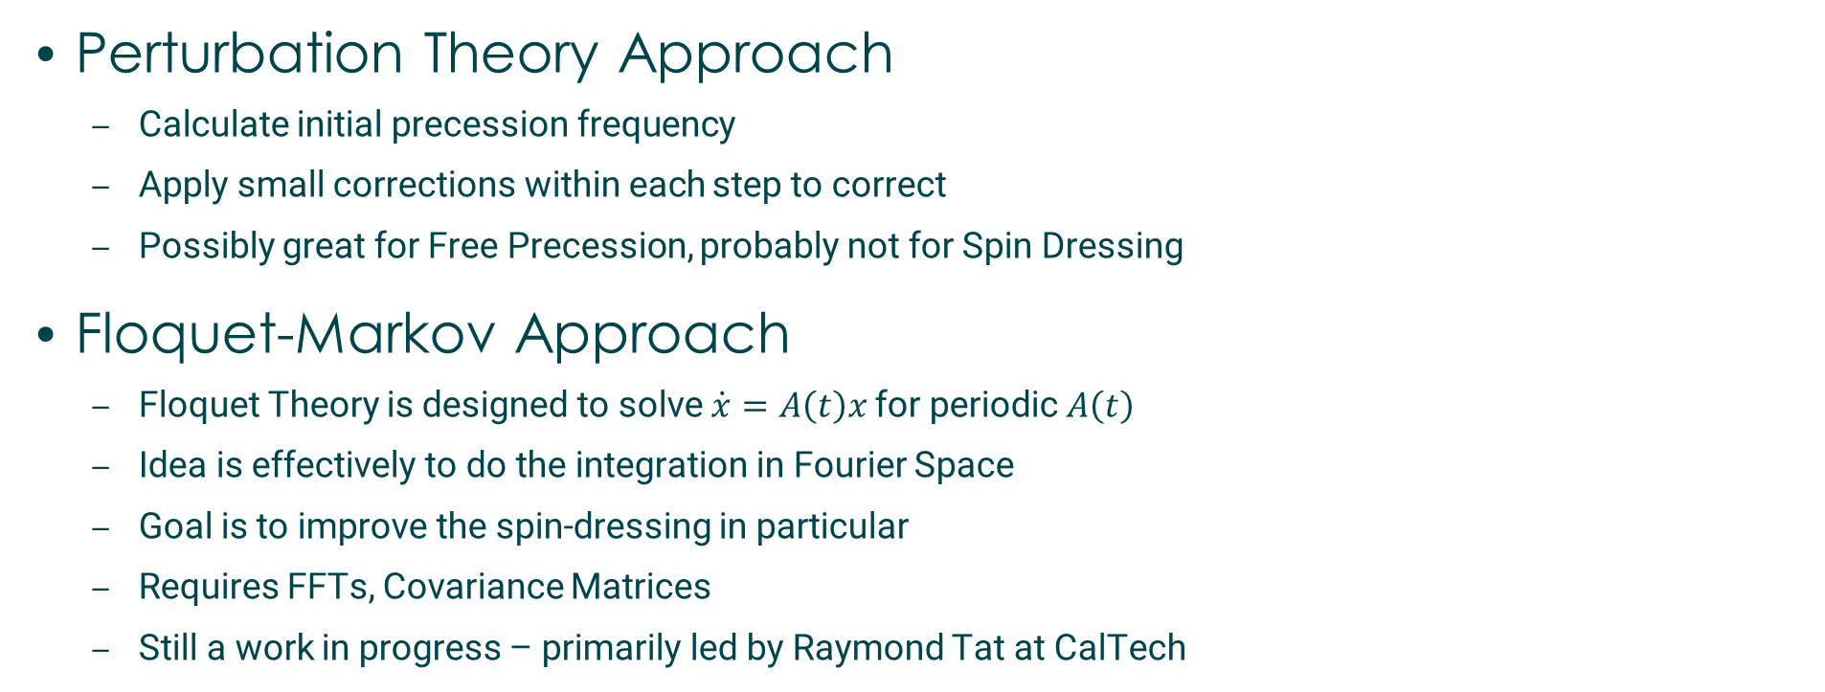
Ongoing Work – Algorithm Improvements
Perturbation Theory Approach
Calculate initial precession frequency
Apply small corrections within each step to correct
Possibly great for Free Precession, probably not for Spin Dressing
Floquet-Markov Approach
Floquet Theory is designed to solve $\dot{x}=A\left(t\right)x$ for periodic $A\left(t\right)$
Idea is effectively to do the integration in Fourier Space
Goal is to improve the spin-dressing in particular
Requires FFTs, Covariance Matrices
Still a work in progress – primarily led by Raymond Tat at CalTech

Slide 20
Conclusion
Found a few ways to significantly speed up neutron spin tracking!
Very helpful for nEDM experiments
Ongoing effort to make this broadly applicable for stuff like polarization simulations, that sort of thing
Hoping to get two papers out of this
1 describing moving these simulations to GPUs and optimizations for the hardware
The other for exploring solving the differential equations
Still very much a WIP depending on how far we want to go
Also working with people at GT to test integration efficiency on different computing hardware
Performance/Watt sort of metrics, very helpful for environmental studies and whatnot

