Slide 1
(Nuclear) Arms Control: The Role of Physics and Engineering
Seth McConchie
Advanced Detection and Applied Data Science
2024 October 4

Slide 2
Nuclear Arms Tests for Nuclear Data

Slide 3
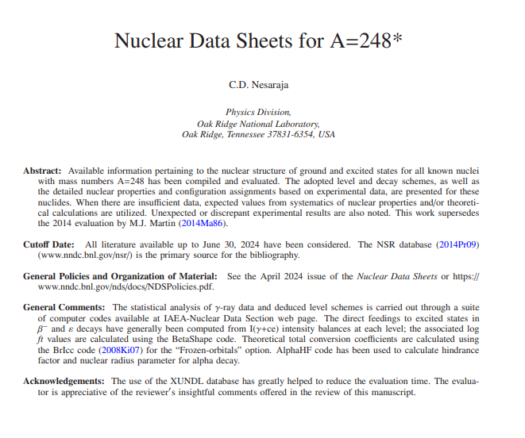

Slide 4
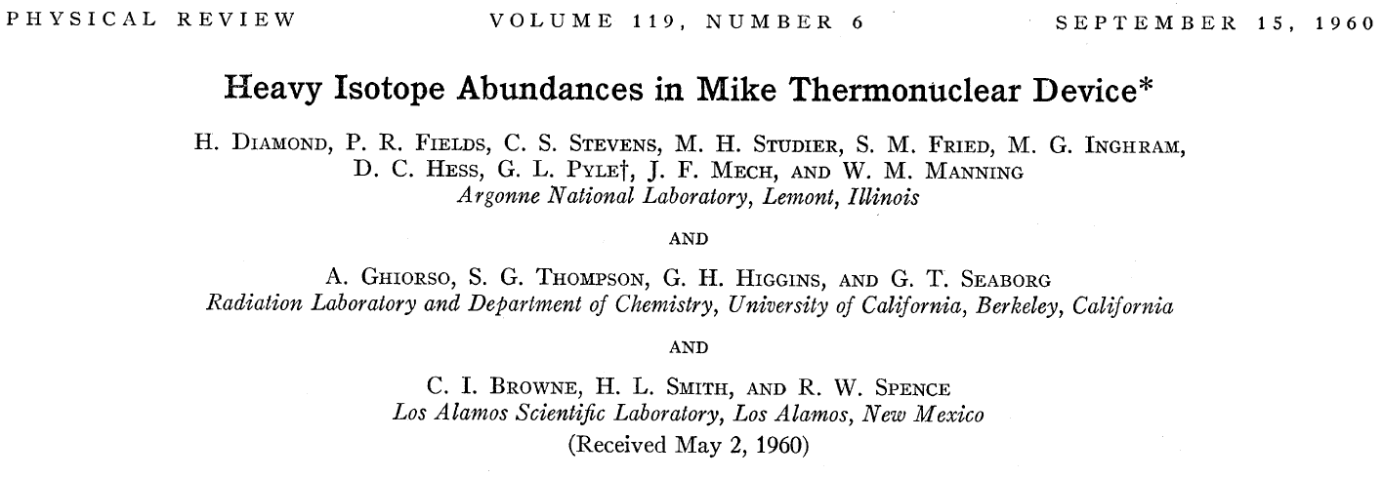
From DOE/NV-209-Rev16, “United States Nuclear Tests …”

Slide 5


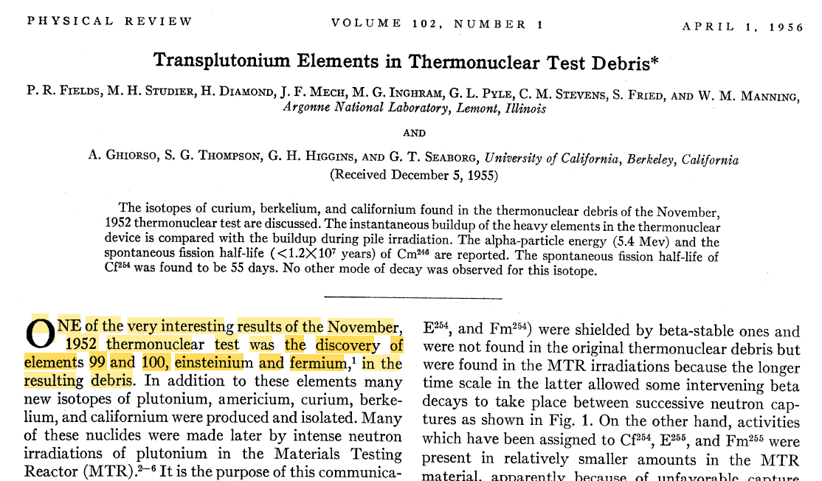

Slide 6
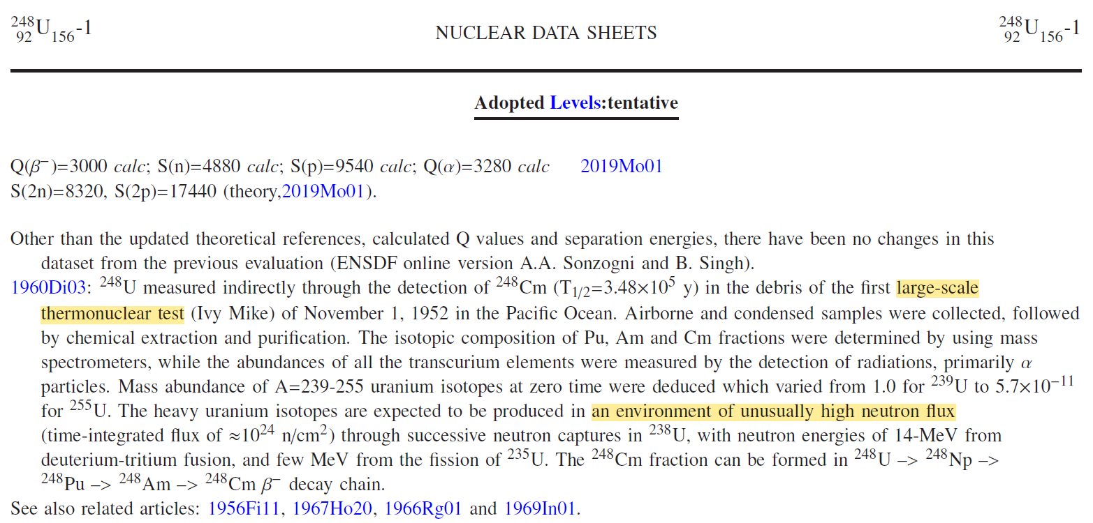
From Caroline Nesaraja’s draft update to the Nuclear Data Sheets for A=248

Slide 7
Historical Highlights of Nuclear Arms Control

Slide 8

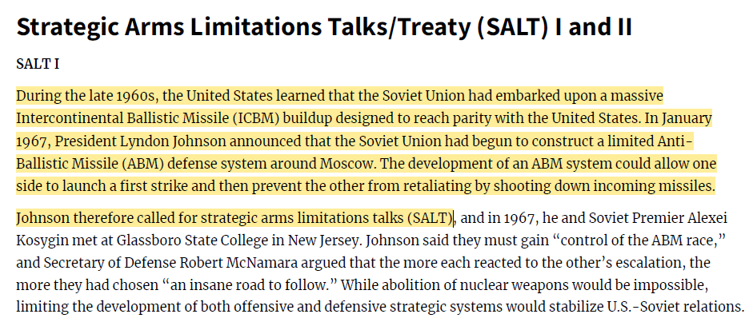
Advent of
nuclear
arms control

Slide 9
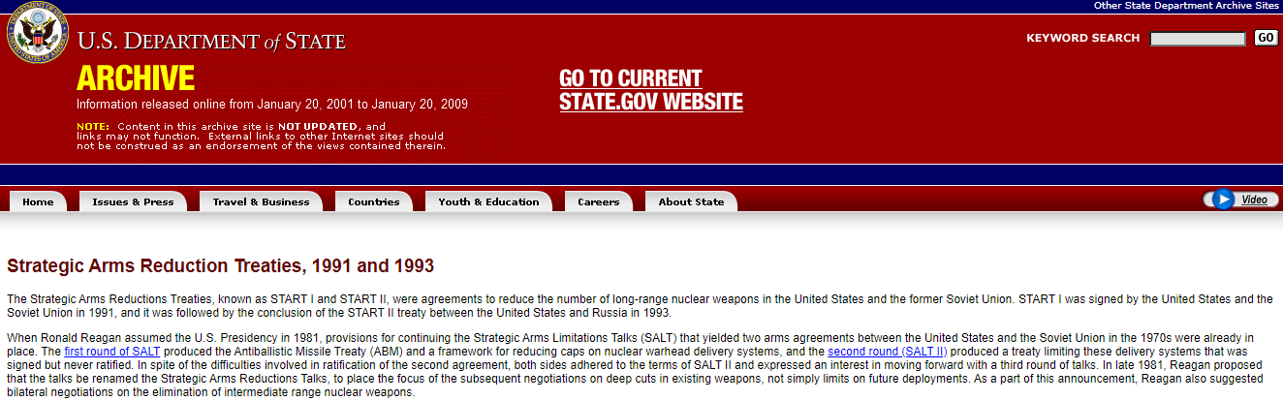
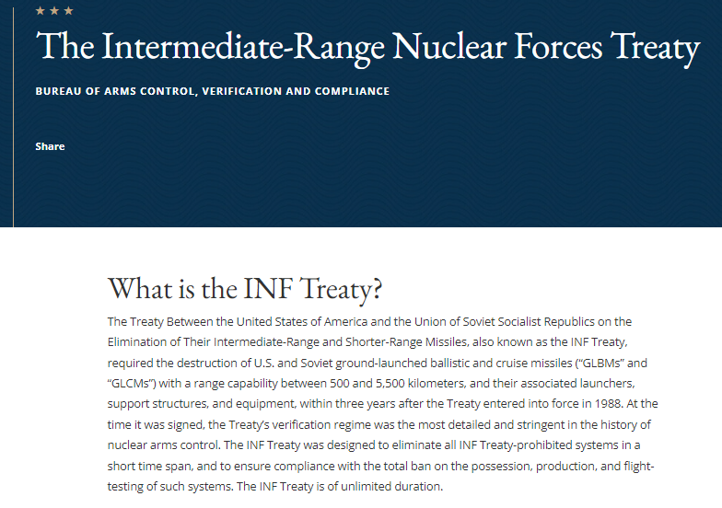
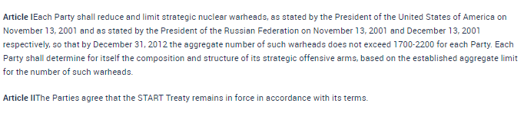
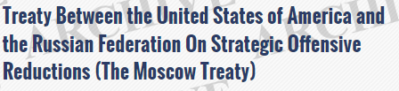
1987-2019

Slide 10
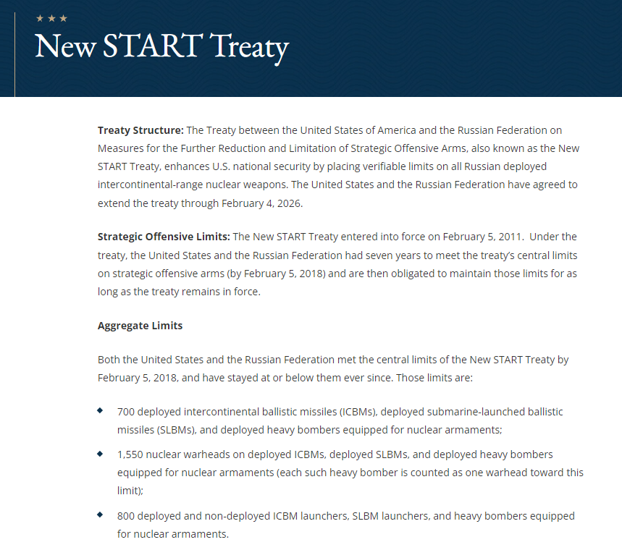

Slide 11
Technology to Achieve Policy

Slide 12

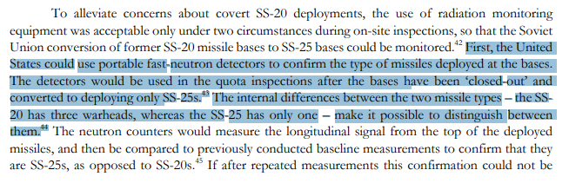
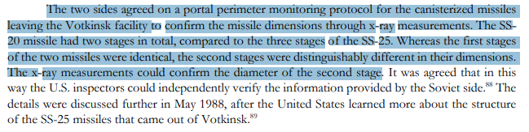

Slide 13

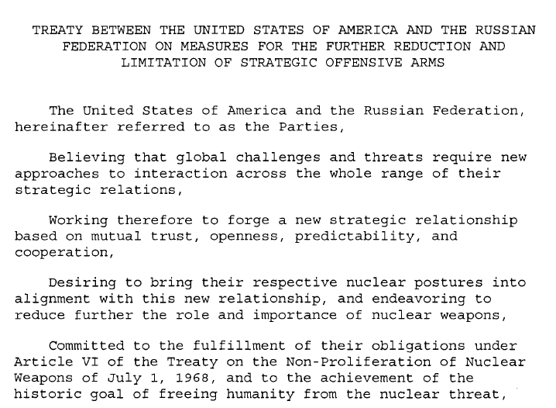
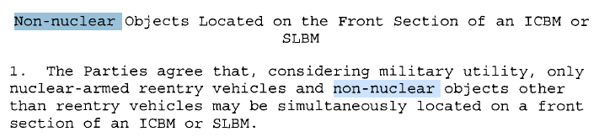
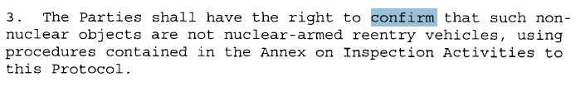
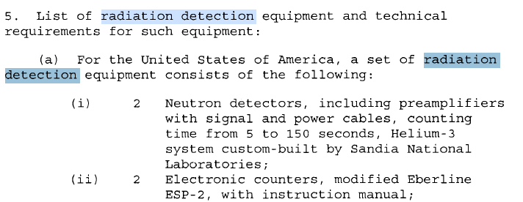

Slide 14
Hypothetical Future for Nuclear Arms Control

Slide 15

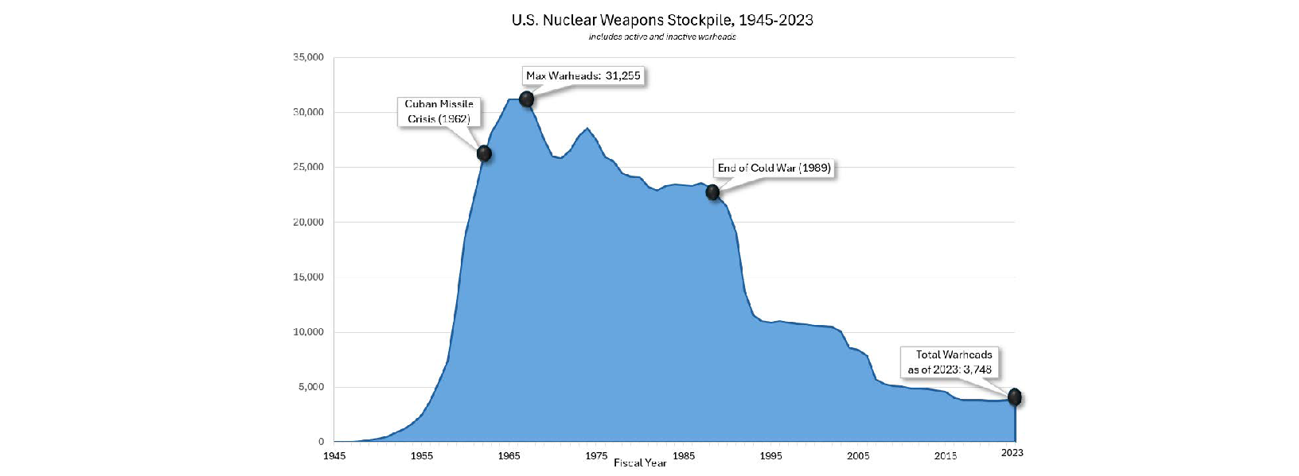
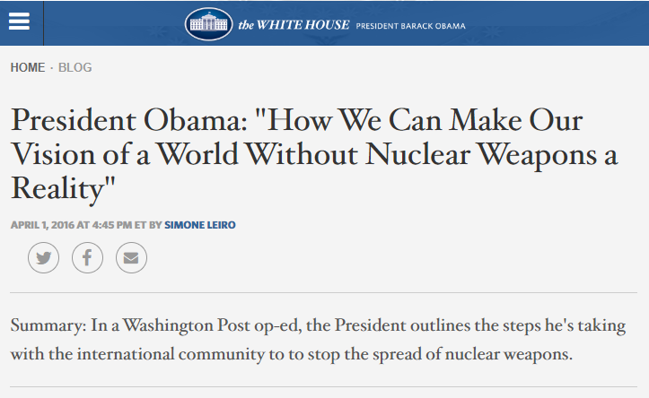

Slide 16
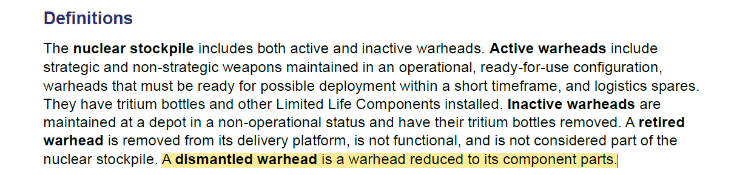
New START expires in February 2026
Will Russia want a follow-on treaty?
Will the trend of reducing stockpile sizes continue?
Will future verification depend upon size of stockpiles?
Will additional confidence building measures be needed to ensure that treaty obligations are being met?

Slide 17
“A dismantled warhead is a warhead reduced to its component parts.”
How does a treaty partner have confidence that another partner’s warhead has been reduced to its component parts when the internal configuration of the warhead cannot be shared?
One option is to confirm one or more “attributes” where an attribute is a declared statement that can be confirmed oftentimes with a measurement technology
Example declarations:
Warhead X contains greater than Y grams of weapons-grade plutonium
When warhead Z is dismantled, the explosives is physically separated from the fissile material

Slide 18
What technology best confirms a declared statement (inspecting partner equity) and protects non-shareable information (warhead owner equity) is a persistent R&D question
Consider the declaration: “When warhead Z is dismantled, the explosives have been physically separated from the fissile material” – How could this declaration be confirmed?
Explosives typically consist of H, C, N, and O with chemical bonds that distinguish them from non-explosive materials that can contain the same elements
Warheads and component parts are rarely not containerized so chemical sampling is usually infeasible
Stand-off measurements are preferred, so what about inferring the presence of the elements?

Slide 19
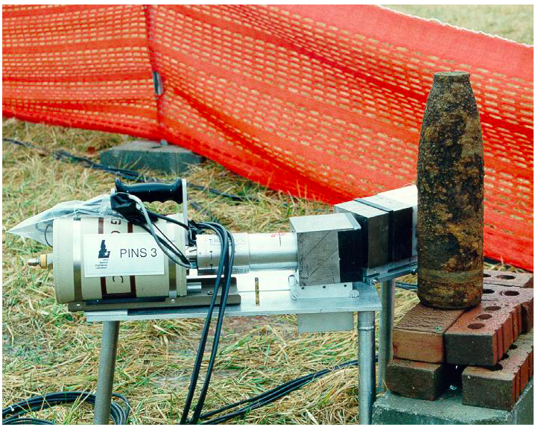
One approach is neutron induced gamma spectrometry (e.g., PINS)
What is the best measurement system?
Modeling a source, item, and detectors would be useful
Scope physics limitations – What gamma signatures are observable for a given measurement time?
Optimize system design parameters – How should the core system components be arranged given application constraints?
Develop analysis algorithms – What is the best algorithm for translating a detector signal to a useful quantity?
MCNP and Geant are popular radiation transport modeling tools but have limitations and some require improvements to ENDF libraries
INL PINS

Slide 20
Nuclear Data for Nuclear Arms Control

Slide 21
In FY19, a multi-laboratory study assessed modeling and nuclear data needs for active neutron interrogation and prompt gamma production
Summary of shortfalls in the ENDF libraries and modeling
Unavailability of multiplicities for photo production for many isotopes or several states of an isotope (e.g., no data for ¹⁴N)
Incomplete or inaccurate cross-section data
ENDF-6 format limitation of 40 excited states
Inability to adequately model excitations to the continuum of states and de-excitations to the ground state

Slide 22
Study recommendations
Update the gamma emission data in ENDF/B-VIII to be consistent with ENSDF to address missing discrete state data
Extend the Generalized Nuclear Database Structure (GNDS) to include the level density information and allow states to be embedded in the continuum to address the ENDF-6 limitation of 40 excited states
Develop a computationally practical event generator that can handle excitations to the continuum of states to address the inability to model correlations for sufficiently energetic neutron sources
Assess/correct existing or fill in missing cross-section and gamma emission data
Engage users to assess any improvement in the ability to model secondary gamma emissions

