Slide 1
Materials Characterization Core (MCC) User Overview: Physics NS&AT Meeting
Jason K. Smith – MCC Coordinator
PSD/MSTD

Slide 2
Introduction
ORNL Homepage → Index → Materials Characterization Core (MCC)
Access to instrumentation, experts, and collaborators.
MCC operationally has a large customer scope.
Essentially, it’s a calendar/scheduling system with lots of functionality.
Bulletin board, scheduling system, automatic cost recovery system
Flexibility for owner/custodian. Can set up the account based on the users needs.

Slide 3
Benefits of MCC
Instrument Directory.
List of equipment and details, points of contacts, RSS, locations, cost
Overview of available resources to customers and managers
Instrument owners COMPLETELY retain control
Who is permitted to use the instrument (calendar permissions control)
When the instrument is used by others
How the instrument is fiscally supported, maintained, shared…
Allow users to independently operate or allow custodian support
Shared Equipment
Not a requirement, but beneficial in certain situations
Group instruments related by type, process, or physical location

Slide 4
Operational Hierarchy
Instrument Management
Cost Recovery
Instrument Directory (Bulletin Board)
Instrument Scheduling
PSD/MSTD
28 resources in directory
Agilent iLab Software Platform
Categorized instrument list
Can record usage time, user, & charge account
Controls access to schedule
Reporting function

Slide 5
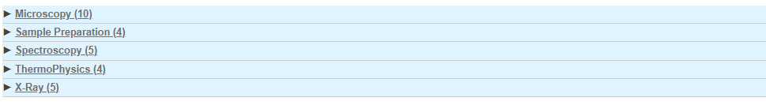
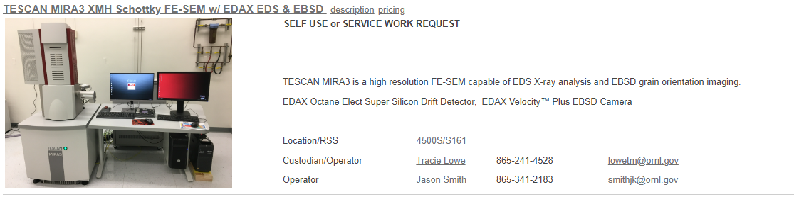
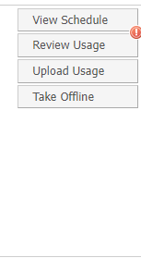
Categorized List of Instruments
Instrument Management
Cost Recovery
Instrument Directory (Bulletin Board)
Instrument Scheduling
contacts, capabilities, links to location and RSS.

Slide 6
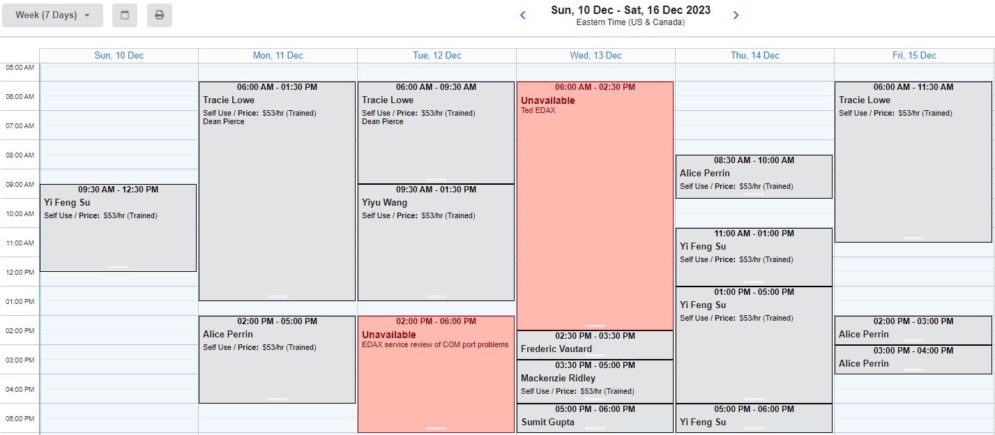
Instrument Scheduling
Instrument Management
Cost Recovery
Instrument Directory (Bulletin Board)
Instrument Scheduling
Draw box on the calendar for the desired time.
User’s charge number is entered.
Service can be scheduled and noted on the calendar.

Slide 7
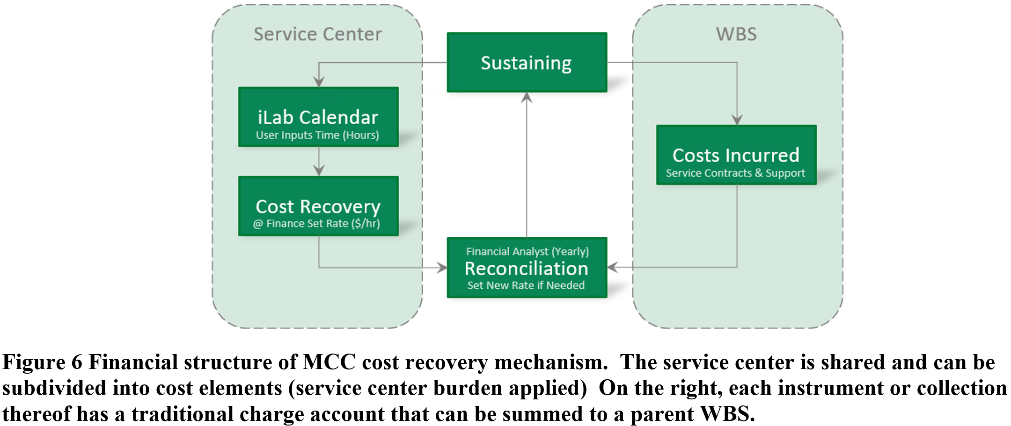
Cost Recovery
Instrument Management
Cost Recovery
Instrument Directory (Bulletin Board)
Instrument Scheduling
Service Center
WBS Ops Costs
Service contracts, consumables, time to keep instrument operational, PM, etc.
Recovered Costs
Scheduled hours x rate
Set by financial analyst
SC burden rate!
>20% Shared Saves $

Slide 8
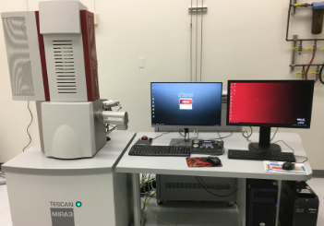
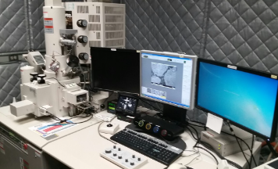
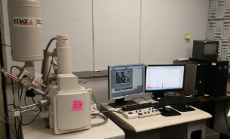
Instrument Management
Instrument Management
Cost Recovery
Instrument Directory (Bulletin Board)
Instrument Scheduling
Fully Shared Systems
No central PI, some LDRD systems
Custodian supported
Training and user feedback
Service contracts, service visits
Managing costs, repairs, upgrades

Slide 9
Shared Instrumentation Benefits
Prevents duplication
Costs/time associated with purchasing, contracts, approvals, crafts, space, opportunity cost, etc.
Service contracts typically, 10% of the instrument cost, but necessary.
Charge recovery lessens financial burden of the operator if shared >20%
Service center data is an official record of use

Slide 10
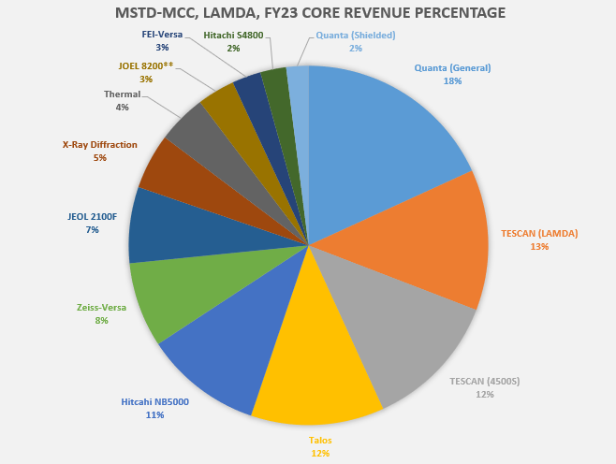
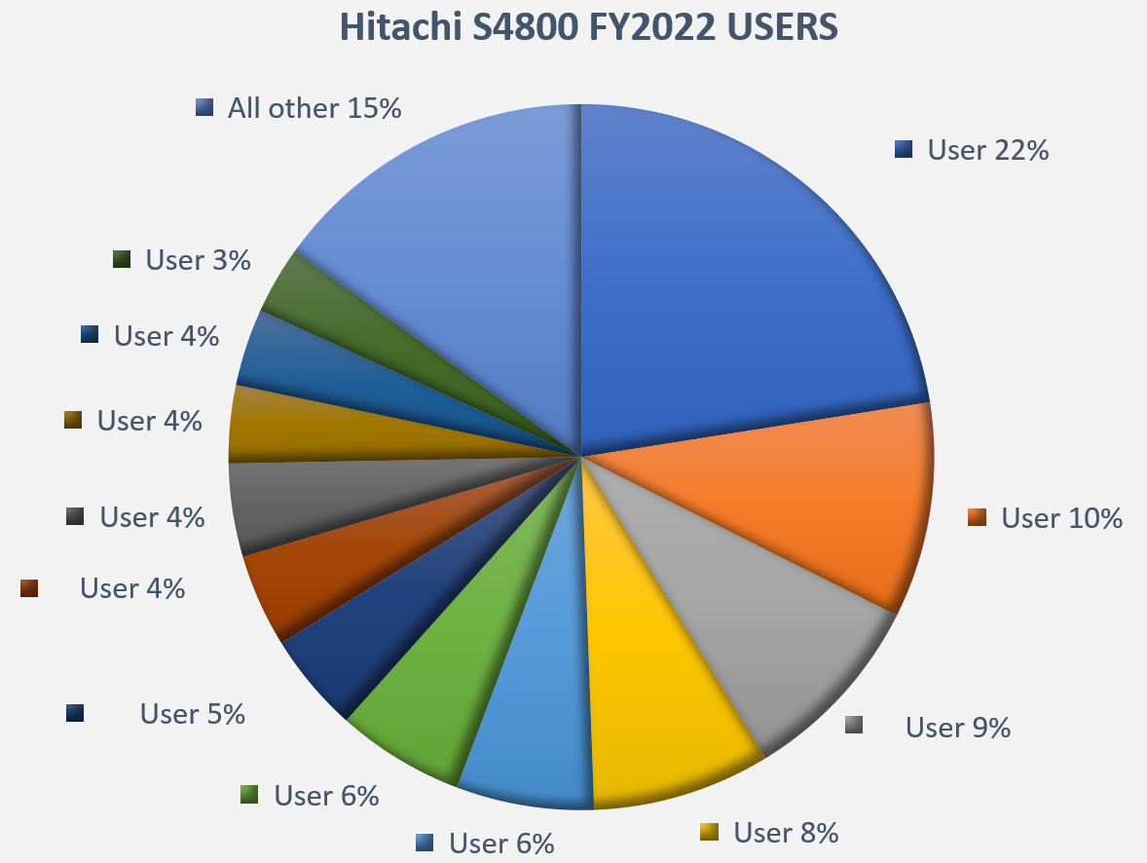
iLab Reporting
Versatile report functions
For example, core revenue and user distribution.

Slide 11
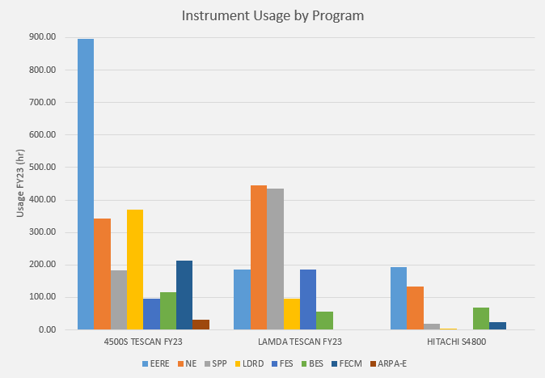
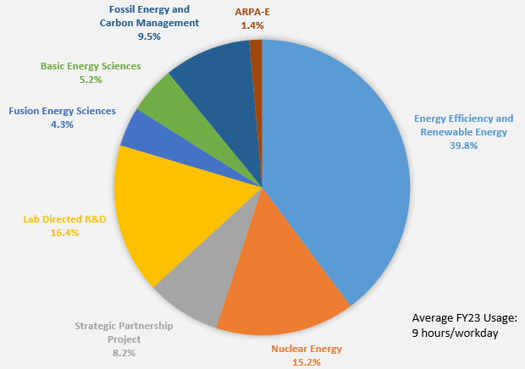
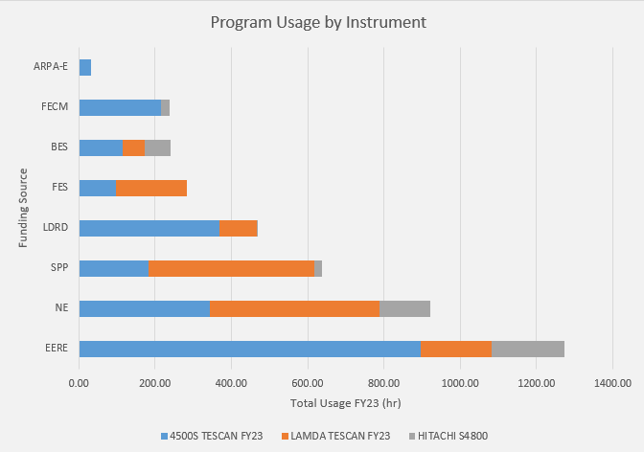
Reporting – Combining iLab and SAP Metadata

Slide 12
MCC Live View
Once an MCC/iLab account is active:
https://ornl.corefacilities.org/service_center/show_external/4236

Slide 13

Discussion

Slide 14
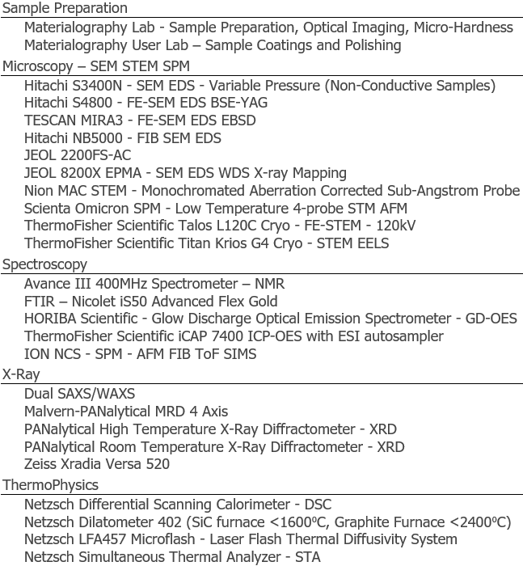
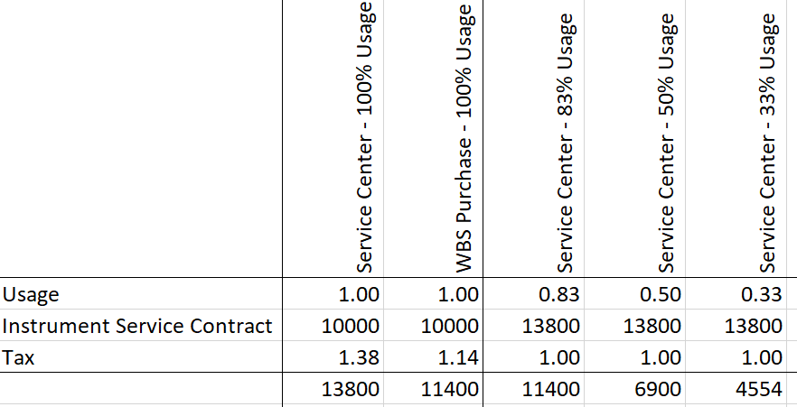
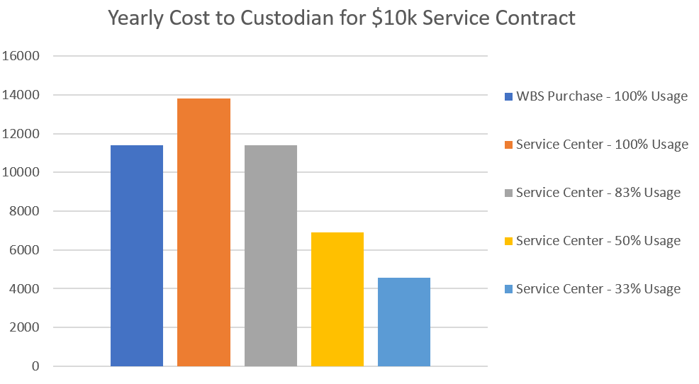

Slide 15
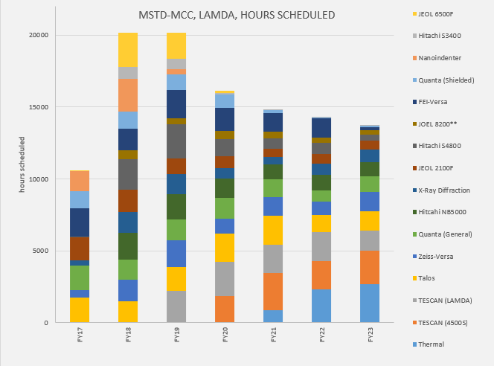
Reporting Continued

Slide 16
