Slide 1
Coded-Aperture Gamma Ray Image Reconstruction via Linear Regression
Jacob Daughhetee
September 6th, 2024

Slide 2
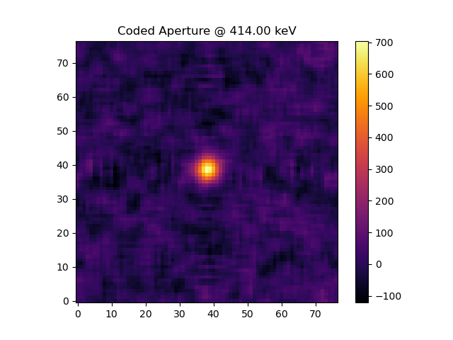
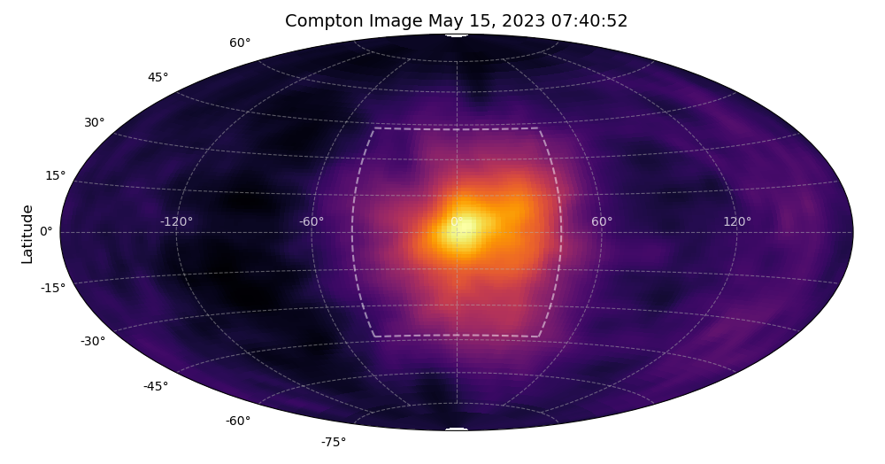
Gamma Imaging Methods
Pinhole (< 800 keV)
Pair-production Tracking ( > 1 MeV)
Imaging Atmospheric Cherenkov Technique ( 50 GeV - 50 TeV)
Coded Aperture (< 800 keV)
Compton Scattering ( 200 keV -> few MeV)

Slide 3
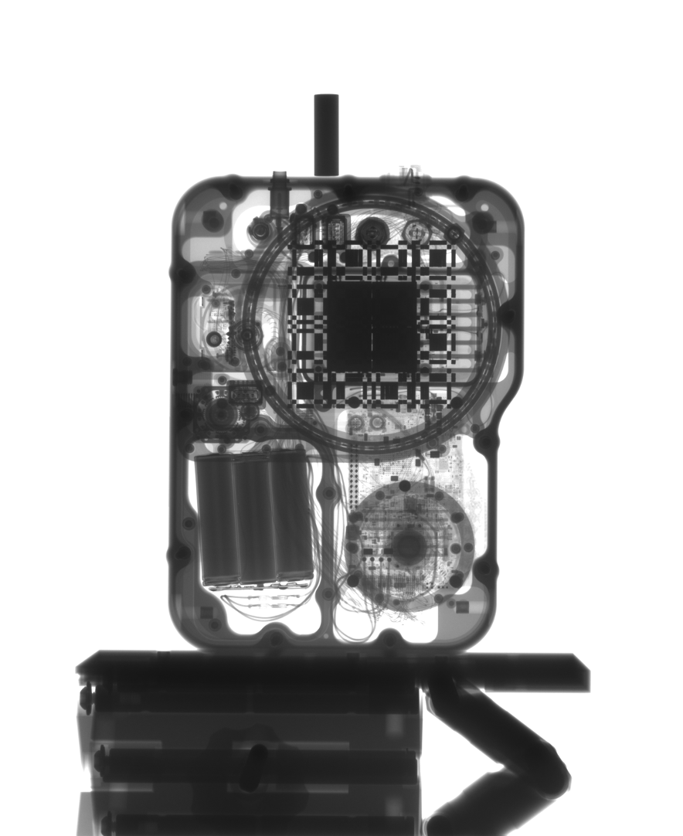
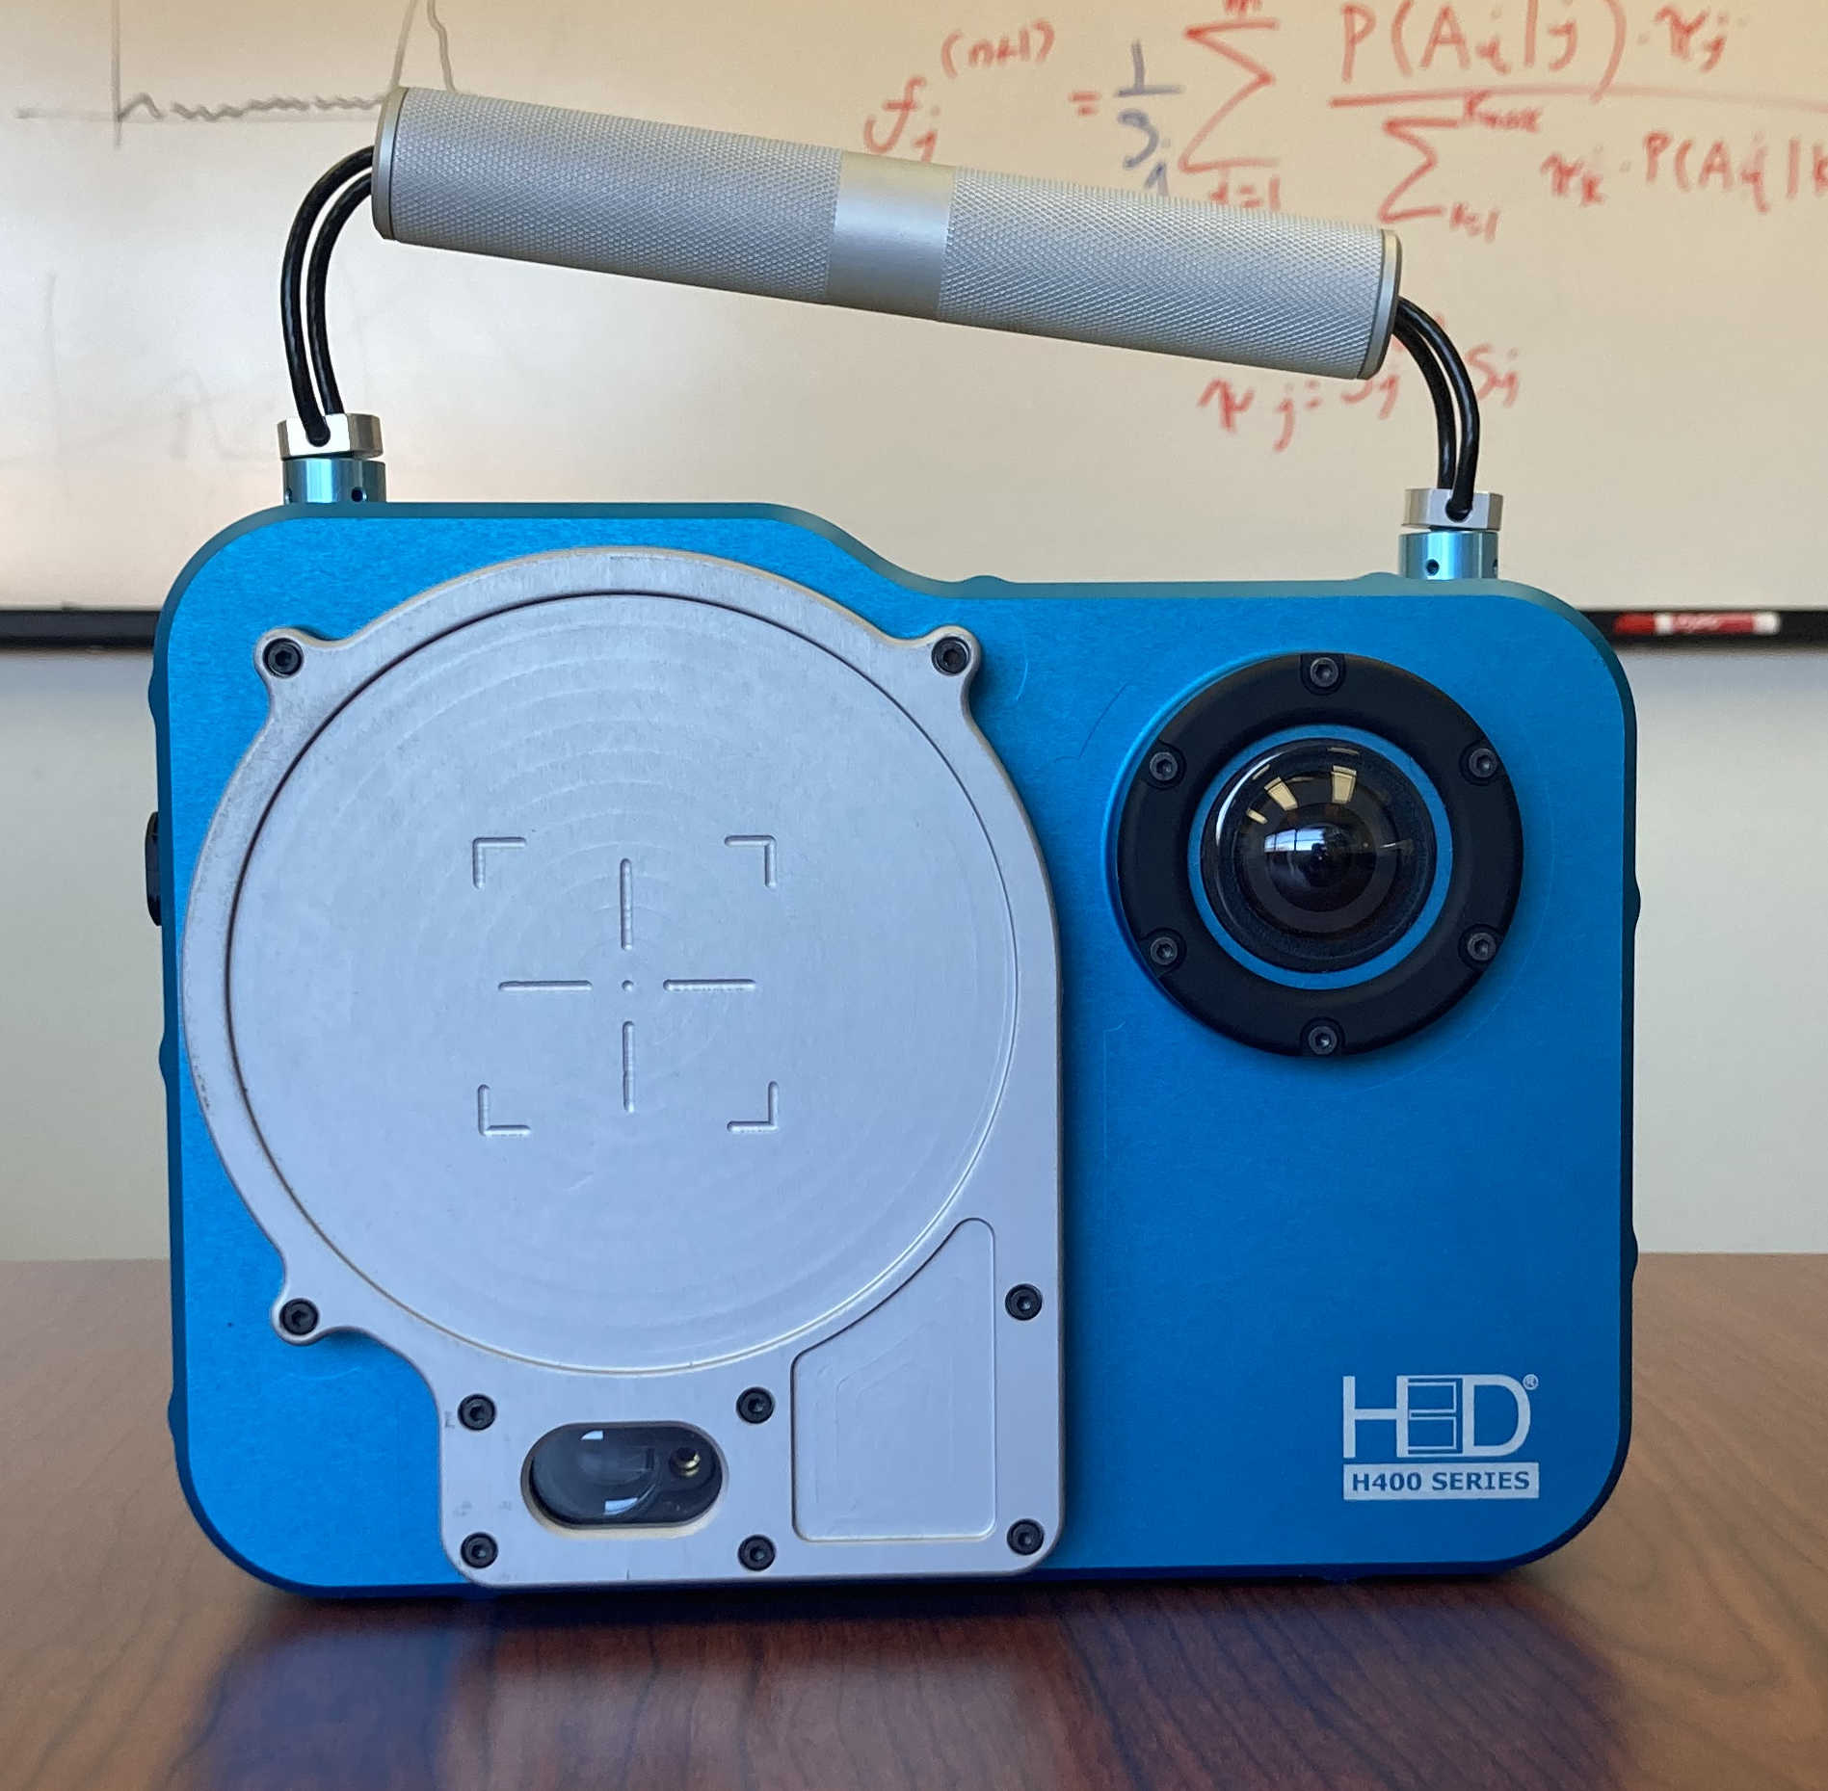
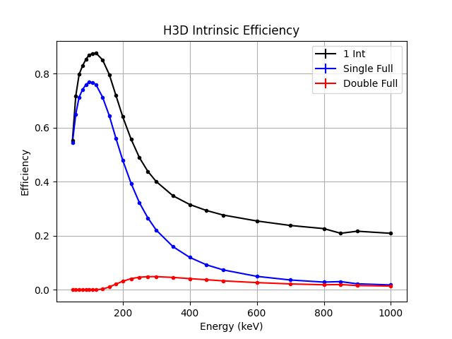
H3D CZT Imager
H420 imager capable of coded-ap and Compton imaging.
Detection element: 4 CZT crystals (2.2 x 2.2 x 1 cm).
All the following image examples and tests use either real or simulated data for this imager.
Method is applicable to any system though!

Slide 4
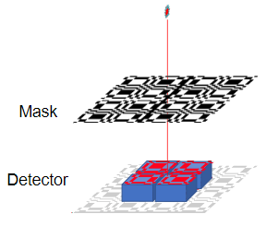
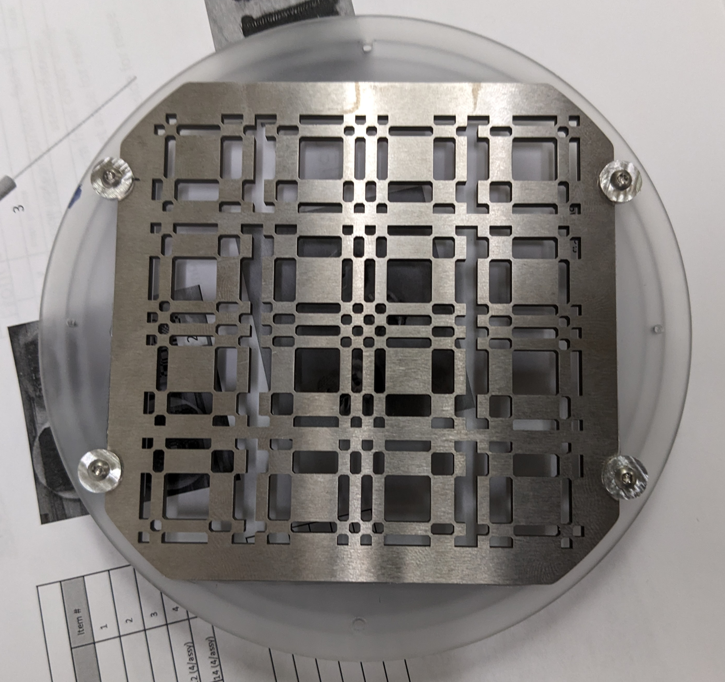
Conventional Technique
Coded aperture mask casts shadow onto position sensitive detector
Mask pattern designed to auto-correlate to a delta function
Simple cross-correlation produces image
Challenges:
  Imperfect detector behavior introduces artifacts
  Imaging efficiency changes across the field of view
  Energy dependent effects, such as depth of interaction, change the focal length – degrades the image without use of more complicated analysis.

Slide 5
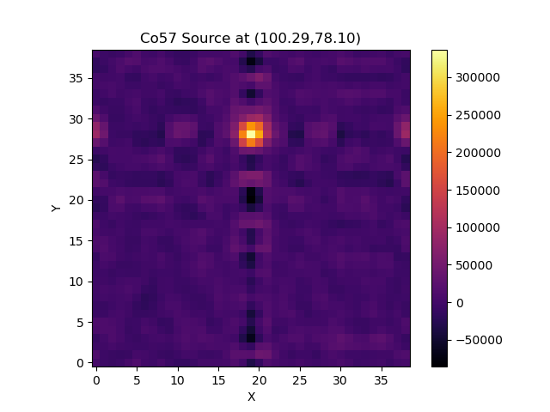
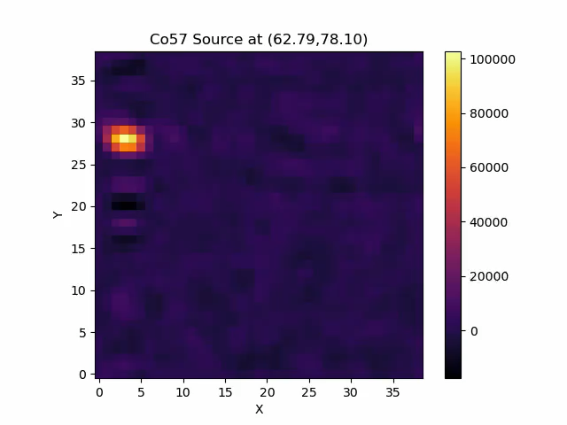
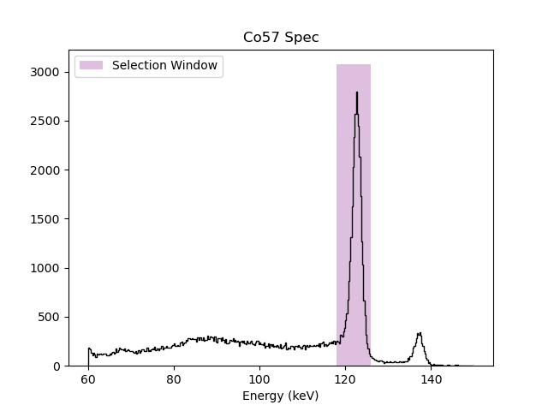
Calibration Point Source
X
Co57 calibration source is scanned across the field of view of the detector at a distance of 1 meter.
These calibrations are necessary for understanding the imaging efficiency as a function of location within the FOV.
Image created using event selection about the 122 keV peak.
Activity: 283.5 uCi
Y

Slide 6

Iterative Reconstruction
Iterative reconstruction seeks to reproduce the observed data using a combination of precalculated detector responses. It assumes the following:
  We can predict what the shadow pattern on the detector will look like for any arbitrary location in the field of view (via ray tracing or MC).
  A basis set of possible patterns can be constructed that represents some volume in the FOV.
  Any measured detector pattern can be described by some linear combination of the predicted patterns in the constructed basis set.

Slide 7
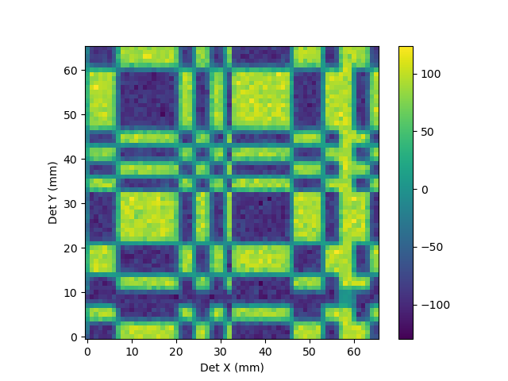
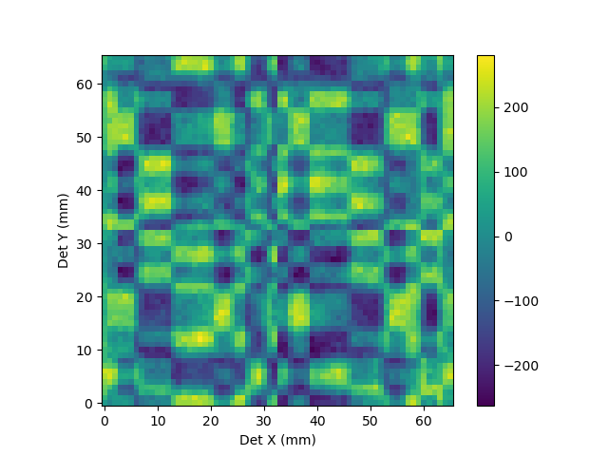
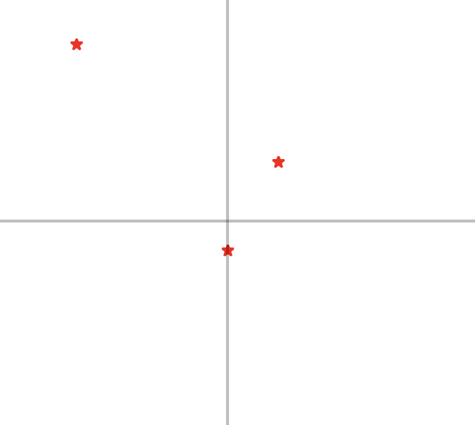
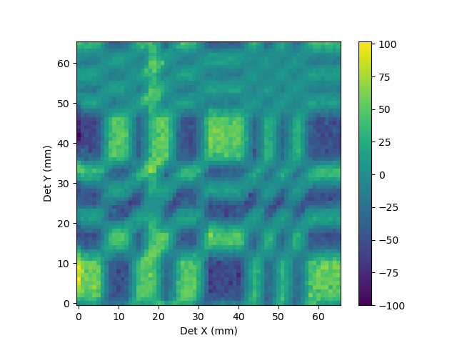
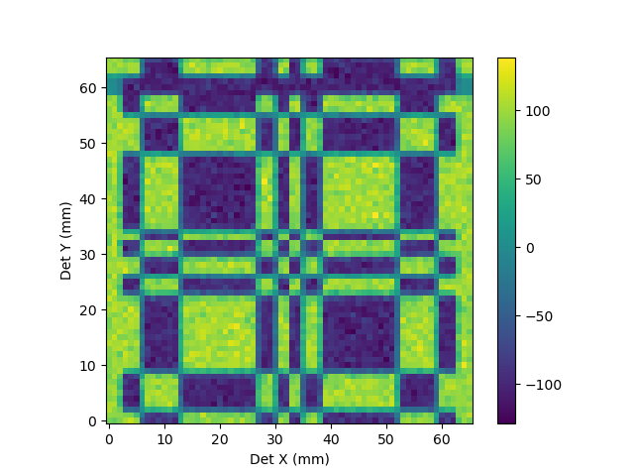

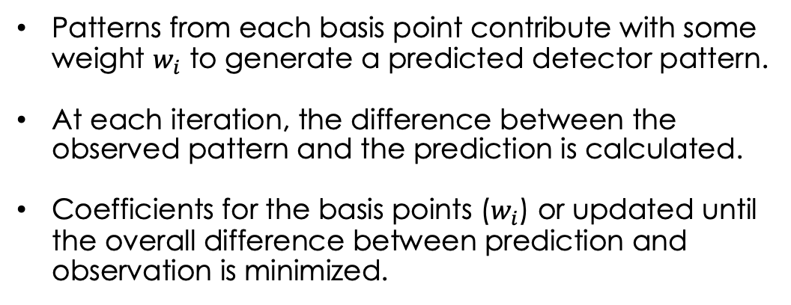
Iterative Reconstruction
$$1+2+3$$
2
1
3
Imager POV
Patterns from each basis point contribute with some weight $w_{i}$ to generate a predicted detector pattern.
At each iteration, the difference between the observed pattern and the prediction is calculated.
Coefficients for the basis points ($w_{i}$) or updated until the overall difference between prediction and observation is minimized.

Slide 8
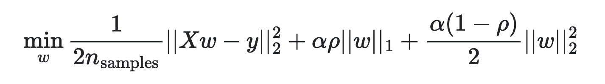
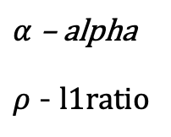
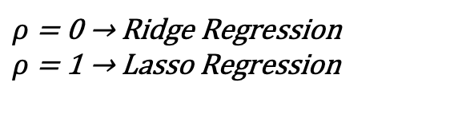
Elastic Net Model
$α$ – alpha
$ρ$ - l1ratio
L1 Norm (Sparsity)
Hou Zou and Trevor Hastie (2005)
Ordinary Least Squares
L2 Norm (Collinearity)
Elastic net uses two regularization terms to overcome issues that can commonly arise with OLS regression.
The L1 term seeks to keep the overall scale of the coefficients low (therefore concentrating on the most relevant).
The L2 term helps with feature selection and equal weighting to highly correlated predictors.
$ρ$ = 0 → Ridge Regression
$ρ$ = 1 → Lasso Regression

Slide 9
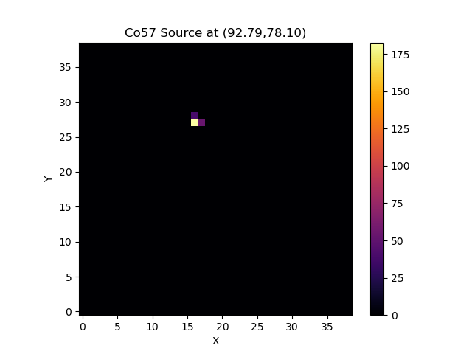
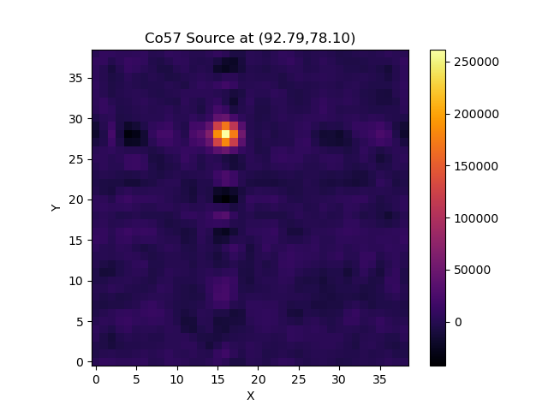
Calibration Point Source – LR Fit
Fit Activity: 276.6 uCi

Slide 10
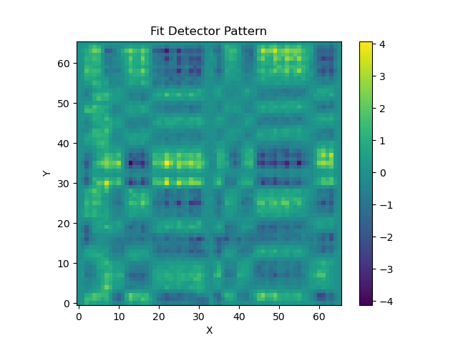
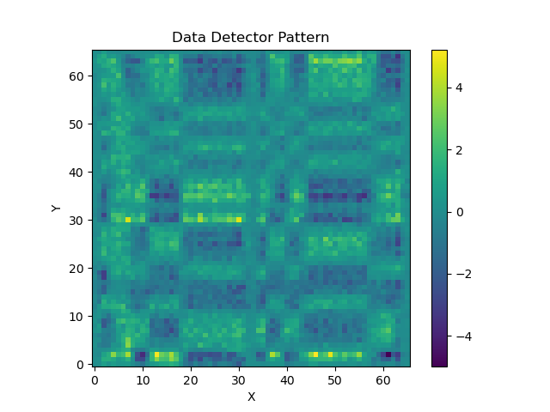
Calibration Point Source – LR Fit
Simulation Basis Fit
Data

Slide 11
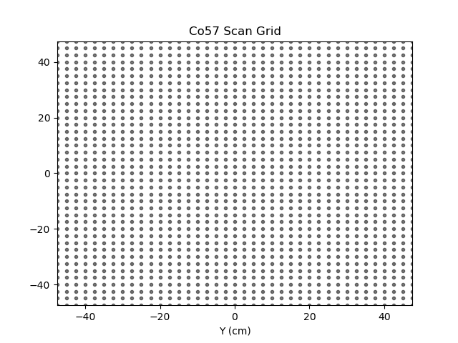
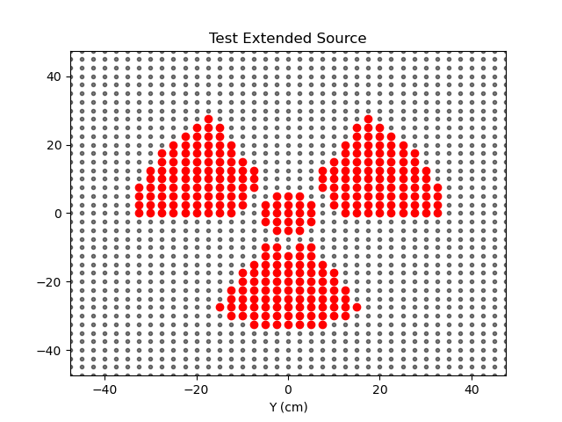
Extended Source Test
Point sources are easy – let’s try something a little more challenging.
Some extended sources are available, but creating a pseudo-extended source is easier!
Combine multiple datasets from the Co57 scan to emulate an extended source.

Slide 12
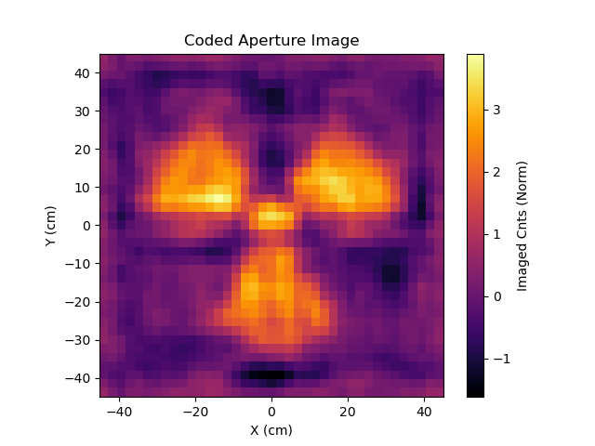
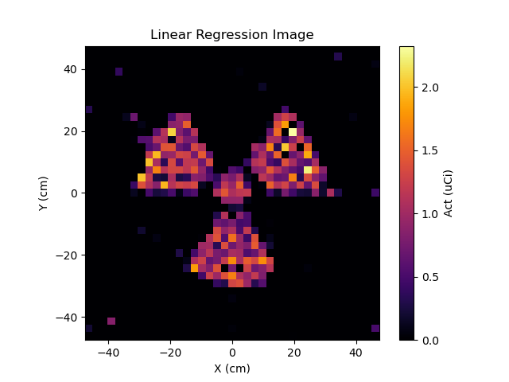
Extended Source Test
Fit Activity: 251.72 uCi
True: 283.5 uCi

Slide 13
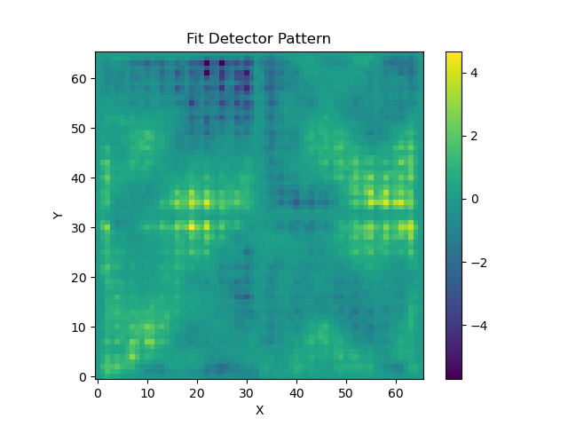
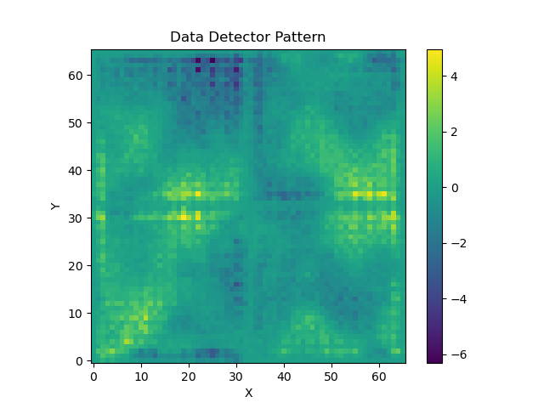
Calibration Point Source – LR Fit
Simulation Basis Fit
Data

Slide 14
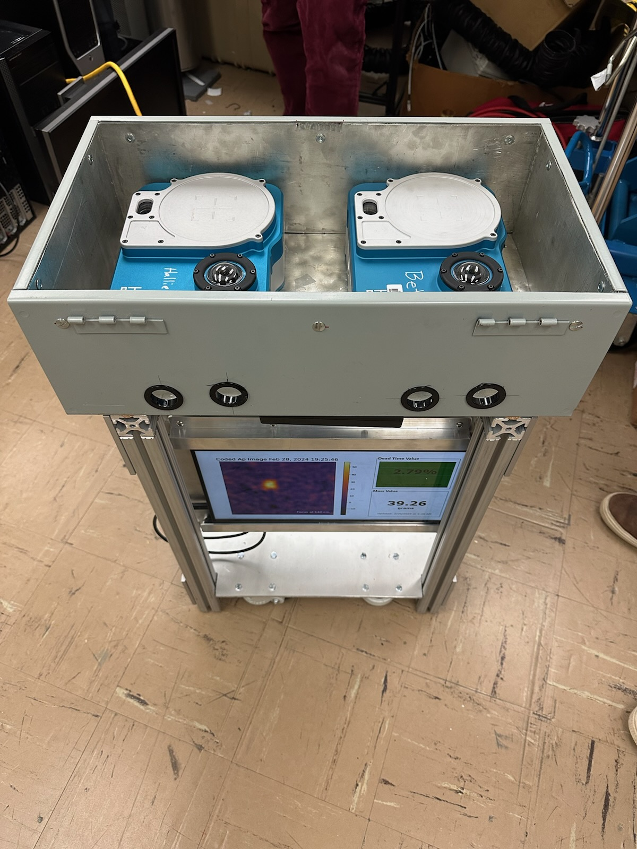
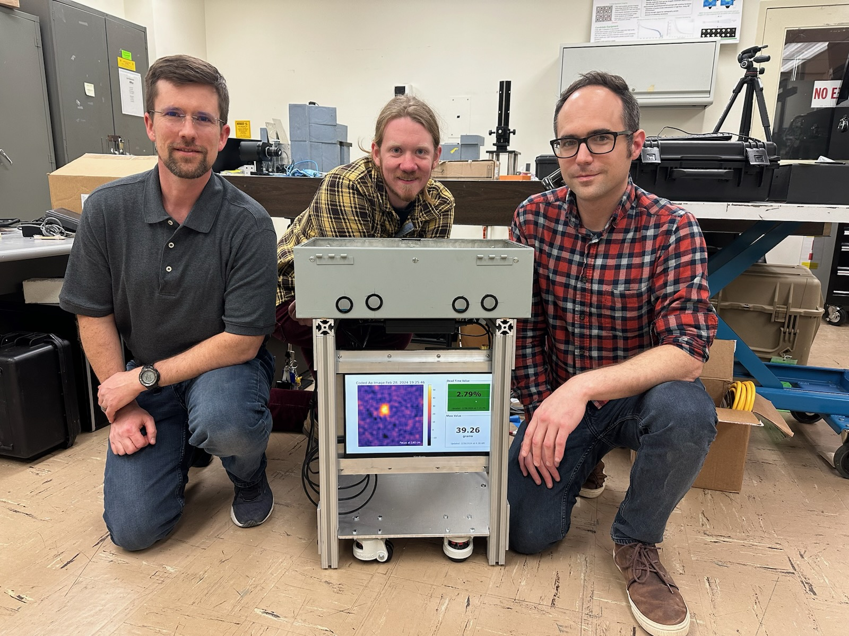
(Near) Real-time Imager Deployment at SRS
March 2024 presented another deployment opportunity – a chance to test prototype ideas!
New imaging system features two H3D imagers allowing for better 3D reconstruction.
Connected computer reads streaming data from one of the imagers and generates coded-aperture images every 15 minutes.
Filter mass estimate is obtained by looking at the imaged spectrum for recent runs meeting specific criteria.
14
Contributors not pictured:
Keith Vaigneur , Janice Romasco, Klaus Ziock, Tim Aucott, Tad Whiteside, Dawn Dhom

Slide 15
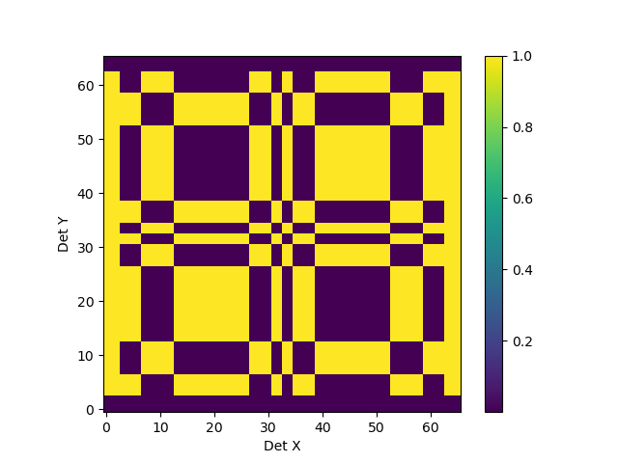
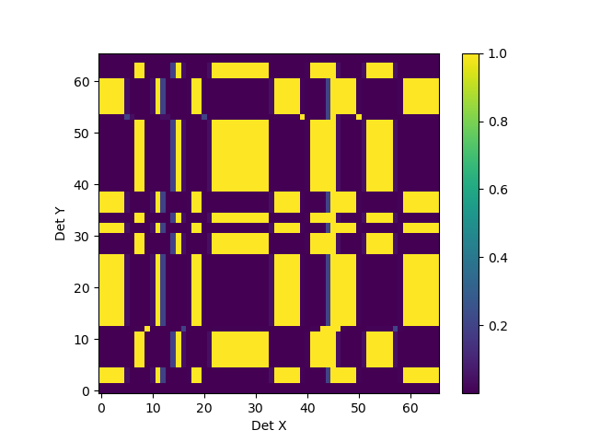
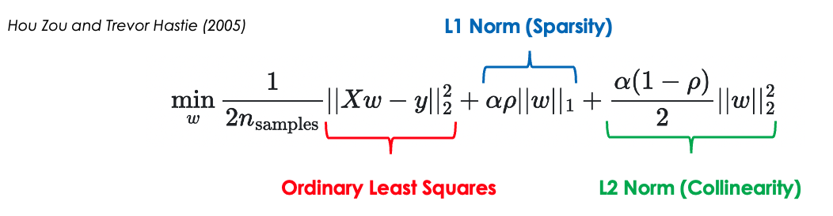
Iterative Reconstruction
Image analysis is relatively straightforward, but it requires an assumed image plane.
Unable to disentangle activity on the filter and activity on the glovebox floor along the line of sight.
Instead of generating an image, methods such as MLEM or linear regression attempt to find a source distribution that reconstructs the observed detector pattern.
Compare the observed Mask-Anti data to a set of simulations. Find the combination of simulated source points that best matches the data.
Filter
Simulated Mask Patterns
Glove Box Floor
Create a basis set of consisting hit patterns for an array of sources at 40 cm and at 140 cm

Slide 16
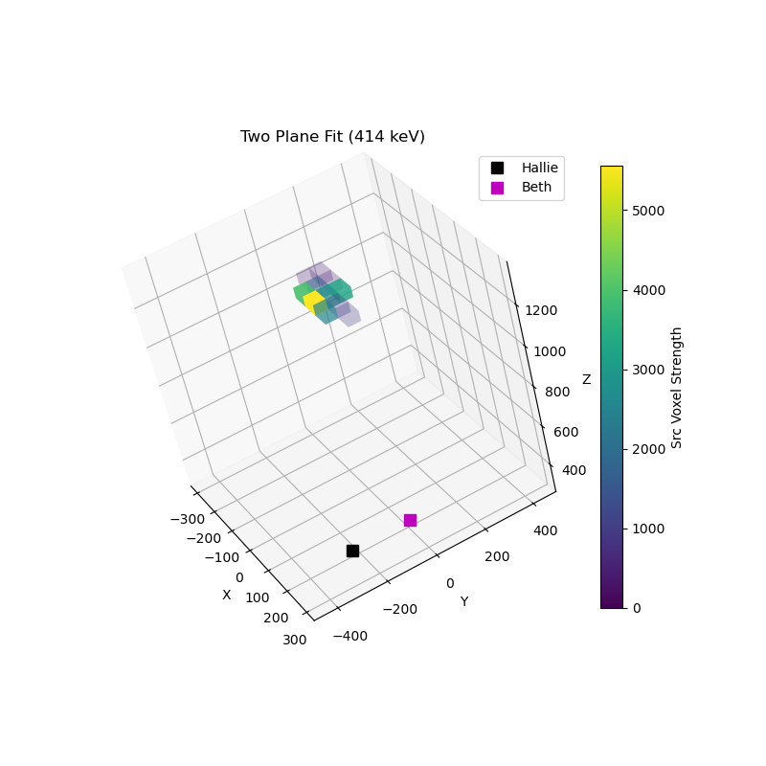
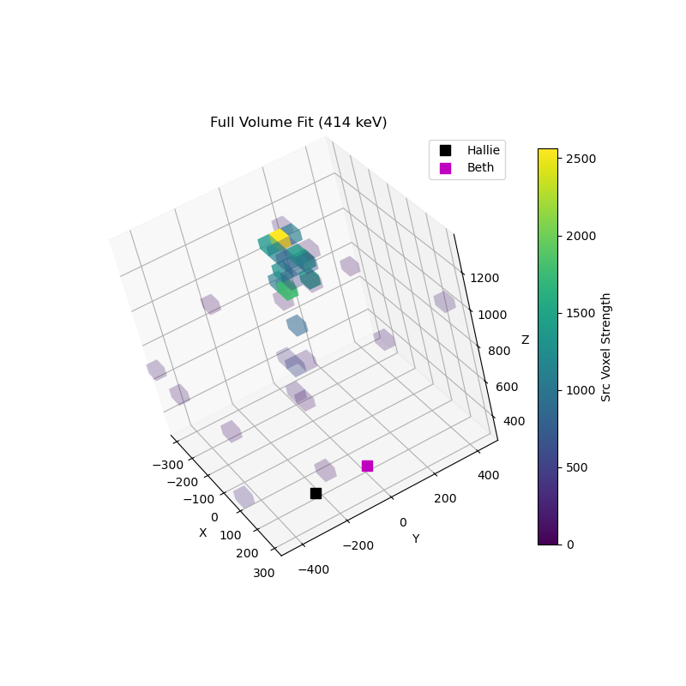
Iterative Reconstruction

Slide 17
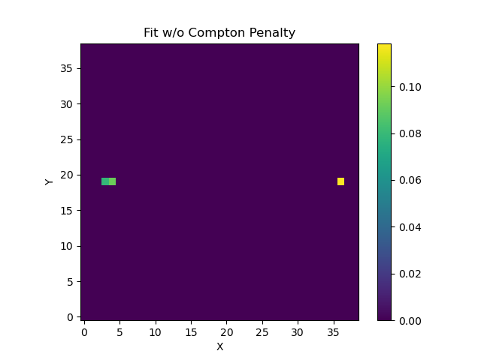
Integrating Compton Info into Linear Regression
Previous musings on how to incorporate Compton information into iterative fits assumed binned Compton map as additional data to be fit.
What if the Compton image is used as a penalty term:
True Source Location
+ wC
Ba133 Source – 356 keV
Penalty term formed by taking product of basis point weights (w) and and most closely aligned pixel in Compton image.

Slide 18
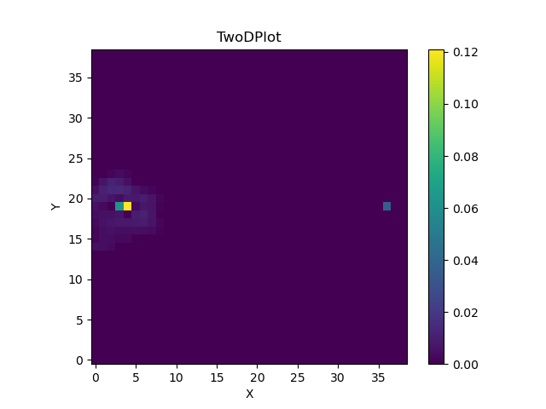
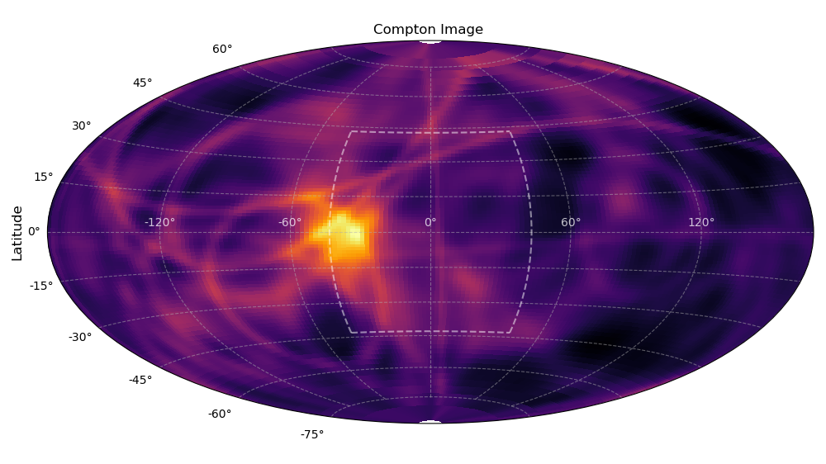
Integrating Compton Info into Linear Regression
True Source Location
Ba133 Source – 356 keV

Slide 19
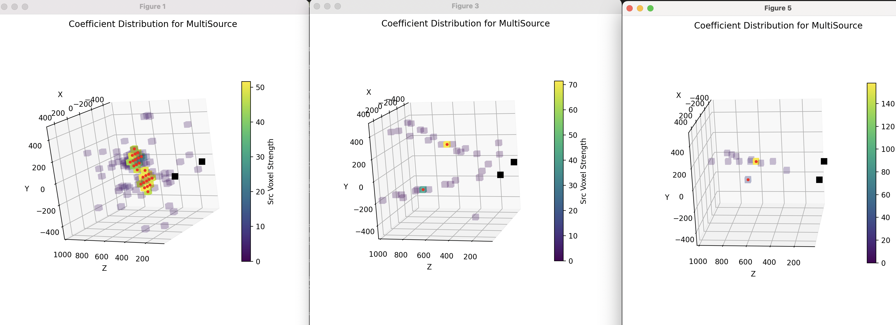
Status
Image reconstruction via linear regression works rather well and provides a straight-forward path for integrating data from multiple imagers.
Full 3d scene reconstruction is possible with multiple imagers, thorough testing of ability to properly normalize results still needed.
Significant interest in this technique for holdup measurements and 3D scene reconstructions.

