Slide 1
Update on impact of a 3mT offset
Leah Broussard, Frank Gonzalez, Cary Rock
8/8/2024

Slide 2
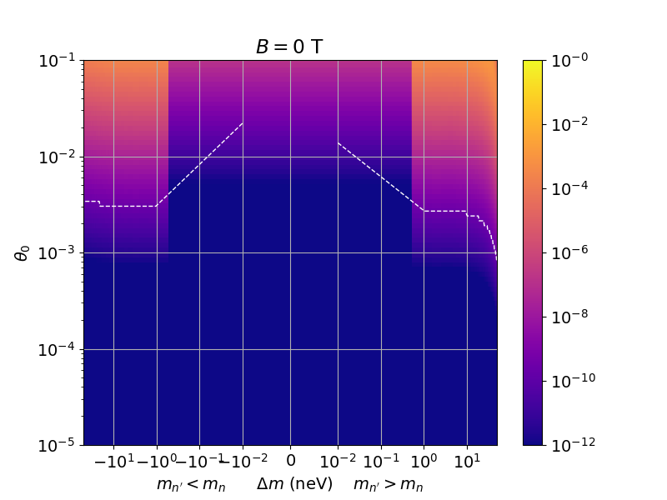
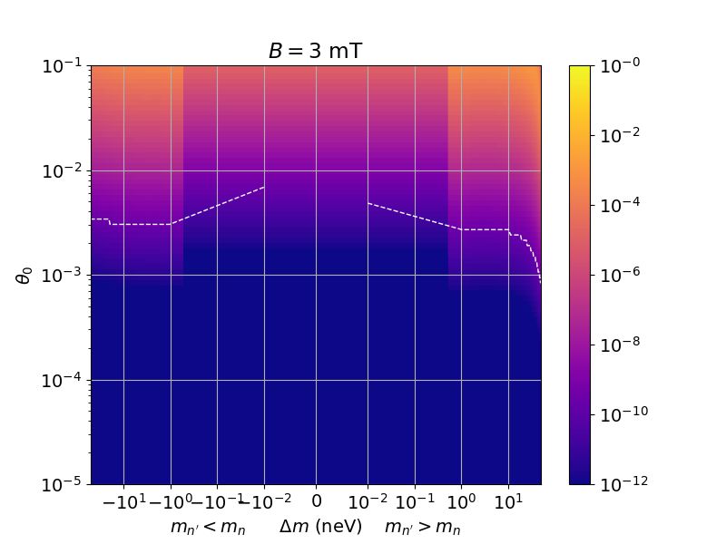
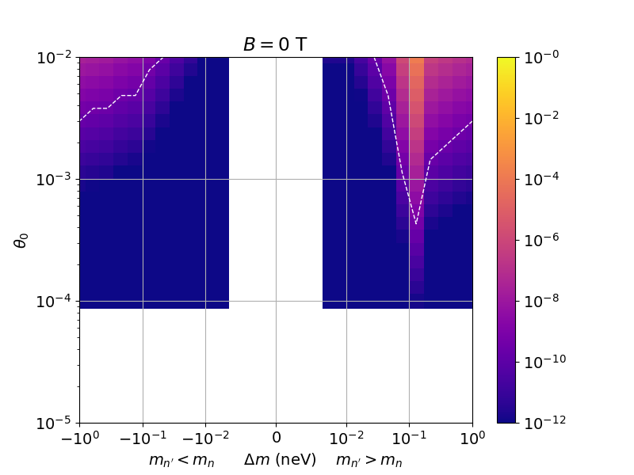

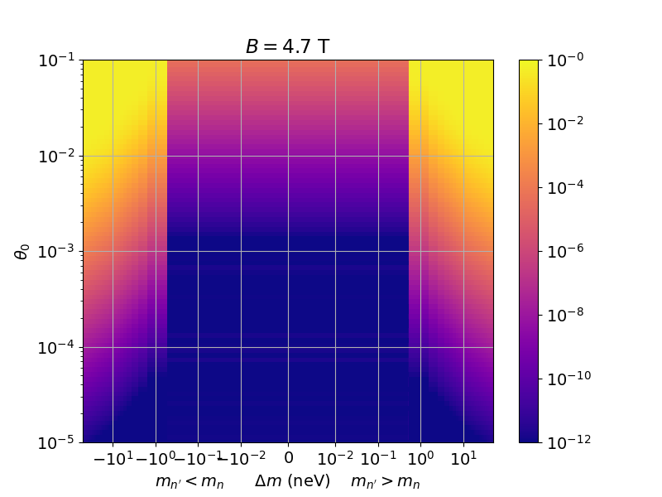
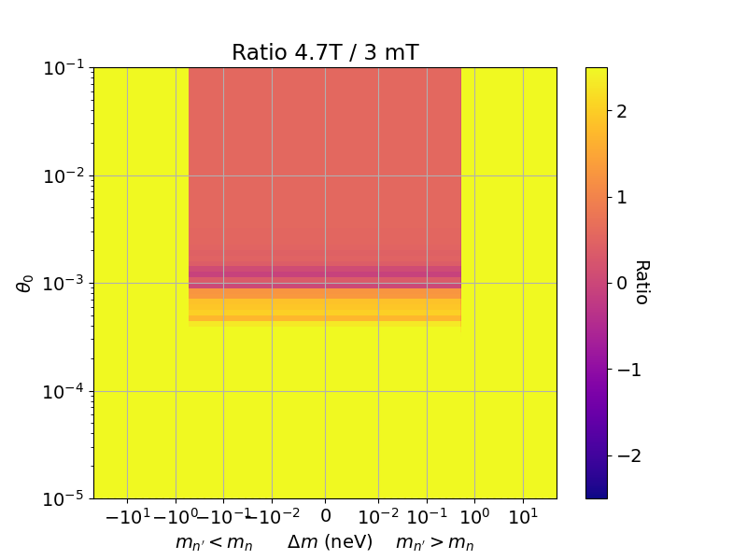
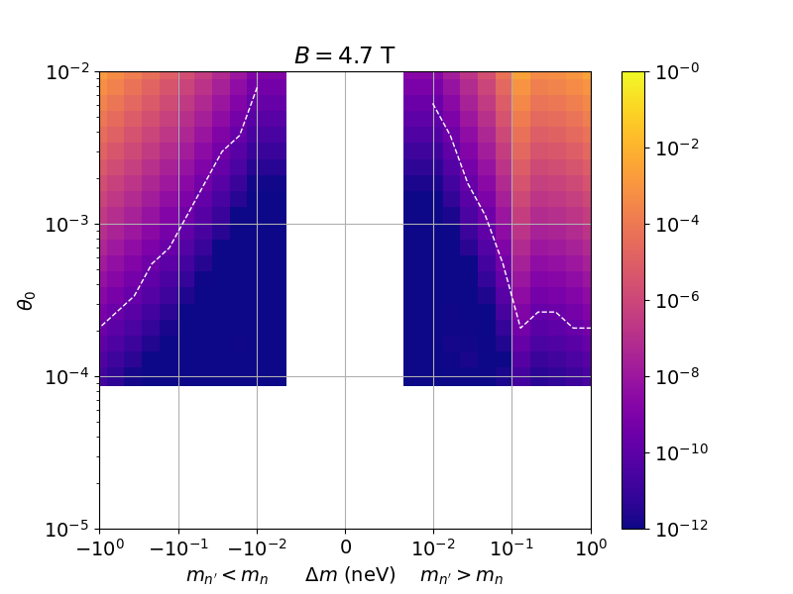
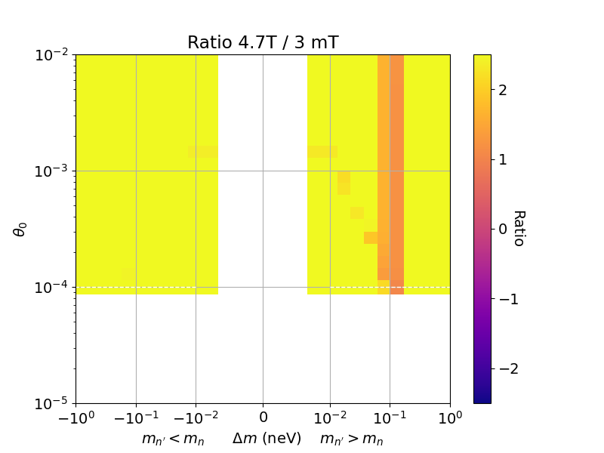
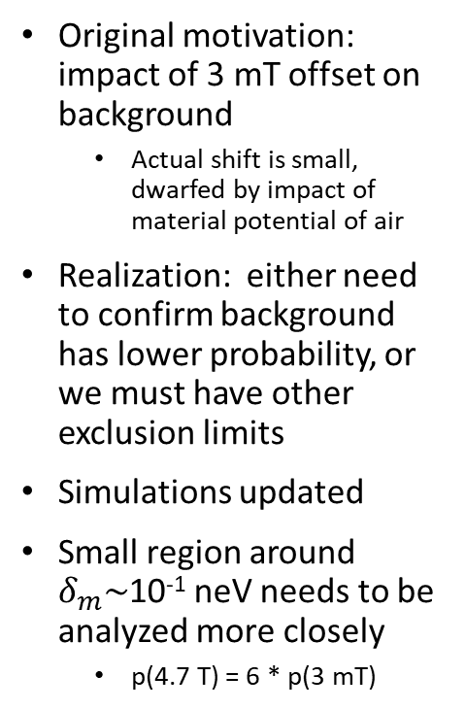
Update
Ruled out by other expts
Ruled out by other expts
Original motivation: impact of 3 mT offset on background
  Actual shift is small, dwarfed by impact of material potential of air
Realization: either need to confirm background has lower probability, or we must have other exclusion limits
Simulations updated
Small region around
$δ_{m}\sim$10⁻¹ neV needs to be analyzed more closely
  p(4.7 T) = 6 * p(3 mT)
Ruled out by other expts
Ruled out by other expts
Below our sensitivity

