Slide 1
Impact of a 3mT offset
Leah Broussard, Frank Gonzalez, Cary Rock
7/31/2024

Slide 2
3 mT offset
When we mapped the magnetic field, we observed a 3 mT residual field after performing ramps but when the magnet was ramped to nominal 0 T.
What is the impact?
  Effect of 3 mT shift on 2.5 T or 5 T is obviously small (smaller than our magnetic field measurement uncertainty)
  Main impact is likely on our background run
  Because our lower limit is ~1 mT, there could be an effect between 1 mT and 3 mT (blue boxes)

Slide 3
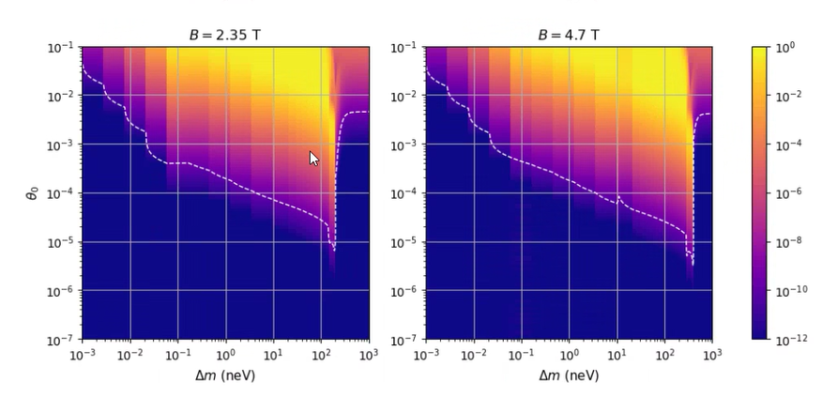
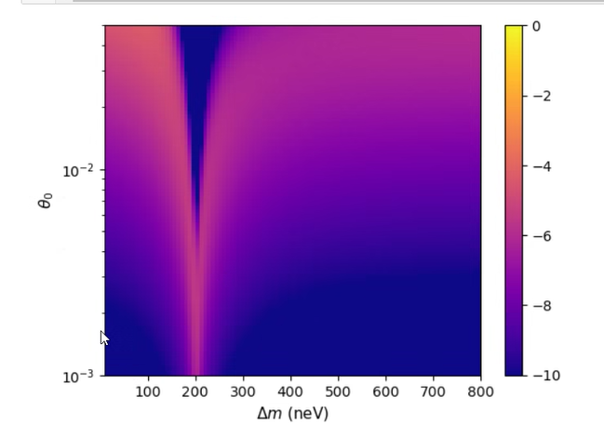
A side-note on our assumptions
We use B=2.35 T / 4.7 T as “signal” and B=0 T as “background”.
This is valid ONLY:
  Where the probability p(B=0) << p(B=4.7)
  If other experiments rule out that parameter space (discussed later)
Regarding point 1
  Our sensitivity is reduced as p(B=0) approaches p(B=4.7) and vanishes if p(B=0) = p(B=4.7)
  p(B=0) << p(B=4.7) is “obvious” in the Landau-Zener regions (pink << yellow)
Note, this is actually boron carbide, but it’s what I had handy)

Slide 4
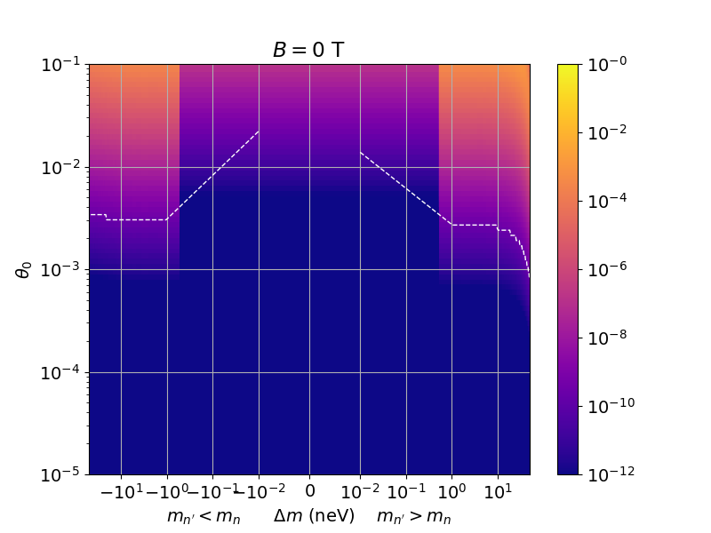
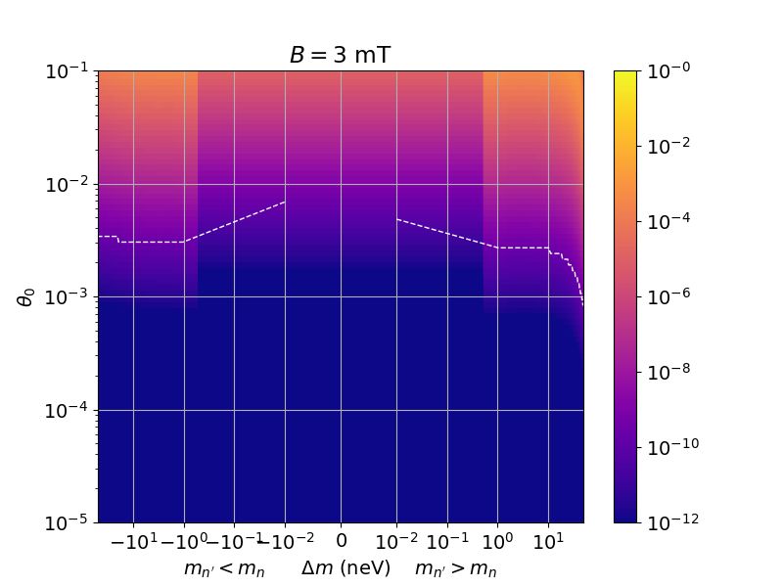
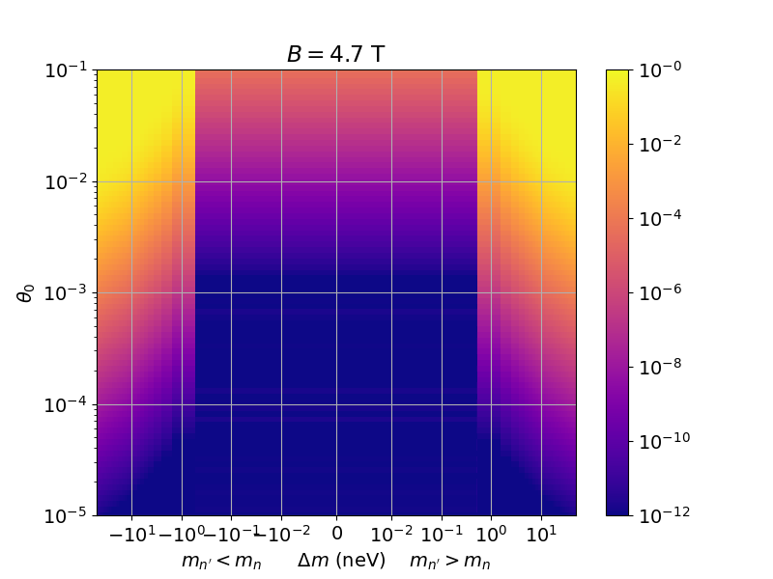
Point 1 illustration
Comparison of 0 T, 3 mT, and 4.7 T
  NOTE: We have since found an important error in the simulation, but the below illustrates our concern
The p(B=3 mT) << p(B=4.7 T) criteria is clearly not met below 1 neV
Note: we do see a Landau-Zener spike at 3mT. If we flip 3mT = signal and 4.7T = background, this actually enhances our sensitivity in that regime. I propose to neglect that improvement as the 3 mT is not well-studied.

Slide 5
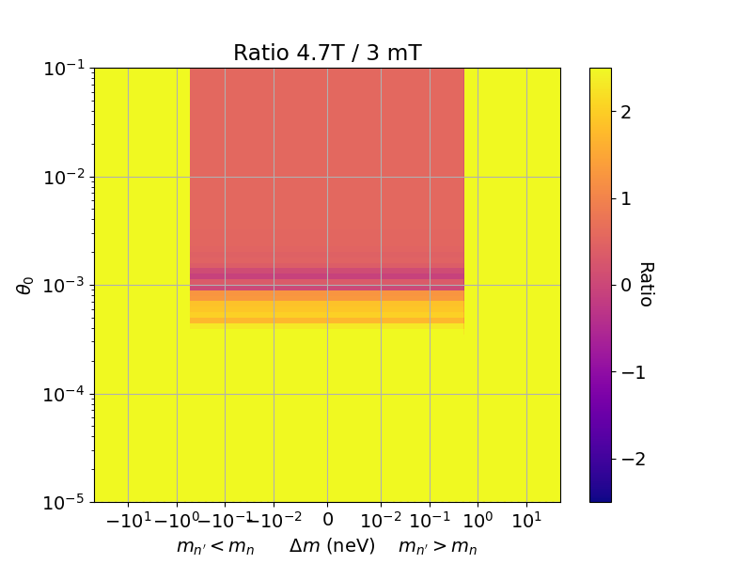
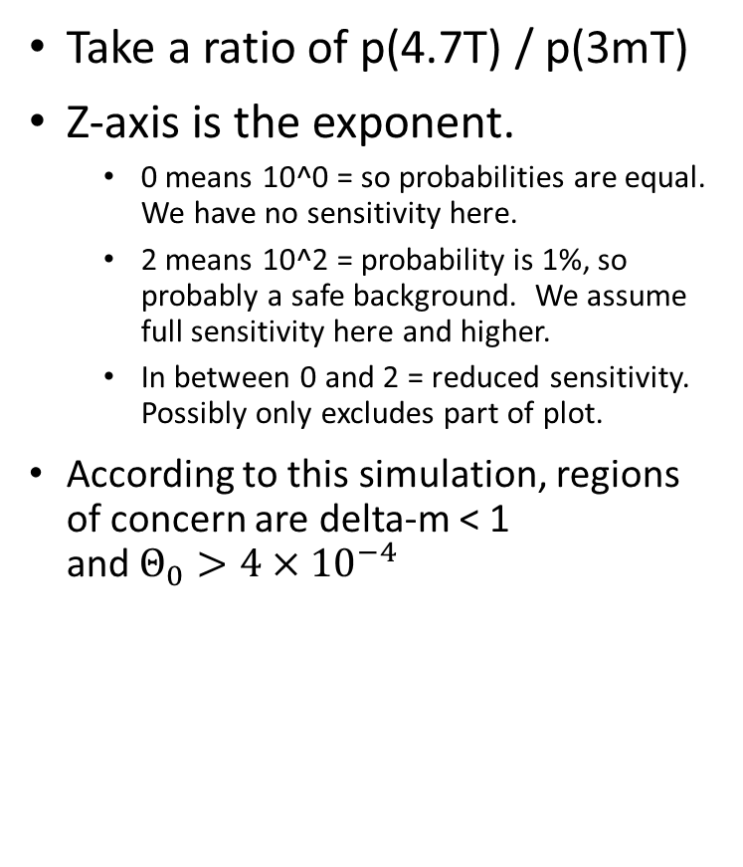
Point 1 illustration (based on incorrect simulation)
Take a ratio of p(4.7T) / p(3mT)
Z-axis is the exponent.
  0 means 10^0 = so probabilities are equal. We have no sensitivity here.
  2 means 10^2 = probability is 1%, so probably a safe background. We assume full sensitivity here and higher.
  In between 0 and 2 = reduced sensitivity. Possibly only excludes part of plot.
According to this simulation, regions of concern are delta-m < 1
and $Θ_{0}>{4×10}^{−4}$

Slide 6
Point 2: Using other experiments to confirm we have a good background run
Note this is all by eye and needs a real analysis
Example: 0.06 neV
  2θ² < 10⁻⁵ is ruled out, or θ<2 x10⁻³(top plot)
  This corresponds to max transmission < 10⁻¹⁰ (bottom plot)
  Our intensity is ~10⁹ n/C, so this means an extra ~0.1 n/C in our “background” run
  Our background is = 44 +- 0.7 n/C → so 0.1 n/C is not detectable, and we have a safe background
Example: 0.2 neV
  2θ² < 10⁻⁴ is ruled out, or θ<7 x10⁻³ (top plot)
  This corresponds to max transmission of ~ 10⁻⁸ (bottom plot)
  Our intensity is ~10⁹ n/C, so this means an extra ~10 n/C in our “background” run
  Our background is = 44 +- 0.7 n/C → so 10 n/C IS detectable, and we do NOT have a safe background
    Pulling in accurate numbers is important here

Slide 7
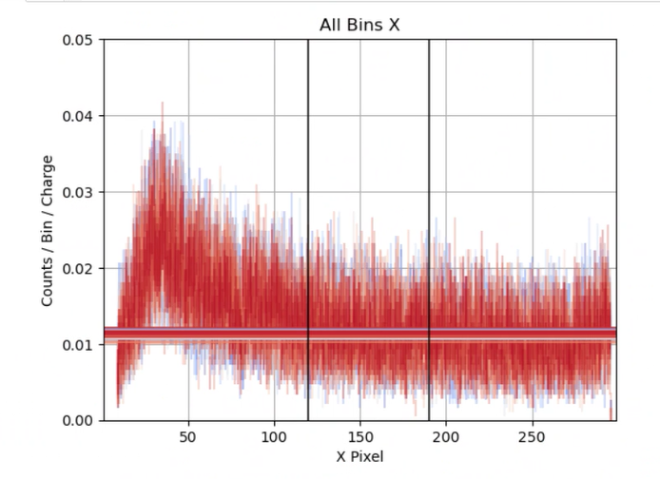
Other possible resolutions
Investigate actual reduced sensitivity:
  Effect = Signal – Background ➔ Effect = Signal – p * Signal (p = probability for effect in “Background” run)
  Sensitivity is reduced because we have less discriminating power
Take sensitivity by comparing rate in ROI to rate outside ROI
  Frank has done this and slightly overestimates the background. How to quantify uncertainty with an obvious bias?
  Measured background = 44.9±0.7; fit background = 47.9
Accept the reduced sensitivity limits
ROI

