Slide 1
A Real-time Solution for Fast-neutron Spectroscopy
Project Number: OR24-ML-ProtonRecoilNeutronSpec-PD2Jb
James Till Matta
Lorenzo Fabris
Jason T. Nattress
Tyler Borgwardt
Michael Febbraro
Juan J. Manfredi

Slide 2
Goals and Objectives
Handheld neutron spectrometer
Efficient enough for useful spectrum after 5 min at 1m from a 10⁶ n/s source
Low SWaP for long battery life and easy deployment
Stretch: Automatic coarse source identification
  SF, ⁹Be(𝛼,n), D+T, etc

Slide 3
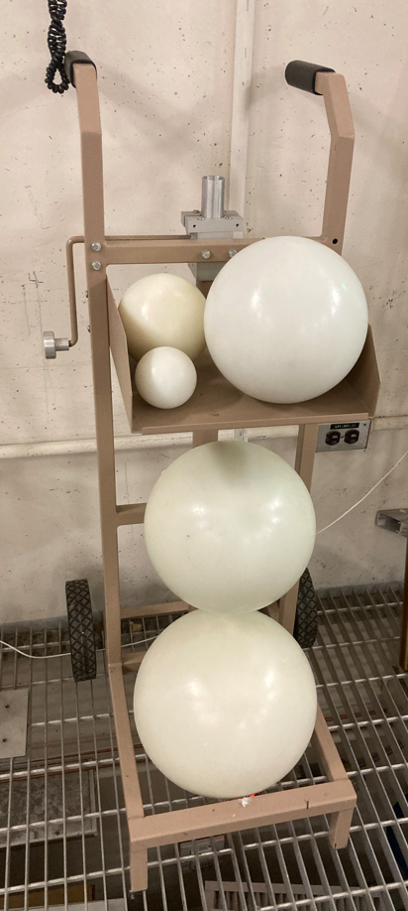
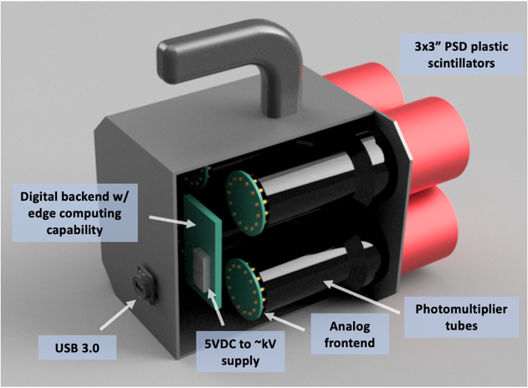
Introduction
Neutron energy spectra can provide a wealth of information
Current field deployable methods are…
cumbersome.
Scatter cameras could measure spectra and
direction
  Low efficiency
  Unweildy
Our solution will be:
  Handheld
  Mobile
  Real time

Slide 4
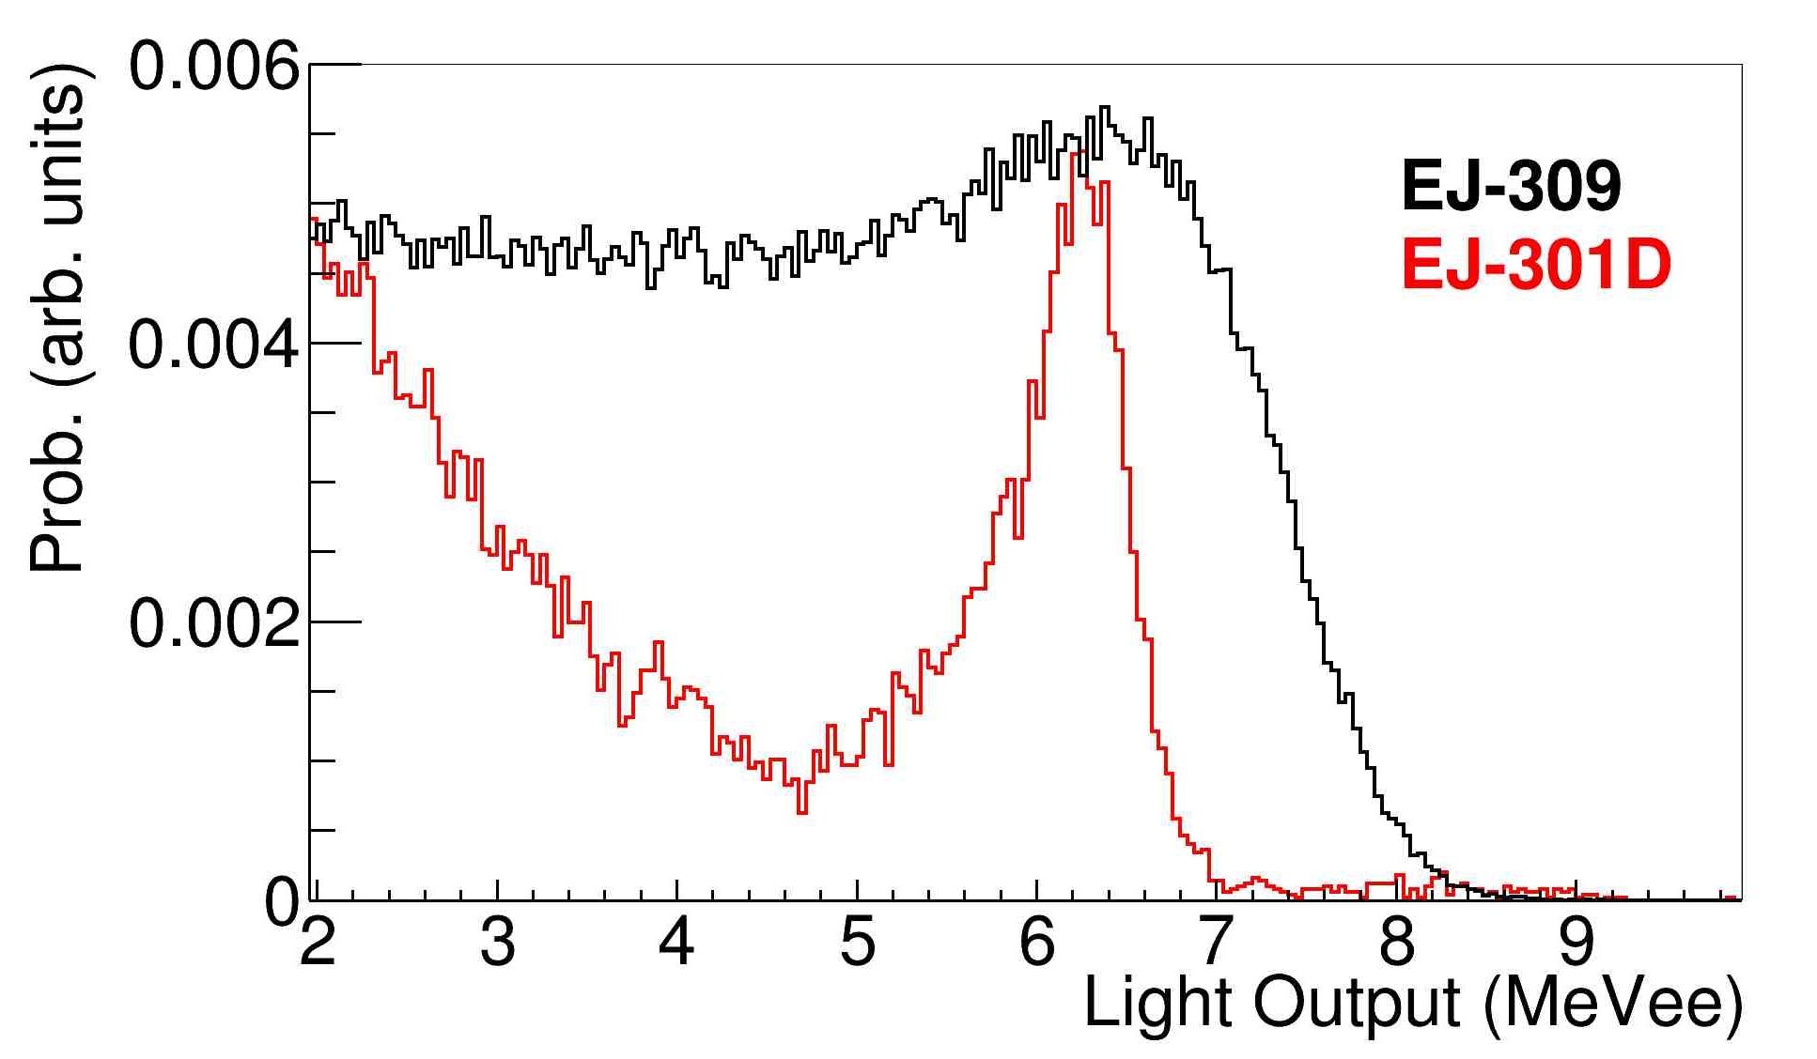
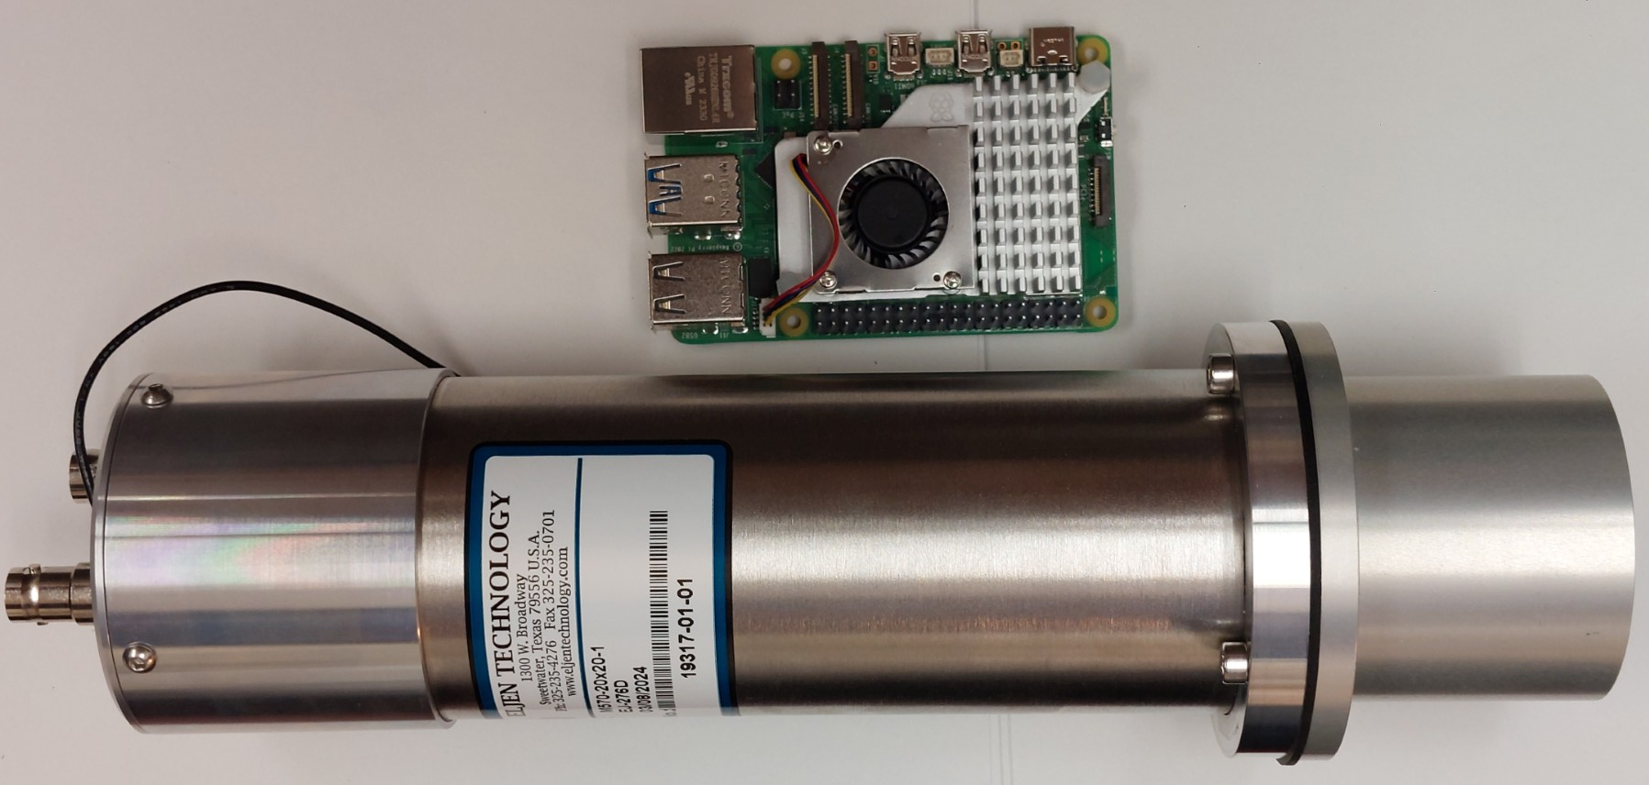
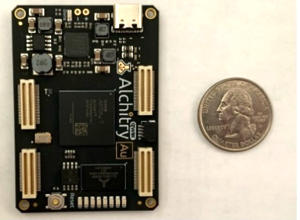
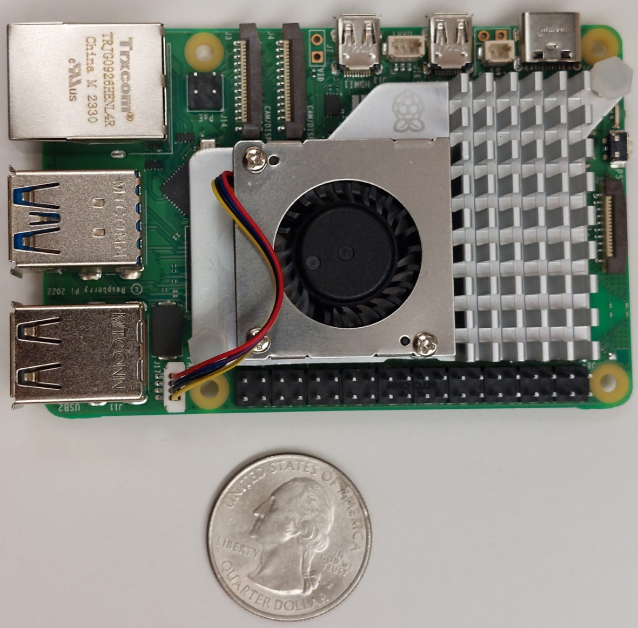
Method
Combine:
  Deuterated PSD plastic scintillators
  Analog energy and PSD determination
  Low Power COTS development boards
  Well known algorithms (MLEM for spectrum decomposition)
Expected power consumption is less than10W which gives 10+ hours on battery.
(And the batteries are hot-swappable)

Slide 5
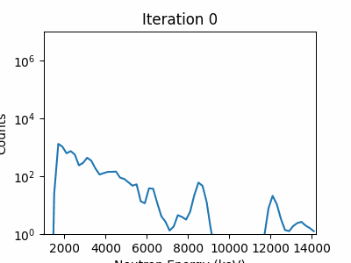
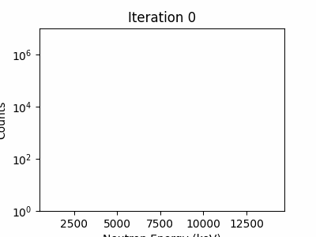
Real-time Unfolding
Fission source
Feed-forward MLEM
  as data comes in, the algorithm will determine neutron energy for that portion and seed the next round of “unfolding” with the prior.
  Speed up convergence.
  Targeted update is on the order of a second to both acquire and determine the neutron energy spectrum
Example:
  Loop through the data in 5-second chunks (1st iteration bins and unfolds the first 5 s of data, 2nd iteration bins and unfolds the first 10 s, etc.)
Counts
Neutron Energy (keV)
PuBe
Counts
Neutron Energy (keV)

Slide 6
Current Progress
Acquired development boards, EJ276D detectors
Geant4 simulation of detector developed
  0.02% absolute efficiency for four 2”x2” @ 1m from ²⁵²Cf point source
    60,000 counts above threshold in 5 minutes with 10⁶ source (plenty)
Testing electronic switches for suitability in gated integrators
Contract established with Cadre5 for GUI and DAQ development.
Characterization of 2”x2” and 3”x3” EJ276D detectors at LANSCE as baseline
Detector and housing frame being designed

Slide 7
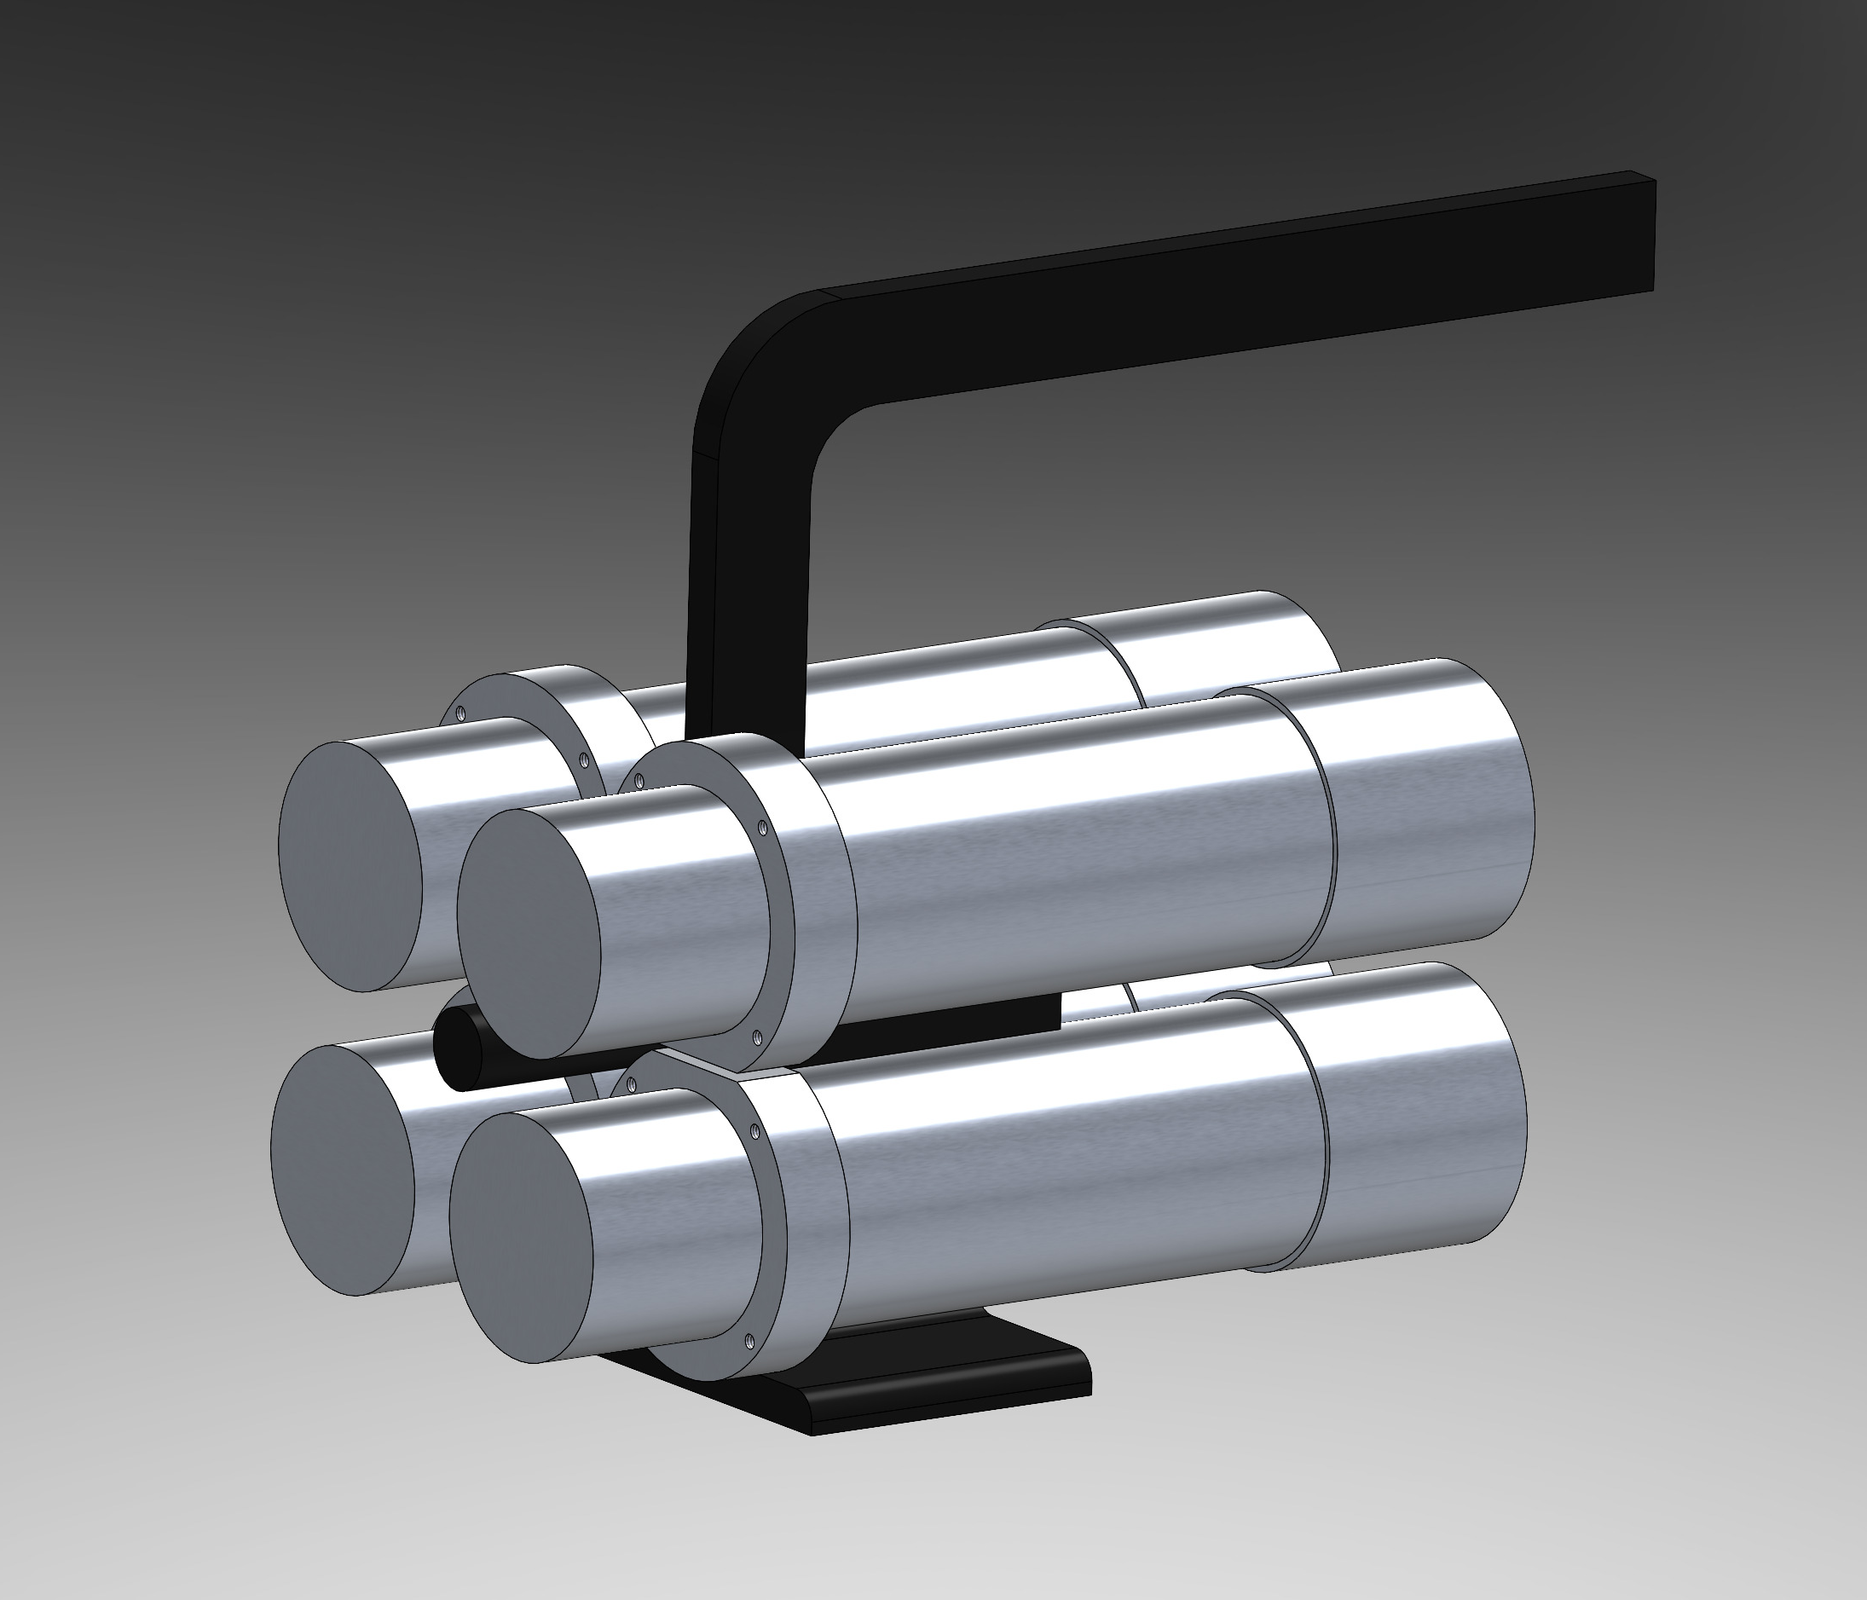
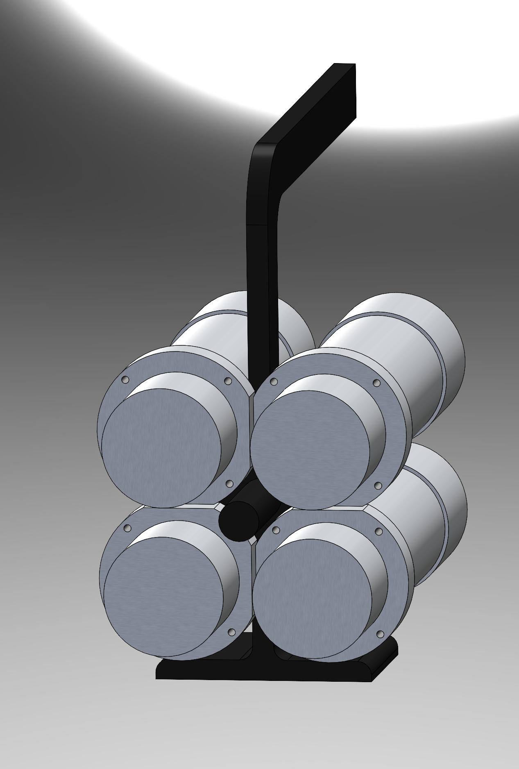
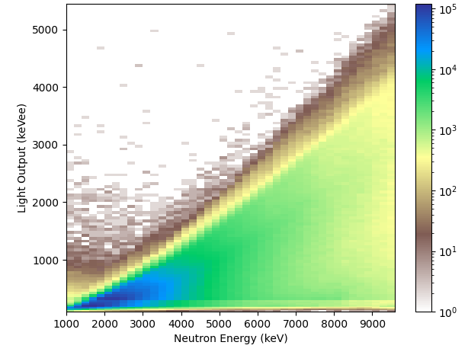
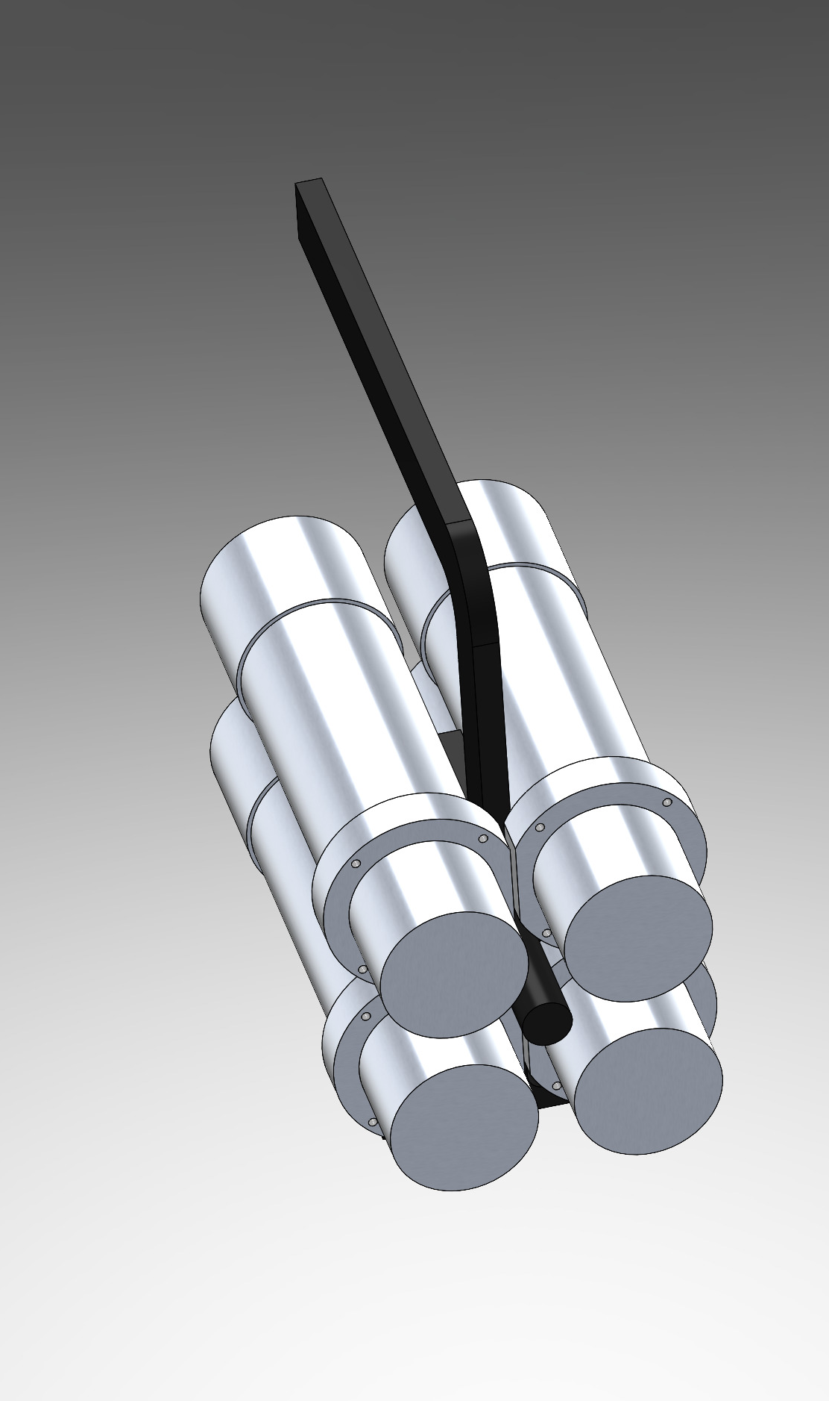
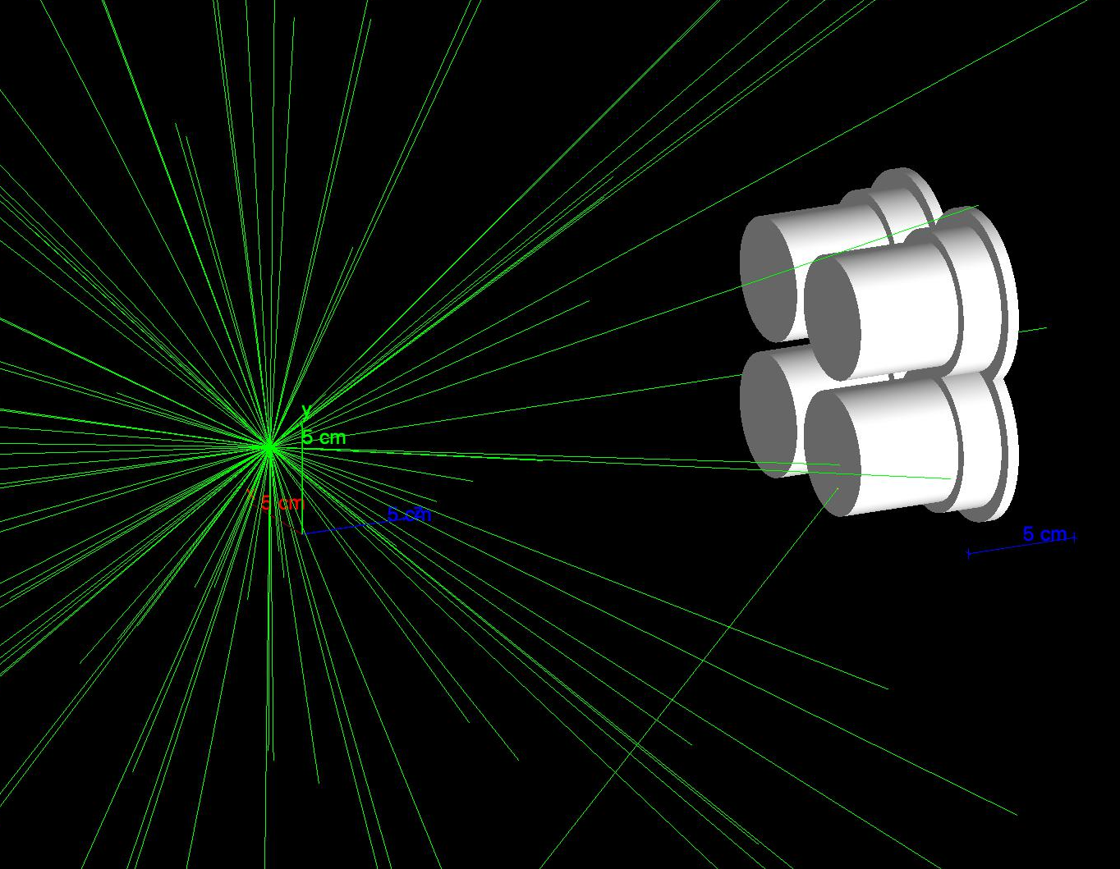
Current Progress

Slide 8
Next Steps
Finalize and construct first revision of analog and power board.
Construct detector frame.
Design and construct housing for detectors and electronics.
Acquire and test/practice with scintillator molds at AFIT.
Develop simplified “simulator” firmware and DAQ backend components for Cadre5 to proceed with development.

Slide 9
Conclusion
A handheld neutron spectrometer is a great boon for many applications.
  There are significantly fewer benign neutron emitters.
The project is just getting started but the path forward is clear.
The team expects great things to come!

Slide 10
Backup

Slide 11
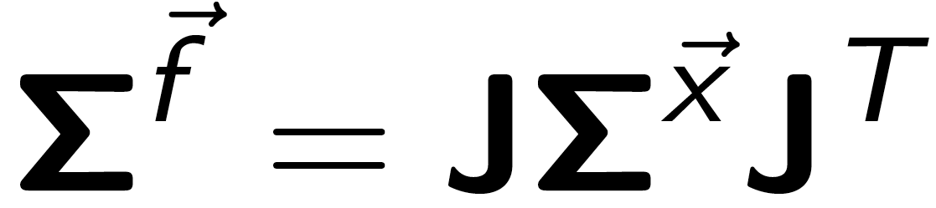
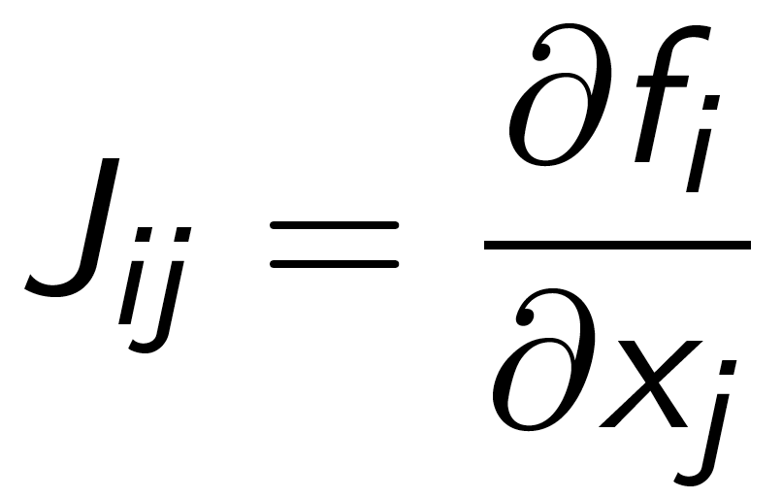
Error Propagation The Basics
To first order, the covariance matrix of some vector valued function f is:
Where J is the Jacobian matrix defined as:
and Σ^{x} is the covariance matrix of the input parameters x_{j}.
(approximated as diagonal)

Slide 12
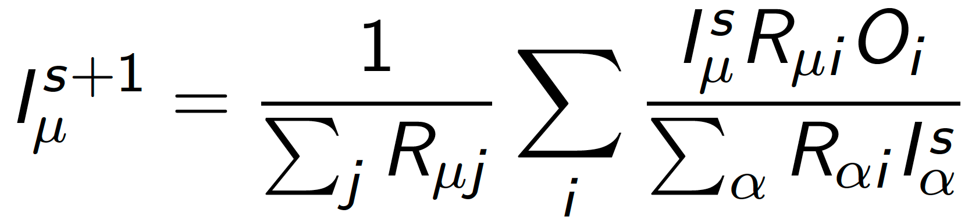
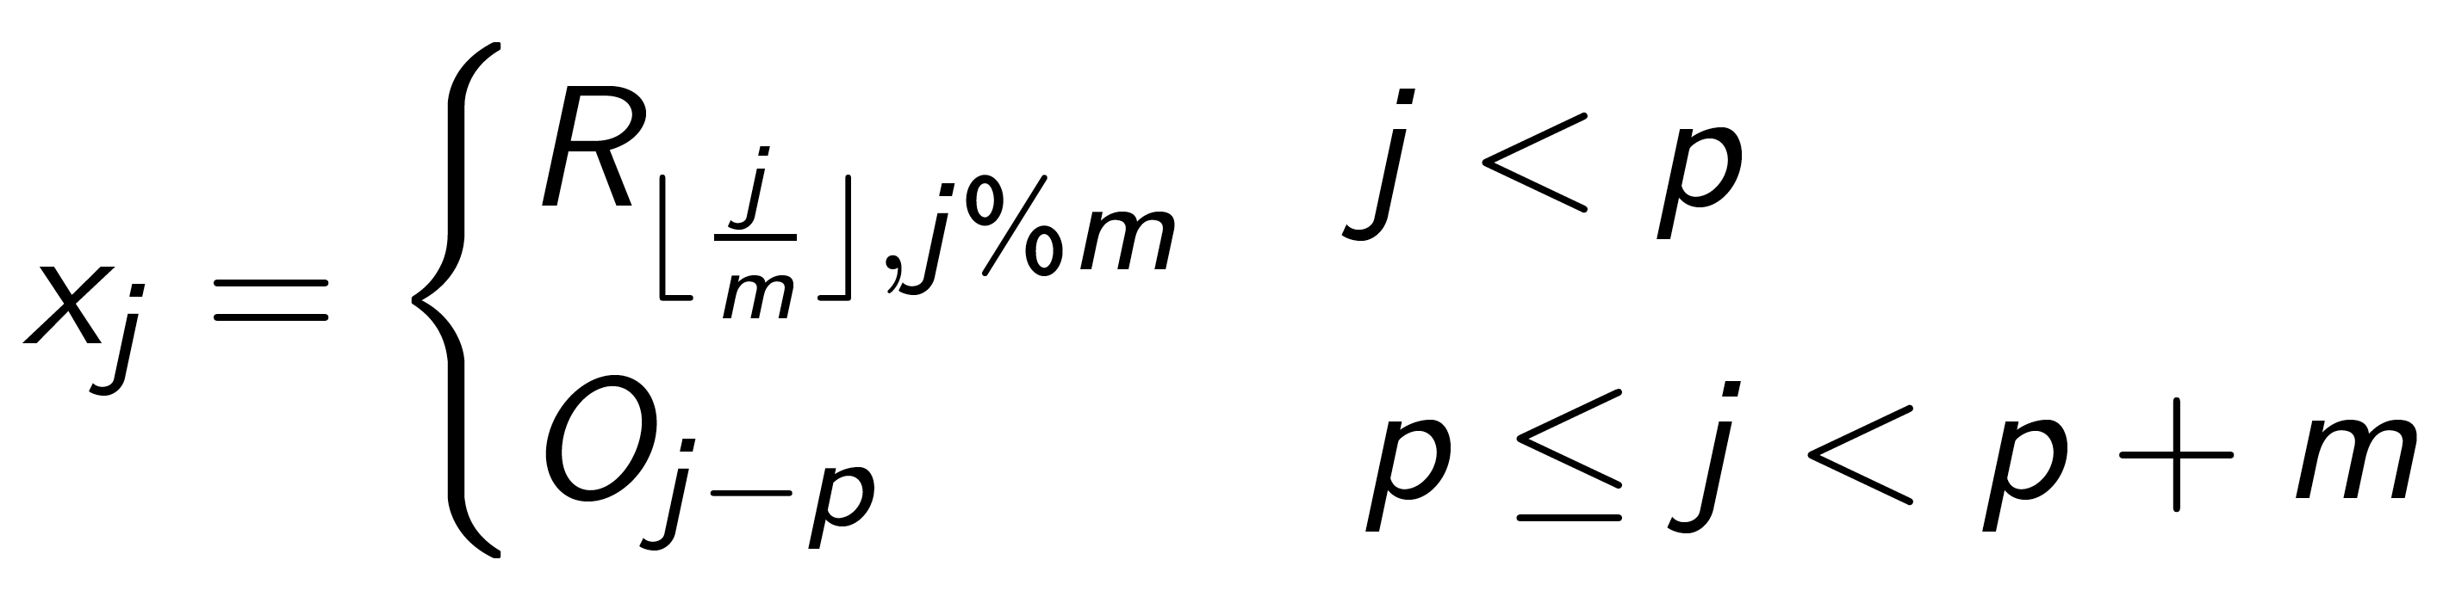
Error Propagation Step 1
In this case the vector valued function f is:
Define the input parameters x_{j}. To be:
Here m is the length of the response functions / input spectrum, n is the number of response functions, and p is m*n.

Slide 13
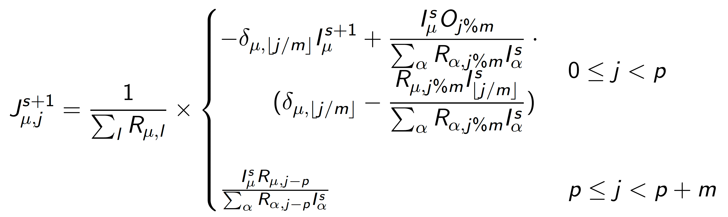
Error Propagation Step 2
With this the Jacobian matrix is:
Plugging that into the equation for the covariance matrix gives the errors on the diagonal of the output covariance matrix.

