Slide 1
Fast Neutron Imaging Detector Update
Work in Progress
3 May 2024
Paul Hausladen, Keith Vaigneur, Brandon Longmire, Matthew Heath, James Matta, Jake Daughhetee, Lorenzo Fabris

Slide 2
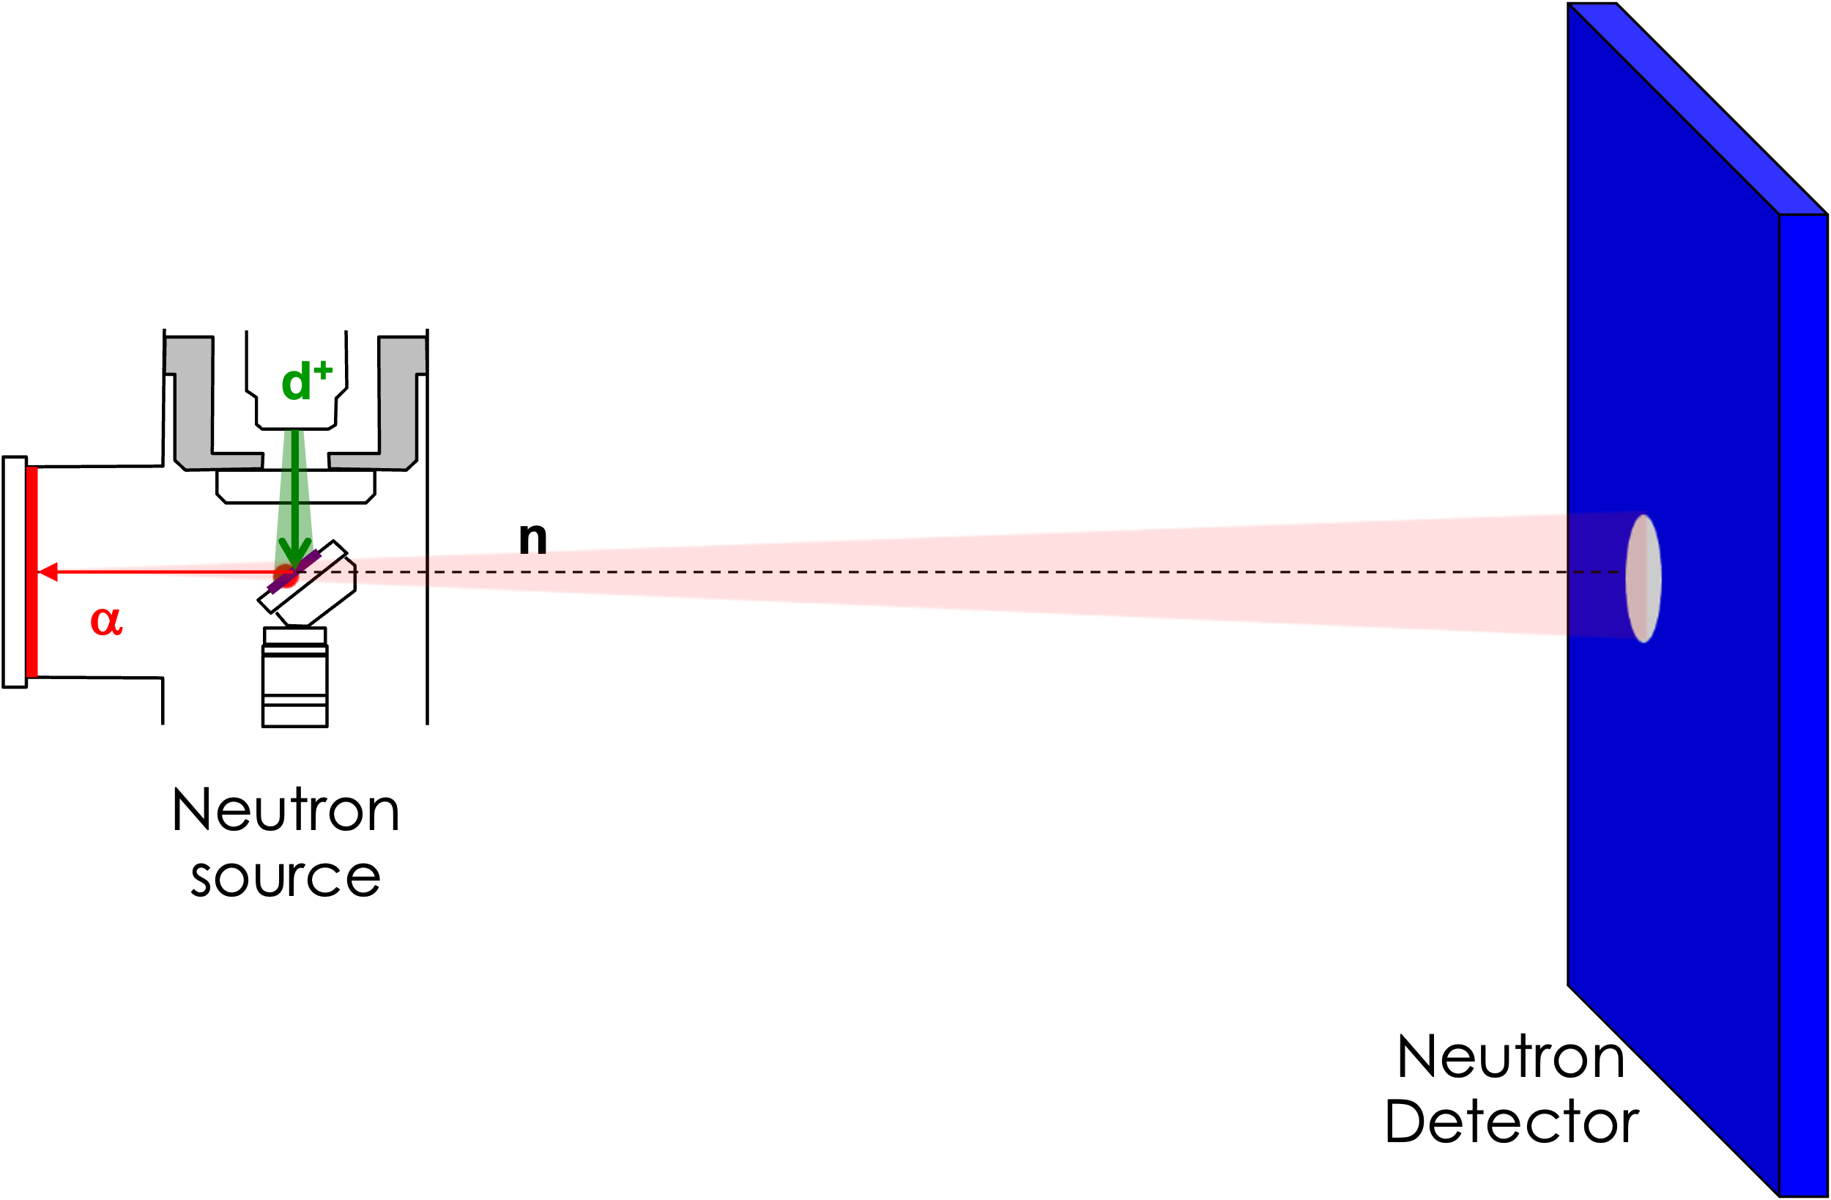
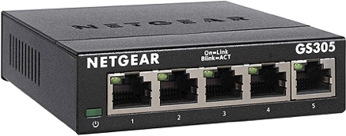

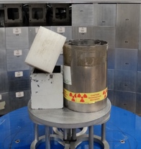
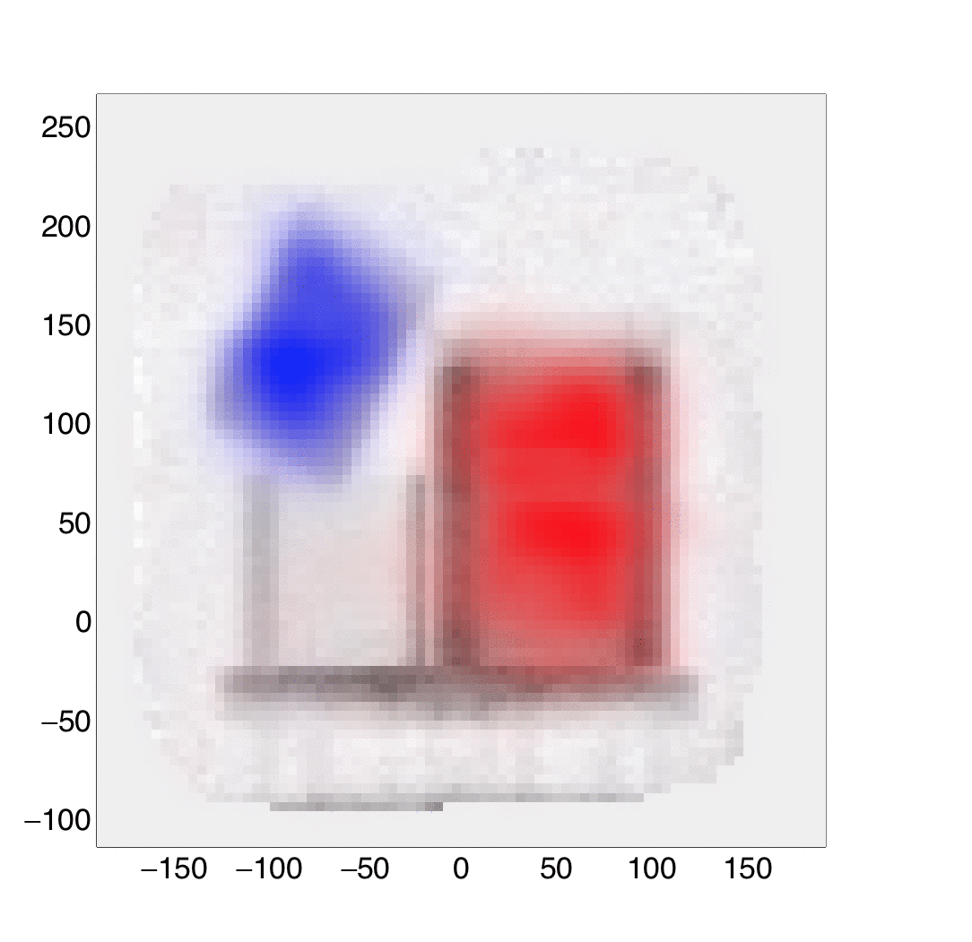
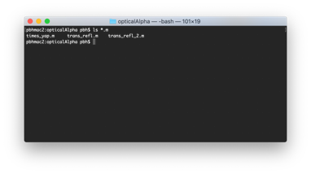

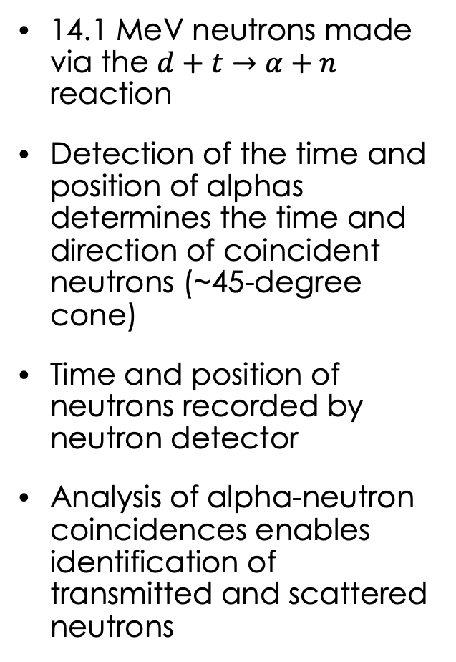
Fast Neutron ”Associated Particle Imaging” (nAPI)
14.1 MeV neutrons made via the $d+t→α+n$ reaction
Detection of the time and position of alphas determines the time and direction of coincident neutrons (~45-degree cone)
Time and position of neutrons recorded by neutron detector
Analysis of alpha-neutron coincidences enables identification of transmitted and scattered neutrons
API DT neutron generator
Alpha-particle detector
Neutron detector
(scintillator array,
readout)
Detector slider to position, execute mosaic
High data throughput DAQ and analysis software

Slide 3
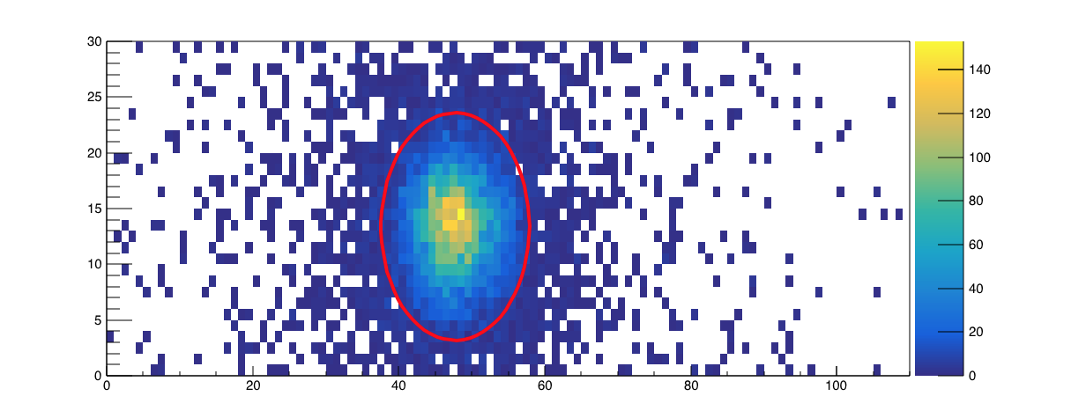
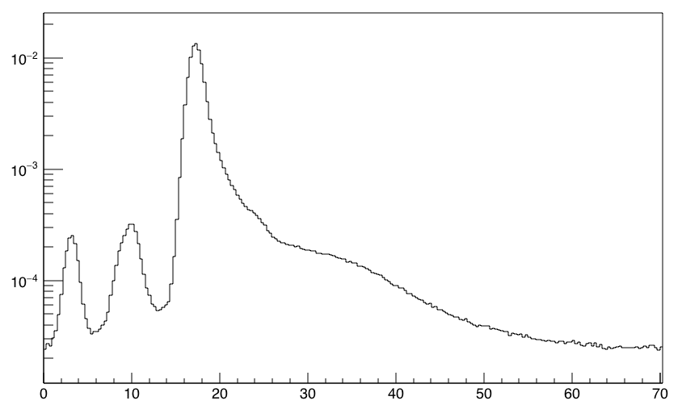
Fast Neutron ”Associated Particle Imaging” (nAPI)
Coincidence in space
API DT neutron generator
Alpha-particle detector
Transmission and small angle elastic scattering
Fission, inelastic scattering, hydrogen elastic neutrons
Counts per alpha
High data throughput DAQ and analysis software
Time of Flight (ns)
Source and object gamma rays

Slide 4
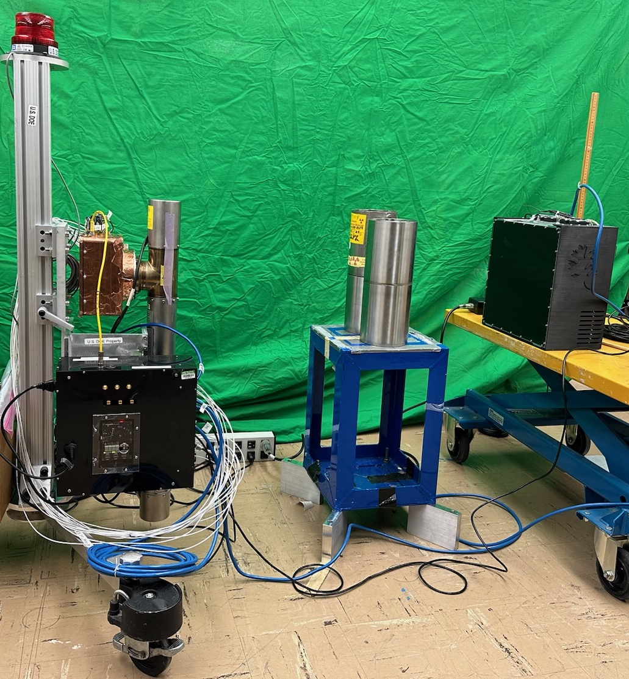
Laboratory Prototype
To enable field operation, first need to operate without a gantry
  Distributed DAQ (we use off-the-shelf digitizers, GbE switch, custom clock board)
  Methods to determine the detector position from data, calculate normalization for an inferred position, and stitch multiple images
Want detector with minimum non-scintillator volume
DT neutron generator
Neutron Detector

Slide 5
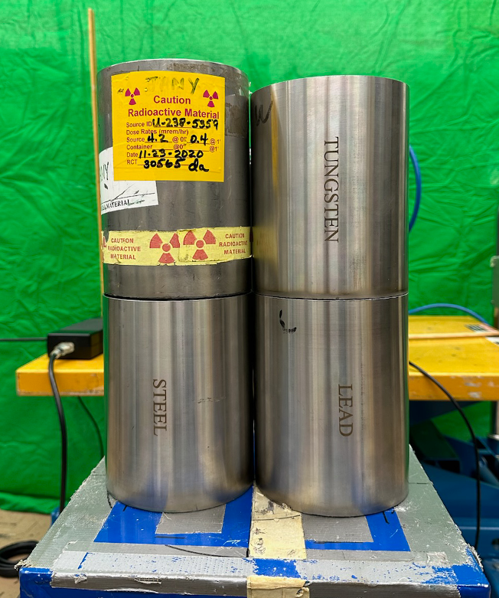
Example Image
DU
W
Steel
Pb
Find detector position using known alpha-coincident directions and times of flight
Calculate normalization given absolute efficiency for position and orientation of detector and corrections for relative efficiency of individual pixels
Project each image into a common plane to stich

Slide 6
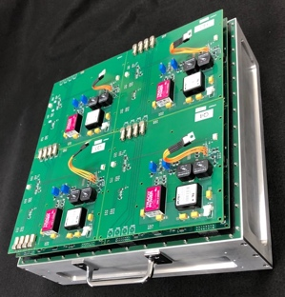
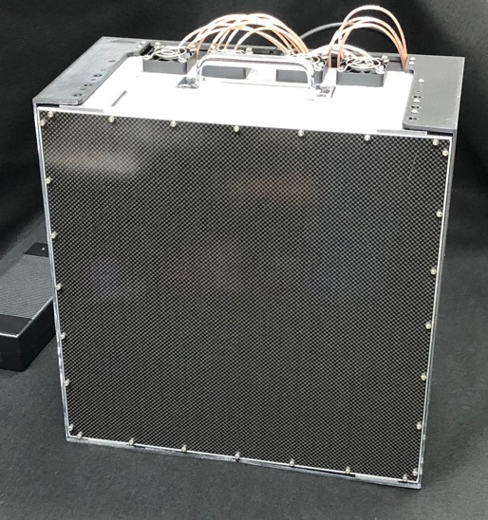
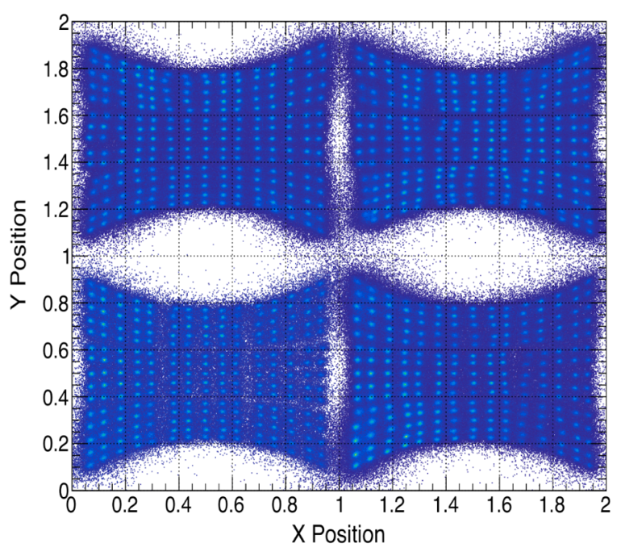
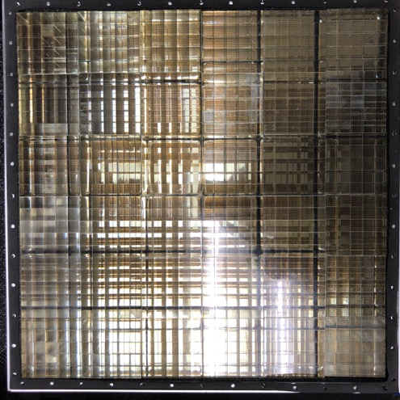
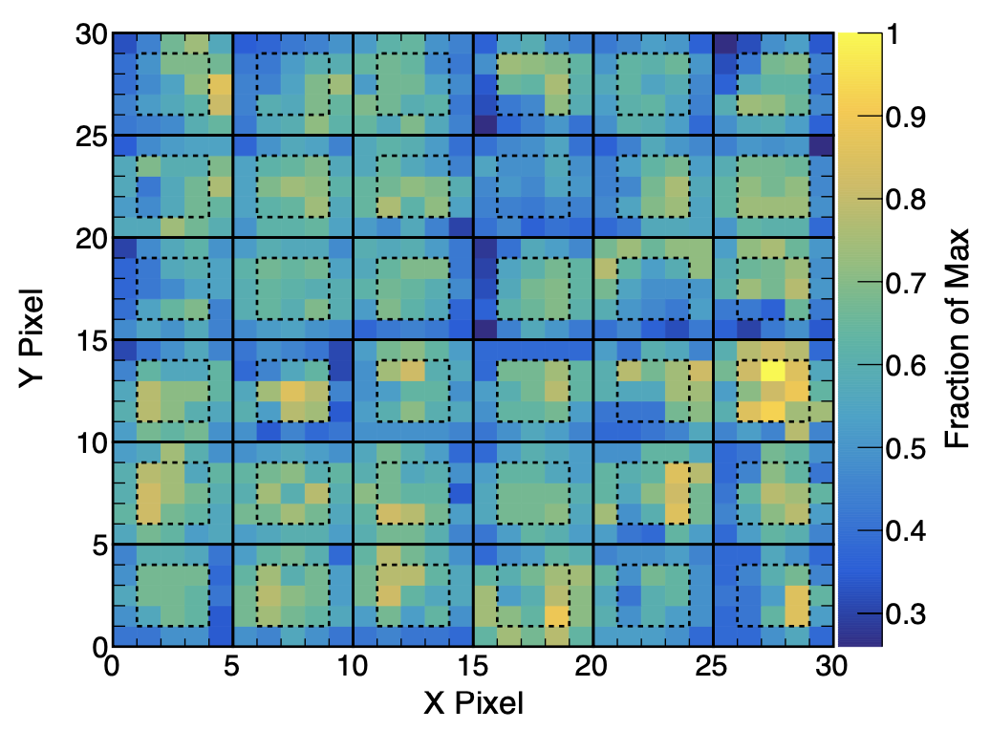
Original Neutron Detector
Position response
Gain map
900 pixels of EJ-299-33m scintillator (yellowed with age), each 1.04 × 1.04 × 5 cm³, covering 973 cm² area
Four quadrants of four-corner readout of 9 flat-panel PMTs (36 total) digitized by 16-channel Struck SIS-3316 waveform digitizer
Uses ~90 W of wall power (~60 W digitizer, 20 W HV), fan cooled, 43 lbs
Connections for data (Ethernet cat 6), clock (Ethernet cat 8), HV control (USB) and power

Slide 7
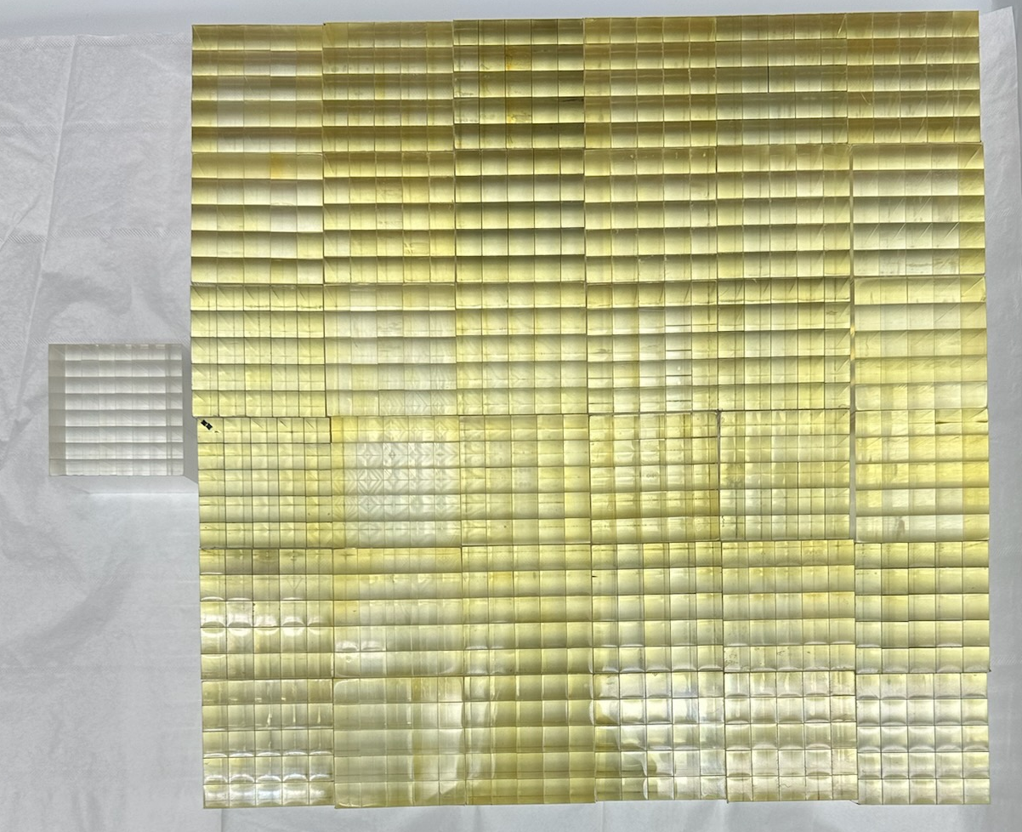
Problem – Scintillator Aging
EJ-299-33m “PSD plastic” scintillator yellows with age/exposure to oxygen
Now approximately ~1/2 the light output it had in 2019, much diminished pulse shape discrimination
Preferable for new arrays to have smaller pixels

Slide 8
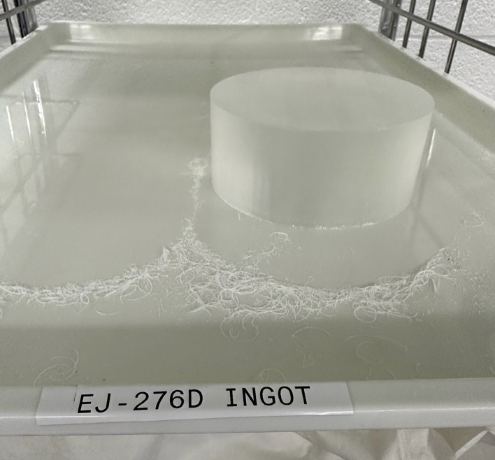
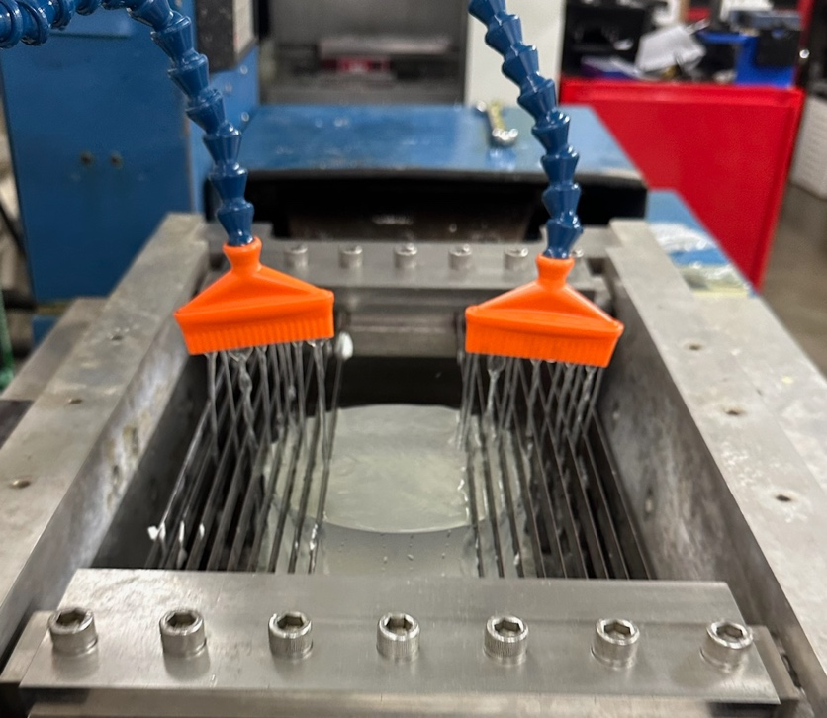
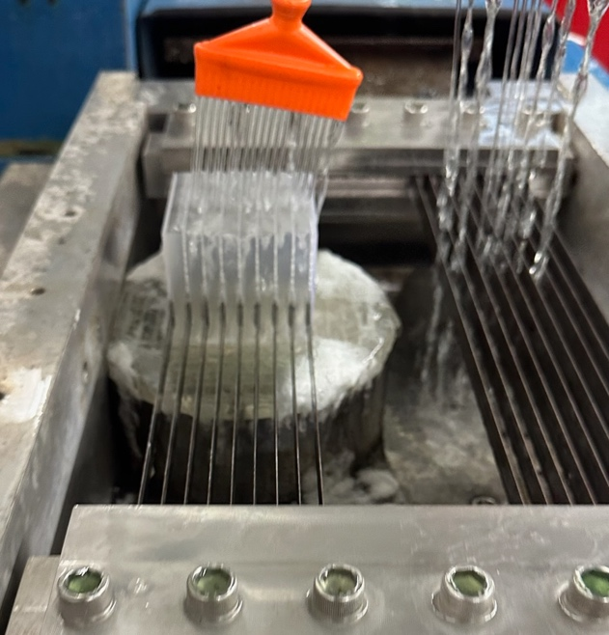
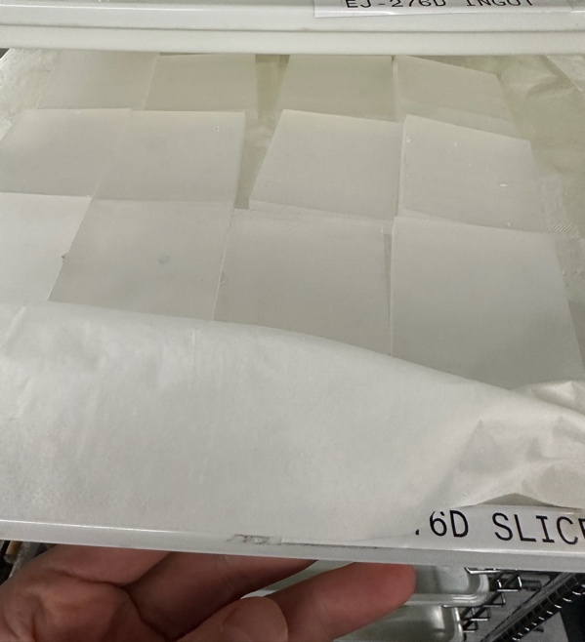
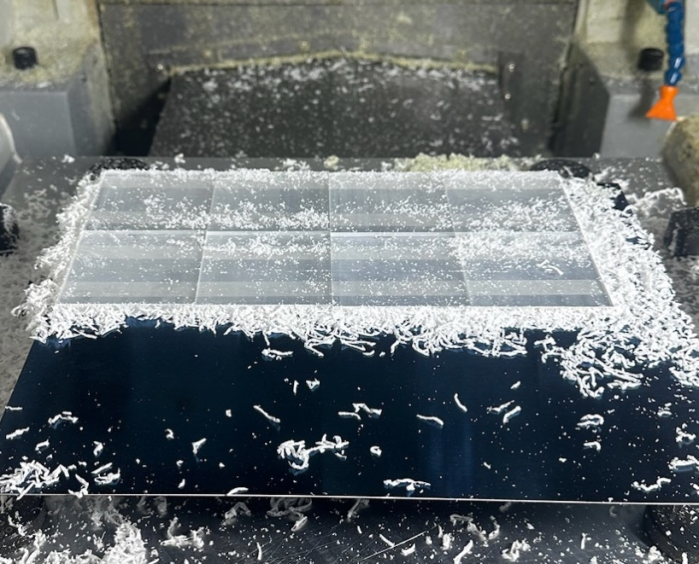
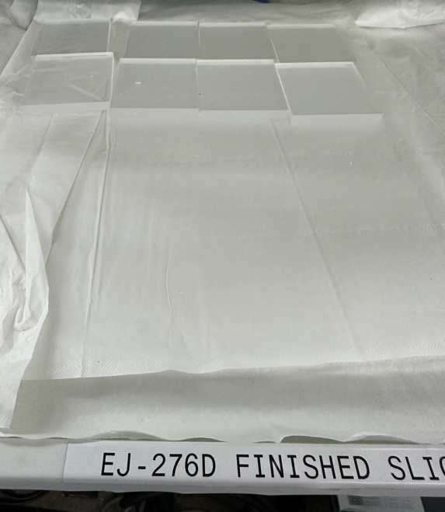
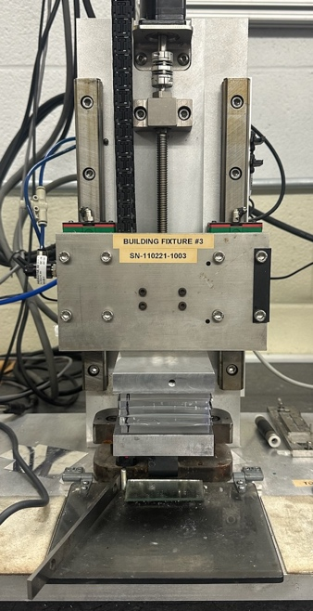
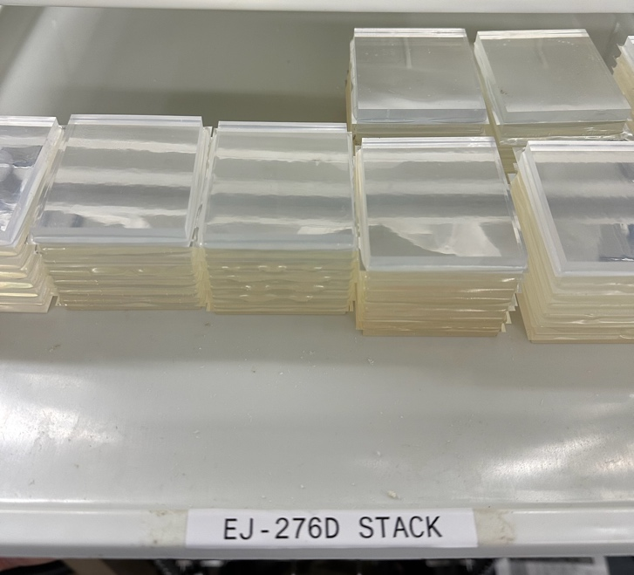
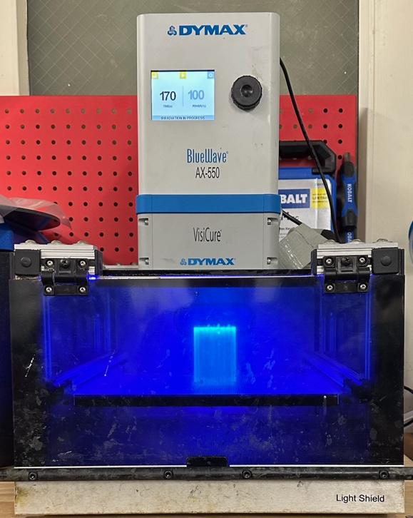
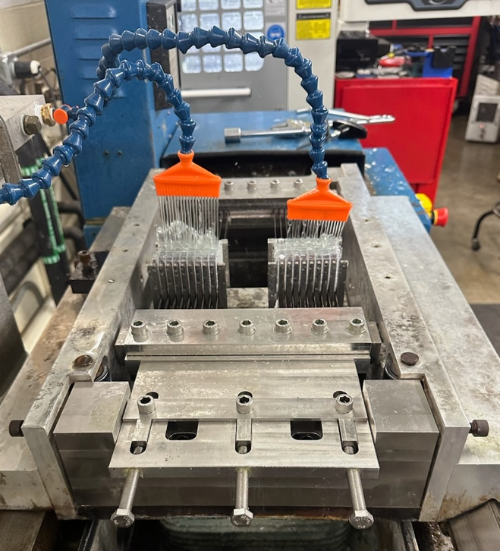
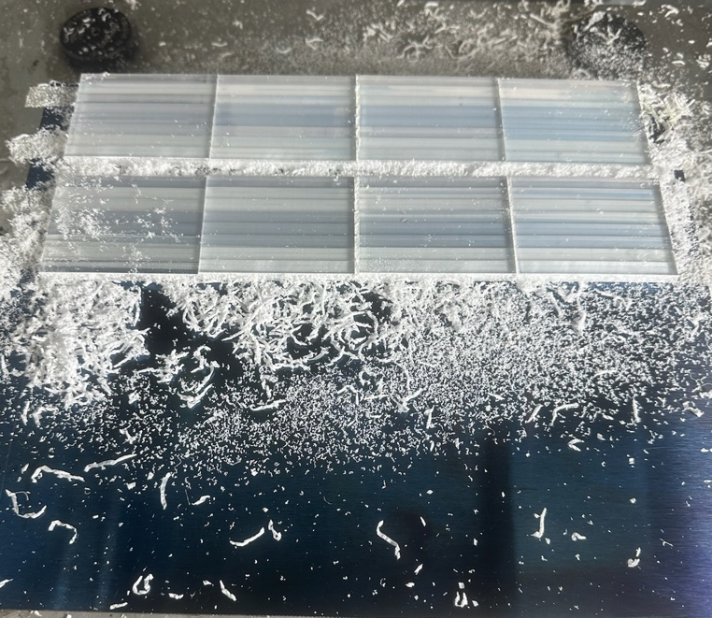
ORNL Process to Build New Pixel Arrays
Scintillator ingot
Gang saw (3 cuts) into slices
Rough-cut slices
Face and diamond mill slices
Finished slices
Assemble slices
Assembled stacks
Post-cure
Gang saw into rows
Face and diamond mill rows

Slide 9
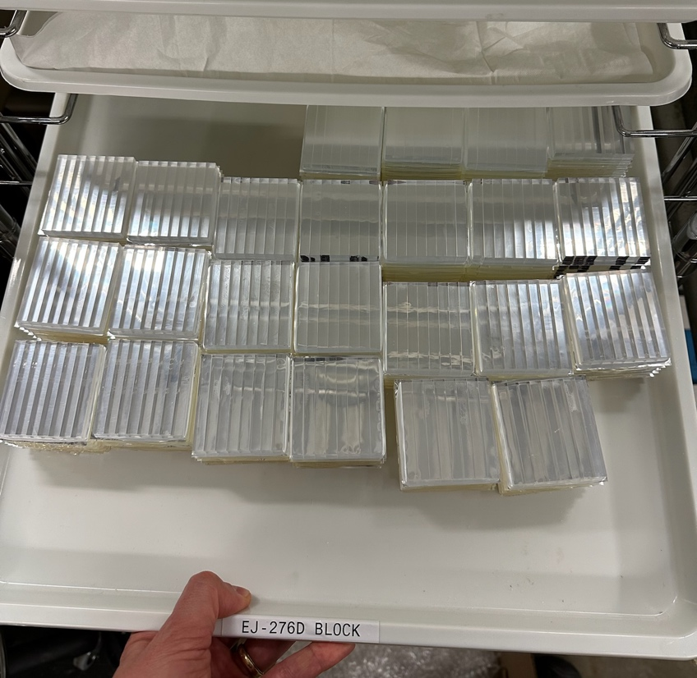

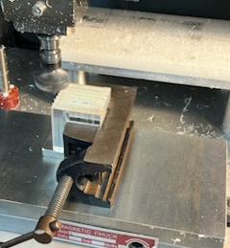
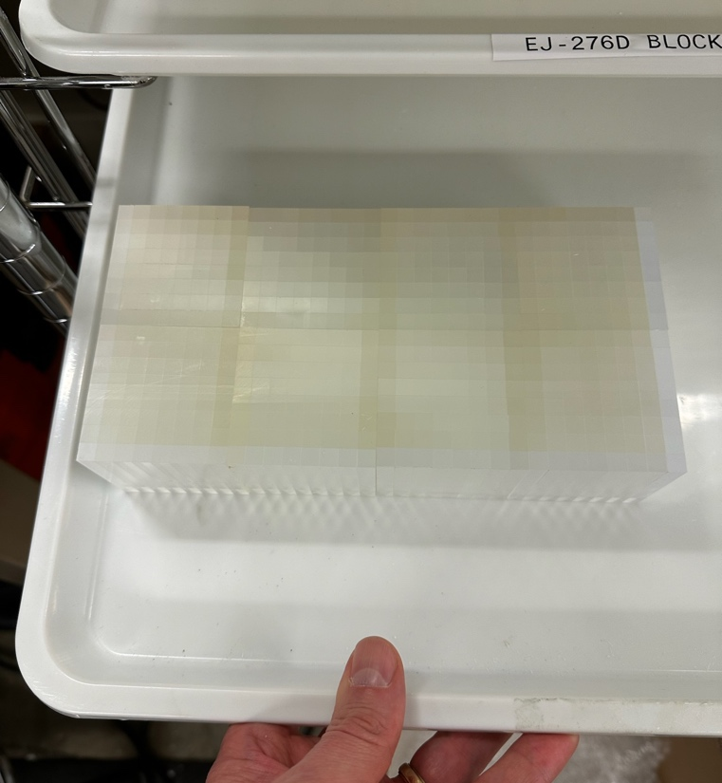
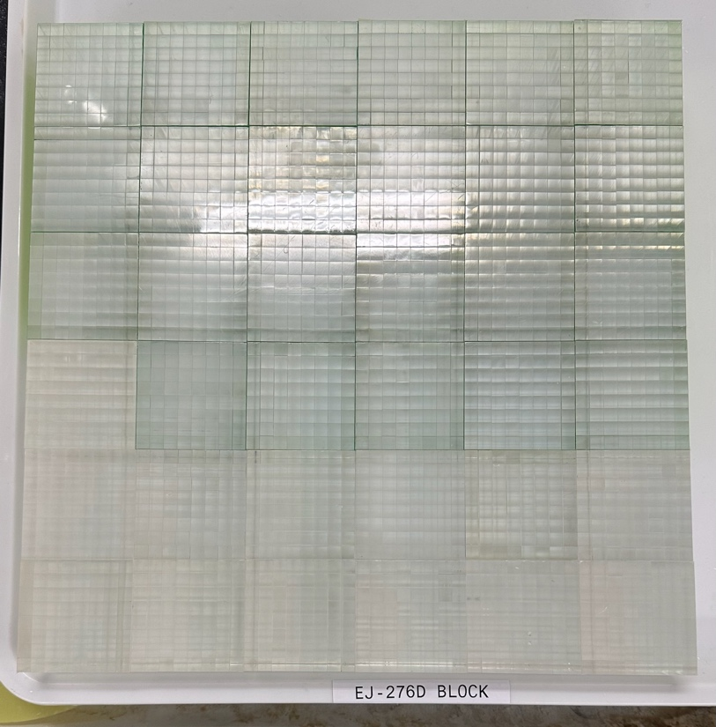
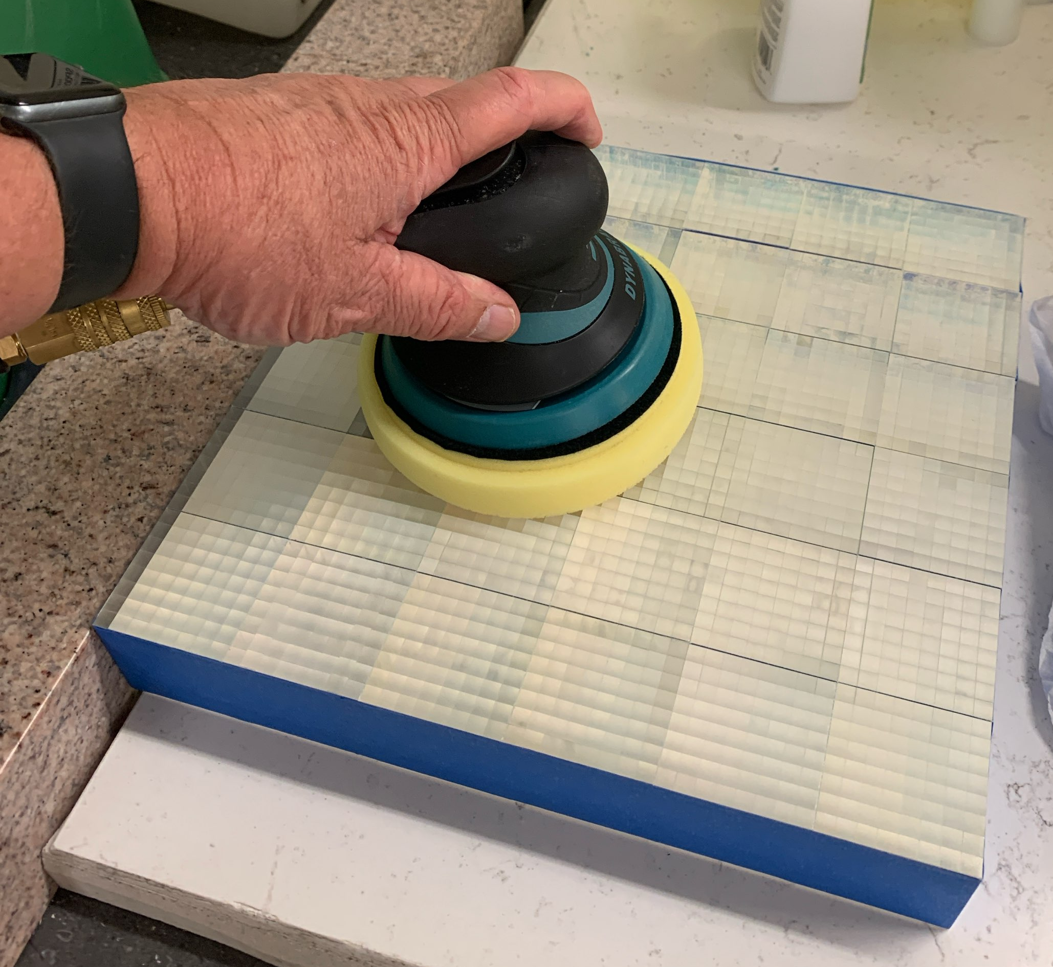
Process to Build Pixel Arrays (Cont.)
Finished detector is 973 cm² with 2304 pixels
Assemble rows
Rough arrays
Post-cure
Machine to finished dimensions
Dimensioned arrays
Polish and wrap with reflector
Final buffing

Slide 10
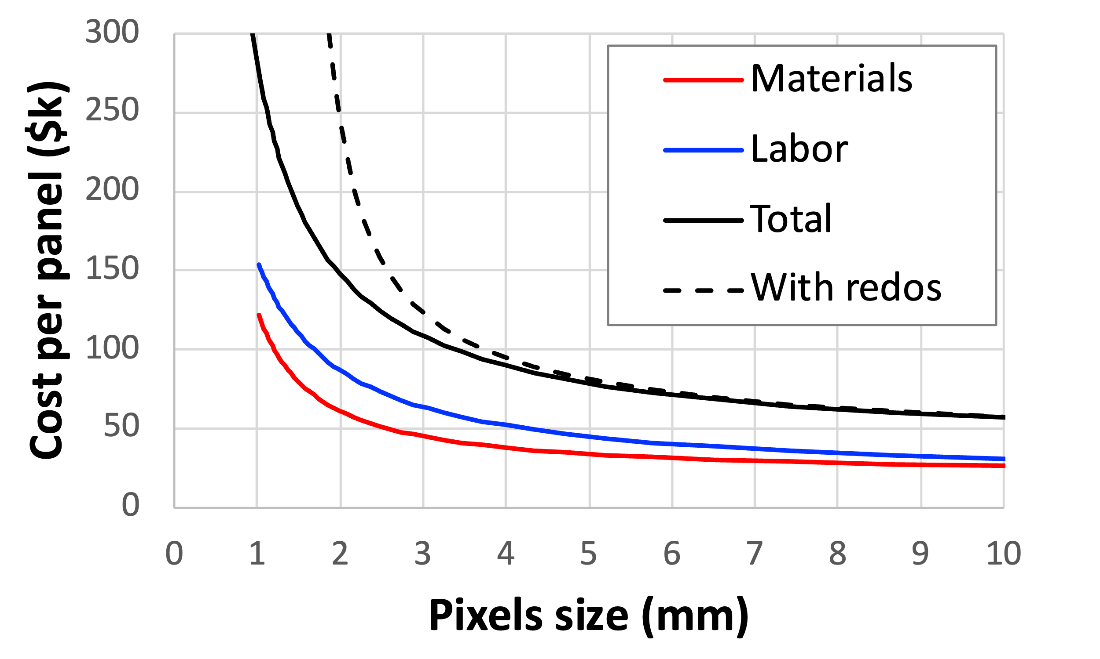
Scaling of Fabrication Process to Smaller Pixels
Array | ~ 6 mm (8x8) | ~ 3 mm* (16x16)
Scintillator | $750 | $1000
Adhesive | $100 | $200
Reflector | $15 | $30
Hours/array | 5.3 | 8.3
Stacking (% of effort) | 40% | 55%
*Requires new tooling
Present labor cost (with no down time) is similar to cost of materials but can be additionally reduced by finishing automation of stacking (many subtleties)
We think we can build arrays with pixels as small as ~ 3 mm, but method will become limited by row breakage for smaller pixels

Slide 11
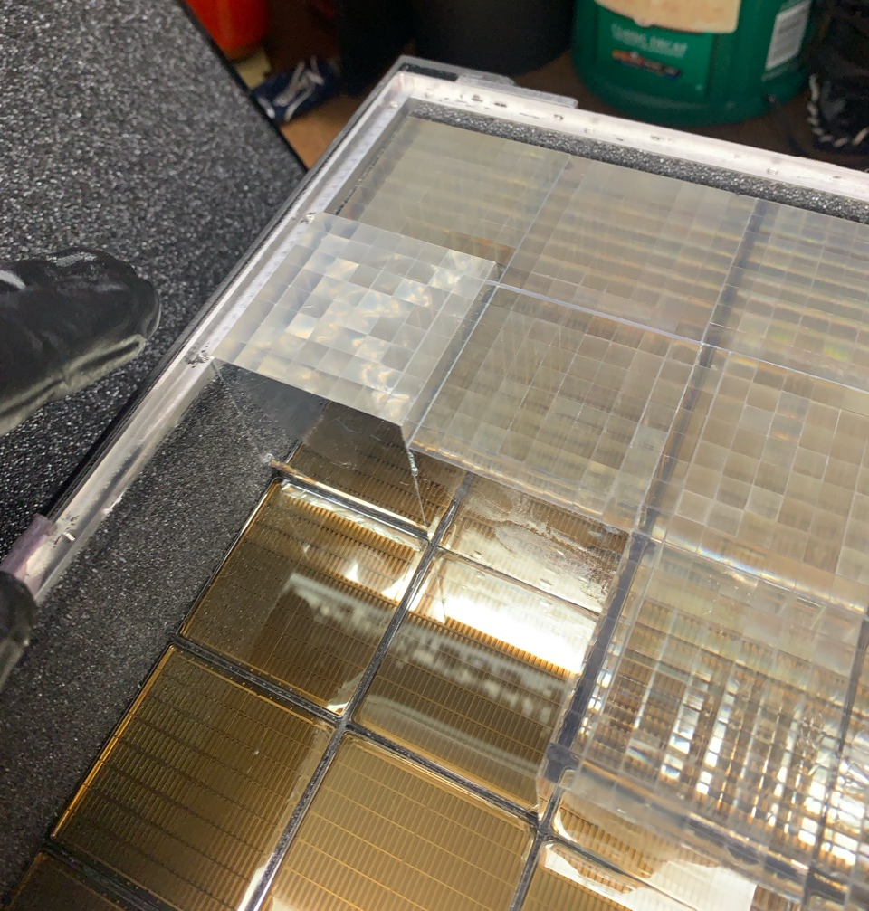
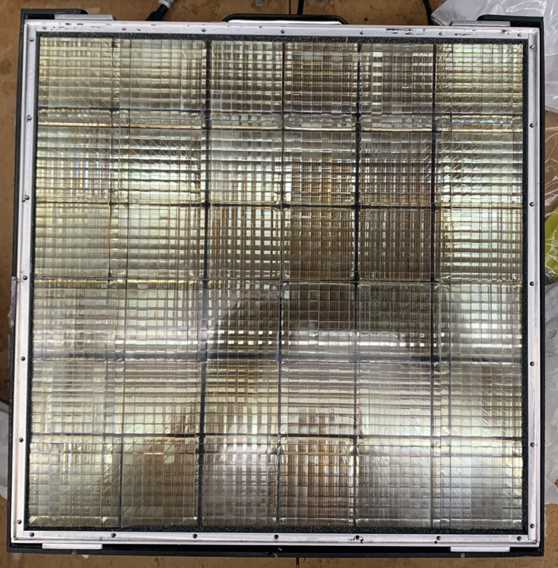
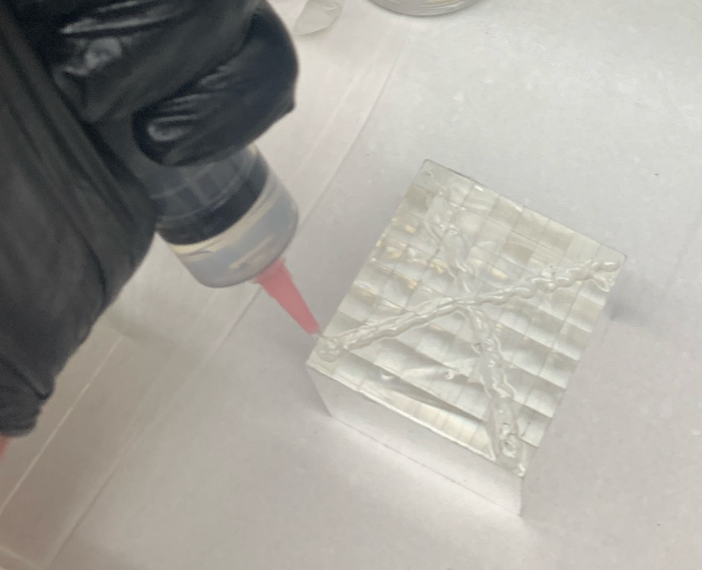
Loading Detector
Pixel arrays optically coupled one at a time

Slide 12
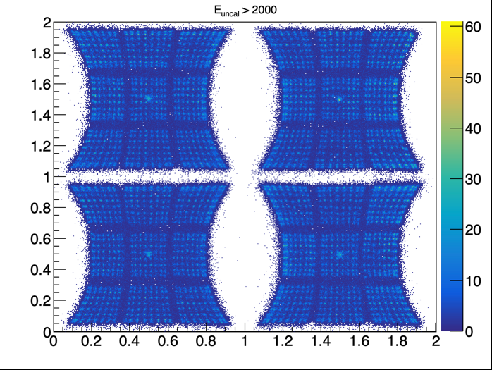
New Panel Position Response - Background
Background count shows cosmic ray MIPs reconstructing at readout quadrant centers

Slide 13
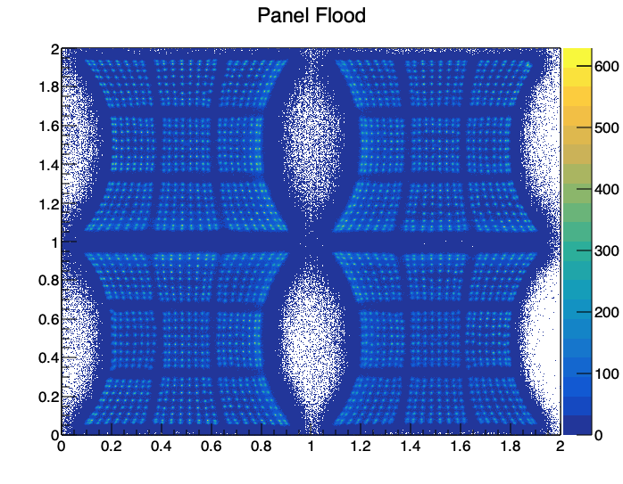
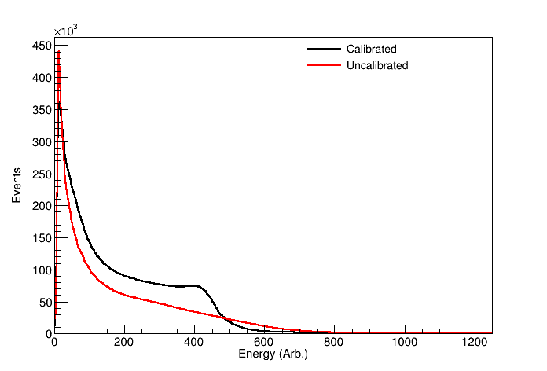
New Panel Position Response – Cs-137 Calibration
Pulse height calibration in process, next is timing…

Slide 14

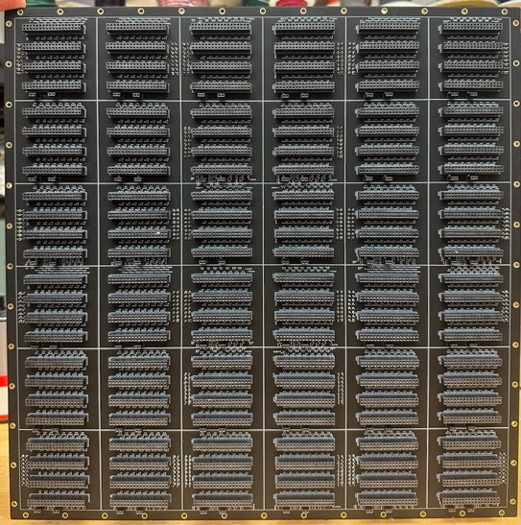
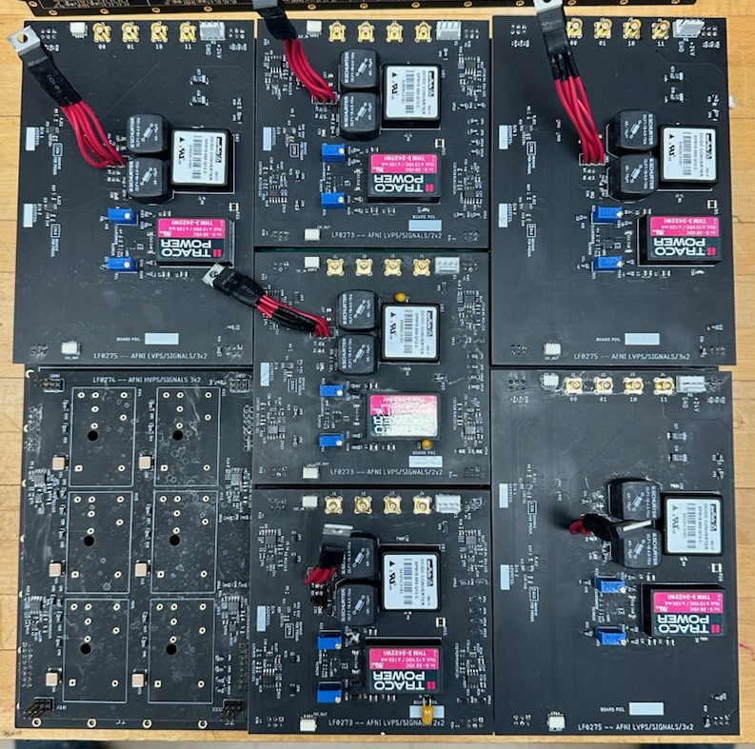
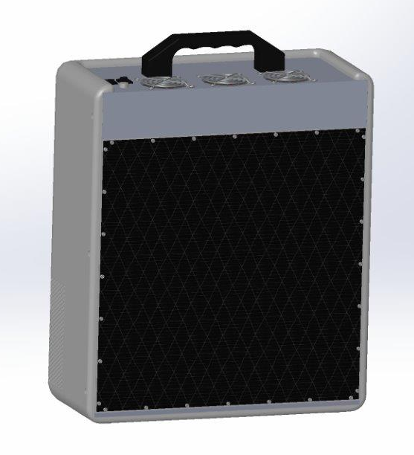
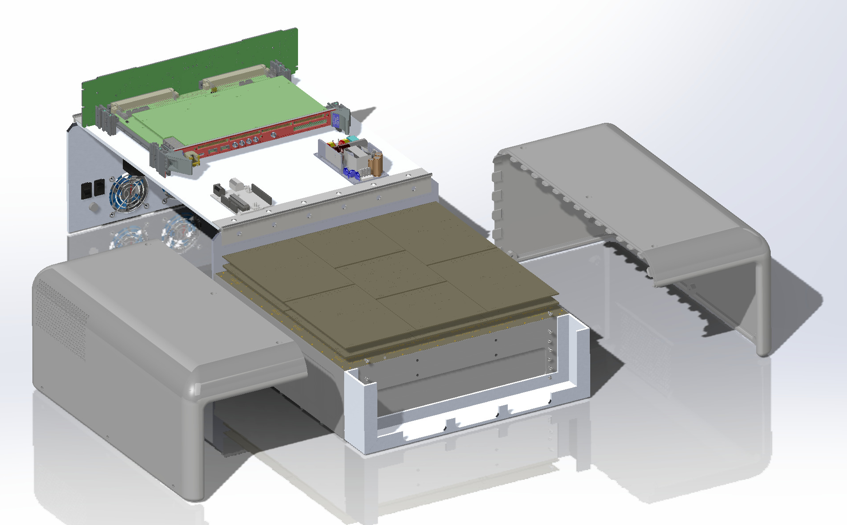
More Granular Readout Nearly Complete
Implementing new readout (7 readout units of four-corner readout digitized by 32-channel CAEN VX2730 500 MS/s,14-bit waveform digitizer)
Will enable higher panel rates (1.5× – 2.25×)

