Slide 1
Perspectives on Organic Scintillators for Fast Neutron Imaging
Work in Progress Seminar
5 April 2024
Paul Hausladen
(repurposed from NA-22 Workshop on Radiation Detection Materials and Applications)

Slide 2
Workshop on Radiation Detection Materials and Applications
“The WORDMAp Workshop will involve R&D performers and users from DOE national laboratories, universities, industrial companies, and other organizations engaged in nonproliferation R&D and product development. The purpose is to build a consensus view among subject-matter experts on existing methods for radiation detection, shortcomings in the current state of the art, commercialization issues that are restricting the adoption of new technology, and new materials-related R&D priorities leading to significant improvements in next-generation radiation detectors useful in a variety of nonproliferation applications.” – https://www.bnl.gov/wordmap/
I was present as a ”user” of neutron detector materials rather than a developer

Slide 3
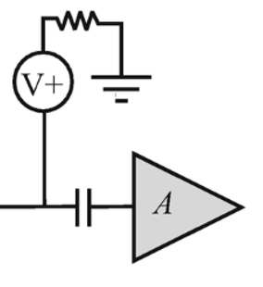

Detecting Fast Neutrons
Direct
Indirect
+
+
+
-
-
-
-
-
-
+
+
+
-
-
-
+
+
+
+
+
+
-
-
-
-
-
-
+
+
+
+
+
+
-
-
-
-
-
-
+
+
+
+
-
-
-
-
+
-
+
Neutron
+
Neutron
+
Neutron
-
+
Organometallic semiconductor?
CH₂ converter + semiconductor, storage phosphor
Scintillator + photosensor
Not demonstrated for neutron detection
Converter limited to proton recoil path length (2-3 mm), eff < 1%
For 14.1 MeV neutrons, proton-recoil scintillator is the material of choice (capture reactions do not give practical efficiency)
Can scale to thick, efficient detectors

Slide 4
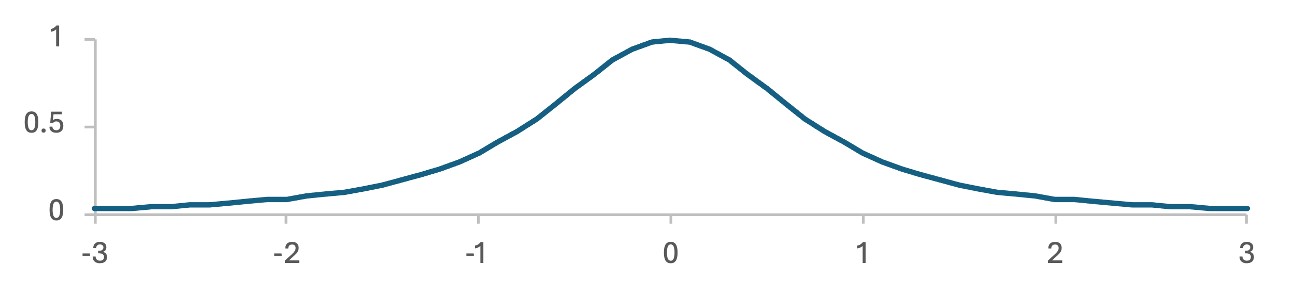


Integrating Detectors
Observed resolution is width of light distribution (FWHM is 1.53 times height above photosensor) – favors thin detectors
Integrate both neutrons and gamma/x-rays (also produced by neutron sources)
Photodiode has gain ~1 (QE 0.8)
For good images, want more current from neutron exposure than dark current (as much as 1pA/mm²), requires 10⁵ – 10⁶ neutrons/cm² per second – favors thick detectors for efficiency
Retroreflector or black
Scintillator
$$\sqrt{h^{2}+x^{2}}$$
h
$$θw$$
x
Photosensor

Slide 5
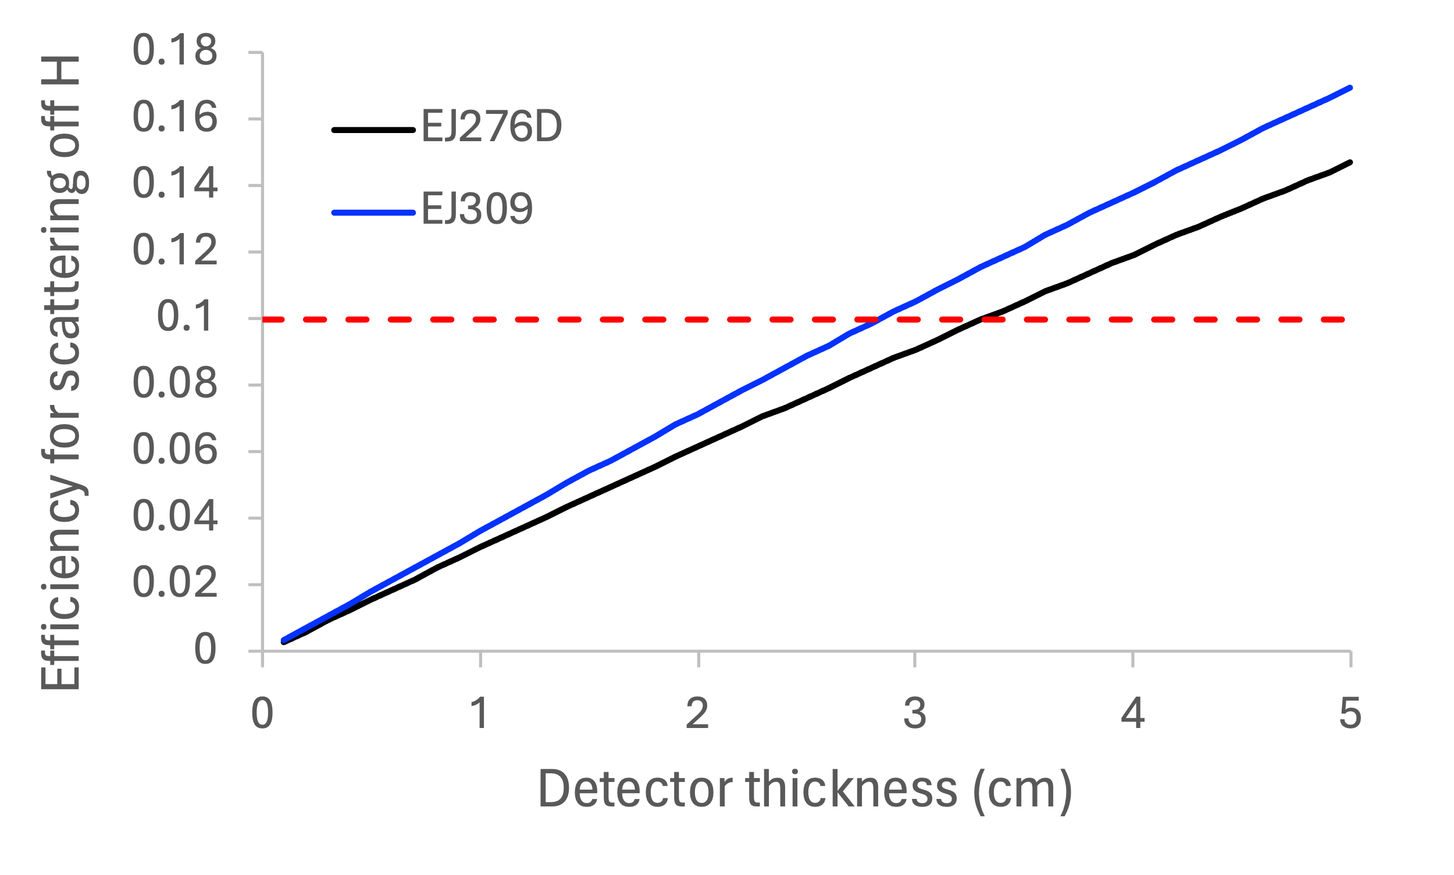
Efficiency of Proton Recoil Scintillators
For 14.1 MeV neutrons, need ⩾ 3 cm of detector thickness to achieve 10% efficiency
EJ276D: 4.647⨯10²² H atoms/cm³
EJ309: 5.43⨯10²² H atoms/cm³
1/3 of interactions on H, 2/3 of interactions on C

Slide 6
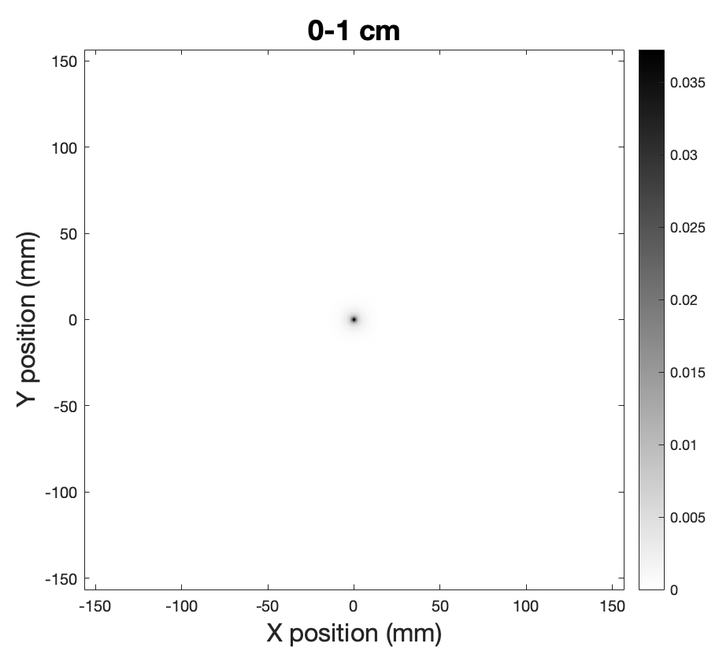
Resolution vs. Height in Detector
PSF
Idealized optical transport with no reflections (or retroreflection) off top surface

Slide 7
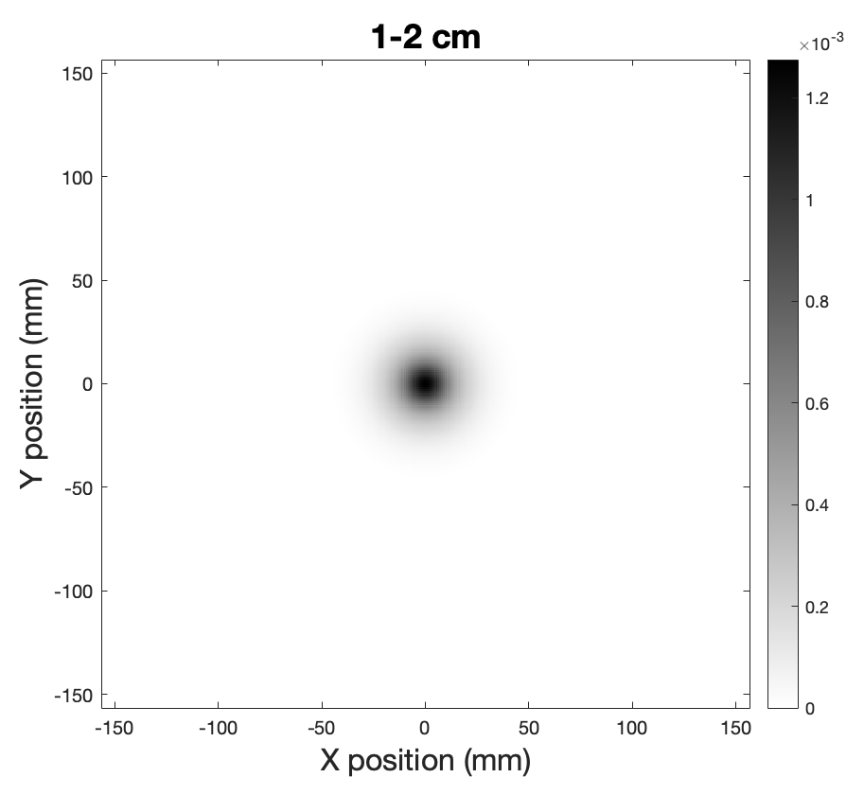
Resolution vs. Height in Detector
PSF
Height of 15 mm gives 23 mm FWHM

Slide 8
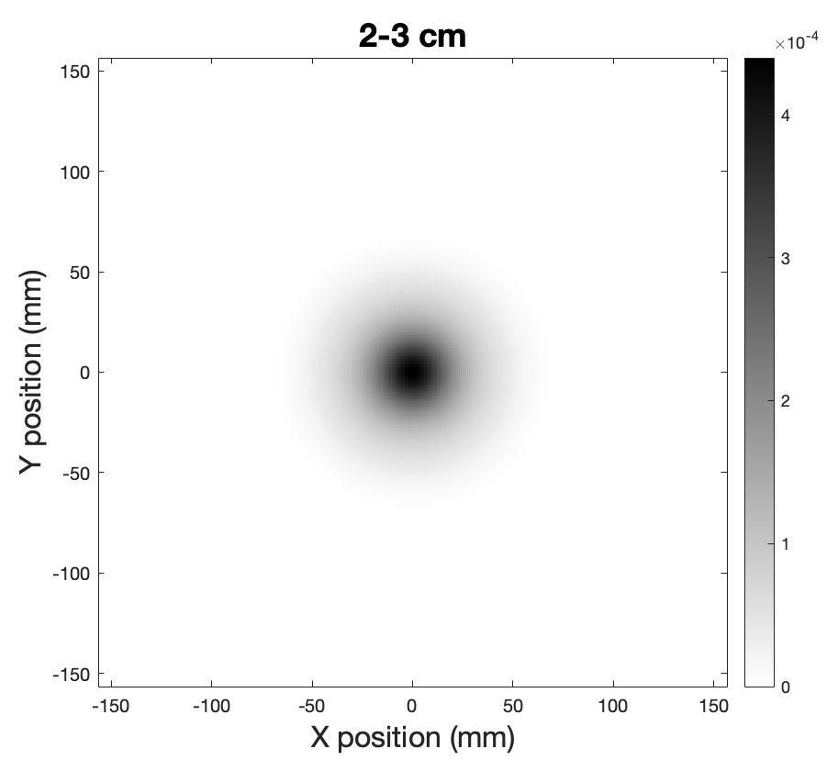
Resolution vs. Height in Detector
PSF
Height of 25 mm gives 41 mm FWHM

Slide 9
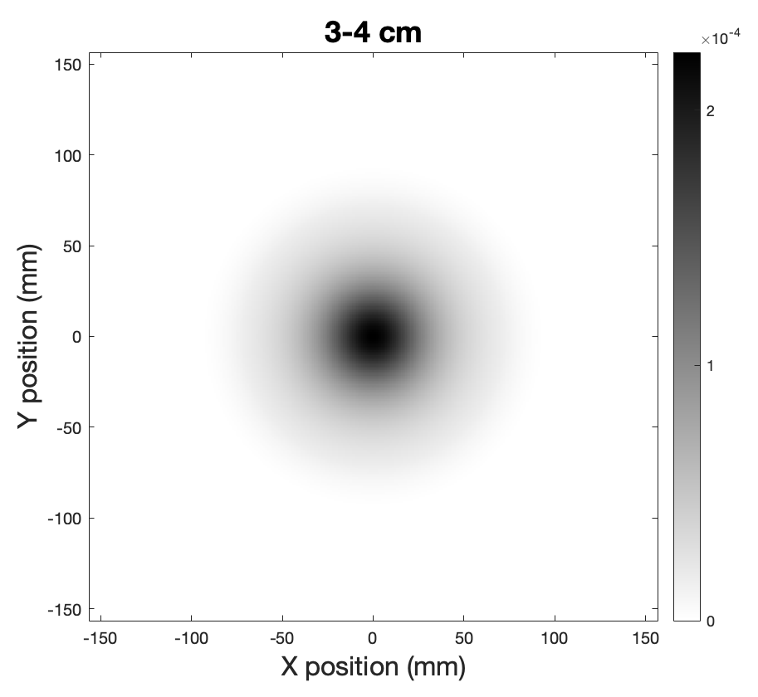
Resolution vs. Height in Detector
PSF
Height of 35 mm gives 59 mm FWHM

Slide 10

Resolution vs. Height in Detector
PSF
Height of 45 mm gives 75 mm FWHM

Slide 11
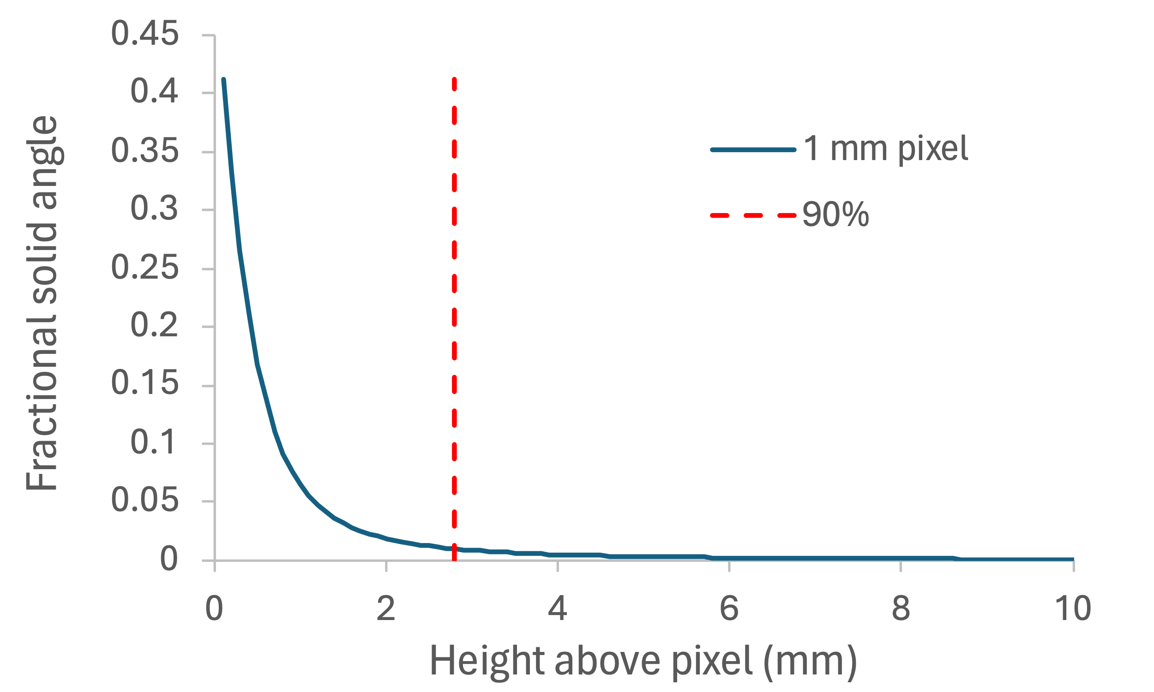
Contribution to Desired Resolution
For a monolithic scintillator, 90% of light collected on a 1 mm photosensor pixel originates in the lowest 2.8 mm of the column above it.
Most of the light is collected, but in the wrong place. What does this look like?

Slide 12
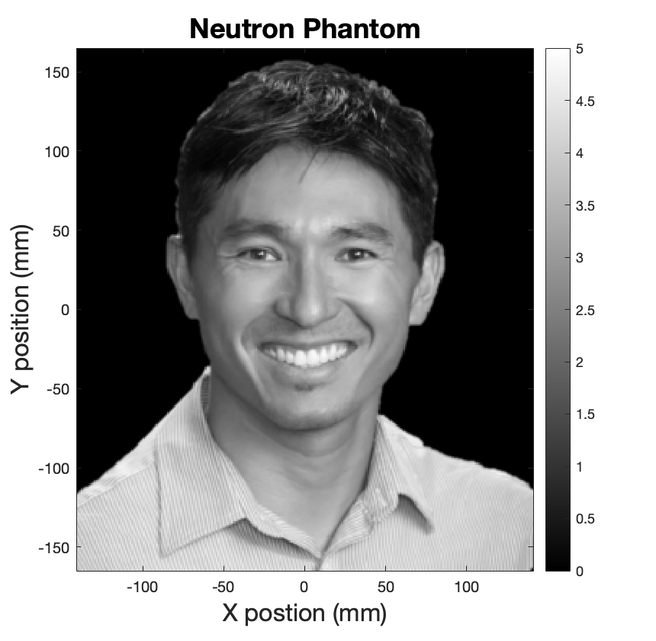

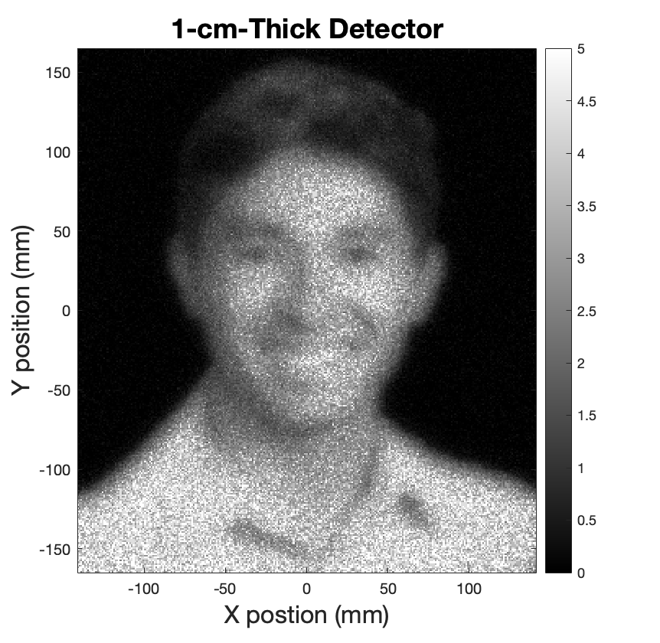
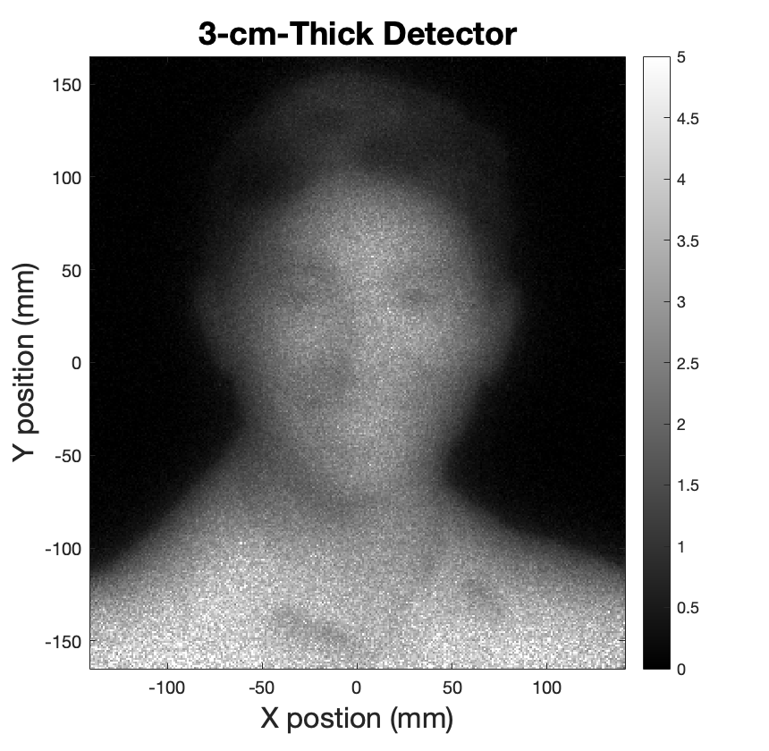
Effect of Thickness on Statistics, Resolution
3 mm
1 cm
No benefit from increased efficiency due to loss of resolution
3 cm
Mean free paths
Neutron phantom and idealized measurements by 0.3, 1.0, and 3.0 cm scintillator (5e8 neutron generator at 1 m for 60 s)

Slide 13

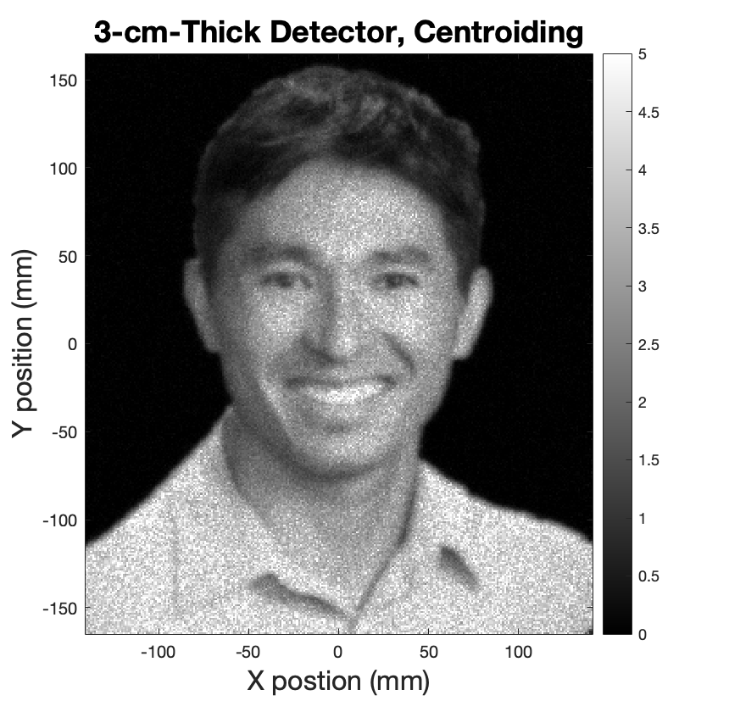

Recovering Resolution in Thick Detectors
Assume 2 mm optical channels
Assume pulse-counting, 100 photoelectrons in centroid
Resolution for thick detectors can be recovered by finding centroid of detected light or channeling light to photosensor

Slide 14
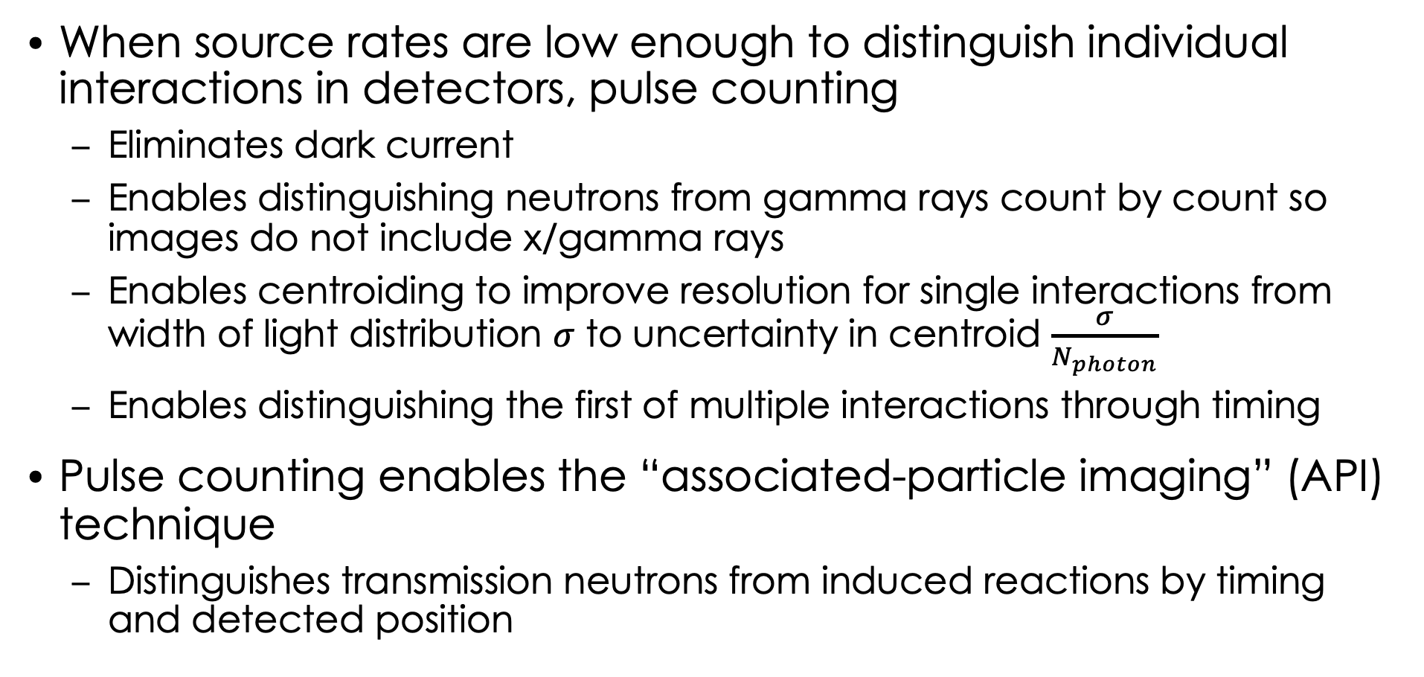
Pulse-Counting Detectors
When source rates are low enough to distinguish individual interactions in detectors, pulse counting
Eliminates dark current
Enables distinguishing neutrons from gamma rays count by count so images do not include x/gamma rays
Enables centroiding to improve resolution for single interactions from width of light distribution $σ$ to uncertainty in centroid $\frac{σ}{N_{photon}}$
Enables distinguishing the first of multiple interactions through timing
Pulse counting enables the “associated-particle imaging” (API) technique
Distinguishes transmission neutrons from induced reactions by timing and detected position

Slide 15

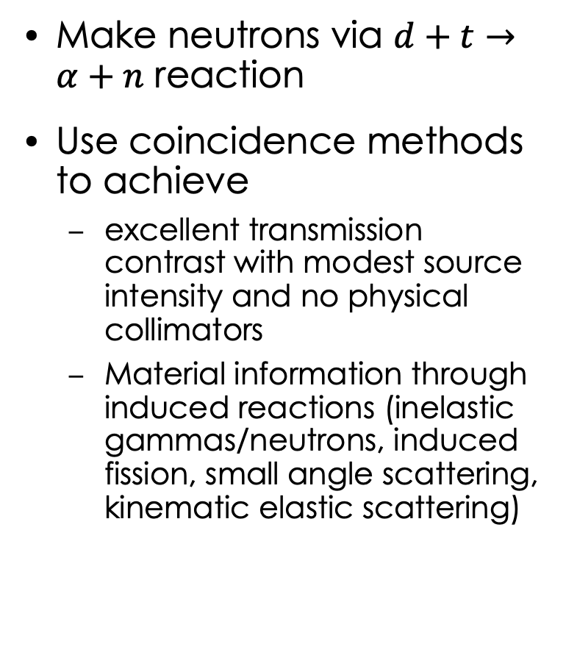
Imaging Using API Neutrons
Make neutrons via $d+t→α+n$ reaction
Use coincidence methods to achieve
excellent transmission contrast with modest source intensity and no physical collimators
Material information through induced reactions (inelastic gammas/neutrons, induced fission, small angle scattering, kinematic elastic scattering)
d⁺
n
α
Neutron source
Storage casting in shielded drum
Neutron Detector

Slide 16
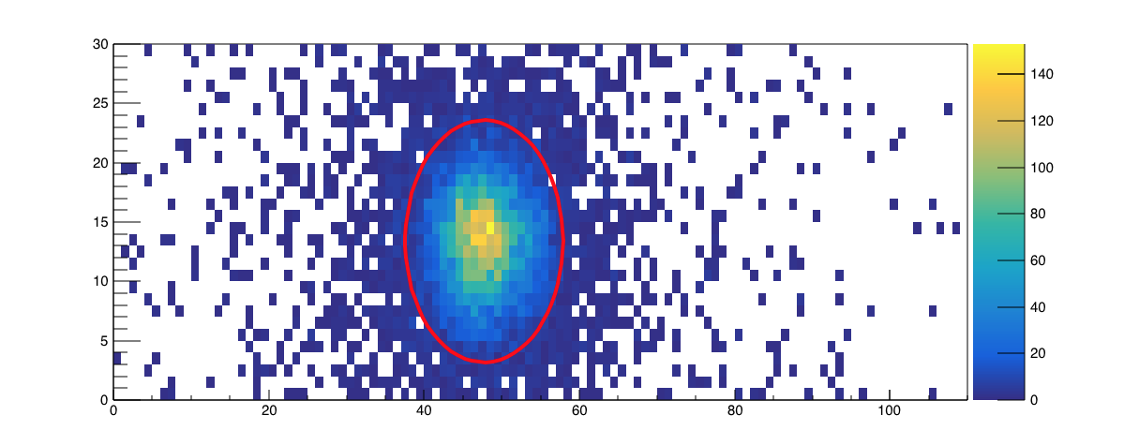
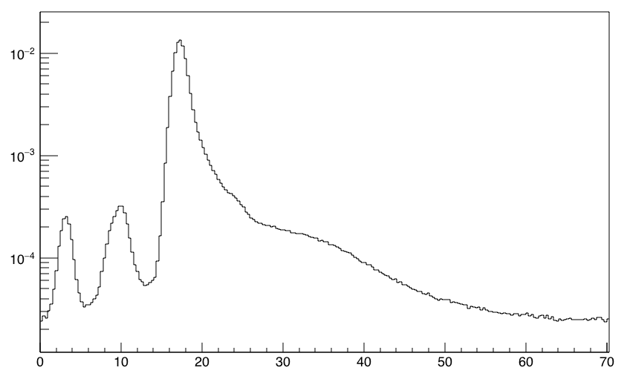
Imaging Using API Neutrons
Coincidence in space
d⁺
Transmission and small angle elastic scattering
n
α
Fission, inelastic scattering, hydrogen elastic neutrons
Neutron source
Counts per alpha
Storage casting in shielded drum
Neutron Detector
Time of Flight (ns)
Source and object gamma rays

Slide 17
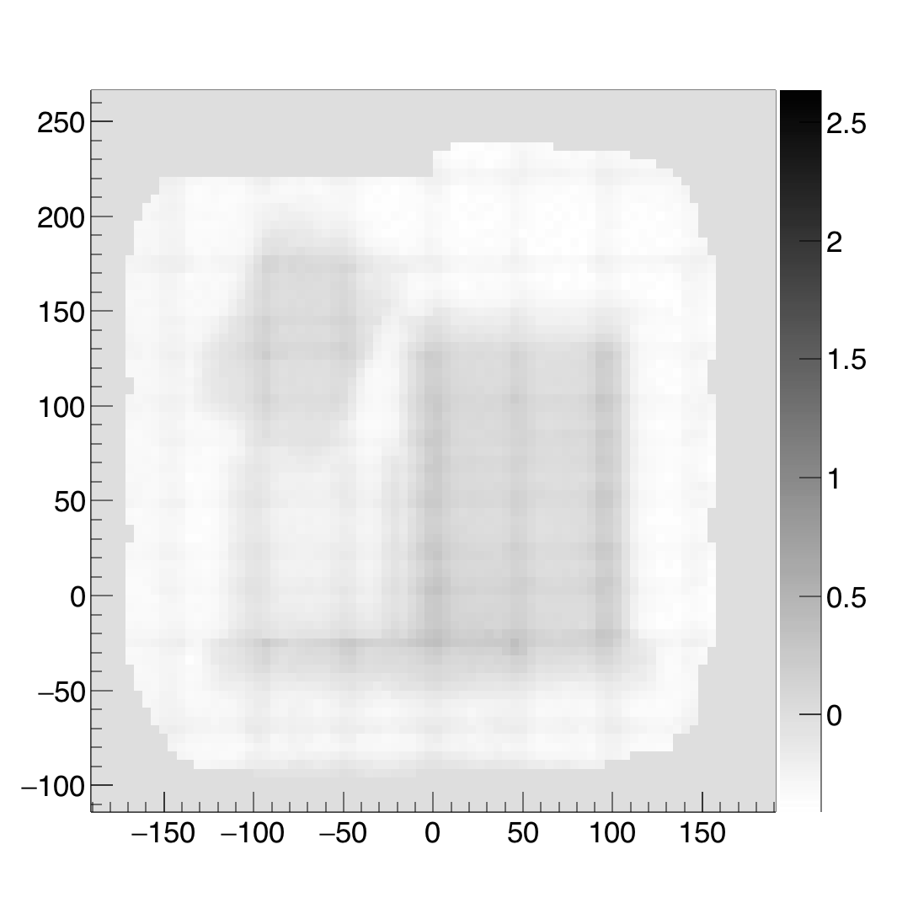
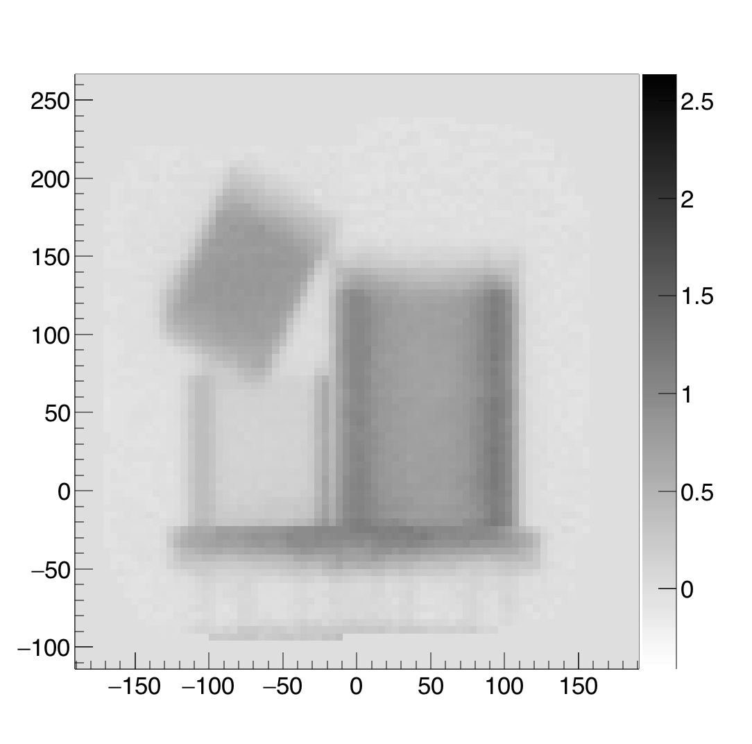
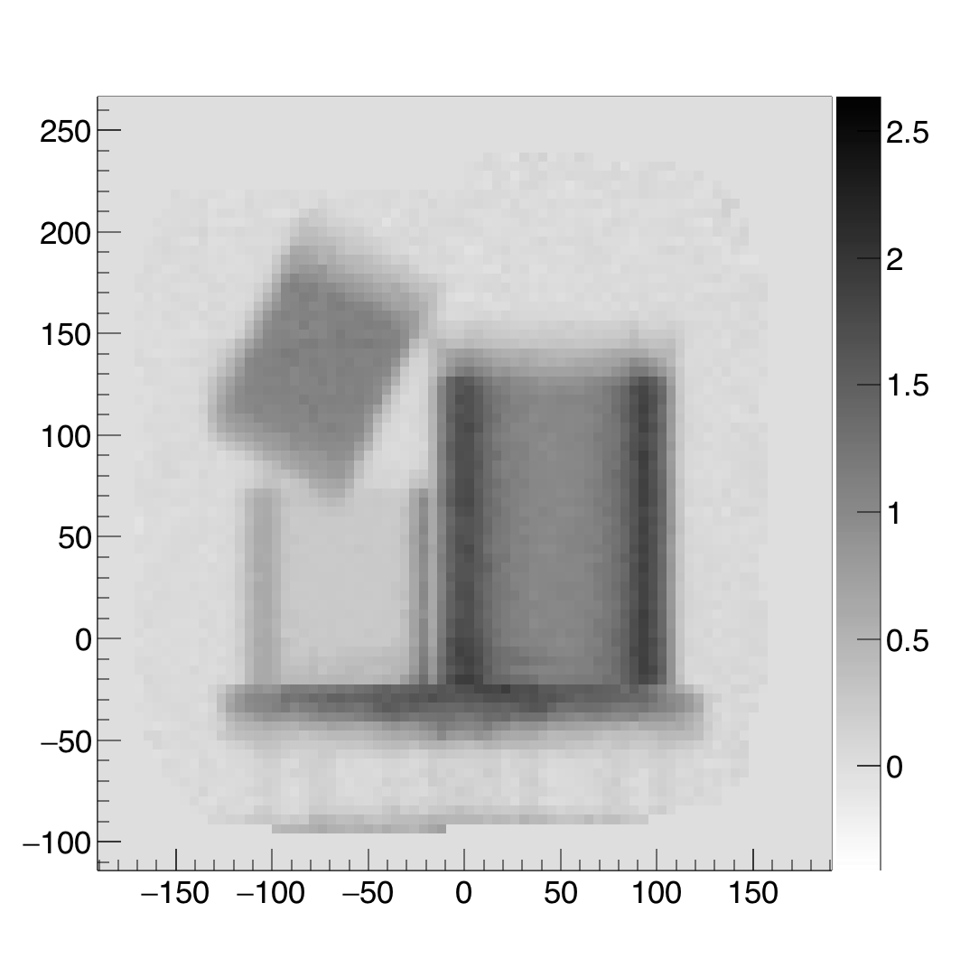
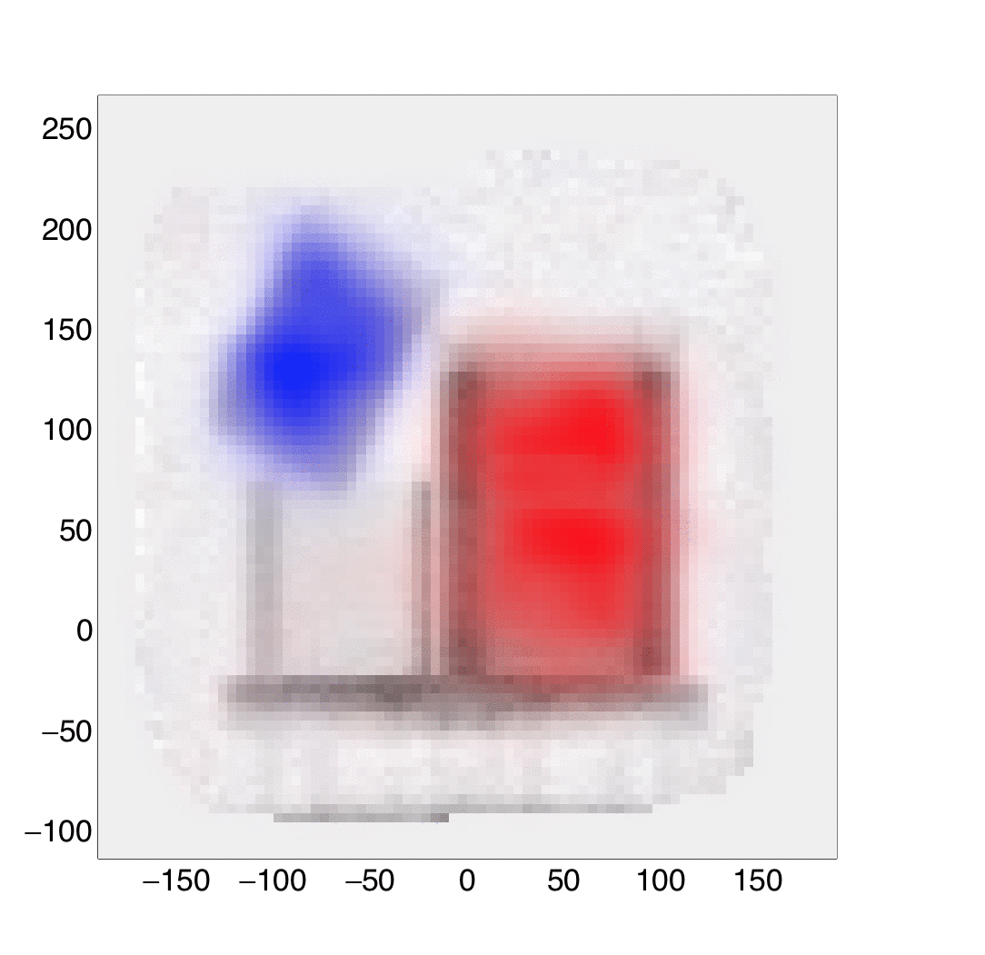
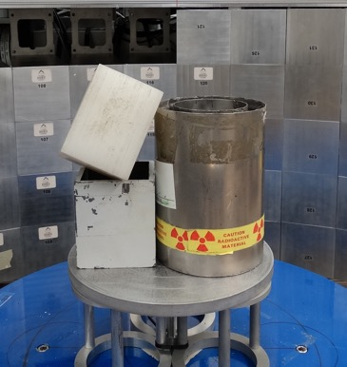
Example Images
No alpha tag
Any alpha tag
18 ns window
Alpha tag via pixels
3 ns window
Overlay of (blue) H-scatter and (red) fission doubles
Maximum attenuation level
Coincidence techniques enable excellent contrast
Use of late counts and initial trajectory enable labeling of (blue) hydrogen elastic scattering and (red) induced neutron doubles (fission) to assist in identification of materials

Slide 18
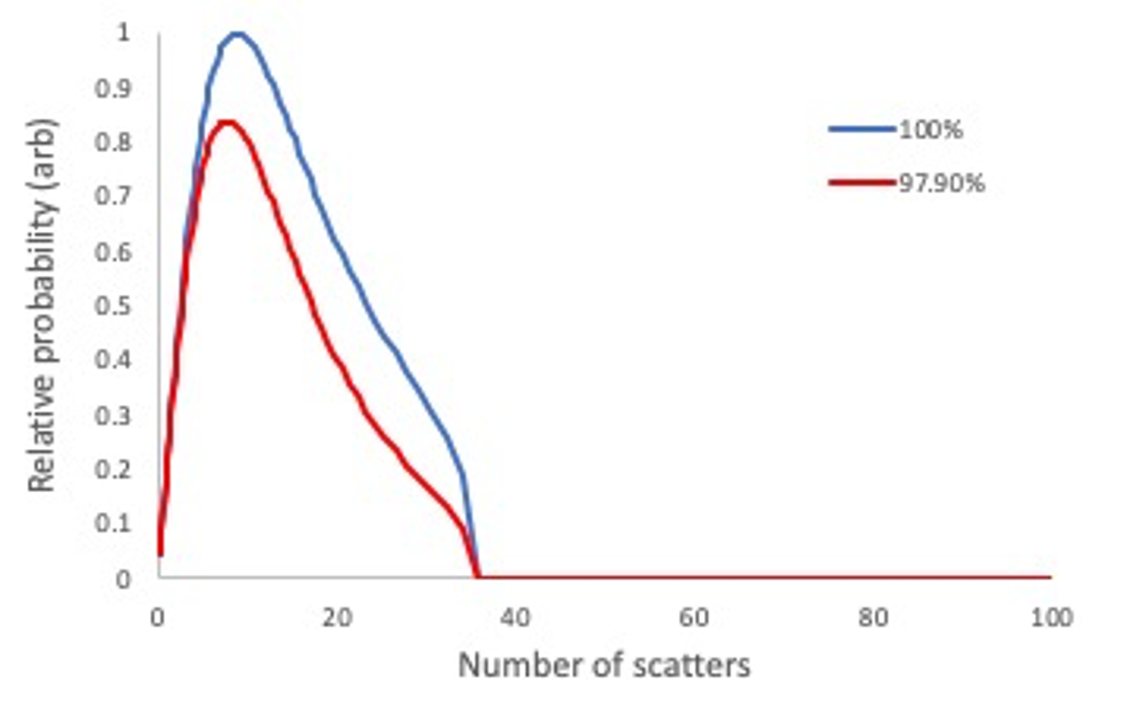
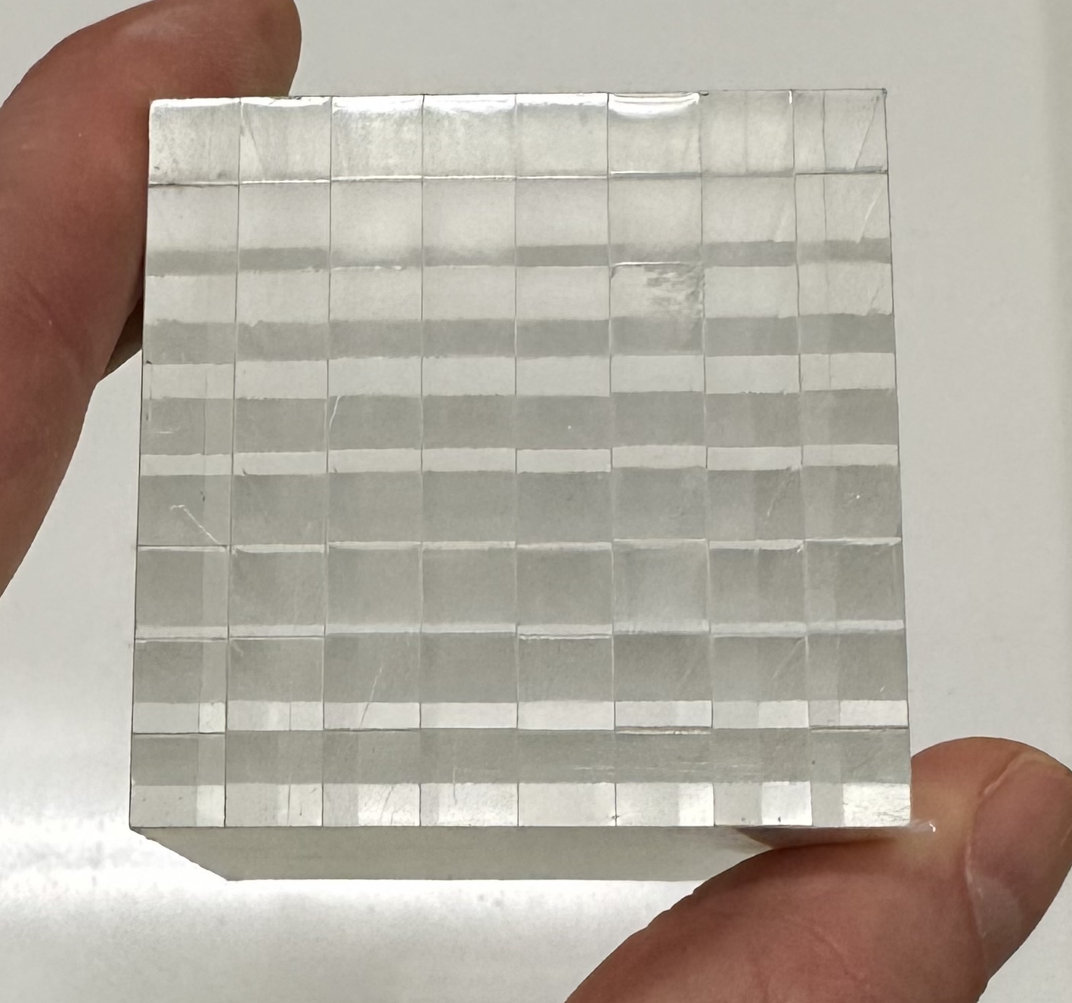
Structures that Guide Light: Precision Arrays
EJ-276D scintillator bonded with 3M ESR reflector (6-mm pixels)
10:1 aspect ratio
To collect 70% of ideal
Substantial effort (and material loss) to fabricate
Resolution determined by pixel; pixel size limited by
Breakage of pixel rows during fabrication
Light collection for high aspect ratio pixels
Dead area when fraction of reflector/bonds becomes large

Slide 19
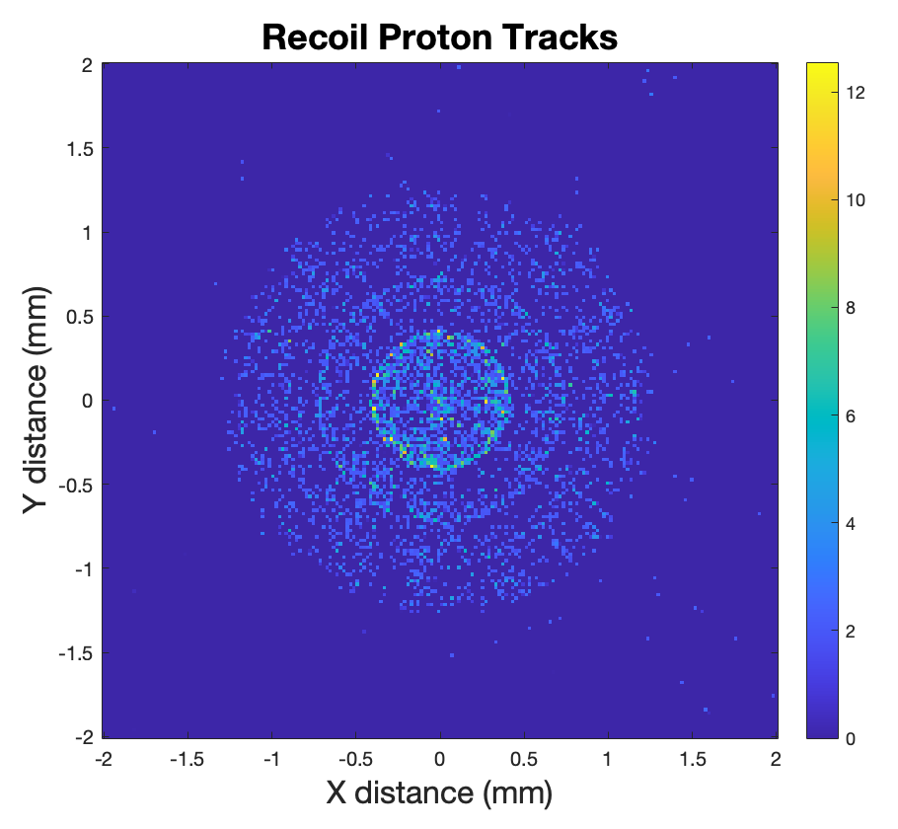
Smallest Optical Channels – Proton Track Lengths
Optical channels comparable to the recoil proton track will mean a sizable fraction of protons lose energy in inactive reflector/bond
For a pencil beam of neutrons, recoil proton can go as far as 1 mm in transverse direction
For this approach, 2-3 mm is a reasonable pixel dimension
1 mm

Slide 20
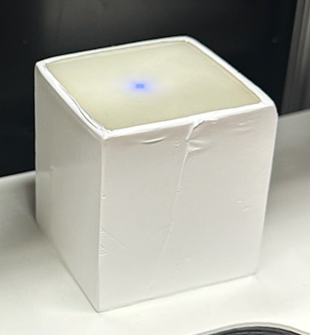
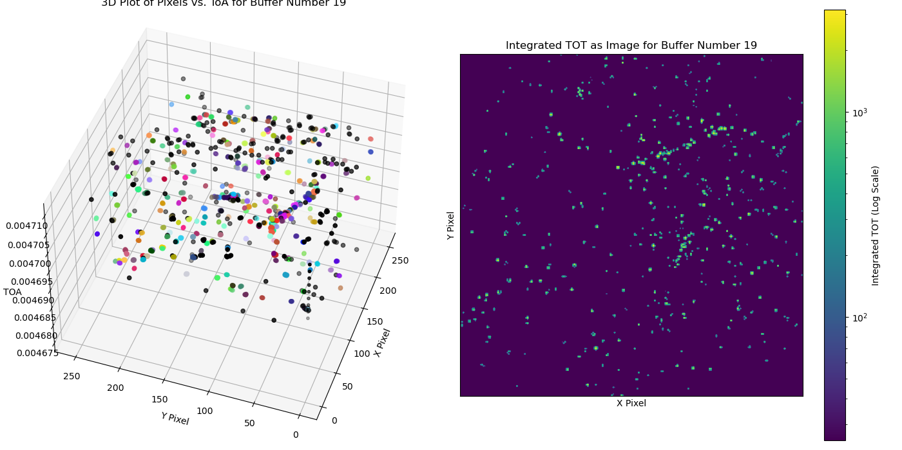
Structures that Guide Light: Nanoguide
Scintillating Nanoguide
Figure provided by Alex Long, LANL
Resolution possible to ~6-10 𝜇m – with this resolution, it is possible to see the transverse projection of proton recoil tracks, can be all scintillator
With this resolution, can in principle,
Reconstruct for the vertex of a proton track to achieve resolution of tens of microns
Check that the kinematics are consistent with origination in the neutron generator

Slide 21
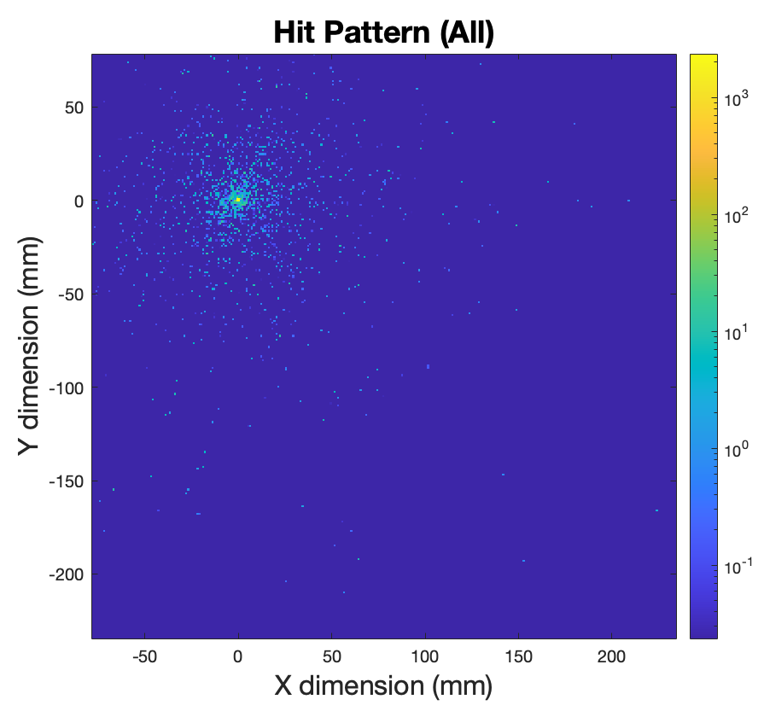
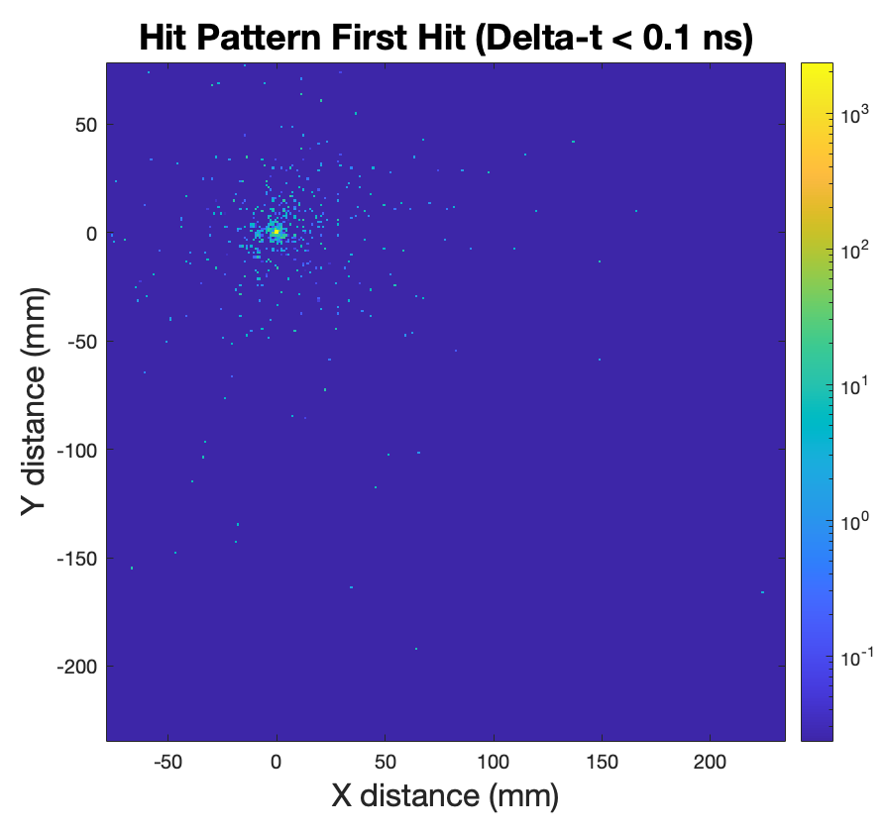
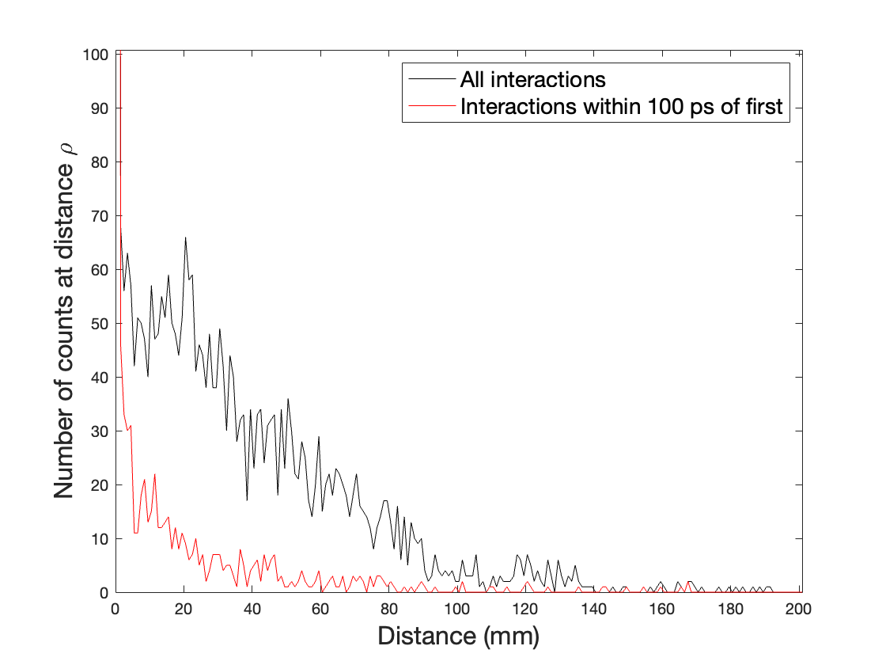
Scattering in Detector
With 5-cm-thick detector, 70% of hits are recorded away from initial incidence (primarily due to scattering off C)
Fast timing can eliminate most of the additional hits

Slide 22
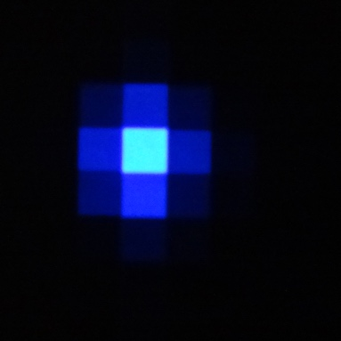
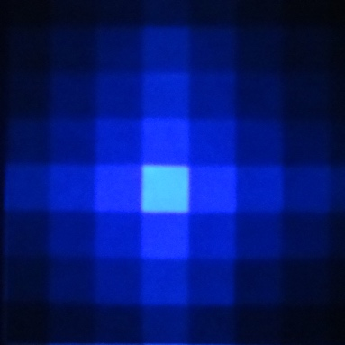
Parallax
Spread in light may be used to identify depth of interaction
For modest intensity neutron sources, expect source to be close (1-2 m) to detector
Non-normal incidence will blur resolution in detector, but depth resolution can recover resolution
For imaging, want single-sided readout

Slide 23
Review What We Want
For neutron imaging with modest sources, want thick, efficient detectors (~10% efficiency for 14 MeV transmission requires 3 – 5 cm)
Optical structuring essential to maintaining mm scale spatial resolution in a way that maintains active volume and light collection (small differences in reflectivity are big when reflecting 25 times)
Thick detectors involve additional challenges
Fast timing (~200 ps FWHM) can identify first of multiple interactions
Want depth resolution approximately 2.5 times the pixel width to mitigate parallax, ideally from single-sided readout
Fast timing (~ 200 ps FWHM) also desirable to reject random coincidences for API imaging
Do all the above while maintaining neutron-gamma discrimination

