Slide 1
Temperature dependent non-linearity and gamma spectral stabilization for inorganic scintillators
Irakli Garishvili
WIP seminar
Mar 1, 2024

Slide 2
Problem setup
Inorganic scintillator detectors (NaI (Tl), etc) most common gamma-ray detection instruments used for radiological and nuclear threat search and monitoring applications in urban and open-field environments.
Accurate calibration needed for algorithms for precise isotope identification
Environment change can have large effects on detector response(gain drift etc.)
Bad adjustment to gain drift -> Bad calibration -> false alarms and missed sources
Focusing on NaI(Tl) but results applicable to other non-organic scintillators

Slide 3
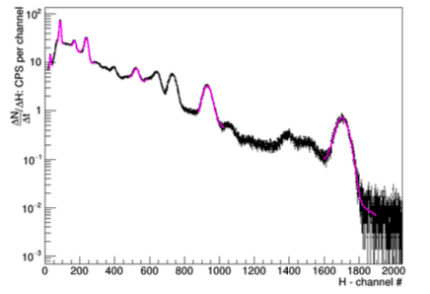
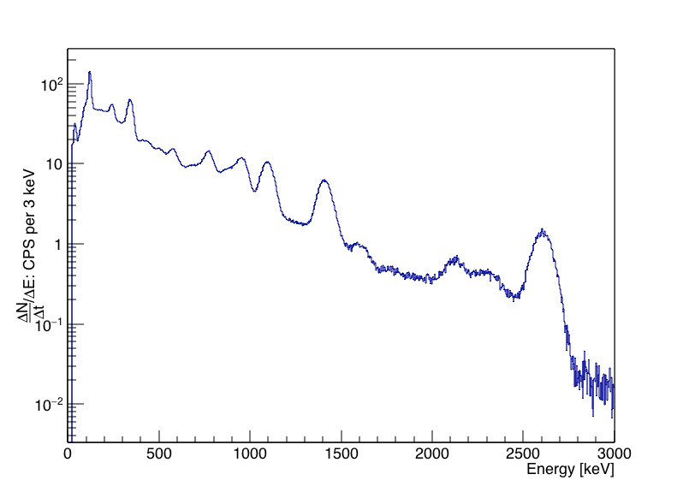
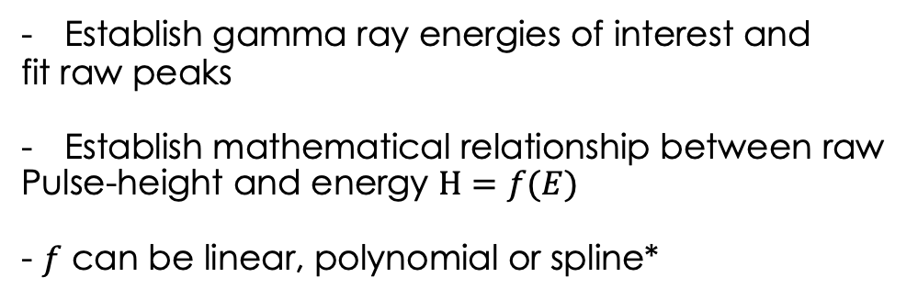
Response to gamma-ray: calibration
Establish gamma ray energies of interest and
fit raw peaks
Establish mathematical relationship between raw
Pulse-height and energy $H=f(E)$
- $f$ can be linear, polynomial or spline*
Raw gamma-ray pulse-height spectrum measured with the 2”×4”×16”
NaI(Tl) detector at 25oC for Eu152 source
Calibrated spectrum
Eu152 gamma lines used:
39.91 keV, 121.78 keV, 244.69 keV, 344.29 keV, 778.92 keV and 1,408.00 keV
Th232:
2614keV

Slide 4
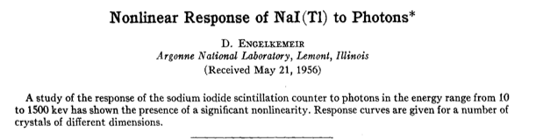
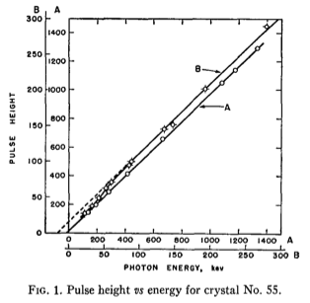
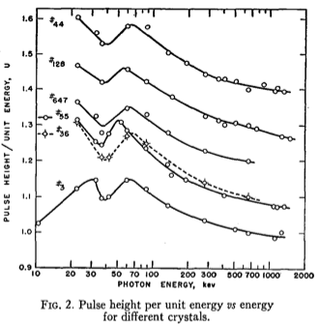
- Response to gamma rays is not linear
Largest deviation from linear scale below
100keV
- Cause is likely interplay between light production physics in crystal and PMT mechanics

Slide 5
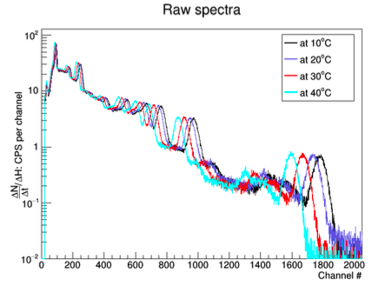
Detector response vs temperature
- Detector response substantially change with temperature variation
- Solution1: New calibration every time change occurs
- Or active feedback gain stabilization: i.e. constantly adjusting gain based on some reference raw gamma peak
- Is there a better option?
Raw gamma-ray pulse-height spectra measured with the 2”×4”×16”
NaI(Tl) detector at 25oC for Eu152 source vs various temperatures

Slide 6
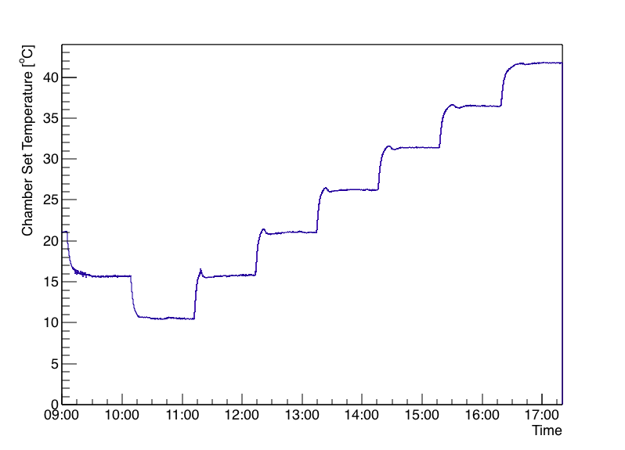
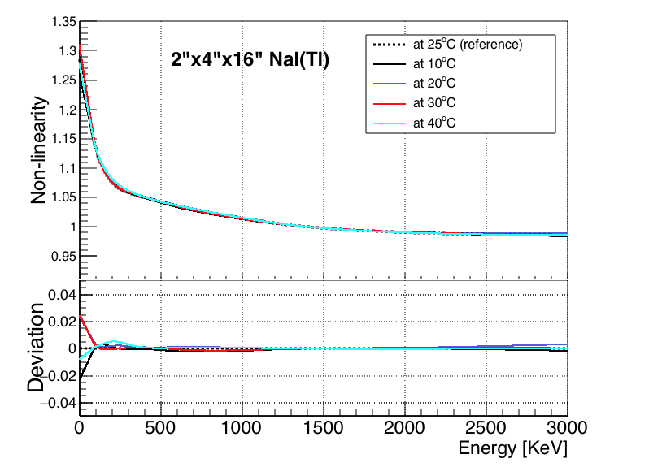
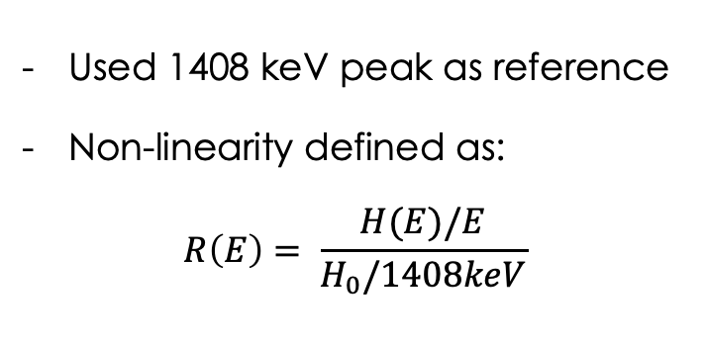
Non-linearity vs. Temperature
Used 1408 keV peak as reference
Non-linearity defined as:
$$R\left(E\right)= \frac{H(E)/E}{H_{0}/1408keV}$$
Environmental chamber temperature profile as
a function of time during the measurements.
Measurements show that above 100keV Non-linearity
is unchained as a function of temperature within 0.5% accuracy
Below 100keV get worse… but needed more peak due to complicated gamma response

Slide 7
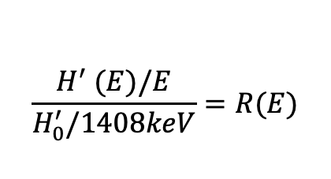
Extracting “changed” calibration from non-linearity curve
- Assuming non-linearity is constant vs Temperature:
$$\frac{H^{′} (E)/E}{H_{0}^{′}/1408keV}=R(E)$$
R’(E) = R(E)

Slide 8
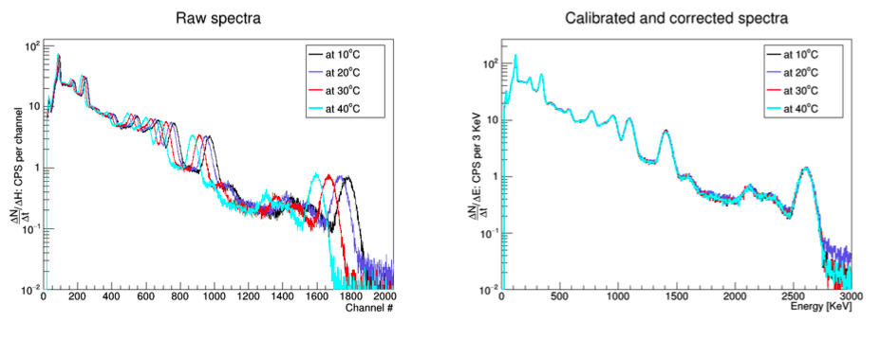
Extracting “changed” calibration from non-linearity curve
- Assuming non-linearity is constant vs Temperature:
$$\frac{H^{′} (E)/E}{H_{0}^{′}/1408keV}=R(E)$$
R’(E) = R(E)

Slide 9
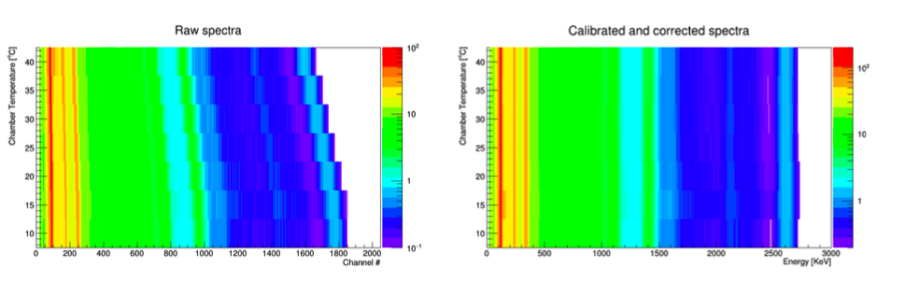
calibration from non-linearity curve for wider T range

Slide 10
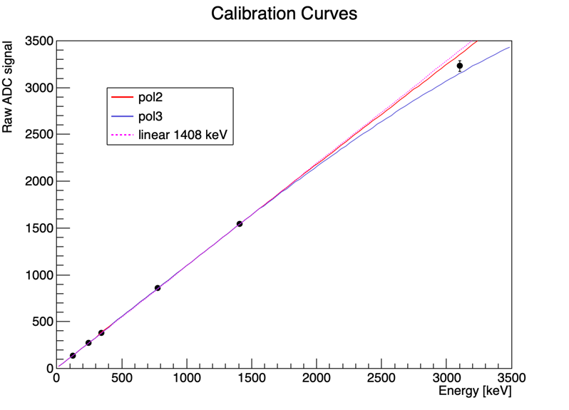
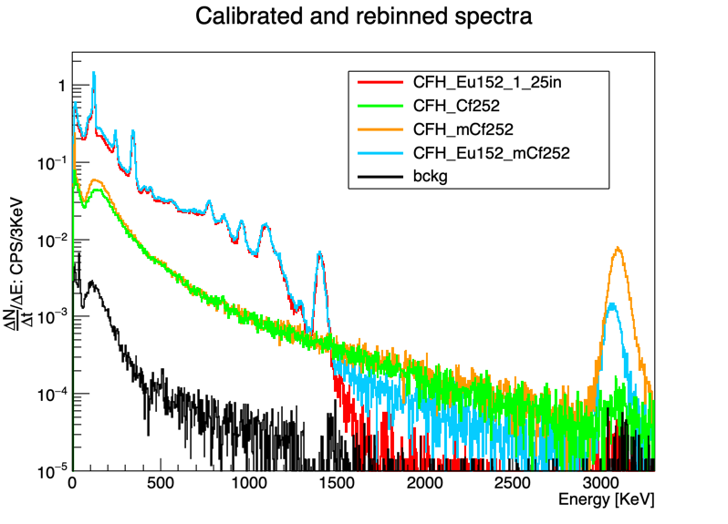
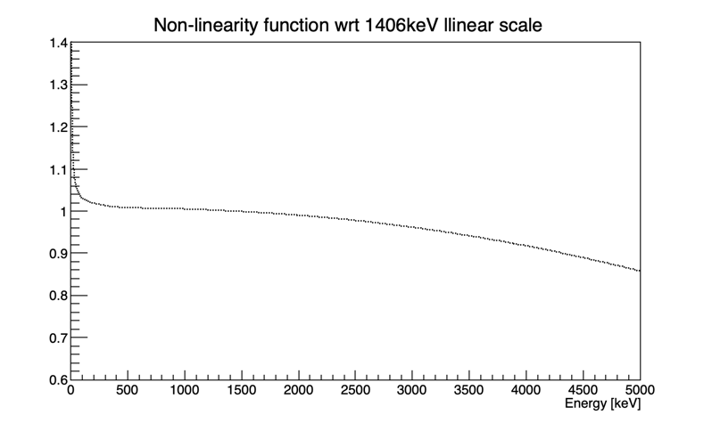
CLLBC detector
Final calibration ~1-1.5% at 3.1 MeVee

