Slide 1
Systematics and Other Updates
Frank Gonzalez
1/17/2023

Slide 2
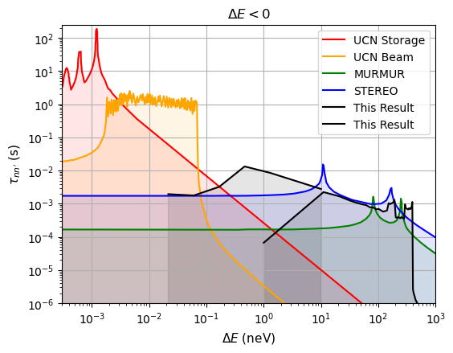
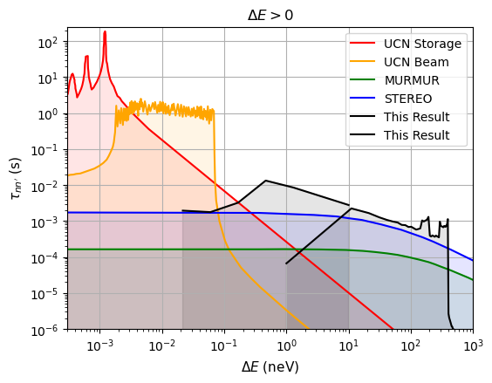
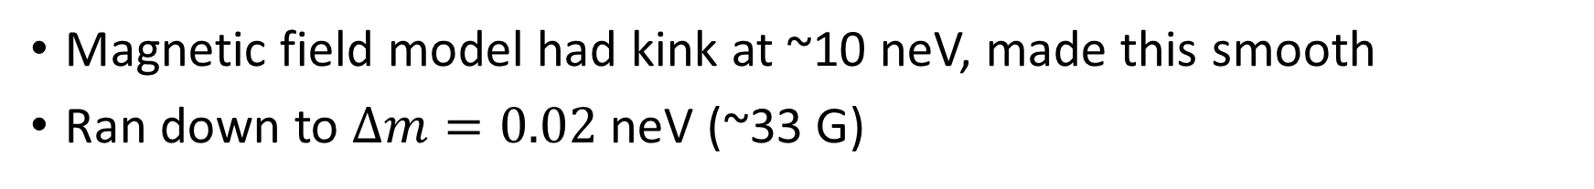

Extending to Lower $Δm$
Magnetic field model had kink at ~10 neV, made this smooth
Ran down to $Δm=0.02$ neV (~33 G)

Slide 3
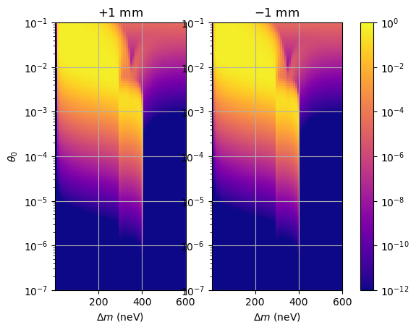
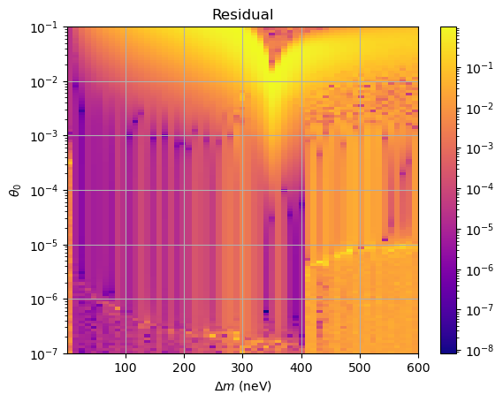

Shifting Position
Shifted the beamstop by $±1$ mm in z, re-simulated
Tentative, need to figure out the shift and assign an uncertainty

