Slide 1
ORNL-UTK
Group Research Meeting 11/1/22
Devyn Powers
UTK Dept. of Physics and Astronomy

Slide 2
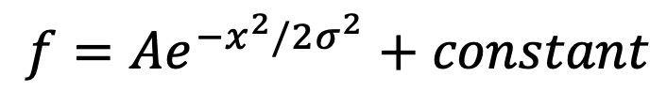
Current task
Fit simulation background data to Gaussian function, minimize chi squared per NDOF
Three parameters in function:
  A, sigma, constant
Optimization function in SciPy library can take an initial guess of parameters and minimize chi squared for best fit
$$f=Ae^{−x^{2}/2σ^{2}}+constant$$

Slide 3
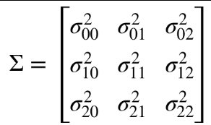
Covariance Matrix
SciPy function returns a covariance matrix along with minimized chi squared and corresponding parameters
Covariance matrix describes a “link” between different parameters
  Correlation between parameters
  In this case, A, sigma, constant
Diagonal of matrix gives respective errors of three parameters
  Example:

Slide 4
Data Table
Raw data for Monte Carlo simulations from 18-24pc, along with new data for new 18pc simulations with differing numbers of source particles from Dr. Heilbronn:

Slide 5
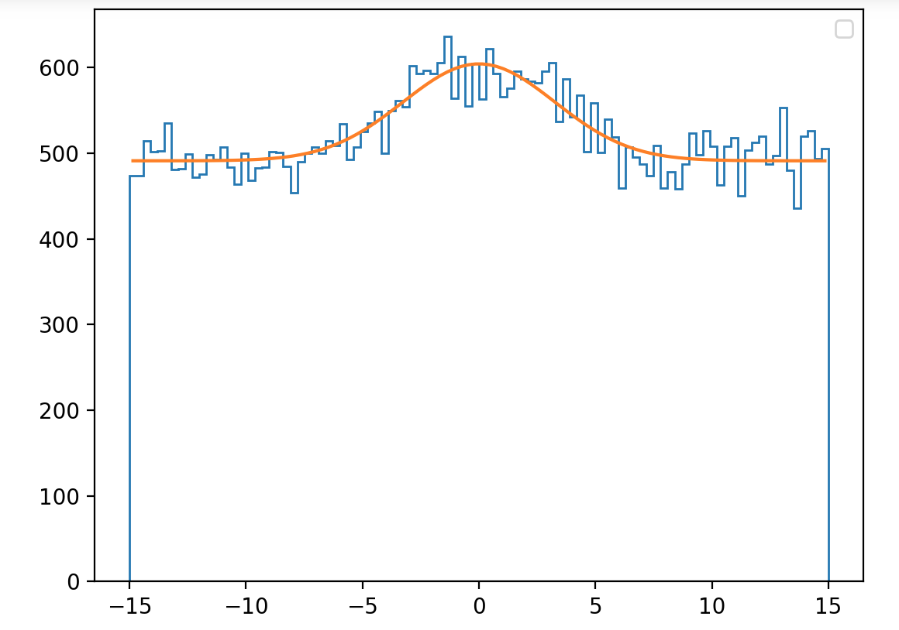
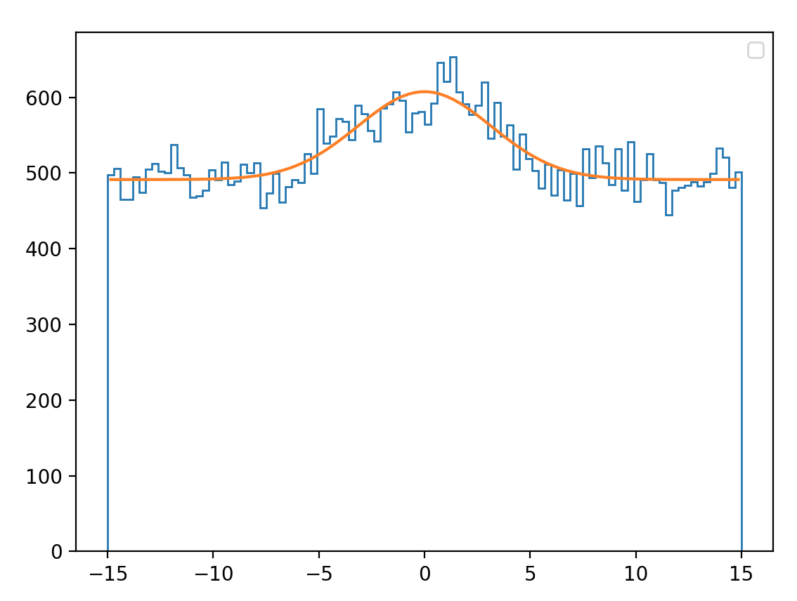
Old data – 1e9 source particles (room temp)
18 pc – horizontal x pixel
18 pc –vertical y pixel
Counts
Counts
Position [cm]
Position [cm]

Slide 6
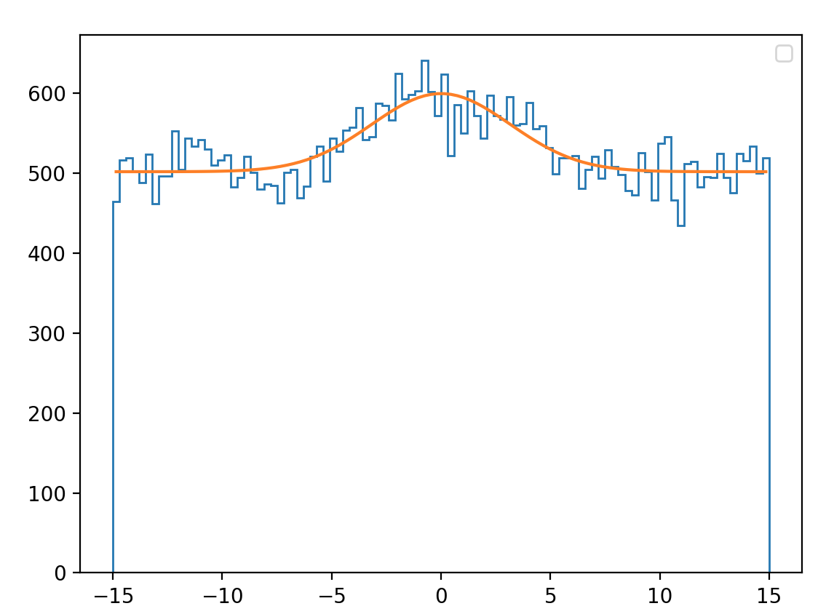
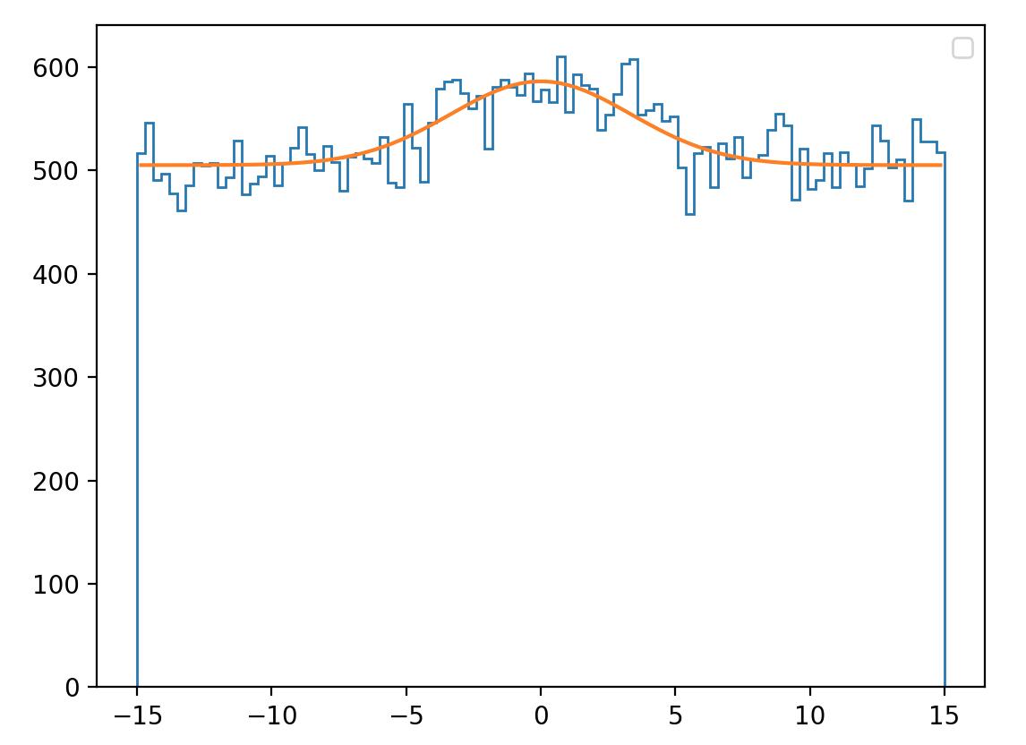
Old data – 1e9 source particles (room temp)
19 pc – horizontal x pixel
19 pc –vertical y pixel
Counts
Counts
Position [cm]
Position [cm]

Slide 7
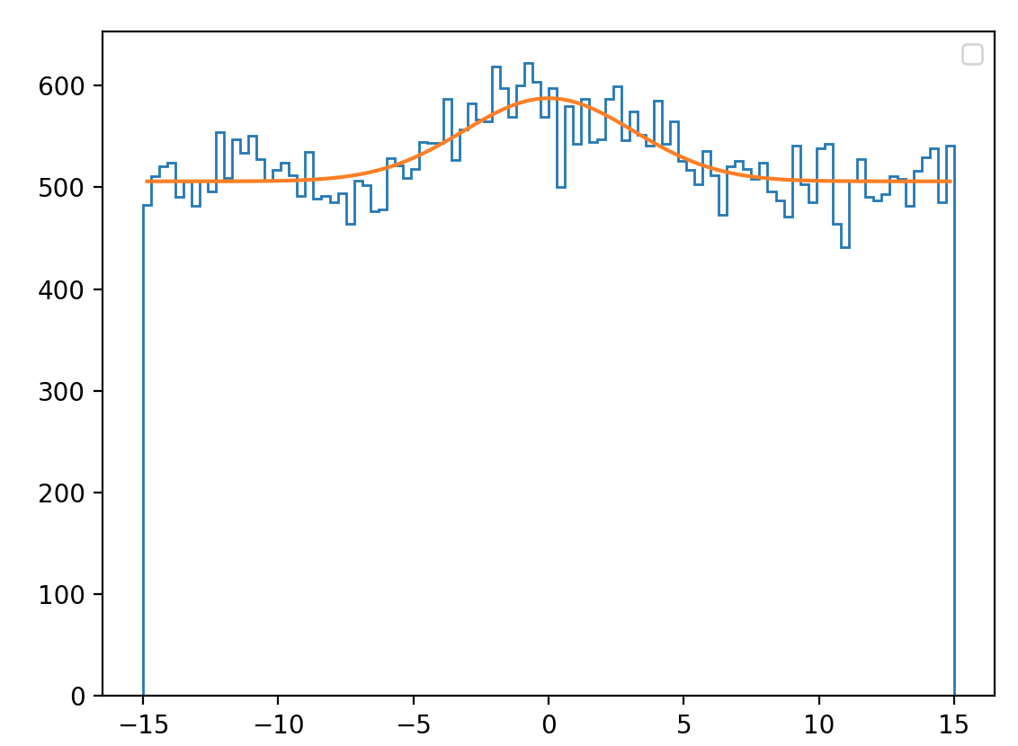
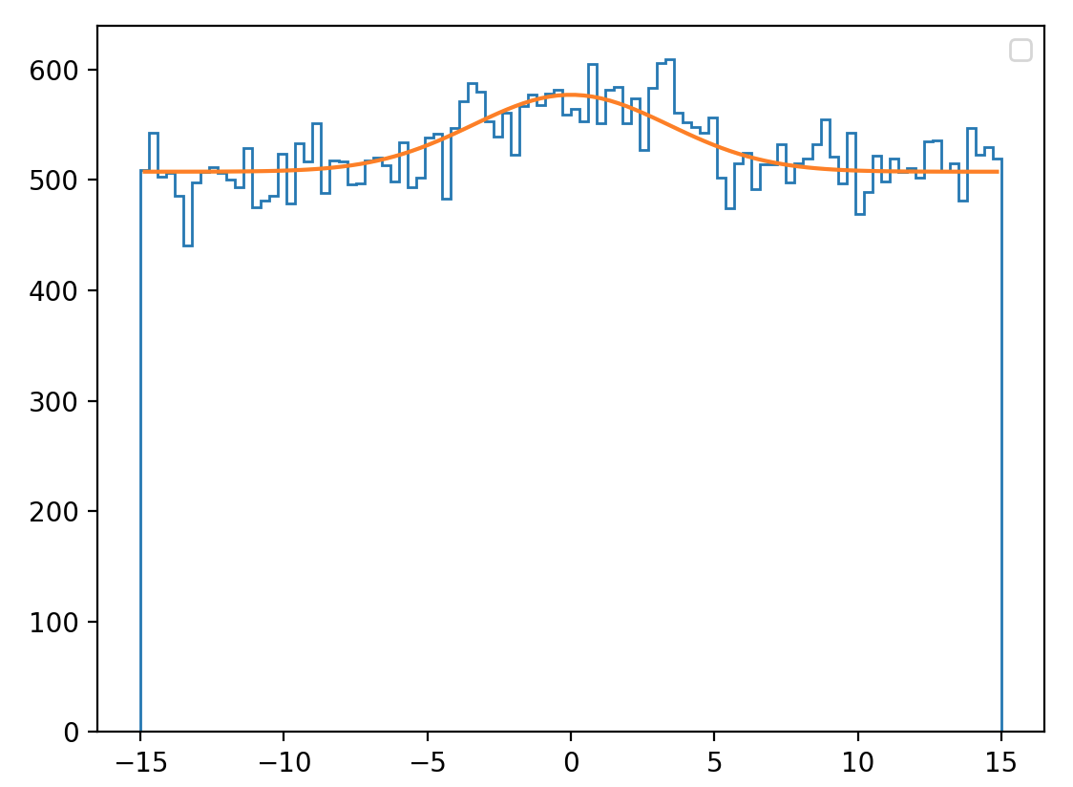
Old data – 1e9 source particles (room temp)
20 pc – horizontal x pixel
20 pc –vertical y pixel
Counts
Counts
Position [cm]
Position [cm]

Slide 8
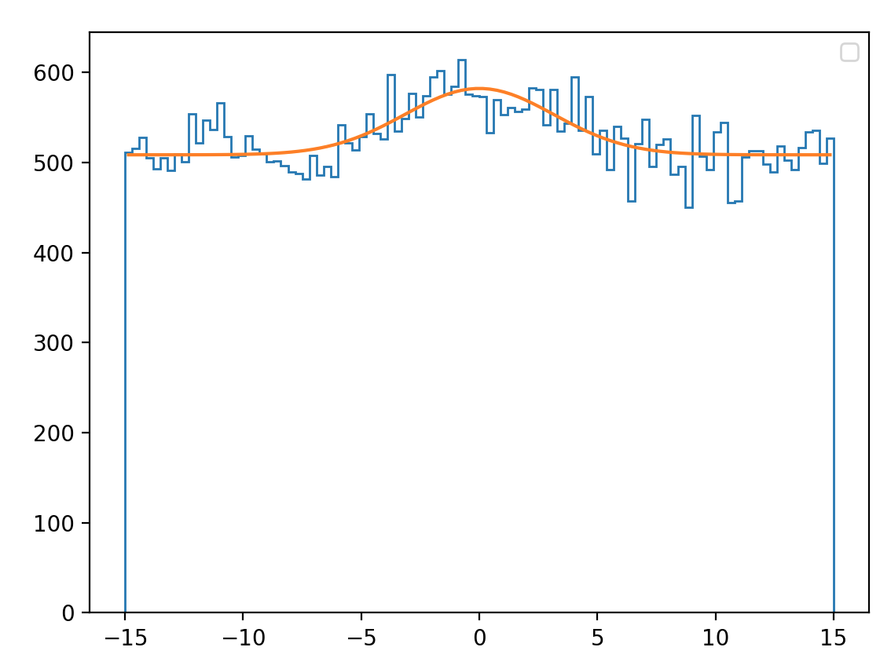
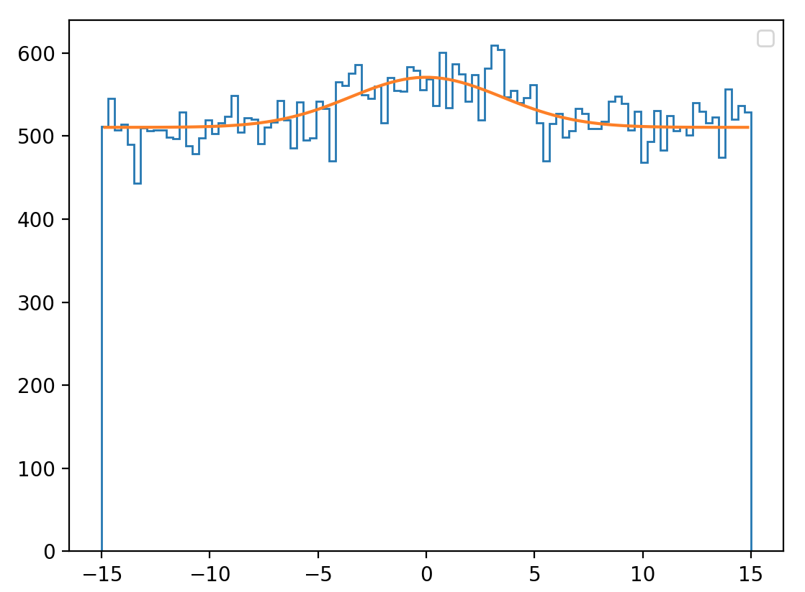
Old data – 1e9 source particles (room temp)
21 pc – horizontal x pixel
21 pc –vertical y pixel
Counts
Counts
Position [cm]
Position [cm]

Slide 9
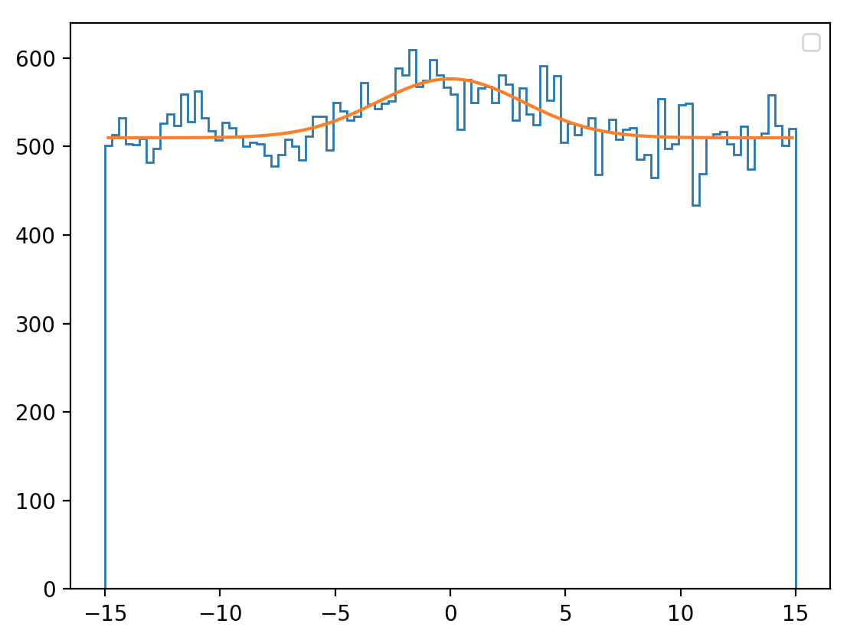
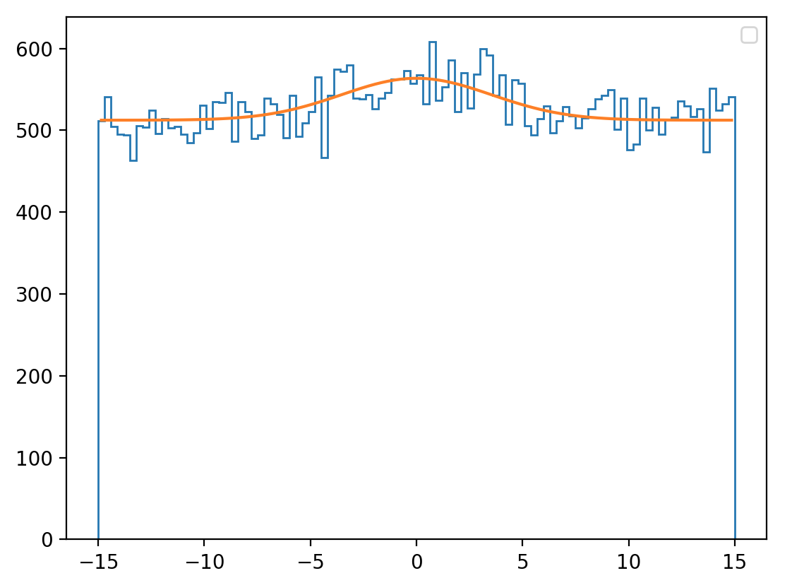
Old data – 1e9 source particles (room temp)
22 pc – horizontal x pixel
22 pc –vertical y pixel
Counts
Counts
Position [cm]
Position [cm]

Slide 10
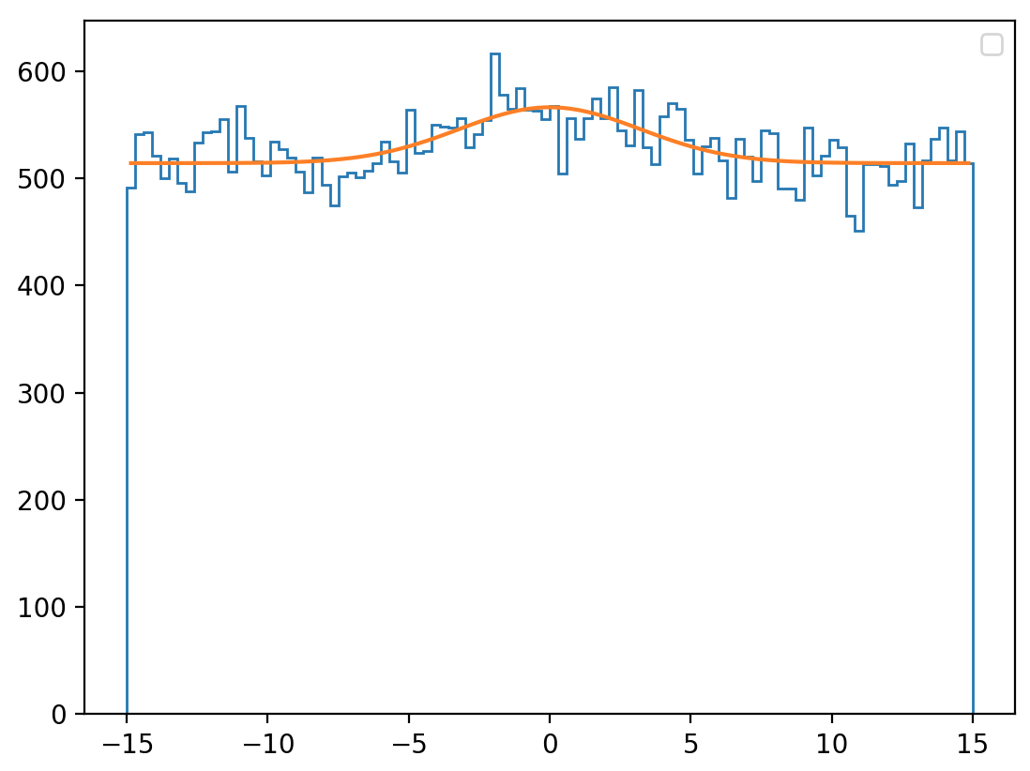
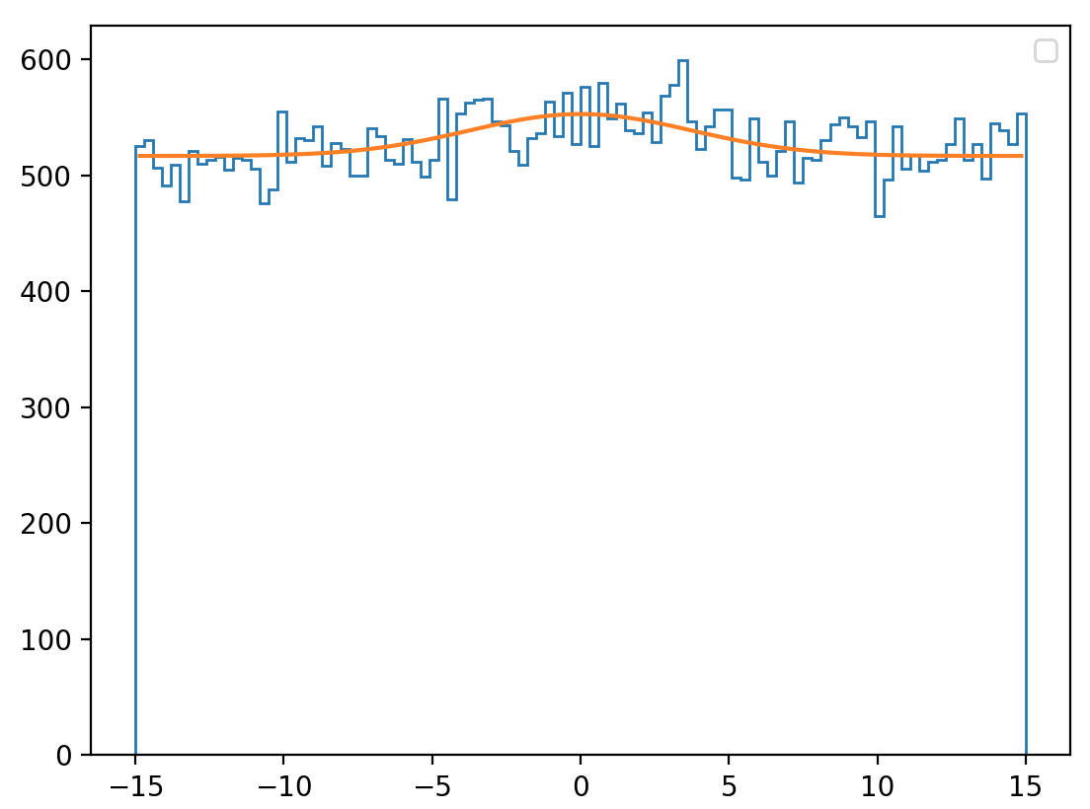
Old data – 1e9 source particles (room temp)
24 pc – horizontal x pixel
24 pc –vertical y pixel
Counts
Counts
Position [cm]
Position [cm]

Slide 11
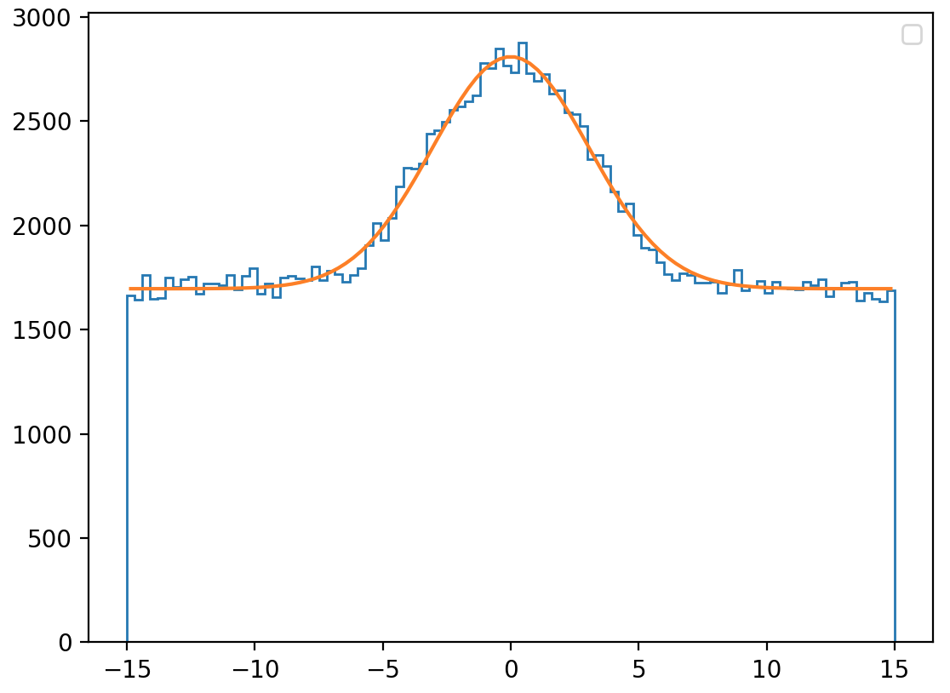
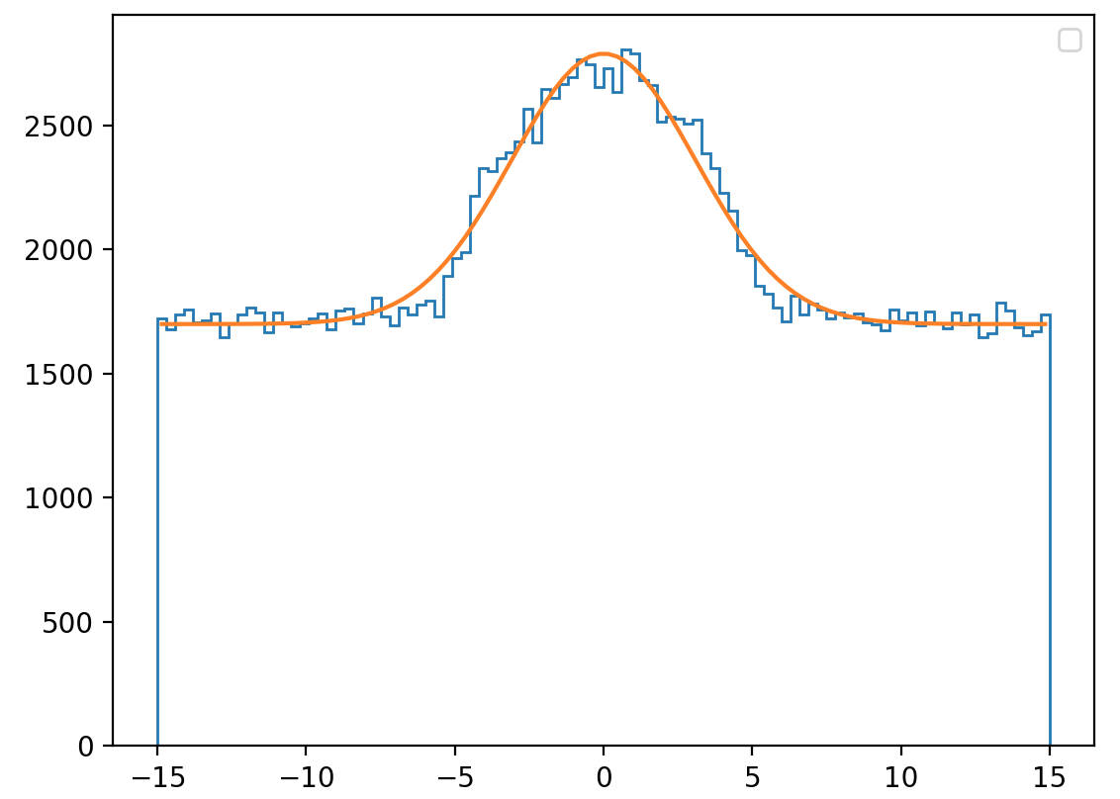
New data (Oct. 1) – 18 pc, 3.5e9 source particles (room temp)
18 pc (3.5e9) – horizontal x pixel
18 pc (3.5e9) –vertical y pixel
Counts
Counts
Position [cm]
Position [cm]

Slide 12
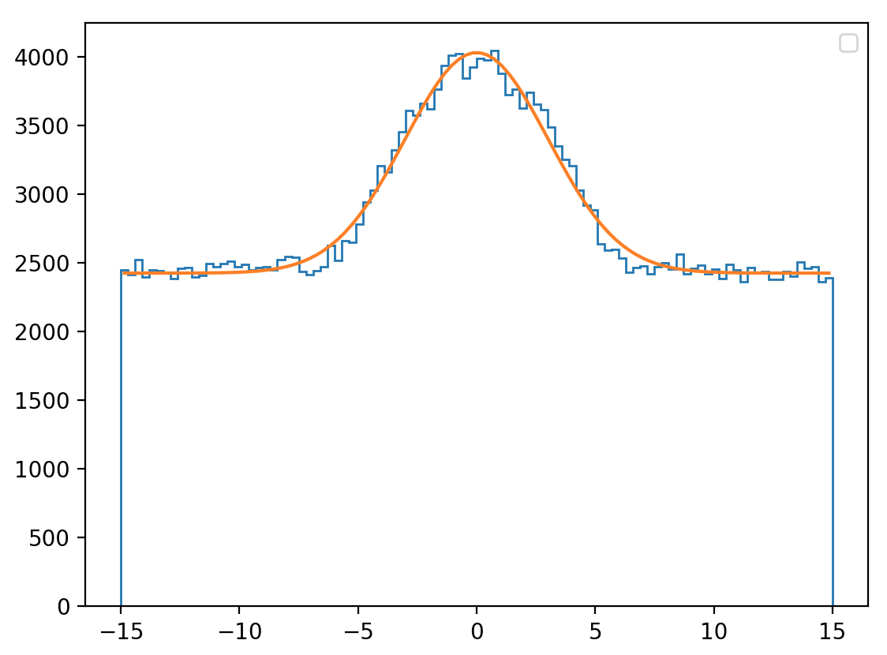
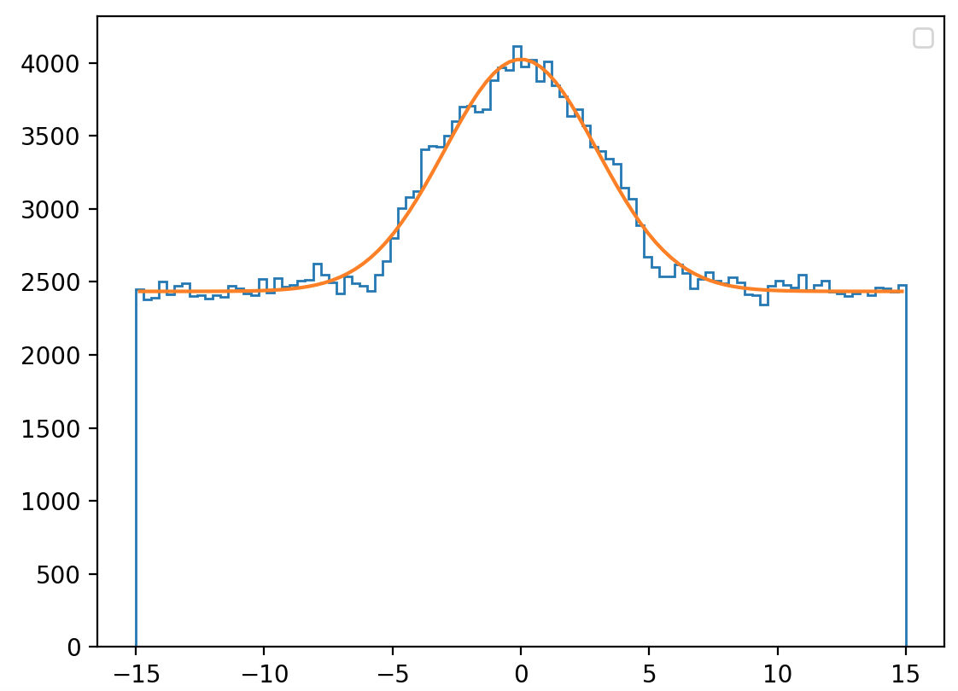
New data (Oct. 1) – 18 pc, 5e9 source particles (room temp)
18 pc (5e9) – horizontal x pixel
18 pc (5e9) –vertical y pixel
Counts
Counts
Position [cm]
Position [cm]

Slide 13
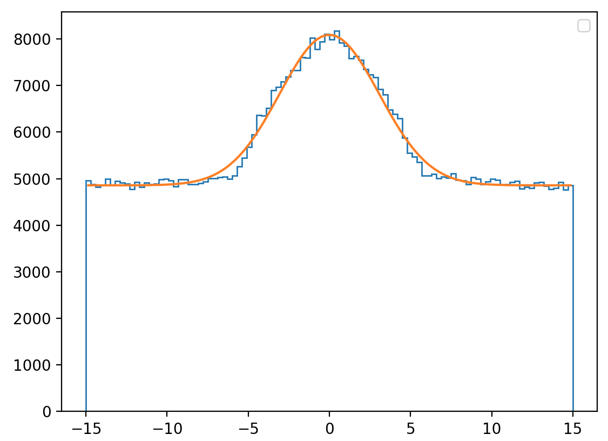
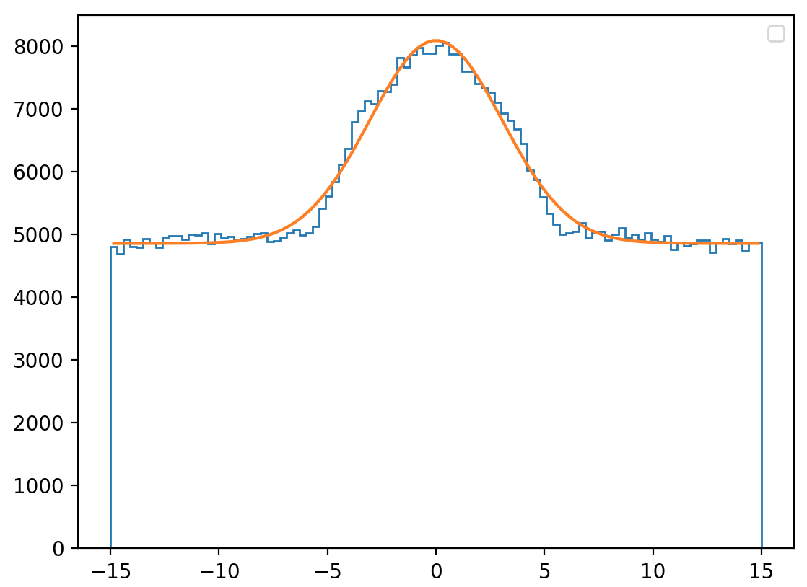
New data (Oct. 1) – 18 pc, 1e10 source particles (room temp)
18 pc (1e10) – horizontal x pixel
18 pc (1e10) –vertical y pixel
Counts
Counts
Position [cm]
Position [cm]

