Slide 1
A “Speed Limit” for Neutron Detection in Commerce
“Work in Progress” 3 June 2022
Paul Hausladen, Jason Newby, Lorenzo Fabris, Angela Lousteau, Jason Nattress, Ian Gross, Kirsten Pena

Slide 2
Application
Suppose you are looking for contraband neutron sources…
Traditional approach
  Radiation portal monitors (RPMs) at chokepoints (border crossings, entrances to facilities) measure vehicles singly and at low speed with detectors close to traffic
Nontraditional approaches
  Screen without impeding traffic
  Detector networks, imaging detectors, contextual sensors, machine learning
Want
  A way to compare performance of potentially very different systems
  The “speed limit” for detection/quantification limited by statistical fluctuations alone

Slide 3
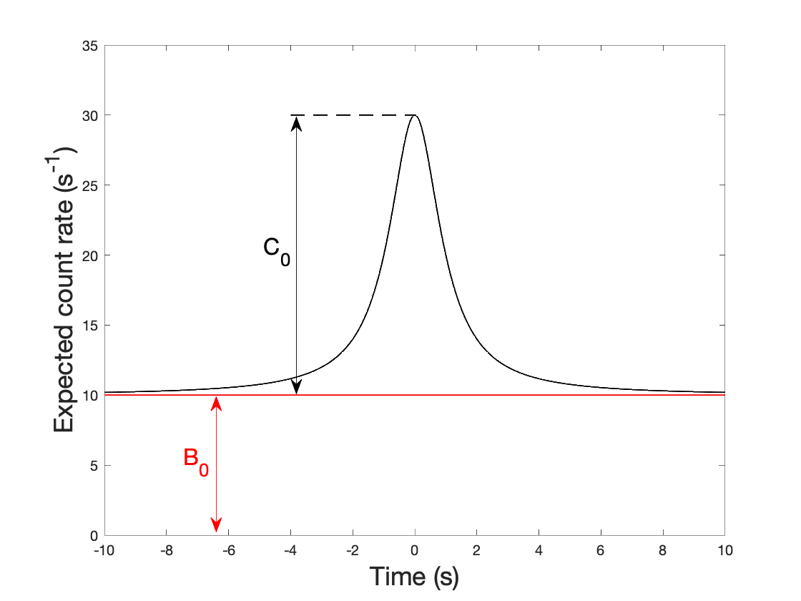
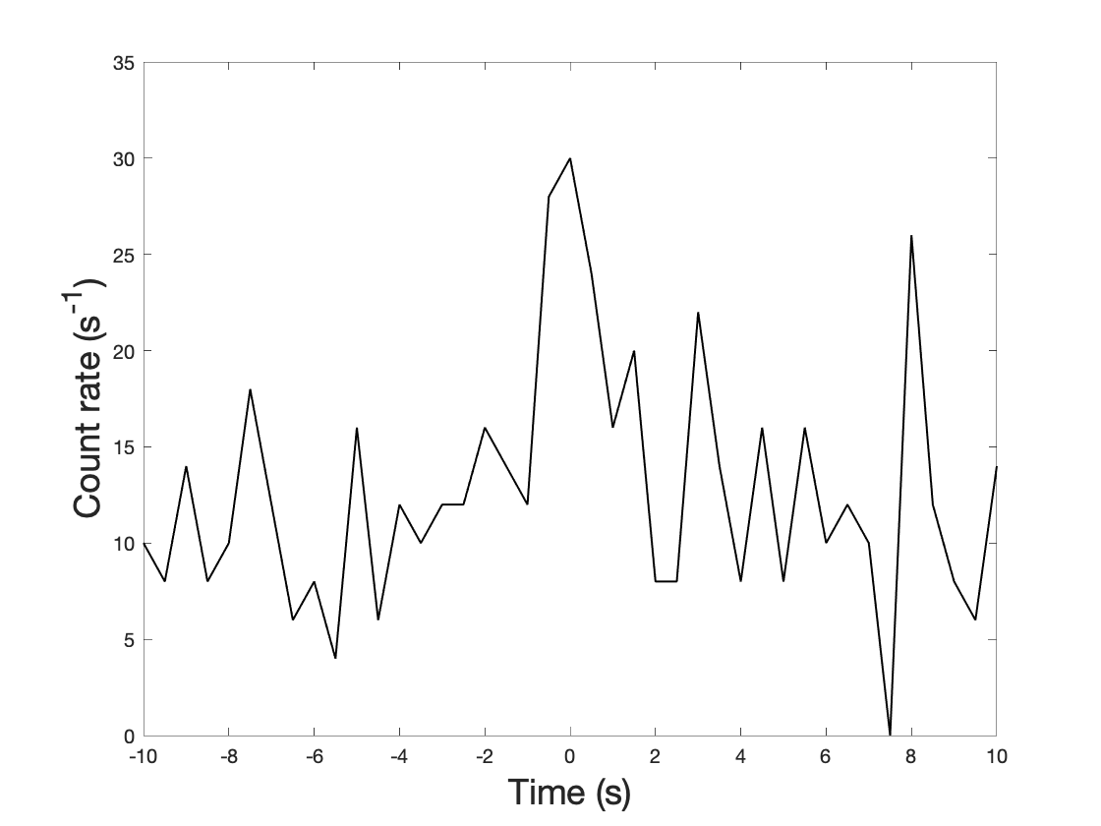
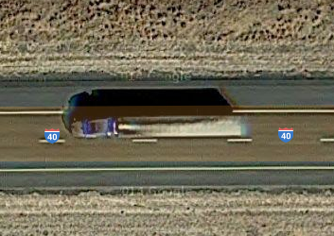
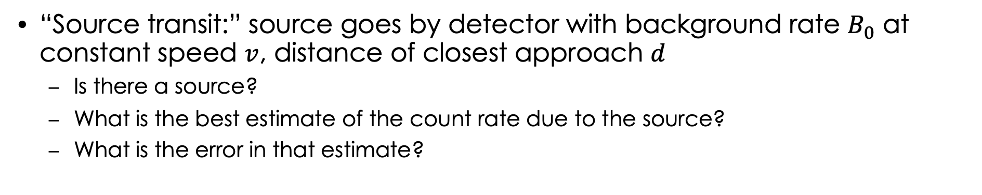


Source Transits and Neutron Detection
Scenario
Ideal
Particular observation
$$d$$
$$v$$
(Counts in 0.5 s bins)
“Source transit:” source goes by detector with background rate $B_{0}$ at constant speed $v$, distance of closest approach $d$
  Is there a source?
  What is the best estimate of the count rate due to the source?
  What is the error in that estimate?

Slide 4
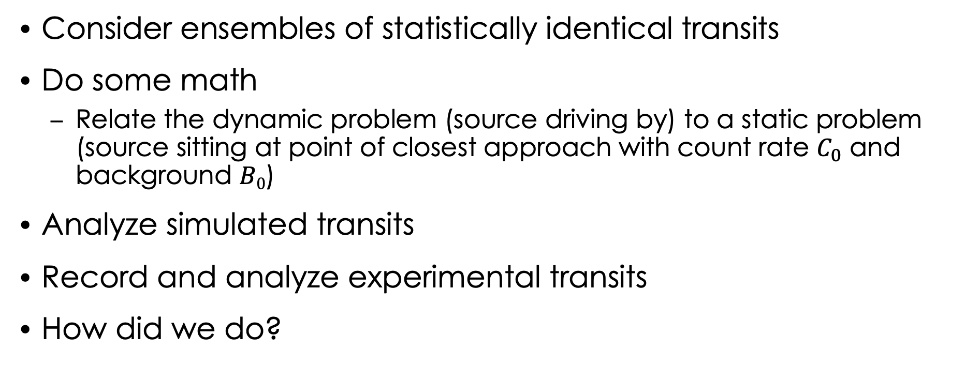
Approach
Consider ensembles of statistically identical transits
Do some math
  Relate the dynamic problem (source driving by) to a static problem (source sitting at point of closest approach with count rate $C_{0}$ and background $B0$)
Analyze simulated transits
Record and analyze experimental transits
How did we do?

Slide 5
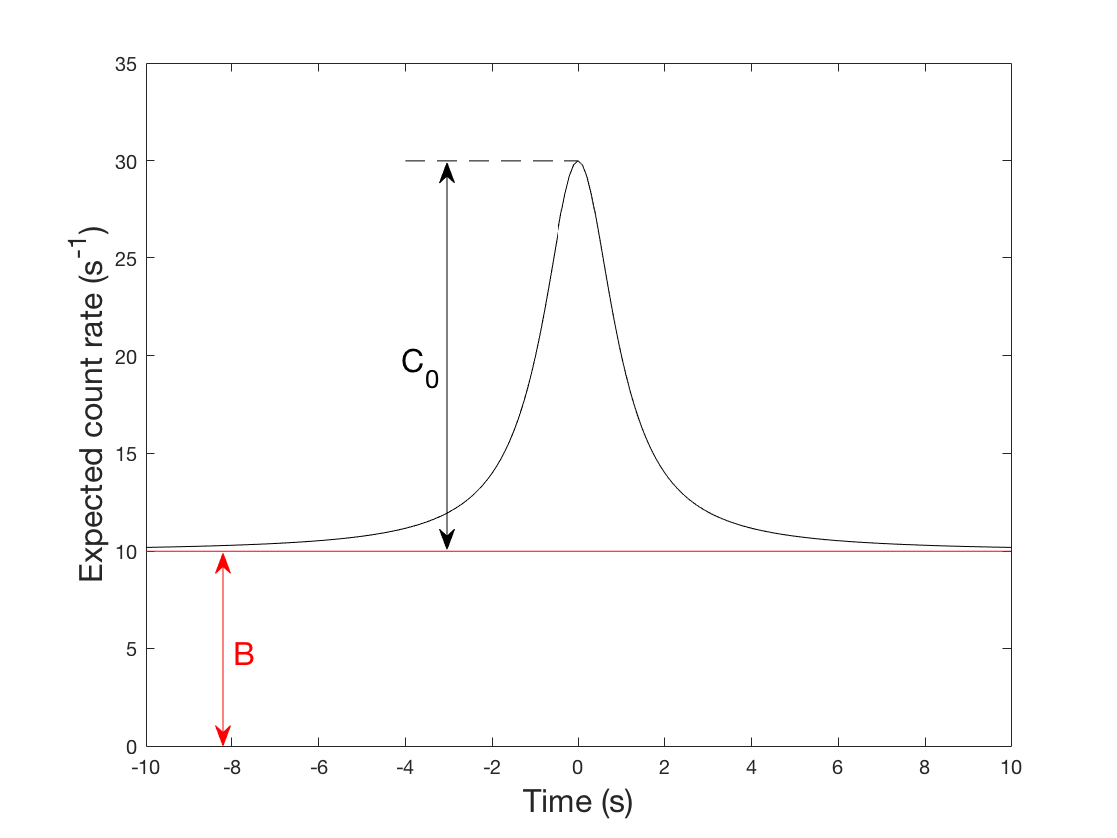
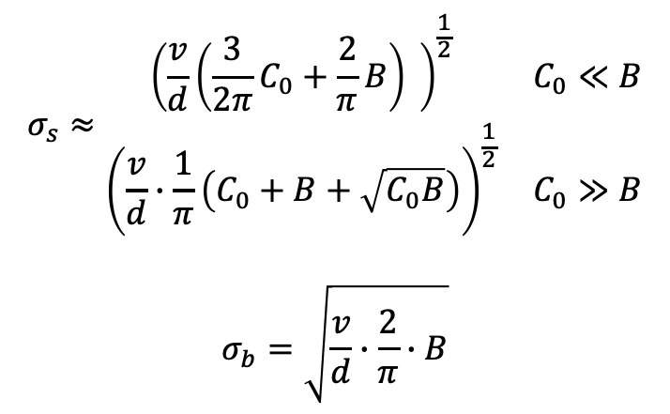
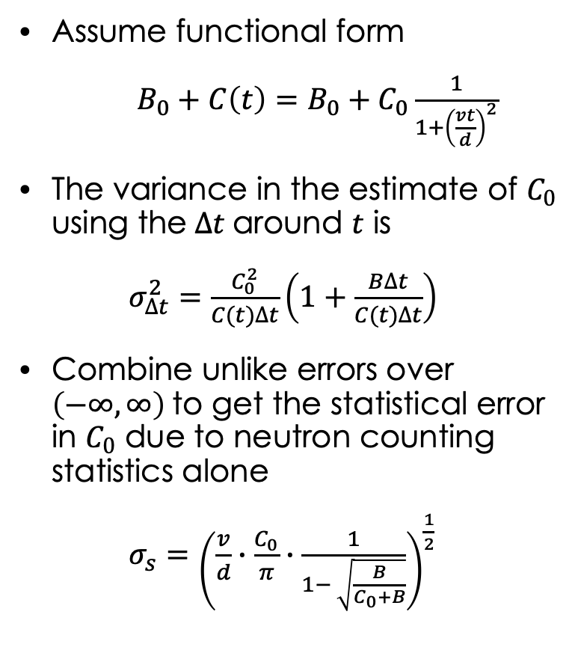

Uncertainty in Count Rate at Closest Approach
Assume functional form
$B_{0}+C\left(t\right)=B_{0}+C_{0}\frac{1}{1+{\left(\frac{vt}{d}\right)}^{2}}$
The variance in the estimate of $C_{0}$ using the$∆t$around $t$ is
$σ_{∆t}^{2}=\frac{C_{0}^{2}}{C(t)∆t}\left(1+\frac{B∆t}{C(t)∆t}\right)$
Combine unlike errors over $\left(−∞,∞\right)$to get the statistical error in $C_{0}$ due to neutron counting statistics alone
$σ_{s}={\left(\frac{v}{d}∙\frac{C_{0}}{π}∙\frac{1}{1− \sqrt{\frac{B}{C_{0}+B}}}\right)}^{\frac{1}{2}}$
$$∆t$$
$$σ_{s}≈\begin{matrix}{\left(\frac{v}{d}\left(\frac{3}{2π}C_{0}+\frac{2}{π}B\right) \right)}^{\frac{1}{2}} & C_{0}≪B \\ {\left(\frac{v}{d}∙\frac{1}{π}\left(C_{0}+B+\sqrt{C_{0}B}\right)\right)}^{\frac{1}{2}} & C_{0}≫B\end{matrix}$$
$$σ_{b}=\sqrt{\frac{v}{d}∙\frac{2}{π}∙B}$$
Approximation:
No source:
Notes:
Some arctangents if a finite interval
Only 1% error in variance for vt/d = 7.7

Slide 6
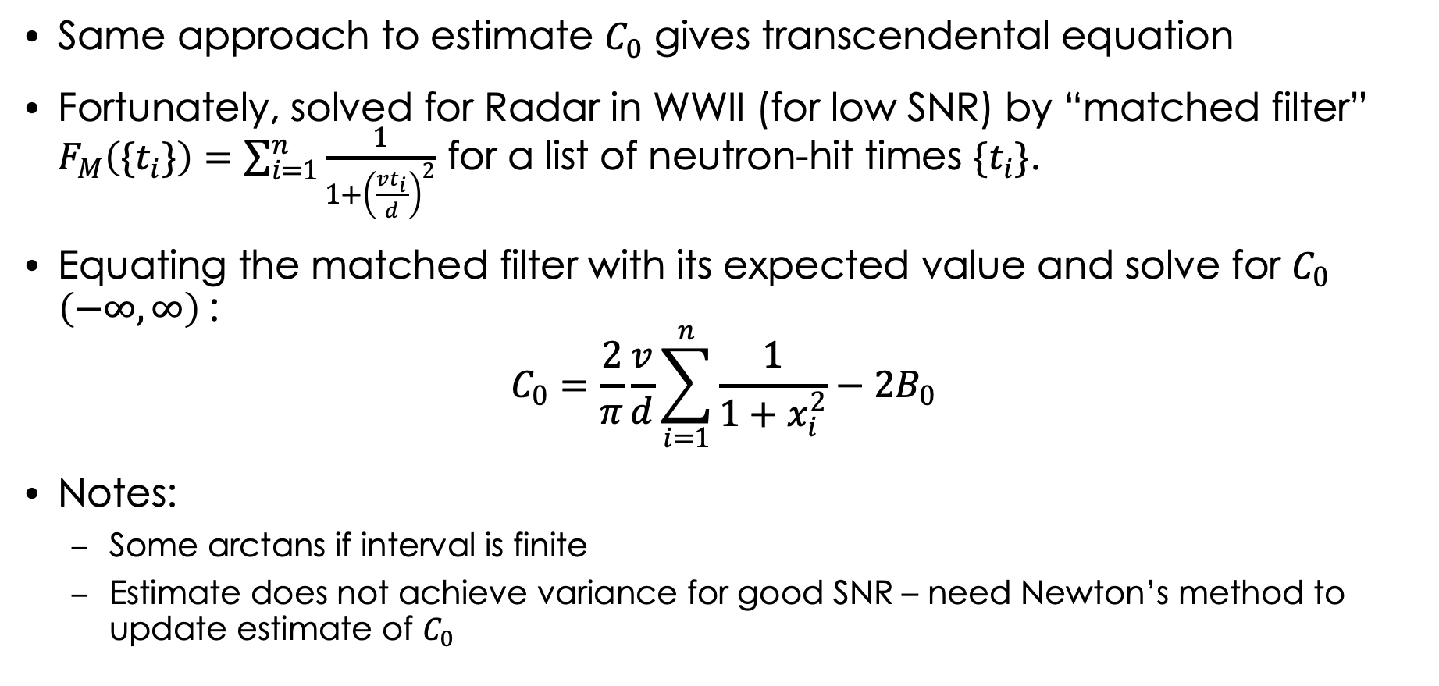
Counting Rate Estimate
Same approach to estimate $C_{0}$ gives transcendental equation
Fortunately, solved for Radar in WWII (for low SNR) by “matched filter” $F_{M}\left(\{t_{i}\}\right)=\sum_{i=1}^{n}{\frac{1}{1+{\left(\frac{vt_{i}}{d}\right)}^{2}}}$ for a list of neutron-hit times $\{t_{i}\}$.
Equating the matched filter with its expected value and solve for $C_{0}$ $\left(−∞,∞\right)$:
$$C_{0}=\frac{2}{π}\frac{v}{d}\sum_{i=1}^{n}{\frac{1}{1+x_{i}^{2}}−2B_{0}}$$
Notes:
  Some arctans if interval is finite
  Estimate does not achieve variance for good SNR – need Newton’s method to update estimate of $C_{0}$

Slide 7


Example (Simulated) Transits and Interpretation
Individual transits and inferred signal
Signal $C_{0}$
Histogram of extracted amplitude for 500 transits
Noise $σ_{s}$
500 statistically identical transits sampled, and amplitude extracted
“Signal” is amplitude, “error” is the standard deviation of amplitude
This SNR = 4.9

Slide 8
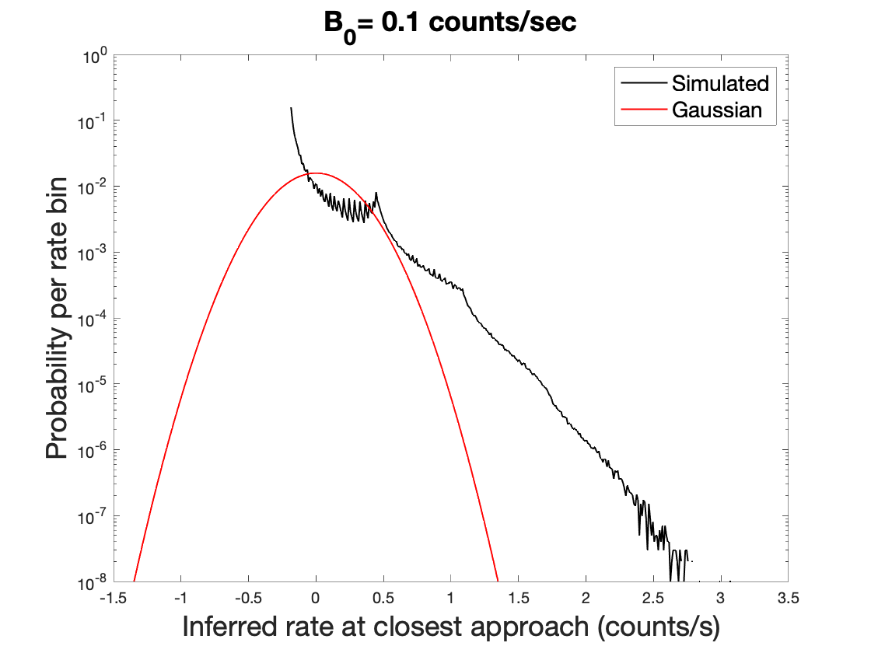
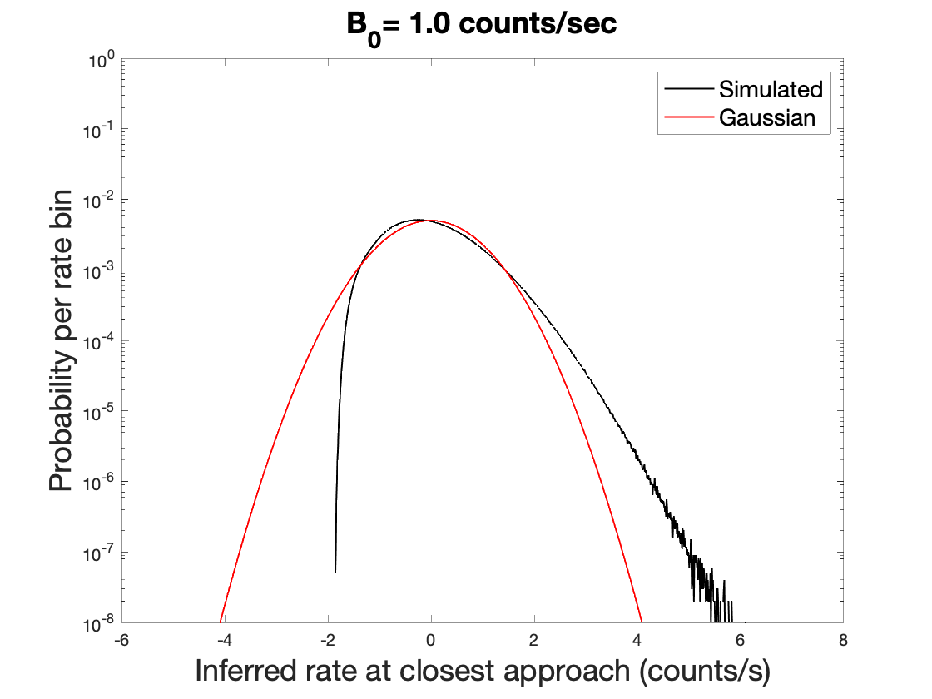
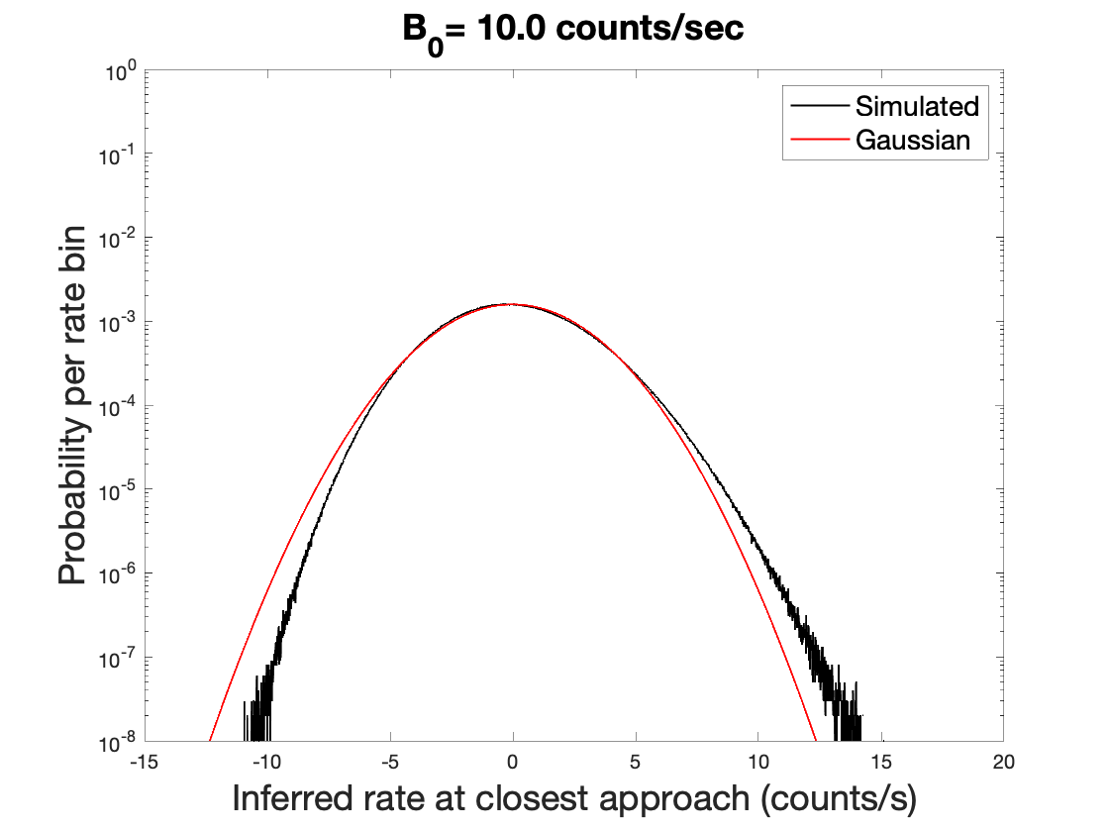
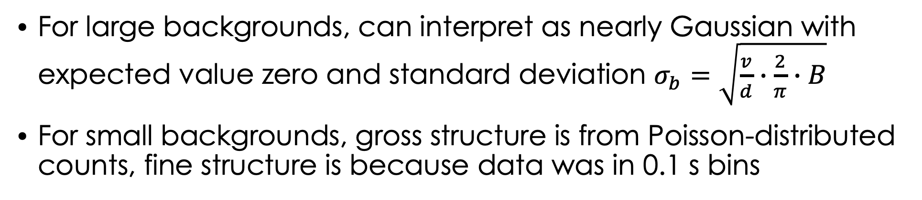
Transits with No Source Present
For large backgrounds, can interpret as nearly Gaussian with expected value zero and standard deviation $σ_{b}=\sqrt{\frac{v}{d}∙\frac{2}{π}∙B}$
For small backgrounds, gross structure is from Poisson-distributed counts, fine structure is because data was in 0.1 s bins

Slide 9
Measurements
Neutron detectors
3
4
3 m
-7.108 m
Source
7.108 m
Track
1 m
1
2
Used linear motion system in 7603 high bay to move neutron sources past four neutron slab detectors, Each roughly 18% efficient and 0.30 m² area, two positioned 1 m from track and two 3 m from track
Recorded times of neutron hits for each detector, magnetic switches along track to measure speed and time of closest approach

Slide 10
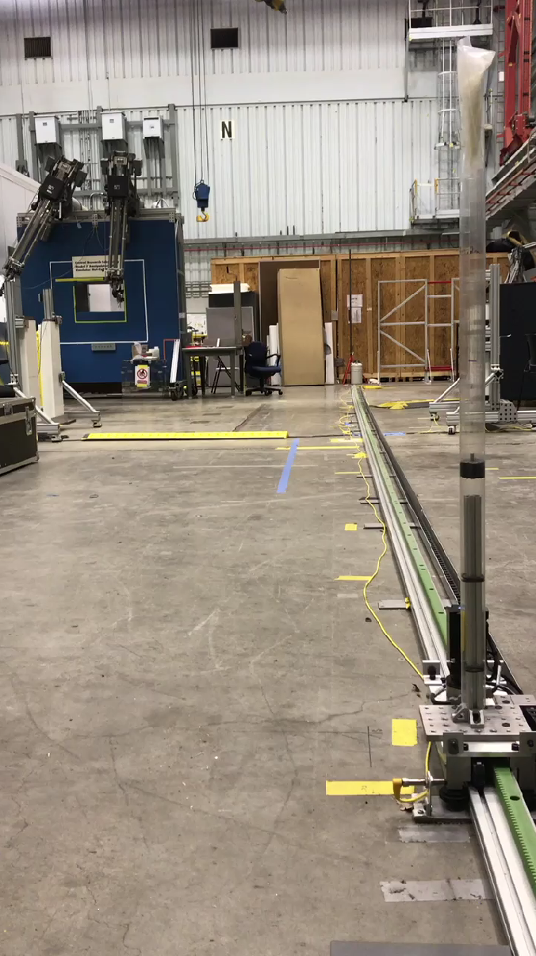
Setup
Varied
  source strength an order of magnitude
  background rate an order of magnitude,
  detector area a factor of 2
  Distance of closest approach a factor of 3
~400 source transits for each configuration
Total of 20,016 transits
Detector 4
Detector 3
Source
Magnetic switch

Slide 11
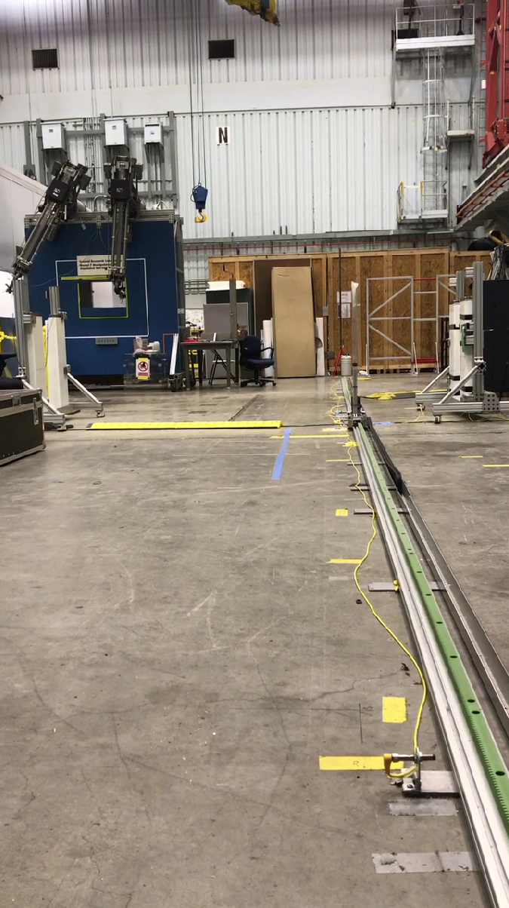
Setup (Cont.)
Calibrated source intensity known to ~1% on day of measurements
Detector 4
Detector 2
Detector 3
Detector 1

Slide 12
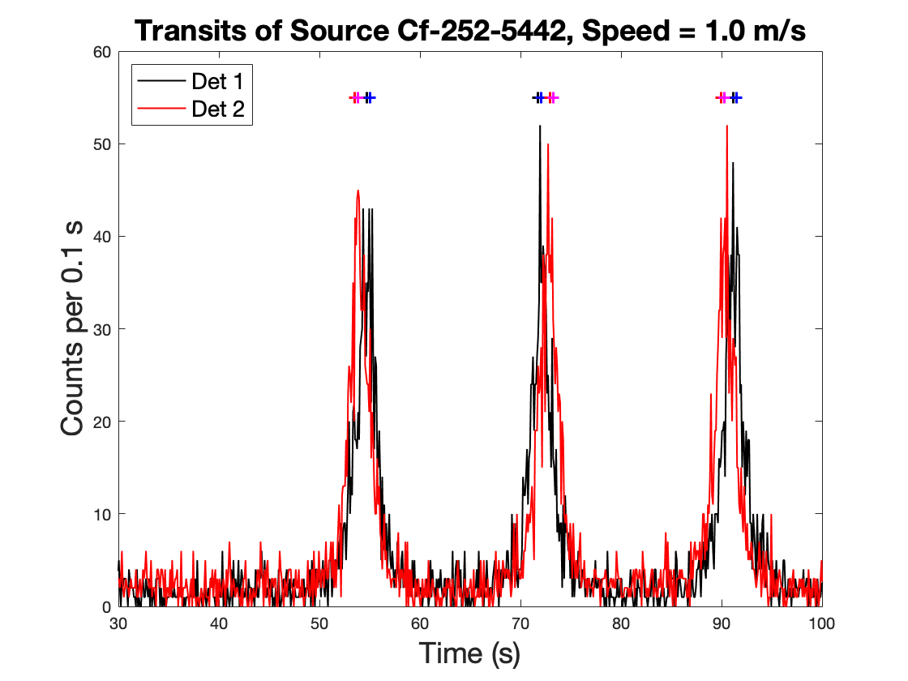
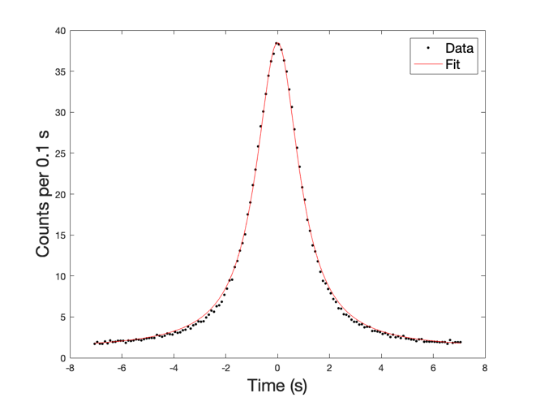
Example Data
Data aligned to passage of source (few mm)
Aligned data summed over many transits validates functional form

Slide 13
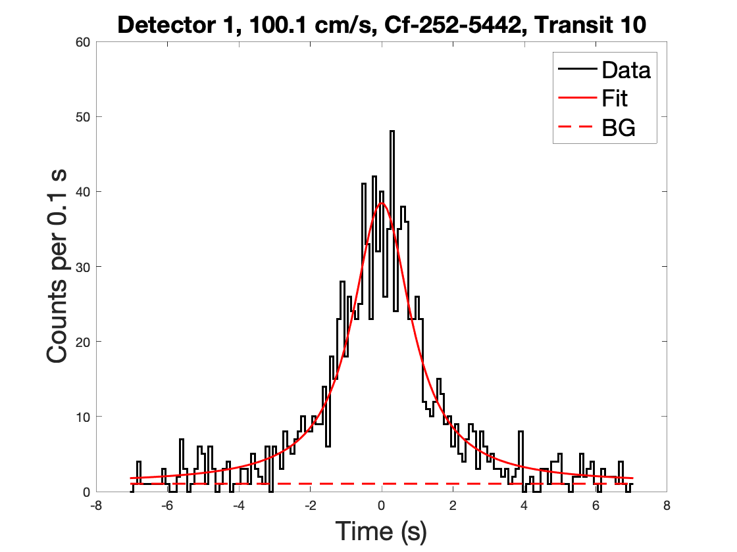
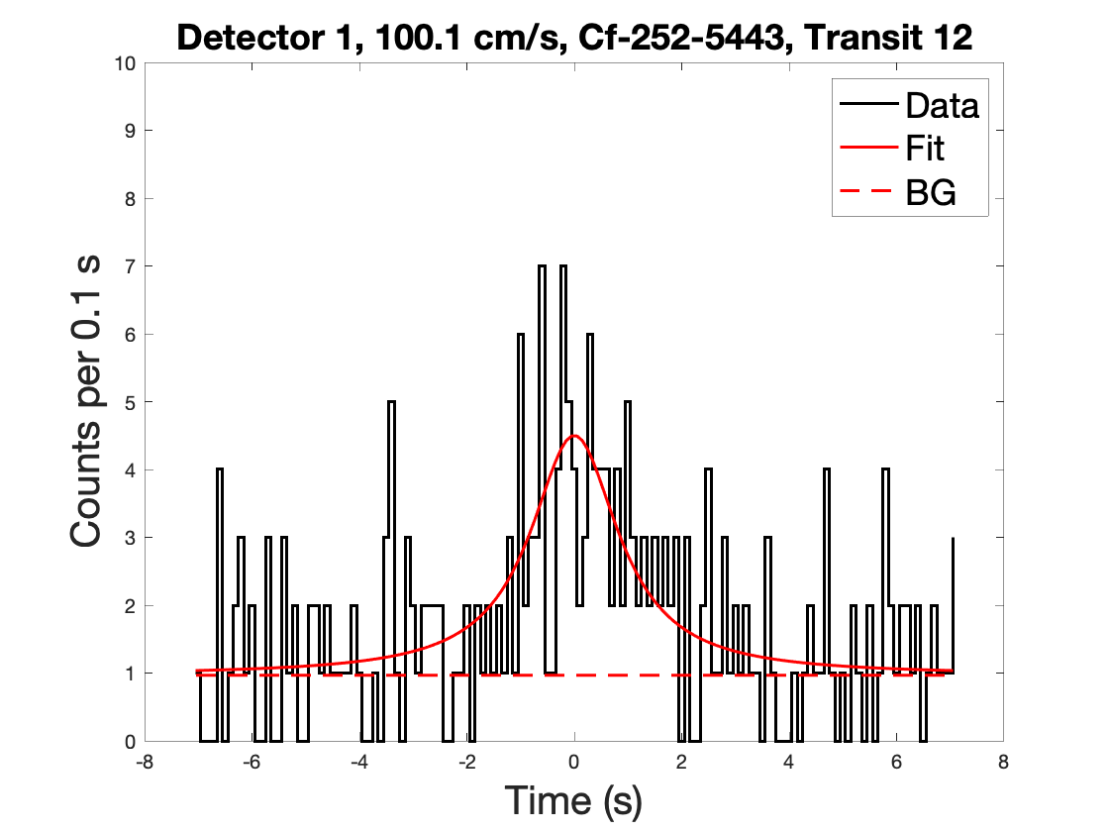
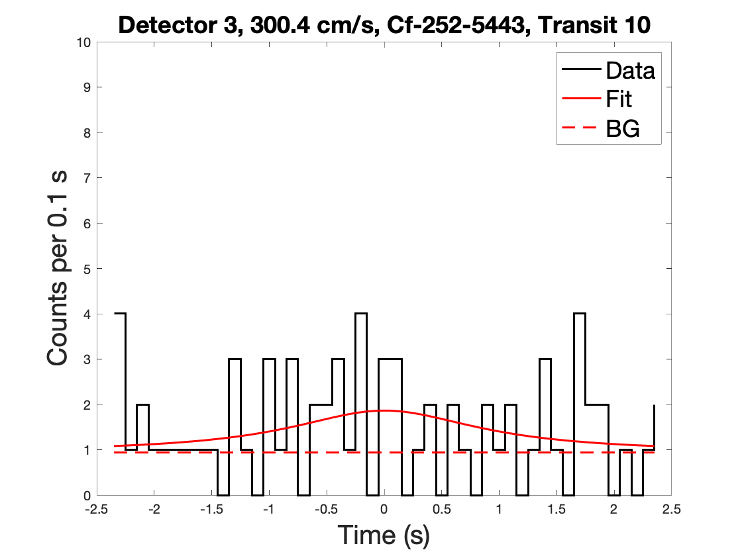
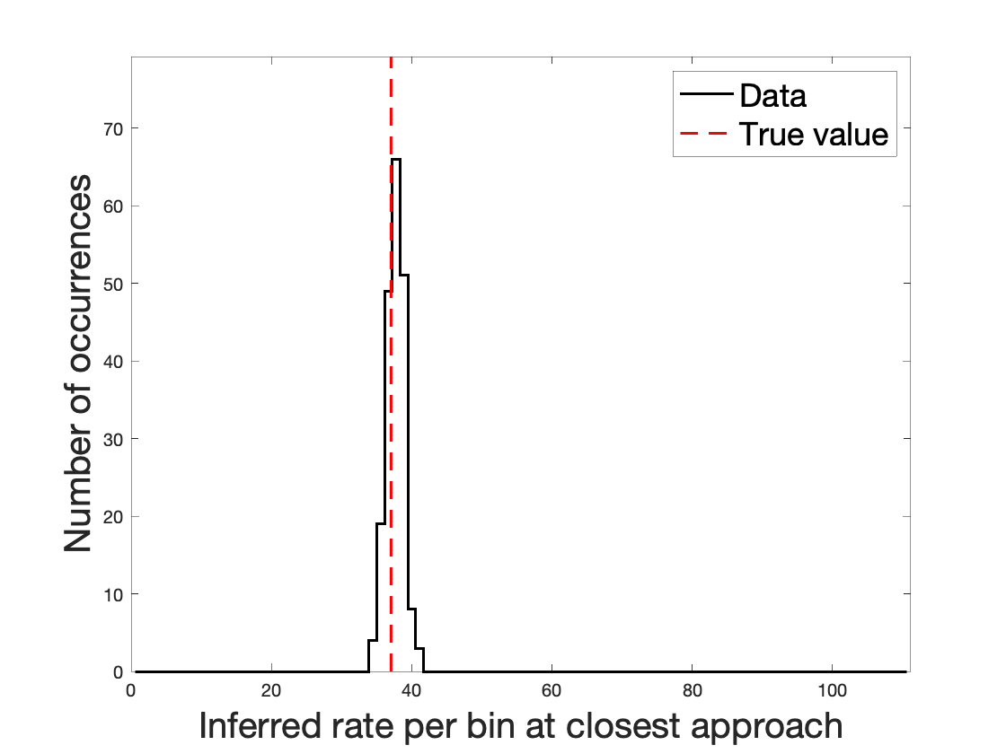
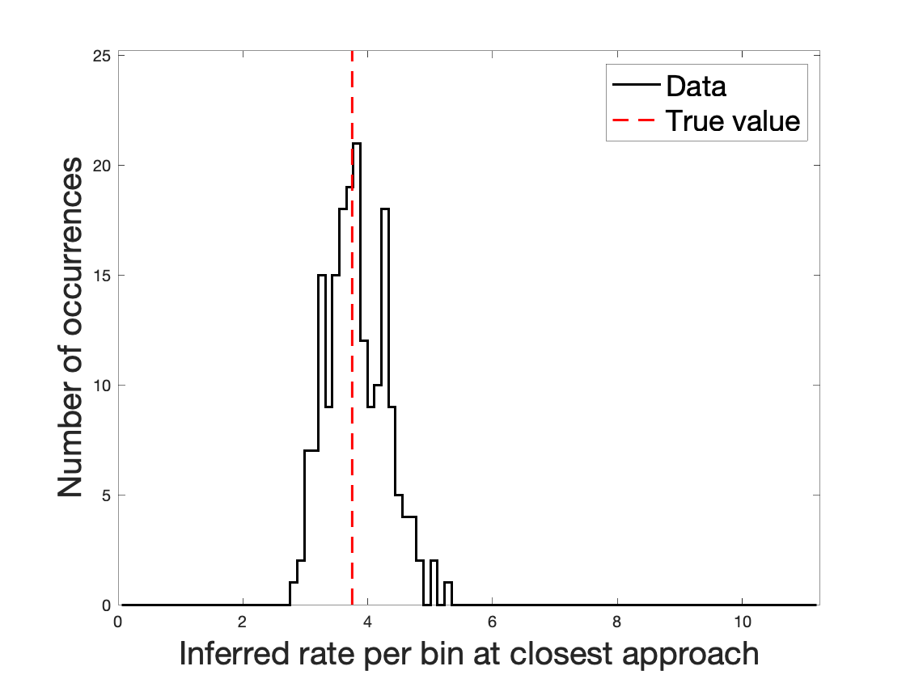
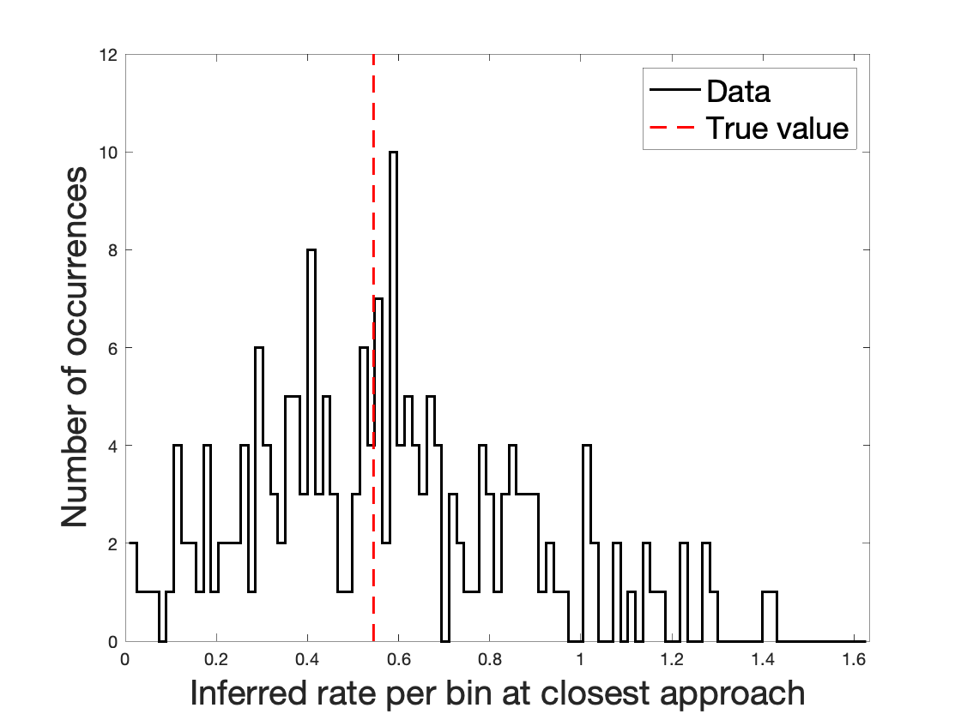




Example Analyzed Transits
$C_{0}$ = 374.5 s⁻¹
$C_{0}$ = 35.3 s⁻¹
$C_{0}$ = 9.3 s⁻¹
SNR = 30.3
SNR = 7.9
SNR = 1.7
SNR = $C_{0}/σ$

Slide 14
Results
For the totality of transit data, the average relative difference between the measured and predicted SNR is -1.47%.
This is 3.3 standard deviations from 0, so there are likely systematic errors not accounted for of order 1%

Slide 15
Equivalent Performance
With understanding of counting statistics, can define “equivalent performance” transits
Either
  For source quantification, the same SNR
  For source detection, the same probability of false alarm and 50% detection probability
Then, equivalent performance can be used to compare very different detection systems

