Slide 1
Silicon MAPS Readout in ALICE and sPHENIX
J. Schambach
Oak Ridge National Laboratory
(for the ALICE ITS Upgrade & sPHENIX MVTX collaborations)

Slide 2
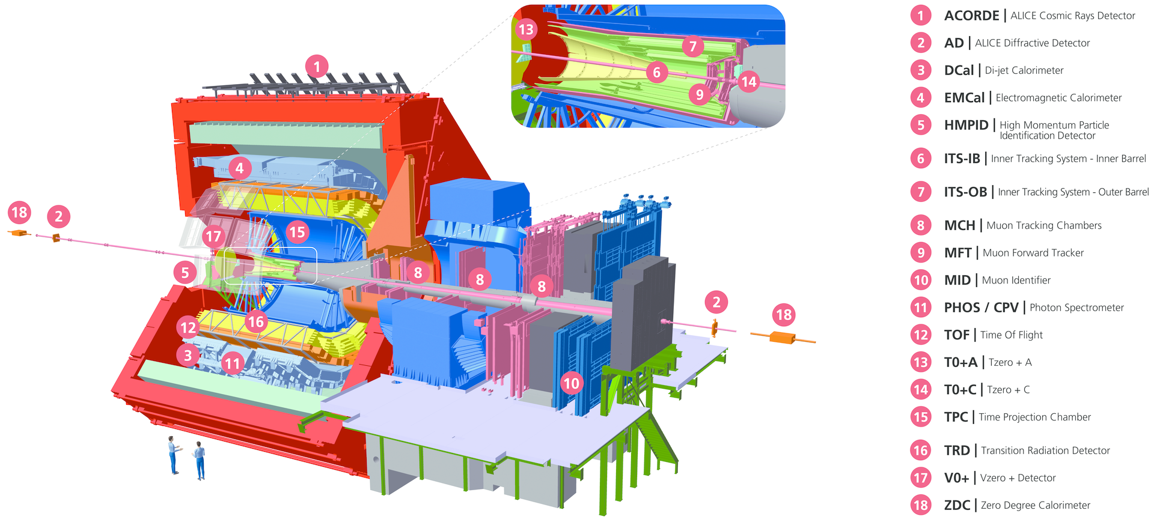
ALICE Upgrades
ALICE Central Barrel Tracking from very low (100 MeV/c) to very high p_{t} (100 GeV/c)
Silicon: r = 22 – 400 mm
Gas (TPC, TRD): r = 88 – 368 cm
➔ large BL² (bending power), comparable to CMS

Slide 3
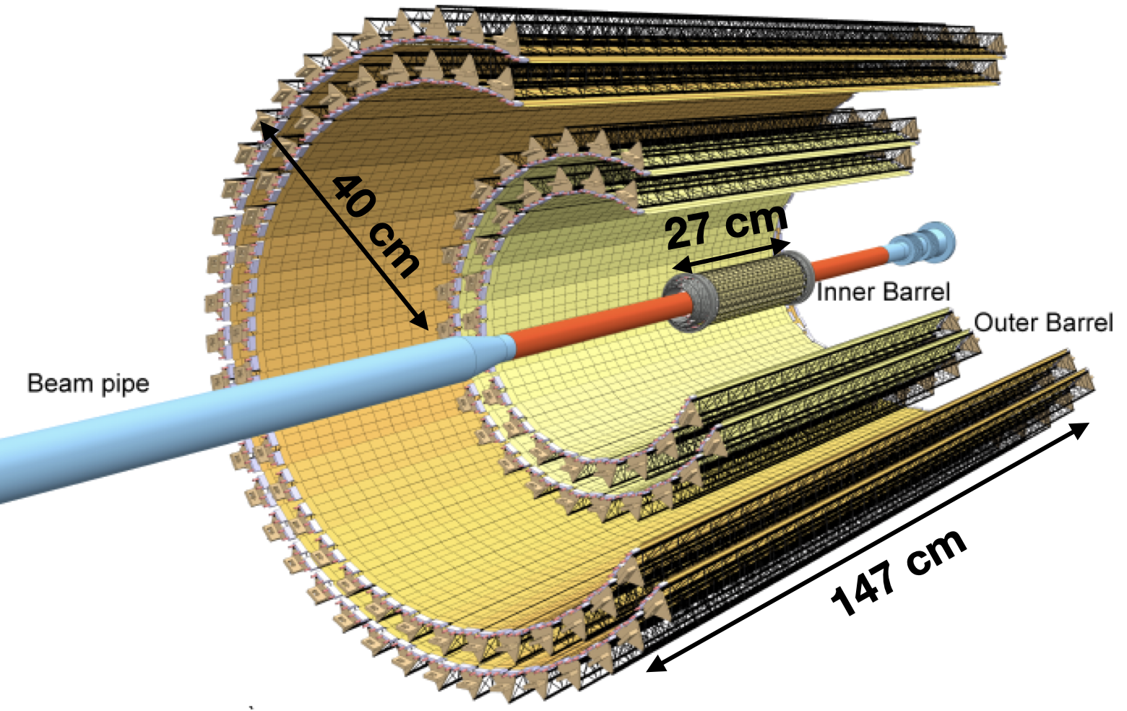
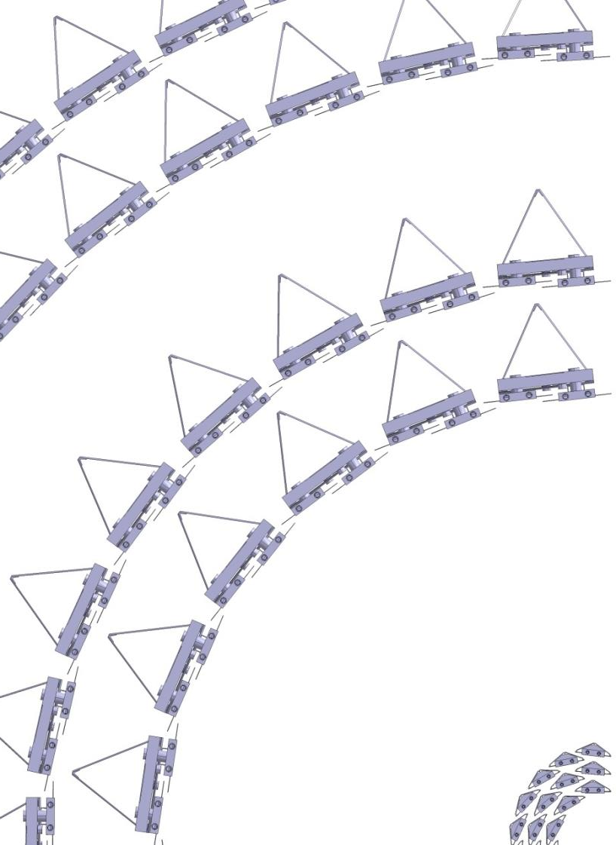
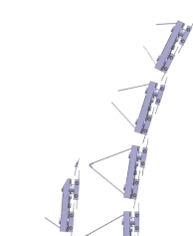
New ITS Layout
2 Outer layers
Outer Barrel
1% X₀
2 Middle layers
7-layer barrel, based on CMOS MAPS sensors (“ALPIDE”)
Coverage: r 22 – 400 mm, |η| ≤ 1.22
~24k pixel chips (a 12.5 G pixel camera)
~10m² active area
Inner Barrel
3 Inner layers
0.3% X₀
48 42 30 24 20 16 12
= 192 Staves in Total

Slide 4
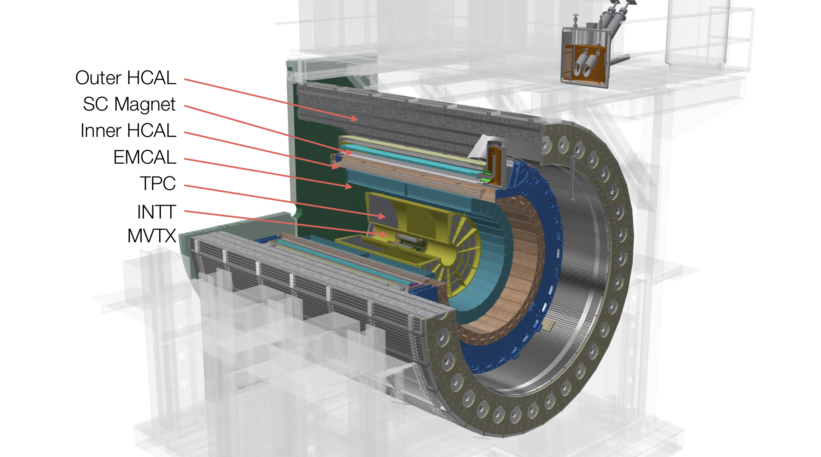
sPHENIX - MVTX
Proposal Document: sPH-HF-2018-001
https://indico.bnl.gov/event/4072/
sPHENIX cost-effectively reuses the ITS electronics as built, replacing the ALICE CRU with the ATLAS FELIX backend
Modified ALICE ITS mechanics to fit it into sPHENIX
3-layer sensor barrel equivalent to ITS IB
- 48 staves, 432 chips
MVTX parameters: L = 271 mm
MVTX Readout Units, PUs
& other services
Located Outside Magnet on Platform:
Much lower Radiation than ITS

Slide 5
ALPIDE Principle of Operation
C_{det}~2.5 fF @ -6 V_{bb}
C_{in}~1.6fF
Reset : ~1 ms
OUT_D
Particle hit
~2 us Peaking time
6 µs
PIX_IN
OUT_A
t1
t2
STATE
(Latch)
Threshold
STROBE
ΔV = Q/C : ~ 10 ns
Particle hit
ultra low-power front-end circuit
40nW / pixel
Front-end acts as delay line
Sensor and front-end continuously active
Upon particle hit front-end forms a pulse with ~1-2μs peaking time (“analog delay”)
Threshold is applied to form binary pulse
Hit is latched into memory if strobe is applied during binary pulse

Slide 6
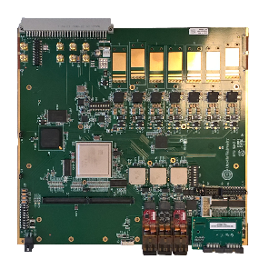
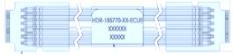
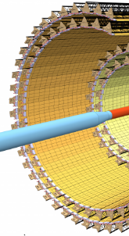
ITS Readout Hierarchy
ALICE Timing and Trigger
LHC Bunch Clock (40.08 MHz)
Timing and Trigger messages
LTU / CTP
11× FLP
RU
3× GBT LINKS/RU
CRU
IL
3200Mb/s
110 Gb/s
9×960 Mb/s
110 Gb/s
RAM
ML
EPN
110 Gb/s
16×320 Mb/s
OL
8× RU/CRU
24× LINKS
NIC
<40 GB/s
100 Gb/s
28×320 Mb/s
DETECTOR LINKS
One READOUT UNIT
for each STAVE
CRU to FLP
FLP to EPN
GBT LINKS

Slide 7
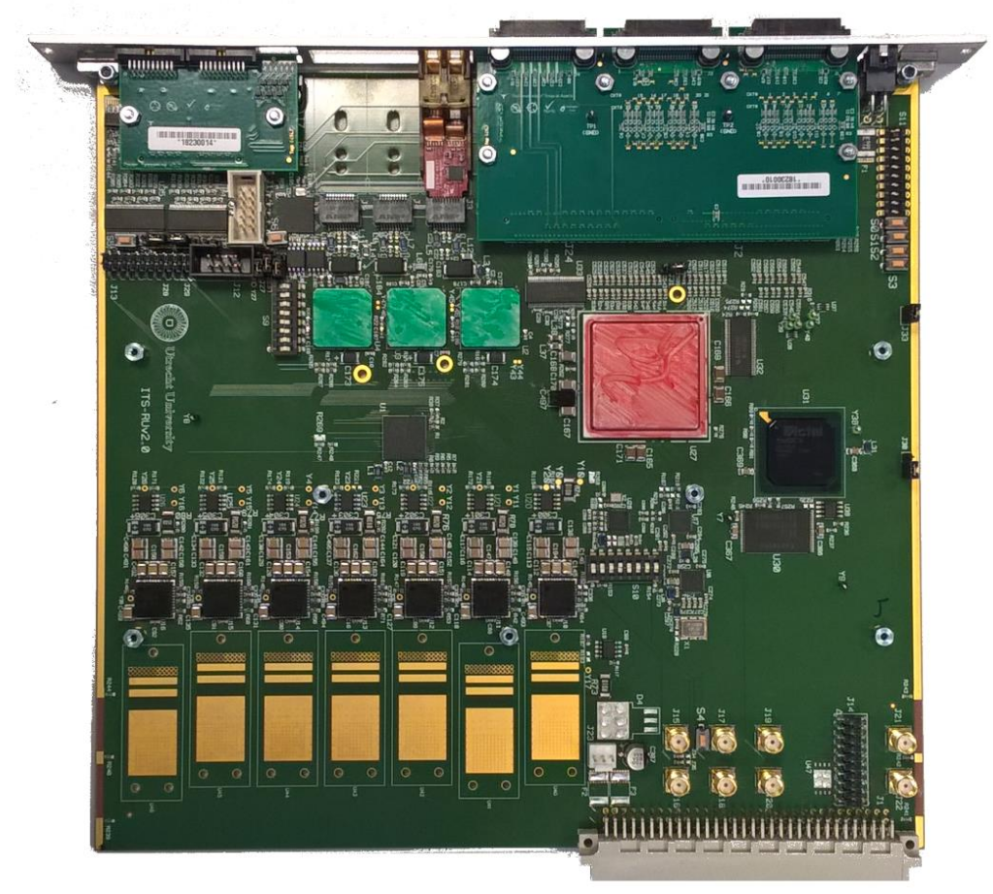
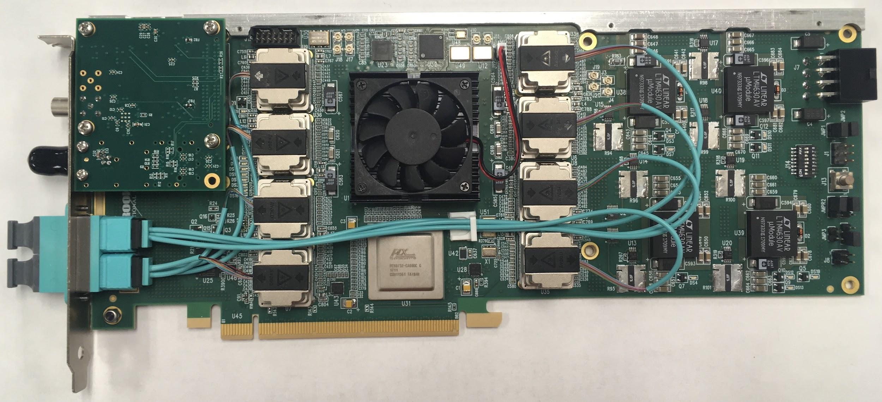
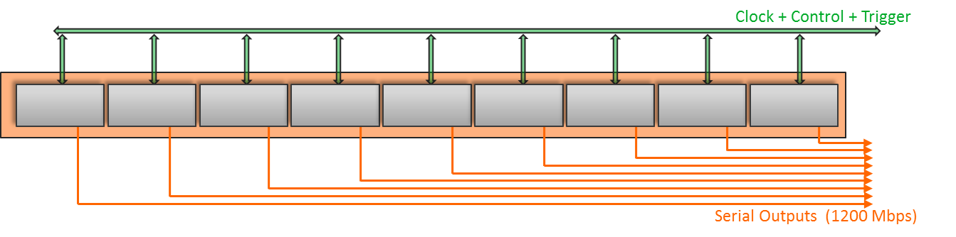
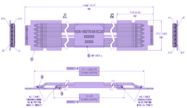
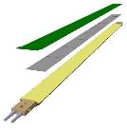
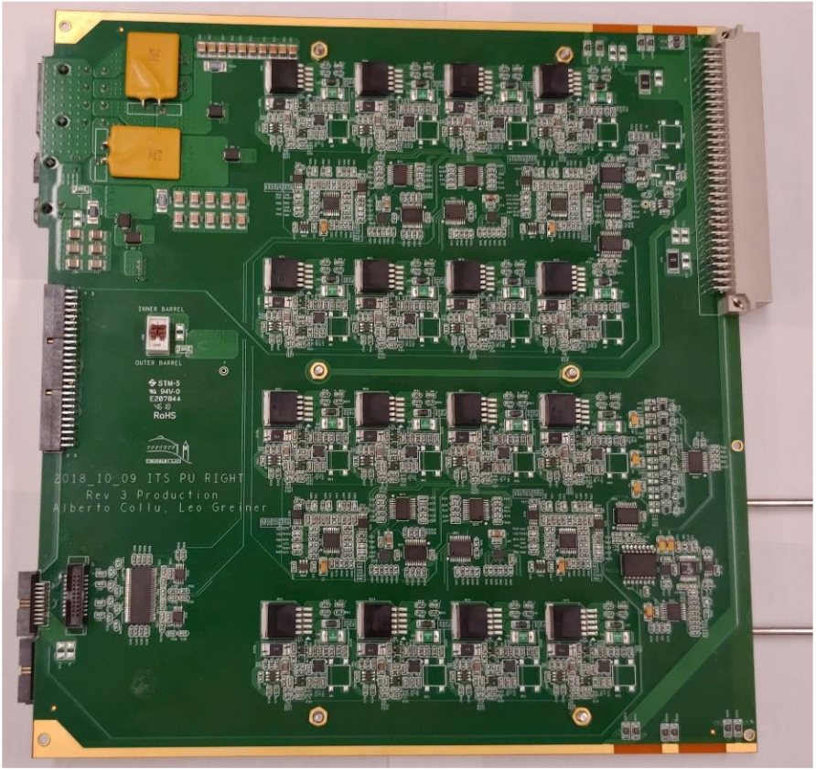
MVTX Readout System
Readout Unit
Front End
FELIX
Back End
5-10 m twinax
GBT Optical Links
9-sensor stave
Control
Data (9x1.2Gbps), Clock, Control/Trigger
Data (3x4.8 Gbps)
Trigger
PCIe
FPC
Clock/Trigger
ALPIDE Sensors
Regulated power
Power
Power supplies
Cold Plate
DAQ and Slow Control
Power Board
sPHENIX GTM
Interaction Region
Experimental Hall
Counting House

Slide 8
Main Challenge: Expected Radiation Levels
Both TID and Fluence levels at the location of the RU are not a concern for modern micro-electronics material degradation and component reliability.
High energy hadrons are the real concern, as they can cause latch-ups in electronic components and SEU on logic devices.
Testing showed that latch-ups are not a problem, while proper design is required to mitigate SEU effects.
FEE
Position with respect to beam |  |  | Radiation levels (total)
r | z | Name | Total Ionizing Dose (TID) | 1 MeV neq fluence | High energy hadron flux* | Charged particle flux
[cm] | [cm] |  | [krad] | [cm⁻²] | [kHz cm⁻²] | [kHz cm⁻²]
2.2 | [-13.5 ÷ 13.5] | ITS L0 | 2734 | 1.7 × 10¹³ | 765 (770) | 890 (910)
40 | [-73.7 ÷ 73.7] | ITS L6 | 20 | 8.1 × 10¹¹ | 3.4 (4.9) | 4.5 (6.7)
100 | 330 | RU | ≈ 5 | ≈ 1.6 × 10¹¹ | 0.86 | 1.7
258 | [-260 ÷ 260] | TPC Out | 0.86 | 1.4 × 10¹¹ | 0.27 (0.37) | 0.2 (0.3)

Slide 9
Readout Unit – Top Level Diagram
CAN
Bus
Main SRAM
FPGA
FLASH
FPGA
FLASH
Memory
3 × GBTx
Rad-hard by design
Low cross section per bit (not zero!)
GBT
SCA
Rad-hard CRAM
(but SEFI possible)
USB
3.0
4 × I²C
Hardware includes:
Xilinx Kintex Ultrascale KCU060 FPGA (main programmable logic device)
MicroSemi ProAsic3 FPGA A3PE600L (for Ultrascale scrubbing & configuration)
4 Rad Hard GBT Fiber Optic Transmitters (3.2 Gb/s each)
2 Rad Hard GBT Fiber Optic Receivers (3.2 Gb/s each)
Rad Hard Slow Controls Adapter (GBT-SCA) for monitoring and control
12 channel twinax copper interconnects to stave
Mezzanine to allow different stave configurations (“transition board”)
Power board control interface via mezzanine
CANbus interface as power board interface in case GBT is not available
Sensors

Slide 10
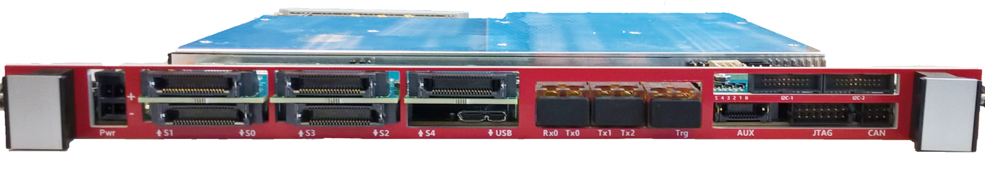
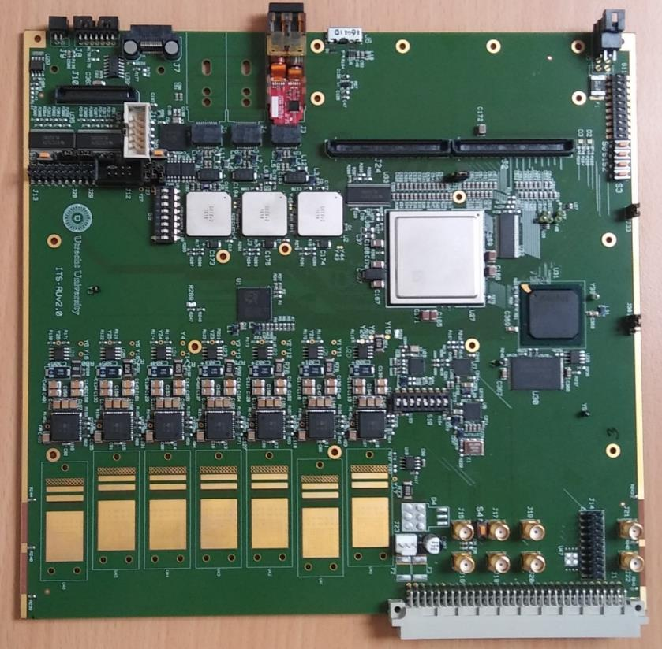
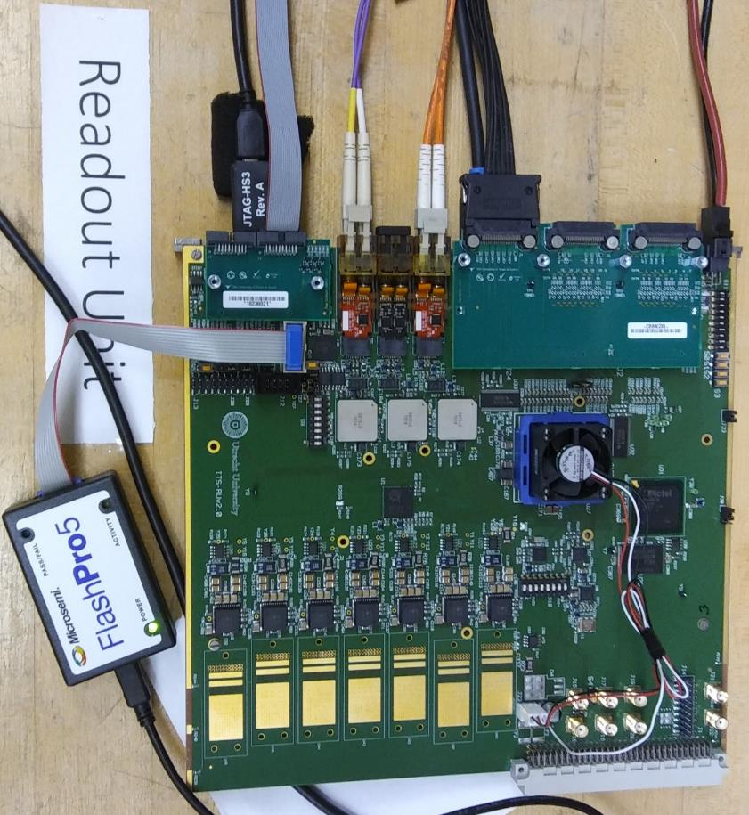
ITS Readout Unit
Pro
ASIC3
Flash
Kintex
Ultrascale
Transition Board
I/F to sensors
GBTx
GBTx
GBTx

Slide 11
Hardware & Firmware Radiation Protection Measures
Radiation hard components from the LHC “Radiation Hard Optical Link Project” for communication with the control room at Gigabit speed (3.2 Gbps payload):
  “GBTx” (Transceiver) ASIC, “VTRx” opto electronics, “Slow Controls Adapter” (SCA) ASIC
Triplication of FPGA I/O’s at the hardware level for important signals
“Scrubbing” (periodic refresh of FPGA CRAM) via a flash-based FPGA
SRAM based FPGAs are sensitive to Single-Event Upsets (SEUs)
Combine scrubbing with Triple Modular Redundancy (TMR)
  TMR with majority voters of firmware modules and FSM states
  ECC protection of memories / FIFOs (1-bit correction, multi-bit detection)
Expecting improvement of Mean-Time Between Failure > 3 orders of magnitude vs unprotected designs

Slide 12
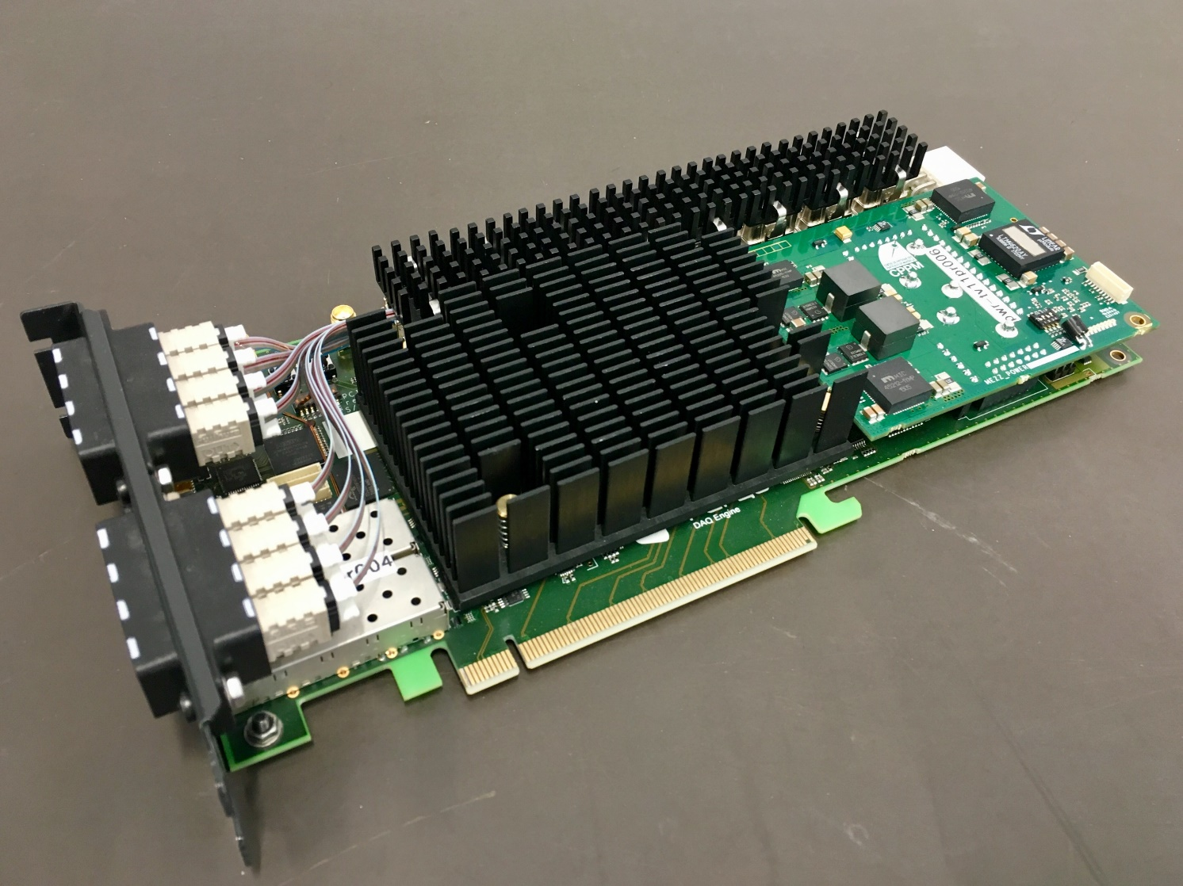
ALICE Common Readout Unit (CRU) v2
Altera Arria 10 FPGA
Custom designed cooling
Avago Minipods:
  4x 12 TX
  4x 12 RX
48 optical outputs (MTP), 48 optical inputs (MTP)
USB Blaster II
X16, Gen3 PCIe (CFM rev 3.0); 128 Gb/s

Slide 13
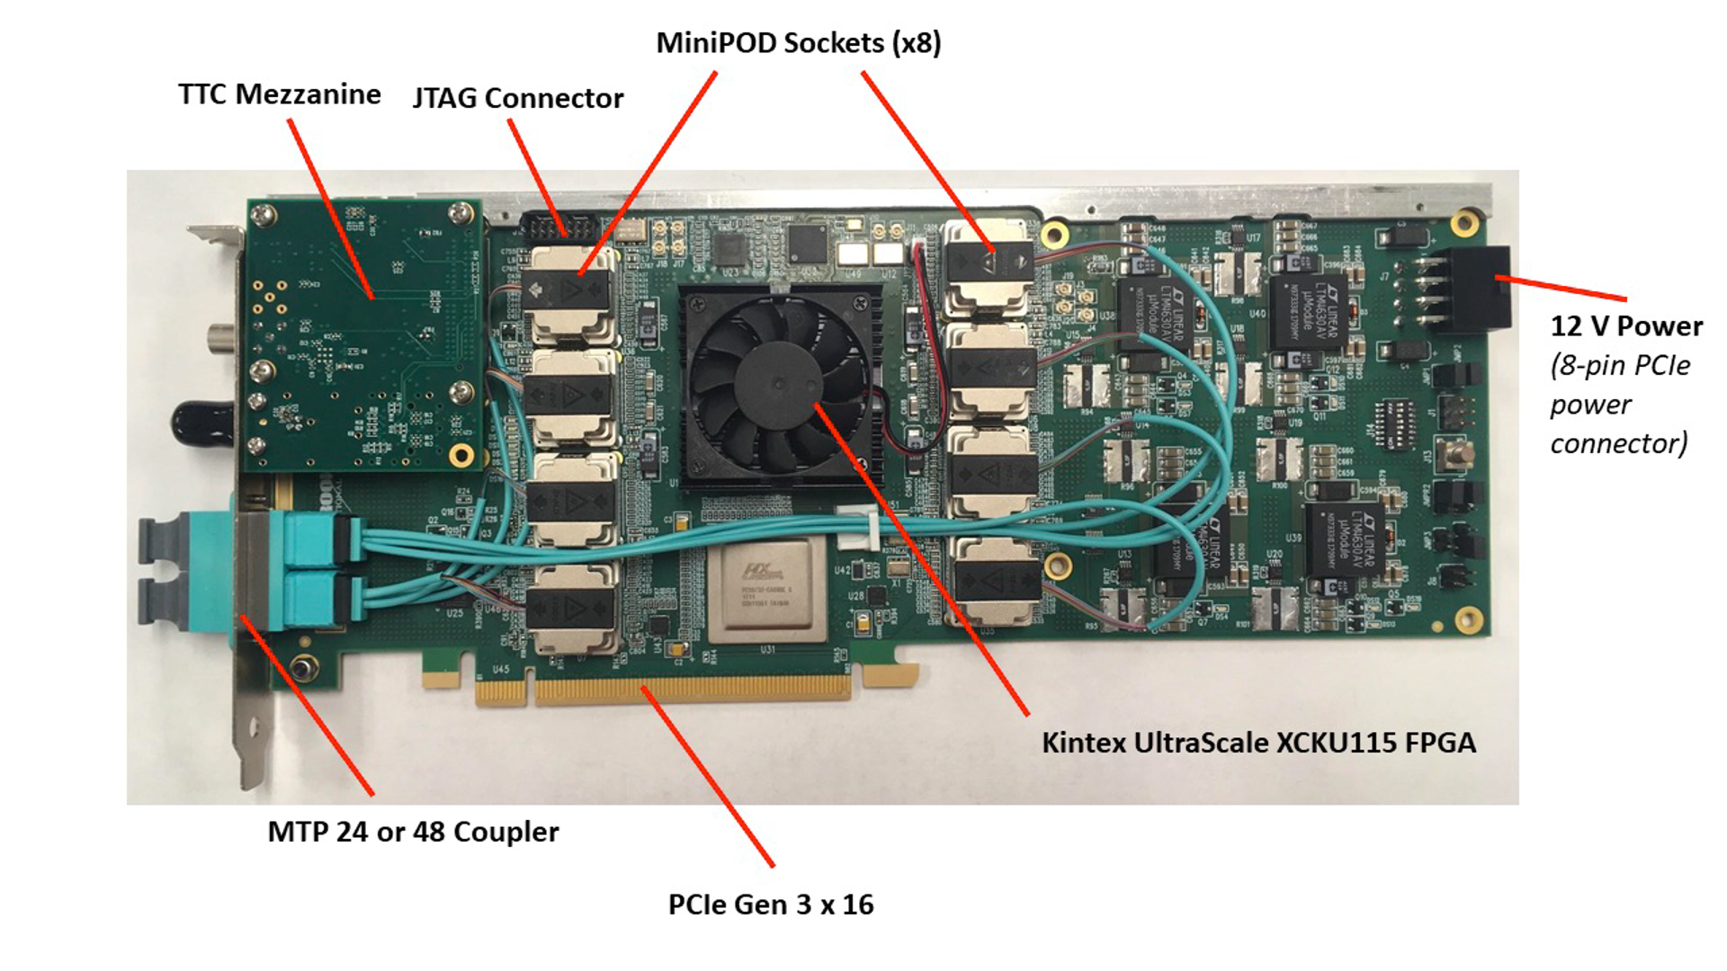
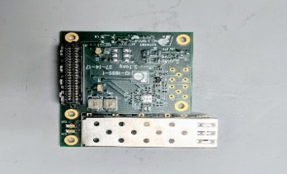
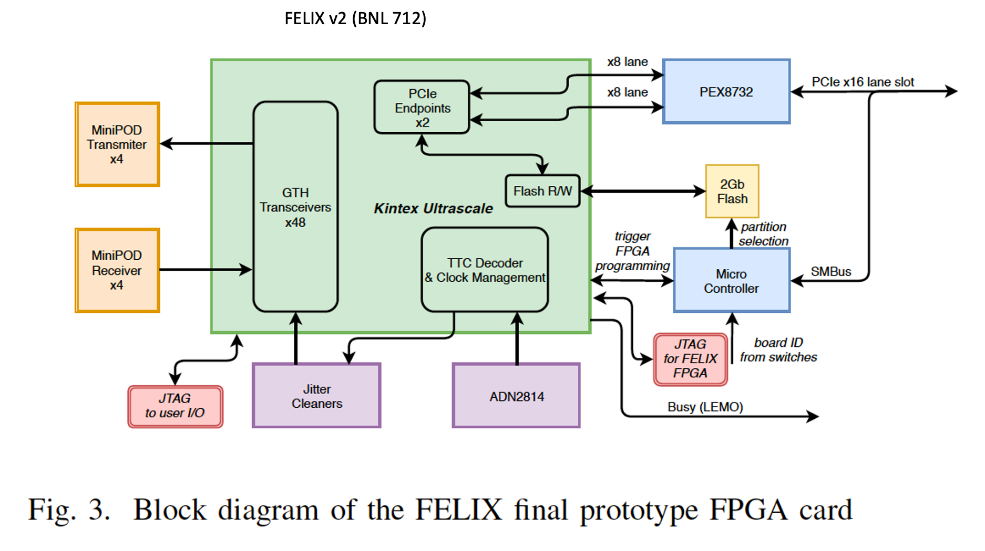
sPHENIX “BackEnd”: ATLAS FELIX
sPHENIX Timing Mezzanine
Architecture Highlights:
Xilinx Kintex Ultrascale KU115 FPGA
48 bi-directional GBT links
16 lane Gen 3 PCIe
Mezzanine site for sPHENIX timing system card
Performance:
PCIe Tx > 100Gb/s

Slide 14
BACKUP

Slide 15
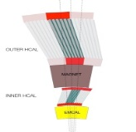
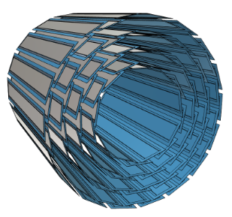
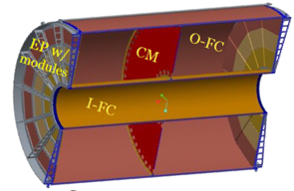
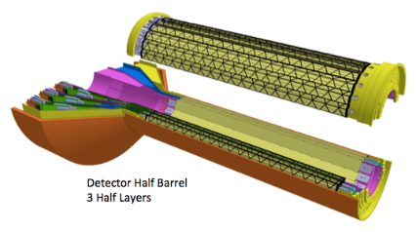
sPHENIX DAQ Architecture
FEM
Event Builder
DCM
DCM2
DCM
DCM
DCM
DCM
Network
Switch
Buffer Box
FEM
DCM
SEB
ATP
DCM
DCM
DCM2
DCM
DCM
ATP
DCM
Buffer Box
FEM
DCM
SEB
ATP
DCM
DCM
Calorimeters, INTT, MBD
DCM
DCM2
ATP
Buffer Box
DCM
SEB
DCM
To the
RACF/HPSS
DCM
ATP
ATP
TPC
FEE
ATP
Buffer Box
DCM
DCM
FELIX
EBDC
ATP
DCM
ATP
Buffer Box
FEE
DCM
DCM
FELIX
EBDC
ATP
Buffer Box
MVTX
DCM
ATP
FEE
DCM
FELIX
EBDC
DCM
ATP
Buffer Box
DCM
Rack Room
Acronyms:
FEE Front End Electronics
FELIX Front End LInk eXchange
EBDC Event Buffer and Data Compressor
ATP Assembly and Trigger Processors
Buffer Box Interim storage
FEM Front End Module
DCM2 Data Collection Module
SEB Sub-Event Buffer
MVTX Hardware:
  48 Staves
  48 FEE (Readout Units v2.0)
  6 FELIX v2.0
  6 EBDC servers

Slide 16
ALPIDE Sensor Technology
ALPIDE
Pixel Sensor CMOS 180 nm Imaging Process (TowerJazz)
  3 nm thin gate oxide, 6 metal layers
1024 pixel columns
AMP
COMP
TH
zero suppression
zero suppression
zero suppression
zero suppression
N_{A} ~ 10¹⁶ cm⁻³
N_{A} ~ 10¹³ cm⁻³
N_{A} ~ 10¹⁸ cm⁻³
512 rows
0.5 MPixel Matrix
Not to scale
Buffering and Interface
Key Features
29 μm x 27 μm pixel pitch, chip size 30 mm x 15 mm, 50 μm (IB) / 100 μm (OB) thick
Continuously active, ultra-low power front-end (40nW/pixel)
Ultra-low power matrix readout (< 200mW whole chip)
Global shutter: triggered acquisition or continuous readout
High speed output serial link: 1.2 Gbit/s (IB), 400 Mbit/s (OB)

Slide 17
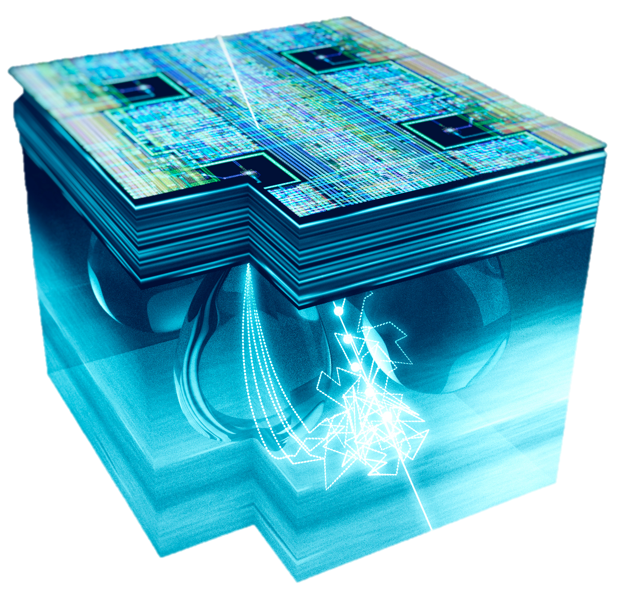
Matrix Readout
0
511
STATE
STATE
STATE
STATE
512
512
512
512
collection electrode
RESET
RESET
…
RESET
RESET
28 µm
Pixel front-end
Pixel front-end
Pixel front-end
Pixel front-end
512
512
512
512
Priority encoder
Priority encoder
2 x 2 pixel
volume
0.3 pJ / bit
10
10
VALID
ADDR
VALID
ADDR
SELECT
SELECT
C_{in} ≈ 5 fF
Periphery
Q_{in} (MIP) ≈ 1300 e  V ≈ 40mV
Bias
Clock
Control
+ trigger
Pulser
Data
low-power matrix readout ~ 2mW
Pixel Matrix - Hit driven architecture
  Priority encoder sequentially provides addresses of all hit pixels present in double column
  No activity if no hit (no free running clock) ➔ low power

Slide 18
ALPIDE Architecture including TMR
ALPIDE elements potentially SEU sensitive
1. Pixel Logic: mask and pulse registers (not protected)
Mitigation : Refresh pixel mask bits in background
2. Periphery logic: state machine, FIFO pointers, counters and configuration registers with TMR
3. Top readout unit and data management unit FIFO with Hamming protection
4. Region Readout DPRAM partially protected
format protected
hit data not protected
5. Data Transmission Unit: PLL and Serializer with TMR
32 readout regions
16 double columns
1
8b DACs
Pixels Config
Region Readout (1)
RR (2)
RR (3)
RR (32)
4
2
128x24b DPRAM
11b ADC
Configuration Registers
24b×40MHz
32:1 DATA MUX
Basic Triple Modular Redundancy register cell
Readout Sequencing
3
Top Readout Unit
FF0
Bandgap +
Temp Sens
24b×40MHz
RESET_VALUE
SEU_ERROR
Data Management Unit
IN
FF1
Control Bus Logic
8b/10b
VOTING
LOGIC
OUT
Triggers
30b×40MHz
Data Transmission Unit
FF2
PLL
5
Serializer
Driver
Differential Control Port
(40 Mbps)
Serial Out Port
(1200 Mbps / 600 Mbps/ 400 Mbps)
AUTO CORRECTION

Slide 19
Radiation Validation: Detailed Impact
Failure mode | Affected section | Estimated occurrence in ITS operations (average MTBF) |  |  | Corrective action | Downtime per occurrence
 |  | IB | OB | Whole ITS
Sensor data lane | 1 sensor for IB ½ module for OB | 22 - 40 h | 4 - 6 h | 3 - 5 h | Self-repairing | < 1 s >
GBT data* | 1 full stave | 29 h | 10 h | 7 h | 30% self repairing, 70% reset by slow control | < 5 s >
Clock resources | 1 full stave | Negligible | Negligible | Negligible | Reset by slow control | < 5 s >
Transceiver settings | 1 sensor, IB only | > 932 h | – | – | Reset by slow control | < 5 s>
Flash memory | 1 full stave | Negligible | Negligible | Negligible | FLASH reprogramming (30 s beam off, 15m beam on) | 30 s – 15 m
¹PA3 | 1 full stave | 172 h | 58 h | 43 h | Reset by slow control | < 0 s>
²DCDC power glitch | 1 full stave | 294 h | 98 h | 72 h | Power cycle | < 10 s >
* Data for the non-TMR block, the final version will use a TMR protected block. This failure mode also includes sensor control and clock failures. ¹ When PA3 gets stuck, the main FPGA is not compromised, and therefore no downtime occurs. TMR of key blocks in PA3 firmware will further improve that. ² Considering 200 RU with 8 DCDC each (20% overestimation)

Slide 20
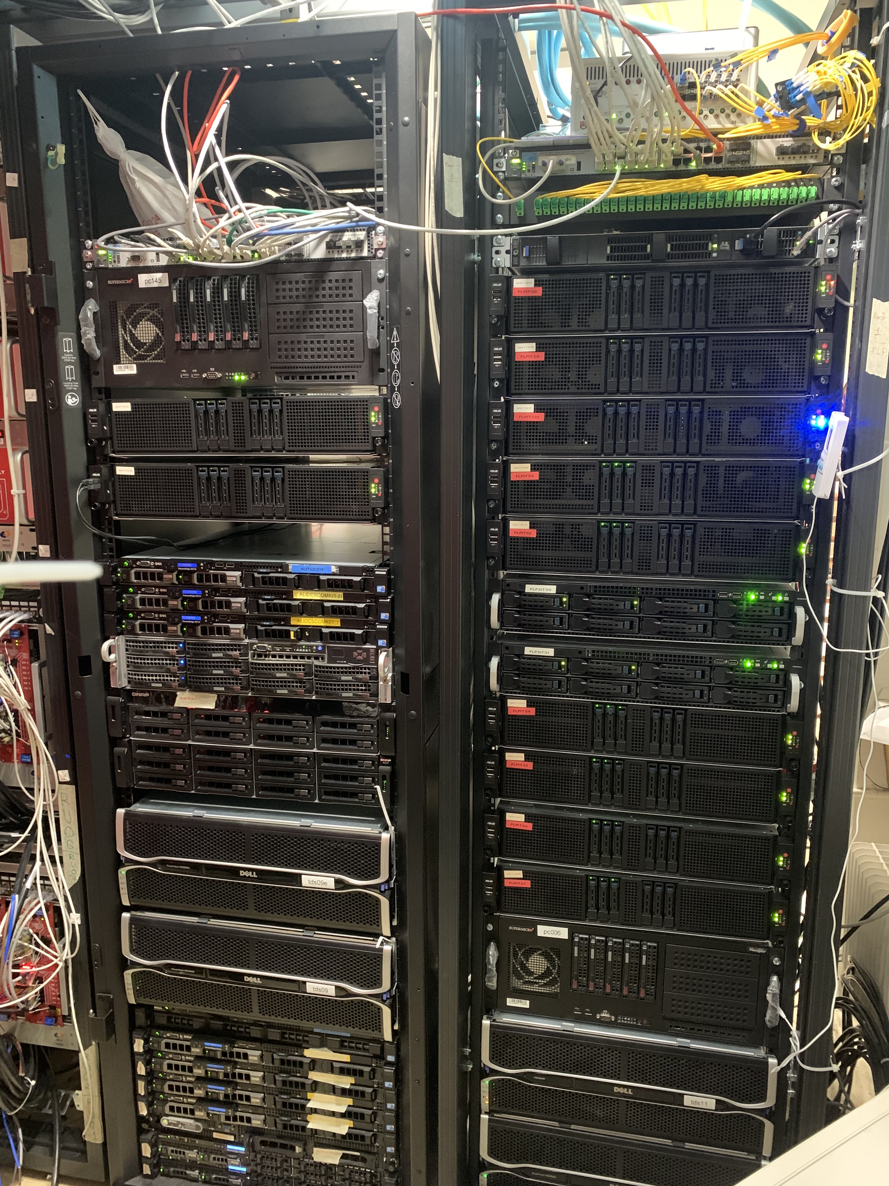
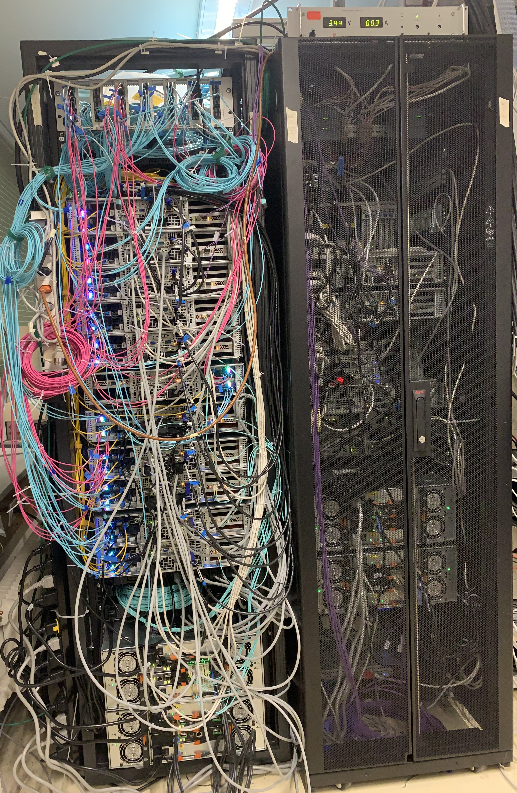
Server/GPU Farms for Data Acquisition and Online Processing
Data Acquisition Servers & Electronics
11 “First level Processors” (FLP)
2 CRUs & 8TB of local storage each
Storage Farm for commissioning:
  200 TB local disk server + 500 TB cloud storage
Event Processing Nodes (GPU Farms)

