Slide 1
Novel direct photon-to-digital conversion technique for light readouts
Lorenzo Fabris
A collaboration between ORNL and Université de Sherbrooke

Slide 2
Applications
The main application for the technology is high-sensitivity, fast timing applications such as high-resolution, depth of interaction fast neutron radiography.
  Large panels of PSD scintillators
  Single-volume scatter cameras.
  Focus on pixel size, detector size, power, timing, cost, portability.
Not a self-contained development.
  We see this as part of and an important contribution to on-going multi-lab efforts in neutron imaging/radiography.

Slide 3
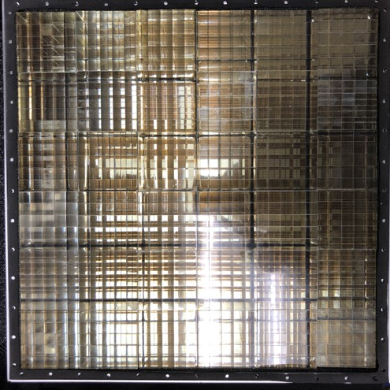
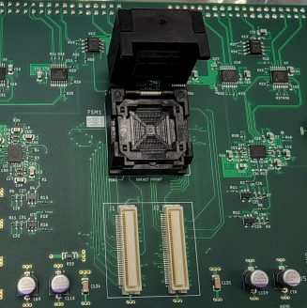
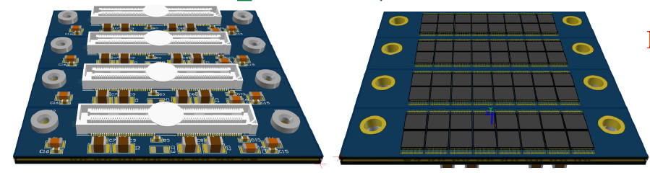
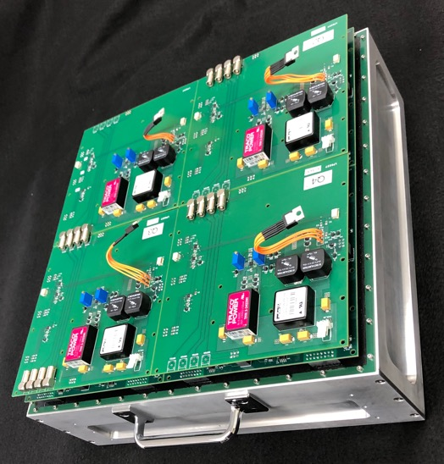
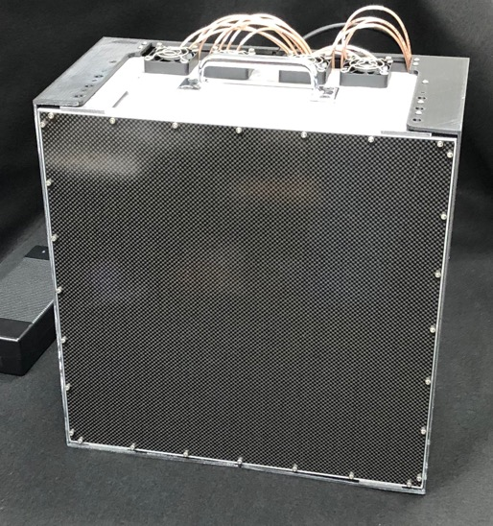
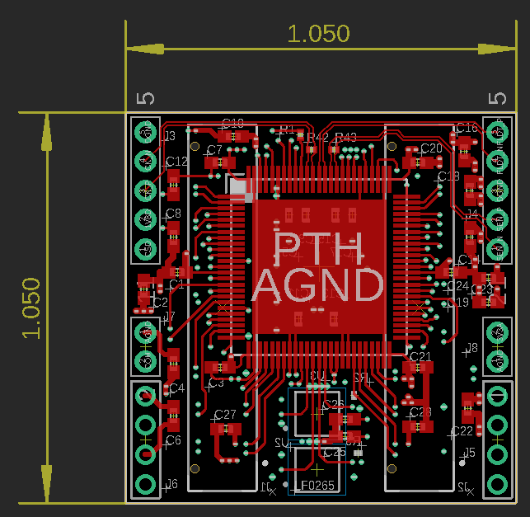
State-of-the-art
Typically focused on portability, the field has evolved much recent years:
Photon-to-Digital Converters (PDC) Based – Next state-of-the-art
All-digital, starting from the photon interaction in silicon (lowest power, very fast timing (10-100 ps), high scalability
PMT Based – Present state-of-the-art
Simple resistive divider readout
SiPM Based – Near-future state-of-the-art
ASIC readout (lower power, better timing, compact)

Slide 4
The Enabling Technology
PDCs are loosely based on SiPMs, but have fundamental differences that enable unprecedented performance
SiPM
Bias
PDC
Bias
Response of the SPAD is a ‘yes’ or ‘no’ (fixed charge)
SPAD
SPAD
Quench
Quench
DSP
Amplifier, Shaper,…
ADC
Analog current sum
SiPM capacitance (=electronic noise)
The amplifier transforms charge into voltage and then BACK to digital
No D/A+A/D conversion. Everything stays digital

Slide 5
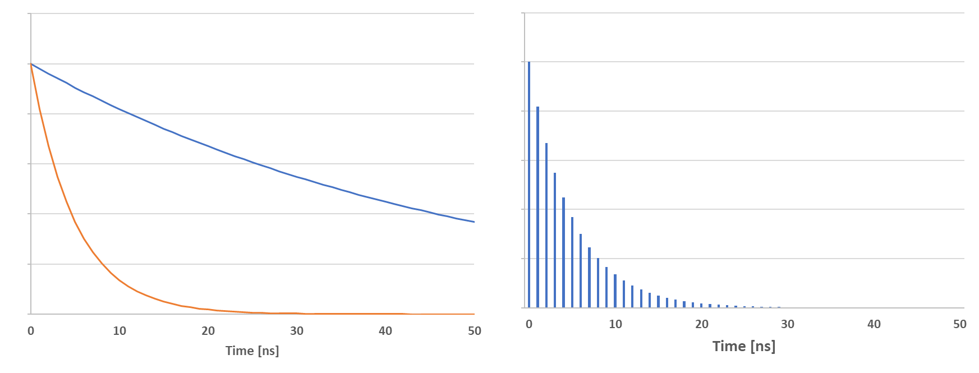
Analog Conversion Limits Performance
Analog conversion within SiPM
  Analog readout = signal distortion, limited timing and PSD performance
  More power required for BW, SNR, and signal integrity
  Large readout capacitance, SNR∝[Gain/(Noise=f(CDET))]
No analog conversion = virtually infinite SNR.
  Low power
  Fast timing (tens of ps)
  High precision
  Individual control of
  SPADs
01001
SiPM leading/trailing edge
distortion induced by readout
and quenching
10000
“Binnable” digital Sum Output
10110
11010
…
11110
Scintillator intrinsic response

Slide 6
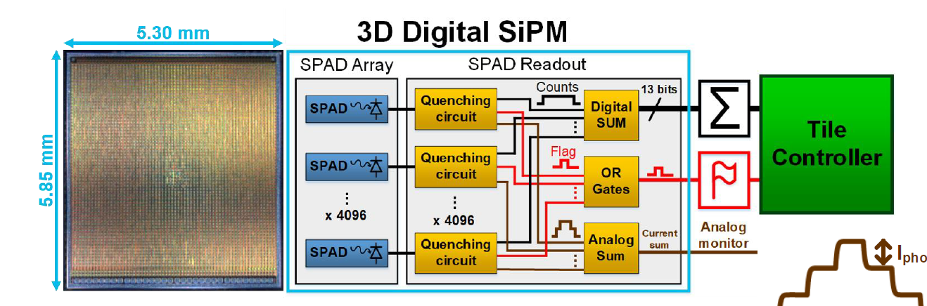
PDC Device
To 63 more chips
4096 Channels of electronics
readout on a single chip.
61 test SPADs in a 1D row on
the same chip.
The only external component
needed is a “tile controller.”
PDC Chip
The SPAD array is the light-sensitive part

Slide 7
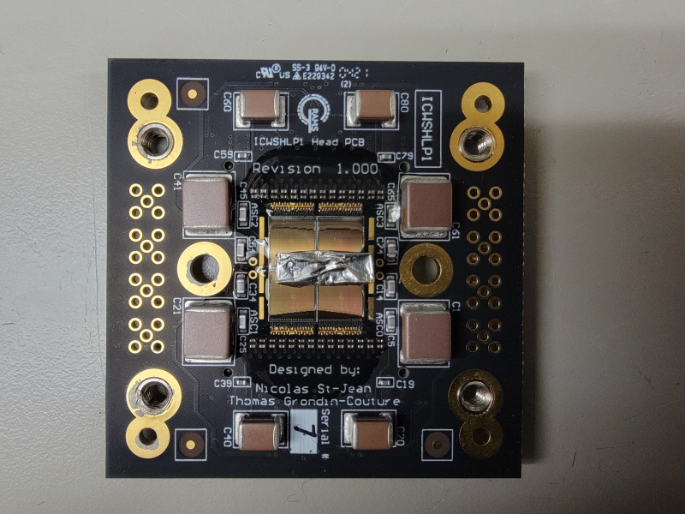
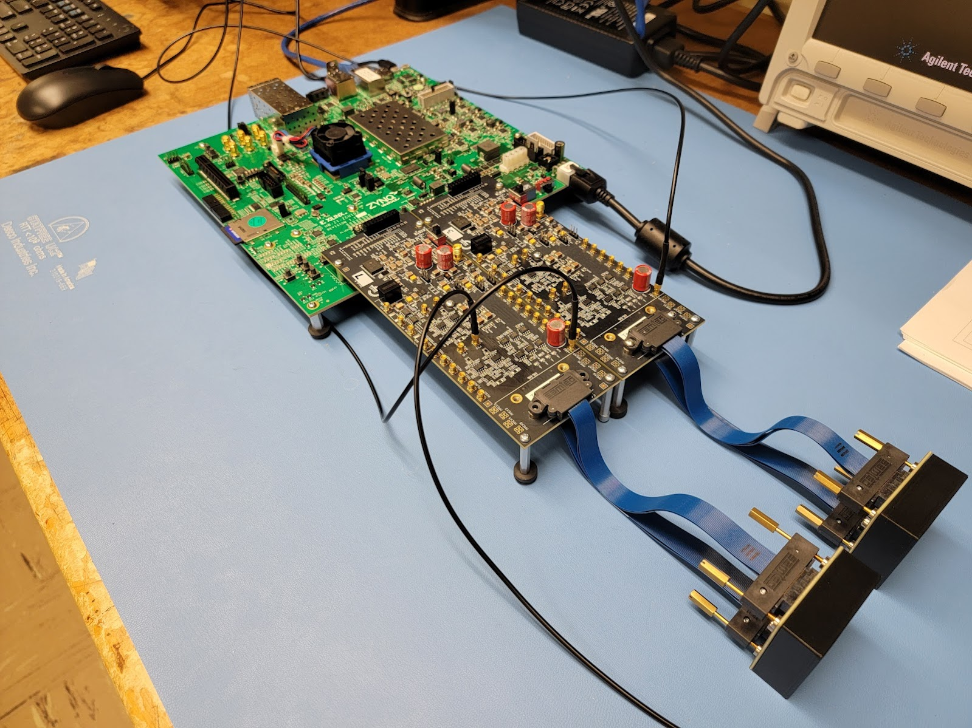
Progress
Demonstrated
functionality of SPADs
and readout electronics.
Building 8x8 tile (same
tile controller)
Tile controller
Temporary Interface
2x2 PDC heads

Slide 8
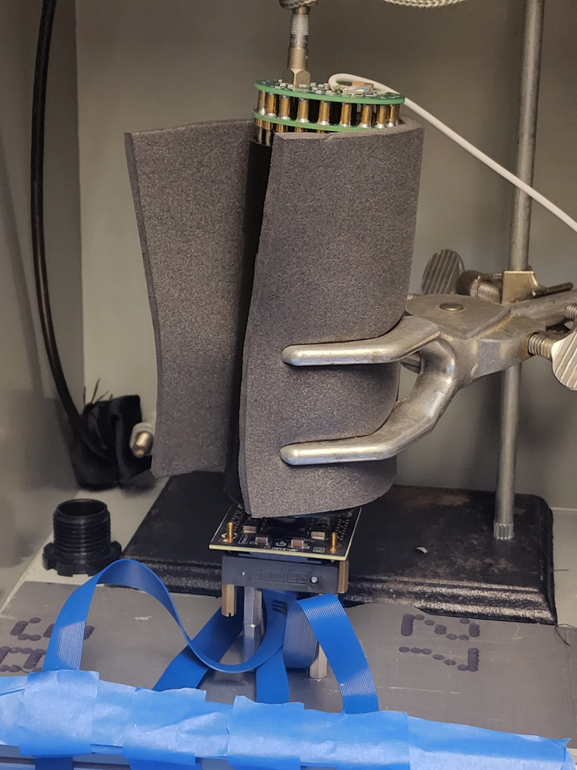
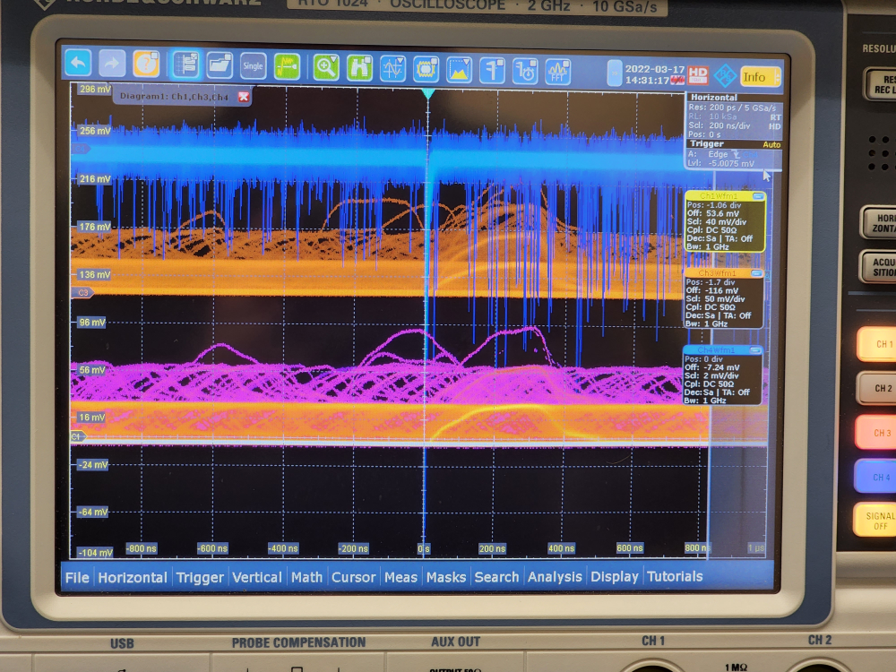
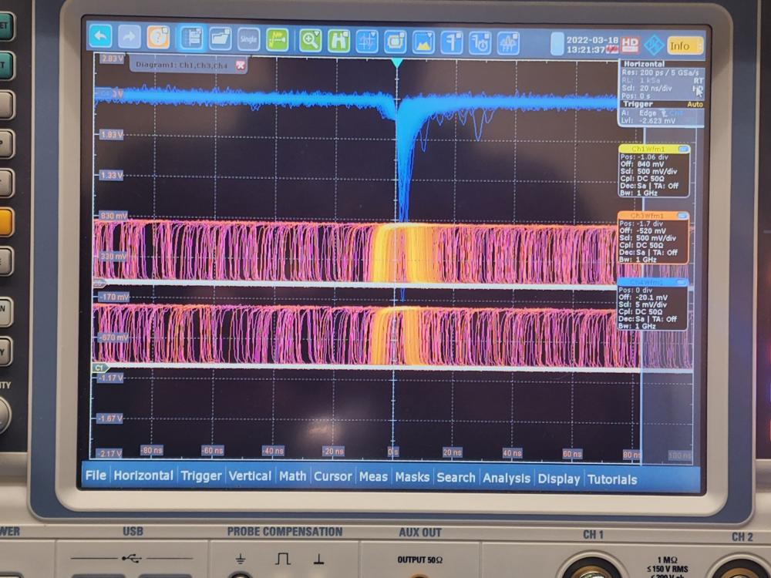
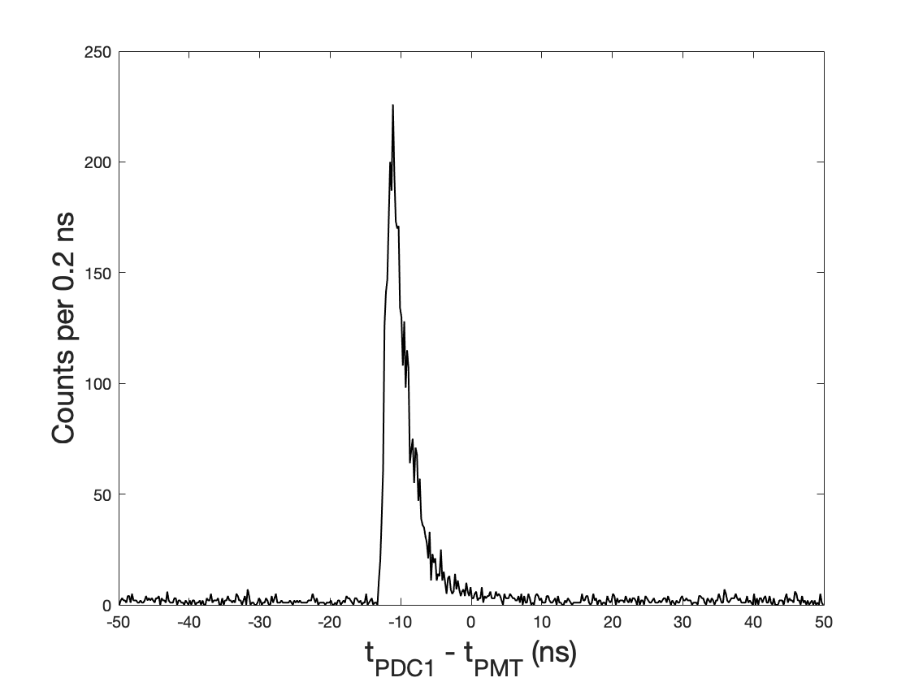
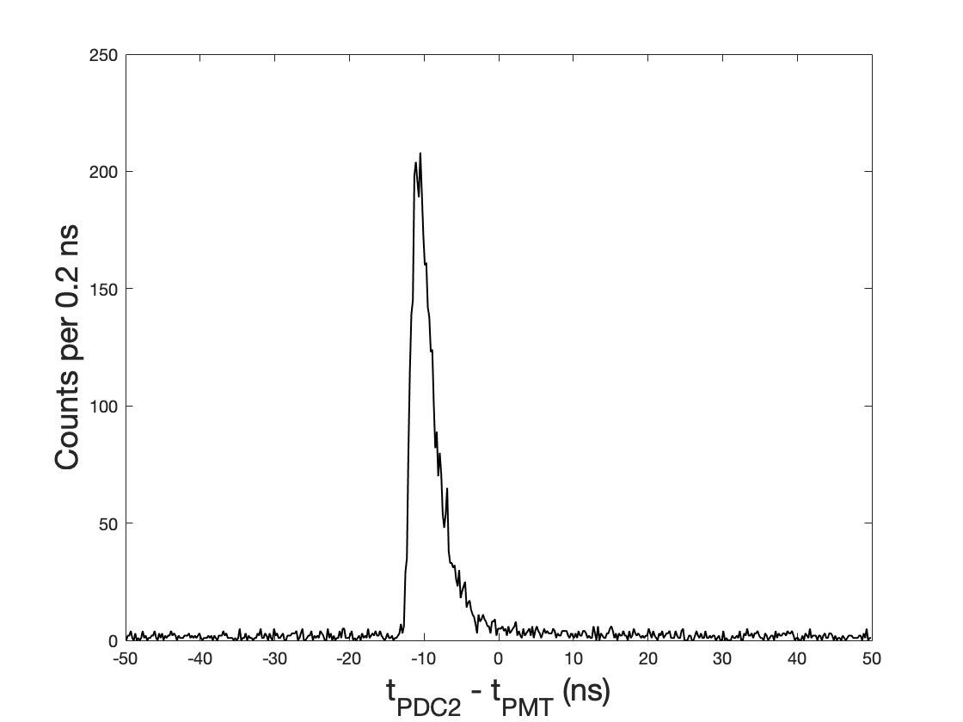
Tests done
Coupled scintillator to PDC head and set up a PMT coincidence measurement. Runs proved positive light
detection for the first time.
PDC1
PDC2

Slide 9
Future Developments
What was done until now, was to demonstrate that everything works, with some limitations.
  The PDCs only have 61 SPADs (but all readout channels)
  The tile controller is an FPGA dev kit.
We want to work towards removing these limitations.

Slide 10
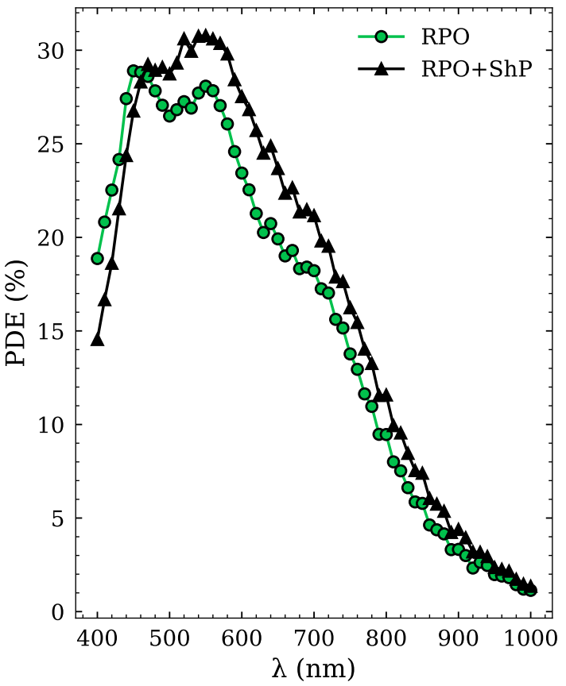
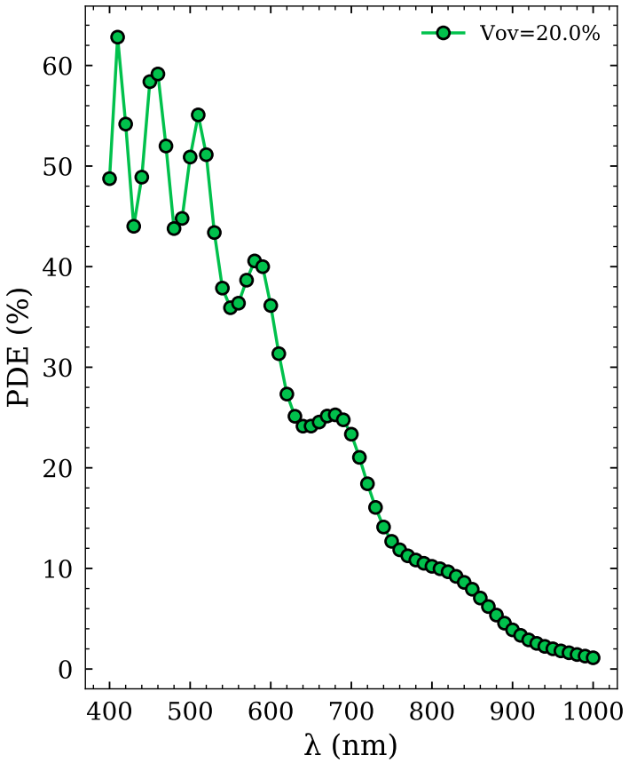
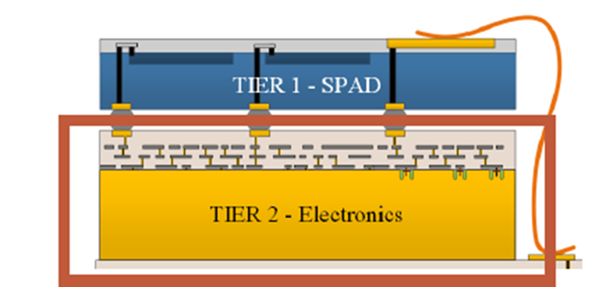
Step 1: 2D SPAD arrays with 3D interconnects
The first logical step is to produce 2D SPAD arrays.
  The SPAD arrays must be integrated on top of the readout electronics using 3D vertical interconnection techniques to be further developed.
  Use a dedicated SPAD process to improve current characteristics (already comparable to commercial SiPMs, but we would like better SPADs)

Slide 11
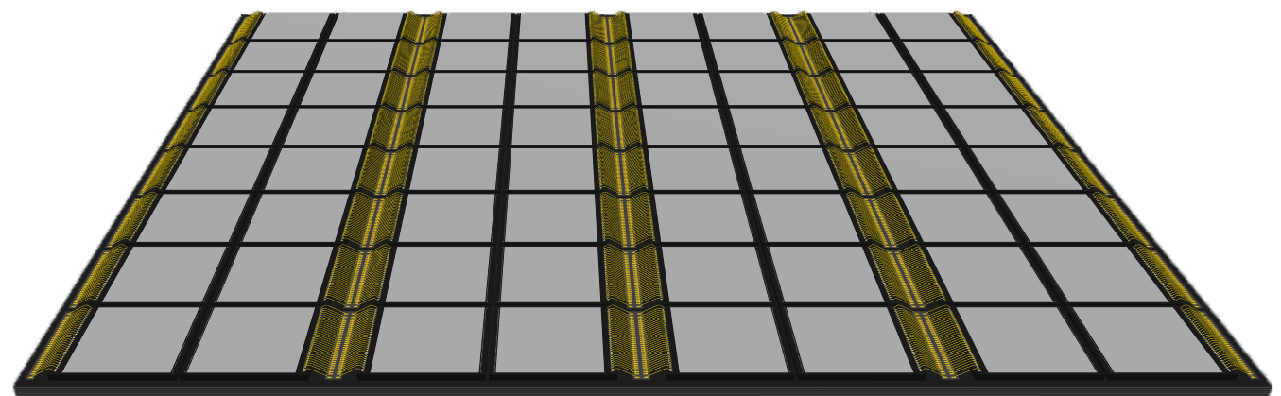
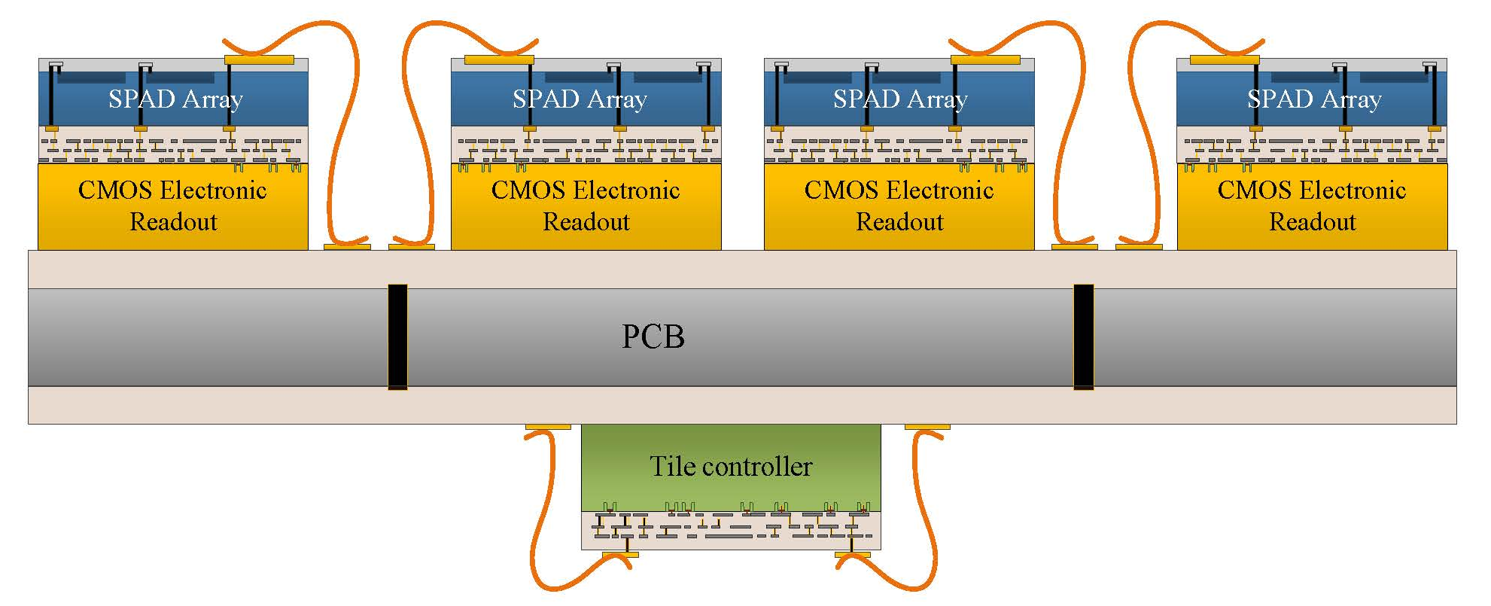
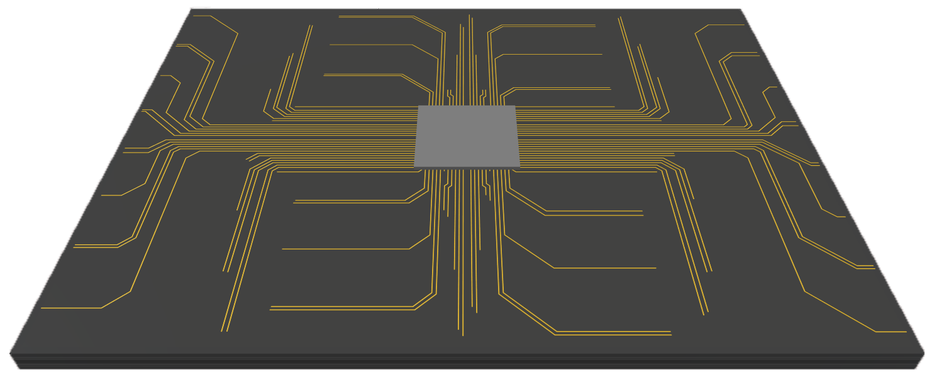
Step 2: system integration
The second logical step is to design the tile controller into an ASIC.
  Manage up to 8x8 arrays of SPADs
  Offer high speed serial bus to back-end.
  TOP
2D SPAD Arrays
Readout Electronics
  BOT

Slide 12
Step 3: make panels/cube readouts

