Slide 1
A single slide on 2020 data analysis
Frank Gonzalez
12/6/2021

Slide 2
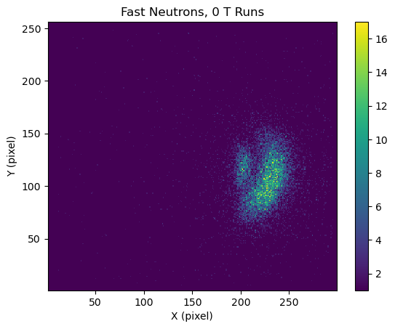
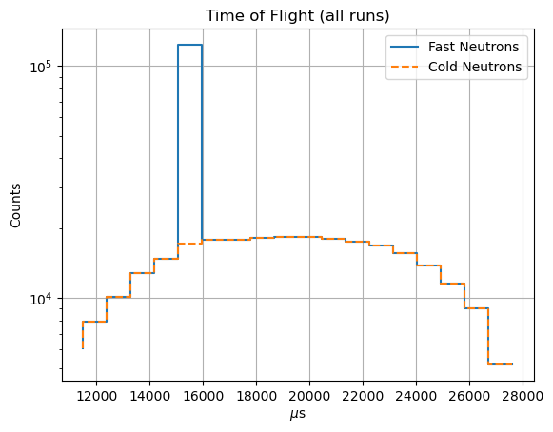
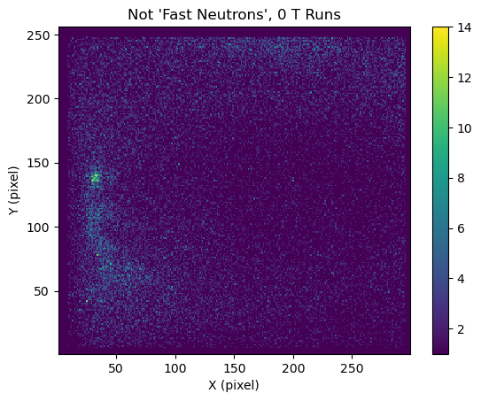
Times of Flight
Remove the “Fast Neutrons” that occur within 50us of a pulse
  Explains the odd background seen previously

