Slide 1
SNS Data 2020
Frank Gonzalez
11/29/2021

Slide 2
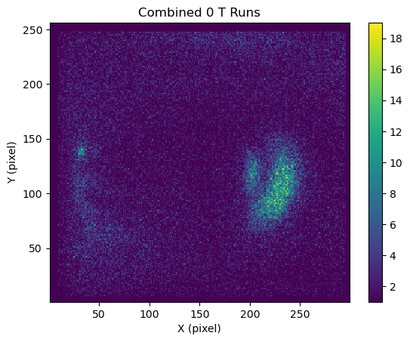
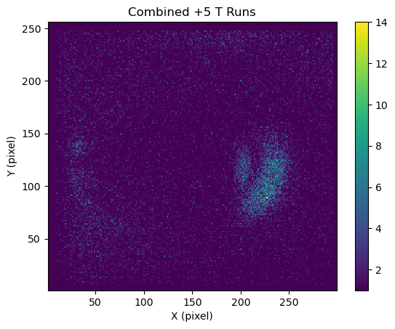
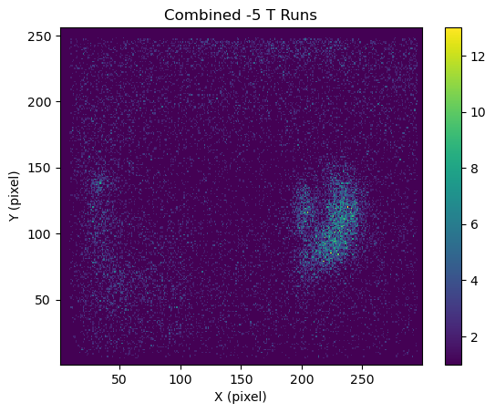
First order looking at SNS 2020 data
First step: Sum up all our runs. Z-scale in counts (no rate/charge normalization)
Not sure what the weird backgrounds are? Suggestion of fast neutrons. TODO look more into this.

Slide 3
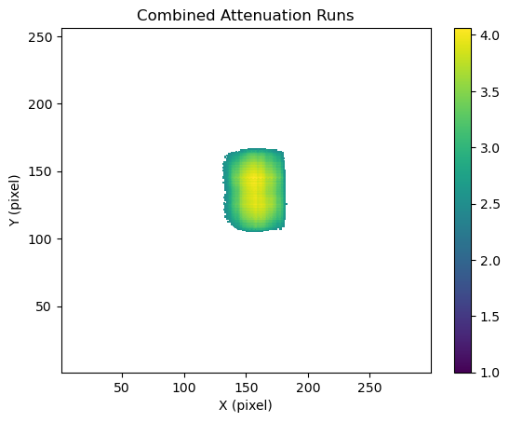
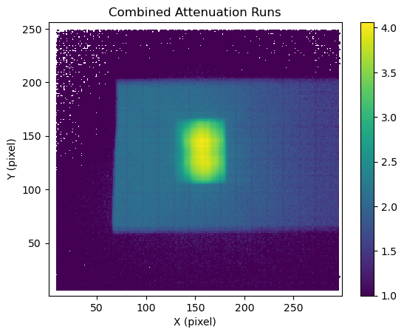
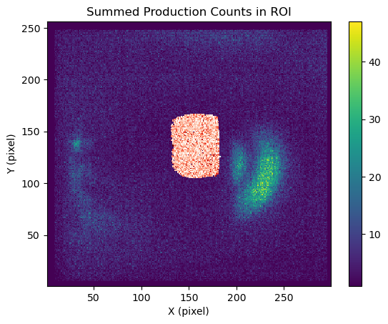
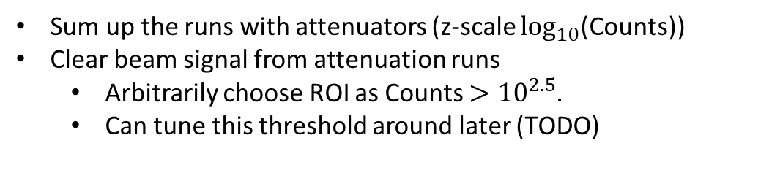
And the ROI:
Sum up the runs with attenuators (z-scale $\log_{10}$(Counts))
Clear beam signal from attenuation runs
  Arbitrarily choose ROI as Counts $>{10}^{2.5}$.
  Can tune this threshold around later (TODO)

Slide 4
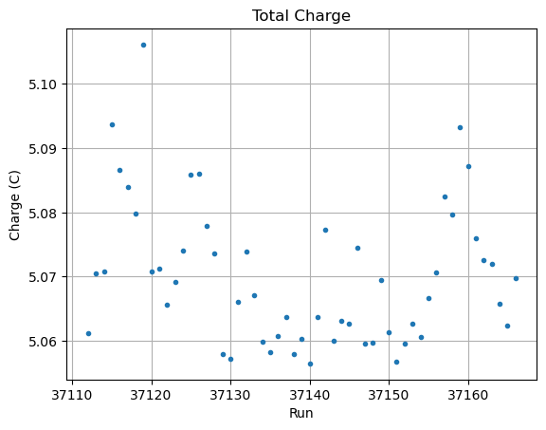
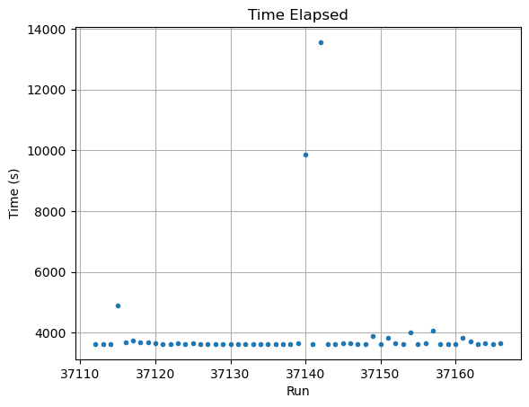
Normalizing to Summed Charge
We want to compare the signal with the expected signal from the proton beam
  Summed up the proton charge of all events
  Runs have varying lengths, beam was out for some sections (should we account for this?)

Slide 5
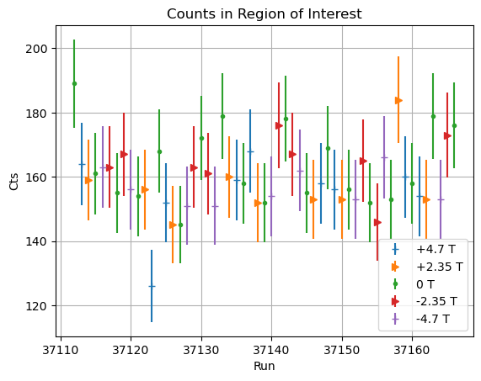
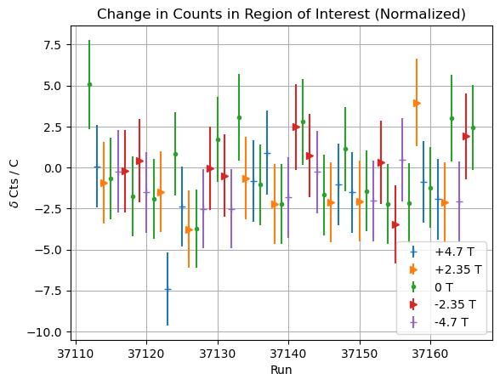
Total Counts in ROI
Now can just go through each run and sum up the signal
  Separate out into different magnetic fields
  Can “normalize” by dividing by summed charge and subtracting out 0T data.

Slide 6
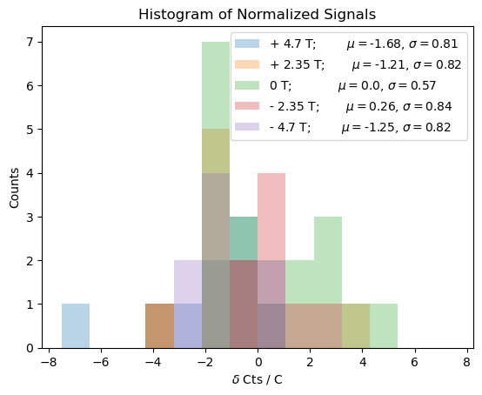
Can then histogram out the signal
Take a weighted average of the counts in the ROI
  Define 0T data as background
  Using purely Poisson statistics for uncertainties – can probably change these around a little
TODO calculate chi2
  Also double check run 37123, it’s an outlier for some reason

