Slide 1


The Core of ²⁵F in the rotational model
Augusto O. Macchiavelli
Nuclear Science Division
Lawrence Berkeley National Laboratory
Seminar
November 19th, 2020
Research Discussion 02/08/2018
Work supported under contract number DE-AC02-05CH11231.

Slide 2
Outline
Short introduction
Shell Model and residual interactions
Deformation and the Nilsson Model
Particle Rotor Model 101
Application to ²⁹F
The structure of ²⁵F and its core
RIBF (p,2p) studies
NSCL p-KO
The PRM view
Summary and Conclusions

Slide 3
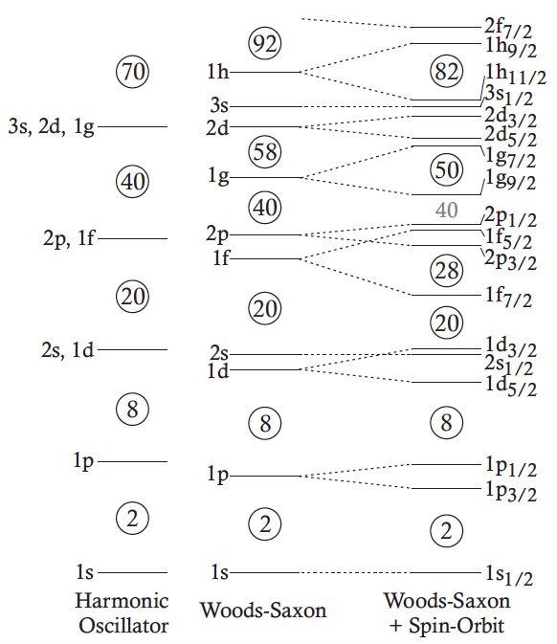
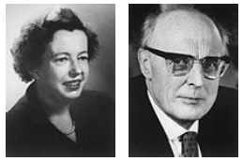

Nuclear Shell Model
Maria Goeppert-Mayer & Hans D. Jensen
1963
Maria Goeppert-Mayer, Phys. Rev. 75, 1969 (1949).
O. Haxel, Phys. Rev. 75, 1766 (1949).

Slide 4
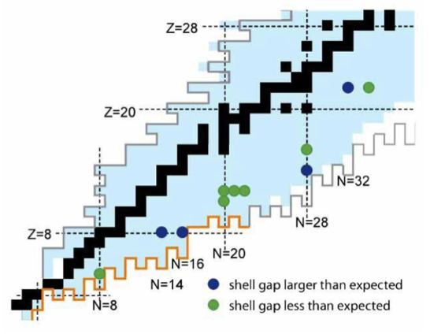
Evolution of Shell Structure and Collectivity
“Classic” magic numbers are generally correct only for stable
and near stable isotopes
Experimental studies of new exotic isotopes revealed changes in shell structure and collectivity, and provided insight on the important role played by the central, tensor, (and 3N) forces in these changes
R.V.F Janssens, Nature, Vol. 435, 2005.
A. Poves and J. Retamosa, Phys. Lett. B 184, 311 (1987).
E.K. Warburton, J.A. Becker and B.A. Brown, Phys. Rev. C 41, 1147 (1990).
T. Otsuka et al., Phys. Rev. Lett. 87, 082502 (2001).
O. Sorlin and M. Porquet, Prog. Part.Nucl. Phys. 61, 602 (2008).
K. Heyde and J. L. Wood, Rev. Mod. Phys. 83, 1467 (2011).*
T. Otsuka, A. Gade and O. Sorlin, Rev. Mod. Phys.,92(2020)

Slide 5
Evolution of Shell Structure and Collectivity
“Classic” magic numbers are generally correct only for stable
and near stable isotopes
Experimental studies of new exotic isotopes revealed changes in shell structure and collectivity, and provided insight on the important role played by the central, tensor, (and 3N) forces in these changes
R.V.F Janssens, Nature, Vol. 435, 2005.
Much evidence has been obtained for the existence of deformed ground states,
and a good understanding of the physical mechanism behind the inversion.

Slide 6

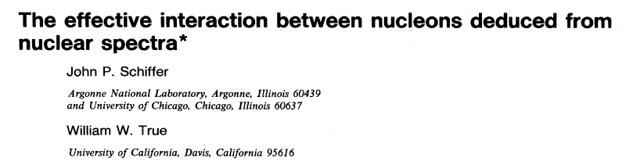
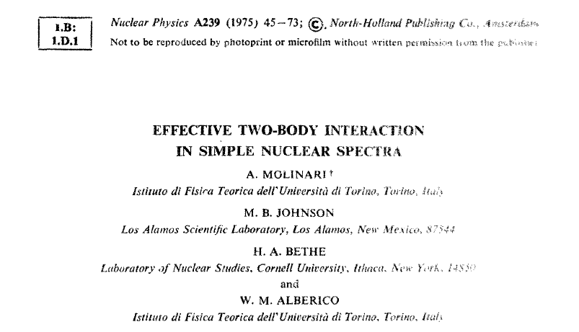

Slide 7
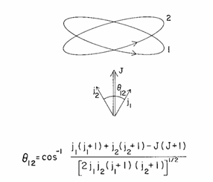
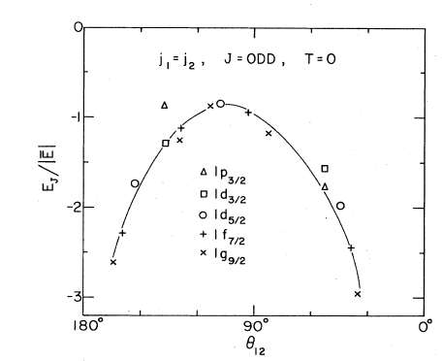
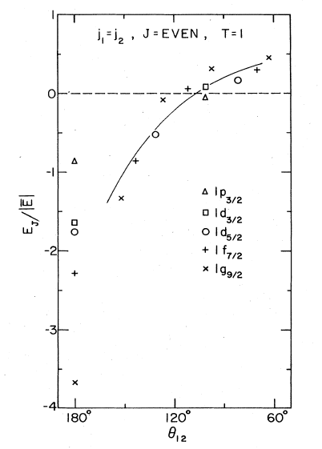
Short-range (Pairing ) + long-range (Quadrupole)
2

Slide 8
Evolution of Shell Structure and Collectivity
“Classic” magic numbers are generally correct only for stable
and near stable isotopes
Experimental studies of new exotic isotopes revealed changes in shell structure and collectivity, and provided insight on the important role played by the central, tensor, (and 3N) forces in these changes
R.V.F Janssens, Nature, Vol. 435, 2005.
For many body configurations the single-particle energy scale plays a major role
A delicate balance between the monopole field and correlations.

Slide 9
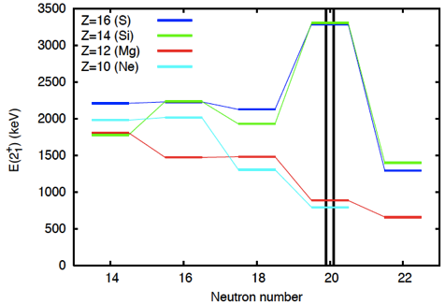
Evolution of Shell Structure and Collectivity
N=20 shell gap
A. Poves and J. Retamosa, Phys. Lett. B 184, 311 (1987).
E. K. Warburton, J. A. Becker, and B. A. Brown, Phys. Rev. C41, 1147 (1990).

Slide 10
Evolution of Shell Structure and Collectivity
N=20 shell gap
Y.Utsuno et al PRC 60 (1999) 011301(R)
Role of the π d_{5/2}- ν d_{3/2} interaction
20
Δl=Δj=2
Quadrupole
Correlations
Ne
Ca
d_{5/2} | s_{1/2}| d_{3/2}

Slide 11
Harmonic Oscillator Shell Closures
d_{5/2}
d_{5/2}
V_{π} _{p3/2- ν p1/2}
s_{1/2}
s_{1/2}
8
p_{1/2}
N=8
p_{1/2}
6
p_{3/2}
6
p_{3/2}
p_{3/2}
p_{3/2}
/////
Z=6
Z=2
p_{3/2}
p_{3/2}
f_{7/2}
f_{7/2}
V_{π d5/2- ν d3/2}
20
d_{3/2}
d_{3/2}
16
14
s_{1/2}
s_{1/2}
N=20
d_{5/2}
/////
d_{5/2}
d_{5/2}
14
d_{5/2}
Z=14
Z=8
d_{5/2}
d_{5/2}
g_{9/2}
g_{9/2}
V_{π} _{f7/2- ν f5/2}
40
34
f_{5/2}
p_{1/2}
p_{1/2}
N=40
f_{5/2}
32
p_{3/2}
p_{3/2}
f_{7/2}
/////
28
f_{7/2}
28
f_{7/2}
f_{7/2}
Z=28
π
ν
Z=20
π
ν
N/Z
O. Sorlin and M. Porquet, Prog. Part.Nucl. Phys. 61, 602 (2008).
Notes:
To summarize the N=8 and N=2à dispappearence has a common origin. For N=28, the removal of p3 protons leads to a much smaller binding energy of the neutron p1/2, which comes closer rto the sd intruders. The role of the pn interaction is therefore essential. Similarly for the N=20 shell, the d5 – d3 pn interaction plays a similar role acting to reduce N=20 and bringing collectivity, in addition yto creating a new shell gap at N=16. We may question whgether a similar effect coulkd act to destrothe next HO shell number, N=40. For the latter, the removal of protons f7 from Ni should provoke a destruction of the N=40 shell closure.

Slide 12
How about the deformed shell model ?

Slide 13

Nilsson Model
Anisotropic harmonic oscillator potential
If axial symmetry is presumed:
An elongation parameter, ε, is introduced such that:
Without spin-orbit and l² term the Nilsson energy levels are given by:
In addition to the principal oscillator number N and its component n₃ the
Nilsson quantum numbers are Λ=l_{z}, Σ=s_{z}, Ω=Λ+Σ=j_{z} and parity π=(-1)^{l}.
Nilsson levels are labeled: [Nn₃Λ]Ω^{π}
S. G. Nilsson, Dan. Mat. Fys. Medd 16, 29 (1955).

Slide 14
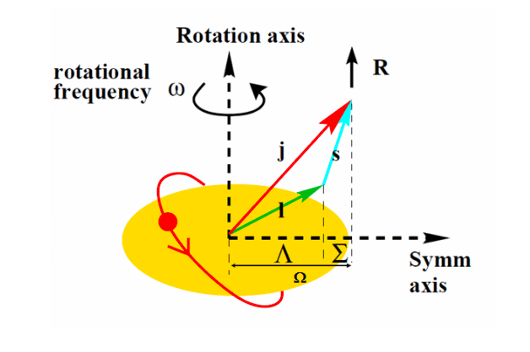
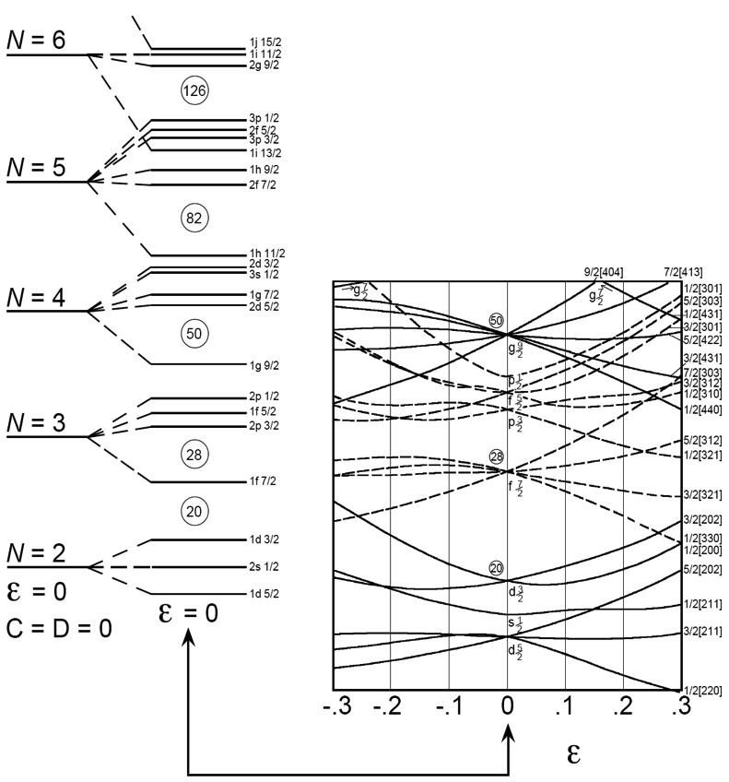
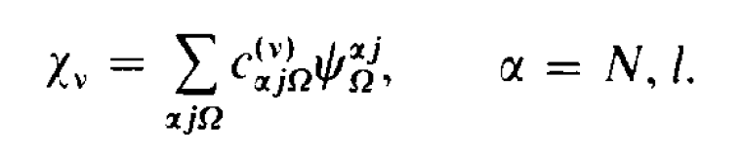
Nilsson Diagram
The effects of deformation
can be seen in the diagram.
Each spherical level labeled
by N(l_{j}) at ε=0, is split into
(2j+1)/2 levels with
The remaining degeneracy
means that each level can
accommodate two nucleons.
Orbits with lower Ω are
shifted downwards for ε>0 (prolate) and upwards for ε<0 (oblate).
Deformed Mean Field

Slide 15

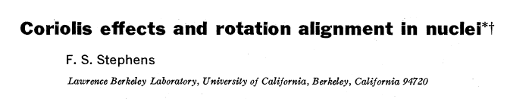

Reviews of Modern Physics, Vol. 47, No. 1, January 1975

Slide 16





The Particle plus Rotor Hamiltonian

Slide 17
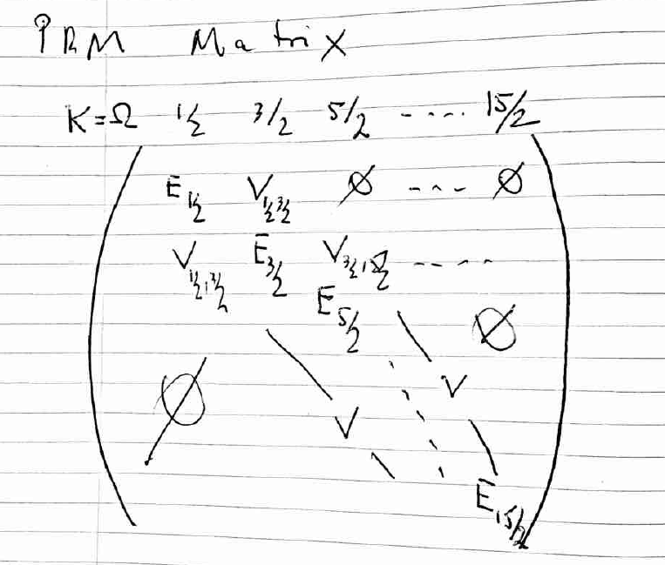


Slide 18
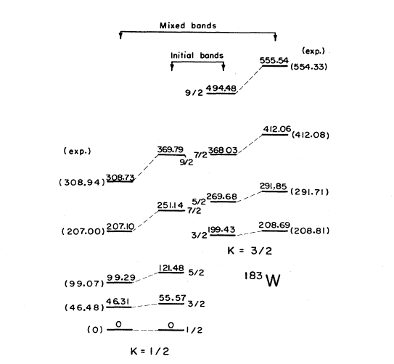
The first study
Kerman, A. K., 1956, Dan. Mat. Fys. Medd. 30, No. 15.

Slide 19


Coupling Limits
I=K, K+1, ...

Slide 20
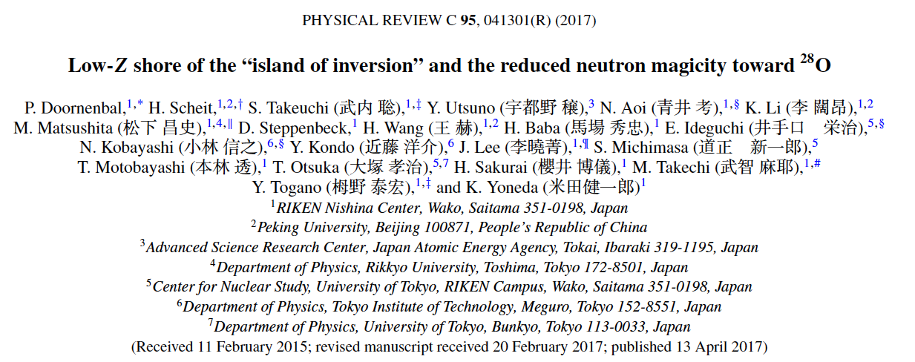
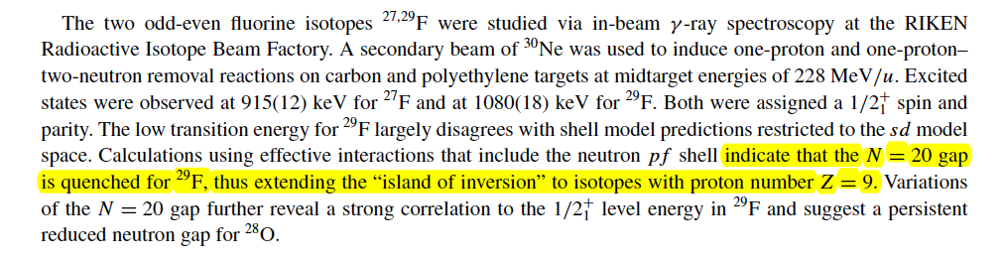
Structure of ²⁹F

Slide 21

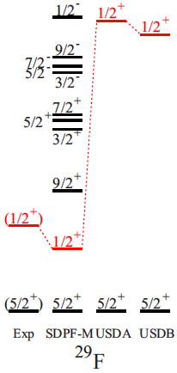
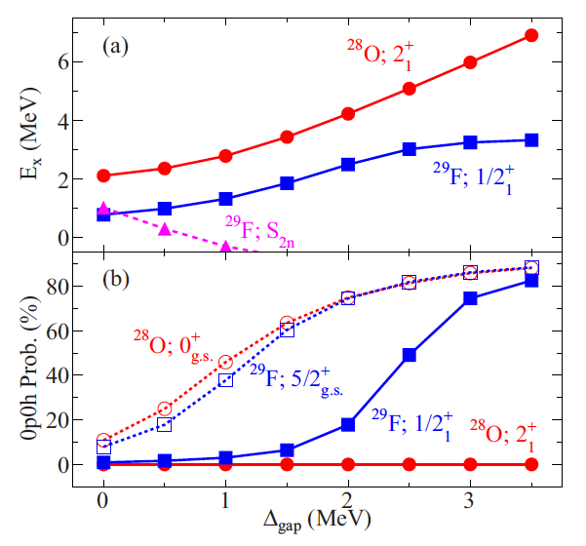
Structure of ²⁹F

Slide 22
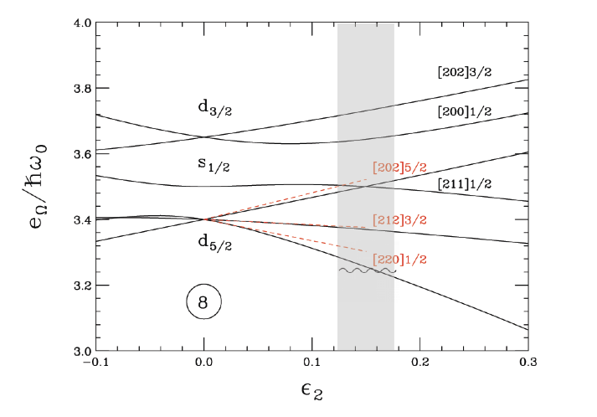
The Nilsson view

Slide 23
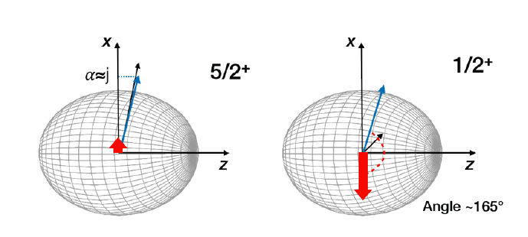
Structure of ²⁹F: Geometry
AOM et al. Physics Letters B 775 (2017) 160–162

Slide 24
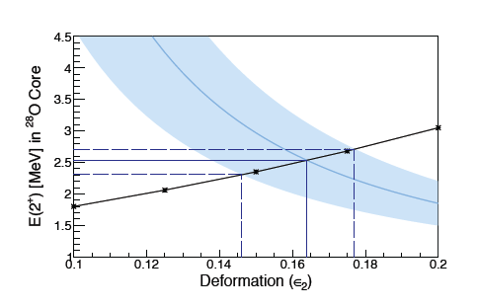

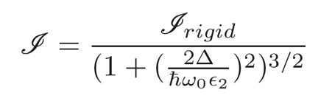
Structure of ²⁹F: PRM Solution
PRM

Slide 25
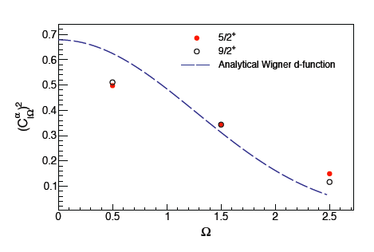


Structure of ²⁹F: Decoupled Band

Slide 26
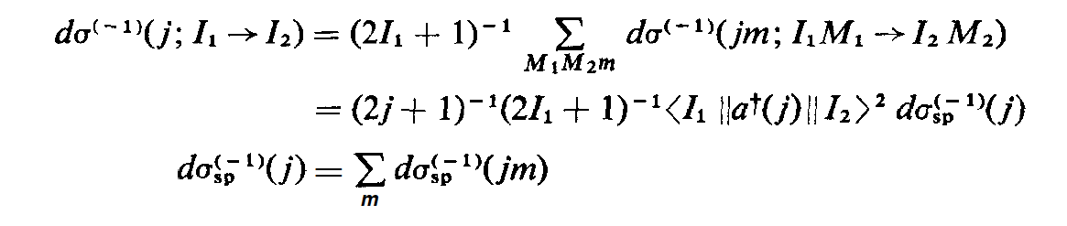
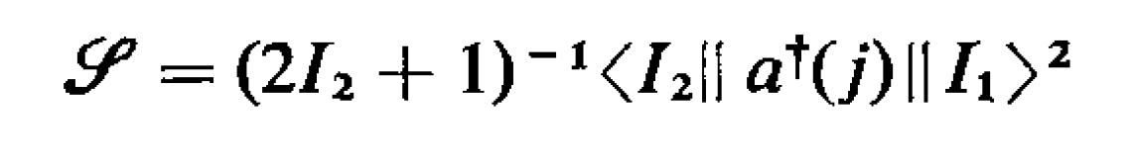
Direct reactions
Structure
Reaction
DWBA
Eikonal
DWIA
Macfarlane, M. H., and French, J. B. (1960), Rev. Mod. Phys. 32, 567.

Slide 27
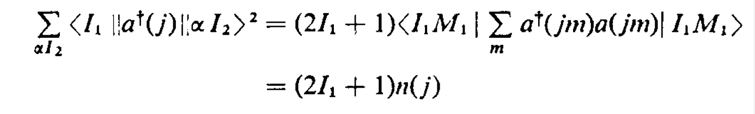
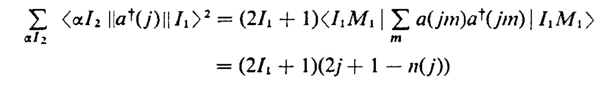
Direct reactions
Sum rules
Macfarlane, M. H., and French, J. B. (1960), Rev. Mod. Phys. 32, 567.

Slide 28
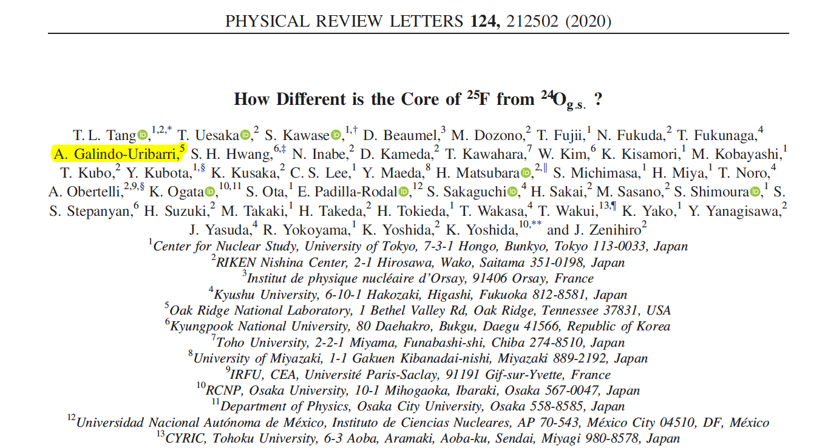

Slide 29
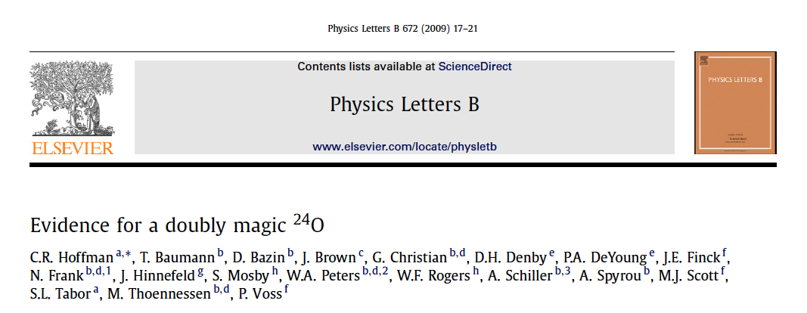
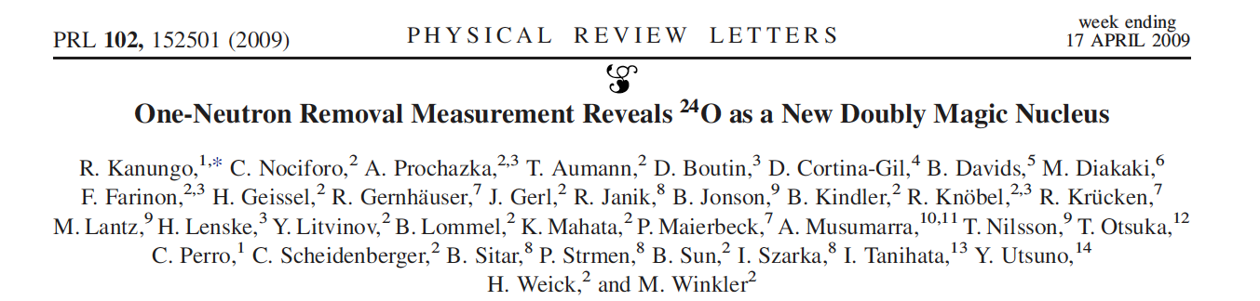
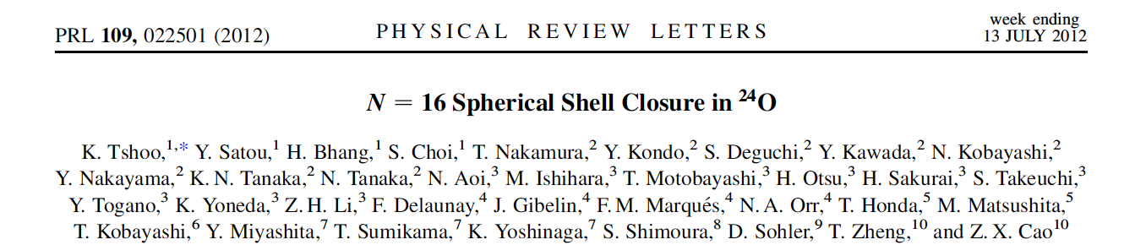
NSCL
MoNA
²⁶F 85 MeV/A
GSI FRS
²⁴O at 920 MeV/A
RIKEN
²⁴O(p,p’)

Slide 30
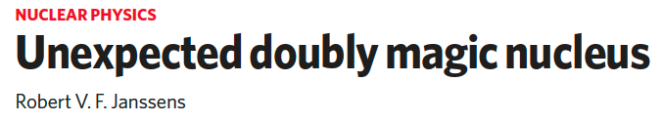
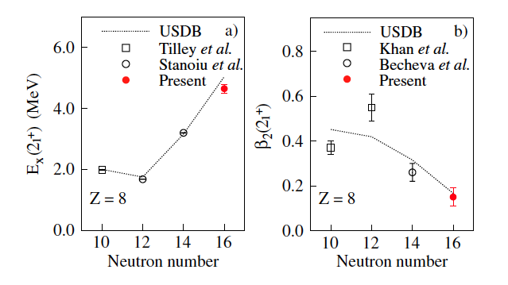
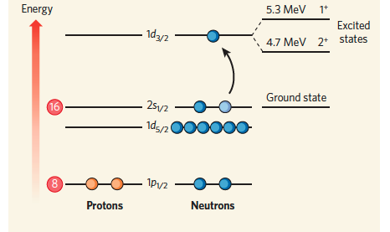
²⁴O
NATURE -- Vol 459 -- 25 June 2009
PRL 109, 022501 (2012)

Slide 31
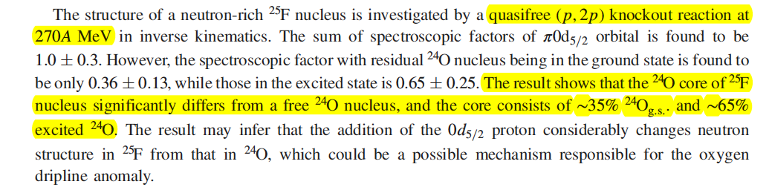
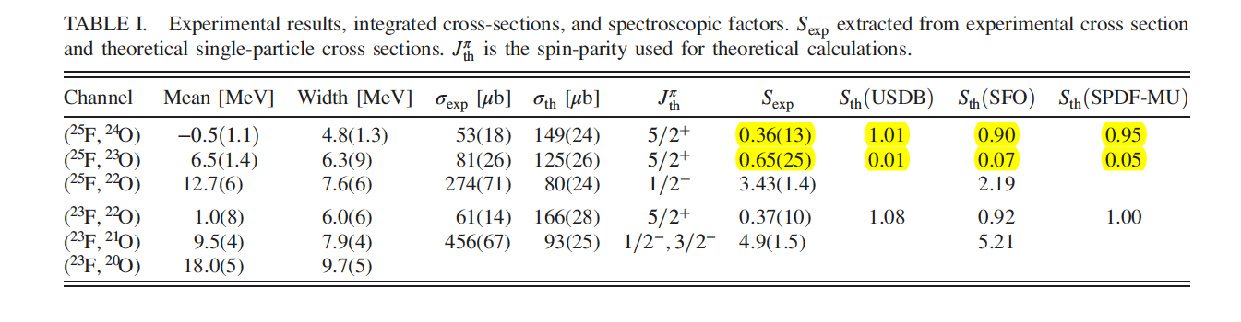
PRL 124, 212502 (2020)

Slide 32
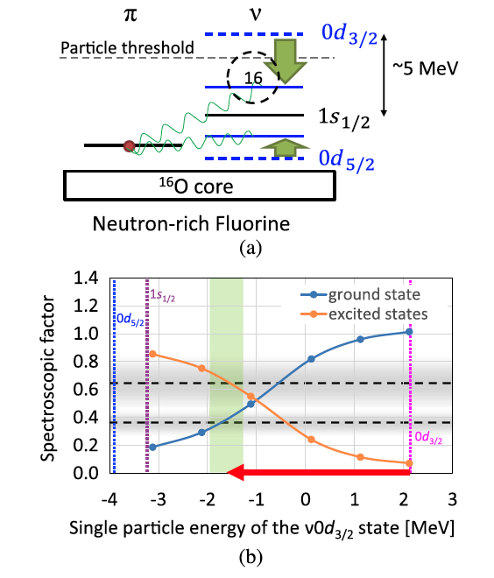
The 0d_{5/2} proton knockout from ²⁵F populates the ²⁴O ground state with a smaller probability than the ²⁴O excited states. This result indicates that the oxygen core of ²⁵F is considerably different from ²⁴O_{gs} and has a larger overlap with the excited states of ²⁴O. The change in the neutron-shell structure due to the 0d_{5/2} proton may be responsible for the small overlap between ²⁵F and ²⁴O_{gs}
A comparison with the shell model calculations indicates that the USDB, SFO, and SFPD-MU interactions are insufficient to reproduce the present results. A stronger tensor force or other mechanism such as the 3N force effects, or both, might be needed to explain the experimental results. More experimental and theoretical studies are necessary to clarify the mechanism for the change in the core of neutron-rich fluorine from the ground state of oxygen isotopes.

Slide 33
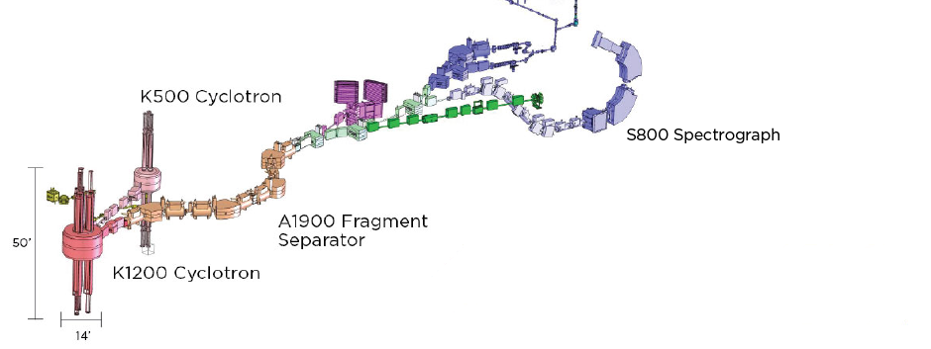
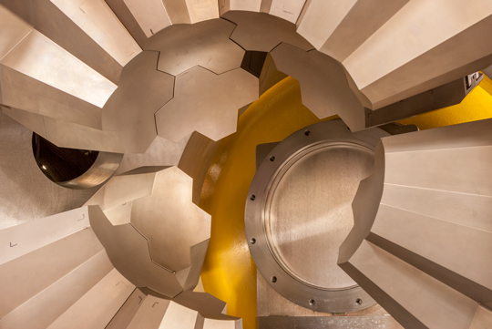

Proton Knockout at NSCL
E16022: M.D. Jones, H. L. Crawford, et al.
γ
²⁴O*
²⁵F
α
α
α
α
α
α
α
α
α
α
⁹Be

Slide 34
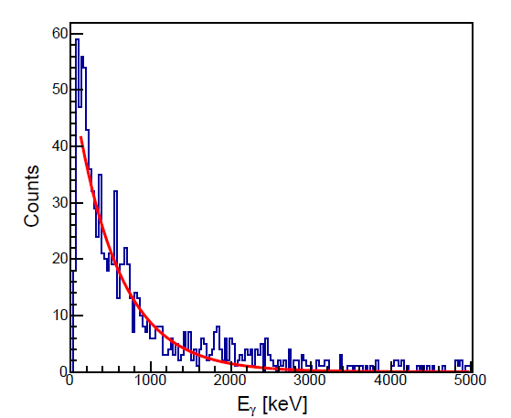
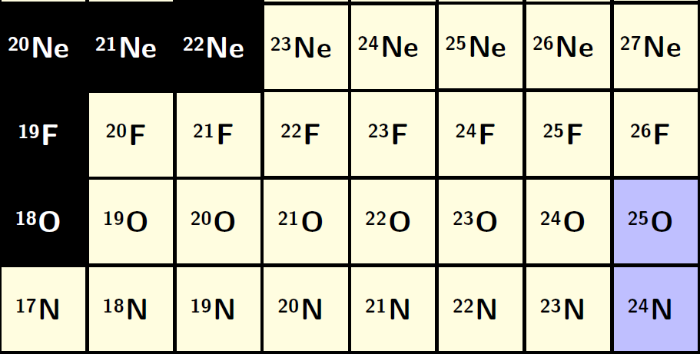
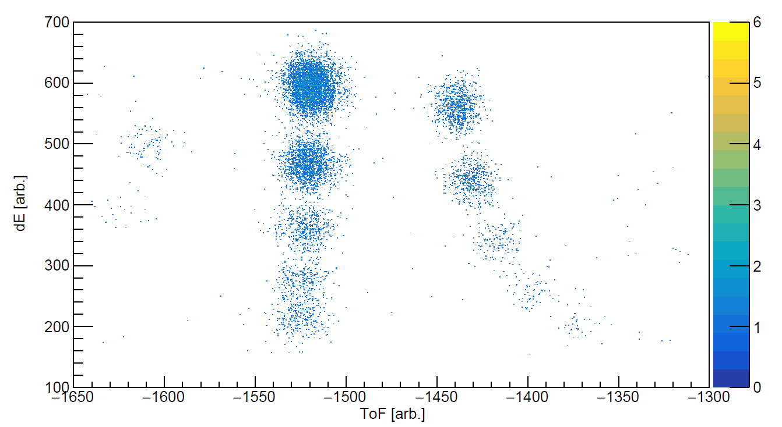
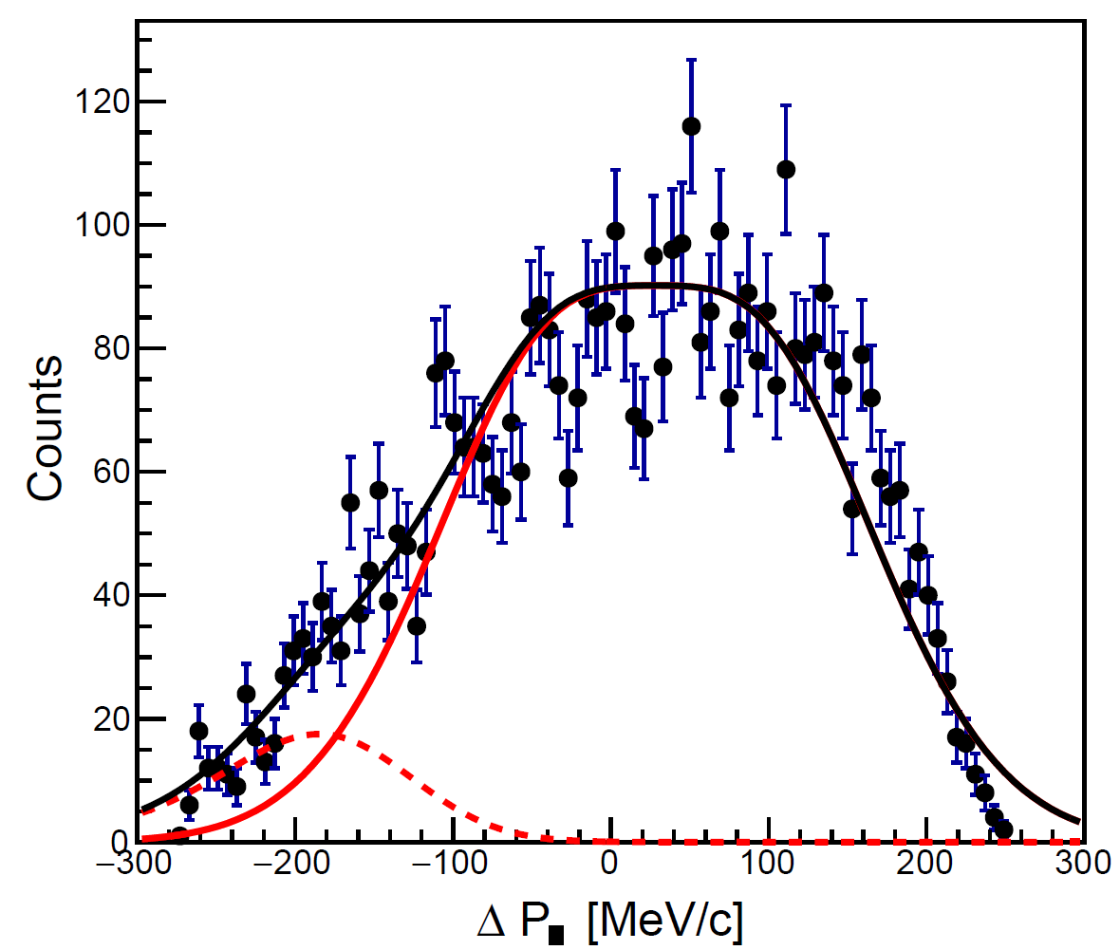



Proton Knockout at NSCL
PRELIMINARY
²⁴O
L=2 → d_{5/2}
$$σ=5.14 mb$$
$$σsp=17 mb$$
$$S=0.30 (5)$$

Slide 35
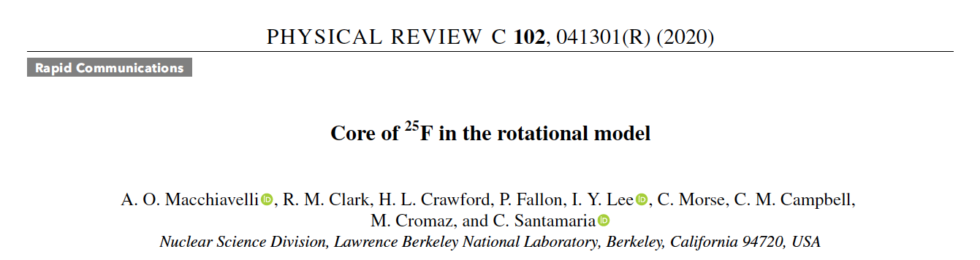

Slide 36
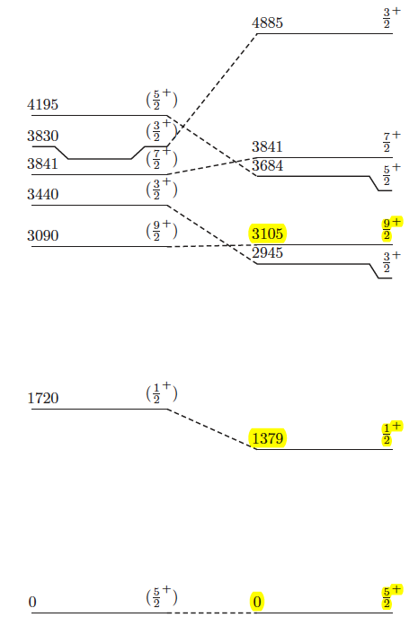
²⁵F in the PRM
The effective ²⁴O core in ²⁵F can be interpreted as a slightly deformed rotor with:
E₂⁺ (core) ≈ 3.2 MeV and ε₂ ≈ 0.15,
“²⁴O”
Experiment Theory
Zs. Vajta et al., Phys. Rev. C 89, 054323 (2014).

Slide 37
²⁵F in the PRM
Furthermore, in ²⁶F * the 1⁺ ground and 4⁺ isomeric states can be associated with the antiparallel and parallel couplings of the odd neutron in the d_{3/2} Nilsson multiplet to the structure of ²⁵F.
The former, favored by the Gallagher-Moszkowski rule gives 1⁺ as the lowest state and the latter a 4⁺ as the bandhead of a doubly decoupled band.
* A. Lepailleur et al., Phys. Rev. Lett. 110, 082502 (2013)
Experiment Theory
Zs. Vajta et al., Phys. Rev. C 89, 054323 (2014).

Slide 38
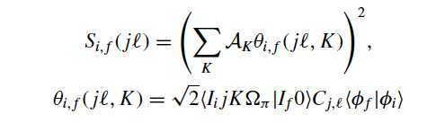
Spectroscopic factors
PRM
Nilsson amplitudes
Core overlap

Slide 39
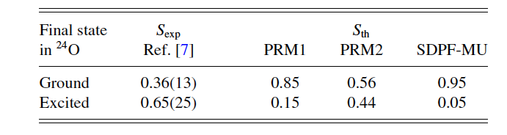

Spectroscopic factors
**
*
Following: T. Takemasa, M. Sakagami, and M. Sano, Phys. Rev. Lett. 29, 133 (1979).
T. Takemasa, Comput. Phys. Commun. 36, 79 (1985).
**Not Quenching ??
*

Slide 40
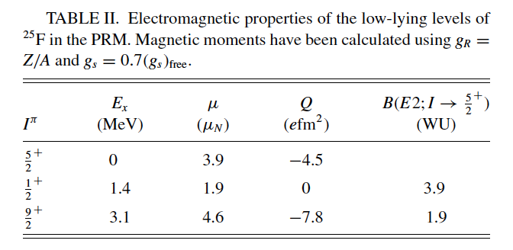
Further studies ?

Slide 41
Summary and conclusions
The low-lying structure of ²⁵F can be understood in terms of the rotation-aligned coupling limit of the PRM.
Coriolis coupling on the d_{5/2} proton Nilsson multiplet gives rise to a decoupled band with a 5/2⁺ bandhead.
Calculated proton spectroscopic factors for the ²⁵F(5/2⁺)(−1p) ²⁴O reaction are in agreement with the experimental data. The observed fragmentation of the
d_{5/2} strength is due to both deformation and a core overlap.
The Nilsson plus PRM picture suggests that the extra proton with a dominant component in the down-sloping [220] ½ level polarizes ²⁴O and stabilizes its dynamic deformation. Thus, the effective core in ²⁵F can be interpreted as a slightly deformed rotor with E2+ (core) ≈ 3.2 MeV and ε₂ ≈ 0.15, compared to the real doubly magic 24O with E2+ ≈ 4.7 MeV and weak vibrational quadrupole collectivity.
Electromagnetic observables for the three lowest experimental levels, obtained in the PRM, suggest that measurements of the magnetic and quadrupole
moments of the 5/2⁺ state as well as Coulomb excitation will shed further light on the validity of our interpretation.

Slide 42
Thank You !

