Slide 1
Results from simulations of Cd foil pinhole measurements
Cd foil was placed halfway between S1 and detector plane
  Two foil thicknesses were run
    1 mm
    0.5 mm
Used the same pinhole spectrum that was used for the polycarbonate absorber runs
  Beam originates at S1
  1 cm by 1 cm square beam shape
Pin hole diameters of 500 and 200 microns were used

Slide 2
1 mm Cd, 500 micron hole
Linear scale y-axis
log scale y-axis

Slide 3
1 mm Cd, 200 micron hole
Linear scale y-axis
log scale y-axis

Slide 4
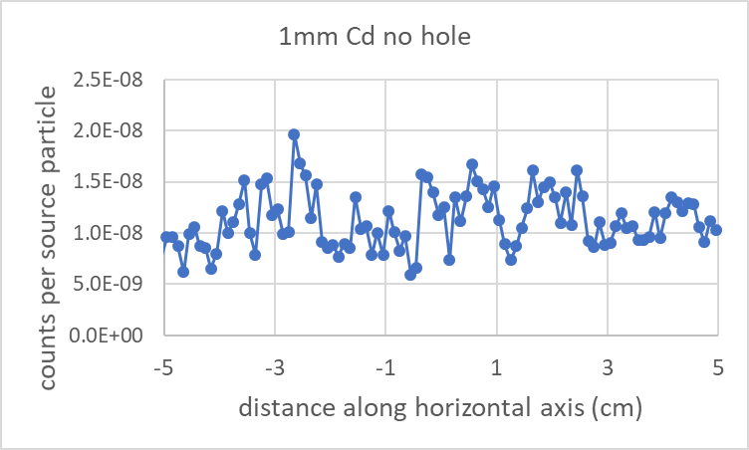
1 mm Cd, no pin hole

Slide 5
0.5 mm Cd, 500 micron hole
Linear scale y-axis
log scale y-axis

Slide 6
0.5 mm Cd, 200 micron hole
Linear scale y-axis
log scale y-axis

Slide 7
0.5 mm Cd, no pin hole

