Slide 1
Testing the Standard Model of Particle Physics with Cold Neutrons at the Spallation Neutron Source
August 06, 2026
2026 Physics Division Early Career Research Proposal Showcase
Wolfgang Schreyer
Neutron Symmetries
Notes:
Accessing Title Slide Options
The standard ORNL presentation template includes five branded title slide layouts:
Title | Standard. The preferred layout for lab-wide and general presentations. Features a default aerial photograph of the lab.
Title | Custom Image. Allows replacement of the default background with a custom full-slide image (16:9 or 4:3 landscape format).
Title | Custom Portrait Image. Supports inclusion of a custom 4:3 portrait image positioned next to the introductory text.
Title | Custom Landscape Image. Supports inclusion of a custom 16:9 landscape image positioned next to the introductory text.
Title | Text Only. Offers additional space for longer titles and multiple presenters.
Additional Lab-approved title slides specific to directorates and user facilities are available in PowerPoint under the following folders: Custom Title Slides and User Facility Templates, located in Presentation Templates.
Custom Title Slide Guidelines
Image Rights. Any custom images, graphics, or photography must be owned by ORNL or used with documented permission from the original creator or source.
Appropriate Image Use. Select images that work well with the layout. Ensure the focal point of the image is not obscured by the title text and white overlay box.
Relevance and Impact. Visuals are a key element of effective communication. Whenever possible, use imagery that enhances the message of your presentation and reflects ORNL’s mission and values.
Quality and Clarity. Use high-resolution images for clarity on large screens. Avoid overly complex or dark images that may conflict with the title text.
Text-Only Option. If no appropriate or approved imagery is available, or if imagery is not permitted for the subject matter, the Title | Text Only layout provides a clean, professional alternative.
Learn more about ORNL presentations
https://ornl.sharepoint.com/sites/Branding/SitePages/Presentations.aspx

Slide 2
Bottom line up front

Slide 3
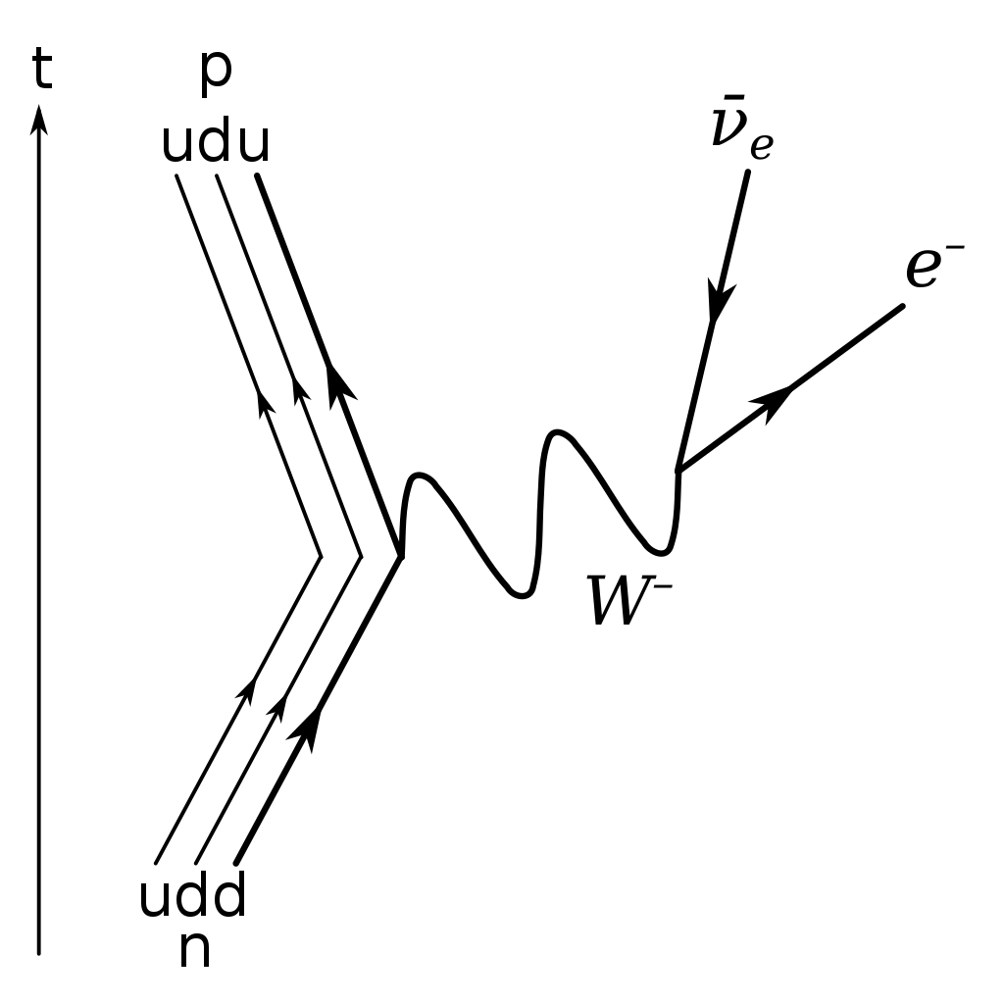
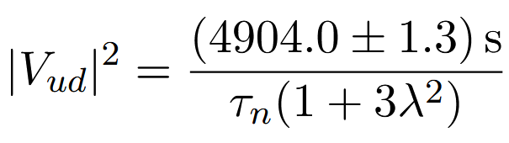
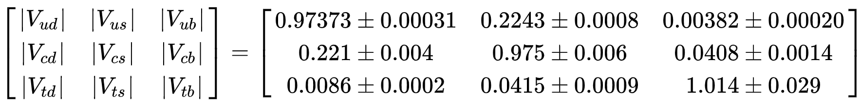
Free neutron decay can serve as a precise probe of CKM unitarity
Neutron
lifetime
Axial-vector- to
vector-decay ratio
= 1 in Standard Model
Notes:
CKM matrix governs weak interactions between quark generations
Vud element can be calculated from neutron decay (d -> u transition)
Standard Model of particle physics requires unitarity of CKM matrix (Vud^2 + Vus^2 + Vub^2 = 1)

Slide 4
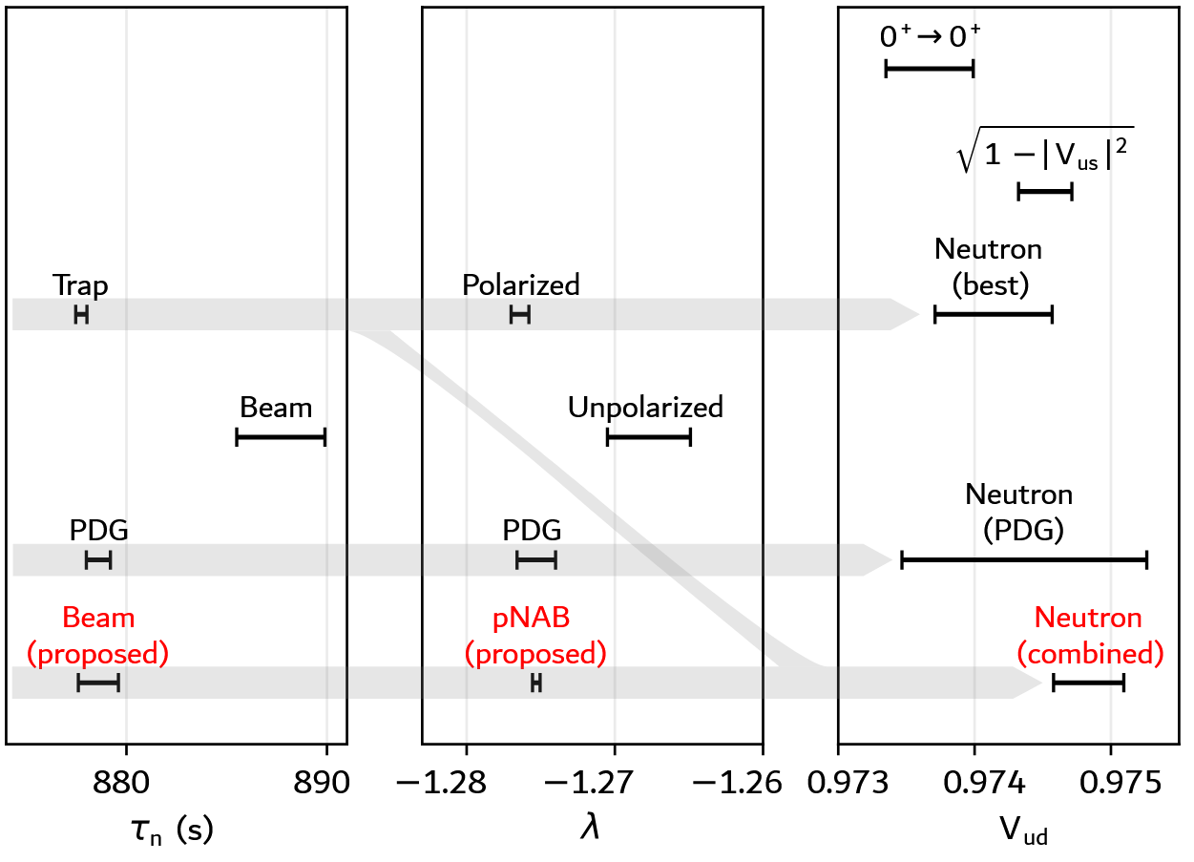
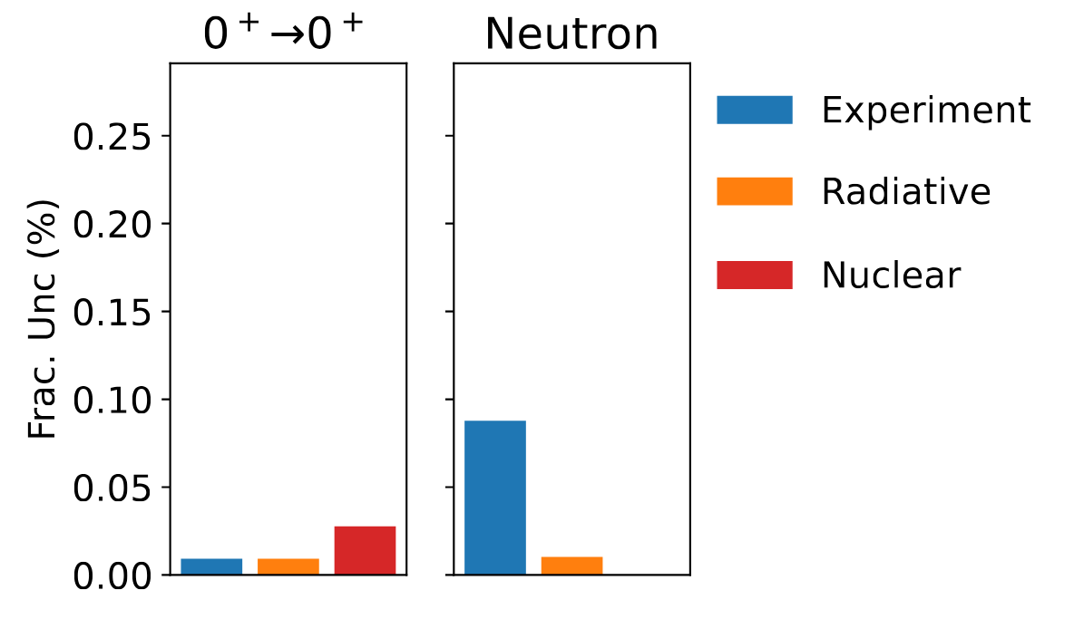
Neutrons can provide world-leading measurement of V_{ud}
– if experimental uncertainties can be improved
V_{ud}
M. Brodeur et al. Nuclear β decay as a probe for physics beyond the Standard Model. 2023. arXiv:2301.03975

Slide 5
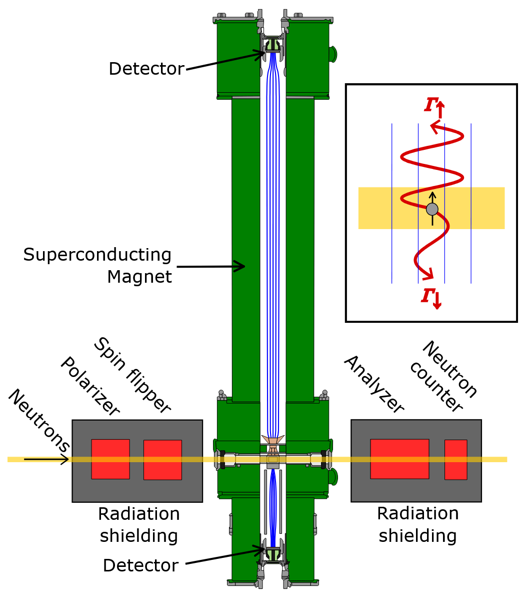

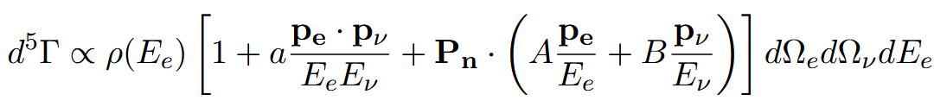
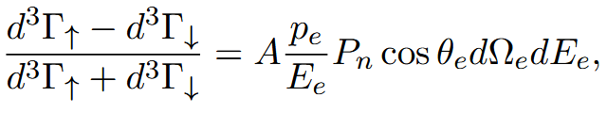
Objective 1: minimize dominant uncertainty in λ measurement with pNAB
Nab spectrometer + polarized neutrons = pNAB
Need to measure: electron energy,
neutron polarization,
spectrometer acceptance

Slide 6
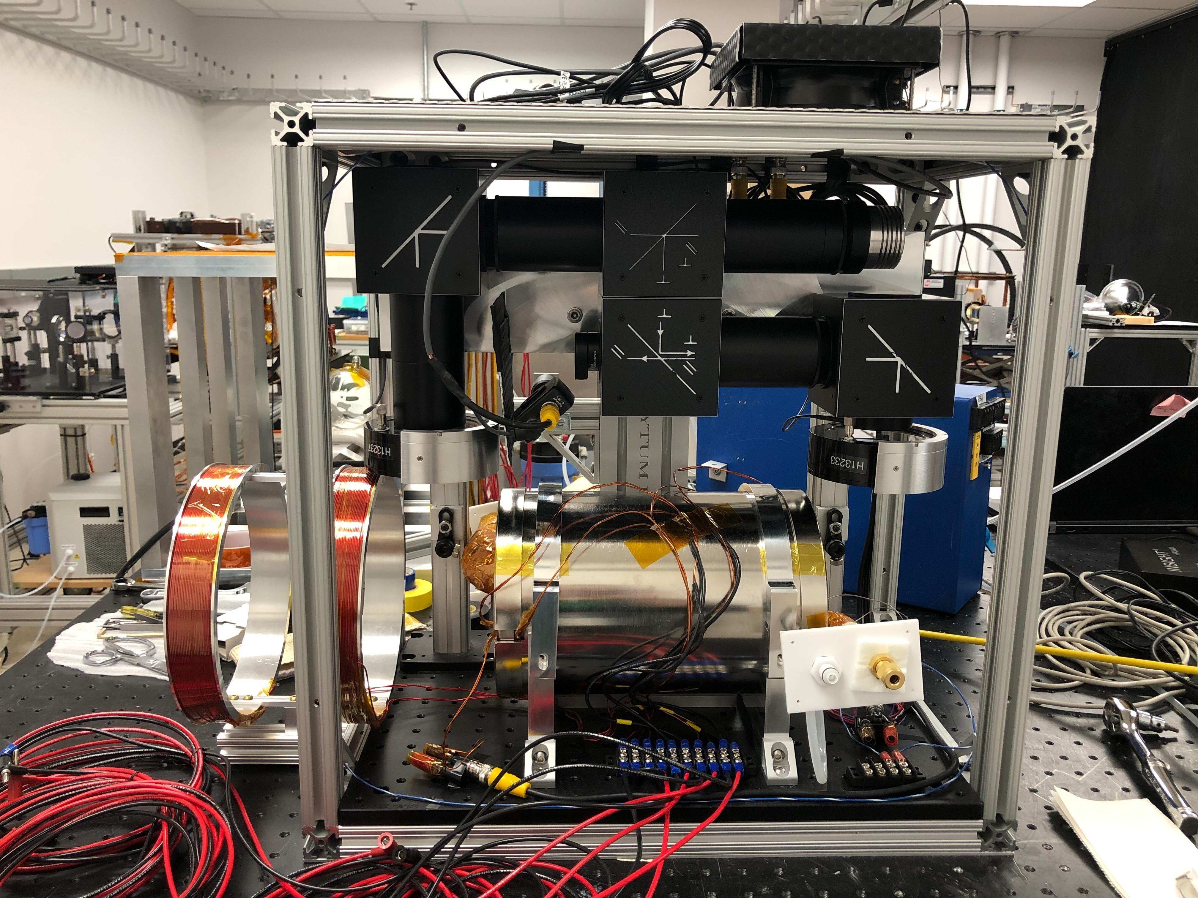
Goal: build compact ³He neutron polarization analyzer with in-situ optical pumping and 10⁻⁴ accuracy
Laser optics
➔ Demonstrate ability to achieve Δλ/λ ≤ 0.02%
(20% improvement of pNAB target)
Magnet coils
Heated 3He cell

Slide 7
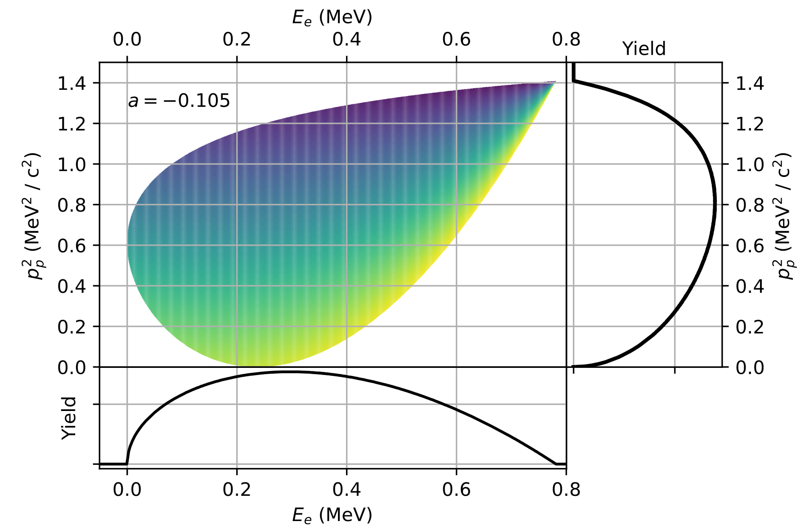

Objective 2: demonstrate new technique to measure neutrino asymmetry B
Nab can reconstruct full decay phase space, including neutrino momentum
Determine optimal spectrometer parameters
Estimate uncertainties
Collect data with pNAB (~1 month) to match current best measurement (ΔB/B = 0.5%)
➔ λ measurement cross check, sensitive to exotic
interactions (e.g. right-handed weak currents)

Slide 8
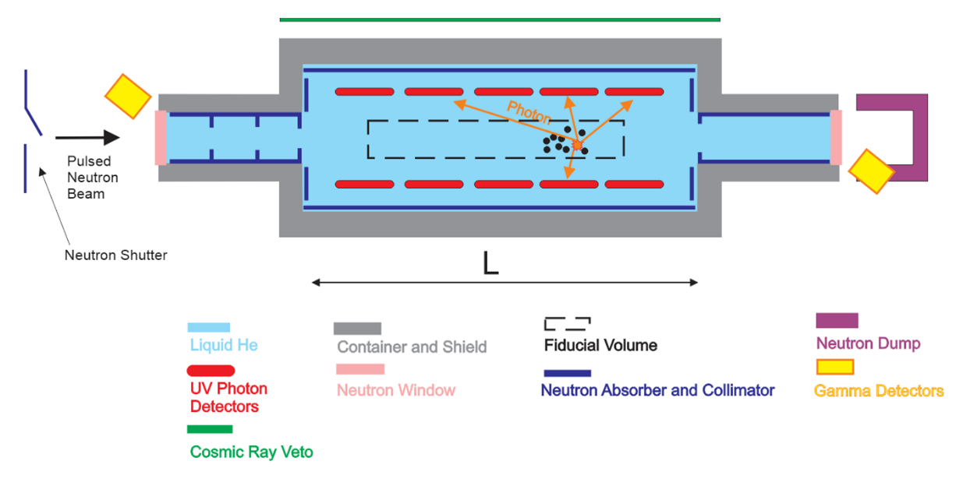
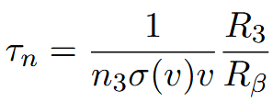
Objective 3: Advance novel neutron-lifetime concept
Decay/³He capture
Need to measure: 3He density
Capture xsection
Decay & capture rate

Slide 9
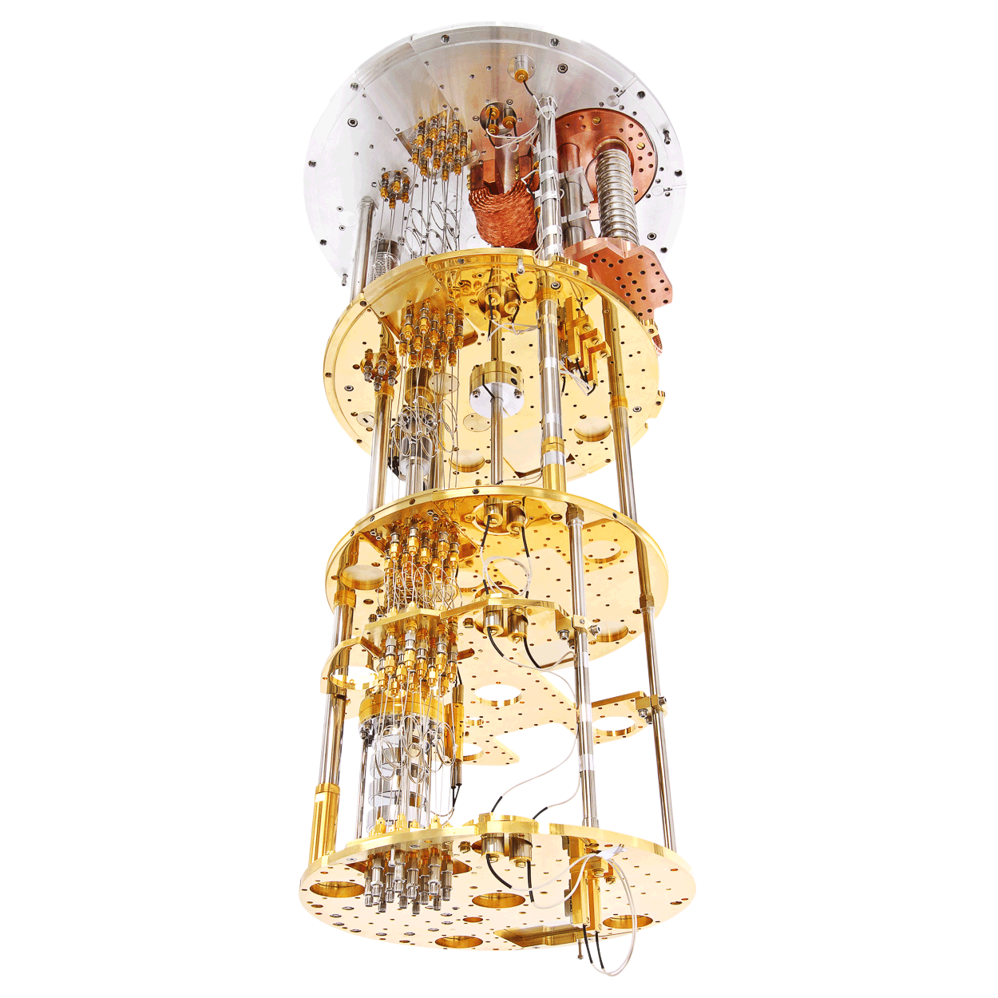
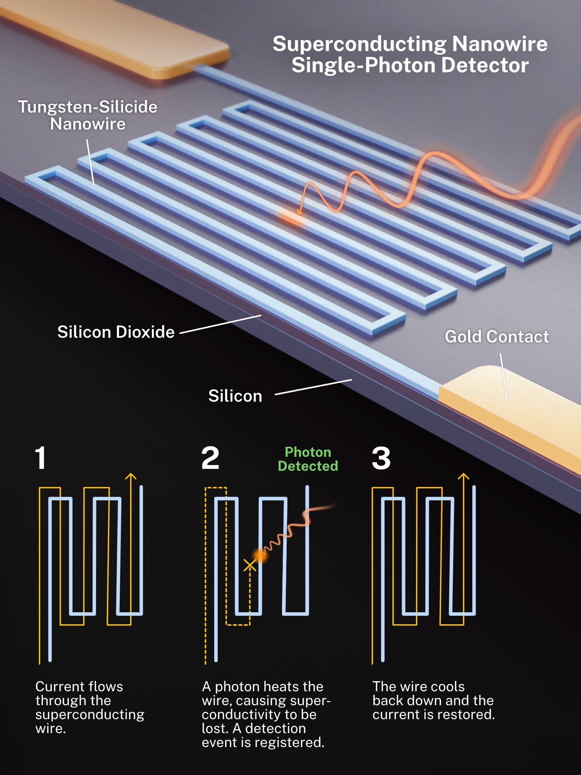
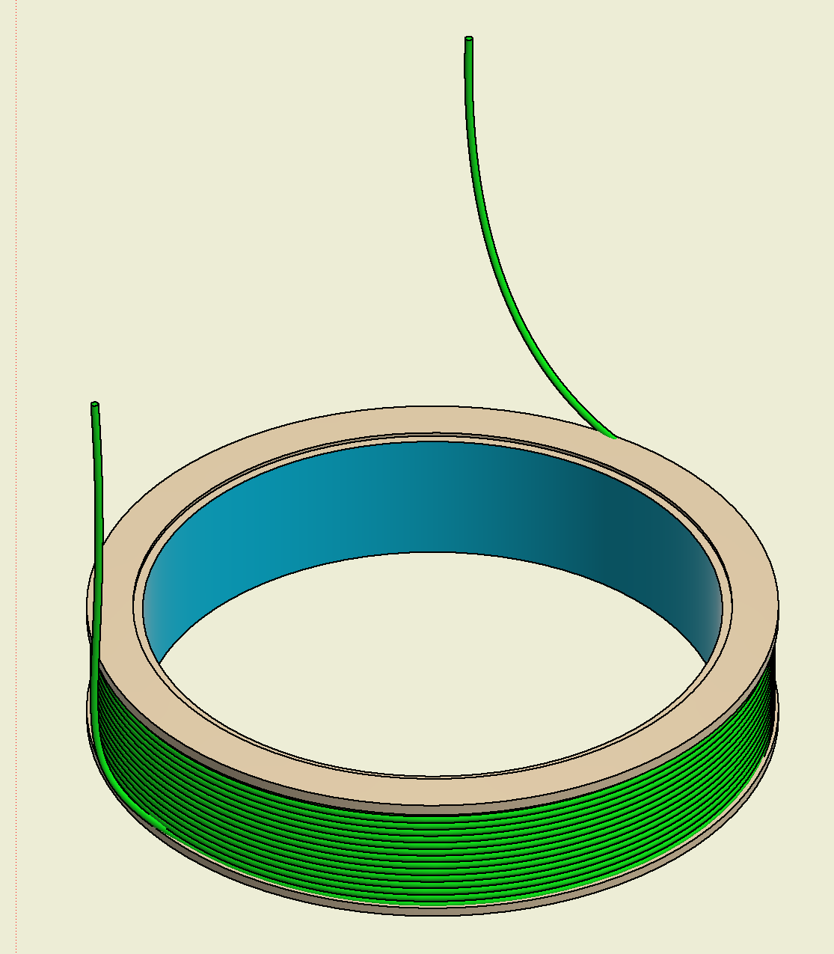
Goal: build prototype light detector for 16eV scintillation photons
Evaluate technologies:
Silicon photomultipliers vs superconducting-nanowire single-photon detectors
Demonstrate discrimination of alpha and beta decays (photon yield, spatial & temporal distribution)
Optimize light-collection geometry
➔Enable 1s lifetime precision
TPB-coated
acrylic cylinder
WLS fiber
Bluefors dilution fridge
purchased by Physics Division
S. Kelley/NIST

Slide 10
Proposed research enables multiple tests of Standard Model of particle physics
Discrepancies resolved
Discrepancies not resolved
pNAB: 5x improvement in Δλ
Beam lifetime: 2x improvement in Δτ_{n}
3x improvement in V_{ud} from neutron decay
World-leading CKM unitarity test
Discrepancies in λ and τ_{n} elevated to > 5σ
New λ discrepancy from B measurement could indicate exotic interactions

Slide 11
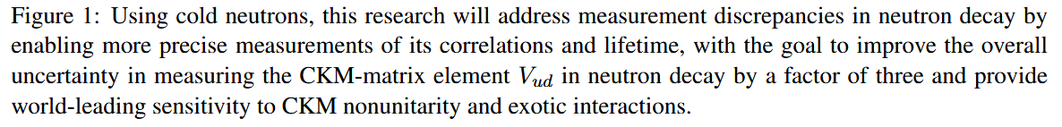
Figure 1 (Thanks to Adam Malin)
“Gaps”
“Objectives”
“Impact”

Slide 12
Three pieces of advice
Start early
Use the templates
Get feedback early

