Slide 1
Mubi Khan
University of Kentucky
July 14, 2026

Slide 2
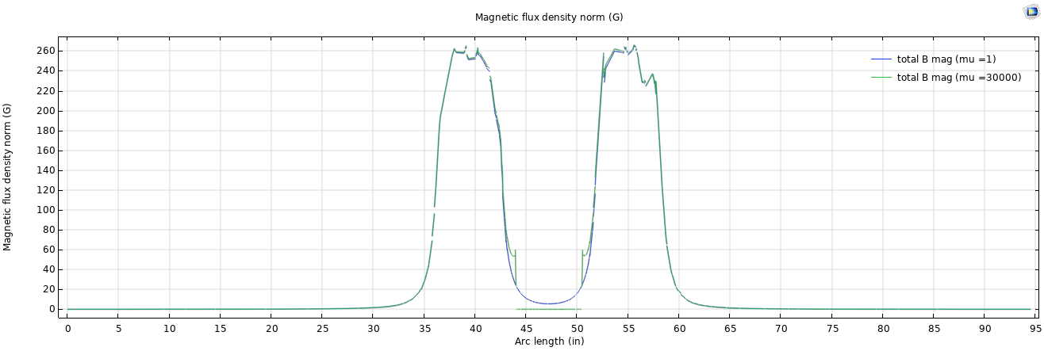
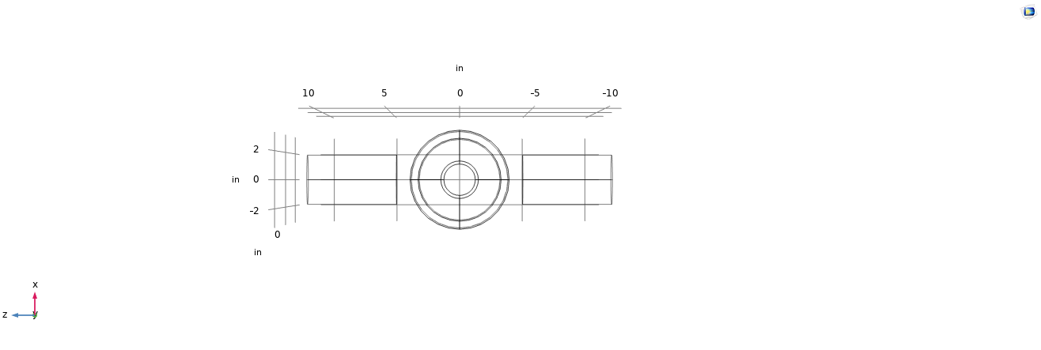
Coil | Endcap | Shield | Dist.
No | No | Yes (mu = 30k) | Yes
 |  | No (mu =1)

Slide 3
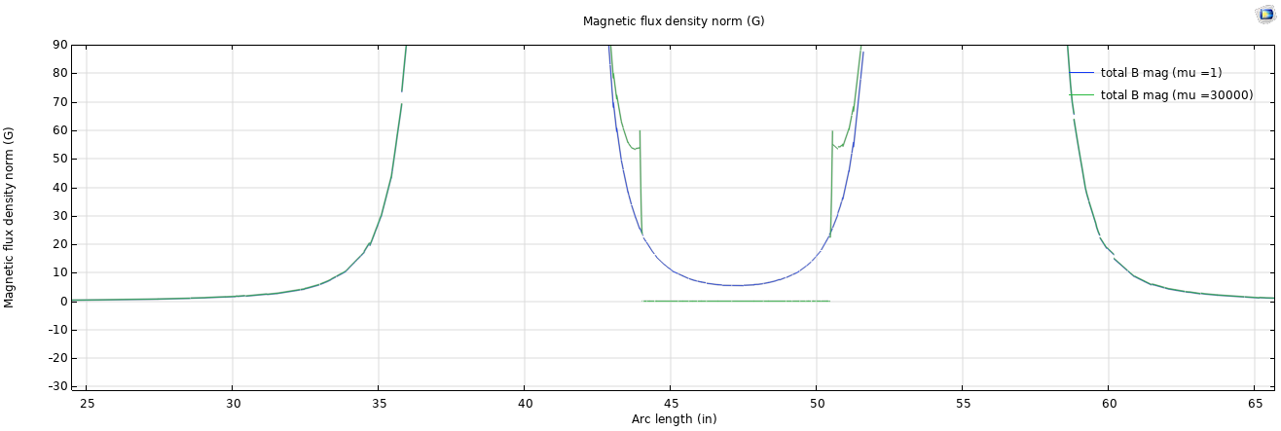



$μ =1$, $|B| = 5.484 G$
$$∆ \left|B\right|=5.482 G$$
$μ = 30000$, $|B| = 0.002G$
Coil | Endcap | Shield | Dist.
No | No | Yes (mu =30k) | Yes
 |  | No (mu= 1)

Slide 4
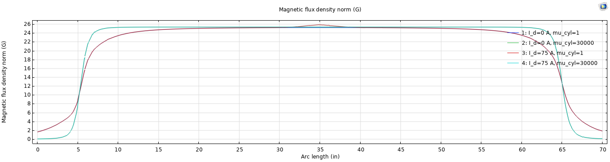
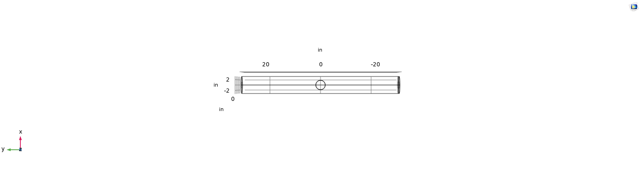
Coil | Endcap | Shield | Dist.
Yes | Yes (mu =30k) | Yes (mu = 30k) | Yes
 |  |  | No
I_d (0=no dist., 75A = 5G dist.) | Mu_cyl (1=no shield, 30k = shield present

Slide 5
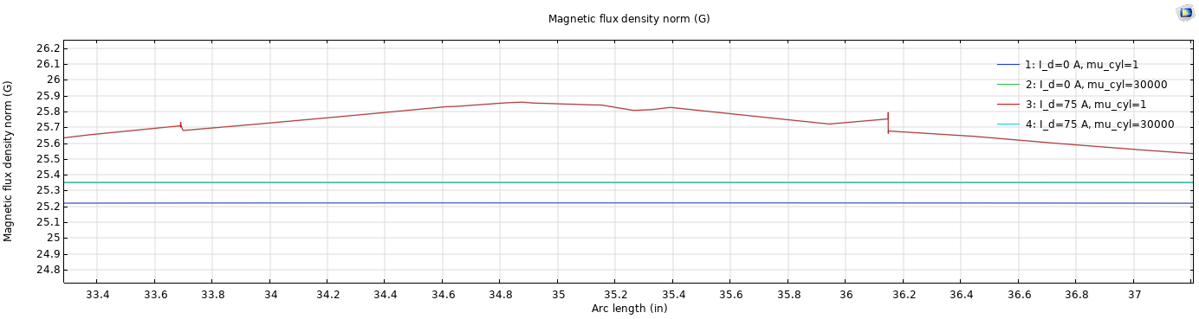




$$3:\left|B\right|=25.849 G$$
$$3:\left|B\right|=25.351 G$$
$$2:\left|B\right|=25.351 G$$
$$1:\left|B\right|=25. 222 G$$
Coil | Endcap | Shield | Dist.
Yes | Yes (mu =30k) | Yes (mu = 30k) | Yes
 |  |  | No
I_d (0=no dist., 75A = 5G dist.) | Mu_cyl (1=no shield, 30k = shield present)

