Slide 1
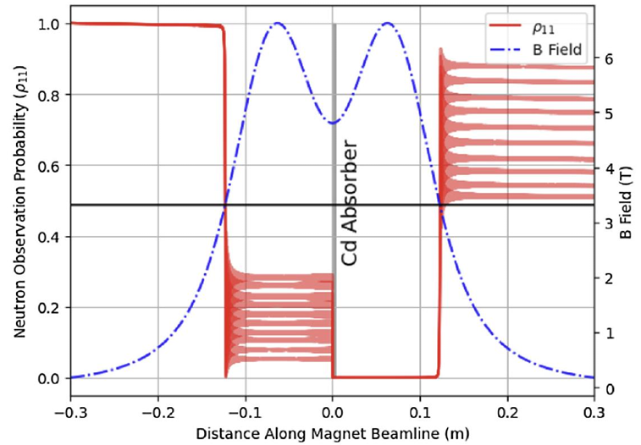
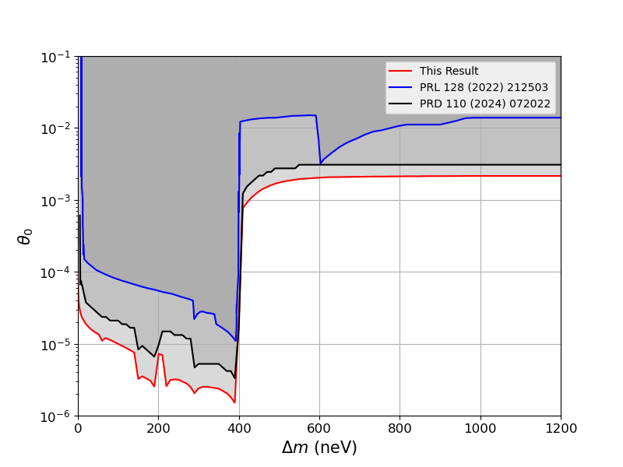
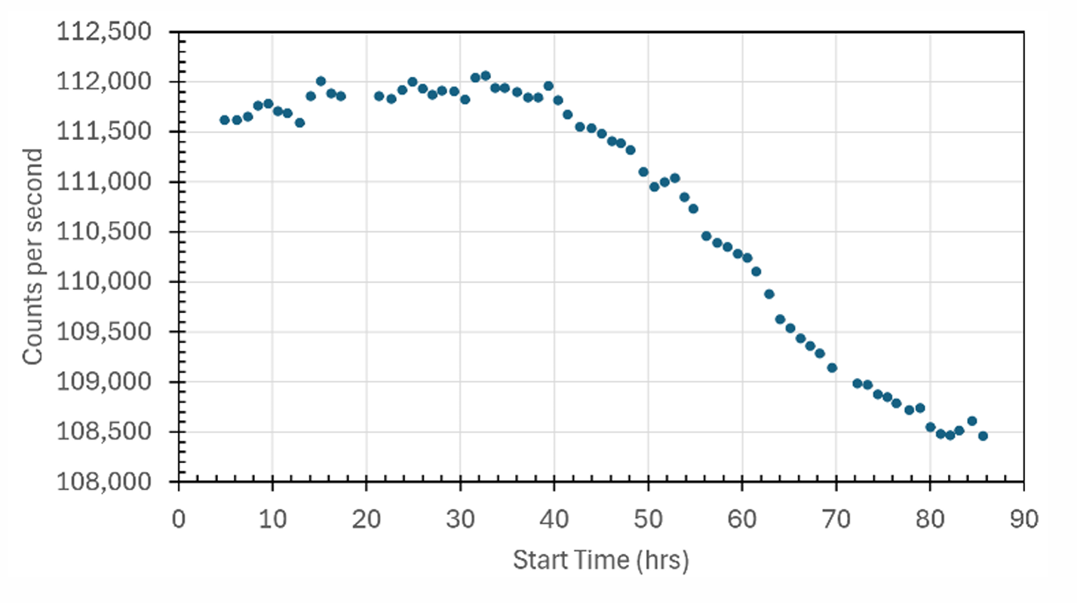
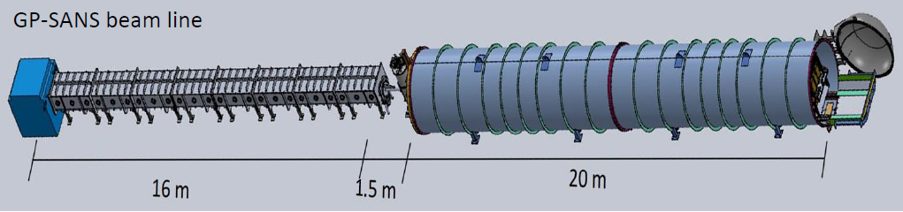
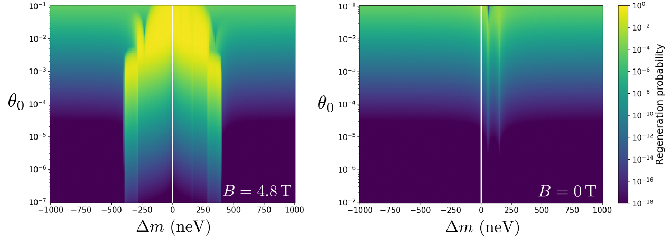
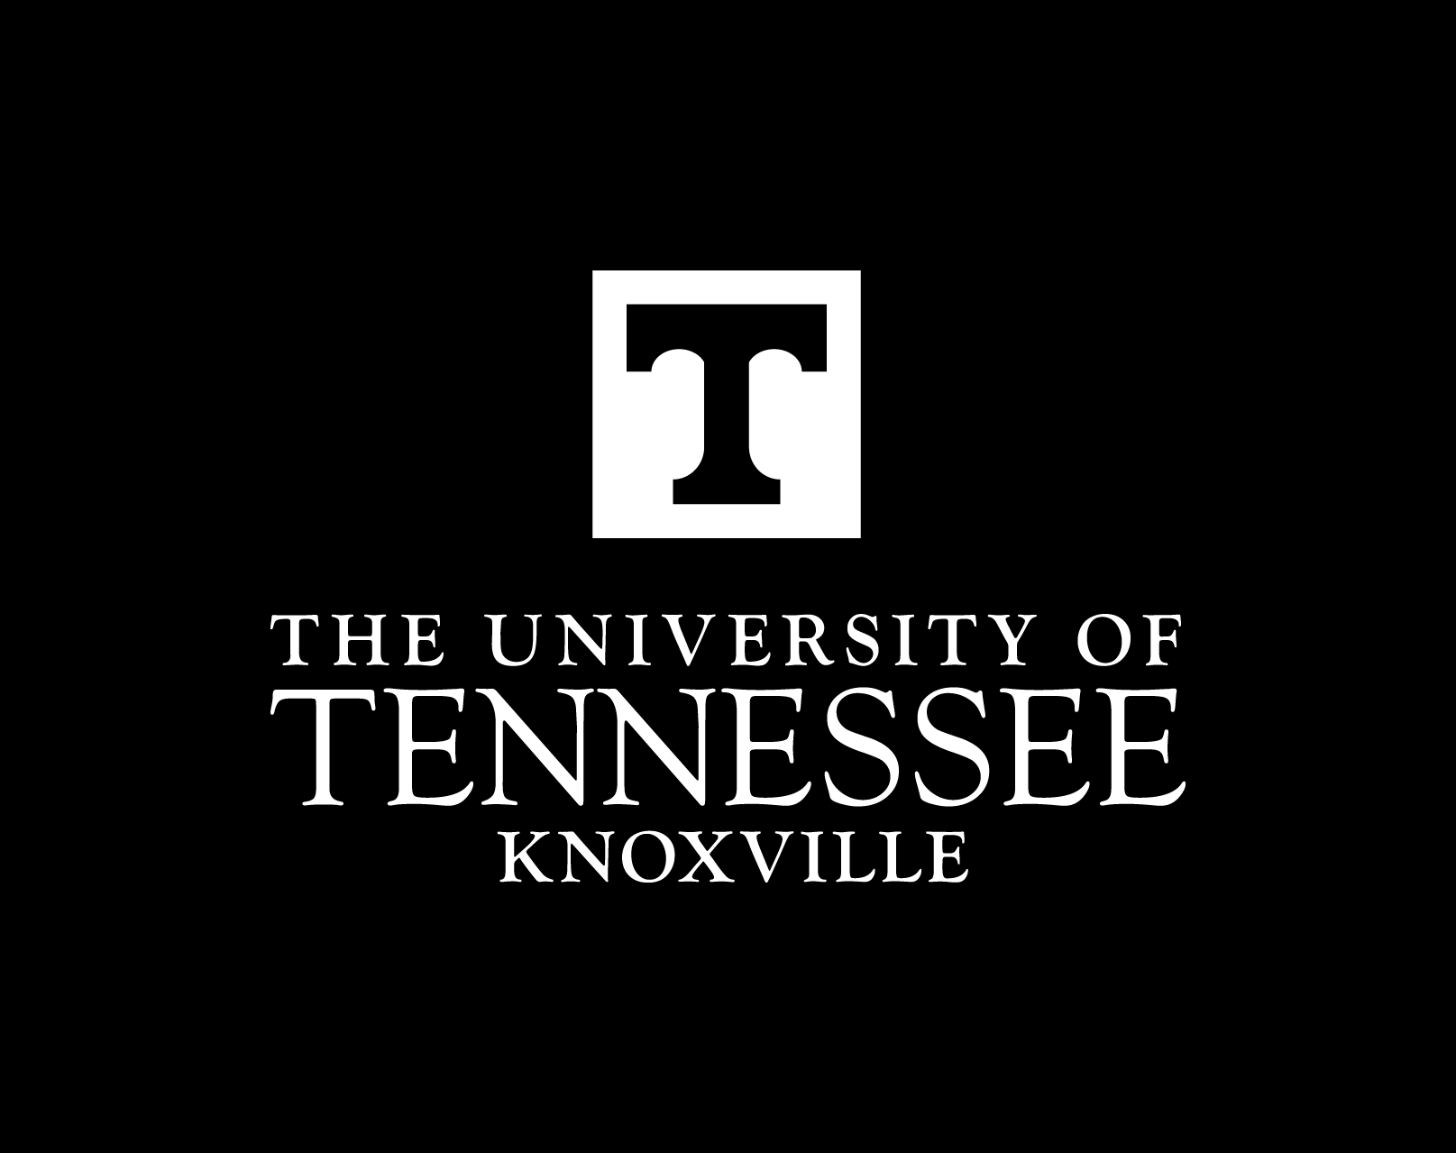
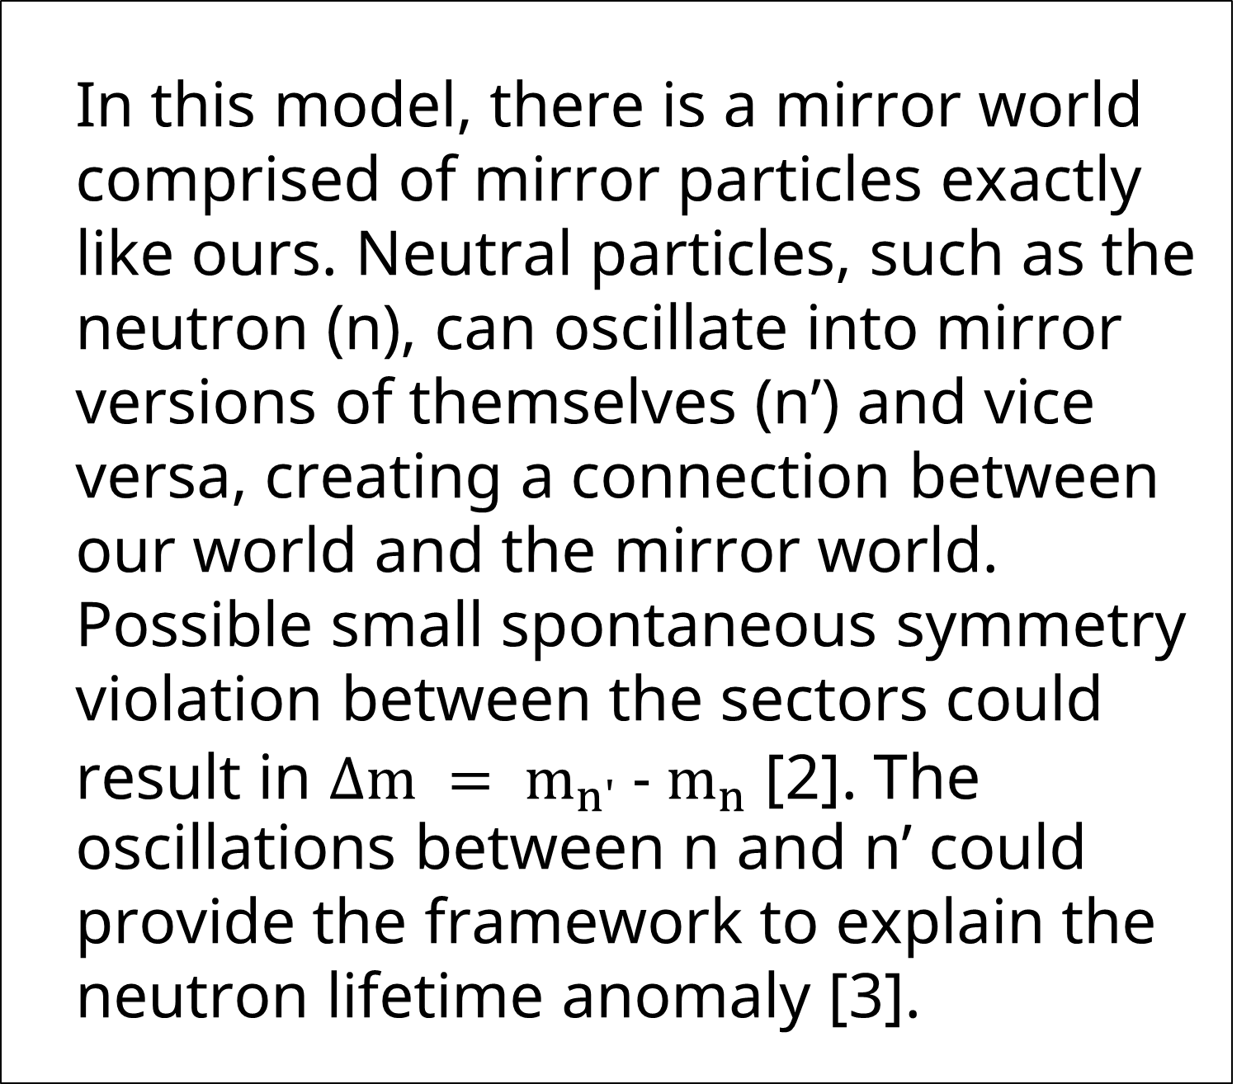
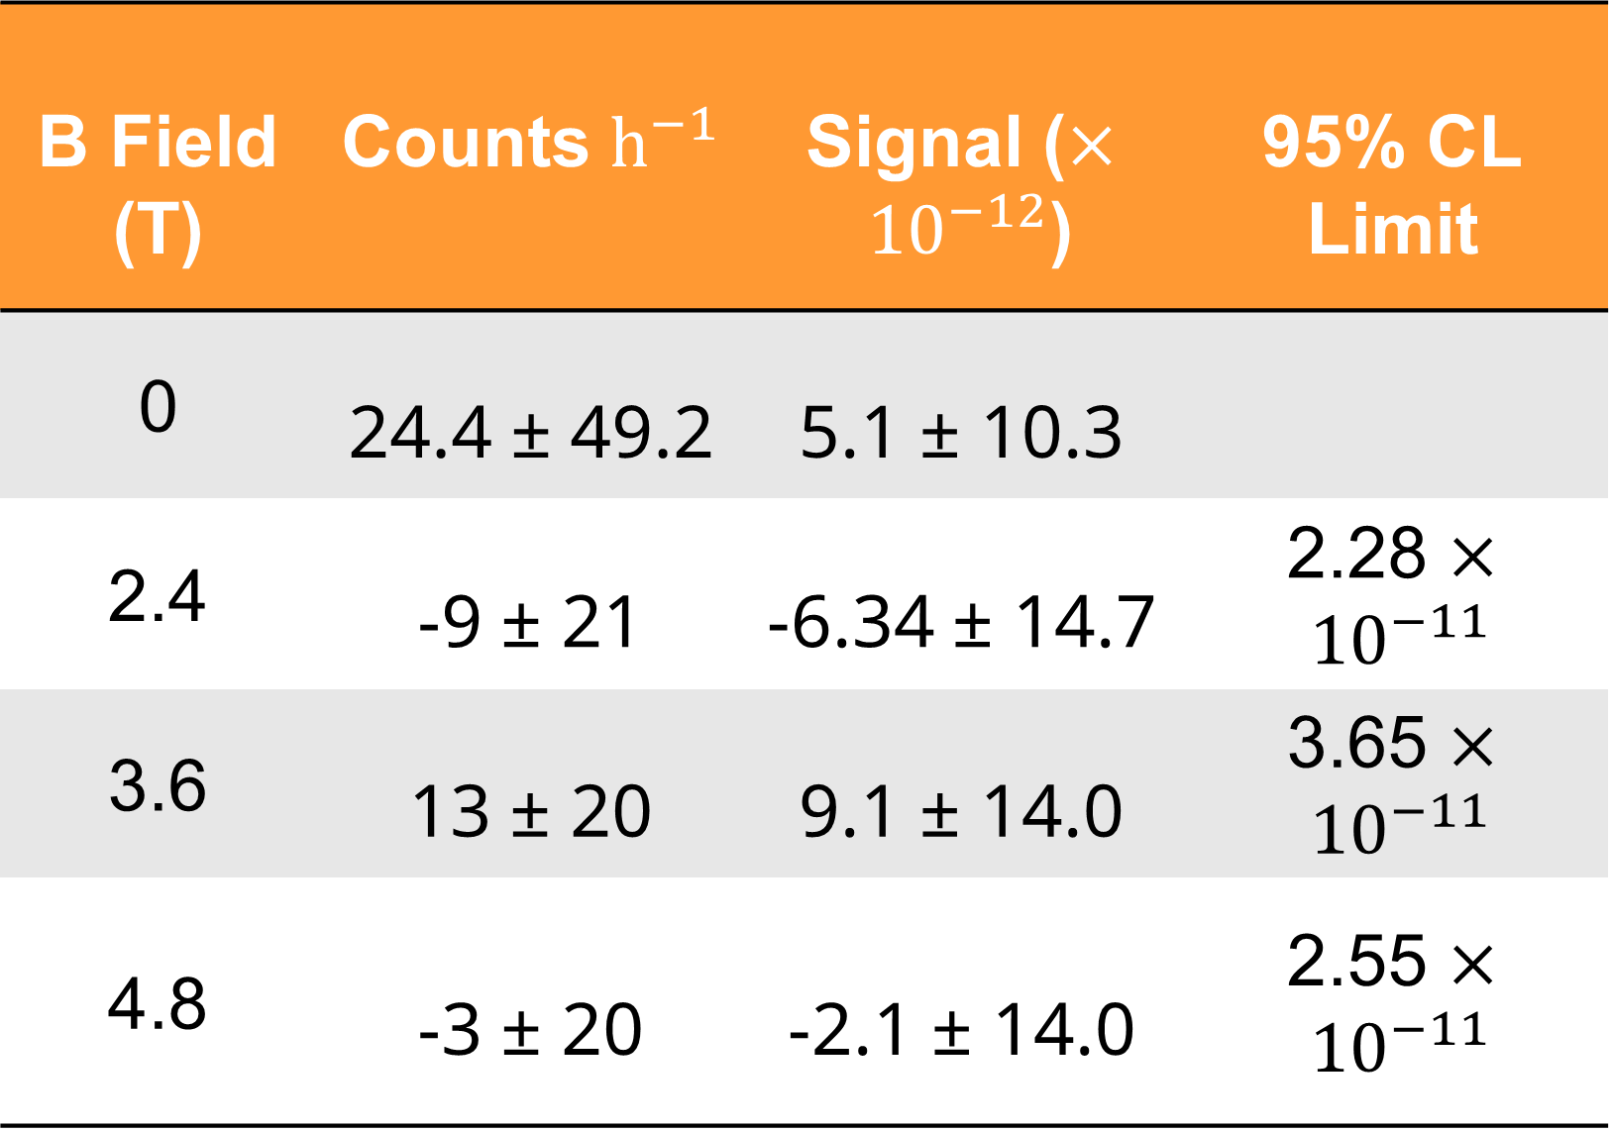
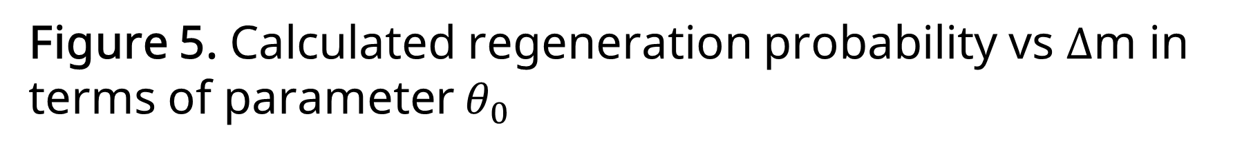
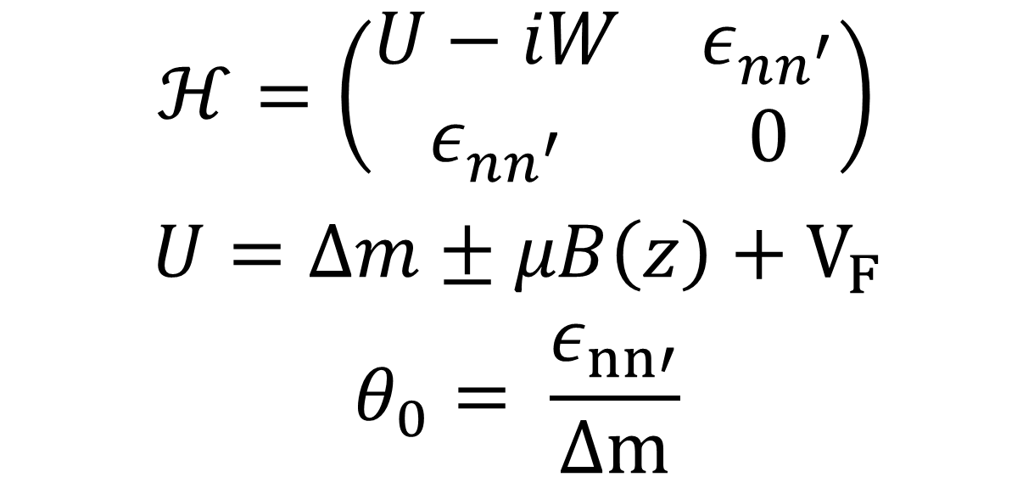
Search for Neutron Regeneration n → n’ → n via Sterile Neutron with Cold Beam at HFIR
Presented by Carolyn Haviland on behalf of UTK-ORNL-UKY-Lund nn' Collaboration
DPF Meeting July 20-24, 2026
What is the mirror model?
B Field (T) | Counts $h^{−1}$ | Signal ($× {10}^{−12}$) | 95% CL Limit
0 | 24.4 ± 49.2 | 5.1 ± 10.3
2.4 | -9 ± 21 | -6.34 ± 14.7 | 2.28 $× {10}^{−11}$
3.6 | 13 ± 20 | 9.1 ± 14.0 | 3.65 $× {10}^{−11}$
4.8 | -3 ± 20 | -2.1 ± 14.0 | 2.55 $× {10}^{−11}$
In this model, there is a mirror world comprised of mirror particles exactly like ours. Neutral particles, such as the neutron (n), can oscillate into mirror versions of themselves (n’) and vice versa, creating a connection between our world and the mirror world. Possible small spontaneous symmetry violation between the sectors could result in $∆m = m_{n'} - m_{n}$ [2]. The oscillations between n and n’ could provide the framework to explain the neutron lifetime anomaly [3].
Figure 3. Non-adiabatic n → n’ → n transition in strong magnetic field gradients of HFIR experiment
Table 1. FC confidence limits set on each magnetic field
Looking for an Effect
$$ℋ=\left(\begin{matrix}U−iW & ε_{nn^{′}} \\ ε_{nn^{′}} & 0\end{matrix}\right)$$
$$U=∆m±μB\left(z\right)+V_{F}$$
$$θ_{0}= \frac{ε_{nn′}}{∆m}$$
The analysis process aimed to complete three main things.
Subtract background from each run
Find regenerated counts of combined magnetic fields
Set new Feldman-Cousins limits [4] on the probability of regeneration per neutron.
The results of the analysis procedure are shown in the table as counts regenerated and limits on the probability.
New Limits
With the increased intensity of HFIR, the limits set from the 2024 data was able to improve upon the ones set from two previous experiments performed by the collaboration at the Spallation Neutron Source (SNS).
Equation 1. Hamiltonian describing evolution of mixed neutron-mirror neutron wave function
Regenerating Neutrons
This experiment was conducted at the High Flux Isotope Reactor (HFIR) at ORNL using the GP-SANS beam line.
Cold neutrons are sent down 16 m of guides
Neutrons travel halfway through 5T magnet and hit Cd absorber
Sterile mirror neutrons travel through the rest of the magnet
Regenerated neutrons are counted in ³He detectors
Figure 5. New limits set (red) from this experiment compared to previous at SNS in terms of mixing angle vs. ∆m
Figure 4. Beam intensity as a function of time used in final correction factors
Next Steps
The procedures and limits set by this experiment have guided our continued search for a mixing mechanism. The next experiments to be conducted focus on the neutron transition magnetic moment (nTMM).
Figure 2. GP-SANS beam line at ORNL
Figure 5. Calculated regeneration probability vs ∆m in terms of parameter $θ_{0}$
[1] L.B. Okun, “Mirror particles and mirror matter: 50 years of speculations and search”, Phys.Usp. 50 (2007) 380-389;
[2] Z. Berezhiani “Neutron Lifetime Puzzle and Neutron – Mirror Neutron Oscillation,” Eur. Phys. J. C79 (2019) no.6. 484;
[3] Serebrov, A.P. Neutron Lifetime: Experimental Problem or Anomaly? Talk at NORDITA Workshop: Particle Physics with Neutrons at the ESS, Stockholm. December 2018. Workshop Website.
[4] Feldman, Gary J., and Robert D. Cousins. "Unified approach to the classical statistical analysis of small signals." Physical review D 57, no. 7 (1998): 3873.
Acknowledgements: I’d like to thank Dr. Yuri Kamyshkov and the rest of the collaboration for their help and the opportunity to work on this project. I’d also like to thank the UTK office of Undergraduate Research and Fellowship and department of physics for funding my research and my travel.

