Slide 1
Data Generation for Spiking Neural Networks Using Allpix-Squared
28 April 2026 | Vienna, Austria
Amanda L Steinhebel
Oak Ridge National Laboratory
Notes:
Accessing Title Slide Options
The standard ORNL presentation template includes five branded title slide layouts:
Title | Standard. The preferred layout for lab-wide and general presentations. Features a default aerial photograph of the lab.
Title | Custom Image. Allows replacement of the default background with a custom full-slide image (16:9 or 4:3 landscape format).
Title | Custom Portrait Image. Supports inclusion of a custom 4:3 portrait image positioned next to the introductory text.
Title | Custom Landscape Image. Supports inclusion of a custom 16:9 landscape image positioned next to the introductory text.
Title | Text Only. Offers additional space for longer titles and multiple presenters.
Additional Lab-approved title slides specific to directorates and user facilities are available in PowerPoint under the following folders: Custom Title Slides and User Facility Templates, located in Presentation Templates.
Custom Title Slide Guidelines
Image Rights. Any custom images, graphics, or photography must be owned by ORNL or used with documented permission from the original creator or source.
Appropriate Image Use. Select images that work well with the layout. Ensure the focal point of the image is not obscured by the title text and white overlay box.
Relevance and Impact. Visuals are a key element of effective communication. Whenever possible, use imagery that enhances the message of your presentation and reflects ORNL’s mission and values.
Quality and Clarity. Use high-resolution images for clarity on large screens. Avoid overly complex or dark images that may conflict with the title text.
Text-Only Option. If no appropriate or approved imagery is available, or if imagery is not permitted for the subject matter, the Title | Text Only layout provides a clean, professional alternative.
Learn more about ORNL presentations
https://ornl.sharepoint.com/sites/Branding/SitePages/Presentations.aspx

Slide 2



Project enabled through interdisciplinary team
A. Bean
S. Hortua
M. Benoit (PI)
J. Sparger
T. Evans
S. Johnson
S. Kilkarni
K. Mack
A. Nicholson
A. Steinhebel
A. Young
L. Zhang
S. Spanier
C. Schuman

Slide 3
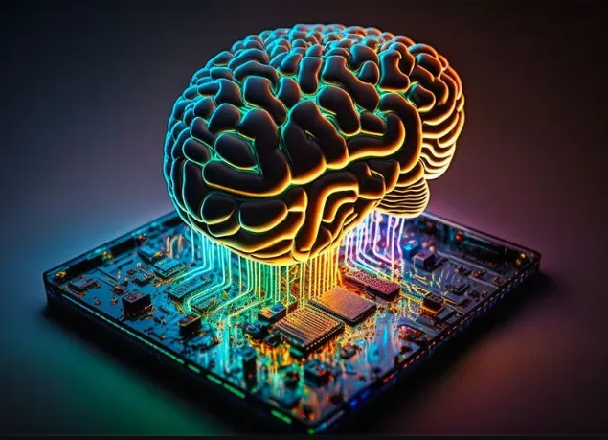
The NEUROPix Project Overview
NEUROmorphic computing framework for PIXelated detector data processing
Motivation: Pixel detectors return high bandwidth datastreams with granular information (timing, energy, pixel location…)
Solution: Neuromorphic computing framework for edge computing
Solution without buzz words: Perform classification, anomaly detection, beam luminosity, etc. tasks directly from detector data streams with a low-power Spiking Neural Network deployed in hardware
Leverage previous work from Smart Pixels team [1]
https://www.thedigitalspeaker.com/neuromorphic-computing-hyper-realistic-generative-ai/
[1] S. Kulkarni et al 2023 ICONS ’23: Proceedings of the 2023 International Conference on Neuromorphic Systems 3 pp. 1-8

Slide 4
Traditional vs Neuromorphic Computing
Traditional Neural Computing
Neuromorphic Computing
Layers of maximally-connected nodes
Structure enables layering scheme
Recurrent networks – not all node connections used, no layers
Structure based on human brain

Slide 5
Traditional vs Neuromorphic Computing, Continued
Traditional Neural Computing
Both
Neuromorphic Computing
Designed for low power OR fast compute
Inherently low power to support fast compute
Implementable in hardware
Established methods, algorithms, development
Area of active research requiring experts and manual defining
Can provide AI advantage
Sequential processing through layers
Event-driven and massively parallel

Slide 6
Spiking Neural Networks (SNNs)
Network Inputs
Network Outputs
Temporal information is crucial
Spike trains must be encoded / decoded
“spike train”
“neuron”
“synapse”

Slide 7
Spiking Neural Networks (SNNs)
Network Inputs
Network Outputs
01001000001100
10000000000000
Temporal information is crucial
Spike trains must be encoded / decoded
00001000001000
“spike train”
“neuron”
“synapse”

Slide 8
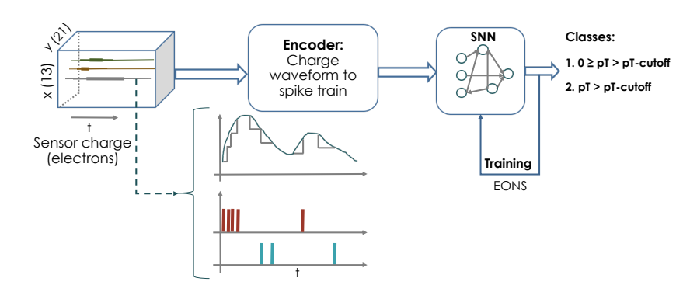
Smart Pixels example SNN application
[1] S. Kulkarni et al 2023 ICONS ’23: Proceedings of the 2023 International Conference on Neuromorphic Systems 3 pp. 1-8

Slide 9
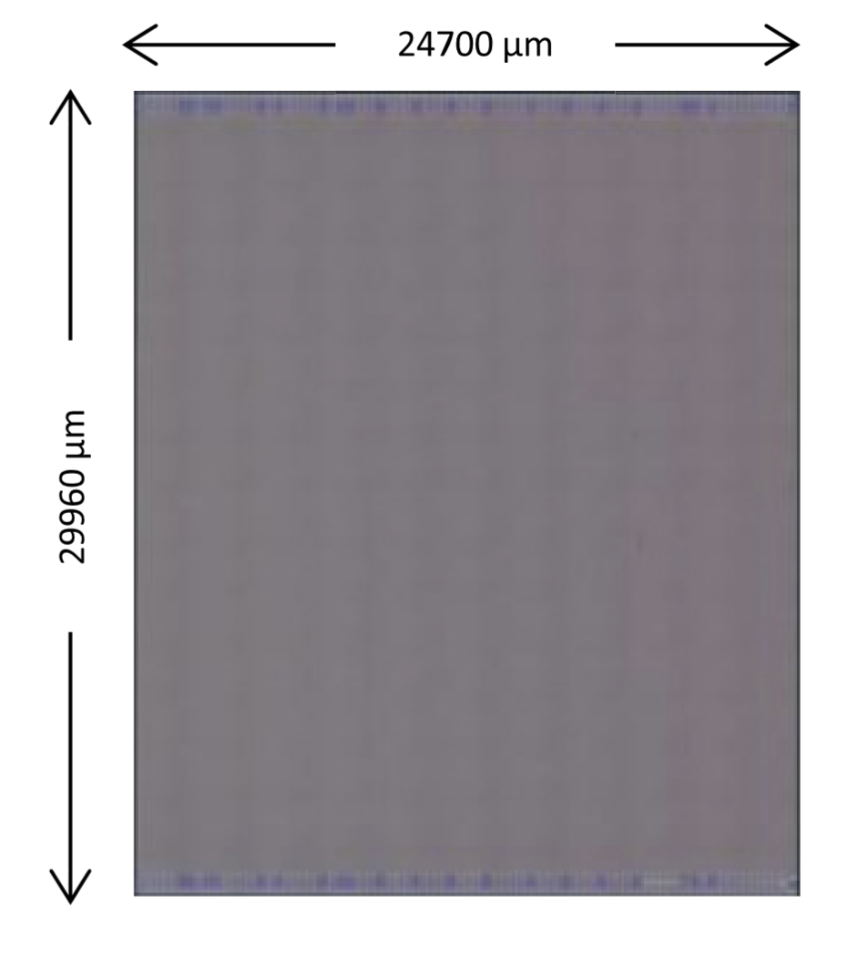
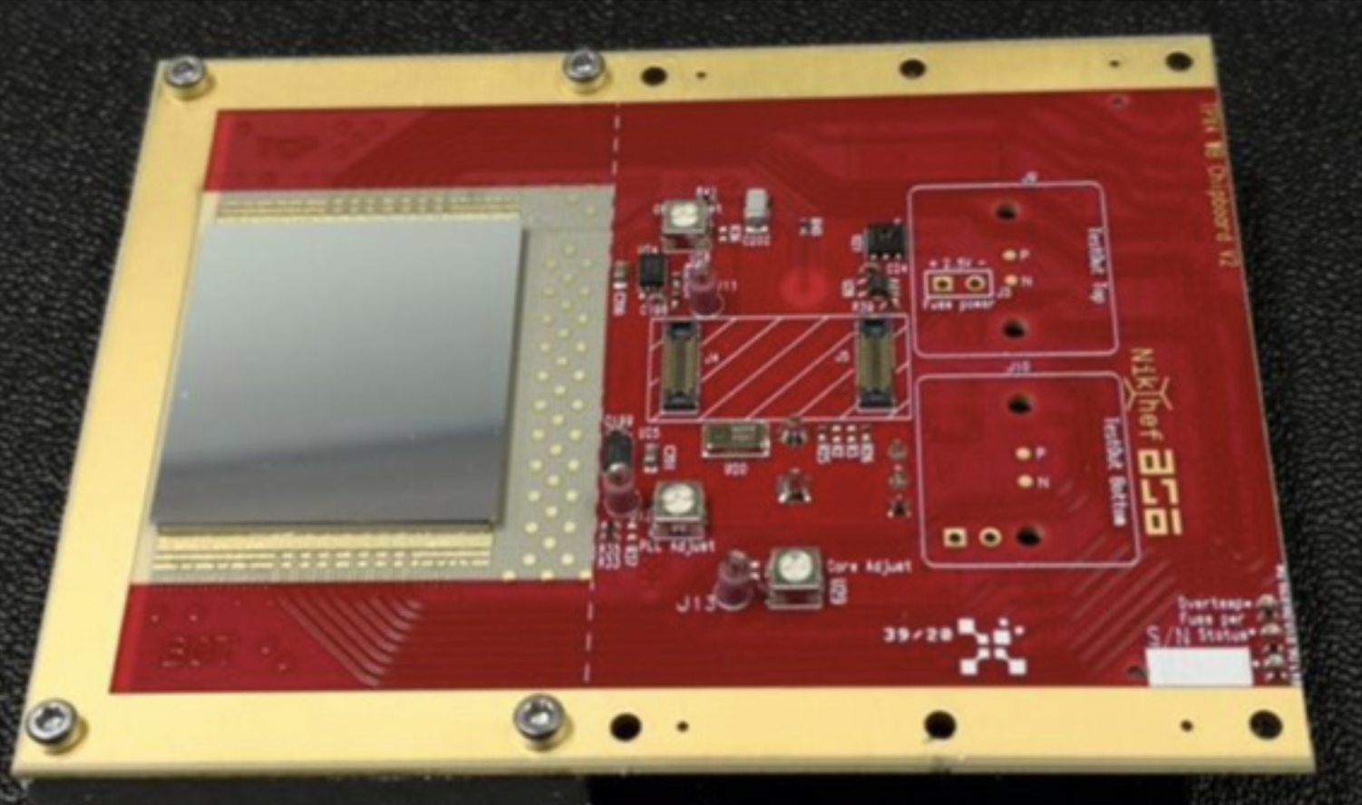
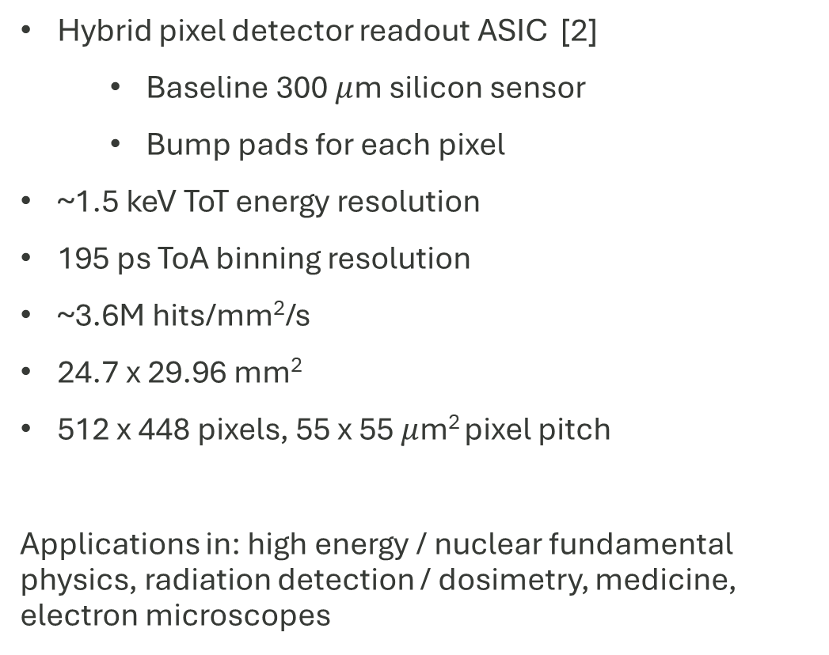
Timepix4
Hybrid pixel detector readout ASIC [2]
  Baseline 300 $μ$m silicon sensor
  Bump pads for each pixel
~1.5 keV ToT energy resolution
195 ps ToA binning resolution
~3.6M hits/mm²/s
24.7 x 29.96 mm²
512 x 448 pixels, 55 x 55 $μ$m² pixel pitch
Applications in: high energy / nuclear fundamental physics, radiation detection / dosimetry, medicine, electron microscopes
[2] X. Llopart et al 2022 JINST 17 C01044

Slide 10
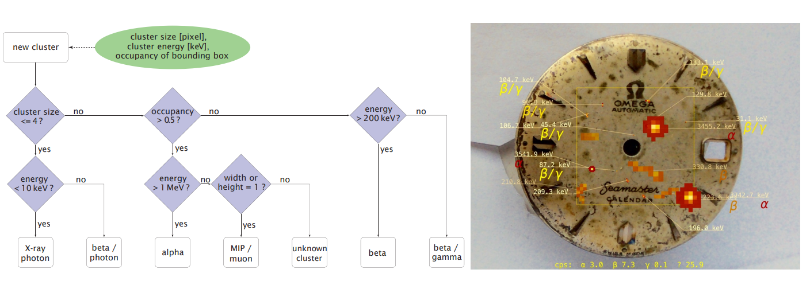
First step – use SNN for pixel hit clustering and particle identification
Can compare SNN results with “classical” results using standard¹ clustering algorithms and cut-based particle ID
[3] O. Keller et al 2016 JINST 11 C11032
¹Recurseive Agglomerative Clustering

Slide 11



Developing a data pipeline with simulation and real data
Simulation
ROOT-to-HDF5
Data-like bitstream
Data selector/mixer
Data
SNN
Timepix4
Timepix-to-HDF5
Training/valid./test data set separation
Spike train encoding
SNN training
Data loader

Slide 12
Dataset requirements for SNN Training
Enabled by…
Large, representative, unbiased dataset
  Don’t want to “teach” the SNN something accidentally
Realistic dataset that mimics detector output
  Including temporal information
Truth-level information
Idea of “good” qualities for the SNN to learn
  Adjust weights in the system to guide learning toward “good/accurate” output and away from “bad”
Allpix-squared, ORNL computing
Allpix-squared
Allpix-squared
Physics studies

Slide 13
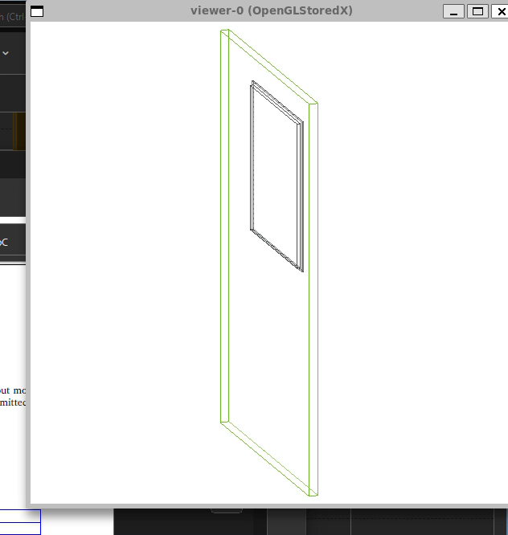
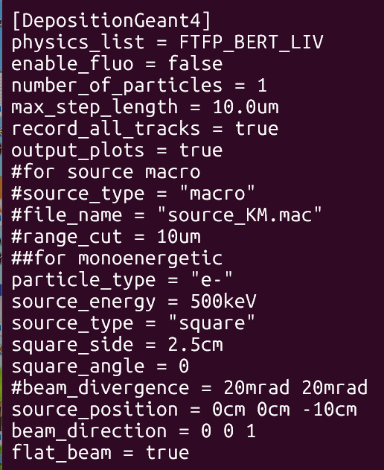
Step 1: Allpix-Squared Simulation
One Timepix4 chip mounted on a standard PCB
Square beam the size of Timepix4 1-10cm in front of detector
  Distance set based on particle type
Flat beam profile
All incident particles interact with detector at normal incidence
Monoenergetic beam
Single particle species per file
Well defined truth information in each file
Default digitizer and electric field settings as a first try
Room for improvement
[4] S. Spannagel et al 2018 NIM A 901 pp. 164-172

Slide 14
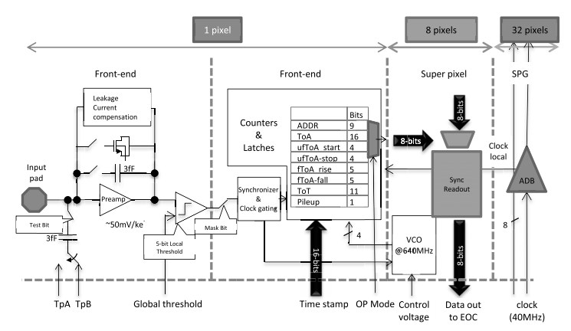
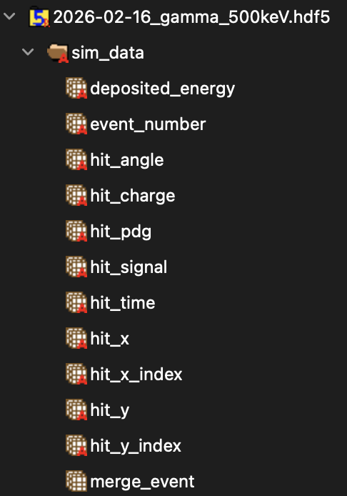
Step 2: Allpix-Squared output to HDF5
Step 3: Add data-like bitstream
Use PixelHit location information to calculate Timepix4-like address value
Custom conversion of key Allpix-Squared output values from ROOT file to HDF5 format
Get data compression for free
Straightforward format for ingestion by SNN
Metadata and PixelHits
ROOT
HDF5
46 MB
521 KB
Use geometry, timing, and pileup information to create 64 bit output bitstream:
1100000010100011000000000000000000000000000000000000000000000000
[2] X. Llopart et al 2022 JINST 17 C01044

Slide 15
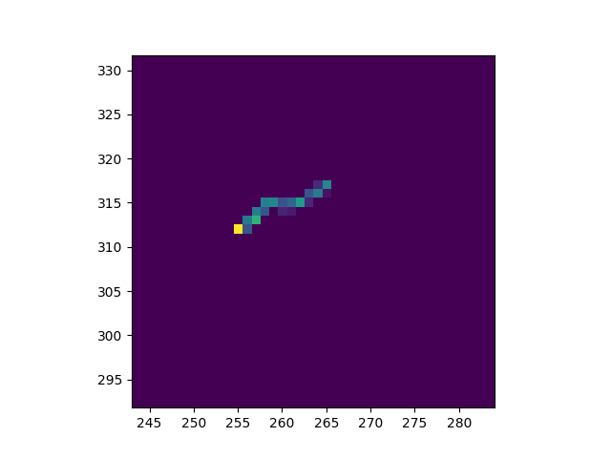
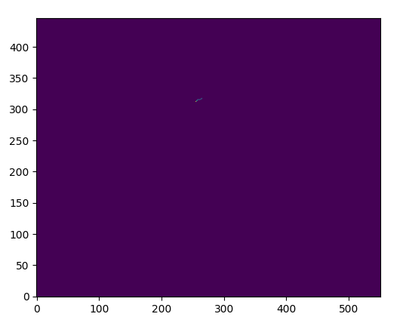






Step 4: Enhance dataset without additional simulation
Geometric Transformations
Data Selector / Mixer
Artificially inflate number of events in individual data files without changing the physics
500 keV electron example – one event becomes two
Philosophy: create ‘database’ of well-defined Allpix-squared output and pull individual events from the database to create a large dataset.
Customizable inputs
‘Selector’ for cuts on geometry, energy, etc
Generate database only once and can mix in infinite ways
270º rotation
Database
Mixer
Output
$$α$$
$$γ$$
100 keV
100 keV
Full spectrum $γ$
$$α$$
$$γ$$
2D
translation
500 keV
500 keV
y pixel index
$$α$$
$$γ$$
y pixel index
1 MeV
1 MeV
All 500 keV
$$e$$
$$e$$
x pixel index
x pixel index
100 keV
500 keV

Slide 16
Preliminary versions of most of the data pipeline
Simulation
Slide 13
Slide 14
Slide 14
Slide 15 (plan)
ROOT-to-HDF5
Data-like bitstream
Data selector/mixer
Custom script to select variables and compress
Calculate from AP2 output
First database created
Data
SNN
Timepix4
Timepix-to-HDF5
Training/valid./test data set separation
Spike train encoding
SNN training
Data loader
Custom ingestion library
3 first schemes ready for testing
20GB of electron data
Custom library for data handing
Custom app designed

Slide 17
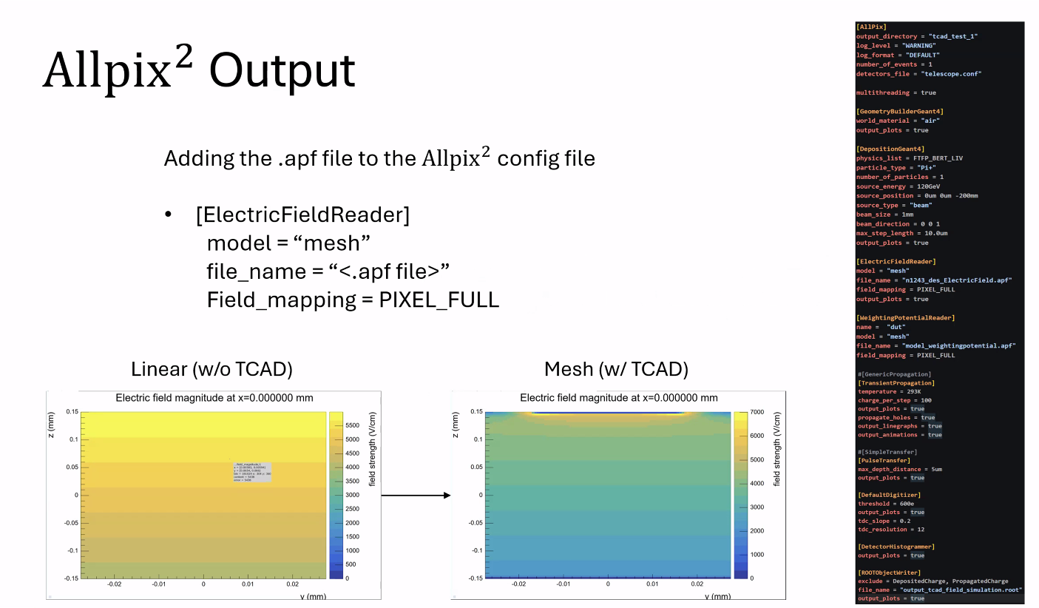

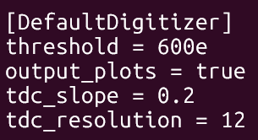
Simulation improvements
Runtime and Memory
Electric Field TCAD Simulations
Large jobs were crashing in [ROOTObjectWriter] from strain on system memory
Working fixes
Reduce terminal output to bare minimum
Increase modules excluded from output file
Run on larger systems/clusters
  Original problem occurred running locally on a Macbook
Timing Resolution
[GenericPropagation] [SimpleTransfer]
[ElectricFieldReader] model = “linear”
Timepix4 resolution is much finer than default values for [DefaultDigitizer]
Defaults
tdc_slope = 10
tdc_resolution = 0
[TransientPropagation]
[PulseTransfer]
[ElectricFieldReader] model = “mesh”
[WeightingPotentialReader]
S. Hortua
Much more realistic output for 10x slowdown per event

Slide 18
The path forward involves Allpix-Squared improvements
Next Steps
Allpix-Squared works in progress
Update dataset with improvements from Slide 17
  Use timing information to inform ToA, ToT
Test SNN app
Compare SNN to classical PID (and other ML)
Compare SNN output to real data
Repeat with other detectors
How to define/attribute global timing in data mixer (ex. Define a rate)?
Fast, efficient creation of large datasets (don’t save empty events? Etc.)
Native ROOT-to-hdf5 with conditions on what is saved?
Community experience with data mixer type work?
Way to get Timepix4 fine-granularity timing information?
  Bolded values of bitstream are placeholders
1100000010100011000000000000000000000000000000000000000000000000

Slide 19
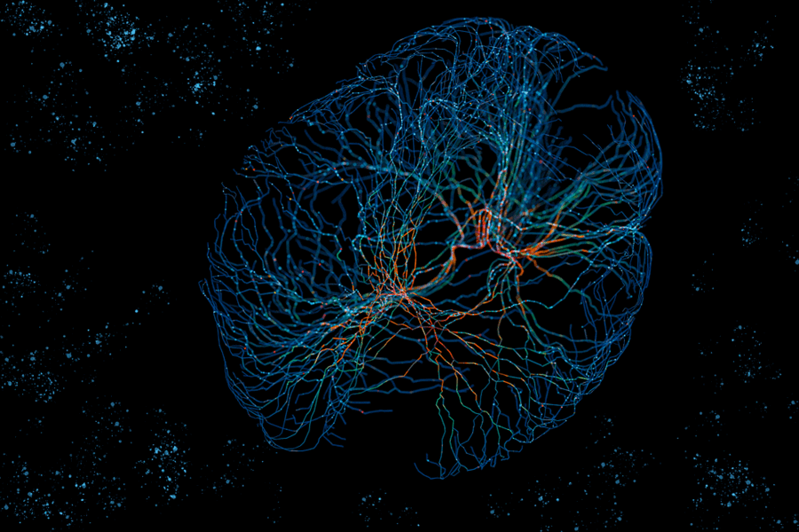
Summary
The NEUROPix project aims to deploy neuromorphic computing (spiking neural network [SNN]) as edge computing for HEP experiments, allowing fast processing of pixelated detector output and the derivation of complex quantities
https://news.mit.edu/2022/neural-networks-brain-function-1102
Allpix-Squared is crucial for the creation of an initial dataset used to train the SNN
Training data must be complete, realistic, unbiased, and large
A preliminary data pipeline has been constructed with much more work to come

Slide 20
Acknowledgements
This work is supported by the U.S. Department of Energy, Office of Science, Office of High Energy Physics, under award associated with DOE Laboratory Announcement LAB 24-3305.
This research used resources of the Experimental Computing Laboratory (ExCL) at the Oak Ridge National Laboratory, which is supported by the Office of Science of the U.S. Department of Energy under Contract No. DE-AC05-00OR22725

Slide 21
Backup

Slide 22
Abstract
Edge computing for future high-energy physics experiments will require the utilization of cutting-edge technology in both hardware and software. Data handling and processing, including particle identification and characterization, is a crucial element of modern experiments in which precise, repeatable calculations must be performed within nanosecond timescales with high data rates. The NEUROPix project aims to redefine this process through the incorporation of spiking neural networks in FPGA-based firmware units and define a path toward a neuromorphic computing ASIC, which would process raw data from Timepix4-like sensors. Like all machine learning techniques, the first step is the creation of a large, detailed, and realistic dataset for training for which we employ Allpix Squared. This talk will cover: strategies used for the creation of this dataset, including the expression of Allpix Squared output into a raw-data-like format and methods for creating large training datasets from a smaller set of well-defined simulation outputs; an overview of constraints inherited from the spiking neural network application; and plans for the NEUROPix project. We also seek community input to refine the simulation’s output and discuss other machine learning applications.

Slide 23
References
[1] S. Kulkarni et al 2023 ICONS ’23: Proceedings of the 2023 International Conference on Neuromorphic Systems 3 pp. 1-8
[2] X. Llopart et al 2022 JINST 17 C01044
[3] O. Keller et al 2016 JINST 11 C11032
[4] S. Spannagel et al 2018 NIM A 901 pp. 164-172

Slide 24


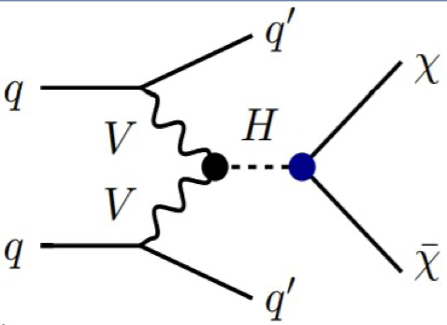



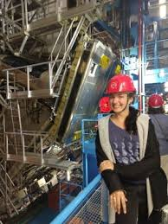

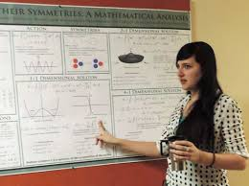

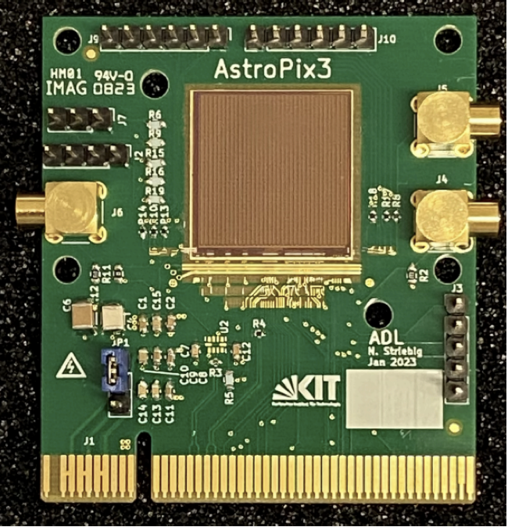
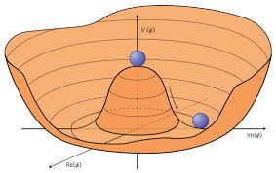
My scientific journey has taken me all around the world
North Canton Hoover High School (Ohio)
The University of Oregon (Oregon)
M.S. Physics
PhD Physics
The College of Wooster (Ohio)
B.A. Physics, Math
NASA Postdoctoral Program, Goddard Space Flight Center (DC)

Slide 25
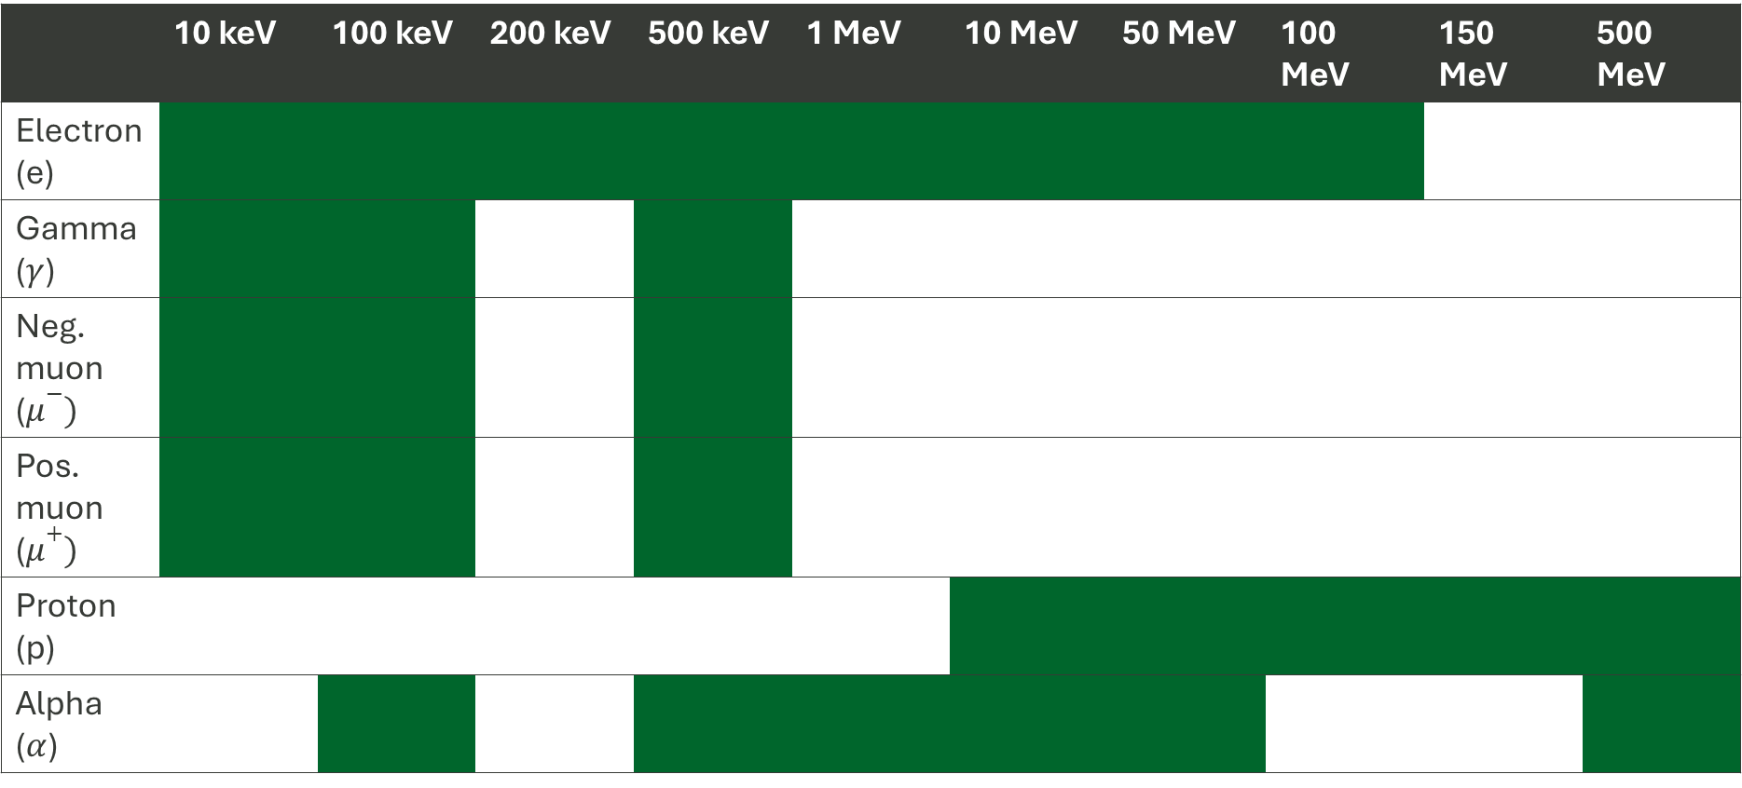
First particle database of Allpix-Squared outputs
100k initial particles, all normal incidence from flat square beam. Distance 1-10cm from detector in air
 | 10 keV | 100 keV | 200 keV | 500 keV | 1 MeV | 10 MeV | 50 MeV | 100 MeV | 150 MeV | 500 MeV
Electron (e)
Gamma ($γ$)
Neg. muon ($μ−)$
Pos. muon ($μ+)$
Proton (p)
Alpha ($α$)

