Slide 1

Total Absorption Spectroscopy Measurement of ${}_{}^{104}{Nb}$
Alex Laminack
6/24/2021

Slide 2
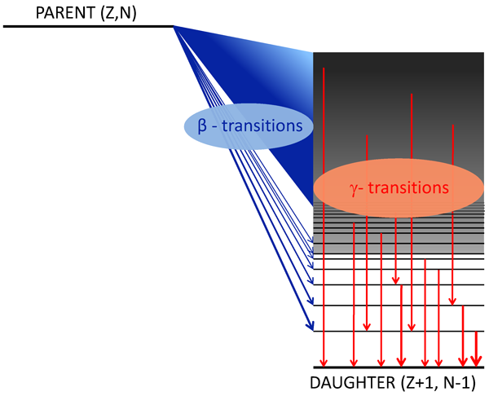
Pandemonium Effect
Unexpected weakness of high-precision, low efficiency setups (germanium)
Low efficiency combined with high density of states and many weak gamma transitions leads to misinterpretation of beta feeding

Slide 3
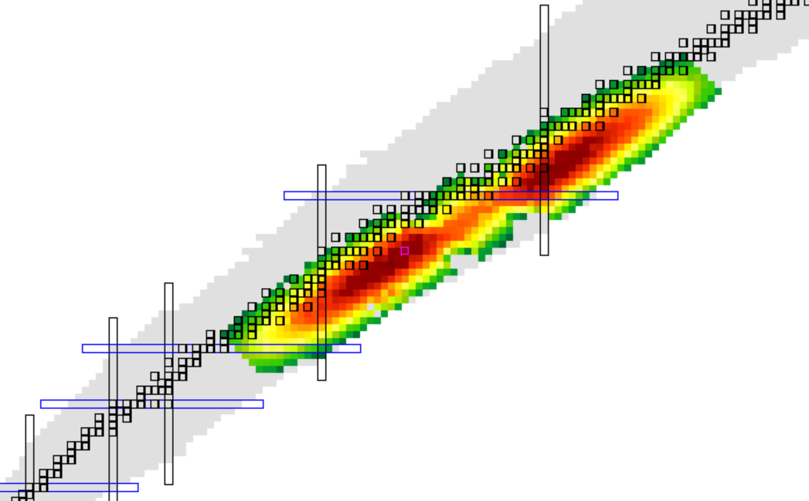
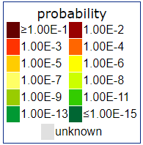
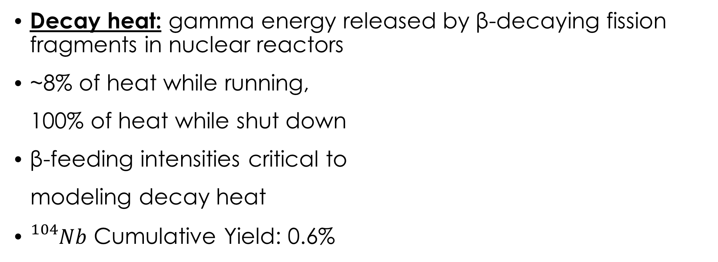


Motivation – Decay Heat
Decay heat: gamma energy released by β-decaying fission fragments in nuclear reactors
~8% of heat while running,
100% of heat while shut down
β-feeding intensities critical to
modeling decay heat
${}_{}^{104}{Nb}$ Cumulative Yield: 0.6%
Direct${}_{}^{239}{Pu}$ Fission Yield
$${}_{}^{104}{Nb}$$
http://www.nndc.bnl.gov

Slide 4
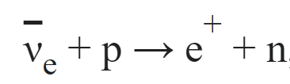
Motivation - Reactor Anti-neutrino Anomaly
Anti-neutrino flux from reactors measured using inverse β decay (IBD)
Anti-neutrino energy threshold for reaction: 1.806 MeV
β-feeding intensities affect predicted anti-neutrino energy spectrum
Inverse β decay

Slide 5
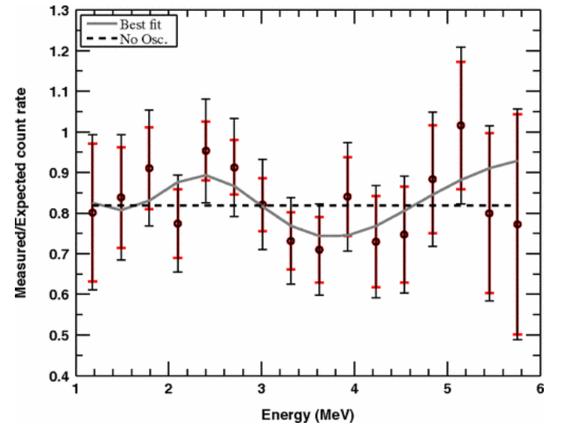
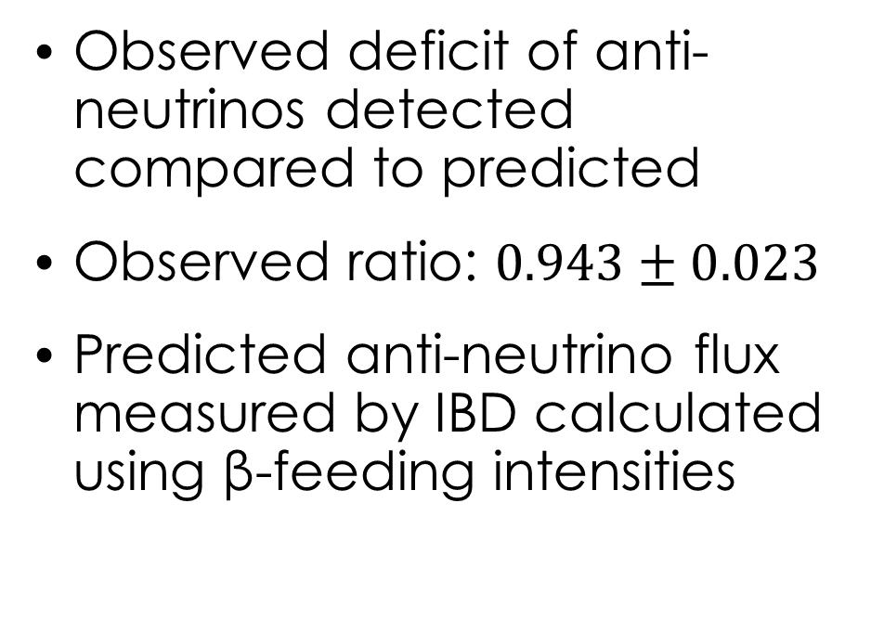
Motivation – Reactor Anti-neutrino Anomaly
Observed deficit of anti-neutrinos detected compared to predicted
Observed ratio: $0.943±0.023$
Predicted anti-neutrino flux measured by IBD calculated using β-feeding intensities
G. Mention, M. Fechner, Th. Lasserre, Th. A. Mueller, D. Lhuillier, M. Cribier, and A. Letourneau Phys. Rev. D 83, 073006

Slide 6
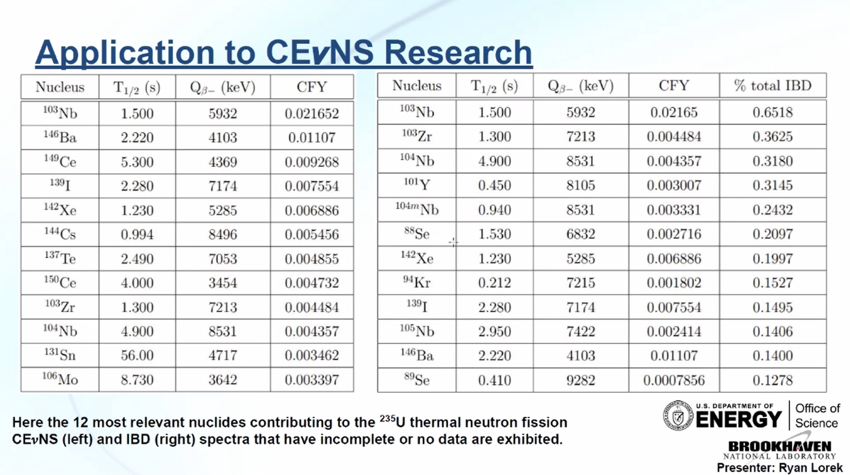

Slide 8
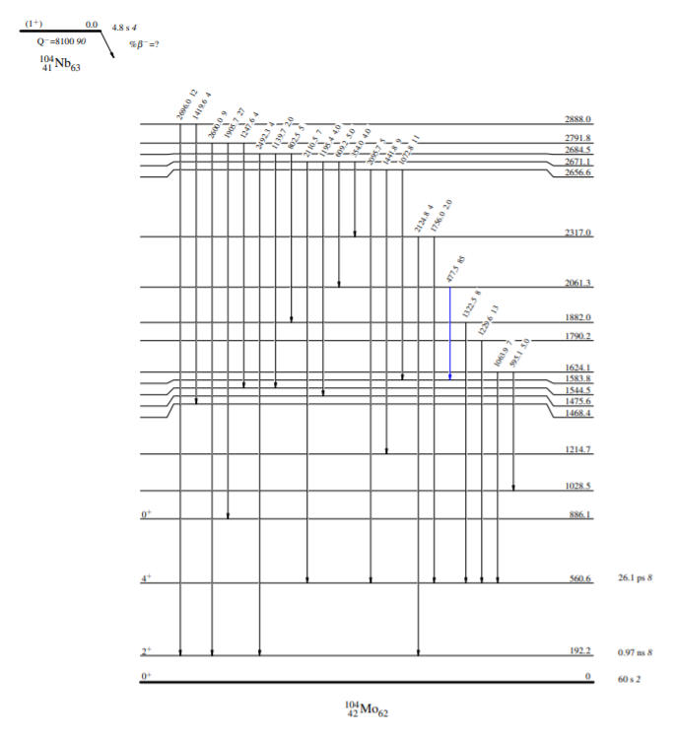
Previous Measurements
Kern et al. (1982)
Germanium measurement: High precision - low efficiency
Partial decay scheme identified
No β-feedings assigned

Slide 9
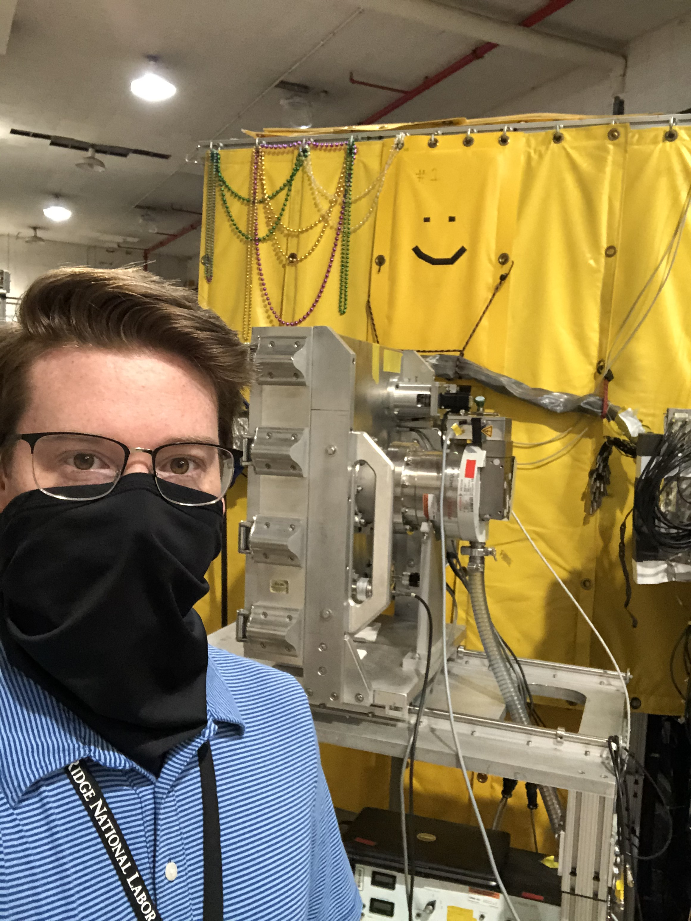
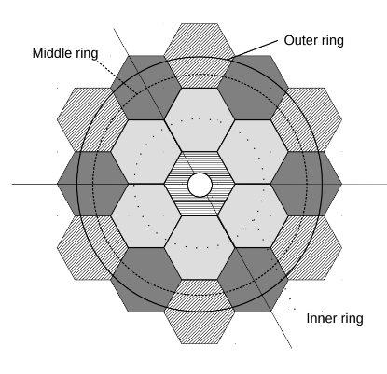
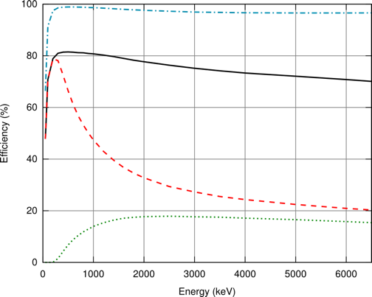
Modular Total Absorption Spectrometer (MTAS)
1 ton of NaI consisting of 19 individual modules
6 tons of lead shielding
Silicon beta trigger
Partial γ
Total γ
Center
Inner
M. Karny et al., NIM A 2016

Slide 10
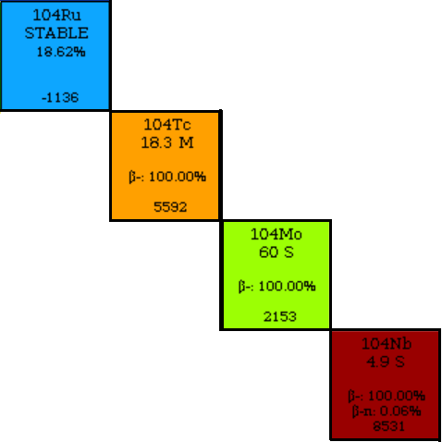
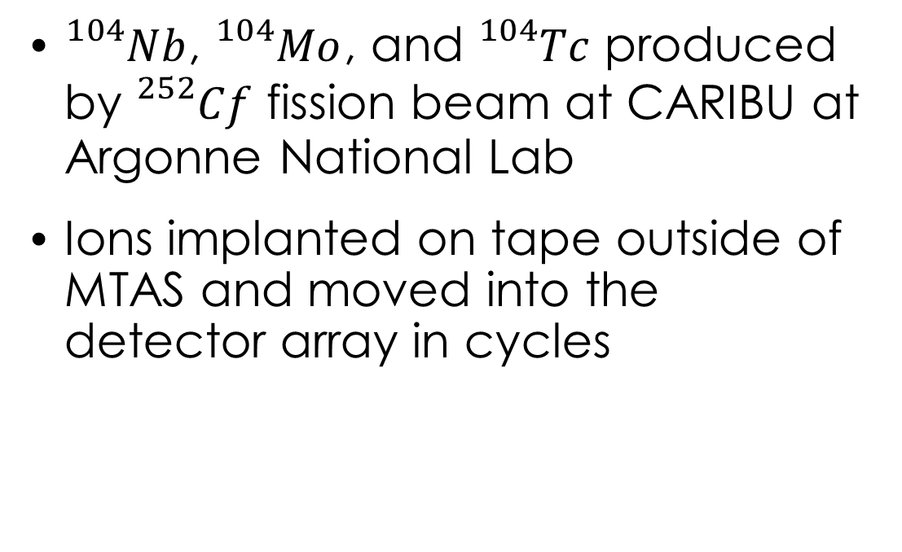



MTAS Experiment
${}_{}^{104}{Nb}$, ${}_{}^{104}{Mo}$, and ${}_{}^{104}{Tc}$ produced by ${}_{}^{252}{Cf}$ fission beam at CARIBU at Argonne National Lab
Ions implanted on tape outside of MTAS and moved into the detector array in cycles
$Q_{β}$: keV
$Q_{β}$: keV
$Q_{β}$: keV
https://nndc.bnl.gov

Slide 11
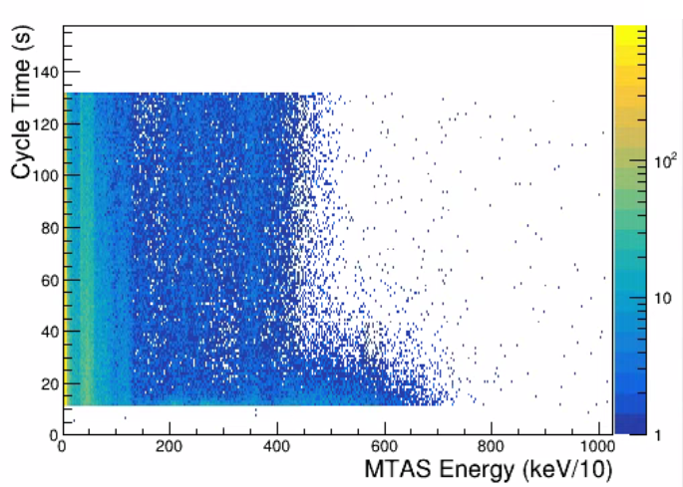
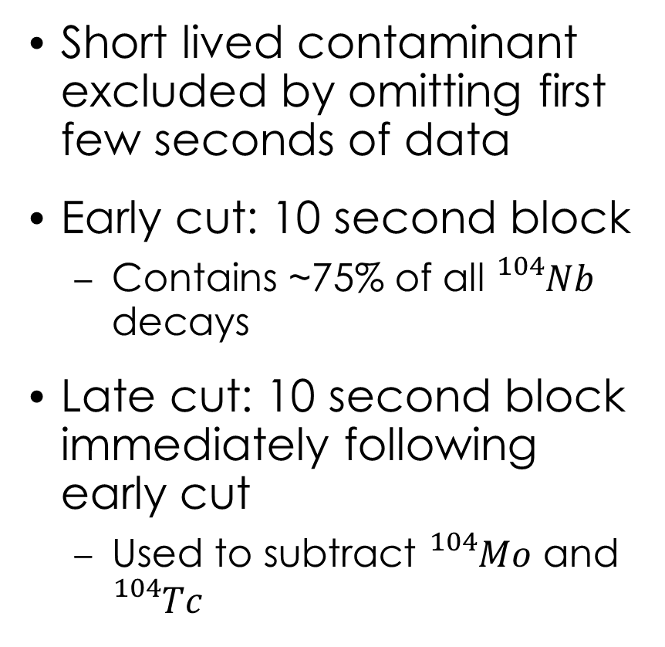
Data
Short lived contaminant excluded by omitting first few seconds of data
Early cut: 10 second block
  Contains ~75% of all ${}_{}^{104}{Nb}$ decays
Late cut: 10 second block immediately following early cut
  Used to subtract ${}_{}^{104}{Mo}$ and ${}_{}^{104}{Tc}$
Late
Early

Slide 12
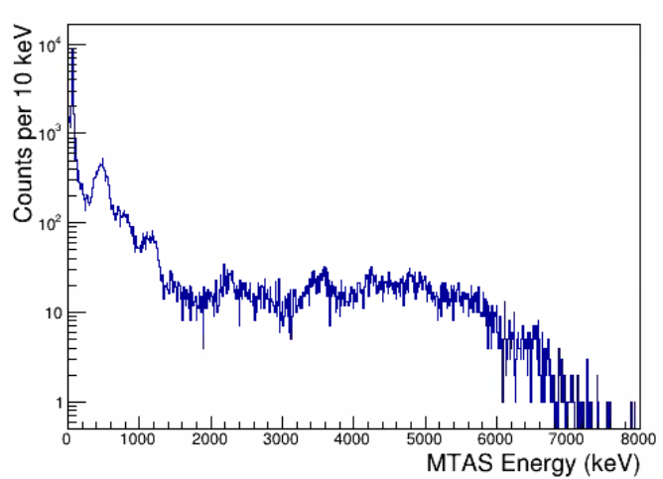
Total β-Gated MTAS Data (Early Cut)

Slide 13



Total β-Gated MTAS Data (Early Cut)
${}_{}^{104}{Mo}$ + ${}_{}^{104}{Tc}$ + ${}_{}^{104}{Nb}$
${}_{}^{104}{Tc}$ + ${}_{}^{104}{Nb}$
$${}_{}^{104}{Nb}$$

Slide 14
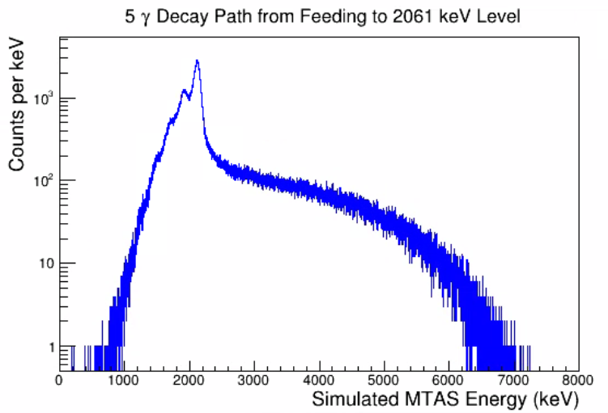
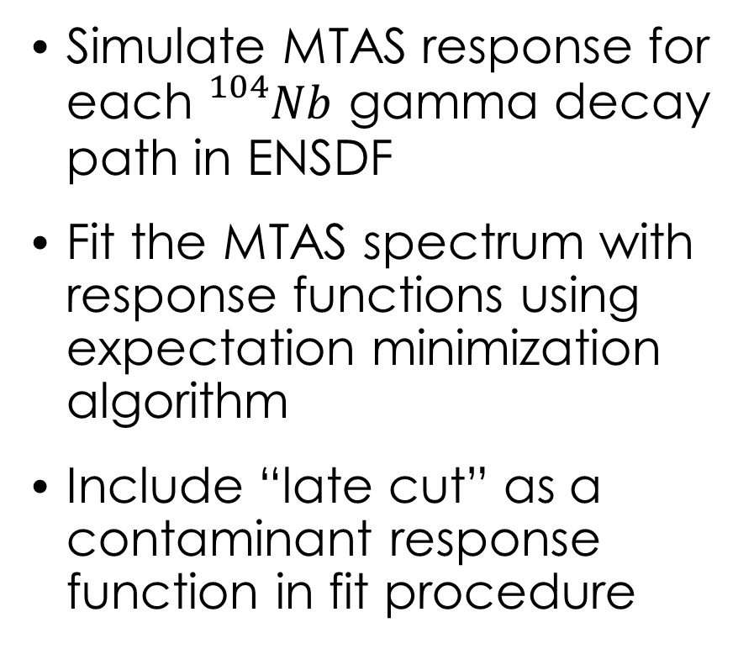
Fitting Procedure
Simulate MTAS response for each ${}_{}^{104}{Nb}$ gamma decay path in ENSDF
Fit the MTAS spectrum with response functions using expectation minimization algorithm
Include “late cut” as a contaminant response function in fit procedure

Slide 15
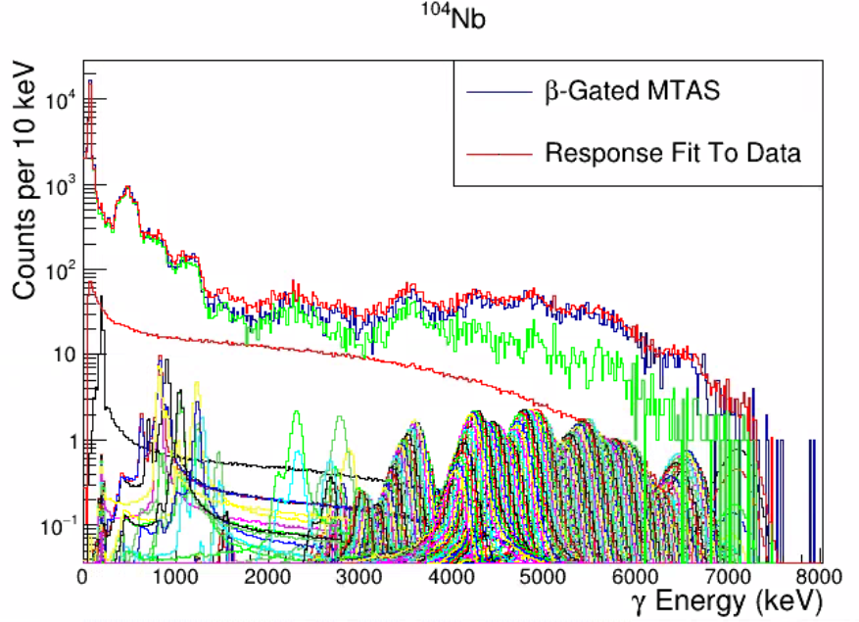
Fit Results

Slide 16
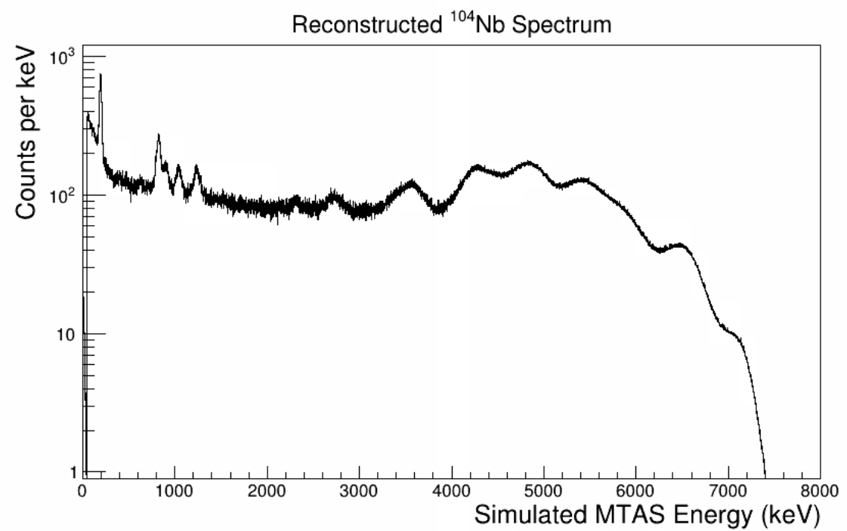

Slide 17
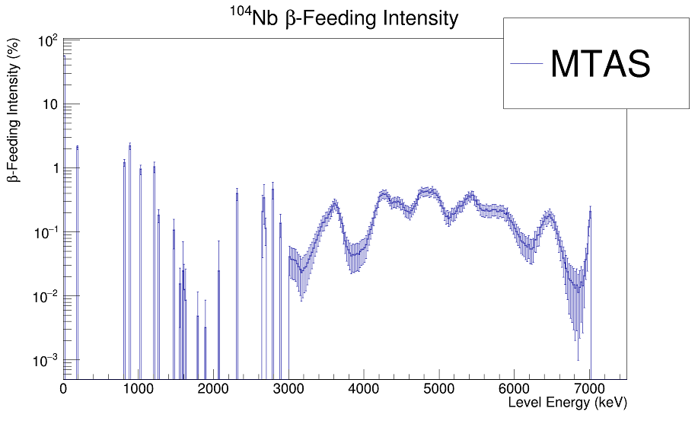
Preliminary

Slide 18
Preliminary
Added Pseudo-Levels
(Not included in ENSDF)

Slide 19
Preliminary
~55% feeding to the ground state
Added Pseudo-Levels
(Not included in ENSDF)

Slide 20
Decay Heat Results
MTAS average gamma energy: 1822 ± 29 keV
ENDF Value: 3058 keV
  Based on β strength calculations

Slide 21
Thanks To Our Collaborators!

Slide 22
BONUS SLIDES!

Slide 23
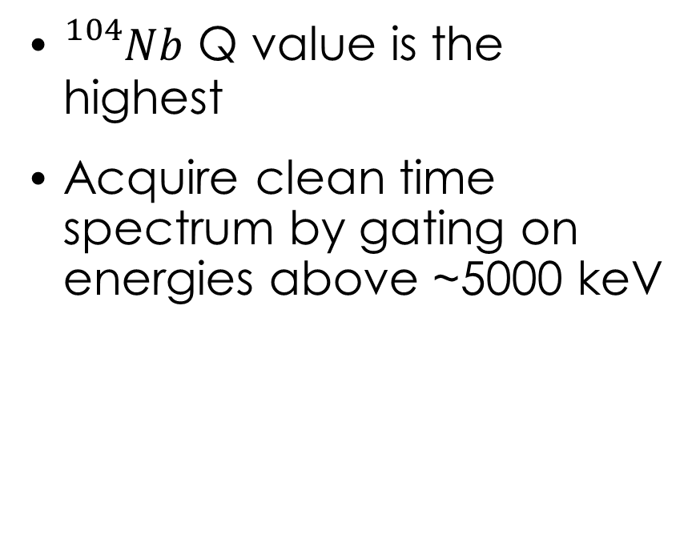
${}_{}^{104}{Nb}$ Half-Life
${}_{}^{104}{Mo}$ ${}_{}^{104}{Tc}$ ${}_{}^{104}{Nb}$
${}_{}^{104}{Nb}$ Q value is the highest
Acquire clean time spectrum by gating on energies above ~5000 keV

Slide 24
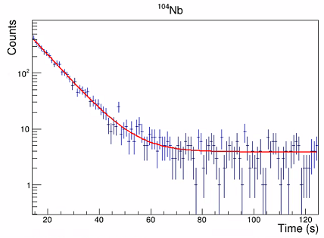
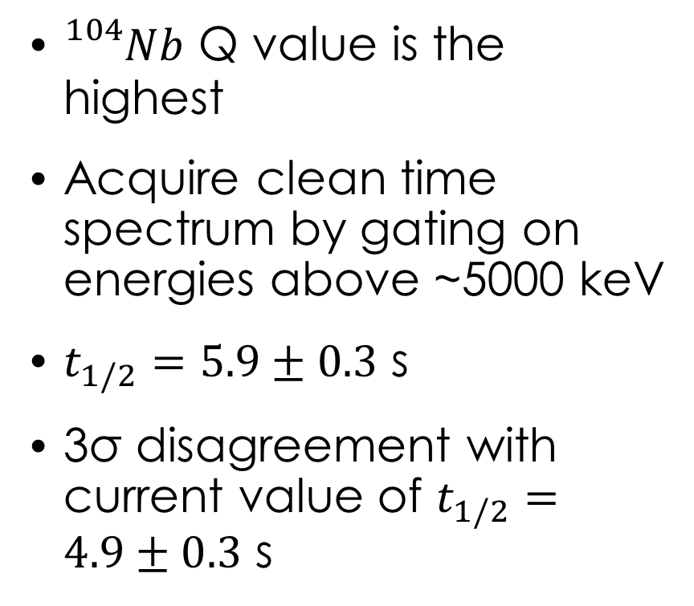
${}_{}^{104}{Nb}$ Half-Life
${}_{}^{104}{Mo}$ ${}_{}^{104}{Tc}$ ${}_{}^{104}{Nb}$
${}_{}^{104}{Nb}$ Q value is the highest
Acquire clean time spectrum by gating on energies above ~5000 keV
$t_{1/2}=5.9±0.3$ s
3σ disagreement with current value of $t_{1/2}=4.9±0.3$ s

